Slide 1

to create and collect taxes, duties, imposts and excises to pay debts. Define each. (NOTE: Collecting taxes is necessary so that we can collect the money that is needed to run our government, including all the expenses of running the three branches and our military.
to borrow money.
to regulate trade with foreign nations and be sure that trade is protected between the states, as well as with the Indian tribes.

Slide 2
to make laws regarding citizenship, and bankruptcies.
to print and coin money and fix the values of it and of standard weights and measures.
to create laws punishing counterfeiters.
to establish a postal system and the roads it needs.
to promote and protect the progress of science and the arts by establishing copyright laws.

Slide 3

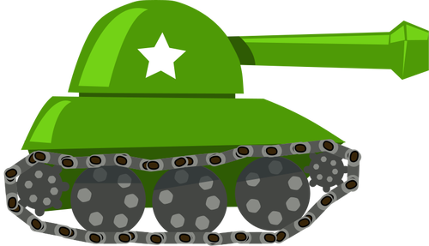

to create a lower court system in addition to the Supreme Court.
to create laws to punish pirates.
to declare war and have power over prisoners of war, as well as being able to grant pardons.
to raise and support a strong military.
to control our National Guard.
to create legislation that rules over all land and territories of the United States

Slide 4




AMENDMENT #1
"Congress shall make no law respecting an establishment of religion or prohibiting the free exercise thereof, or abridging the freedom of speech or of the press, or the right of the people peaceably to assemble and to petition the government for a redress of grievances."

Slide 5
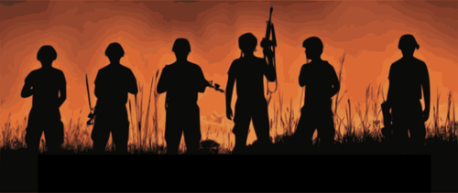
Amendment #2
“A well-regulated militia being necessary to the security of a free state, the right of the people to keep and bear arms shall not be infringed."

Slide 6

Amendment #9
"The enumeration in the Constitution of certain rights shall not be construed to deny or disparage others retained by the people."

Slide 7
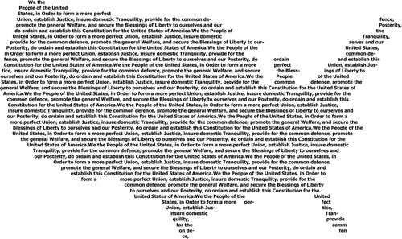
Amendment #10
"The powers not delegated to the United States by the Constitution, nor prohibited by it to the states, are reserved to the states respectively, or to the people."

Slide 8
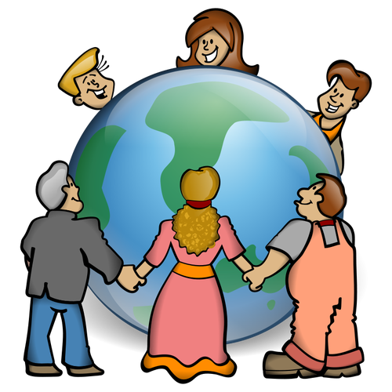
Genesis 1:28a
And God blessed them: and God said to them, Be fruitful, and multiply, and replenish the earth, and subdue it...

Slide 9

Genesis 11:4b:
“…let us make a name for ourselves, lest we be scattered abroad over the face of the whole earth.”

Slide 10
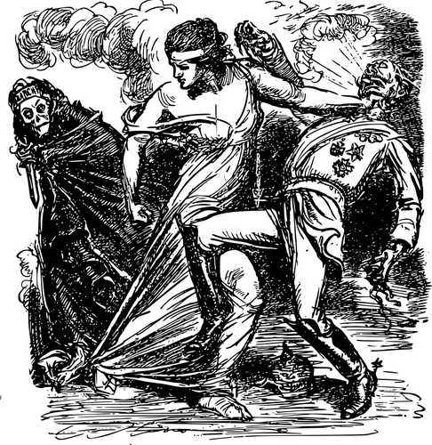
Genesis 11:6
And God said, Look at them, they are one people, and they have one language; and this is what they begin to do…

Slide 15
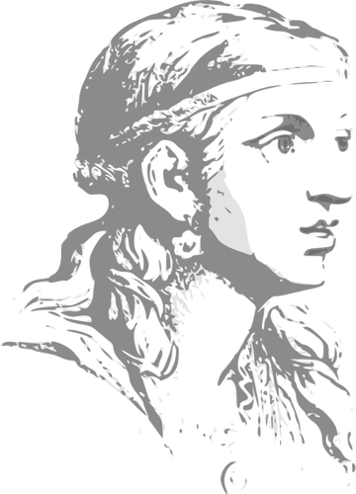
Babylon – the great mother of harlots
The name written on her forehead was a mystery: Babylon the great the mother of prostitutes and abominations of the earth.

Slide 20
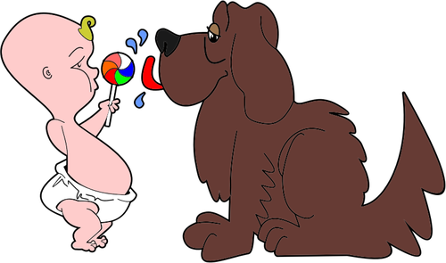
“…for it is the life of all flesh.
Its blood sustains life.” Leviticus 17:14

Slide 23



S
I
X
S
T
O
R I
E
S
4 “

Slide 24
