Slide 1
Pelvic Exam Simulation for Medical Student Education
Jill M. Palko, MD
PGY IV MetroHealth/Cleveland Clinic
May 21st, 2014

Slide 2
BACKGROUND
Education in female pelvic exam is limited, highly variable
Performing female pelvic exams - anxiety provoking and fairly awkward
Limited data on student feelings toward this exam
Simulation reported beneficial in other specialties, fairly new in OB/GYN
Notes:
Education is female pelvic exam is often limited in medical school and can be highly variable. Some students when starting their OB/GYN clerkship in the third year of medical school may only have experience with only one standardized patient, some do not even have that.
Because of this, performing female pelvic exams on real patients can be anxiety provoking and fairly awkward for both the student and patient.
Few studies have focused on the experiences and feelings of the students in this situation. Most studies are directed mainly at their technical skills. Several studies have demonstrated that simulation can help students identify gaps in their learning and motivate them to learn more.
Simulation has been reportedly beneficial in other specialities and is fairly new in OB/GYN.

Slide 3
OBJECTIVE
Determine if incorporating a pelvic exam simulation program into the 3rd year OB/GYN Clerkship improves student anxiety levels, increases confidence and comfort levels in performing this exam over the traditional educational experience

Slide 4
METHODS
3rd year CWRU Medical Students at MHMC
Control group
  Orientation
  Outpatient experience
  End of rotation feedback session
Simulation group
  Orientation
  Outpatient experience
  Mid-rotation session
  End of rotation session
Notes:
This study included 3rd year CWRU Medical Students Rotating during the 4 week outpatient rotation of their OB/GYN Clerkship at MHMC. There were 4 blocks of students throughout the year. Blocks 1 and 3 were assigned as the simulation group and blocks 2 and 4 were assigned to be the control groups.
In terms of their various experiences on the rotation. The control group had a 2 hour introduction during orientation to the female pelvic exam including anatomy, instruments, diagnostic tests and general approach to this exam in a clinical setting. Throughout the rest of the 4 week rotation, the students had the opportunity to practice these exam skills in the clinic while rotating with attendings and residents. At the conclusion of the 4 weeks, the students had an end of rotation session to discuss their experiences.
The simulation group had a orientation though they were introduced to the female pelvic exam simulator at this time and were able to practice their exam skills on the simulator model. Halfway through the rotation, the simulation group had a session to allow students additional practice with the pelvic models. Students were given an actual patient scenario, would perform the exam on the model, discuss diagnosis tests that they would order, would discuss how they would document their physical exam findings and formulate a differential diagnosis. At the end of the rotation, the simulation group also had a session to discuss their rotation, but they were given another patient scenario and access to the simulator model similar to the mid-rotation session.

Slide 5
METHODS
Surveys given at beginning and end of clerkship to both groups
Likert scale (1-5 strongly disagree to strongly agree)
  Baseline
  Comfort
  Confidence
  Anxiety
  Documentation of findings
  Knowledge of anatomy
Notes:
Surveys were given to both simulation and control at the beginning and again at the end of the rotation in order to evaluate student feelings/perception toward this exam.
The responses were assigned to a Likert scale of 1-5 with 1 = strongly disagree and 5 = strongly agree.
Baseline feelings toward prior experiences with standardized patients during their 2nd year of medical school were assessed. The remainder of the questions addressed student anxiety, comfort and confidence levels in performing this exam, comfort in documenting findings and knowledge of anatomy. For example, survey questions were phrased such as I feel comfortable performing a female pelvic exam or I feel anxious about performing a female pelvic exam.

Slide 6
Statistical Analysis
Unpaired t-test was used to compare answers between the two groups at baseline
Paired t-test was used to evaluate the change in scores between pre and post rotation surveys
Notes:
Unpaired t-test comparing answers between groups at baseline
Paired t-test evaluating change in scores between pre and post
Leave out chi squared - did not show any difference

Slide 7
RESULTS
Approximately 60 students in final analysis
Data based on 2 simulation and 1 control group, N=45
Notes:
Data we present today is based on 2 simulation and 1 control due to timing of the year. We are currently collecting data on the 2nd control group. 60 students will be included in final analysis and the data on 45 students is presented today.

Slide 8
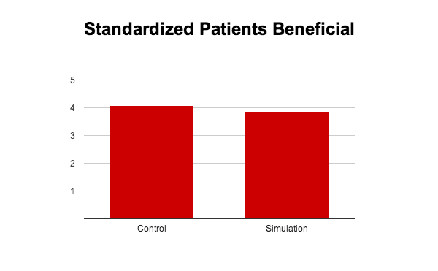
RESULTS
P = 0.1425
Notes:
One of the questions on the survey served as a baseline question, where we assessed if the students felt as though their experience with standardized patients during their 2nd year of medical school was beneficial to their learning female pelvic examinations. As you can see scores for both groups were similar and the difference between the simulation and control groups was not significant at the start of the rotation. Overall, both groups of students felt as though their experiences with standardized patients were beneficial.

Slide 9
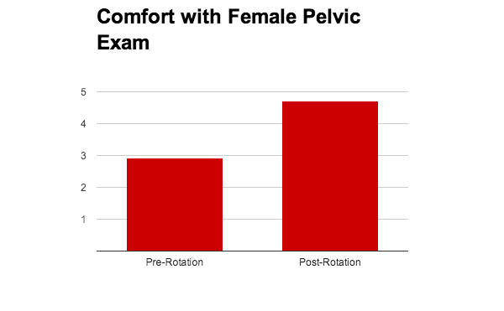
RESULTS
P < 0.0001
Notes:
The chart demonstrates the pre and post rotation comfort levels with the female pelvic exam for all students in both simulation and control groups. There is a statistically significant increase between pre and post rotation for all students surveyed.

Slide 10
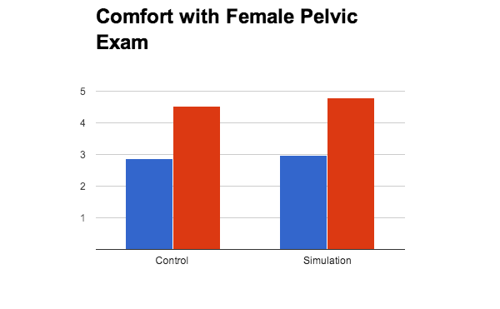
RESULTS
P = 0.0002
P < 0.0001
Notes:
When separated out by groups (control vs simulation), again there is a statistically significant increase in comfort scores between pre and post rotation for both groups

Slide 11
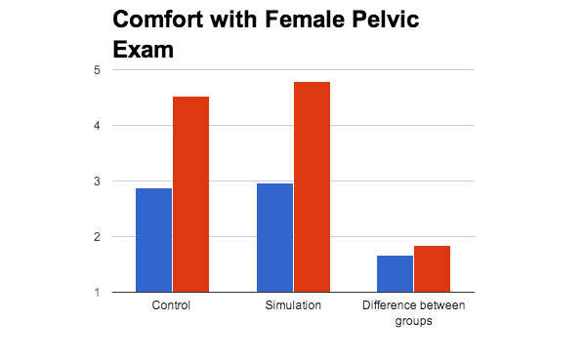
RESULTS
P < 0.0001
P = 0.0002
P = 0.66
Notes:
While there may be a statistically significant increase in comfort scores between pre and post rotation for both groups, when the differences in pre/post scores were compared between the two groups, simulation did not show a statistically significant difference over traditional education experience

Slide 12
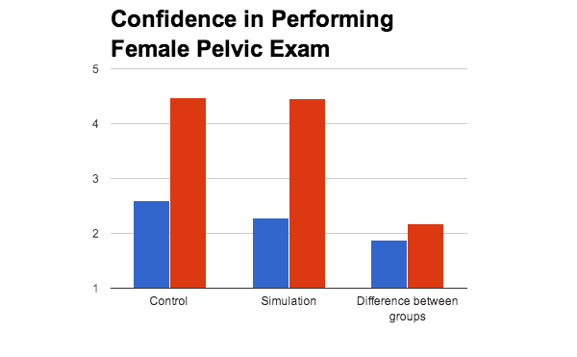
RESULTS
P < 0.0001
P < 0.0001
P = 0.29
Notes:
Confidence scores showed a similar trend - again significant increase between pre and post for both groups but simulation did not show significant difference over traditional curriculum

Slide 13
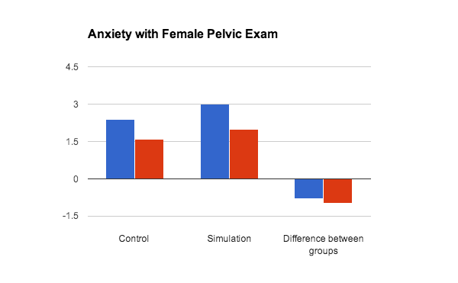
RESULTS
P = 0.0053
P = 0.0026
P = 0.66
Notes:
Anxiety levels again demonstrate a similar trend. Simulation did not show a significant decrease over traditional education.

Slide 14
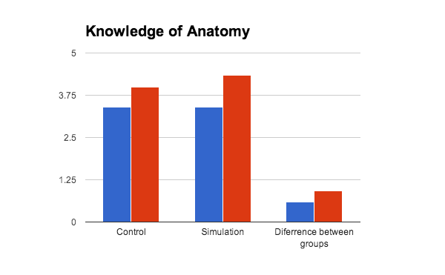
RESULTS
P < 0.0001
P = 0.0025
P = 0.15

Slide 15
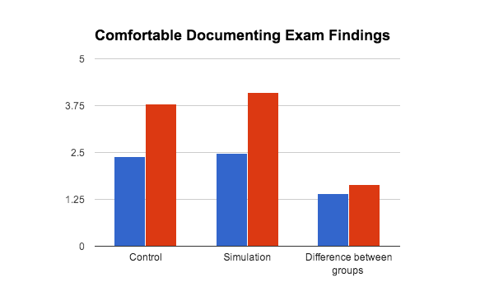
RESULTS
P < 0.0001
P = 0.0017
P = 0.54

Slide 16
Conclusion
Students felt well-prepared
Strong educational experience during the clerkship
Simulation was not shown to be superior
Notes:
Based on baseline scores, they students felt well-prepared for performing female pelvic exams from education prior to beginning their clerkship. Our numbers show that the students felt like their education during the clerkship was beneficial and we did not show that simulation superior to the traditional education experience

