Slide 1
What is Phonics and how can they support my child with early reading
Anita Auer
20.9.23

Slide 2

Introduction
Hastings and St Leonards Excellence Cluster – Literacy Support
Trained to administer and support dyslexia through the Dyslexia Screening Test
Degree in Professional Studies in Learning and Development
2011/12 - Hollington Primary Academy – GTP
2012 - English Subject Lead – NQT year
2014 - SLT
2017 – Secondment to The Baird Primary Academy – Assistant Principal
- Lead Practitioner: Coaching for Success Programme
2018 – permanent move to TBPA
- NPQSL
KS1 Moderator ESCC and Monitor of PSC and KS2 Sats administration
SLE (Primary English) ESCC
Notes:
Interest in socio-economic barriers to learning
Gaps due to deprivation

Slide 3

Expectations through the chatty bit!
Phones on silent
Hands up / interrupt me if you have questions ☺
Notes:
No ice-breaker!
You know one another
Try to keep interactive
Best parts of training is discussion and networking, please do this as if we were in room with biscuits!

Slide 4
What is ‘phonics’?

Slide 5
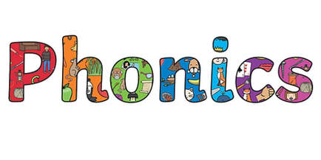
Phonics – the basics!
English written language is basically a code
Phonics is basically ‘cracking that code’
Children must learn the simple bits first and the progress to the trickier bits
Phonics must be taught early, clearly and systematically!
Johnston & Watson (2019) / Rose Review / Bold Beginnings
Notes:
There is a reason why PSC is in year 1
This is the reason why the ‘early reading deep dive’ is now mandatory
Lots of research around the importance of phonics in early reading

Slide 6
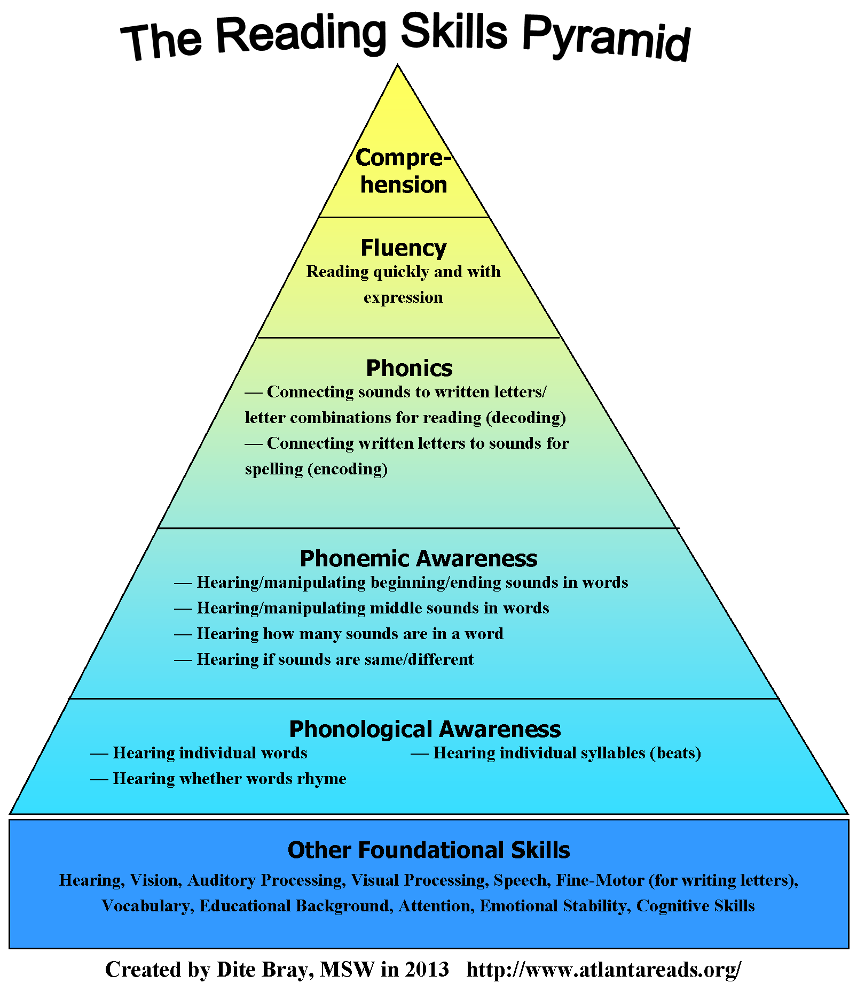
Phonics is important to reading and spelling
Decoding is translating print into speech – READING!
Encoding is putting sounds together to make words.
Vital skill for reading – we all use this skill when tackling an unknown word!

Slide 7
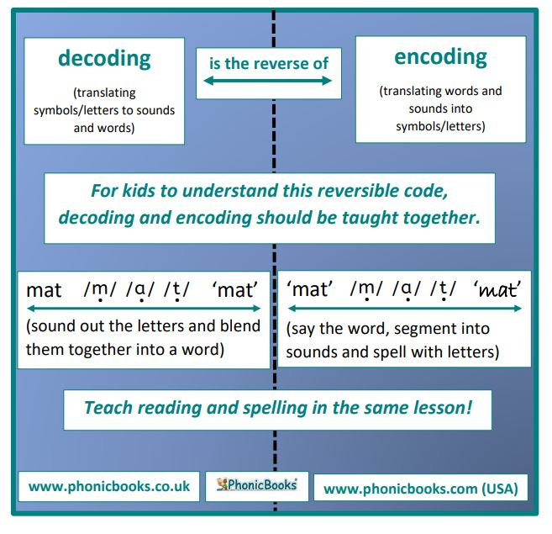

Slide 8
The terminology!
Phoneme – a unit of sound. There are 44 phonemes in English
Grapheme – written representation of sound
Adjacent consonants – still make individual sounds
Digraph – two letters together which make a new sound
Trigraph – three letters together that make a new sound
Grapheme-phoneme correspondence – knowing which matches which
Segmenting – breaking a word into the sounds you hear
Blending – putting the sounds together
Vowel digraphs – two vowels that together make a new sound
Split digraph a-e, e-e, i-e, o-e, u-e

Slide 9
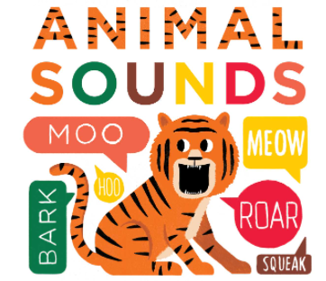
Phonics Phases – Phase 1
Should be covered ‘pre-school’
Concentrates on developing children’s speaking and listening skills
Lays foundations for the phonic work which starts in phase 2
7 aspects:
Environmental sound discrimination
Instrumental sound discrimination
Body percussion sound discrimination
Rhythm and rhyme
Alliteration
Voice sounds
Oral blending and segmenting
Notes:
A whistle stop look at the phases – question about subject knowledge in LKS2 but don’t want to waste time on this today. If you need more, shout or read up
Don’t overlook phase 1 – this could highlight a problem

Slide 10
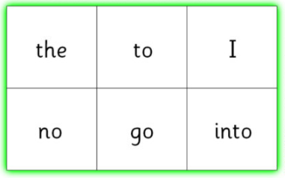
Phase 2 – builds on linguistic focus in Phase 1
In Phase 2, letters and their sounds are introduced one at a time. A set of letters is taught each week, in the following sequence:
Set 1: s, a, t, p
Set 2: i, n, m, d
Set 3: g, o, c, k
Set 4: ck, e, u, r
Set 5: h, b, f, ff, l, ll, ss
As soon as each set of letters is introduced, children will be encouraged to use their knowledge of the letter sounds to blend and sound out words.

Slide 11
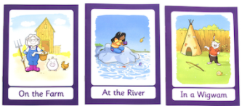
Phase 3 – introduces new graphemes, consonant digraphs, vowel digraphs and trigraphs
Over the twelve weeks which Phase 3 is expected to last, twenty-five new graphemes are introduced (one at a time).
Set 6: j, v, w, x
Set 7: y, z, zz, qu
Consonant digraphs: ch, sh, th, ng
Vowel digraphs: ai, ee, igh, oa, oo, ar, or, ur, ow, oi, ear, air, ure, er
During Phase 3, children will also learn the letter names using an alphabet song, although they will continue to use the sounds when decoding words.
Tricky words – he, she, we, me, be, was, you, they, all, are, my, her

Slide 12
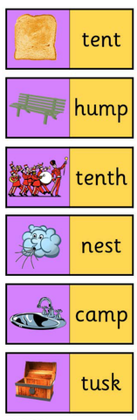
Phase 4 – blending and segmenting adjacent consonants
In Phase 4, no new graphemes are introduced. The main aim of this phase is to consolidate the children's knowledge and to help them learn to read and spell words which have adjacent consonants, such as trap, string and milk.
Tricky words – said, have, like, so, do, some, come, were, there, little, one, when, out, what

Slide 13
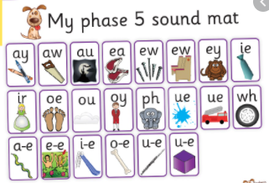
Phase 5 – introduces more graphemes and phonemes
In Phase Five, children will learn more graphemes and phonemes. For example, they already know ai as in rain, but now they will be introduced to ay as in day and a-e as in make.
Alternative pronunciations for graphemes will also be introduced, e.g. ea in tea, head and break
With practice, speed at recognising and blending graphemes will improve. Word and spelling knowledge will be worked on extensively.
Tricky words – oh, their, people, Mr, Mrs, looked, called, asked, could

Slide 14
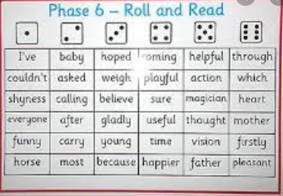
Phase 6 – fluent readers and accurate spellers
By Phase 6, children should be able to read hundreds of words using one of three strategies:
Reading them automatically
Decoding them quickly and silently
Decoding them aloud
Children should also be able to spell most words accurately (this may follow accuracy in reading)
Prefixes and suffixes
Past tense
Memory strategies for HF words
Proof-reading
Dictionary skills
Apostrophes
Spelling rules
These things will be covered in another session ☺
Notes:
These should be taught in year 2 following a successful passing of the PSC – this is the time to move on from phonics being the only reading skills

Slide 15
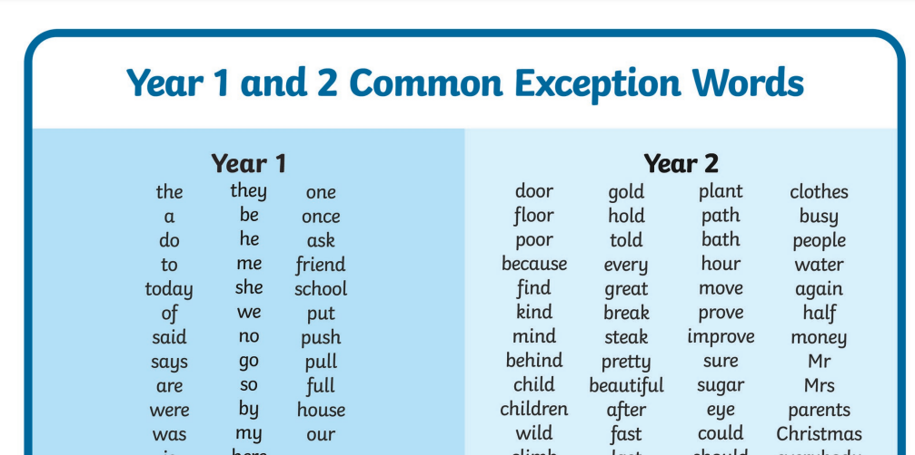
Common Exception Words /
High Frequency Words
We will look at this aspect of ‘Phonics phases’ as future sessions on spelling

Slide 16
How is it taught?

Slide 17




Phonics Schemes
Systematic Synthetic Phonics
Jolly Phonics
Letters and Sounds
Read, Write, Inc
Phonics Play
Linguistic Phonics
Sounds Write
Other
Spelling Shed
Notes:
NB – not my role to advise or criticise – today, I will use L&S as basis
Recent research done for UoBAT – phonics schemes – 3 based in research, 1 on experience, 1 nothing
Are they backed by research? Do you consider this when you start something new?
At the end of the day, the scheme can’t work on its own

Slide 18
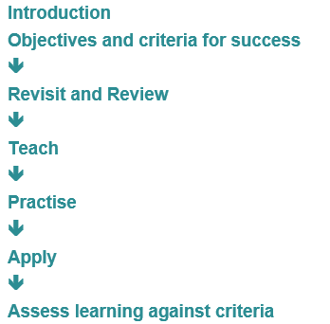
Session structure
All lessons should be regular, short and focused. They should follow this structure:
Notes:
The necessaries
This is the classic phonics lesson structure and is proven to be successful

Slide 19
The daily session
Revisit – previous day’s learning and recent grapheme-phoneme correspondence taught
Teach – New grapheme-phoneme correspondence – visual search for position in words, blending skills for reading words, segmenting words for spelling letter formation
Practice – counting phonemes and spelling words, magnetic boards and letters, mini-whiteboards, fans, quickwrite, ‘sound-talk’, what’s in the box, matching words and pictures, buried treasure, rapid reading using timer, sound hunt etc. This is the crucial part of the session.
Apply – ensure pupil has opportunity to hear / say/ read / write the phoneme / grapheme
Assess learning against criteria – allow child to be reflective

Slide 20
How is it assessed?

Slide 21
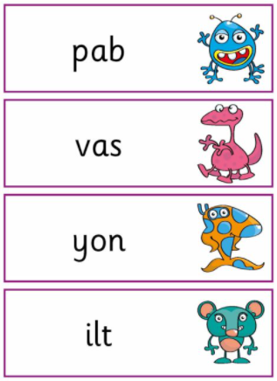
The Phonics Screening Check
Introduced in 2012
DfE (2015) asked experts from NFER to evaluate impact of PSC and found:
- phonics attainment had improved over three years
- pupils who attain the phonics skills measured by PSC are more likely to reach the expected standard in reading at the end of KS1
All children take in Year 1, those who do not reach the standard retake in year 2
Notes:
Do you know what the PSC looks like?
Amanda Spielman has said that, although it is pleasing that phonics results now are consistent at 82%, we really need to aim for much higher
Research suggests that reading is the major key to success in life and a ‘Save the Children’ project (2016) suggests that an ambitious but achievable target would be for 96% of children to read well by 11, and for every child to enjoy reading.
Remember that this difficulty is most likely to affect chn with speech, language and communication needs

Slide 22
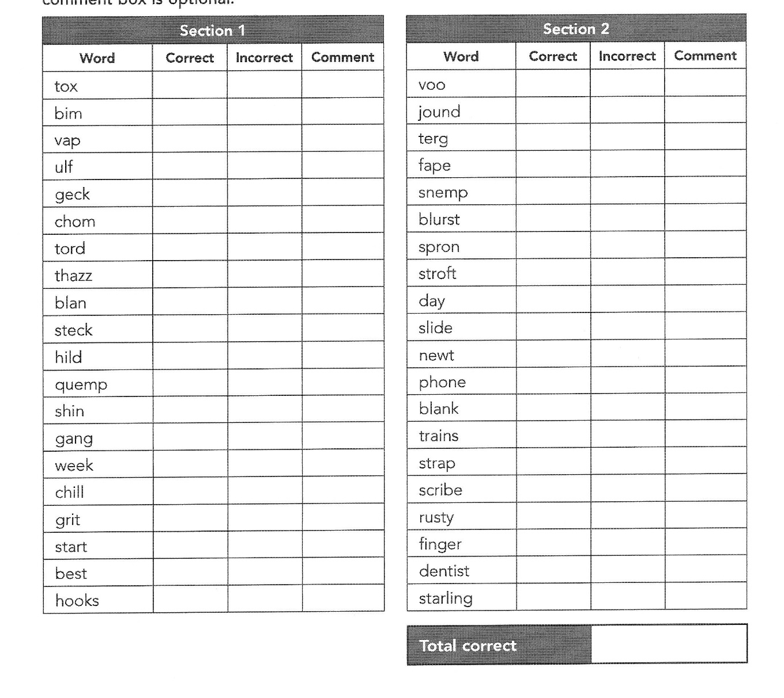
What does the PSC tell us?

Slide 23
Barriers to learning phonics?

Slide 24

What barriers might children have?
Do the children read at home?
Is there a physical issue – hearing, speech, eye sight?
How good is there ‘phonemic awareness’ (their ability to hear and manipulate phonemes)
Are they dyslexic? (1/6 of dyslexic children will not struggle with phonics)
How do they respond to reading / writing sessions?
How do they do in a phase 1 phonics assessment?
Are they ‘summer born’?
Is there a Special Educational Need?
Notes:
I always tell my students and NQTs to keep notes on their pupils that concern them – what works and what doesn’t? This may form part of a picture that could lead to the answer.
Sue Palmer – Toxic Childhood – background noise and the impact of this on today’s children’s ability to listen.
Beth – how children learn to distinguish sounds
Phase 1 phonics assessment – this is vital to unpick any underlying issues, may also encourage you to carry out a DSC. I have one I can share

Slide 25

Where are they stuck – is it phonological awareness?
If they continue to score low on their PSC, it is worth going back to phase 1 to check if the issues are there:
Rhyming
Recognising syllables
Identify same and different speech sounds
Recognising initial sounds of words – e.g. playing i-spy
Recognising final sounds in words (over pronounce if necessary)
Blending and segmenting sounds in spoken words

Slide 26
No time to wait……….
Rose (2006) suggested that early failure in literacy can be overcome if responded to early whereas entrenched reading failure is not only harder to reverse but also detrimental to other areas of learning and self-esteem.
Evidence suggests for every year this remains a problem, it takes twice as long to engage and is twice as likely to fail ☹
Notes:
Evidence suggests for every year this remains a problem, it takes twice as long to engage and is twice as likely to fail ☹

Slide 27
How can I help my child?

Slide 28
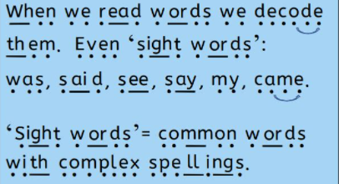
Sound buttons!
Notes:
I don’t know how you can teach phonics without sound buttons
Make sure all your staff know what they are and how to use
Use to support decoding and encoding

Slide 29

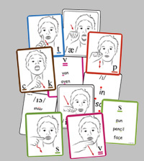
Using more senses
Multi-sensory approaches help to ‘anchor’ sounds to memory
Manipulative wooden or magnetic letters
Tracing over letters
Making letters in sand, shaving foam etc
Cued-articulation
Notes:
This sort of activity is hard to accommodate in a LKS2 classroom so should be an intervention
Cued articulation is a set of hand cues for the teaching individual sounds in a word.
Jane Passey devised for chn with severe S&L problems. Aids auditory recall. – taught to us by our SALT – used in reception

Slide 30
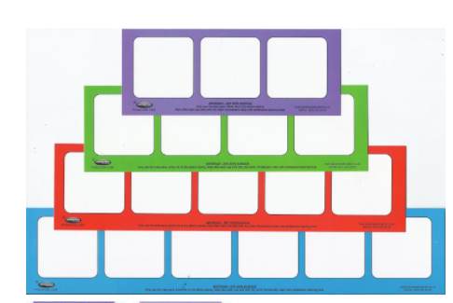
Supporting memory issues
Children with short term memory struggle to hold a sequence of sounds in their mind in order to blend them. To help them, you could:
Play memory games with 2, 3 or 4 steps
Use phoneme frames
Notes:
Tools encouraged in an intervention group must be available in class

Slide 31
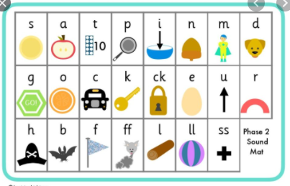
Grapheme-Phoneme Correspondence
Teach the child how to use the appropriate phase sound mat
Think about engaging activities – boggle, bingo, I spy sheets, word search
Notes:
Make sure sound mats are available in class

Slide 32
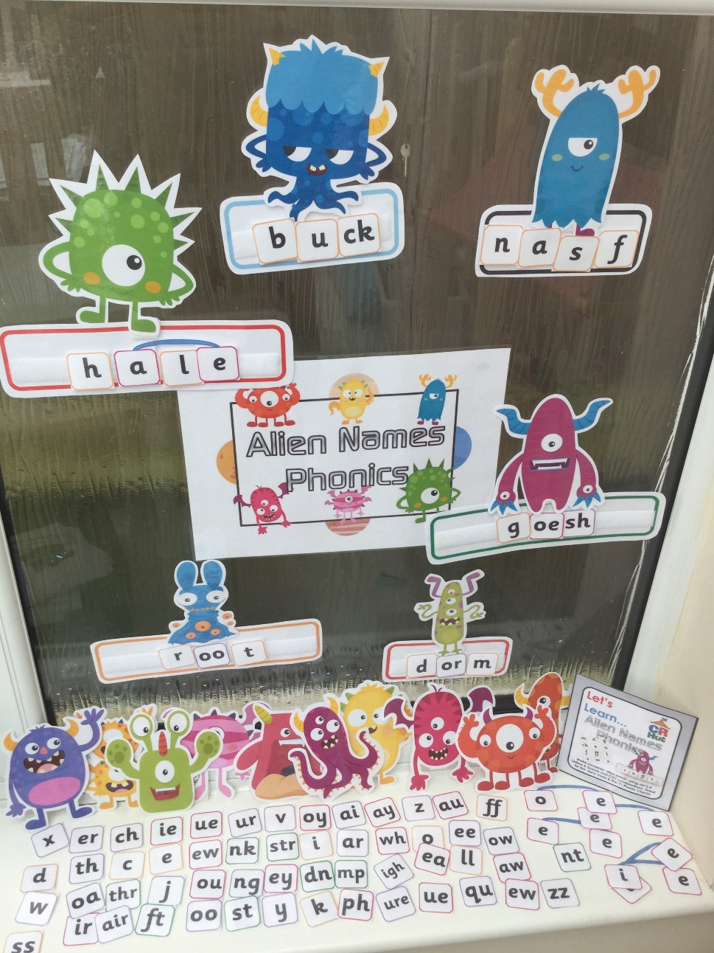
Alien Word (pseudo words)

Slide 33

Electronic Interventions
Teach your monster to read
ICT games
Phonics Play
Reading eggs
PocketPhonics
Geraldine’s Phonics Land
Jolly Phonics
Mr Phonics Kit: Read with Biff, Chip & Kipper
Hairy Letters
Pirate Phonics
Read with phonics
Notes:
May be good for odd times in the day or to share with parents
May need to consider age and maturity of child

Slide 34
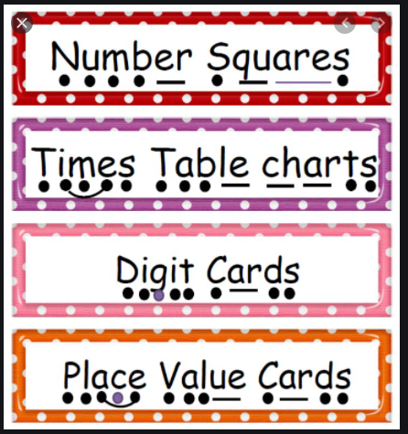

The phonics friendly environment.
Notes:
More sound buttons
Displays

Slide 35
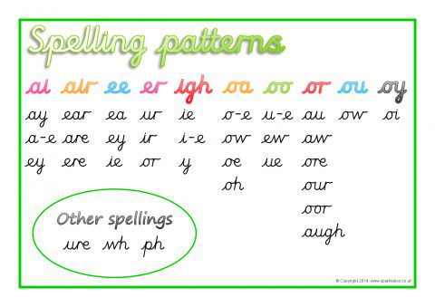
Teach spelling patterns and rules – whole class
Year 3 / 4 spellings (NC)
Suffixes beginning with a vowel added to words with more than 1 syllable
‘I’ sound spelled ‘y’
‘u’ sound spelled ‘ou’
Prefixes
Suffixes – ‘ation’, ‘ly’
-sure, -ture, -sion, -ous, -tion, -sion, -ssion, -cian
‘k’ spelled ‘ch’
‘sh’ spelled ‘ch’
‘g’ and ‘k’ spelled ‘que’
‘s’ spelled ‘sc’
‘ay’ spelled ‘eigh’, ‘ei’, ‘ey’
Possessive apostrophe with plurals
Homophones
We will cover spellings in a later session
Phase 6 introduces spellings rules for:
Suffixes that indicate tense
Adding –ing, -ed, -er, -est, -ful, -ly and –y
Plurals
Prefixes which change meaning
Notes:
Some commonality
Research suggests teaching the rule is much better than sending home lists of spellings
Comment on root word and additions often – modelling comprehension – look for root to help make sense of word
DR – includes vocabulary slides for unknown vocab in next section of text – often unpick root etc

Slide 36
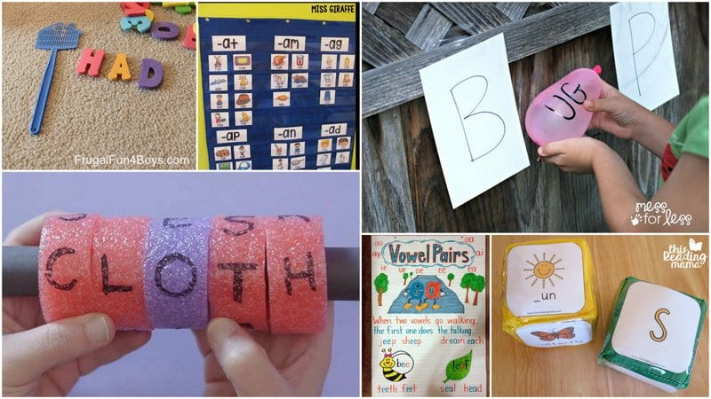
Practical / multi-sensory activities
Quickwrite – adult says phoneme, pupil quickly writes grapheme
What’s in the box? – show the pupil the word, they then find object in the box
Countdown – how many words can a child read in a given time. Can they beat PB?
Sentence Substitution – prepared sentence (A man burnt the toast.) and a selection of alternative words to swap into sentence (The man burnt the towel!)
Matching words and pictures – could use the ‘what’s in the box’ equipment
Buried Treasure – mix of real and pseudo (alien) words, sort into chest or bin
Matching pictures and sentences – which sentence matches the picture
Yes / no – give the child a questions and they answer ‘yes’ or ‘no’
How many can you make? – against the clock, how many words said by the adult, can they make with magnetic letters
Phoneme spotting – within words / text

Slide 37

Any questions?

