Slide 1
Safeguarding Training
28th August 2024
Led by Anita Auer

Slide 2
A little bit about me!
Teacher since 2012
Senior Leader – leading EYFS, KS1, English, Personal Development
Specialist Leader of Education (Primary English)
East Sussex County Council Lead Moderator –Primary
Qualified ‘Designated Safeguarding Lead’
Owner of ‘The Old Post Office Wellbeing Hub’ – offering support to the square pegs struggling to fit into the round holes of the current education system –families, children and school staff!
anita.auer2021@outlook.com
Notes:
Feel free to contact me
For those that did this training last year, I have changed as much as I can but somethings don’t change and messages need reinforcing!

Slide 3
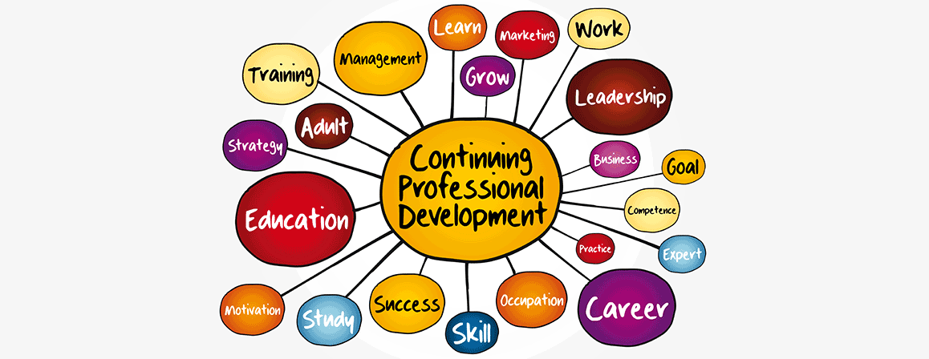
Training agreement
Confidentiality
Professionalism
Challenge yourself as a learner to engage and reflect – this is important training
Be mindful of your wellbeing
Notes:
Interaction with training – please - This training is really important
I will try to keep it interesting – There are a lot of slides and I like to talk – I will try very hard to keep on track.
We won’t read everything on the slides (that would be boring!) but you will get the slides to look back through in more detail.

Slide 4
Stay safe
Due to the nature of the subject, there will be some distressing content
Take care of yourself
You can take some time out if you need to – there will be no questions, no judgement
Samaritans – 116 123
Education Support – 08000 562 561
Notes:
We all have lived experiences and this topic can be very triggering.
If you need to take time out, just go and there will be no judgement or questions

Slide 5
Aims for today
To understand why we are all responsible for safeguarding
To understand what legislation is in place to protect children
To know what maltreatment is and how to recognise it
To be able to recognise vulnerability and threats to children
To know how to deal with disclosures
To know what has changed in KCSIE this year
To know how to keep yourself safe and work in the best interests of all children
To know and understand the specific safeguarding issues that you may see in local schools
Notes:
That looks like a lot – basically we want to make sure that we know our responsibilities with regards to keeping children safe.
If you are confused, please put your hand up or write in the chat

Slide 6
Important Vocabulary for today
Child – anyone up to the age of 18
Maltreatment – all forms of ill treatment, abuse, exploitation, neglect (all equally important)
Safeguarding – preventing harm, we are all responsible for children’s wellbeing
Child Protection – the response, keeping children safe
Notes:
These are the terms that I will use
Neglect is abuse – do not consider otherwise

Slide 7
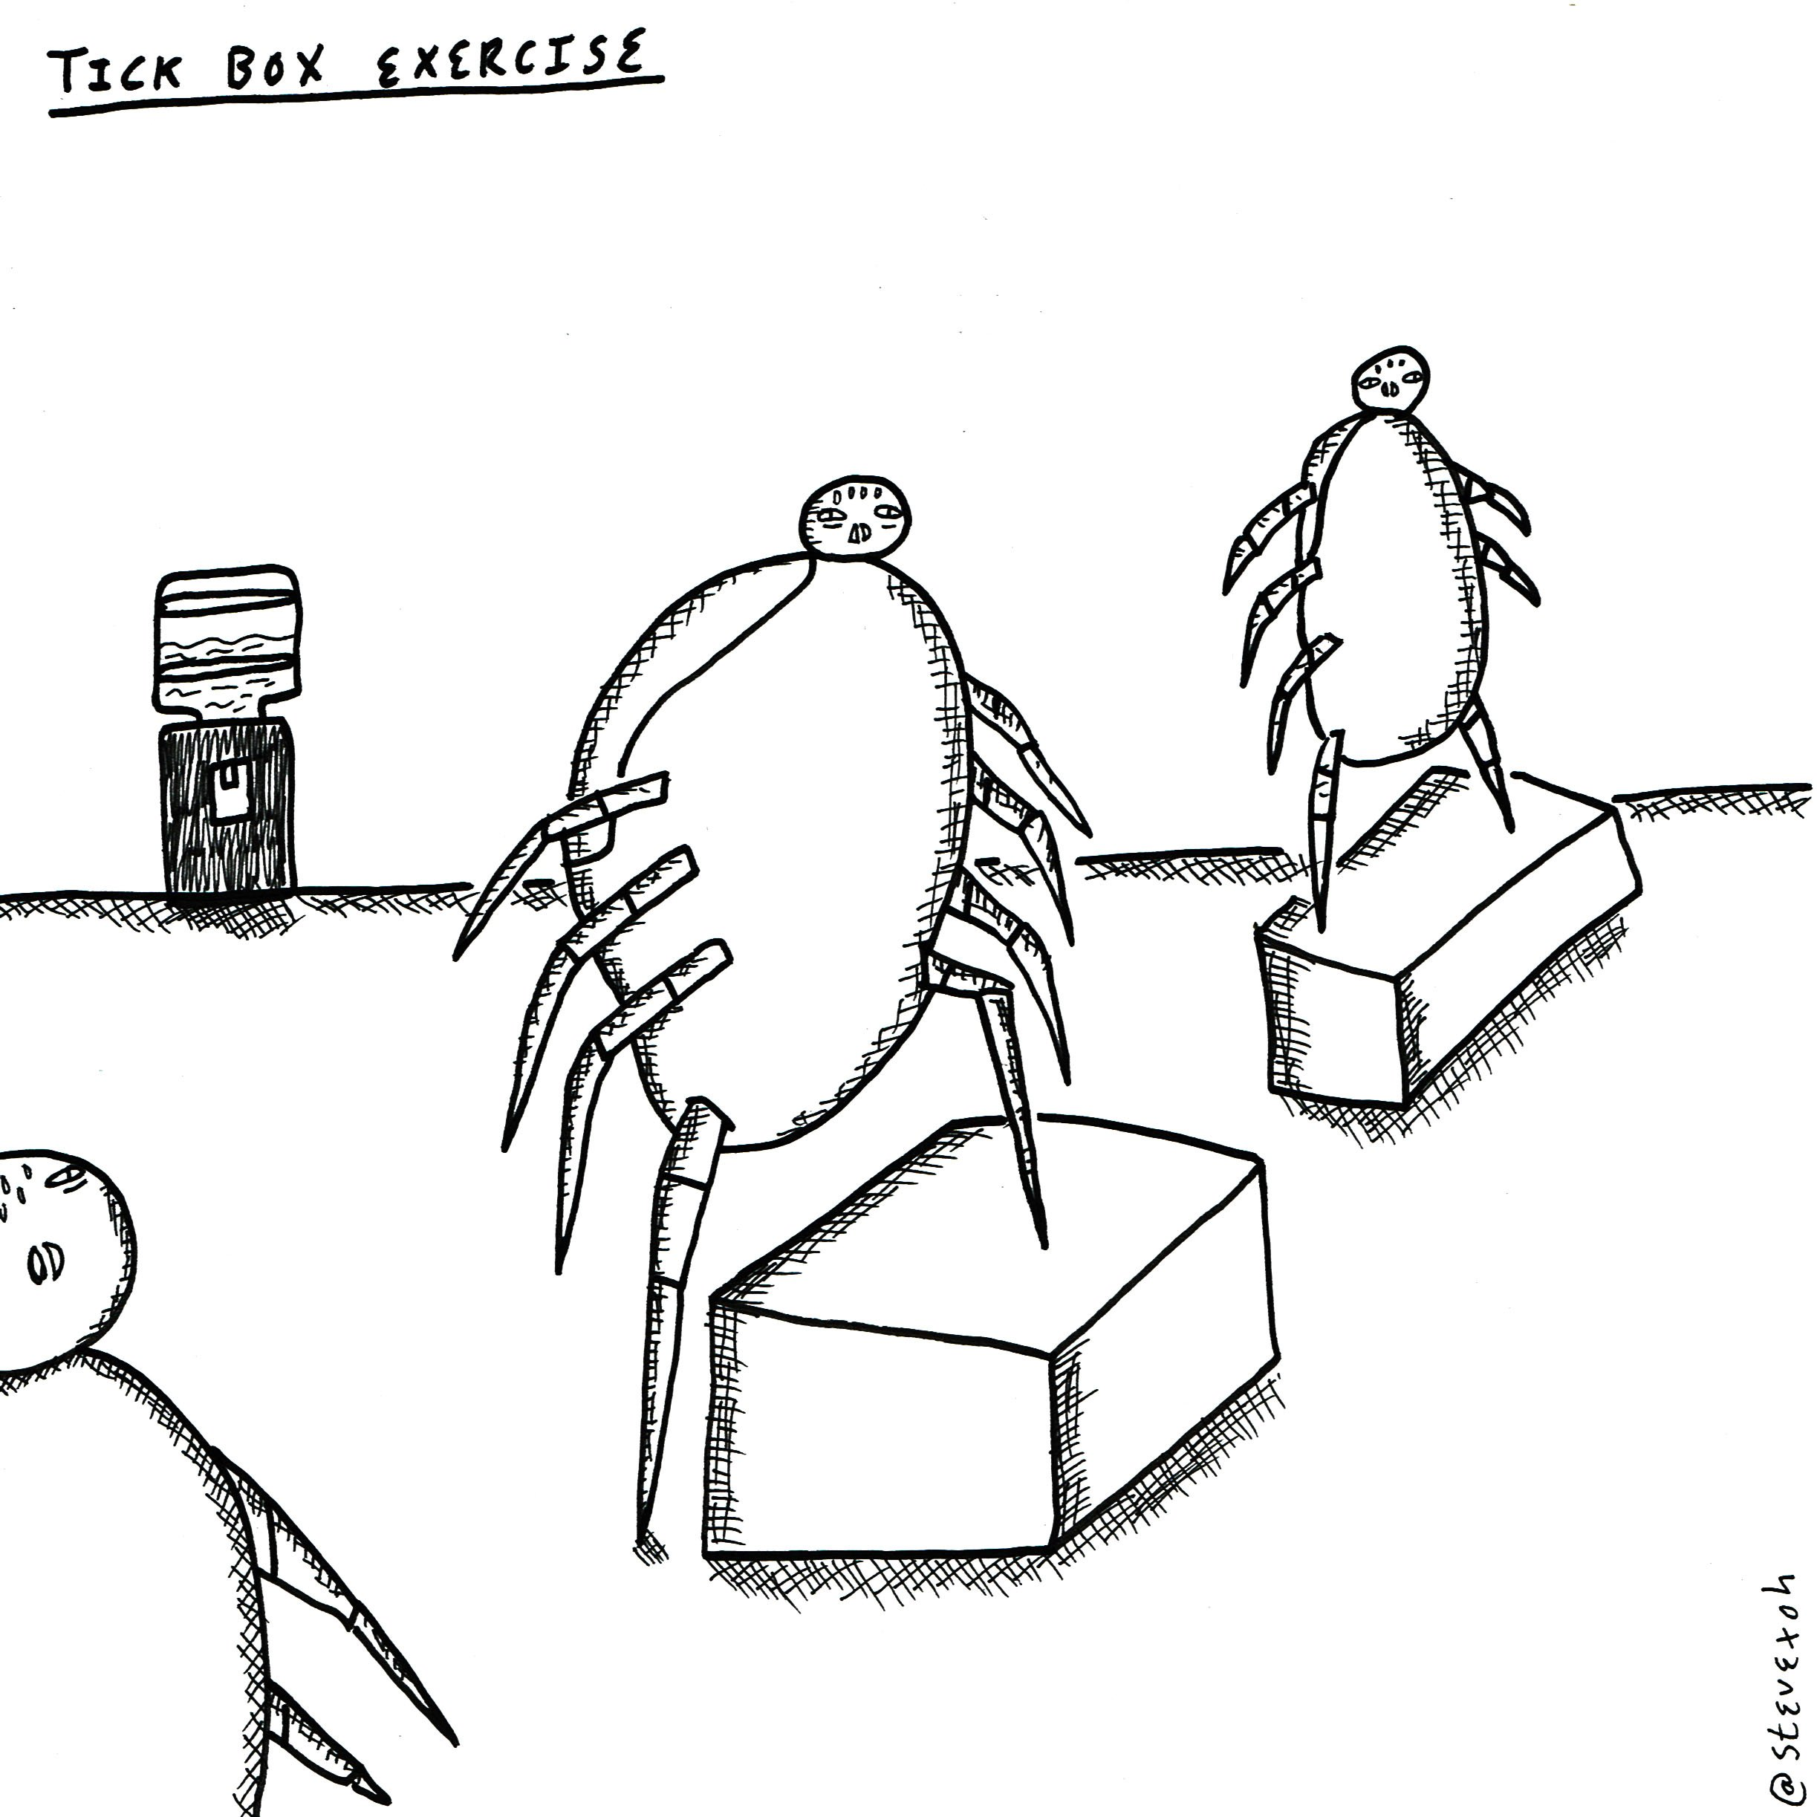
Why do we need to bother about safeguarding?
Notes:
This is not a tick box exercise!!
3D Recruit believe in rigorous CPD

Slide 8
Some scary statistics
Fire over 5 years: 33,000 kids affected
7 in every class has experienced maltreatment by the age of 18
3.1million adults (18-74) estimated to be victims of sexual abuse by the age of 18
52% of adults who experienced maltreatment before 16, went on to experience Domestic Violence, compared to 13% who did not experience maltreatment
1/7 adults who call National Association for people abused in Childhood helpline, have never told anyone about the maltreatment
= approximately 6600 pupils per year affected by fire
Less that 0.1% of pupils
Sexual abuse = 1/20 – 5%
Physical abuse = 1/14 – 7%
Neglect = 1/10 – 10%
Notes:
During this presentation we will learn some scary bits and pieces – you have to believe that there is a real reason for doing this CPD.
Safeguarding is a big issue, and maltreatment is happening to children in our local schools
It is happening now, and you are very likely to encounter it during your career – this is why this training is very important.
My maths isn’t great, but I did a bit of research to try and show how important this is…
Between 2012 and 2020, Zurich announced that 47 schools in UK had been destroyed, 1100 classroom gutted so about 33,000 kids affected by fire in schools
In 2022/3, there were nearly 30,000 maintained schools in the UK, with approximately 9 million pupils in school.
The NSPCC say approximately 1 in 20 children are sexually abused. 1 in 14 physically abused. 1 in 10 neglected.
We practice fire drills, but more children are affected by safeguarding issues – this really is important.

Slide 9
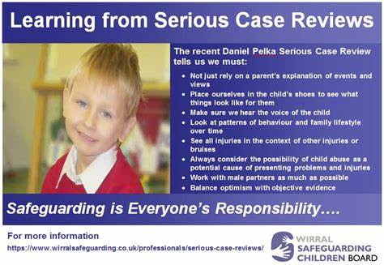
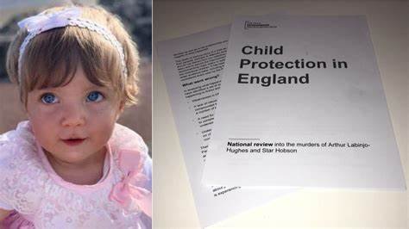
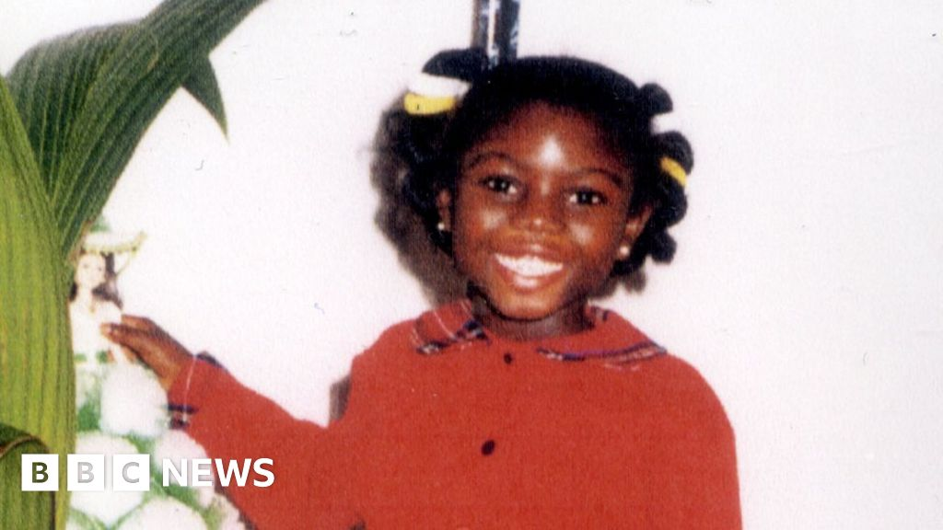
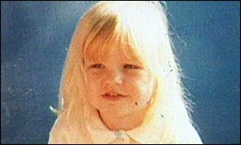
The importance of safeguarding
‘Child Safeguarding Practice Reviews (CSPR)’ have replaced ‘Serious Case Reviews’, in line with ‘Working Together to Safeguard Children, 2023’.
CSPRs are carried out when a child or young person dies or is seriously injured, and abuse or neglect is known or suspects to be factors in the death. They are carried out so that improvements can be identified, and action taken so that agencies work with each other more effectively to keep children, young people and their families safe.
KEY MESSAGE: Why do we need to bother with safeguarding? Because children and young people can be seriously affected by maltreatment, or DIE!
Notes:
Slide first
Click on - As if that isn’t scary enough, these photos bring it home to me every time I look at them. Not all of these children were in school, but we need to be observing all the time – neighbours, in the supermarket, etc
Every year, we hear more horror stories in the news, and it is everyone’s responsibility to be observant and curious

Slide 10
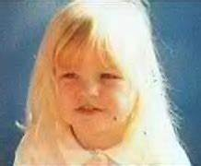
Lauren wright
Lauren was born in July 1993 and died in May 2000, 2 days before the case conference to discuss her Too late for Lauren ☹
From birth she was known to Social Services but was removed from CP register when she went to live with her paternal grandmother in 1998 Does moving in with grandparents automatically mean she’ll be ok?
In 1999, Lauren’s care was transferred to her father, she started school, and dad married a lady who became a playtime supervisor at Lauren’s school
Reports of bruising started in 1999, she was seen by a paediatrician When the stepmother arrived ☹
Anonymous allegations of neglect and emotional abuse (abuse by the stepmother) were made in 2000 ☹
Witnesses saw Lauren being hit, starved of water, made to eat bugs, being treated differently from her siblings, made to stand in front of a hot stove for hours ☹
The teacher reported bruises, scratches and black eyes Who was joining the dots of all these allegations? ☹
The head was horrified by her weight loss – she weighed 2 stone when she died More than ½ the expected weight of a girl this age ☹
The family said Lauren was being bullied, so the social workers asked the teachers to monitor people lie! ☹
A GP suspected abuse, the paediatrician said the bruises were down to bullying. Which the stepmum told the paediatrician about! ☹
The stepmother told school the bruises and weight loss were being investigated at the hospital as possible leukaemia more lies! ☹
Police were told evidence was inconclusive. did they speak to everyone? ☹
Social workers visited Lauren at home on 25th April and alerted social services to her appearance and behaviour. A week before she was hit so hard that her digestive system collapsed. ☹
Between 2-5th May, a fatal blow was dealt to her stomach, she died on 6th May.
RECORD KEEPING
SHARING INFORMATION
BE CURIOUS
BE PERSISTENT
DOUBLE-CHECK
Notes:
This was the first SCR that really got under my skin – so many people shouting out and being ignored. I won’t read all but basically a lot of people were worried about Lauren since her birth, but she was removed from CP register when she went to live with her dad and his new partner. She worked at the school Lauren went to. Lauren suffered horrendous abuse at the hands of the stepmother, and lots of people alerted children’s services to this. The stepmum used her position to tell the hospital that Lauren was being bullied, and the school that the hospital was investigating bruises and weight loss in case it was leukaemia – there was no one asking other agencies for confirmation ☹ Lauren died of horrendous injuries 2 days before the case conference was held to discuss her – too late.
After this, there was meant to be more joined up working, but there have been more SCRs since.
The stepmum was given 15 years, but it was then reduced to 10 as they felt it was ‘excessive’ and she ‘had the reasoning skills of a primary school child’ - ☹
Introduce Take Aways

Slide 11
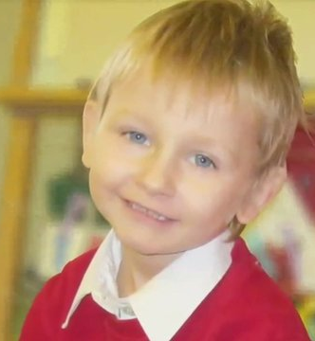
Do you know who these children are?
Think the unthinkable!
Keep pestering
Share information
Notes:
From last year – but still a good reminder!
Arthur Labinjo-Hughes – died in 2020, aged 6, fatal head injury. Evidence of serious physical abuse and neglect, with 130 bruises on his body and evidence of salt poisoning. Arthur was known to children’s social care – having been the subject to 2 CIN assessments. Concerned family members had contacted CSC, school and police.
Star Hobson – 16 months old when she was murdered in 2020. Endured a campaign of physical and psychological torment, much off it recorded on social media! Star received a scull fracture alongside multiple injuries to her scalp, forehead, cheek and back. She suffered a cardiac arrest and died. Concerned family members had made 5 referrals to CSC and contacted the police.
Daniel Pelka – killed by parents - serious case review findings: all 3 of mum’s partners since being in UK were known for DV – 27 reported incidents to police
2011 Daniels arm broken – SW did not think there was need for intervention
2011 started school, Staff saw bruises and unexplained marks, they were not noted
teachers and school nurse worried about his hunger, thinness, scavenging – paediatrician thought it was a medical problem. They were not aware of what school witnessed. 3 weeks later he died of a head injury

Slide 12
EXAMPLES OF POOR PRACTICE COMMONLY SEEN in reviews after children die:
Failure to act on and refer the early signs of maltreatment
Poor record keeping
Failure to listen to the view of the child and reassess concerns when the situation doesn’t improve
Not sharing information with the right people within, and between, agencies and/or sharing information too slowly
A lack of challenge to those who appear not to be taking action
Notes:
Bullet point 3 – why would children lie? What language are they using, does it sound like a child trying to get someone into trouble? Why would a child do that? It would still worry me!

Slide 13
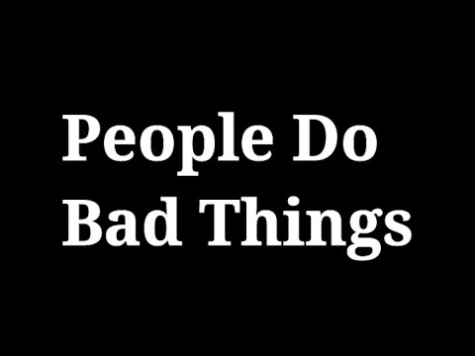
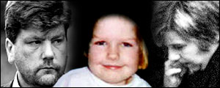
Why don’t people share information?
Worry about confidentiality or data protection – safeguarding / child protection concerns trump these every time!
Confusion about whether they need child/family consent – this is for the DSL to decide, not you
Fear they might be proved wrong and cause unnecessary distress to a child or family – what’s the alternative?
Worry it might reveal something they shouldn’t, and then be subject to disciplinary procedures – you have the right motivation, 3D Recruit have your back
Assumptions that someone else will share
Concern that there may be consequences for the child or family – what’s the alternative?
Concern that sharing information might lead to more work – who would do that!
Not identifying that they need to share information or that the information they have has relevance
Notes:
Lauren’s Wright’s stepmother worked at the school! Did that affect who came forward? How plausible was she?
Bad people do bad things!

Slide 14
Reflection point
Why is safeguarding important?
What’s your role in safeguarding pupils?
Why should you bother?
Notes:
Type into the chat – me type heading

Slide 15
What LEGISLATION PROTECTS CHILDREN?
Notes:
Next section – there is a lot of legislation to protect children
You do not need to know it all, but you do need to be vigilant and protect children!

Slide 16
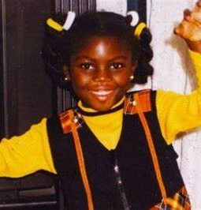
Key child protection and safeguarding legislation
The Children Act 1989: places the duty on the LA to promote and safeguard the welfare of children in need in their area. It introduced the concept of:
- child-centred work
- children in need (section 17)
- child at risk of significant harm (section 47)
The Children Act 2004: followed the inquiry into the murder of Victora Climbie. It made changes to the CP Framework. It:
- placed a duty of LAs in England to:
- make arrangements to promote cooperation with key partners and local agencies
- specified the role of DSL
- stipulated organisations and agencies had a duty to consider the need to safeguard and promote the welfare of children within their role
Notes:
I’m not going to read through all of these, as you can go back and refer to them.
Children’s Act – Child in need – a child unlikely to achieve/maintain a reasonable level of health or development, or whose level of health and development is likely to be further/significantly impaired without the provision of services – OR if a child is disabled
Child Protection – highest level, concerns child has suffered or likely to suffer significant harm
Like Victoria Climbie - A lot of changes come about due to SCRs ☹

Slide 17
Continuum of need
Notes:
Should see in staff rooms
Just need to know about it – DSL and SPOA will use to assess need.
DSL / SPOA are there to help – don’t be afraid to help

Slide 18
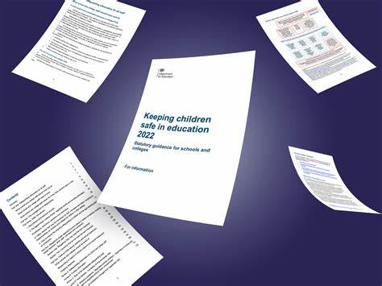
Key child protection and safeguarding legislation
The Education Act 2002: sets out duties and responsibilities for schools in relation to safeguarding children. The roles and responsibilities of schools (including academies, independent and non-maintained schools) has been enhanced by statutory guidance such as KCSIE.
Human Rights Act 1998: protects and promotes the rights of children, including their right to life, education, freedom of expression, private and family life, freedom from slavery, forced labour, and not to be treated in an inhuman or degrading way.
The Equality Act 2010: protects children from discriminations, harassment and victimisation.
The Health and Safety at Work etc Act 1974: requires employers to ensure the safety of children in their care.
Notes:
The Education Act – duties and responsibilities
Human Rights – some we don’t expect to see after the time of Dickens and Shaftesbury!!
Equality Act – watch your prejudice! Maybe take time to reflect in unconscious bias!

Slide 19
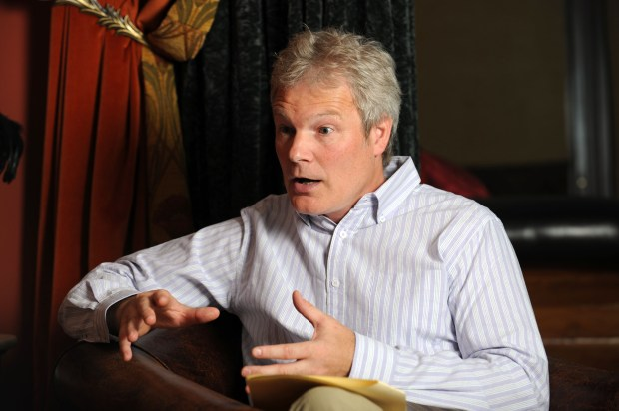
Key child protection and safeguarding legislation
The Children and Social Work Act 2017: has 4 main purposes:
- improving decision making for LAC and previously LAC
- improving joint working at a local level
- promoting safeguarding of children by providing RSE
- strengthening relationships between key agencies in the local area
The Safeguarding Vulnerable Groups Act 2006: prevents people who are deemed unsuitable to work with children from gaining access to them through their work. It introduced ‘safer recruitment’ and the DBS.
Notes:
LAC? A very vulnerable group
Role of RSE
DBS and safer recruitment – a duty of 3D Recruit and important
Who knows this man? Sion Jenkins was taken on as the Deputy Head at William Parker, despite lying about his qualifications on his CV to get the job, and then lying again on the application to become the head of school at the time of the murder! He was told by ESCC that he had got the job subject to references!! What would have happened if they didn’t check up the references!! This wouldn’t happen now – would it Lucy!!

Slide 20
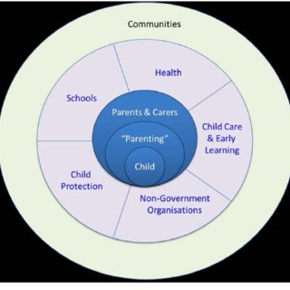
Key child protection and safeguarding legislation
Working Together to Safeguard Children presents key guidance relating to the framework for safeguarding and child protection structure. It:
- states that safeguarding is a shared responsibility
- provides definitions of safeguarding and different types of maltreatment
- outlines roles, responsibilities and expectations
- provides information on when concerns should be addressed
- provides timelines for completing assessments and enquiries
- highlights the need for careful assessment of children and their families
- suggests appropriate support and intervention, using a child-centred approach
Notes:
Working Together to Safeguard Children – an important one! Relevant bits are included in this training

Slide 21
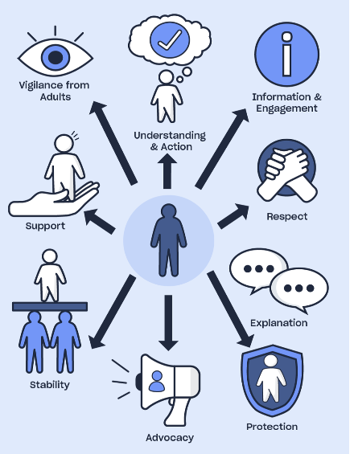
What children said they needed
In ‘Working Together’, children said this was what they needed for an effective safeguarding system:
Be observant
Listen and understand
Act
Share information
Be informed
Explain and support
Protect
Notes:
Child were asked – always a good idea!!
I want to look at the idea of ‘being informed’ in next slide – always comes up – it refers to knowing about what we’re learning about today……not CLICK

Slide 22
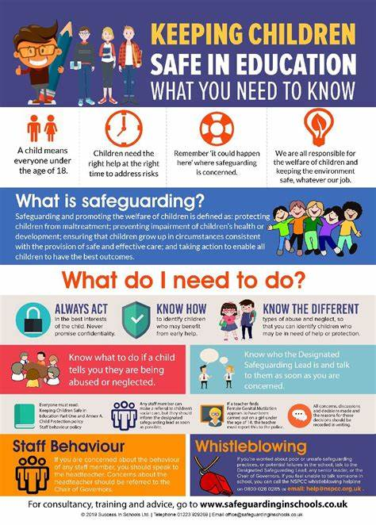
Keeping children safe in education
Statutory guidance for schools and colleges on safeguarding children and safer recruitment
Must = legal requirement to do something
Should = the guidance should be followed unless there is a good reason not to
Victim = those suffering maltreatment
Perpetrator = person causing the maltreatment
NB – a child may be both victim and perpetrator and we should be sensitive to how we use this language with children
Each Year you are asked to read Part 1, prove your understanding and be made aware of the updates.
Notes:
This is the piece of statutory guidance that is most important and what we need to return to each year due to the updates.
Victim and Perpetrator – be careful, a child could be both

Slide 23
Changes for 2024
NB – these changes are not yet finalised; the final version will come into force in September 2024 – 3D Recruit will keep you informed should anything change from what is said today:
Proposed updates
Revised definition of safeguarding, aligned with changes in ‘Working Together to Safeguard Children 2023’
Additional information on early help for children
Updates in abuse, neglect and exploitation
Terminology change for ‘deliberately missing education’
Guidance on data protection
I have taken the guidance that follows from the NSPCC https://learning.nspcc.org.uk/media/jvzhssj3/kcsie-2024-caspar-briefing.pdf
Notes:
This is not finalised until it is published in September, 3D Recruit will keep you in the loop – but this is what is expected to be changed
We will go through these individually

Slide 24
Definition of safeguarding
The definition of ‘safeguarding and promoting the welfare of children’ has been updated to reflect the changes made in ‘Working together to safeguard children’ (2023). The definition now includes the additional points of:
Providing help and support to meet the needs of children as soon as problems emerge
Protecting children from maltreatment, inside and outside the home, including online
Notes:
Safeguarding is about identifying needs as early as possible, and protecting children from maltreatment inside, outside and online

Slide 25
Early help
The update adds that professionals should be alert to the need for early help for a child who:
Is frequently missing/goes missing from education, home or care
Has experienced multiple suspensions, is at risk of being permanently excluded from schools, colleges and in alternative provision or a pupil referral unit
Has a parent or carer in custody or is affected by parental offending
Notes:
There is a greater focus on children not in school – missing, suspended, excluded, alternative provision
Also, a greater focus on those with parents in prison or offending
This is not about ‘stereotyping’, this is about knowing who is most vulnerable

Slide 26
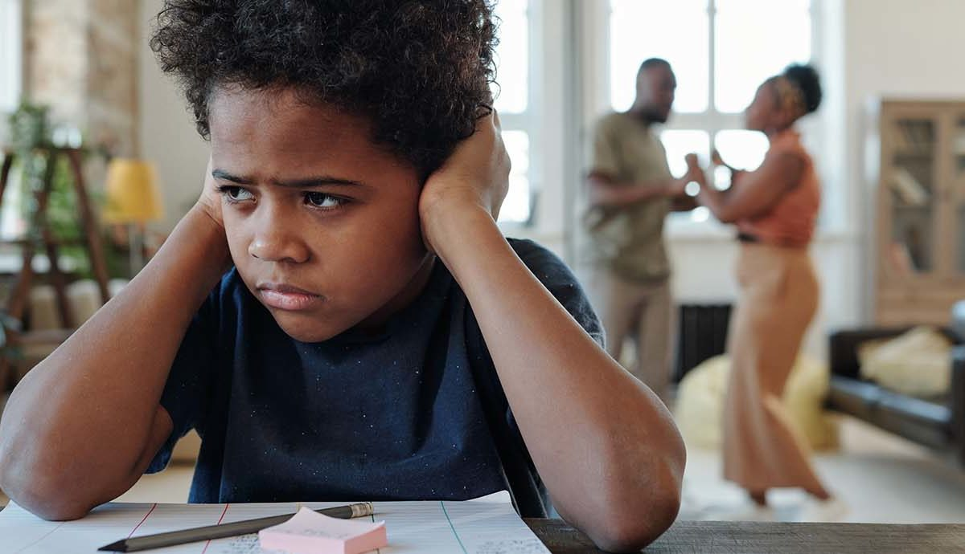
Updates on abuse, neglect and exploitation
Where applicable, ‘abuse and neglect’ has been changed throughout the document to ‘abuse, neglect and exploitation.’
The definition of ‘abuse’ has also been changed to clarify that harm can include witnessing the ill-treatment of others and that this is particularly relevant when children see, hear or experience domestic abuse and its effects.
Notes:
Exploitation is becoming more prevalent so has been added
We are more aware that being around DV is dangerous and has a long-term affect on children

Slide 27
Terminology change for ‘deliberately missing education’
In outlining the signs that children may be at risk of harm, the guidance updates ‘deliberately missing education’ to read ‘unexplained and/or persistent absences from education.’
Notes:
Children missing from education become ‘invisible’ and then very vulnerable.

Slide 28
Data protection
The updated guidance recommends that education professionals read the DfE Data Protection guidance for schools (DfE, 2024). This guidance is aimed at school staff, governors and trustees and sets out how to:
Comply with data protection law
Develop data policies
Understand what staff and pupil data to keep
Prevent data breeches
See 3D Recruit’s Records Retention and Destruction Policy for more guidance on GDPR
Notes:
Data breeches can include access by an unauthorised person, sending personal data to the incorrect recipient, having your device stolen, or losing it, alterations of personal data without permission. If any of these things happen, please contact your link at 3D Recruit as it may need to be reported.

Slide 29
In addition to these changes…
Alternative Provision – when a school places a pupil with an alternative provision provider, the school continues to be responsible for the safeguarding of that pupil
‘Children who are lesbian, gay, bisexual or gender questioning’ – this section is currently under review pending the outcome of the ‘gender questioning guidance consultation
‘Children and the court system’ – the updated guidance now directs schools to two guides that support children in the court system – one for 5-11yrs, and 1 for 12-17yrs
Holding and Sharing Information – the updated guidance highlights that, as well as keeping records, discussions and decisions, designated safeguarding leads should keep record of the rationale for any decisions made.
A full list of changes can be found in Appendix F of KCSIE 2024
Notes:
Just list

Slide 30
Reflection point
How confident are you in your ability to be able to meet your responsibilities?
What bothers you?
What don’t you think you know?
Do you know what you’re looking for?
Notes:
Type into the chat – me type heading

Slide 31
How can I recognise maltreatment?

Slide 32
Types of maltreatment
Maltreatment is the abuse and neglect of children. It encompasses all forms of ill-treatment, abuse, neglect and exploitation. Maltreatment can seriously impair a child’s health, dignity and development.
Abuse is where a child is treated cruelly, violently or forcefully by an adult or another child, causing harm or distress. Abuse is a form of maltreatment. Children can be at risk of abuse in the home, in social situations and online
Physical abuse: intentionally causing bodily injury, e.g. hitting, shaking, poisoning, burning, a parent fabricating illness
Emotional abuse: ongoing emotional maltreatment, e.g. stopping a child expressing opinions, overprotection, serious bullying.
Sexual abuse: forcing or enticing a child to engage in sexual activity. This might not be violent, the child might not be aware. It can be physical contact and/or non-contact acts, e.g. looking at or posing for sexual images
Neglect: not preventing harm, failing to provide adequate supervision, not meeting a child’s basic needs
Notes:
Are you confident about these terms?
Remember – no one is expecting you to diagnose, just be observant

Slide 33
Some other specific types of safeguarding/ child protection issues
Child on child abuse- when children abuse other children, e.g. bullying, physical abuse, sexual violence or harassment. Consensual or non-consensual sharing of images and videos, causing someone to engage in a sexual activity without consent, initiation or ‘hazing’ as a way to get into a group . It can happen in person or online.
Domestic Abuse: when a child sees, hears or experiences the impact of DV in their home, isolated or long-term. They might also suffer DV in their own teenage relationships
Online Abuse: any abuse that happens on the internet or a mobile device; it can include harmful content and interactions, or online gambling. It could be committed by people known to the child or strangers.
Child Criminal Exploitation (CCE): grooming and exploitation of children to carry drugs, guns, money and other items that are used in criminal activities. County Lines is an example of this and is a big issue in the local area.. Cuckooing is when OCGs use high levels of violence or intimidation to protect the ‘county line’ and control them. They may take over a house and target those who are lonely, isolated and vulnerable.
Notes:
Child-on-child, remember the perpetrator could be a victim soon.
Domestic Abuse was a big issue during lock-down. A child may not know it’s not normal, so listen carefully
Online abuse – changes constantly. Ofcom (2023) said that 1 in 5 toddlers (3/4 yrs) in the UK own a smartphone. 8-11 = 55%, by 12 = 97%
County Lines is a big one locally

Slide 34
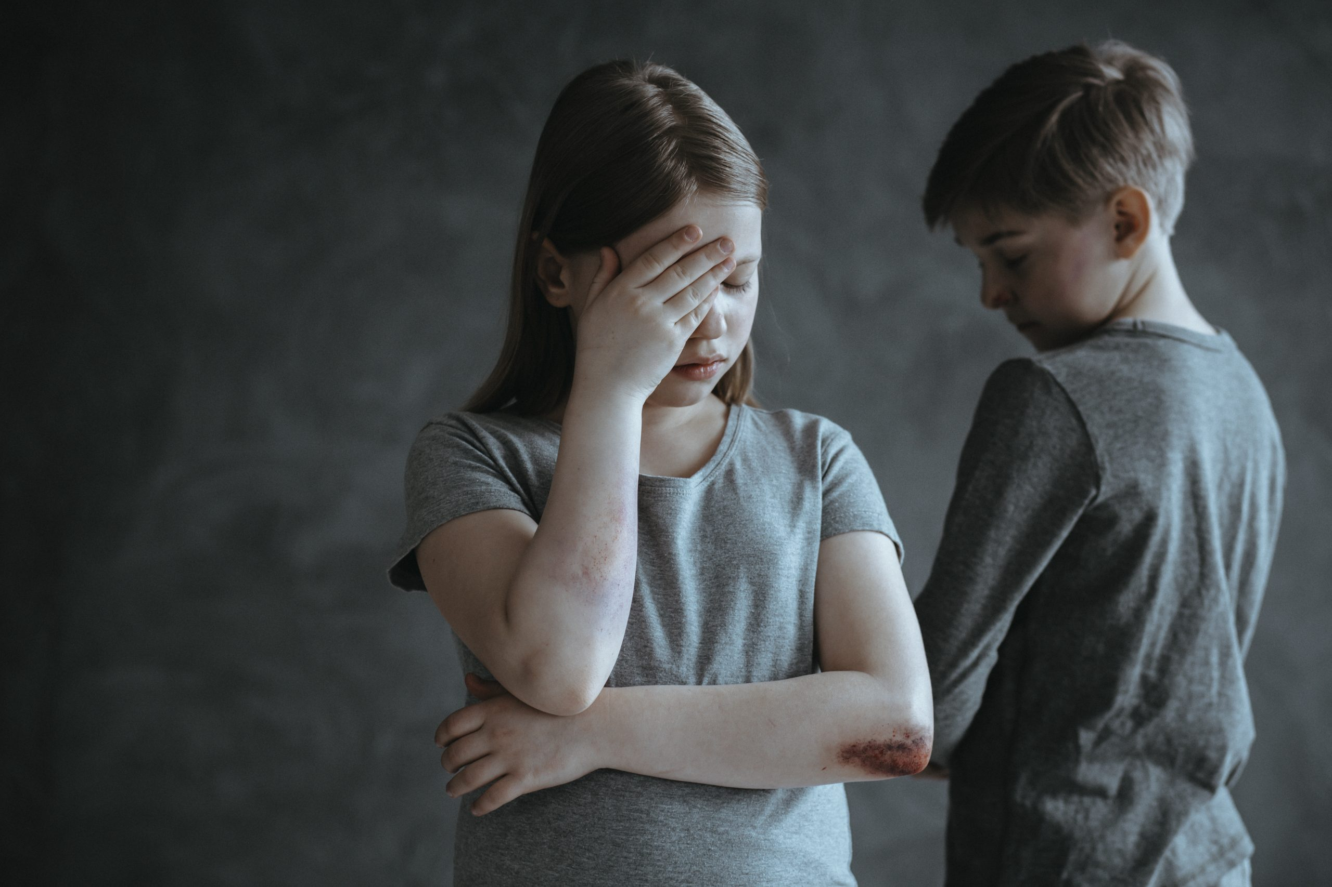
Some other specific types of safeguarding/ child protection issues
Grooming: when someone builds an emotional connection with a child wither online or face to face, gaining their trust for the purpose of sexual abuse, exploitation, radicalisation or trafficking.
Harmful Sexual Behaviour (HSB): when a child displays developmentally inappropriate sexual behaviour for their age, this can lead to abuse and violence and can happen online/face to face or both. Children who display HSB have usually experienced maltreatment themselves, e.g. neglect, domestic abuse, parental substance misuse and sometimes sexual abuse.
Forced Marriage: where one of both parties don’t consent to the marriage (due to age or disability). Since ‘The Marriage and Civil Partnership (Minimum Age) Act 2022, it is illegal for 16 or 17 years-olds to marry in England or Wales, even with parental consent. Forced Marriage includes non-legally binding ceremonies viewed as marriage.
https://learning.nspcc.org.uk/child-health-development/sexual-behaviour
Notes:
https://learning.nspcc.org.uk/child-health-development/sexual-behaviour = NSPCC sexual development and behaviour in children:
Under 5 – curiosity, lack of inhibitions, uncommon to discuss specific sexual acts, use explicit sexual language
5-9yrs – modesty, asking for privacy, questioning about sex, mimicking adult relationships – holding hands with ‘girlfriend’ or ‘boyfriend’
Uncommon to discuss sexual acts or self-stimulate in public
9-13yrs – seeking romantic relationship, more privacy, using sexual language/joking, seeking information in books/online etc, private masturbation
Uncommon to display sexual behaviour in a public place, or regularly display adult-like sexual behaviour, e.g. oral or genital contact or intercourse
13-17yrs – experimenting consensually with those of the same age group, looking for information about sex and sexual relationships, masturbating in private
Its uncommon for this age to masturbate in public or display sexual attraction to a much younger child

Slide 35
Some other specific types of safeguarding/ child protection issues
‘Honour-Based’ abuse: something done to protect or defend the ‘honour’ of a family or community, e.g. Female Genital Mutilation’ (FGM) or ‘Breast Ironing’ (any method used to prevent a girl’s breast growing). – common in some African countries.
Radicalisation and extremism: radicalisation is making someone believe or support extremist ideologies associated with terror groups. Extremist views might be political, religious or ideological.
Modern Day Slavery: children can be forced into slavery, human trafficking, forced labour and domestic servitude. It can be linked to exploitation, such as CSE and CCE
Child Trafficking: recruiting, moving or transporting, and then exploiting, forcing to work or selling of children. This might be for sexual abuse, benefit fraud, forced marriage, domestic servitude, forced labour or, criminal activity. Trafficking is not about distance,, children can be moved from one home to another.
Notes:
As we have more children coming into our local school who are seeking asylum or immigrants, we should be more aware of these types of issues

Slide 36
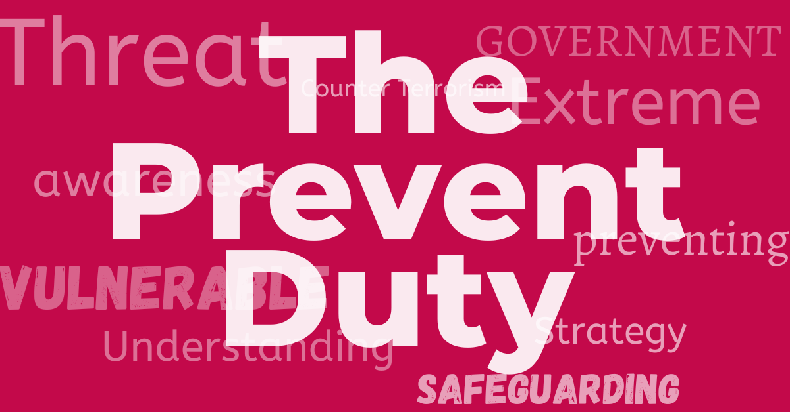
Prevent Duty
Requires all education providers ‘to help prevent the risk of people becoming terrorists or supporting terrorism’; this includes safeguarding learners from extremist ideologies and radicalisation.
Schools must work in cooperation with the local Prevent staff, the police and LAs, and coordinate through existing multi-agency forums
Schools must understand the risks and threats in their local area – we have more issues with Far-Right politics in this area, but children in Brighton have been radicalised and gone to fight in Syria
Schools deal with issues linked to the Prevent counter-terrorism strategy through their curriculum, e.g. British Values
Staff should report any behaviours that might cause concern to the DSL following the usual safeguarding procedures of the school
Notes:
Lucy will provide further guidance, but this comes under safeguarding

Slide 37
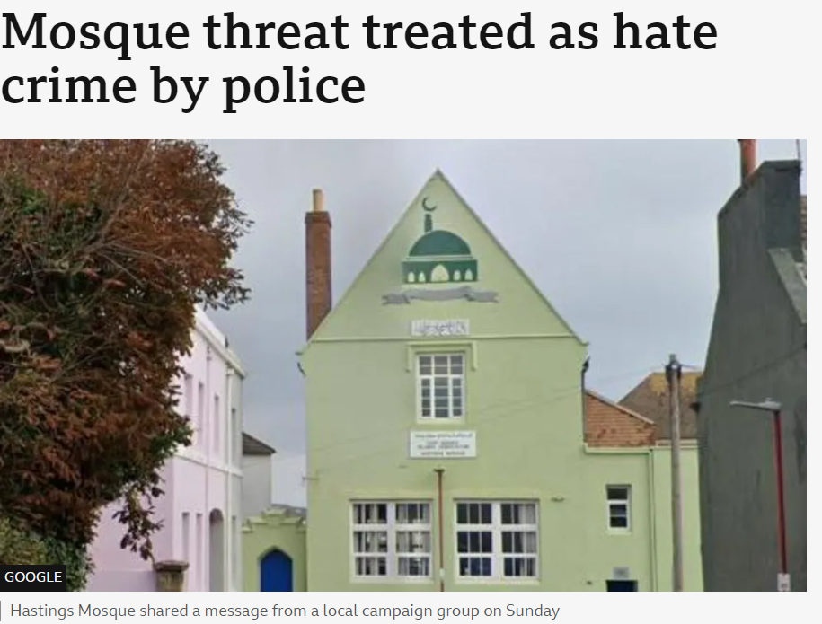
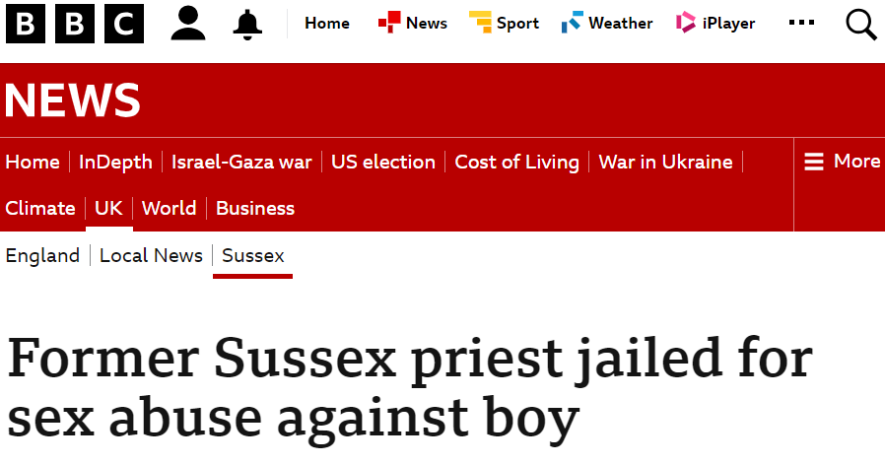
These things are happening locally
BE CURIOUS
OBSERVE
KNOW THE SIGNS
Notes:
Be aware – there are vulnerable children every where – even in leafy village schools.

Slide 38
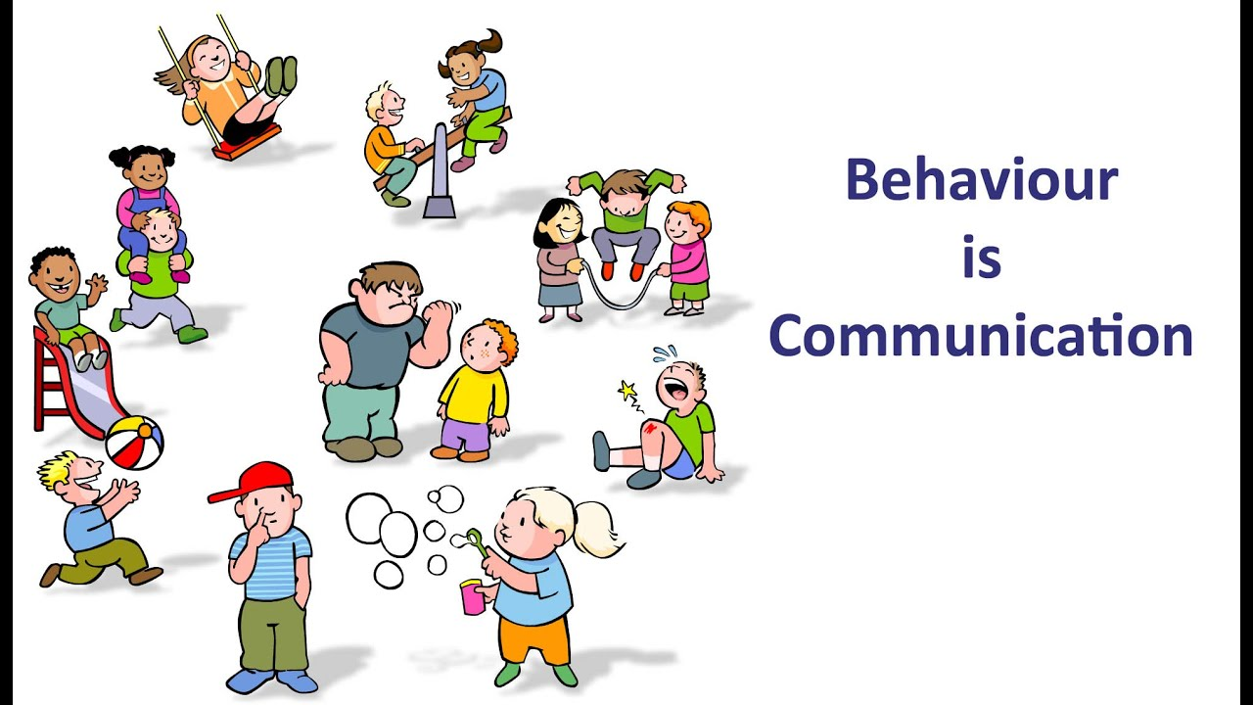
WHAT TO LOOK FOR
Unexplained changes
Becoming withdrawn
Seeming anxious
Becoming uncharacteristically aggressive
Lacking social skills
Few friends, if any
Poor bond/relationship with parent
Inappropriate knowledge of adult issues
Running away
Missing
Wearing clothes which cover their body
Bruising
injuries
Notes:
The list is long and often features change in the child’s behaviour, appearance etc
Next slide considers the issue of only being in class for a short time

Slide 39
What if you’re only in for a day?
Ask someone (e.g. the class TA), ‘is this usual behaviour?’
Follow that up, speak to your contact in school or the DSL, ‘I noticed that Bobby was very dishevelled today, do you want me to write something to record that on your safeguarding database?’
Drop an email to 3D Recruit’s DSL to let them know that you spoke to the school’s DSL about a concern
Be curious
If in doubt, raise a concern
Protect yourself
Take notice, don’t diagnose
Keep notes to pass accurate information on
Notes:
Good question

Slide 40
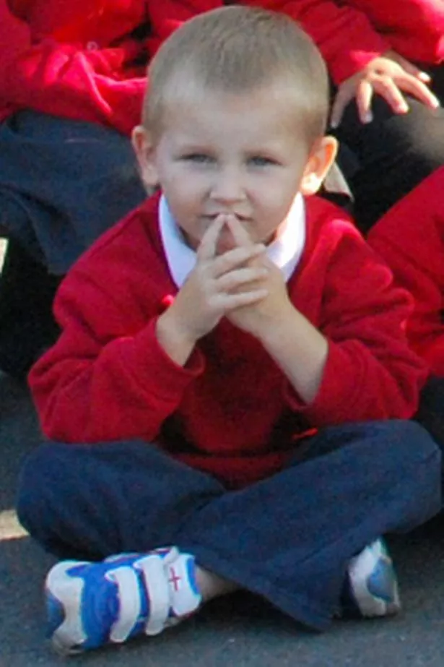
How to spot neglect
What is the difference between neglect and poverty?
Poverty and financial hardship are not the same as neglect – but the cost-of-living crisis has made the line between material poverty and neglect harder to walk. And, it does increase the risk of experiencing neglect.. Report both – the school will be able to offer help.
Signs of Neglect
Numerous accidents Poor medical and dental care
Being hungry, stealing or hiding food Missing school
Being a carer for siblings or other family members
Signs of malnutrition Persistently smelly or dirty
Consistently inappropriate clothing or shoes
Severe or persistent illnesses or infections
Notes:
It is not ok that this family are always like that! It is not ok that kids always have nits, no socks, holes in their shoes.
It is not ok that a child has a packet of Oreos in their lunchbox! Their parent might be having a bad day, lacking funds etc, but it’s not ok for the child! They might need ‘Early Help’

Slide 41
How to spot Physical abuse
Bruises, cuts, scratches or scars
Fractures
Bite marks
Burns or scalds
Vomiting, drowsiness or seizures
Breathing problems
Suspicious illnesses
Notes:
‘Munchausens’ is now referred to as ‘FII – Fabricated or Induced Illness’. It happens
Check out the child that doesn’t want to get changed in front of class - pants
Kids get bumps and bruises …..

Slide 42
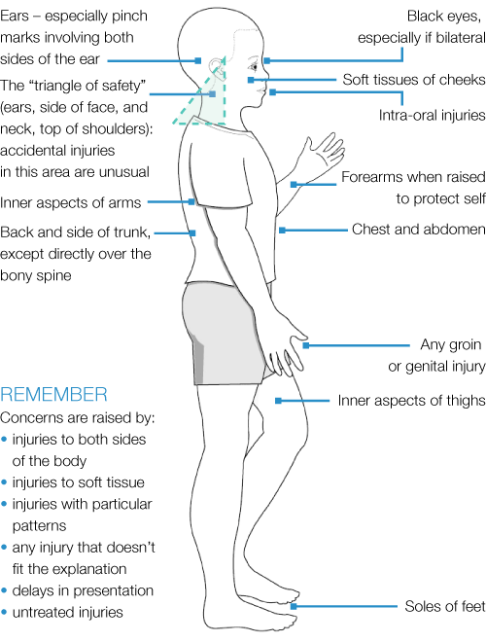
Where wouldn’t you expect to see injuries in a child?
What wouldn’t hit the ground naturally if they fell?
Where would injuries be if a child had been pulled?
A child under 4 months is unlikely to have bruising (kids that can’t cruise, rarely bruise!)
What does defence would look like?
Where would you hide physical injuries that you have caused?
Notes:
Go through key points:
Pointy bits hit the ground
Dislocations
Kids that can’t cruise, rarely bruise
Defence injuries
Hiding physical injuries – soles of feet, under clothes

Slide 43
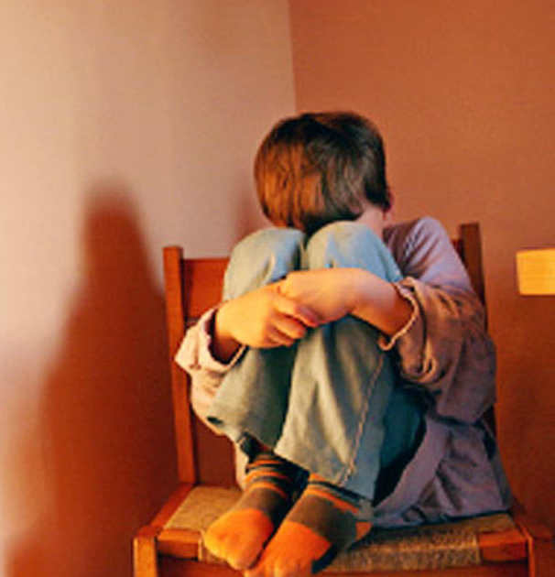
How to spot emotional abuse
Behaviour, language or knowledge you wouldn’t expect for their age
Outbursts
Isolation from parents or carers
Negative interactions with parents or carers
Lacking social skills or friends
Low self-esteem or self-confidence
Trying to make people dislike them
Language development issues
Online it may be:
Teasing and bullying on messaging apps (cyber-bullying)
Being made fun of on social-media (fake accounts, hurtful videos)
Being excluded from online games
Receiving constant messaging from parents or carers while at school
Notes:
Don’t add to it!
Be careful what you say – oh look at Bobby, holding us all up again
Bobby, the lady is here to take you to the special needs room

Slide 44
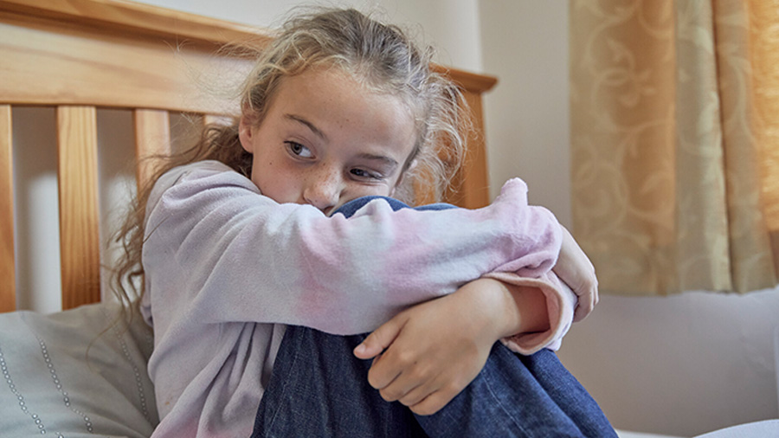
How to spot sexual abuse
Difficulty sitting
Marks or bruises
Poor personal hygiene (often to make themselves less attractive)
Needing to go to the toilet a lot (possible UTIs)
Fear of, or avoiding, a particular person
Sexually inappropriate behaviour or language (not expected for their age)
Dropping hints or mentioning secrets
Secretive online behaviour
Pregnancy or STIs
NB - Adult males aren’t the only perpetrators of sexual abuse. Women can also commit sexual abuse, as can other children
Notes:
- Soiling

Slide 45
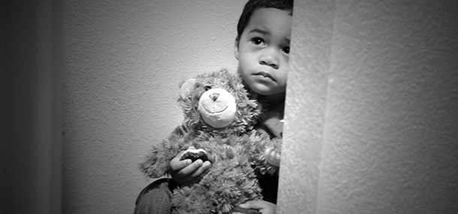
What children might be more vulnerable?
SEND
Persistent absentees
Missing children
LGBTQ+ (or perceived to be)
Parental offender / in prison
Mental health needs
Privately fostered
LAC / been in care
Live in challenging family circumstances (drug / alcohol abuse, domestic violence, adult mental health issues)
At risk of honour-based abuse (including FGM)
At risk of radicalisation
At risk of modern slavery, trafficking or exploitation
Misusing drugs or alcohol
Being drawn into anti-social or criminal behaviour (including gangs and county lines)
Young carers
Notes:
Again, this is not about being accused of racism or stereotyping. We will see FGM in children from Africa, the Middle East and Asia. The statistics show that those in care, or those who have been in care, are more vulnerable

Slide 46
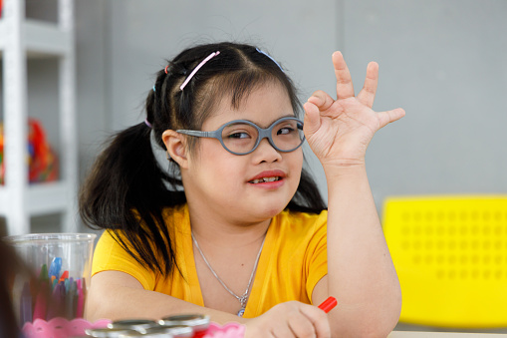
Why are SEND children more vulnerable?
Would you know who they were?
Should you?
How would you find out?
They rely on others
They can be more innocent or trusting
They find it harder to communicate clearly
They are less likely to understand their experiences are abuse
They are more prone to isolation or bullying
SEND children are over 3 times more likely to be abused than other children!
Signs of abuse might be more easily missed or dismissed.
Many forms of SEND are invisible – this doesn’t mean their children are less vulnerable!
Notes:
Someone should make you aware of which children in the class have additional needs and how to accommodate them.
If they don’t, have a quick look around the class, ask the TA

Slide 47
Why are LGBTQ+ children more vulnerable?
Would you know who they were?
Should you?
How would you find out?
More likely to be a target for bullying
At higher risk of homophobic, biphobic or transphobic hate crimes
Feel different and isolated from their peers
Not have a trusted adult to talk to about their identity (1/10 have to leave their family home)
Pupils who may be perceived to be LGBTQ+ share the same risk factors as those who are LGBTQ+
Nearly ½ of all LGBTQ+ experience bullying in school !
Notes:
As with SEND, if it’s important, someone should let you know to save you and the child from embarrassment

Slide 48
How much information should you be given?
It would be inappropriate for a school to tell you about individual children’s backgrounds
Gossip is inappropriate and should be reported
You should be told if there is anything in particular that you should be aware of, e.g. Bobby may be a bit restless today, could you feedback anything that concerns you. This would include a child’s special educational needs and how they are met; this should be shared via a Pupil Passport or similar; gossip of informal feedback is unprofessional and is not helpful for you or the child.
Notes:
How much should you know about the child
This is confidential and could affect your interaction with the child
Treat them as all as if they might need you – notice, be observant, be approachable, build trust, LISTEN,

Slide 49
Reflection point
Which type of abuse is worse?
A parent constantly tells her son that he is like his dad and her daughter is so much better than him.
A child shares a picture on social media of the view up another pupil’s skirt.
A child living in a house where his dad regularly beats his mum.
A child gets some new trainers for holding a phone for someone overnight.
Notes:
Type into the chat – me type heading
NONE!!

Slide 50
We shouldn’t only be watching our pupils!

Slide 51
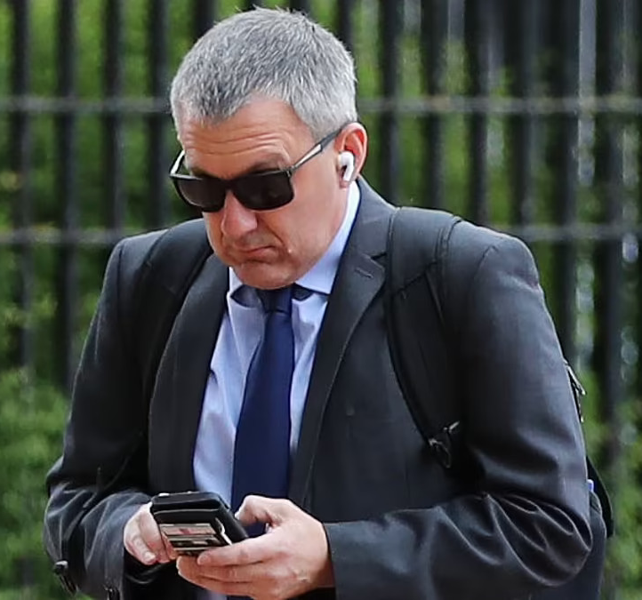
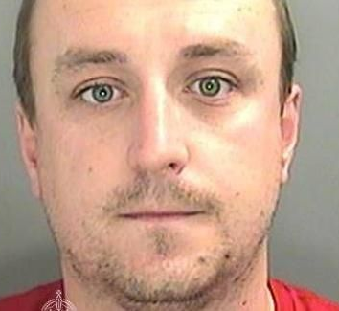
Who are these people?
Think the unthinkable!
Notes:
Matthew Smith (deputy head/head of pastoral care) – August 23 jailed for sexual exploitation, abuse of a child, encouraging the rape of a child, causing a child to engage in sexual activity, arranging the sexual abuse of a child, distributing, making and possessing indecent images of children (IIOC) from 2016-22. No evidence of offending in UK, worked in Nepal prior to UK, and manipulated young men to abuse children in his behalf for financial reward.
Alexander Ralls – child protection office in a private school – posed as a person with medical knowledge who told victims to remove their clothes to examine them and then molested them. 31 charges of sexual assault/ 10 charges of causing a person to engage in a sexual activity without consent / 2 charges of assault by penetration.
Julie Morris – deputy head at a primary school charged with 2 counts of rape, 9 counts of causing or inciting a child under 13 to engage in a sexual activity, 3 counts of taking indecent photos of a child, and 1 count of possessing indecent photos of a child. Her partner was also charged and jailed of similar offenses
Ieuan Bartlett (2023) – a teacher who repeatedly had sex with a pupil, he manipulated and specifically targeted a particularly vulnerable pupil. The girl was 16.

Slide 52
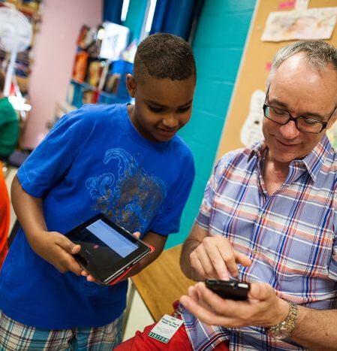
When should I report a colleague?
It’s not just sexual abuse!
contact with children and young people through social media and personal email or phone
emotional abuse, bullying, threats, intimidation or derogatory comments
non-sexual contact, which breaches a code of conduct or positive handling policy
providing rewards and incentives which are not sanctioned within a code of conduct and could single out particular children or young people to the detriment of others
being under the influence of drugs or alcohol in the workplace
inappropriate use of work IT equipment in work or at home e.g. viewing adult pornography
failure to protect or report a safeguarding concern
involvement with Children’s Services, such as care proceedings or Child Protection Plans, for own children
domestic abuse
arrest or prosecution for a criminal offence outside of work
Notes:
After a teacher separated from her boyfriend, her TA gossiped to me “did you know that he was on the sex-offenders register!”

Slide 53
These are ‘low level concerns’
In 2021 and 2022, the DfE added information to KCSIE about ‘low level’ concerns about staff – this is anything that doesn’t follow the school’s code of conduct, including inappropriate conduct outside of work, but the behaviour doesn’t meet the ‘harm’ threshold or isn’t serious enough to refer to the LADO. This could be:
inadvertent or thoughtless behaviour, e.g. not checking up on a pupil that’s been missing from class for longer than anticipated
inappropriate for circumstances – a teacher shows a pupil photos from their private Instagram page which reveals their username
Intended to enable abuse – a teacher asking a pupil for their mobile phone number
Notes:
Low-level but still wrong!
Check out 3D Recruits Code of Conduct if unsure about a fellow supply or yourself

Slide 54
How do I report it?
If it’s a member of staff, speak to the headteacher
If it’s the headteacher, you will need to speak to the Chair of Governors
If there’s a conflict of interest in reporting the headteacher, go to the LADO
Remember that the 3D Recruit DSO’s are here to support you.
If DSL or 3D Recruit’s DSO aren’t available, report your concern to the LADO:
https://www.eastsussex.gov.uk/children-families/professional-resources/allegations/lado

Slide 55
Reflection point
Which of these is ok in school?
Becoming ‘friends’ with pupils on social media so that you can share their homework.
Recording a video of pupils on your personal phone.
Using your phone to show them a relevant picture linked to their learning.
Forgetting to check on a group of pupils doing an activity outside the classroom?
Working with a child 1-1 in a room with a closed door.
Discussing a sexual term that they don’t understand.
Notes:
Type into the chat – me type heading
NONE!!
Discussing a sexual term – RSE – I’m not allowed to discuss that 1-1, let’s call mum

Slide 56
Dealing with disclosures

Slide 57
Direct / indirect
Direct – a child asks to discuss something that is bothering them
Indirect:
Ambiguous verbal statements – Grandpa’s snoring keeps me awake at night.’
Behaviour - self harm, ‘acting out’, quiet and withdrawn
Non-verbal communication – letter writing, drawing, role play, story writing

Slide 58
Creating a safe space

Slide 59
Do not contaminate the evidence!

Slide 60
Let’s have a go…..
Notes:
From 0.55 – 2:44

Slide 61
Reflection point
What do you think about how the teacher dealt with the situation.
What were the most important parts of the disclosure?
Notes:
Type into the chat – me type heading

Slide 62
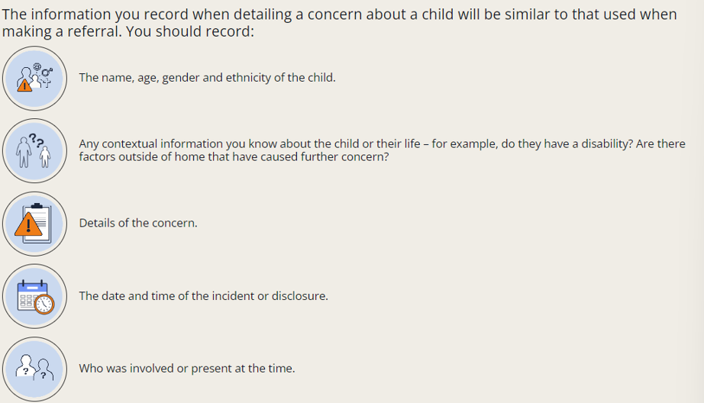
How to write a robust safeguarding report
Notes:
Do it as soon as possible after the disclosure

Slide 63
Next steps……
Pass the report to the school’s DSL (or deputy) - following the school’s safeguarding policy
Tell 3D Recruit’s DSO’s that you have made this report (Amy Gudgeon and Ben Arnold)
In an emergency, or if you cannot contact the DSL or 3D Recruit’s DSO for advice:
call 999
Or
* Speak to SPoA on 01323 464222

Slide 64
What happens next?
You have the right to ask what happened to the report
The answer might be confidential, but you have the right to check
If you feel concerned, speak to 3D Recruits DSO’s

Slide 65
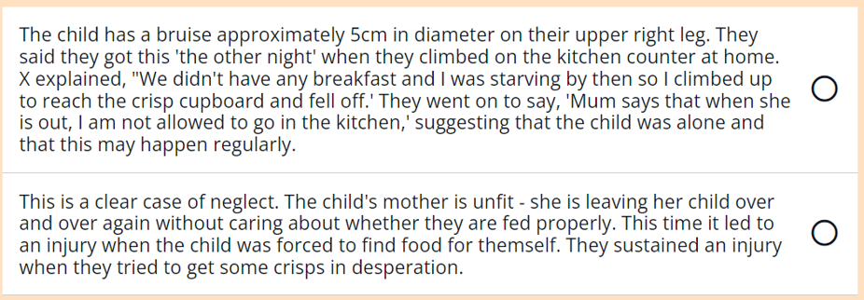
Reflection point
Which one of these is a good report? 1 or 2
Can you tell me why?
Notes:
Type into the chat – me type heading
1 -

Slide 66
Why don’t children disclose information?
Notes:
All very understandable

Slide 67
Why don’t adults take action?
Failure to appreciate that child maltreatment can and does happen everywhere – no matter how ‘affluent’ or ‘quiet’
Worrying about damaging the organisation's reputation
Thinking someone else will deal with it
Concern about someone else getting into trouble, especially if the potential abuser is a relative or partner
Worrying they might have it wrong or make the situation worse
Lack of training on how to respond correctly
Worrying about data protection – NB safeguarding / child protection trump data protection every time!!!
Not wanting to appear discriminatory
Notes:
Don’t be that person – please speak out.
If you’re worried, speak to Amy or Ben

Slide 68
Keeping yourself safe and doing the right thing

Slide 69
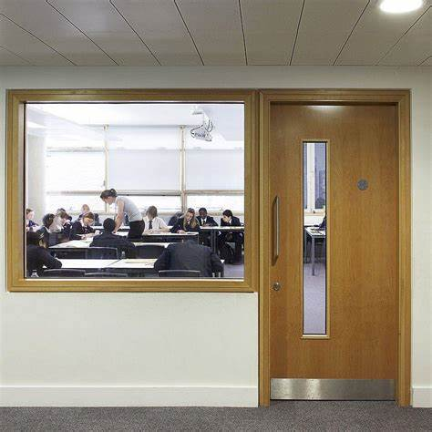
What does it look like to someone looking in?
If someone is passing the classroom and they look in, what are they going to see?
You touching a child
You showing a child something on your phone
You shouting
You sat on a chair
How will it look to them?
Make sure you have read the 3D Recruit Code of Conduct
Notes:
I always like this analogy. Be mindful, these people don’t know you, you may not have a chance to explain

Slide 70
Dealing with an allegation
Allegations get made, and not all are accurate; the important thing is that they are investigated fully.
‘Low Threshold Concerns’ are still concerns and need to be dealt with appropriately. The school/3D Recruit will gain as much evidence as possible to categorise the type of behaviour and determine what further action is necessary. All low-level concerns will be recorded in writing.
Allegations which are above the ‘low threshold concerns’ – the school will need to report this to the LADO (Local Authority Designated Officer) who will investigate; 3D Recruit will consult with the school and LADO and follow any recommendations. If the allegation is made directly to 3D Recruit, they will report to the LADO and the school. Where necessary, the police will be informed.
If there is an allegation made against you, you should try to remain calm and be as honest and open as possible with all agencies involved. 3D Recruit will advise you to contact your union or professional association if you have one. The Managing Director will then explore how they can support you further and may appoint a named-person for this.
The outcomes of an allegations may be: substantiated, false, malicious, unsubstantiated or unfounded. Depending on the outcome, 3D Recruit may consider advice to other staff, risk assessments or changes to practice. If malicious, or deliberately invented, 3D Recruit might advise contacting the police.
The 3D Recruit ‘Allegations and Misconduct Policy’ deals with this in more detail
Notes:
Be honest and open – we all make mistakes sometimes
Also, not everyone tells the truth – for whatever reason. I’ve had 2 allegations go to the LADO, both unfounded, but very scary

Slide 71
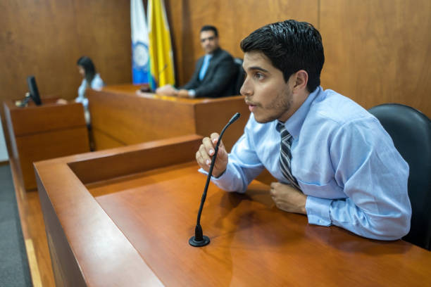
Doing the right thing
Is always going to be doing the thing is in the child’s best interests, including perpetrators
Be observant and professionally curious
If you see something, say something
Don’t be drawn into gossip or hearsay
Write factual, concise reports
If in doubt, SHOUT or ASK – 3D Recruit’s DSLs are always available if you are worried
Listen to the child
Don’t make promises, or agree to keep secrets
Let someone else decide if it’s important
Be persistent
Don’t believe everything you are told!
I didn’t think it was important!
Notes:
This is the best advice I was ever given – imagine sitting in the dock at a serious case review, when a child has died, and saying ‘I didn’t think it was important’. ‘I thought someone else would report it.’ ‘It wasn’t my place’…..

Slide 72
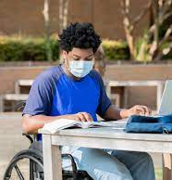
Stay safe
When you get your assignment confirmation email, it includes the contact details of the LADO, the school’s DSL and 3D Recruits’s DSOs.
This is the reason it’s there – make sure you use this documentation.

Slide 73
Anita’s top tip!
If in doubt, shout it out!

Slide 74
Any questions?
Notes:
Hands up
Type into chat

Slide 75
RECAP: Your responsibilities
Notes:
Just going to leave you with this slide

