Slide 1
Spae is grateful for the support of the following organizations:

Slide 2
FIDDLIN’ AROUND: THE DIVERSE HERITAGE OF USA STRINGS TRADITIONS
IDEAS ON DEVELOPING INCLUSIVE, DIVERSIFIED CURRICULUM IN THE TRADITIONAL MUSIC CLASSROOM – ORCHESTRA, BAND, VOCAL, AND GENERAL MUSIC
Diane McCullough, presenter

Slide 3
Questions to ask ourselves Paradigm Shift – Assume you can find material
What do I mean by “Classical” music? – Is that Euro-centered only?
What about classical Indian music, or Balanese, or Senegalese, Ghanaian, or Nigerian?
Is jazz America’s classical music?
Who has been making music in the USA since colonial days?
What is the importance of social dance in the development of American music?
How have Celtic and West African traditions blended to create an American music
How has the recording industry determined how we think about our music and musical genres?

Slide 4
CONTENTS
Colonial Times:
New England and Virginia
Joseph Bologne, Chevalier de St. George
Celtic and West African String Ensemble Traditions
Musical Traditions Coming Together in the USA: carrying the music west
Rich musical milieux in African American Community – 19th Century
Modern Era – William Grant Still – present
Links to Lesson Plans
The Creative Team

Slide 5
Colonial Williamsburg
Old Capitol Building and Colonial Coach, Williamsburg, VA
Scottish social dancing in the 18th century – Neil Gow, fiddler

Slide 6
Publications found in Old Williamsburg
The Tin whistle Tune Book
A Little Keyboard Book
Colonial Keyboard Book
Books & Media - Music - The Shops at Colonial Williamsburg

Slide 7
Popularity of Scottish Music Benjamin and Sally Franklin

Slide 8
Joseph de Bologne, Chevalier de St. George
Educated in France
Violin Virtuoso
Composer/Conductor
Conducted the Le Concert Olympique orchestra – commissioned the Haydn Paris Symphonies – 1786
Major figure in the development of the Symphony Concertante form

Slide 9
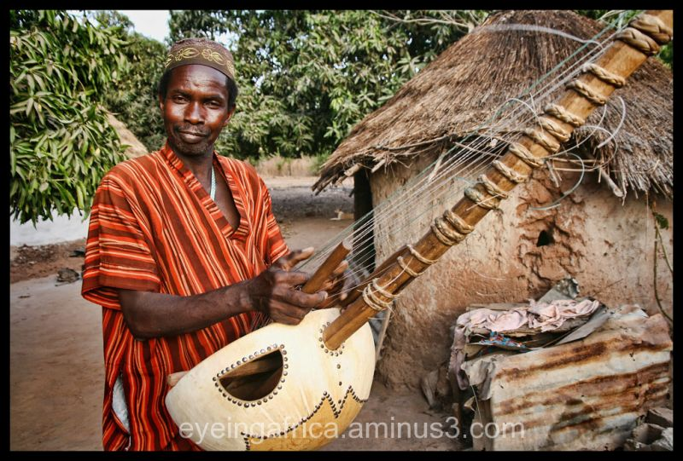
Celtic and West African String Traditions
“FIDDLING IN WEST AFRICA” by Jacqueline Cogdell Djedje
West African Riti and Kora
Djedje lists 89 different ethnic groups in 16 different countries where a one-stringed, bowed instrument is played. Riti is the Wolof word for the instrument.
Juldeh Camara – master player

Slide 10
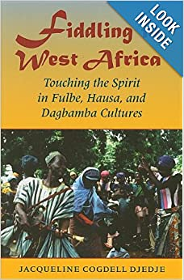
53219299?shipto=US&curcode=USD&msclkid=62de1001f72115a3d8f773b56d2ae610&utm_source=bing&utm_medium=cpc&utm_campaign=pMax-Used-USA%20(PSDW)&utm_term=4582008566890498&utm_content=Asset%20Group%201

Slide 11
Ensembles in Senegal
Kora/n’goni Orchestra
Kasse Mady Diabate and the African Classical Music Ensemble

Slide 12
Hausa tradition - Nigeria

Slide 13
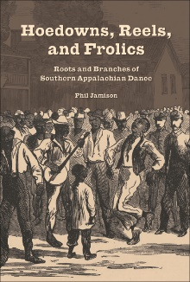
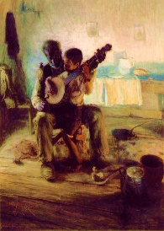
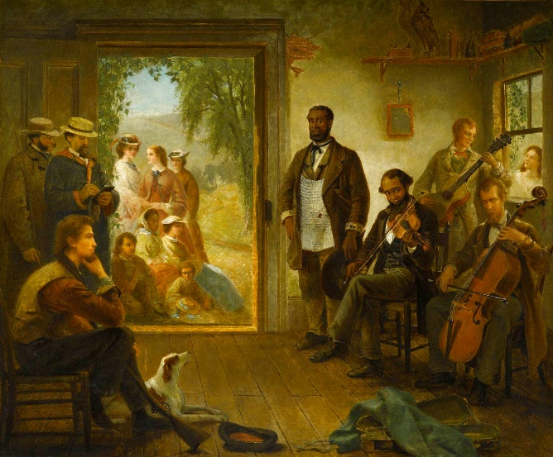
Musical Traditions Coming Together in the USA
1866 painting by Eastman Johnson
The Barber Shop Trenton, NY
The Banjo Lesson by Henry Ossawa Tanner

Slide 14
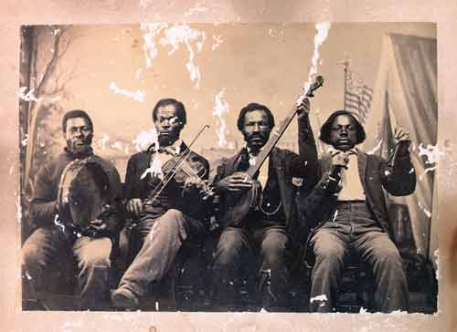
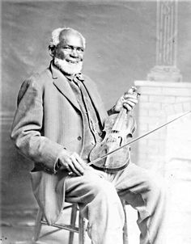
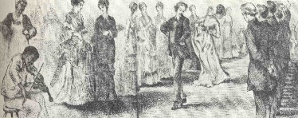
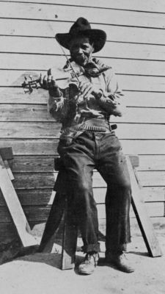
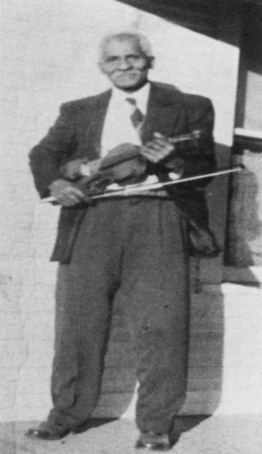
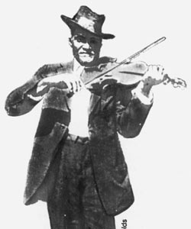
Louis Southworth
Jim Perry
Moving the music to the West and Mid-West
Bill Driver
Bill Katon

Slide 15
The Carolina Chocolate Drops – Rhiannon Giddens

Slide 16
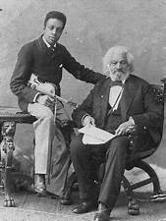
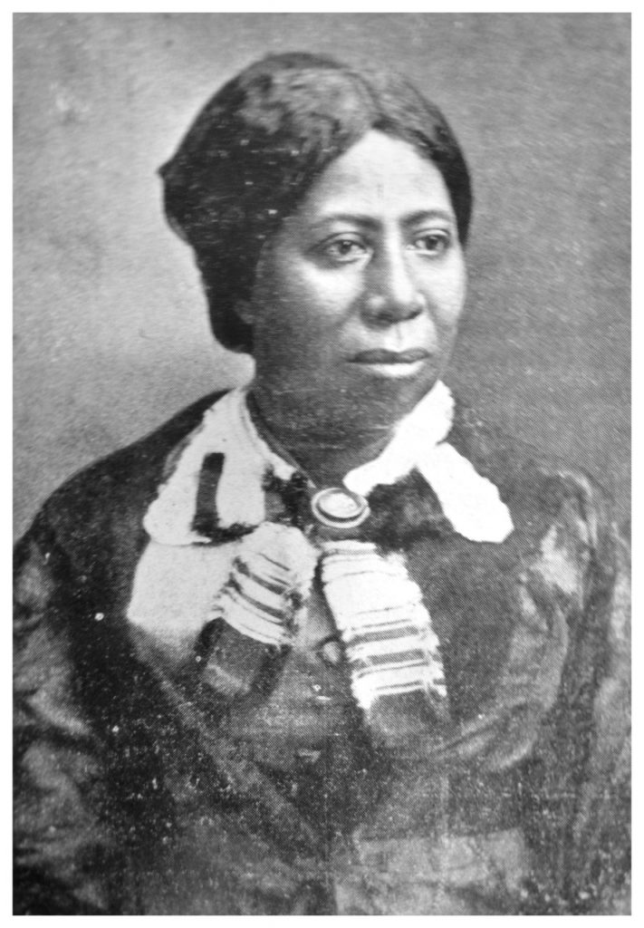
Rich Musical Milieux
Colonel Charles Young Joseph & Frederick Douglass Anna Murray Douglass

Slide 17
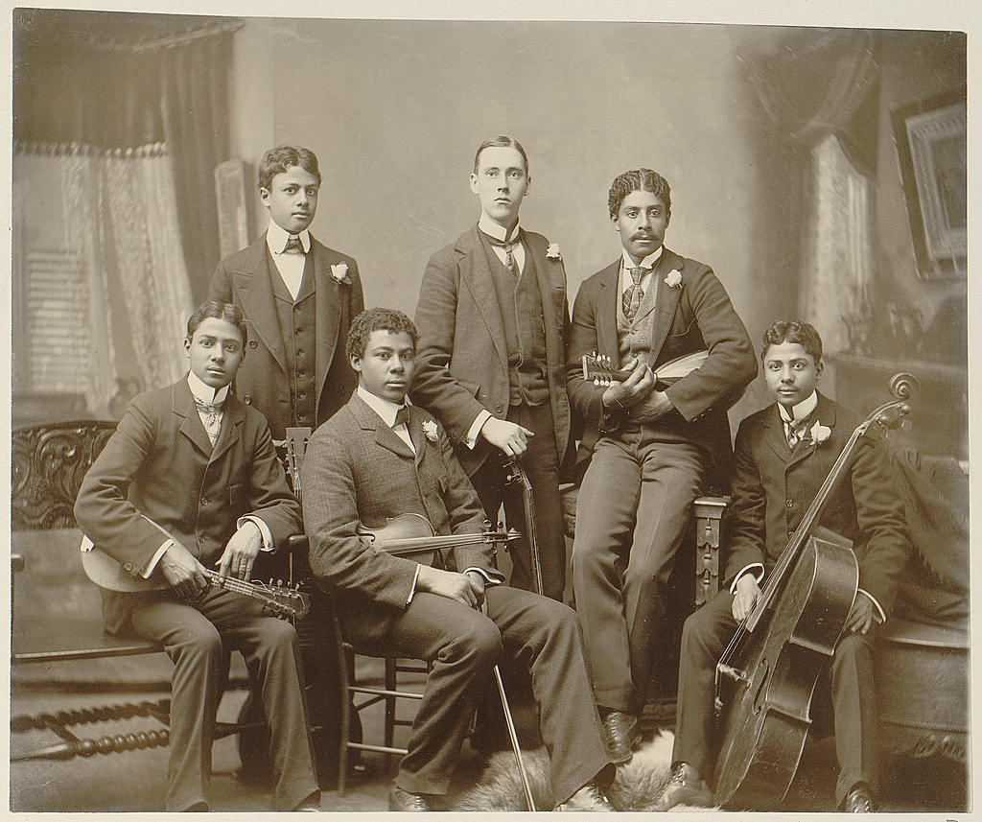
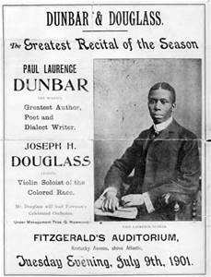
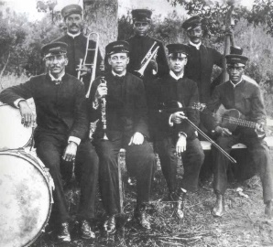
BELOW
Jimmy Palao’s Original Creole Orchestra 1910
ABOVE
Summit Avenue Ensemble, Atlanta, Georgia

Slide 18
William Grant Still, Florence Price, and Other Composers of Note
Francis Johnson 1792-1844
Margaret Bonds 1913-1972
George Walker 1922-2018
T.J. Anderson b. 1928
Alolphus Hailstork b. 1941
Robert Harris b. 1938
Joseph Joubert b. 1958
Rosephanye Powell b. 1962
Anthony Davis b. 1951
Terence Blanchard b. 1962
Damien Sneed
Leslie Adams b. 1932
Tania Leon b. 1943
Shawn Okpebholo b. 1981
Joshua Brian Campbell b. 1994
Fred Onovwerosuake b. 1961 – lives in St. Louis
Wynton Marsalis b. 1961
Two Afro-European Composers:
George Bridgetower 1778-1860
Samuel Coleridge-Taylor 1875-1912

Slide 19
LINKS TO LESSONS
Suzanne Palmer: SPAE Lesson Plan Folder - Google Drive
Blake Hernton: : Josephe Bologne-Chevalier Saint Georges by Blake Hernton on Prezi Next
Fiddlers on the Map by Blake Hernton on Prezi Next
Her Story: Florence B. Price by Blake Hernton on Prezi Next

Slide 20
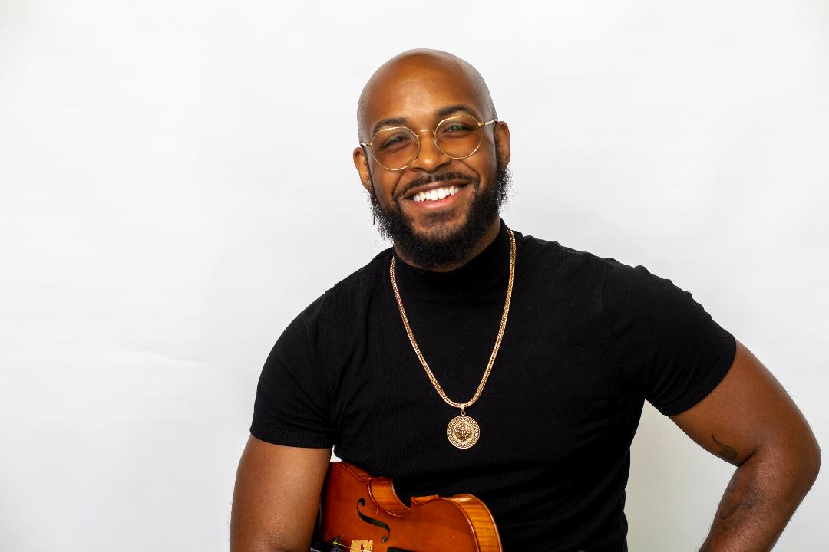
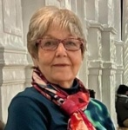
The Creative Team Diane McCullough, Suzanne Palmer, Blake Hernton

Slide 21
Support • Promote • Advocate
Arts Education for ALL Missourians
Key Areas
Fine Arts instruction in Missouri schools
Integrating Arts Across the Curriculum
Leveraging the power of the arts to address issues related to Diversity Equity and Inclusion
www.moaae.org
MAAE Sponsors FREE Professional Learning Communities

Slide 22
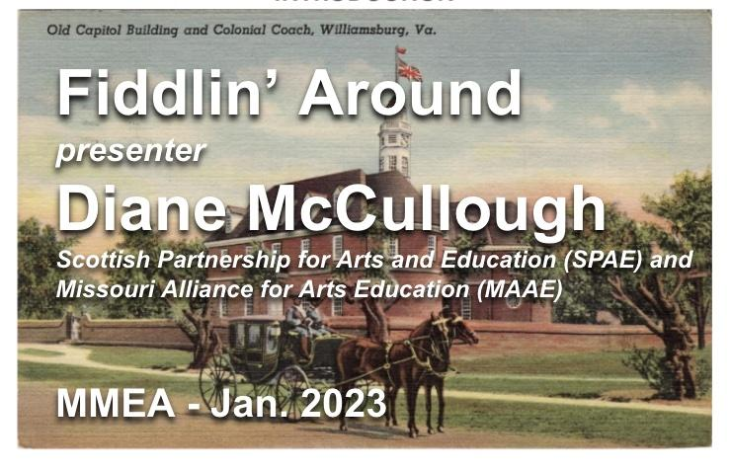
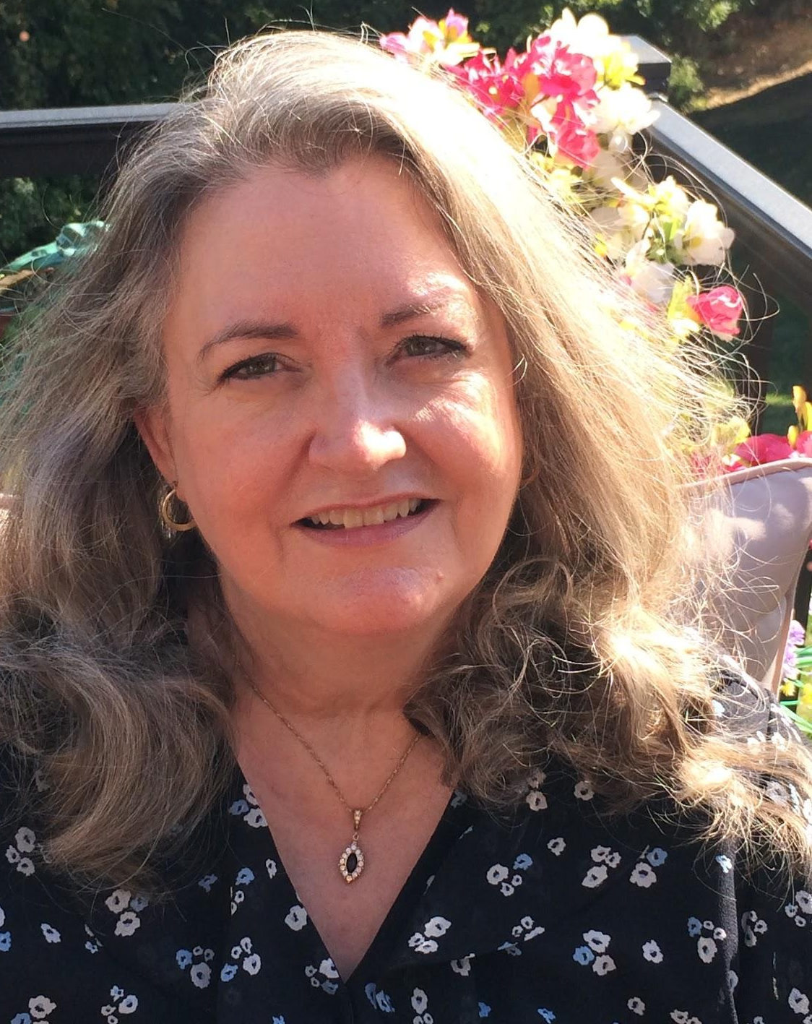
MAAE’s RIDE Committee
Racism Inclusion Diversity Equity
Curricular Support
Promoting inclusive practices
IDEA Quarterly Sessions
DEI and Delicious Dishes Cross-cultural Youth Development Initiative
Phyllis Pasley
director@moaae.org
www.moaae.org
Want to learn more or become involved?
Please reach out!

