Slide 1




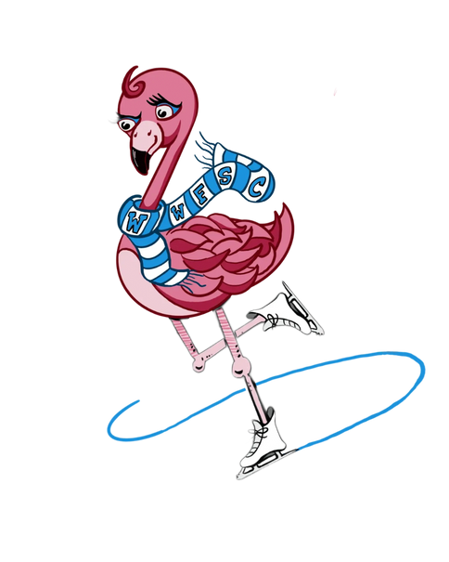
SHOWCASE SKATING
Introduction to Showcase Skating
2025-2026 Season
FUSING
CREATIVITY
AND
ATHLETISIM

Slide 2
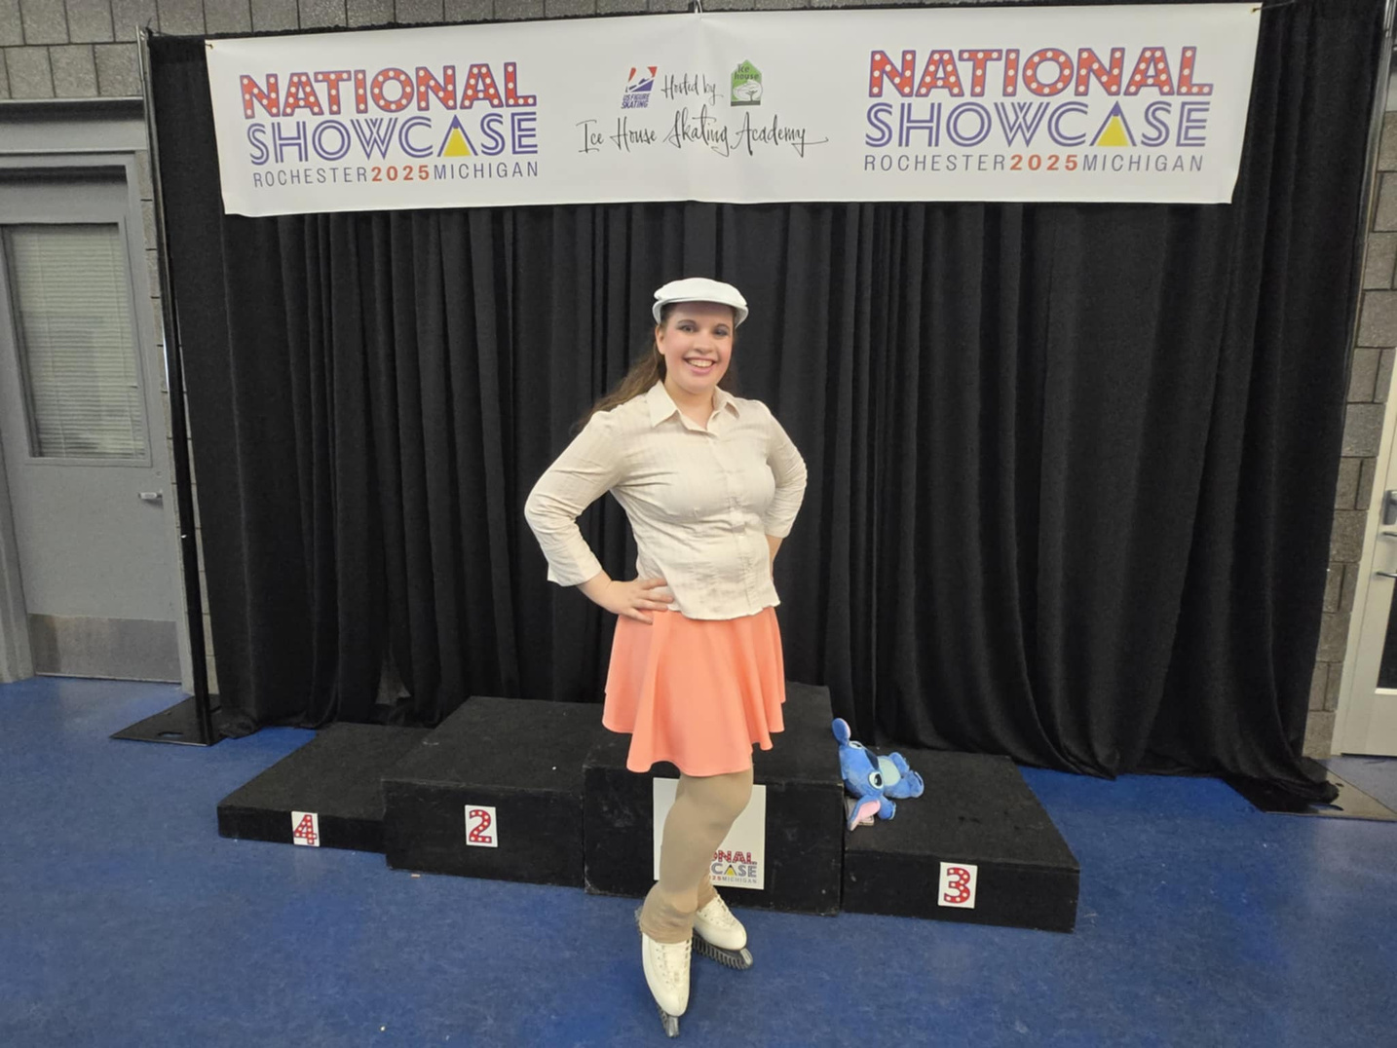
PRESENTOR
Courtney Ozog
Adult Athlete
2022 Adult Gold Comedic Impressions National Champion
Top 10 in 2022 Adult Parade of Champions
U.S. Figure Skating Coach
Learn to Skate Coach

Slide 3
PRESENTOR
Courtney Ozog
B.A. in Dance from Marygrove College (Detroit, MI)
Experience in musical theatre, including high school productions with Wayne Memorial HS and community theatre productions, including Garden City Community Theatre, Inspire Theatre, On Top Of The World Productions, and the 2nd Street Performing Arts Center.

Slide 4
SHOWCASE SKATING
Overview
Skaters participating in showcase events and competitions display their creative skills in the depiction of a character or musical theme exhibited through their routine. Technical skating skill and difficulty will not be rewarded as such; however, skating must be the major element of the performance and be of sufficient quality to support the character or theme chosen.
~ Source Link

Slide 5

CJS SCORING
Scoring
Non-qualifying competitions must use the Component Judging System (CJS), on paper or using an IJS system, to qualify skaters for the National Showcase competition. CJS scoring will use the following Program Components marked on a scale of 0.25 to 10. 1.

Slide 6
ARTISTIC APPEAL
Scoring
Artistic Appeal with Innovation & Creativity (factor 40%)
A performance is truly entertaining when it is in the eyes, ears, and hearts of the audience. It is a measure of how audience members remember the program, how they felt during the performance, their level of involvement during the program, what they take away from it, and how long after they will recall it. The meaning and feeling should be unique and personal. The question to be answered is: Will I remember what I have seen, and would I like to see it again?

Slide 7
PERFORMANCE
Scoring
Performance & Projection: Universe, Musicality and Feeling (factor 35%)
The physical, emotional, and artistic involvement of a skater, using their ability to create a universe. This performance has continuous development of the theme and universe from beginning to end while displaying their musicality skills. It is a measure of how skaters use the ice, music, and the space around them to project feeling and musical awareness into the subconscious of the audience.

Slide 8
SKATING SKILLS
Scoring
Showcase Skating Skills (factor 25%) Showcase skating is the way an athlete uses their skating and physical ability to convey their act on the ice surface. It must show quality to support the selected theatrical performance, and show abilities in the skating vernacular, such as balance, glide, acceleration, ice coverage, one-foot skating, etc. Technical elements often found in singles should not be directly rewarded except where they are directly integrated into the performance and advance the story/theme/concept.

Slide 9
Range of Marks | Theatrical Skating Description
0.25 to 0.75 | Beginning/Starting
1.0 to 1.75 | Emerging/Learning
2.0 to 2.75 | Developing/Progressing
3.0 to 3.75 | Capable/Expanding
4.0 to 4.75 | Confident/Advancing
5.0 to 5.75 | Secure/Competent
6.0 to 6.75 | Proficient/Established
7.0 to 7.75 | Accompished/Good
8.0 to 8.75 | Adept/Very Good
9.0 to 9.75 | Expert/Excellent
10 | Master/Outstanding
RANGE OF MARKS

Slide 10
CATEGORIES
Individual Showcase Events
The following categories are the main events offered under the Showcase Skating discipline.
Skaters use one or more of these events to qualify for National Showcase.

Slide 11
CATEGORIES
Emotional Performance
Programs should portray a story, expressing conflict, resolution, and/or depth of emotion.
The skater should provoke an emotional response from the audience through related skating movements, gestures, and choreographic processes.
The entire spectrum of emotions should be considered when selecting the theme (e.g., love, loss, longing, fulfillment, happiness, melancholy, sadness, etc.).

Slide 12
CATEGORIES
Emotional Performance
Lip synching is not permitted.
Props and Scenery are permitted.
Technical Limitations:
maximum of 2 jumps, jump combinations, or jump sequences

Slide 13
CATEGORIES
Emotional Performance
Levels:
Not included in Compete USA levels
Aspire 4, Pre-Preliminary, and Adult Pre-Bronze only at non-qualifying competitions
Preliminary - Senior, and Adult Bronze - Gold and Masters included at National Showcase.

Slide 14
CATEGORIES
Emotional Performance
Tips from Coach Courtney:
Music selections from stage or movie musicals are a great place to start.
“When the emotion becomes too strong for speech, you sing. When the emotion becomes too strong for song, you dance.”

Slide 15
CATEGORIES
Choreographic Artistry
Programs will have music without spoken words or lyrics. Emphasis should be on developing movement on the ice, using the entire body to express innovative ideas, choreographic processes, and gestures, not creating characters and themes.

Slide 16
CATEGORIES
Choreographic Artistry
Levels:
Juvenile through Senior Elite/Pro-Am
Masters (Adult Intermediate through Senior)
NEW!
Introductory (combined Preliminary - Pre-Juvenile)
Adult Introductory (combined Adult Pre-Bronze through Adult Gold)
*Introductory levels do not participate in National Showcase, but may be added to non-qualifying competition events.*

Slide 17
CATEGORIES
Choreographic Artistry
Lip synching is not permitted.
Props and Scenery are not permitted.
Technical Limitations:
½ rotation only. Rotation in the air of more than 180 degrees is prohibited.
Choreography may include 1 full spin
Additional spins < 3 revs
Costuming:
Should be 1 color.
Crystals/Deco may only be clear or clear AB crystals
No costume or accessories permitted on or on top of the head.

Slide 18
CATEGORIES
Choreographic Artistry
Tips from Coach Courtney:
Consider using a score from your favorite movie or an upbeat song. Using karaoke versions of your favorite songs are great choices, too! (Just make sure there are no backup vocals.)
Think of a highlight for your program.
Develop a variety of skills for your skating. How many different spirals can you do? Can you do a Spread Eagle or Ina Bauer? How well can you twizzle? What positions can you twizzle in?

Slide 19
CATEGORIES
Lyrical Pop
Skaters will perform to a vocal song with lyrics, allowing them to express themselves through the content and narrative of the music.
Think of songs or artists heard on the radio.

Slide 20

CATEGORIES
Lyrical Pop
Lip synching is not permitted
Props and Scenery are not permitted
Technical Limitations:
Maximum of 2 jumps, jump combinations, or jump sequences
Available for Compete USA levels
No technical limitations

Slide 21
CATEGORIES
Character Performance
Skaters will impersonate a character, original or adapted, on the ice. Performances as a character from a movie, musical, book, original idea, or original adaptation are all welcome here.

Slide 22
CATEGORIES
Character Performance
Lip synching is required
Props and Scenery are permitted
Technical Limitations:
Maximum of 2 jumps, jump combinations, or jump sequences
Included in Compete USA levels
No technical limitations

Slide 23
CATEGORIES
Character Performance
Coach Courtney Tips:
Think of a character that is easily identifiable and/or memorable.
Try a character that might not be as mainstream. (You don’t want to be competing with your doppelganger, do you?)

Slide 24
CATEGORIES
Comedic Impressions
A humorous performance intentionally designed to achieve continuous/multiple chuckles, laughs, or audible rises from viewers.
Performance is projected outward towards the audience and entertaining through skating movements, gestures, and physical actions deemed comedic.

Slide 25
CATEGORIES
Comedic Impressions
Lip synching is permitted
Props and Scenery are permitted
Technical Limitations:
Maximum of 2 jumps, jump combinations, or jump sequences

Slide 26
CATEGORIES
Comedic Impressions
Tips from Coach Courtney:
Some characters in stage and movie musicals are naturally funny.
Comedy comes from juxtaposition. What contradictions can you make?
Is your character failing at something over and over (and over and over and over) again?

Slide 27
CATEGORIES
Elective Showcase Events
The following categories are the additional events offered under the Showcase Skating discipline.
Skaters must qualify in one or more of the individual events before they can add on any of the following events for National Showcase.
These events may be offered at unqualified competitions, as well.

Slide 28
CATEGORIES
Duets/Trios
Theatrical performances by two or three competitors. Skaters may enter only one duet/trio, one mini production ensemble, and one production ensemble each.
Programs are performed under spotlights [at all Showcase competitions].
When entering events, the skater with the higher technical achievement shall prevail as the level for the duet/trio to enter.

Slide 29
CATEGORIES
Duets/Trios
Lip synching is permitted
Props and Scenery are permitted
Event is offered for Compete USA levels.
Have your coach inquire with a particular competition if they are offering the event.

Slide 30
CATEGORIES
Inflatables
This is an open-level event with a theatrical performance by one to three skaters wearing a partial body or full-body inflatable costume.
Programs are performed under full arena lighting (for safety reasons).

Slide 31
CATEGORIES
Inflatables
All open inflatable programs are allowed a 1:30 maximum program time.
Inflatable costumes that impersonate humans (e.g., sumo wrestlers) are not permitted.
Lip synching is permitted
Props and Scenery are not permitted

Slide 32
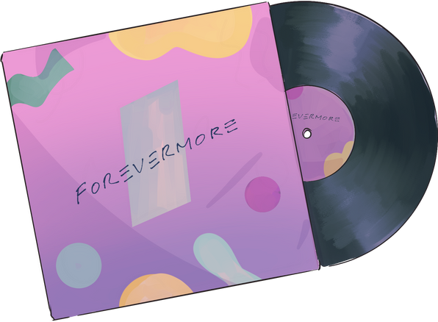
CATEGORIES
Theme Event
Skaters will be able to enter this themed event according to their level, with a program under the theme of:
DIVAS of the 80s and 90s

Slide 33
CATEGORIES
Theme Event
The selected music or sound environment must be a song released between 1/1/1980 and 12/31/1999 or an artist that was active with a song or album released in this time period.
Skaters may use the original, re-release, or a cover of the song.
A diva (regardless of gender) is considered a successful performer or personality who behaves as if they are very special or important.

Slide 34
CATEGORIES
Theme Event
Lip synching is permitted
Props and Scenery are permitted
The theme event should mimic a Parade of Champions event where all program types are represented. Programs should be choreographed as an Emotional, Character, Comedic, Choreographic-Artistry, or Lyrical Pop program.
Since this event is mixed with different styles of programs, the Not According to Requirements deduction will not apply.

Slide 35
CATEGORIES
Production Numbers
Skaters in the following events do not need to qualify in the individual or elective events to qualify for National Showcase.

Slide 36
CATEGORIES
Production Ensemble
Mini Production Ensemble
Theatrical performances by 4-8 skaters
Production Ensemble
Theatrical performances by 9 or more skaters

Slide 37
CATEGORIES
Production Ensemble
All skaters on the team must pass the minimum test requirements (Preliminary or Adult Bronze requirements) in order for the group to be able to compete at National Showcase.
Production Ensembles are available for Compete USA competitions.

Slide 38
CATEGORIES
Mini Production Ensemble
Available for Compete USA competitions (3-7 skaters)
Bronze level may mix Compete USA and US Figure Skating skaters
Silver level qualifies for National Showcase and is open ages group
Gold level qualifies for National Showcase and is for skaters 18 and under
Platinum level (new) qualifies for National Showcase and is for skaters 19 and older
*Levels are determined by skaters’ test levels.

Slide 39
NATIONAL SHOWCASE
Compete USA Levels
Compete USA levels have generally grouped skaters by the following:
Snowplow Sam 1-4
Basic 1-6
Aspire 1-4
Pre-Preliminary
Preliminary

Slide 40
NATIONAL SHOWCASE
Qualifying
Skaters must qualify with one or more of the individual events in order to qualify at National Showcase.
Skaters may add on an elective event at National Showcase.
Skaters in Mini Production and/or Production groups do not need to skate a solo or elective event to skate at National Showcase, only need the minimum test requirements.

Slide 41
NATIONAL SHOWCASE
Qualifying
Skaters must meet minimum test requirements and, new this year, meet minimum score requirements.
Score requirements vary by competition level.

Slide 42
NATIONAL SHOWCASE
Qualifying
How were the minimum scores calculated, and why do they increase in 2026-2027?
Historical data was pulled from Showcase events from March 2021 to June 2025 for all levels. Combined events were excluded (events that were grouped either by event category (LP, EP, CP, CO, CA), by level (Pre-Sr, Adults), or both). High, low, and average scores were calculated by level. We started with scores at or (1-3 points) below the average. Scores will be reviewed and updated annually.

Slide 43
NATIONAL SHOWCASE
Qualifying
How were the minimum scores calculated, and why do they increase in 2026-2027?
The 2025-2026 season allows skaters time to focus on improving their scores overall. The minimum score will increase slightly in the 2026-2027 season. As well, additional training opportunities are being finalized and will be provided to all officials to ensure consistency in judging.

Slide 44
NATIONAL SHOWCASE
Showcase Only Competitions
Showcase only competitions have a special component:
Part of the ice is walled off, generally at the dots on one end of the ice, and follow spotlights are used.
Judges and audience members are on the same side.
Warm ups are behind the curtain and skaters step on, generally, when three skaters ahead begins their program.

Slide 45
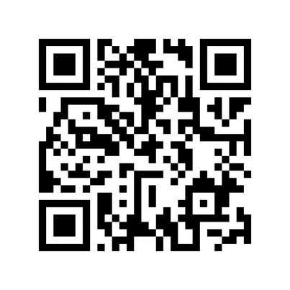
NATIONAL SHOWCASE
Q & A
Survey
Question and Answer time!
Please scan the QR code and fill out the feedback form.

