Slide 1
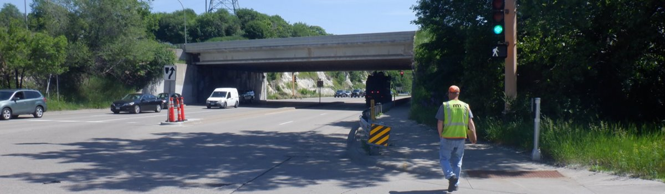
I-35E bridge replacement over Shepard Rd.
Kevin Walker| Communications & Engagement, MnDOT
March 2026

Slide 2
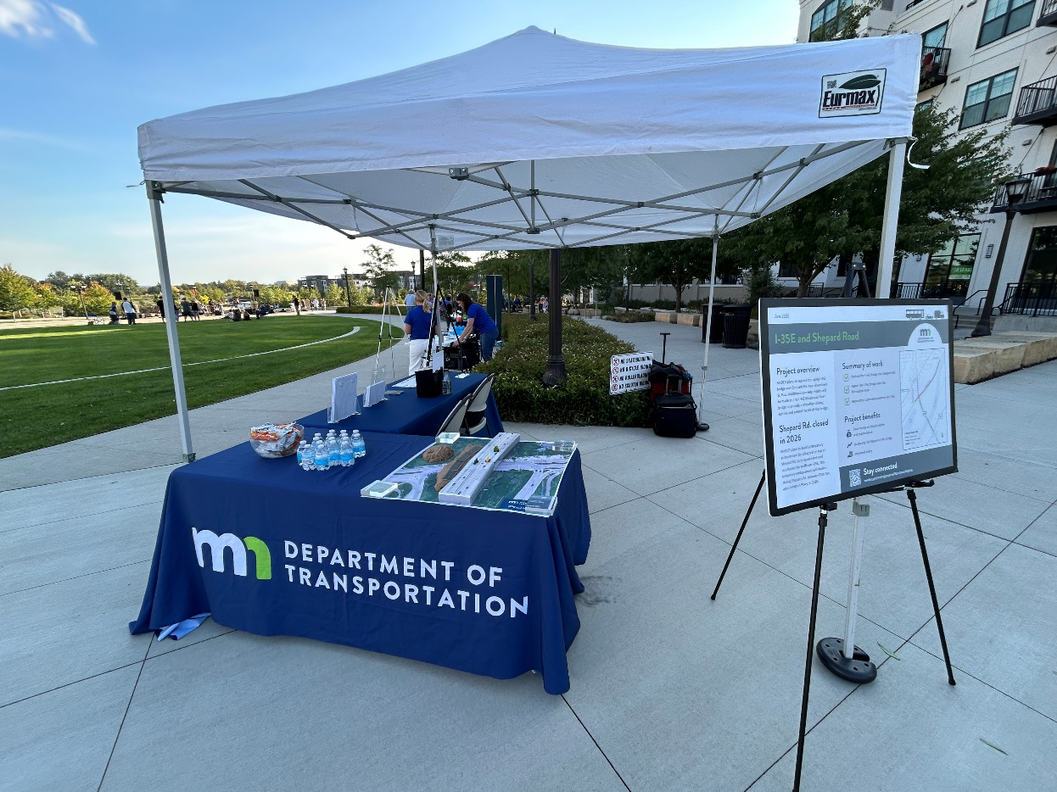
Agenda
Introductions
Project overview
Construction plan
Construction impacts and detours
Communications and engagement
Questions and feedback

Slide 3
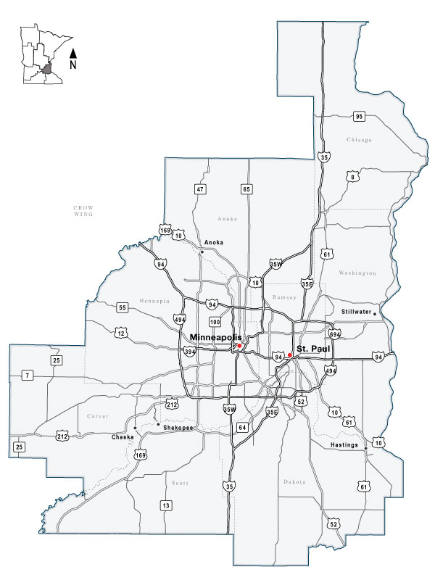
Project team
MnDOT Metro District
Michael Corbett, North Area Engineer Project Manager
Kevin Walker, Communications & Engagement
Kent Barnard, Communications & Engagement
Zan Associates (Engagement Consultants)
Megan Ryan, Engagement Manager
Shepard Rogers, Communications & Engagement
MnDOT Metro District

Slide 4
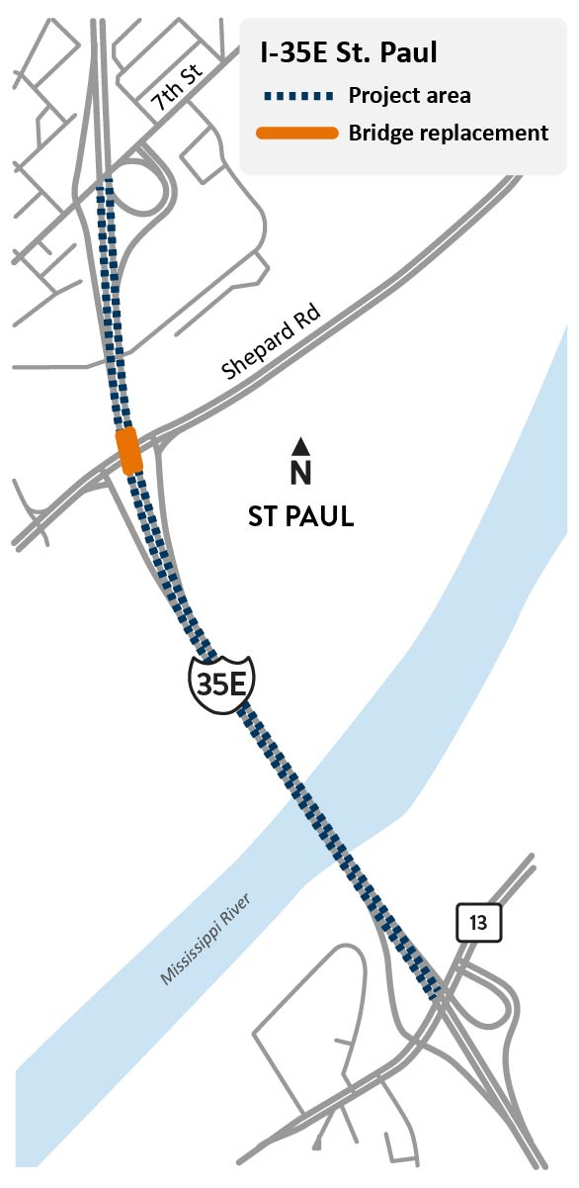
Project overview
Project work
Replace I-35E bridge over Shepard Rd.
Repair I-35E bridge over Mississippi River
Repair I-35E concrete pavement near Shepard Rd.
Project schedule
Construction starts Spring 2026
2026 – 2027
Project budget
$18 million
Project area map

Slide 5
Construction plan
2026 Construction
Construct temporary bridge on Shepard Rd.
Replace I-35E bridge over Shepard Rd.
2027 Construction
Repair I-35E bridge over Mississippi River​
Repair I-35E concrete pavement near Shepard Rd.

Slide 6
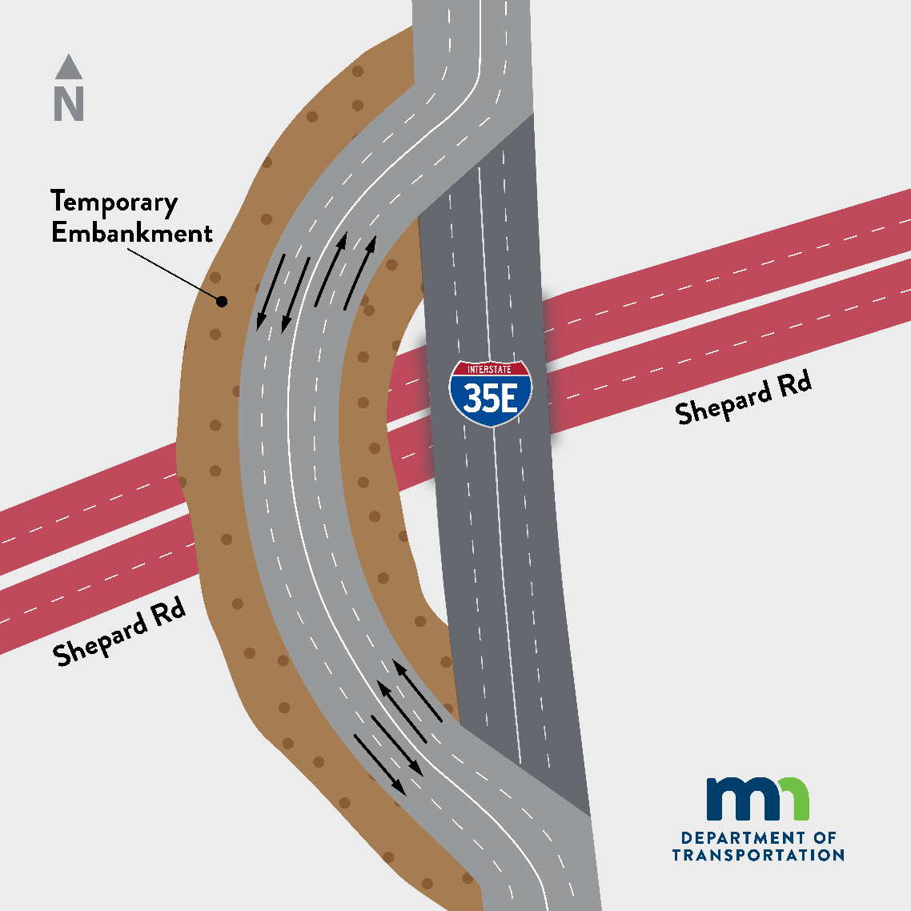
Construction plan
Shepard Rd. bridge replacement - temporary embankment
Bridge must be replaced all at once
Embankment allows traffic to remain flowing on I-35E during this process
Embankment will close Shepard Rd. for the 2026 construction season between Lexington Pkwy. and Otto Ave., including the I-35E entrance ramp at Shepard Rd.
Embankment drawing
Notes:
Impacts the direct route between MSP airport and Downtown St. Paul

Slide 7
Construction goals
Goals
Minimize impacts to the traveling public​
Complete construction as quickly as possible​
No long-term closures of I-35E (weekend closures possible)

Slide 8
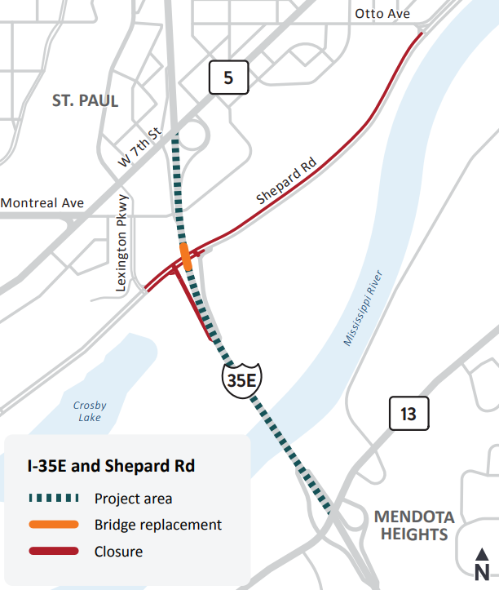
2026 Construction impacts
Season-long impacts
Closure of Westbound Shepard Rd. between Otto Ave. and Lexington Pkwy. S
Closure of Eastbound Shepard Rd. between Lexington Pkwy. S and I-35E
Closure of Southbound I-35E entrance ramp from Shepard Rd.
Closure map

Slide 9
2026 Construction impacts
Short term and occasional impacts
Month long closure of the Northbound I-35E to Shepard Rd. exit ramp
Occasional short-term closures on Shepard Rd. between the Northbound I-35E off-ramp and Otto Ave.
Short-term closures at Hwy 5/7th St. W
Lane closures on I-35E
Pedestrian trail access along Shepard Rd. will be maintained
Closure map
Notes:
Mention the impacts this week.

Slide 10
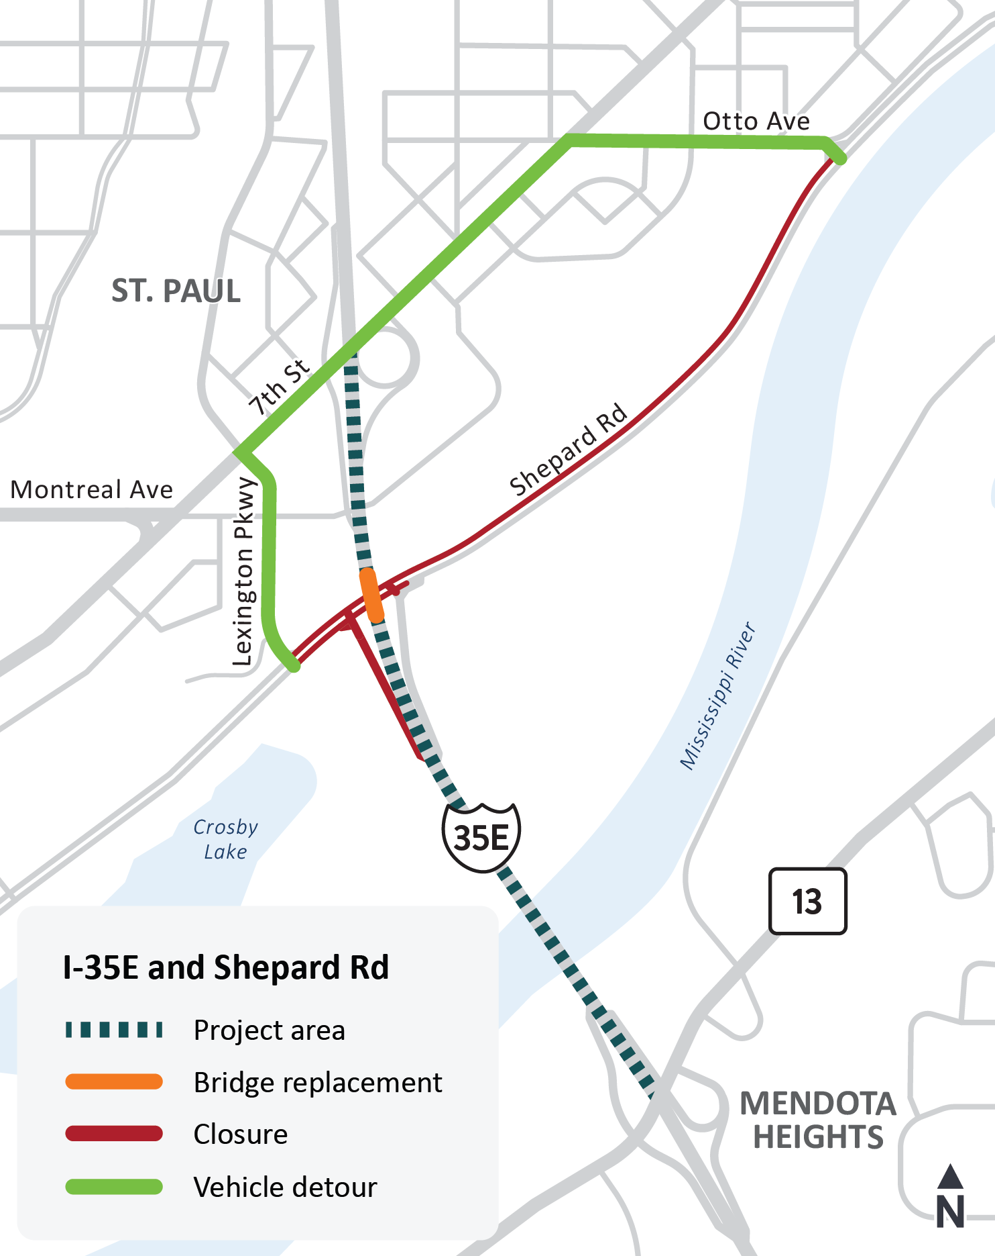
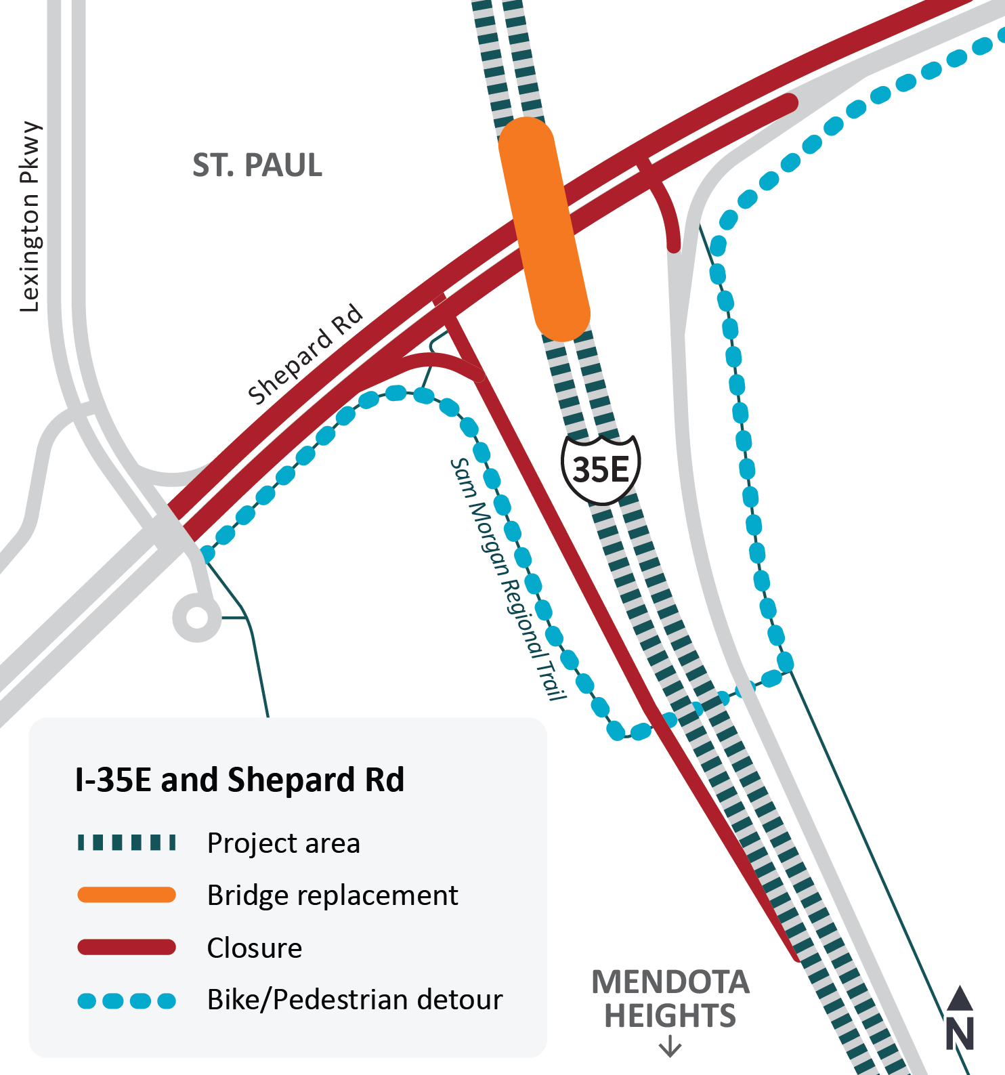
2026 Construction detours
Vehicle detour map
Bicycle and pedestrian detour map

Slide 11
2027 Construction impacts
Anticipated impacts
Lane closures on I-35E
Overnight and weekend closures of I-35E
Project area map

Slide 12
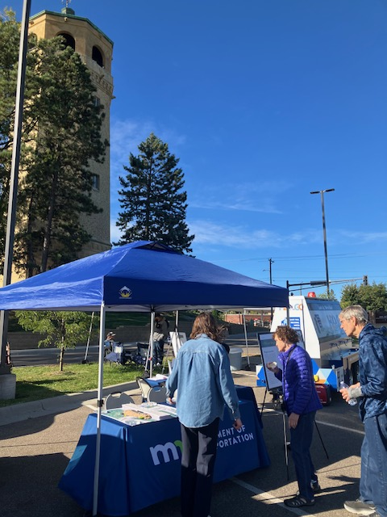
Communications and engagement
Project stakeholders
Local governments / agencies | Large employers
Elected and appointed officials | Schools
Transit operators | Event venues
Businesses and business groups | Faith communities
Freight haulers | Neighborhood and residential organizations
Emergency services | Trail users
Highland Water Tower
Notes:
Shep

Slide 13
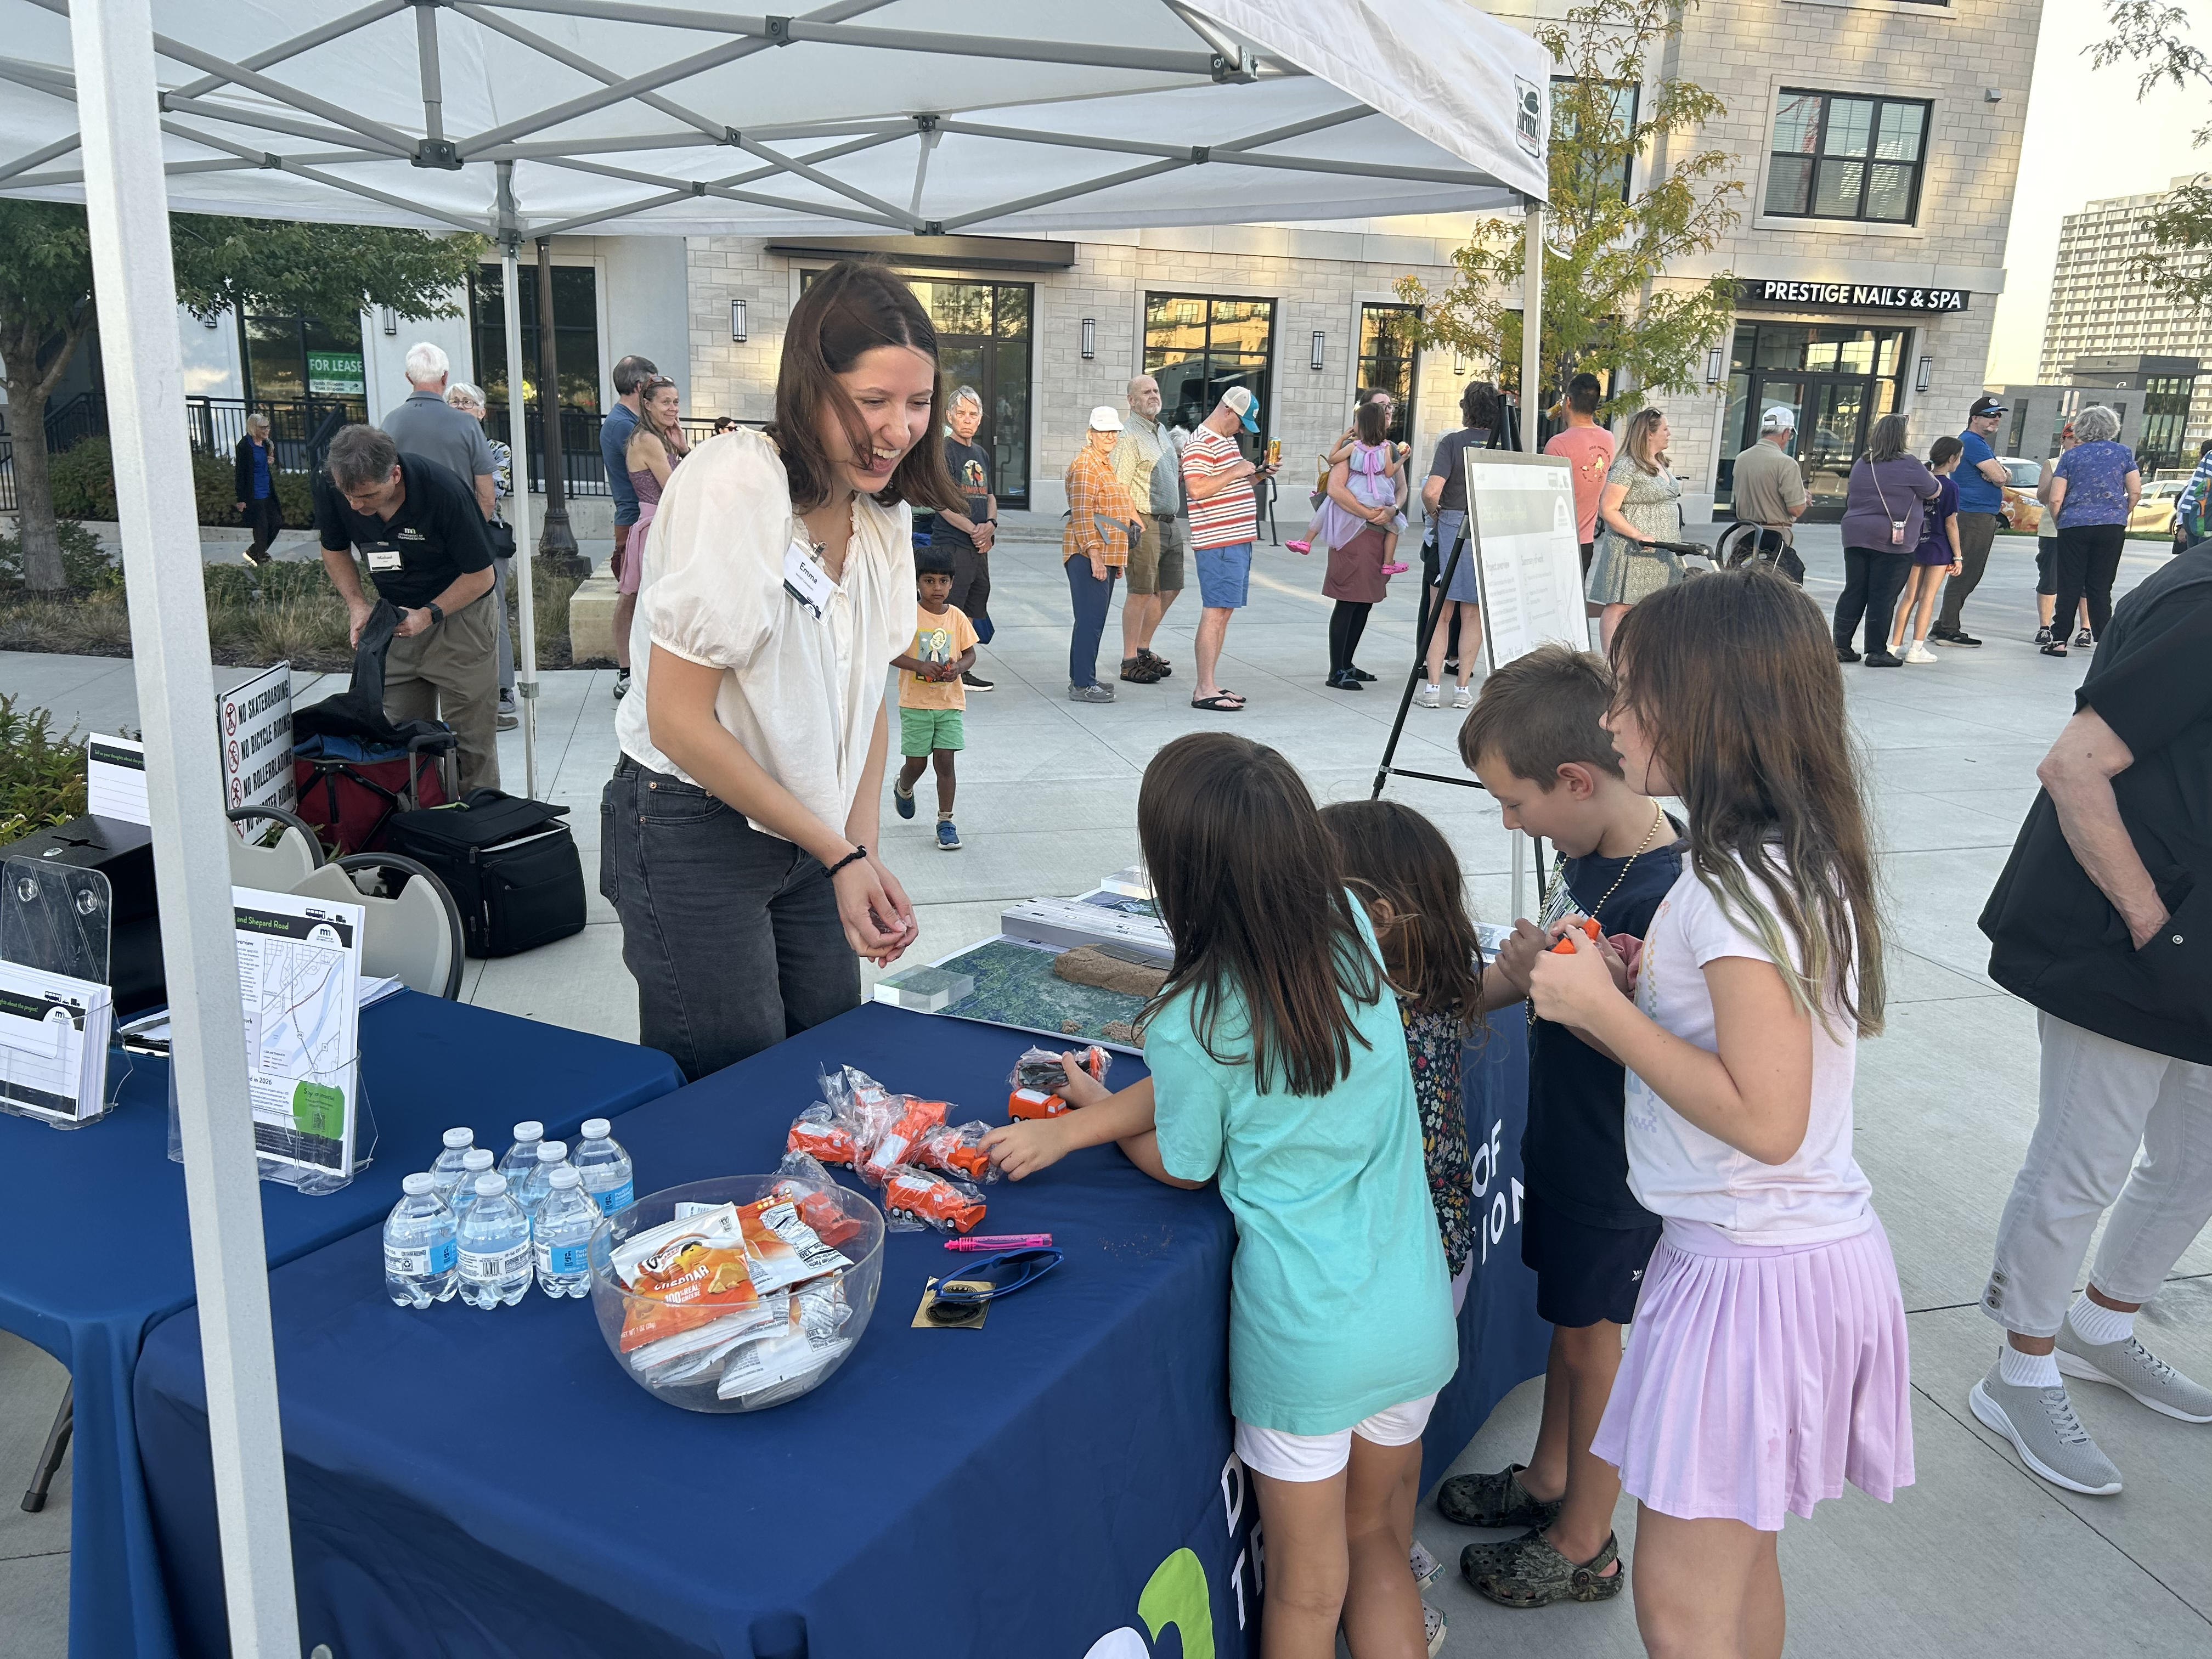
2025 Communications and engagement
Activities
Neighborhood organization outreach
Resident meetings
Chateau Montreal
Lexington Landing
Business outreach
Door-to-door outreach
Pop-up events
Tiffany's Sports Lounge (6/12)
Highland Music at the Bridge (8/14 & 9/12)
Highland Water Tower (7/19 & 10/11)
Highland Music at the Bridge
Notes:
Shep

Slide 14
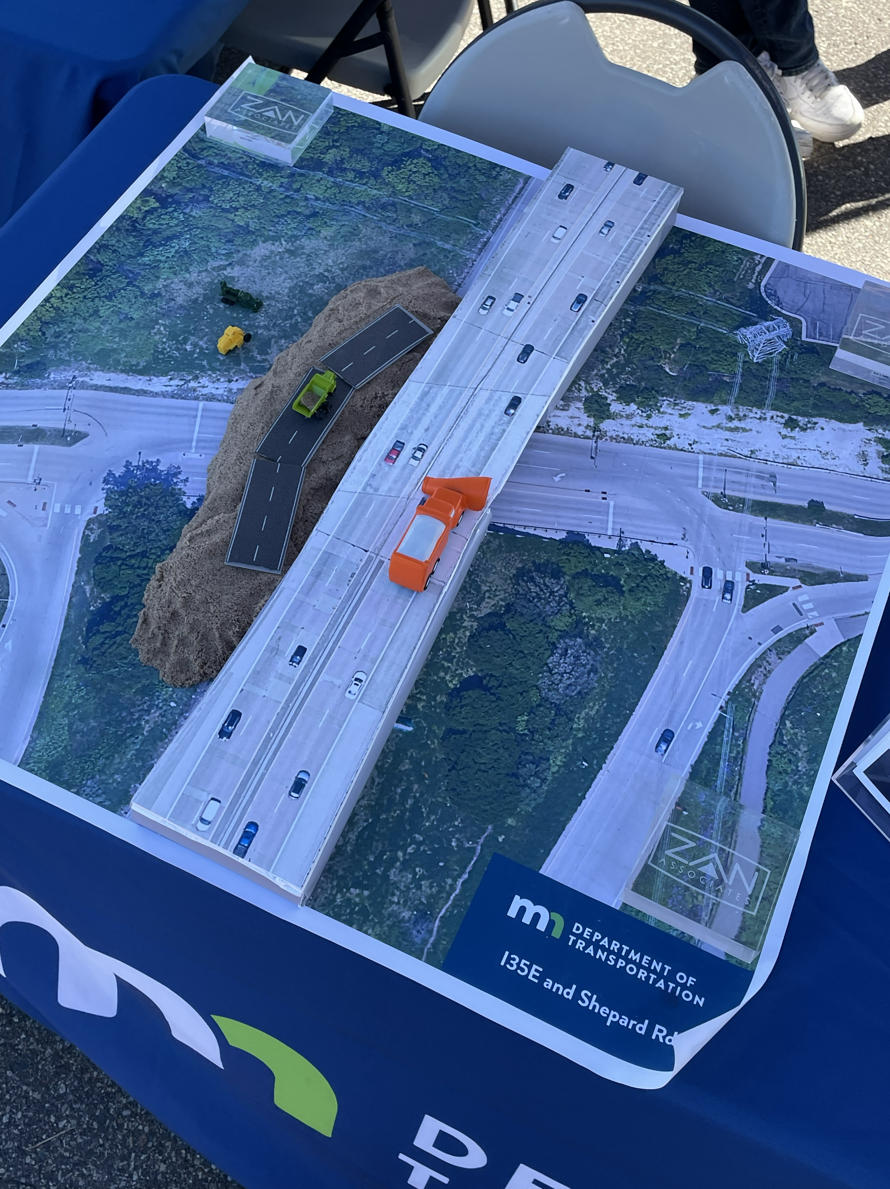
2026 Communications and engagement
March and April activities
Virtual public meeting
March 24, 6-7 p.m. on Zoom
Neighborhood organization outreach
Door-to-door outreach
Resident meetings
Business and employer outreach
Pop-up events
Home Improvements Show (3/7)
Wildflyer Coffee (TBD)
Mississippi Market (TBD)
Embankment activity
Notes:
Shep

Slide 15
Questions and feedback
Any questions?
Notes:
Kevin

Slide 16
Thank you!
Kevin Walker
kevin.walker@state.mn.us
Sign up for email updates on the project webpage:
mndot.state.mn.us/metro/projects/i35estpaul-lilydale/index.html

