Slide 1
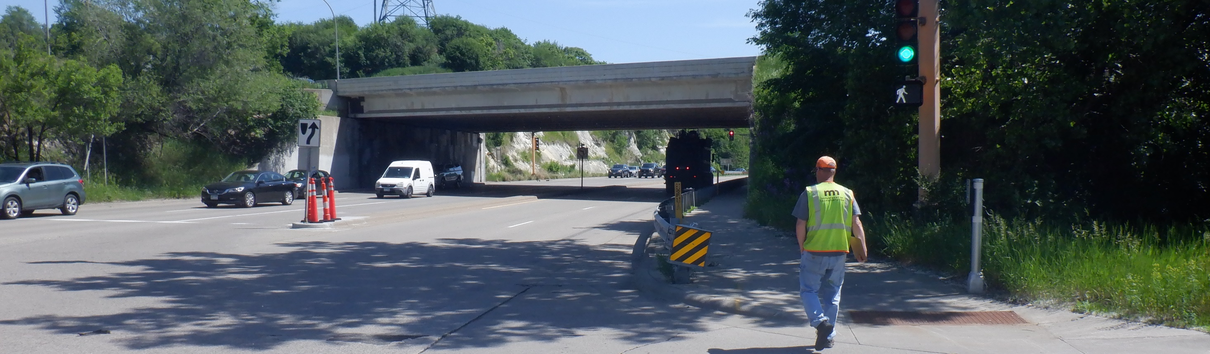
35E Bridge Replacement at Shepard Road
Michael Corbett | North Area Engineer
Metro District
11/05/2025

Slide 2
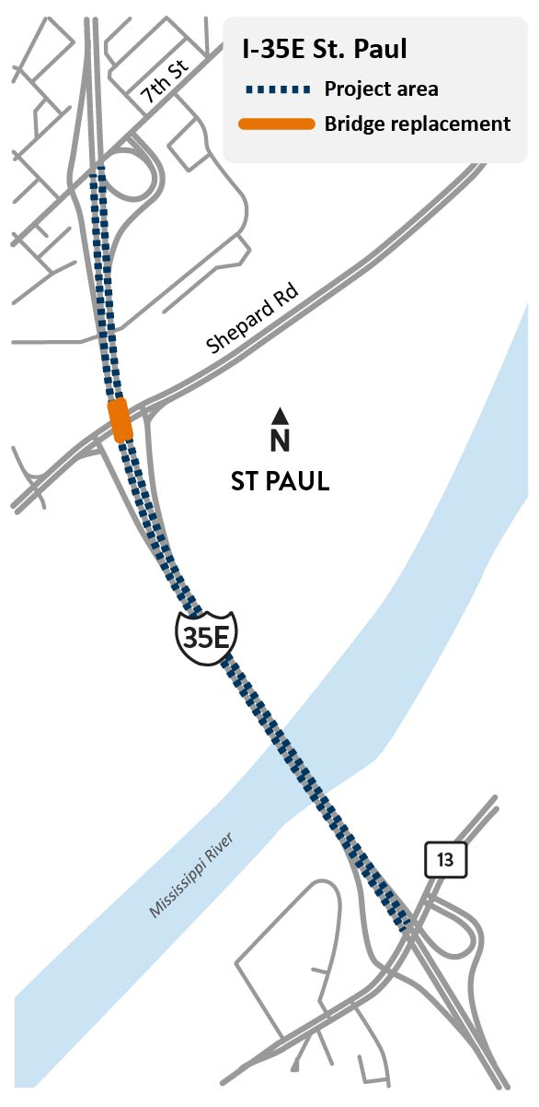
Project Overview
Project Work
Replace I-35E bridge over Shepard Road
Repair I-35E bridge over Mississippi River
Repair I-35E concrete pavement near Shepard Road
Project Schedule
2026 – 2027
Project Budget
$18 million

Slide 3
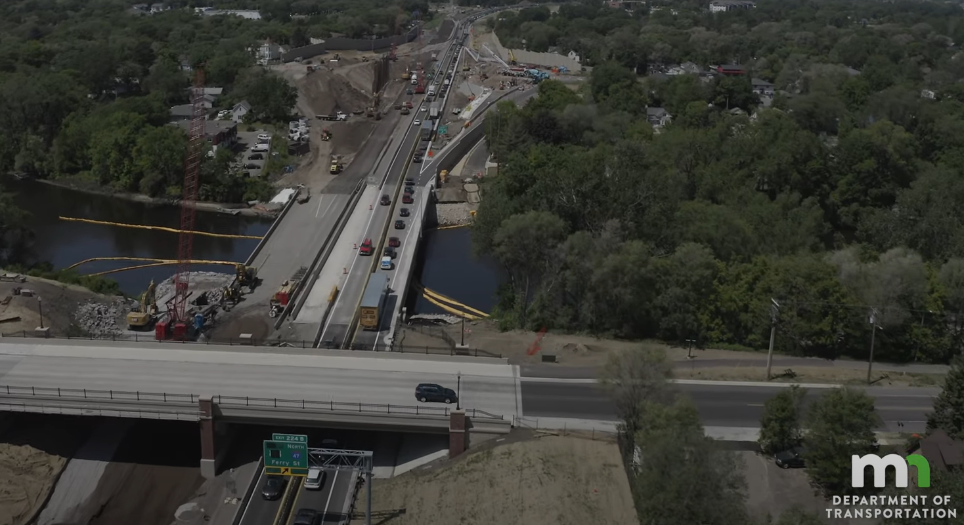
Temporary Construction Impacts
It is not possible to construct the Shepard Road bridge half at a time due to the unique design of the bridge
Bridge must be replaced all at once

Slide 4
Temporary Construction Impacts
Goals
Minimize impacts to the traveling public
Complete construction as quickly as possible
No long-term closures of 35E (weekend closures possible)

Slide 5
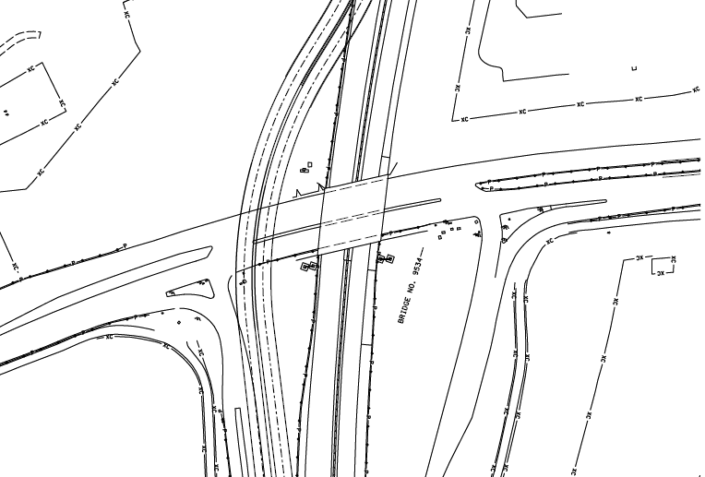
2026 Construction Impacts
MnDOT will construct a temporary bypass for 35E around the bridge
Where the bypass crosses Shepard Road – there are two options:
  Construct a temporary bridge
  Construct a temporary embankment (pile dirt on top of Shepard)
Temporary I-35E bypass
Work Area
Shepard Road

Slide 6
2027 Construction Impacts
Repair I-35E bridge over Mississippi River
Repair I-35E concrete pavement near Shepard Road
Expect lane closures of I-35E
Expect some overnight and weekend closures
2027 Work

Slide 7
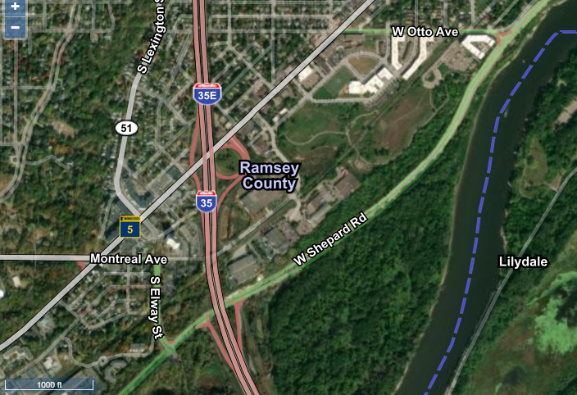
Motor Vehicle Detour
Shepard Detour via Otto Ave., W 7th Street, Lexington Ave.
Ramp from I-35E north to Shepard closed
Ramp from Shepard to I-35E south closed

Slide 8
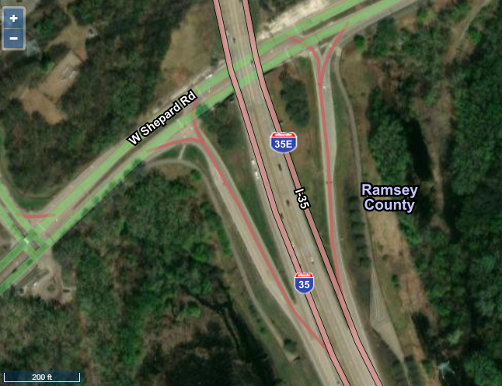
Bicycle/Pedestrian Detour
Additional coordination required around bicycle/pedestrian events to ensure large volumes of bicycles/pedestrians can safely be accommodated on the detour (Saint Paul Classic bike tour and others)
Sidewalk closed during construction
Bicycle/Pedestrian detour via underpass

Slide 9
Thank you!
Michael Corbett
michael.jcorbett@state.mn.us
mndot.state.mn.us/metro/projects/i35estpaul-lilydale/index.html

