Slide 1

Shared Stewardship Series, Mtg. 2:
Designing Regional
Well-Being Portfolios
March 11, 2022
Notes:
Kate
Good afternoon. I'm Kate Dupont Phillips, Executive Director of Healthy Communities Delaware.
We welcome you to the second event in our series about Shared Stewardship for Thriving People and Places.
This four-part series is designed to energize and inspire collaboration to improve health, well-being, and equity in Delaware. Together, we are exploring the roles that each of us can take in moving towards a Delaware where all people and places are thriving, no exceptions.

Slide 2
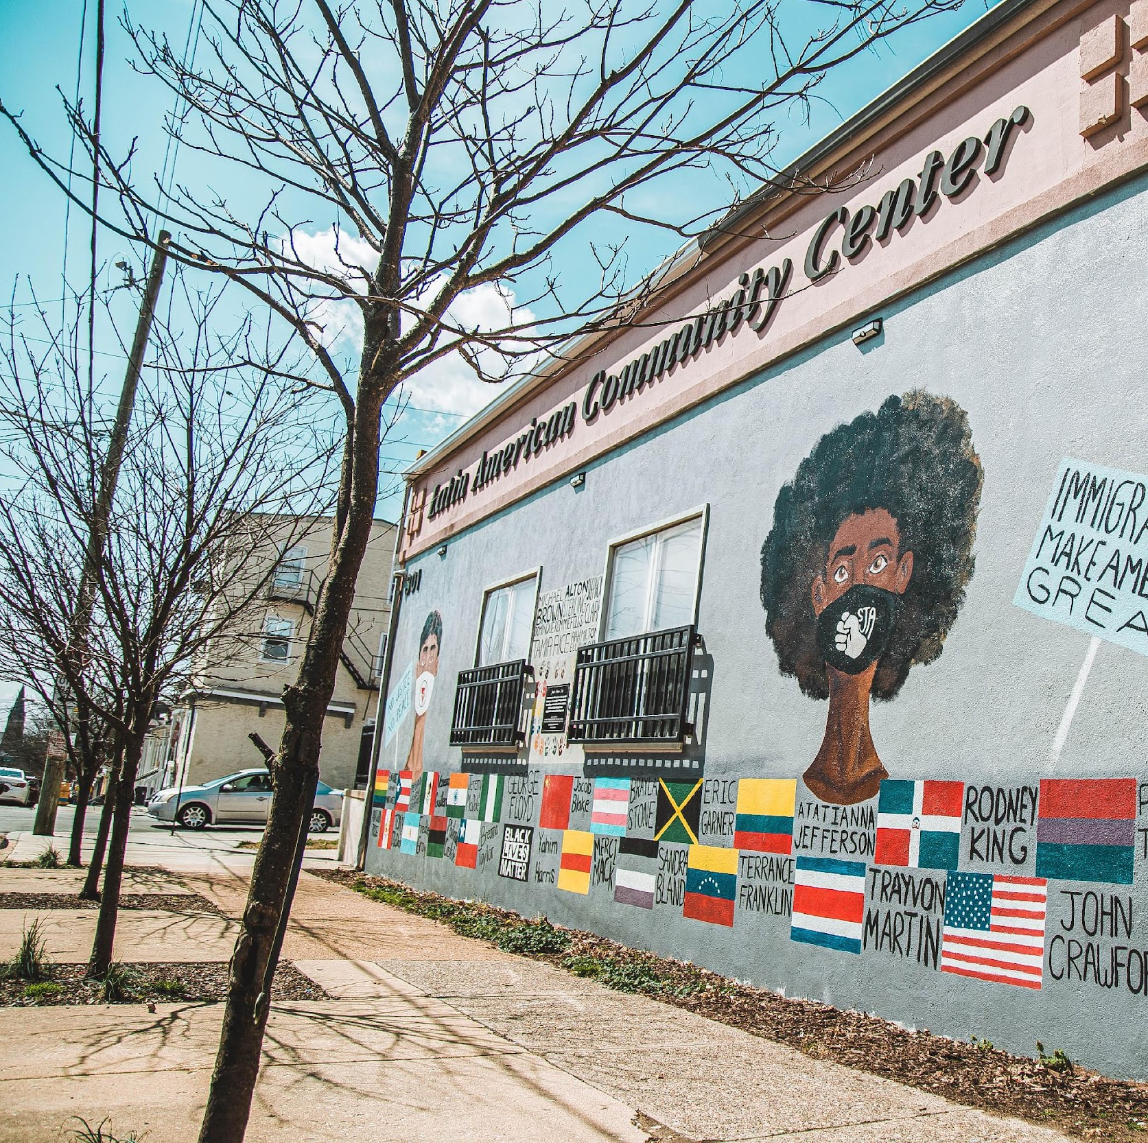
Vision
Healthy, safe and vibrant communities where all people are thriving.
Photo: WestSide, Wilmington. Latin American Community Center.
Notes:
What does it mean to have healthy, safe and vibrant communities across Delaware where all people are thriving?
Thriving conveys our commitment that all people should have a fair chance to participate, to prosper, and reach their full potential.
We are shared stewards of this vision for Delaware.
It will take all of us, working together, to make this vision a reality.

Slide 3







Vital Conditions/Social Determinants for Well-Being
Basic Needs for Health & Safety
Reliable Transportation
Meaningful Work & Wealth
Thriving People
& Places
Lifelong Learning
Thriving Natural Environment
Humane Housing
Belonging & Civic Muscle
Notes:
Vital Conditions/Social Determinants: Properties of places and institutions that we all depend on to reach our potential
Communities that support people to thrive must include opportunities for
Basic Needs for Health & Safety
Reliable Transportation
Meaningful Work & Wealth
Lifelong learning
Belonging and civic muscle
Humane housing and a
Thriving natural environment
It’s important to note that when we talk about well-being we mean a state of physical, mental and spiritual well-being--a whole-person approach. Only together can we create the community conditions that support overall well-being so that all people can thrive.

Slide 4
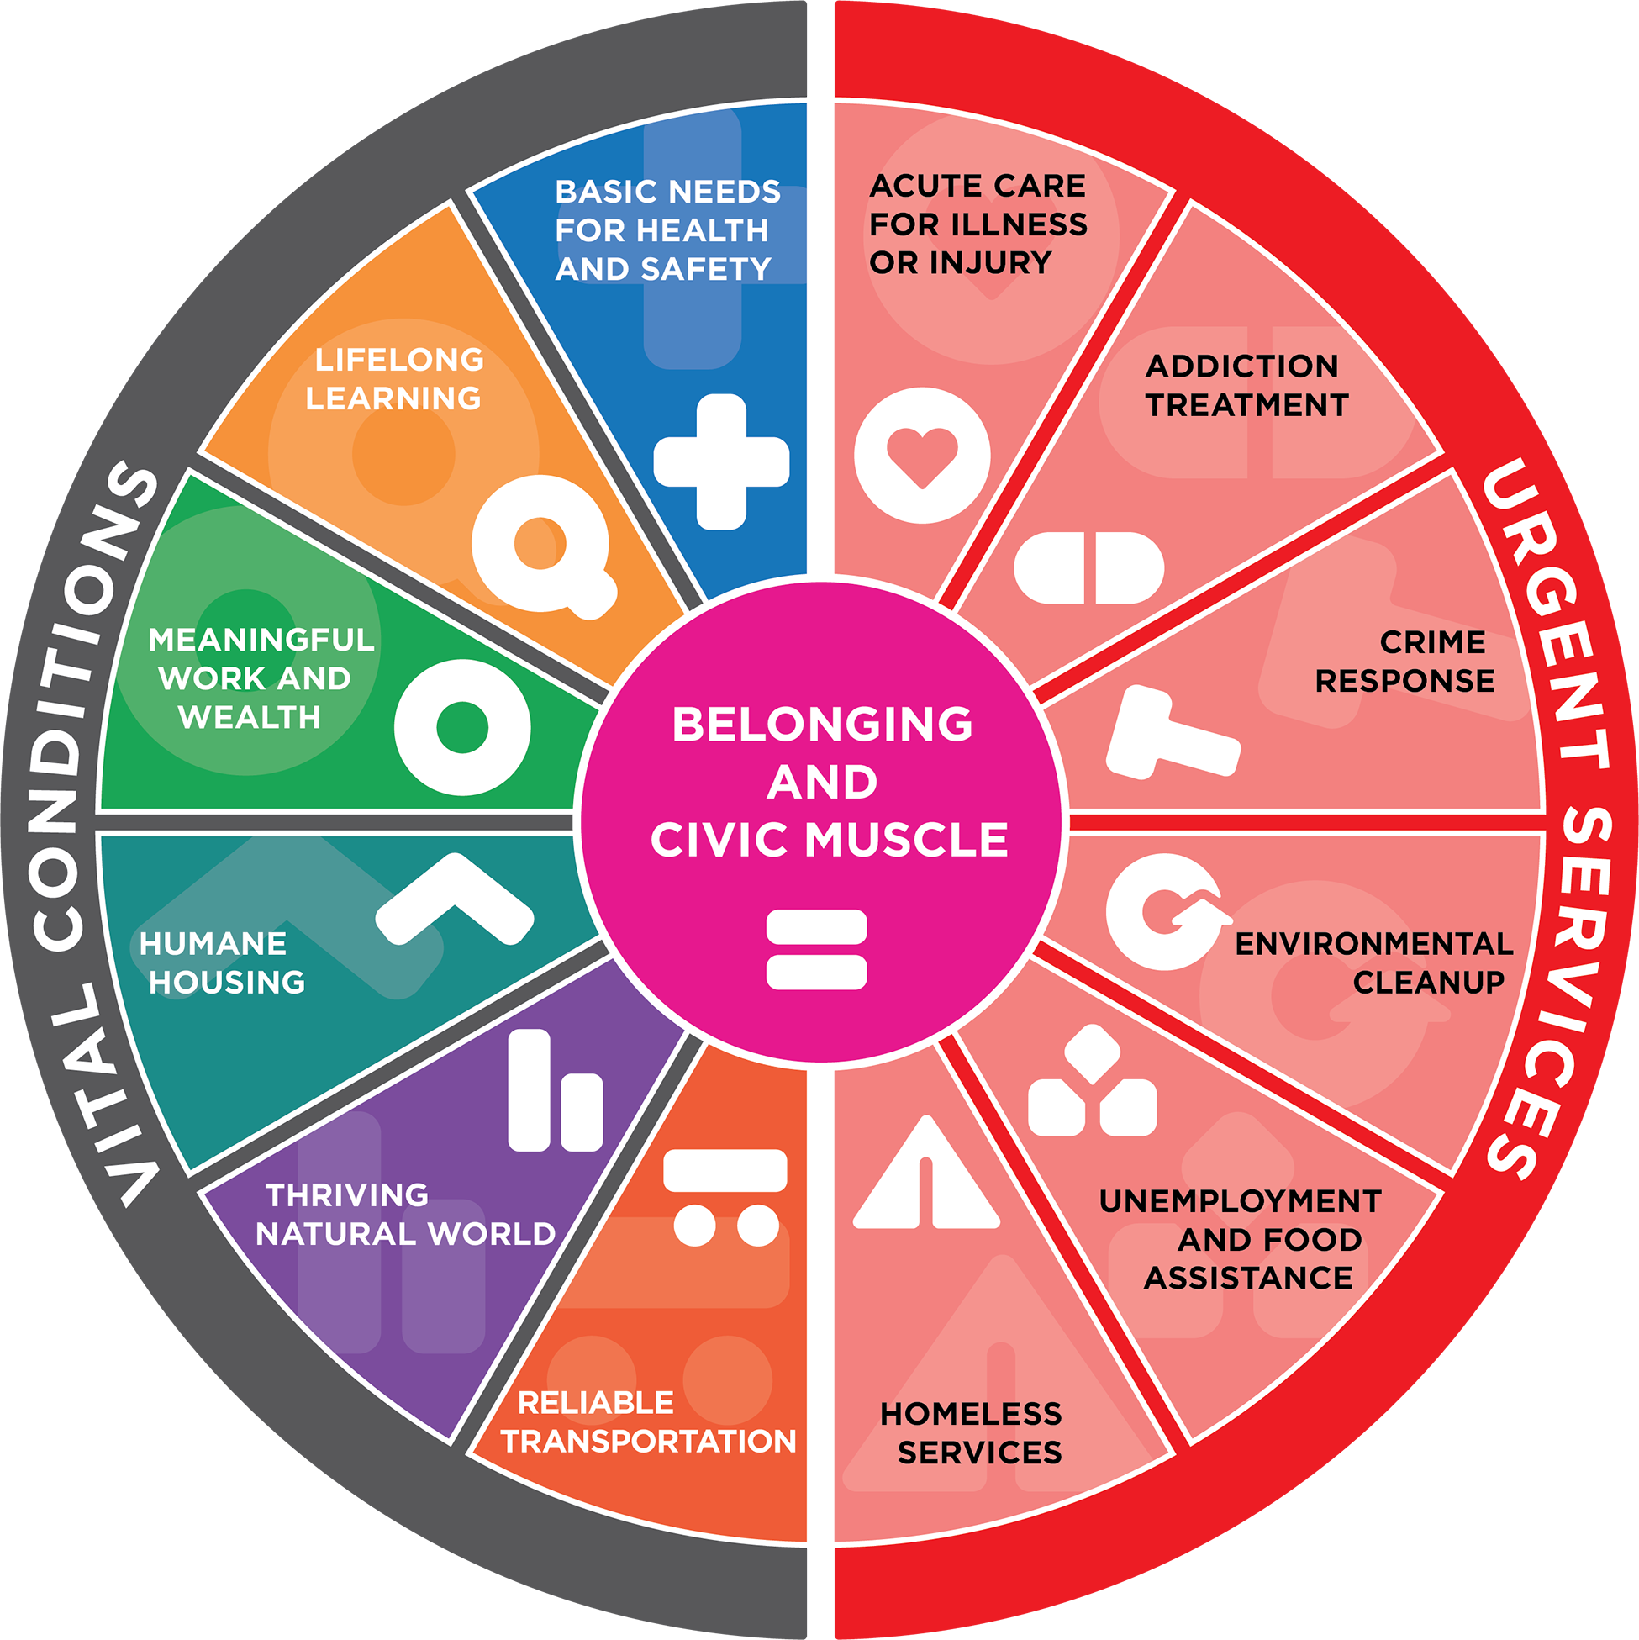
Goals for Today
Introduce the Well-Being Portfolio to see how investments from multiple sources come together
to produce well-being and equity
Practice using the portfolio to explore how current and future investments could create a brighter future for everyone in Delaware
Notes:
The main theme of today's discussion is to explore opportunities to invest together. Our speakers will...

Slide 5
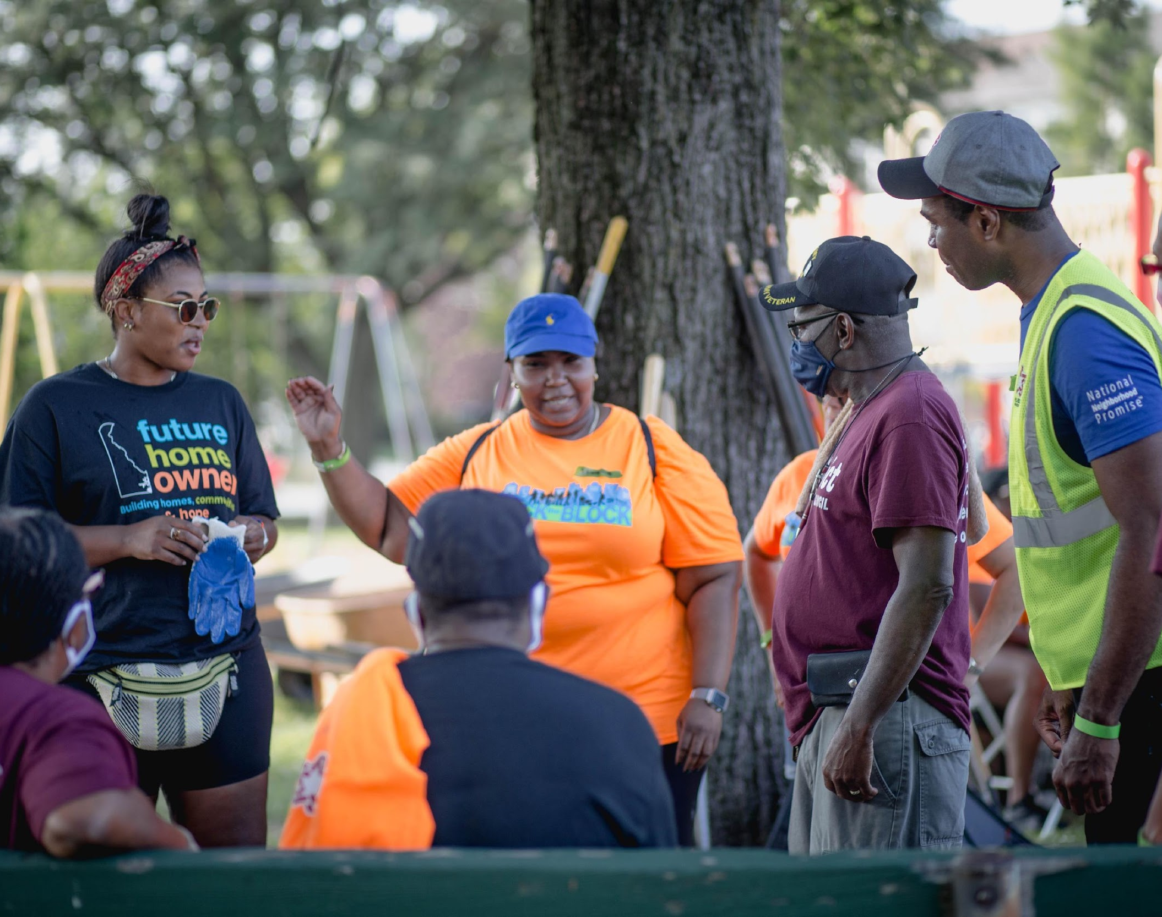
Who is a Steward?
Take responsibility for working with others to create conditions that all people need to thrive
May be affiliated with organizations or act on their own
Have an equity orientation in regard to purpose, power, and wealth
Bring our resources (knowledge, time, money, power, connections) to the table in service of all people and places thriving
Photo: Eastside, Wilmington. Habitat for Humanity of New Castle County: Rock the Block Initiative
Notes:
What is a steward?
People or organizations who take responsibility for working with others to create conditions that all people need to thrive, beginning with those who are struggling and suffering.
May be affiliated with organizations or act on their own, like a community resident
Stewards have (or are interested in developing) an equity orientation in regard to purpose, power, and wealth.
We bring our resources (knowledge, time, money, power, connections) to the table in service of all people and places thriving
We are all stewards and have a role to play ...and why is that important?

Slide 6
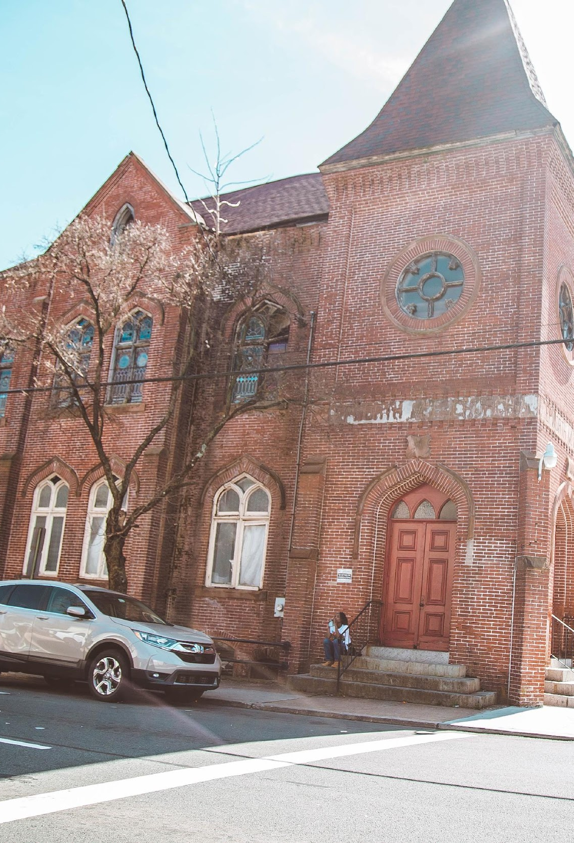
Why Stewardship and Collaborative Investment?
Scope, scale and complexity of the challenges
Work on vital conditions/ SDOH takes time and sustained investment
Collaboration is critical
Photo: Eastside, Wilmington. Central Baptist CDC Community Hub Restoration Project.
Notes:
The scope and scale of the challenges we face are huge, and interconnected. We cannot tackle one problem at a time, but need to create the space and time to embrace the complexity and multi-solve; to choose solutions that contribute to many positive outcomes at the same time.
Work on vital conditions does not happen overnight—it happens over the long term, and requires sustained investment.
This is not a project, it's a culture change; an opportunity to change how we work together over time.
We can't make a dent in the challenges we face unless we do so by sharing the load and the resources—the stewardship.

Slide 7
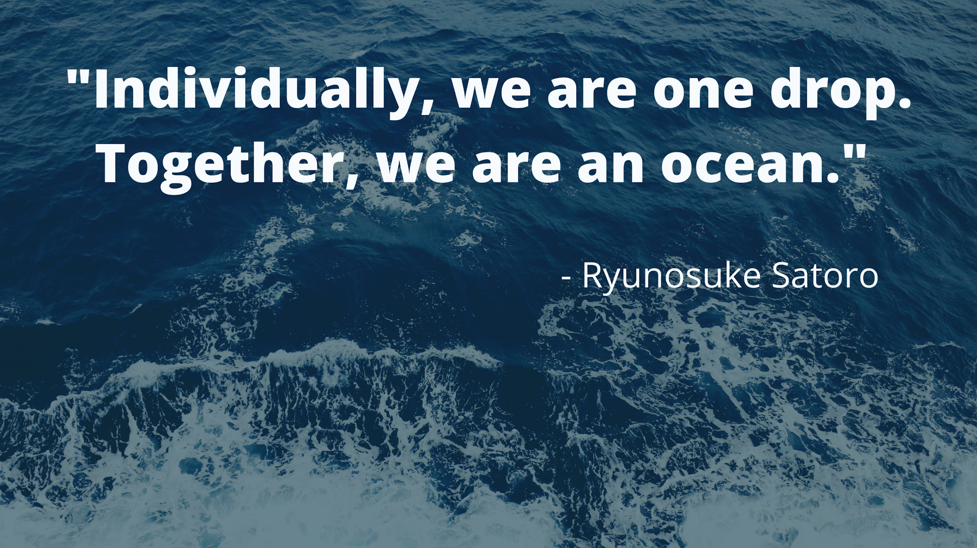

Slide 8
Informing Current & Future Investments
Opportunity for this discussion to inform...
Our collective resources
Delaware’s State Health Assessment
How could we make investments today that will address the root causes of inequities?
Notes:
We have the opportunity to use this conversation to inform current and future investment of resources – our own and those of resource holders in Delaware.

Slide 9
Poll
Which statement best represents your view about resources
(e.g., time, money, knowledge, other assets) to expand
well-being for everyone in Delaware?
A) Most problems can be improved with more resources
B) Most problems can be improved by being more creative
with existing resources
Notes:
Read and field poll.
Respond...
New federal resources are coming to Delaware AND let’s follow the lead of X% who believe we can be more creative with all our many assets.
There is trapped potential in every industry and among ordinary people in every community.
What if we are not limited by scarcity, but our ability to embrace our true abundance?

Slide 10
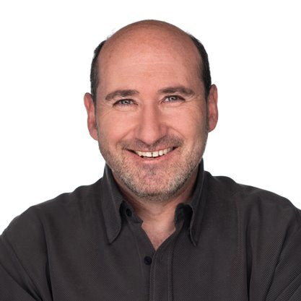
Bobby Milstein PhD, MPH
Director, System Strategy
ReThink Health
Rippel Foundation
Notes:
Bobby Milstein leads several ReThink Health projects focused on large-scale institutional change, including ongoing development of tools that allow leaders to negotiate their own scenarios for transforming regional health.
Previously, Bobby spent 20 years planning and evaluating system-oriented initiatives at the Centers for Disease Control and Prevention (CDC), and was the principal architect of CDC’s framework for program evaluation.

Slide 11
Healthy Communities Delaware
Shared Stewardship Learning Series, Part 2
March 11, 2022

Slide 12
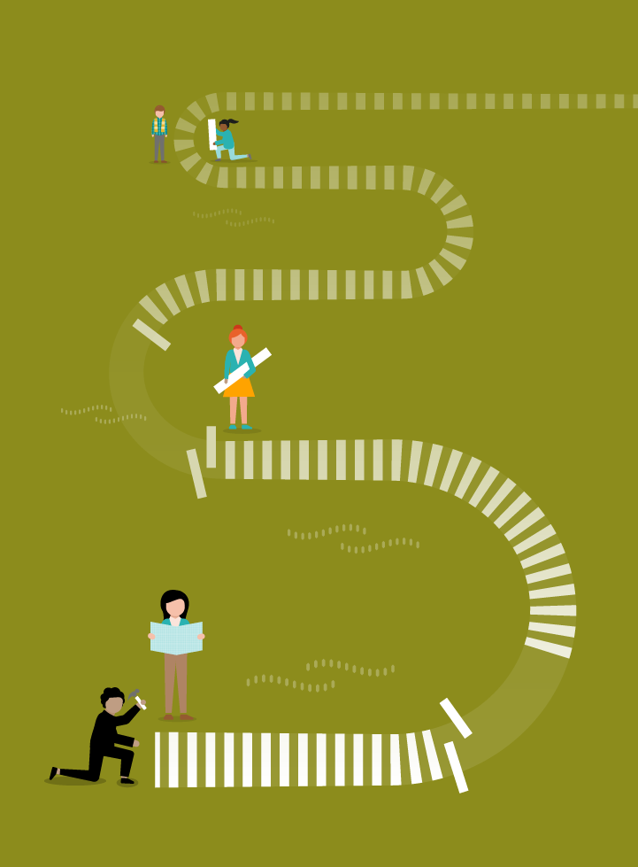

Goal of this Series
To deepen your capacity as stewards of Delaware’s future for health, well-being, and racial justice
STEWARDSHIP JOURNEY

Slide 13
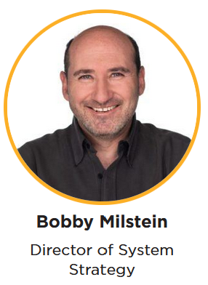
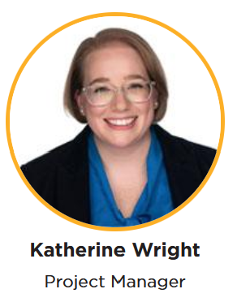
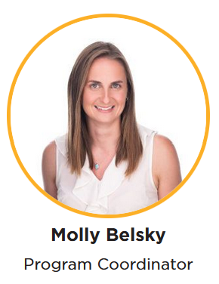
ReThink Health Team Members

Slide 14
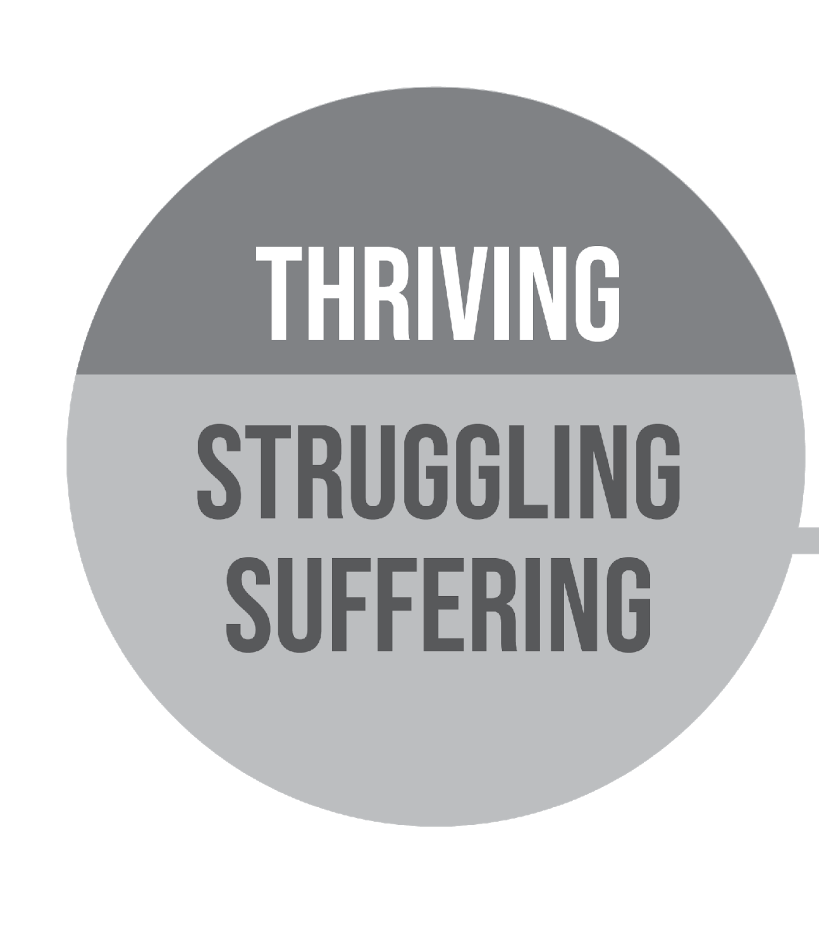
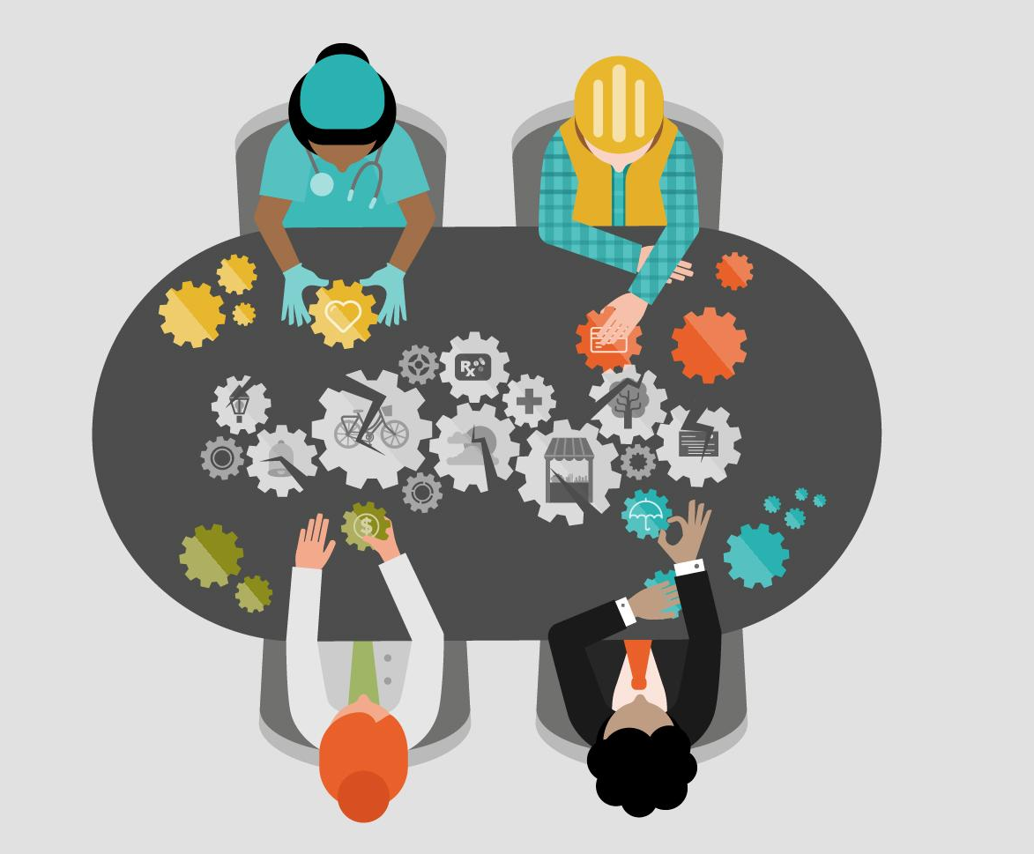
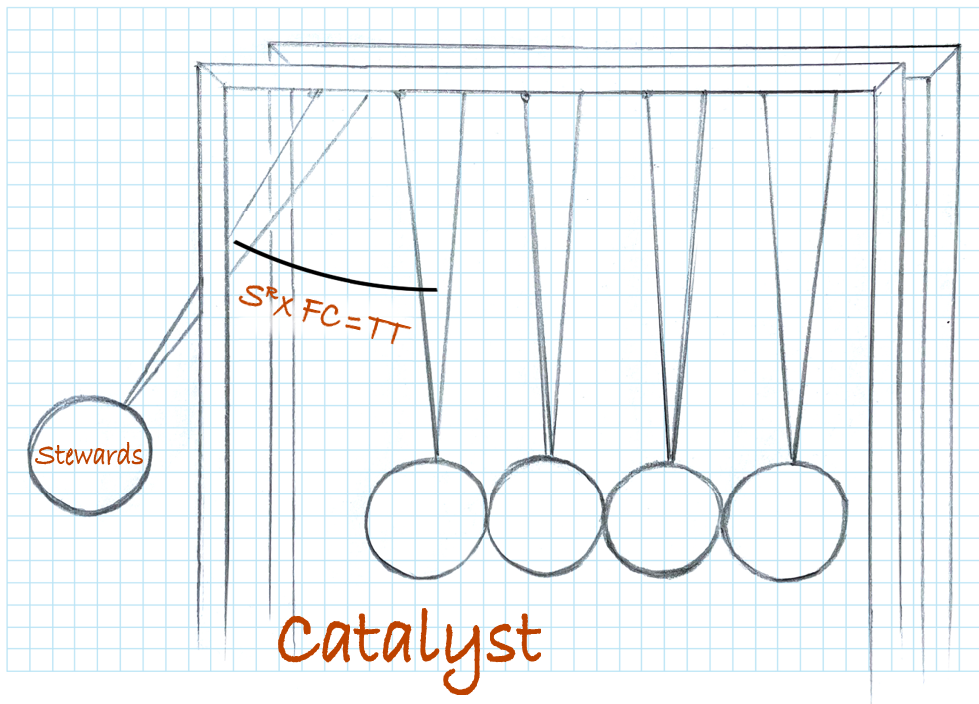
About the Shared Stewardship Learning Series
https://healthycommunitiesde.org/events
October 29
March 11
May 13
June 10
Thriving Together Through Shared Stewardship
Designing
Well-Being Portfolios
Negotiating
with Fellow Stewards
Strengthening
Shared
Stewardship
Videos
Materials

Slide 15
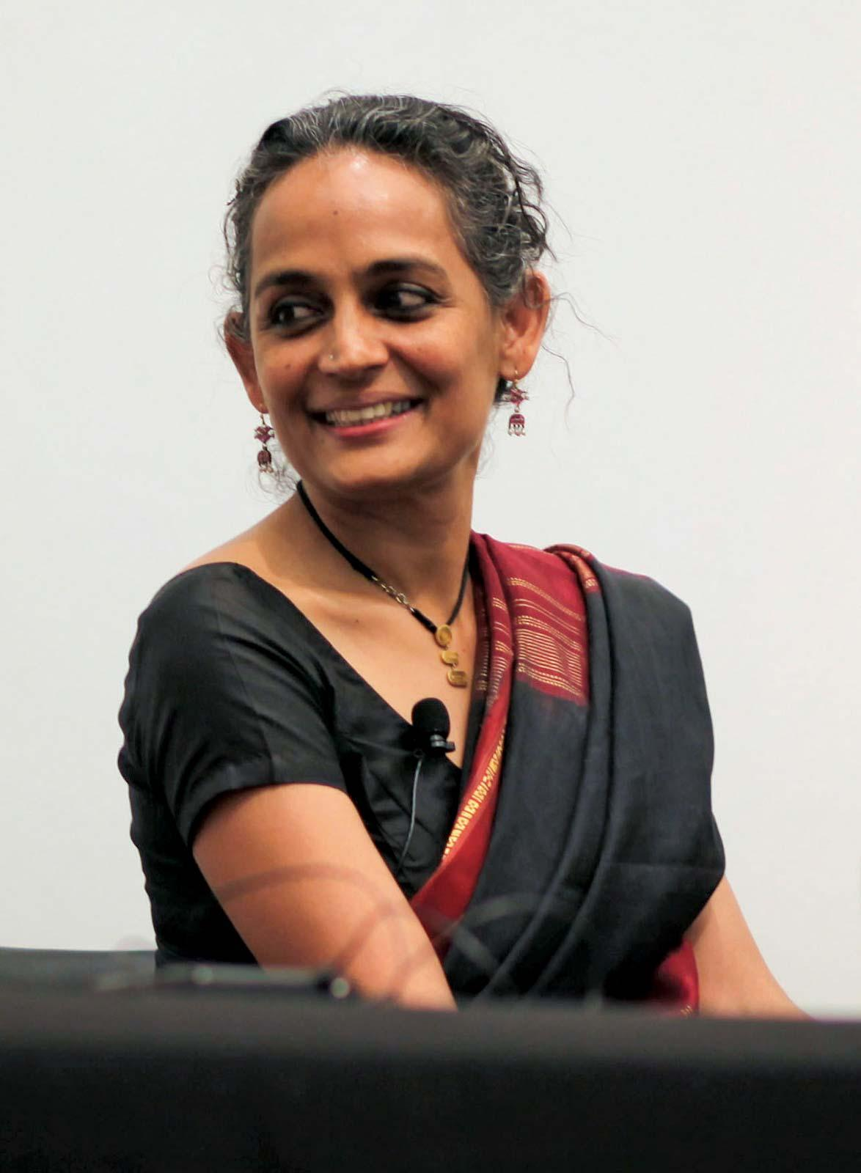
A Legacy Moment
Historically, pandemics have forced humans to break with the past and imagine their world anew. This one is no different. It is
a portal, a gateway between one world and the next.
-- Arundhati Roy
https://www.britannica.com/biography/Arundhati-Roy
https://www.ft.com/content/10d8f5e8-74eb-11ea-95fe-fcd274e920ca

Slide 16
Poll
How confident are you that your current investments will achieve the changes you desire?
If I were a betting person, I would...
Go All In (It is a sure thing)
Ante Up (Very)
Hold (Somewhat)
Fold (Not at all confident)

Slide 17
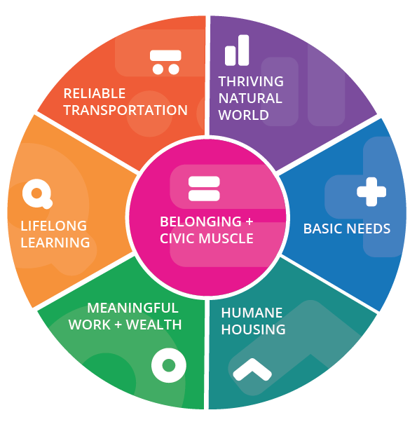

This single dynamic explains
how people with a just cause
can transform failing systems
for the better
-- Thriving Together Springboard,
quoting Otto Sharmer
http://Thriving.US
17

Slide 18
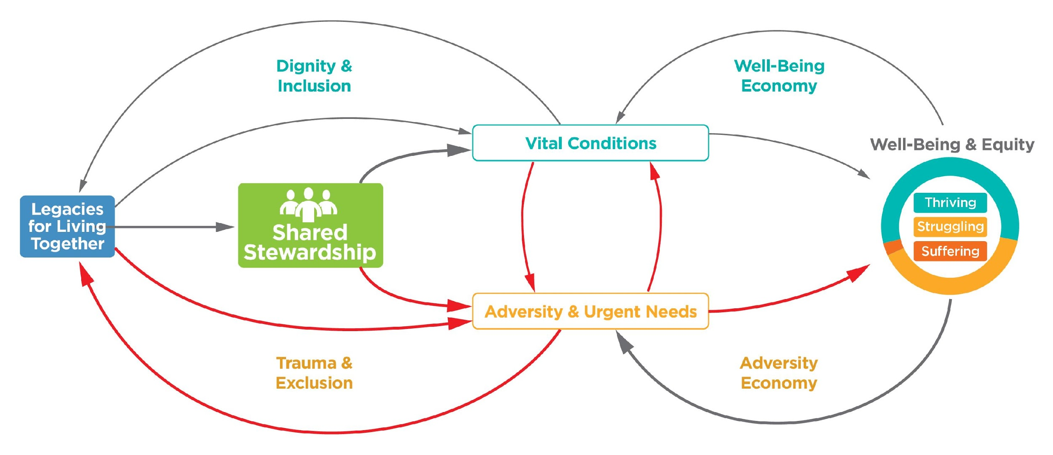
Thriving Together Through Shared Stewardship
Springing Forward Through Crises
Resilience
Reclamation
Relationships
Recovery
Renewal
Response
http://tiny.cc/SharedStewardshipVideo

Slide 19

Approaches to Change
Transactional
Impacts
Health &
Well-Being
Interventions
(programs, projects)
Outcomes
║
Equity
Cost
Transformational
North Star
Mindsets & Actions
Shared Stewardship
System Designed
for Well-Being, Equity, and
Racial Justice
Practices affecting…
• Aspirations
• Mutual Accountabilities
• Interdependent Networks
• Portfolio Design
• Policies & Incentives
• Learning & Adapting
• Other frontiers…
Practices affecting…
• Aspirations
• Mutual Accountabilities
• Interdependent Networks
• Portfolio Design
• Policies & Incentives
• Learning & Adapting
• Other frontiers…
Devoted to equitable…
• Processes (i.e., lived experiences)
• Power (i.e., belonging and civic muscle)
• Opportunities (i.e., vital conditions)
• Outcomes (i.e., WIN measures, HP2030)
Thriving People and Places—
No Exceptions
Anderson T, et.al. Shared Stewardship and Prospects for Thriving Together. ReThink Health. 2021

Slide 20
Well-Being Portfolio
Notes:
Finally comes the filling! The special stuff at the center
Belonging and Civic Muscle. This is our way of talking about the capacities of people and institutions that convey to ALL a sense of belonging in the region and the power to influence the policies, practices, and programs that shape our world.
These include, but not limited to, arts, culture and spiritual life.
Freedom from stigma, discrimination, and oppression.
Support for civil and human rights
Political discourse
And more.

Slide 21

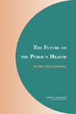
“Public health is what we,
as a society, do collectively to assure the conditions in which [all] people can be healthy.”
“Public health is what we,
as a society, do collectively to assure the conditions in which [all] people can be healthy.”
-- Institute of Medicine (1988, 2002)
More than three decades later, we still haven’t agreed what those conditions are!
Institute of Medicine. The future of public health. Washington, D.C.: National Academy Press, 1988.
Institute of Medicine. The future of the public's health in the 21th century. Washington D.C.: National Academy Press, 2002.
Notes:
Organized actions to assure the conditions

Slide 22

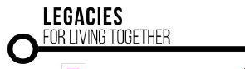























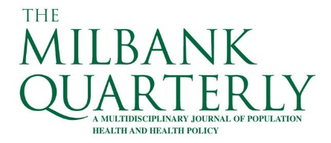













Vital Conditions for Well-Being & Justice
Thriving Natural World
Basic Needs for Health & Safety
Humane Housing
Meaningful Work & Wealth
Lifelong Learning
Reliable Transportation
Belonging & Civic Muscle
Belonging & Civic Muscle wraps around the others because it is both a vital condition and a practical capacity that is necessary for equitable success in every other kind of work
http://Thriving.US

Slide 23
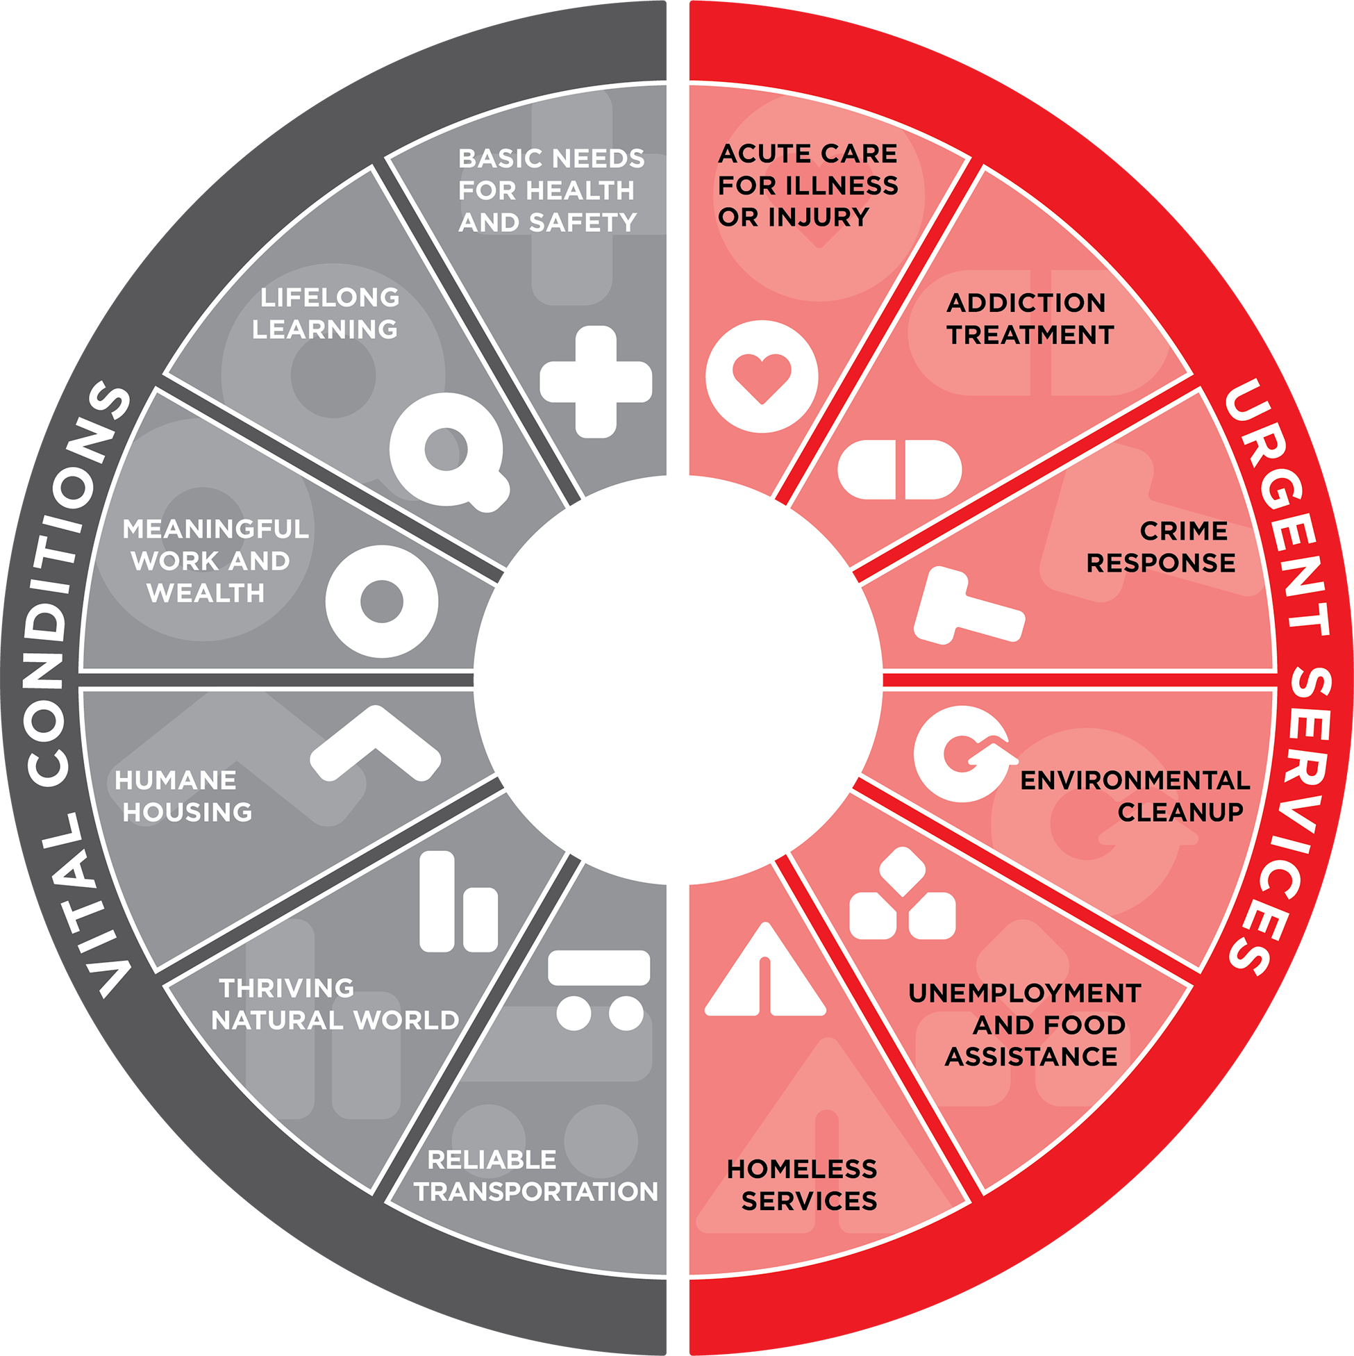
Well-Being Portfolio
Services that anyone under adversity may need temporarily to regain or restore well-being
URGENT SERVICES (N=6)
Acute care for illness or injury
Addiction treatment
Crime response
Environmental cleanup
Homeless services
Unemployment and food assistance
Notes:
There are two halves of the pie (or flavors if you want to stick to the metaphor). There are urgent services on one side- the services that anyone under adversity may need to temporarily regain or restore their well-being. AUDIENCE: what are some the urgent services in your community?
These could be treatment for addiction, emergency food assistance, homeless shelters, or the Emergency Room for a broken arm.

Slide 24
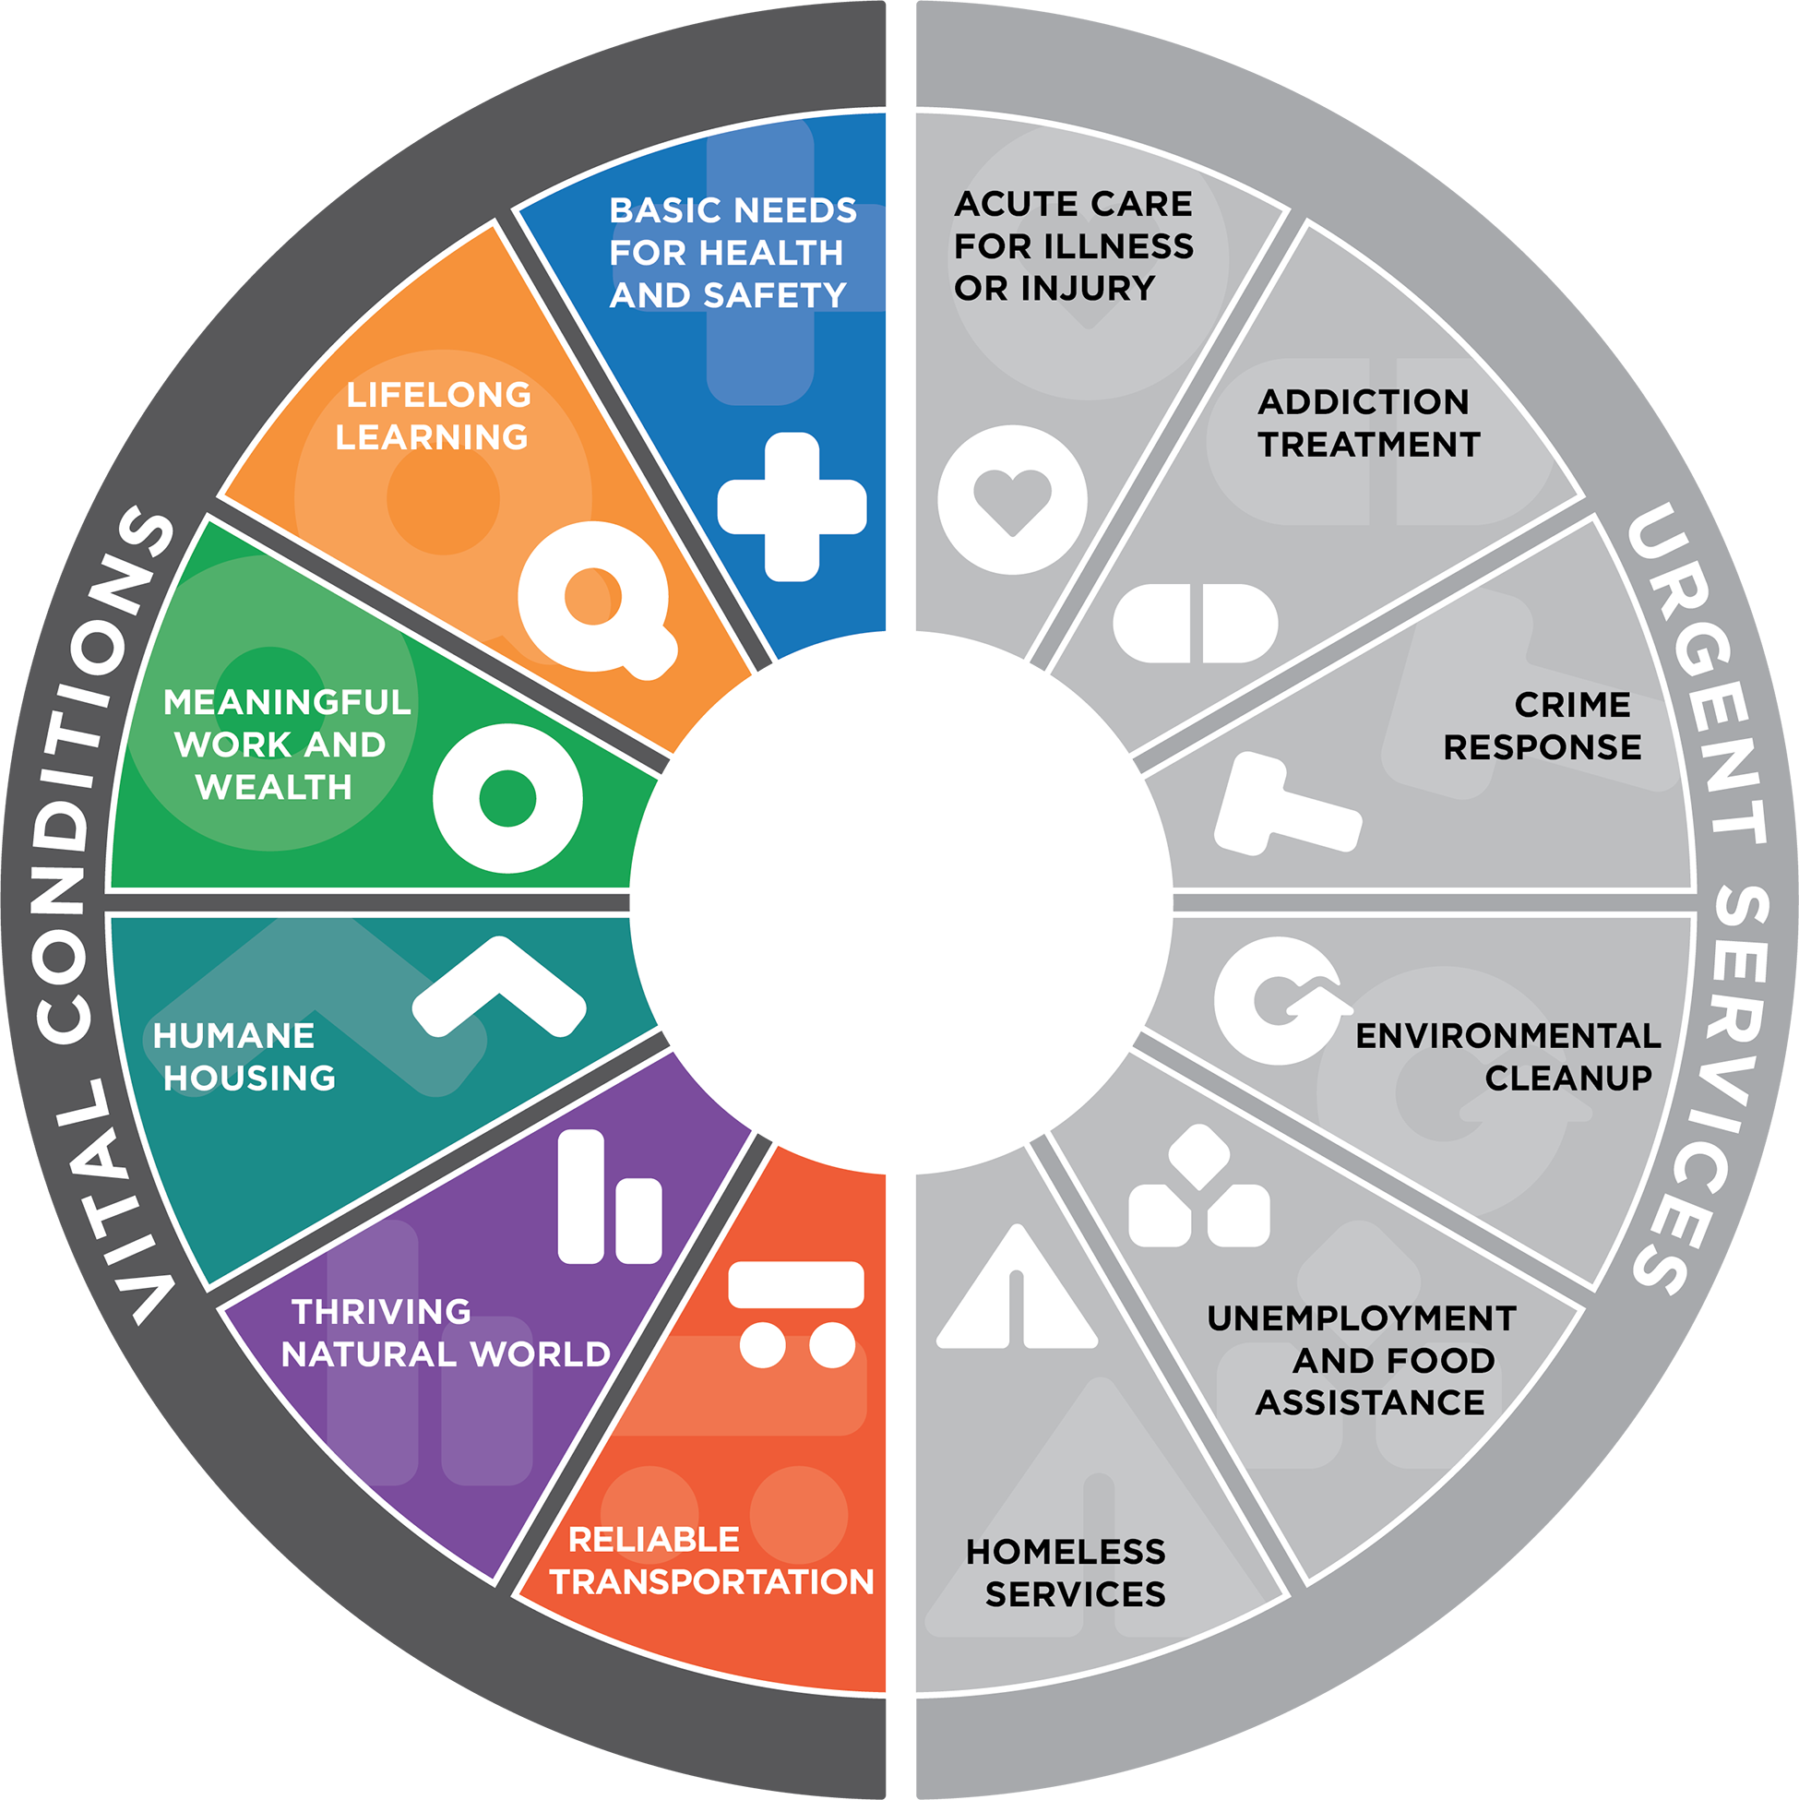
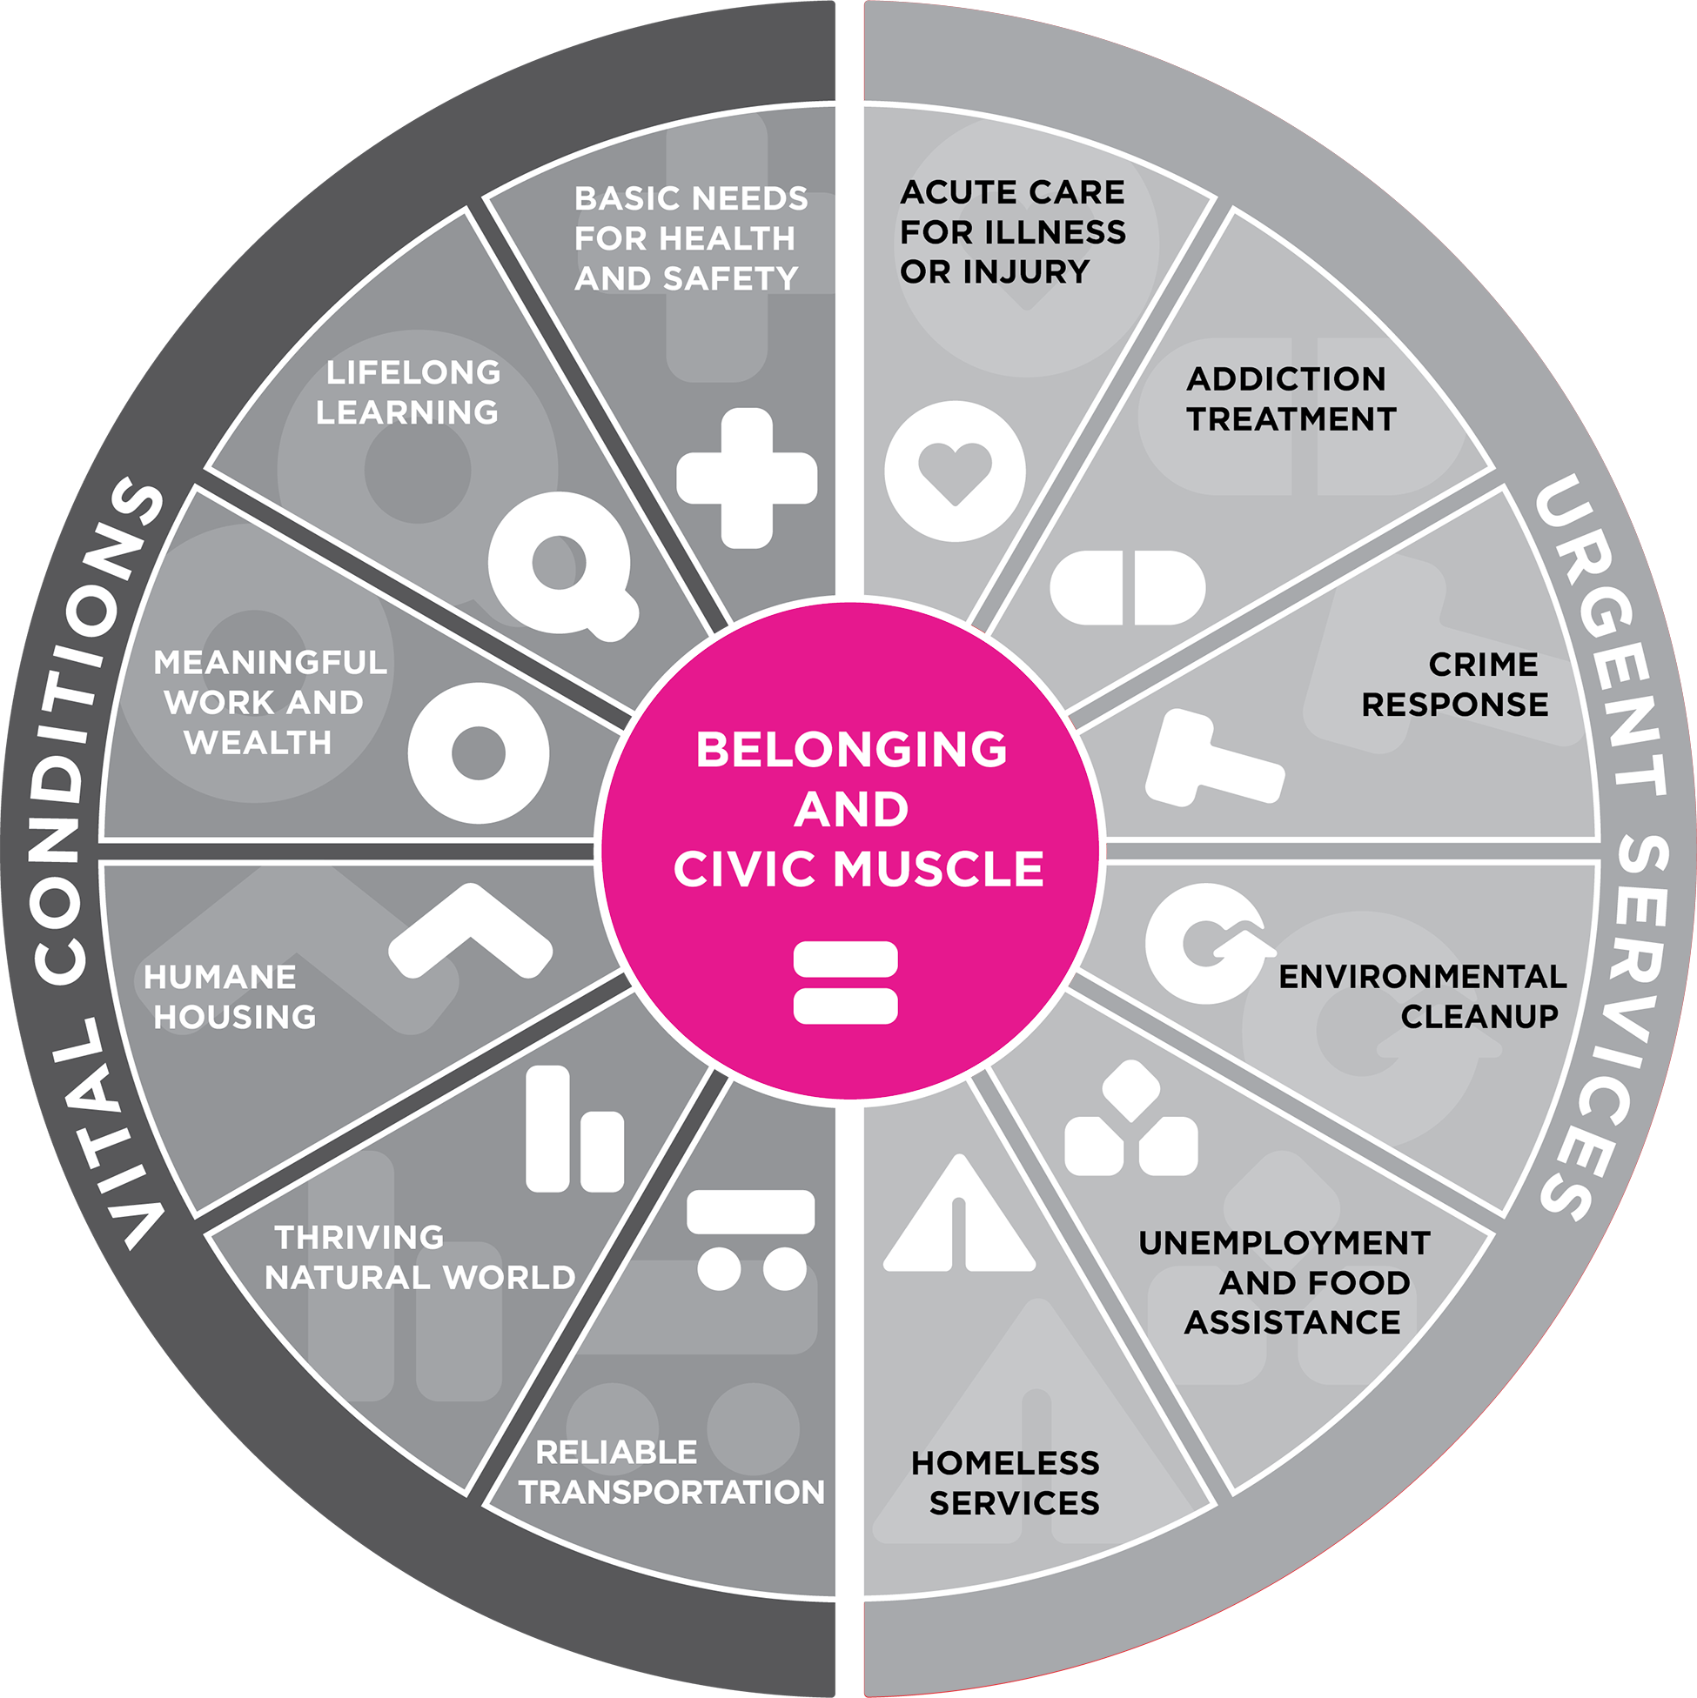
Well-Being Portfolio
Things that ALL people need regularly to be healthy and reach their full potential
VITAL CONDITIONS (N=7)
Thriving natural world
Basic needs for health and safety
Humane housing
Meaningful work and wealth
Lifelong learning
Reliable transportation
Belonging and civic muscle
Notes:
The other half of the pie contains the Vital Conditions. These are the things that ALL people need to be healthy and to prevent harms to well-being. AUDIENCE: examples of vital conditions?
These include meaningful work and wealth, reliable transportation, human housing, a healthy environment, and more.
Do the differences between the two halves of the pie make sense?

Slide 25
Well-Being Portfolio
Belonging and Civic Muscle:
Special capacities to expand a sense of belonging and strengthen power
to shape our world together
Notes:
Finally comes the filling! The special stuff at the center
Belonging and Civic Muscle. This is our way of talking about the capacities of people and institutions that convey to ALL a sense of belonging in the region and the power to influence the policies, practices, and programs that shape our world.
These include, but not limited to, arts, culture and spiritual life.
Freedom from stigma, discrimination, and oppression.
Support for civil and human rights
Political discourse
And more.

