Slide 1
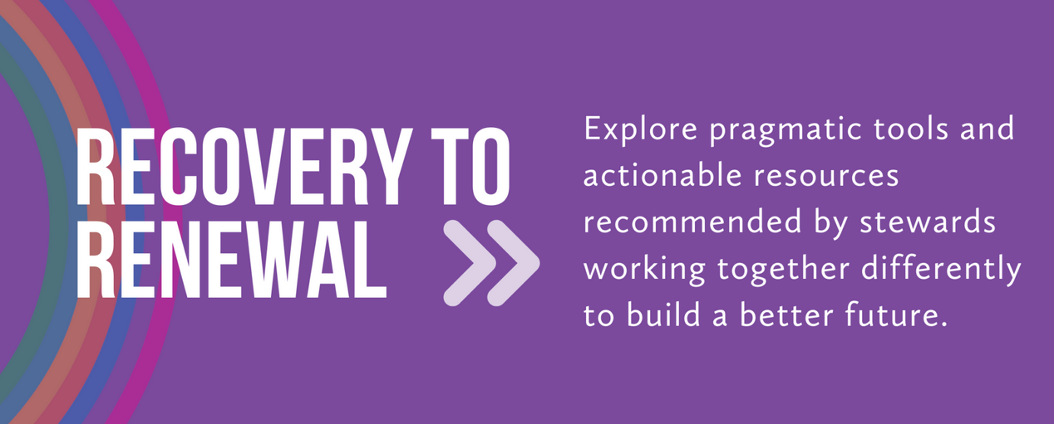

Moving from Recovery to Renewal
The federal government is making unprecedented investments in state, territorial, Tribal, and local governments
Never have communities had access to direct, flexible dollars at this scale
Never have communities had the opportunity to develop local solutions—solutions rooted in the voices and needs of residents
Stewards willing to work together can craft place-based portfolios that built to alleviate urgent needs and expand vital conditions for everyone to thrive together
https://thriving.us/building-blocks/recoverytorenewal/

Slide 2
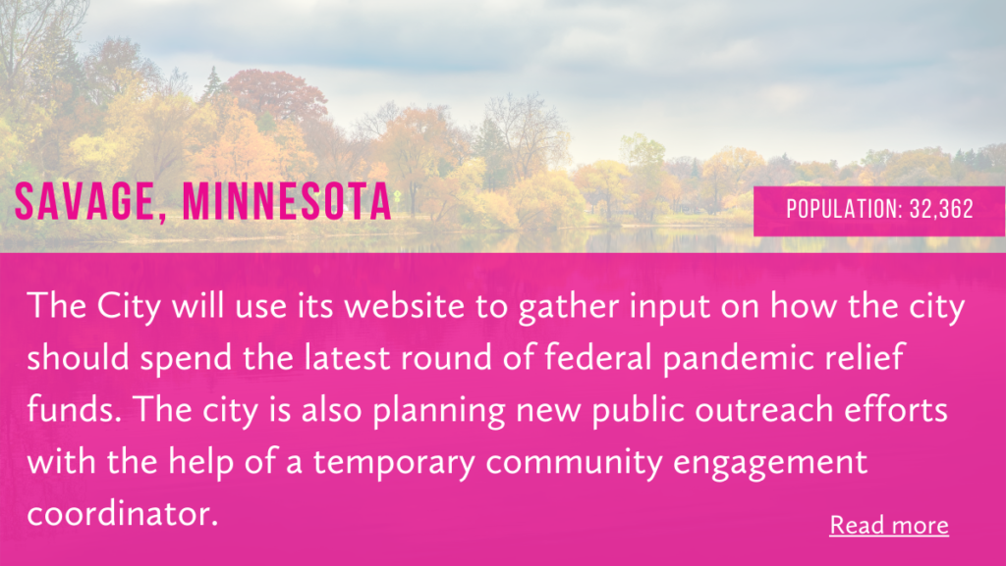
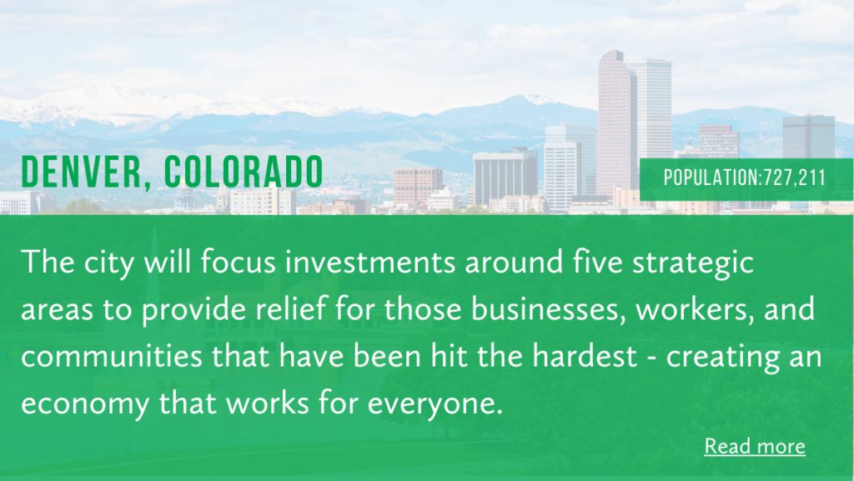
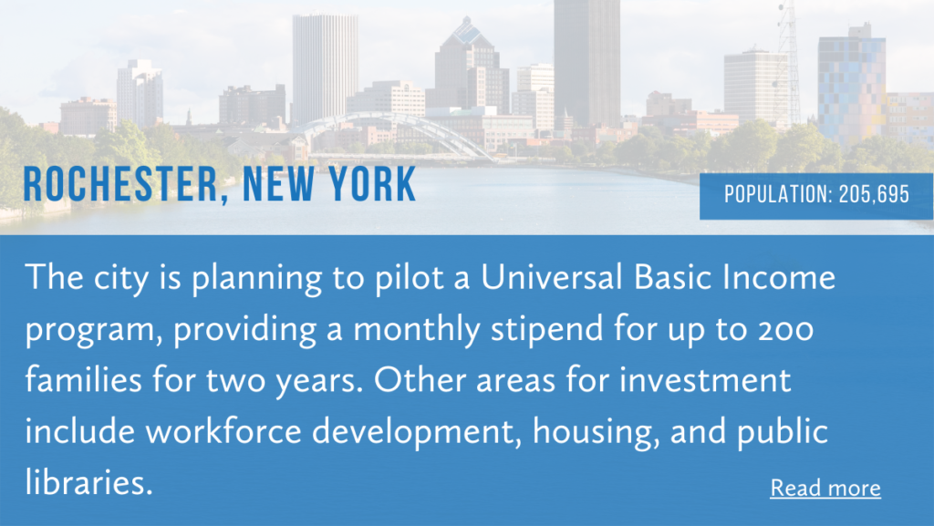
Moving from Recovery to Renewal
https://thriving.us/recovery-to-renewal/
COMMUNITIES ACROSS THE COUNTRY are leveraging recovery funding to strengthen belonging, implement multisolving innovations, and move toward their vision of renewal.
Explore the National League of Cities
Local Action Tracker to learn more
https://thriving.us/recovery-to-renewal/

Slide 3
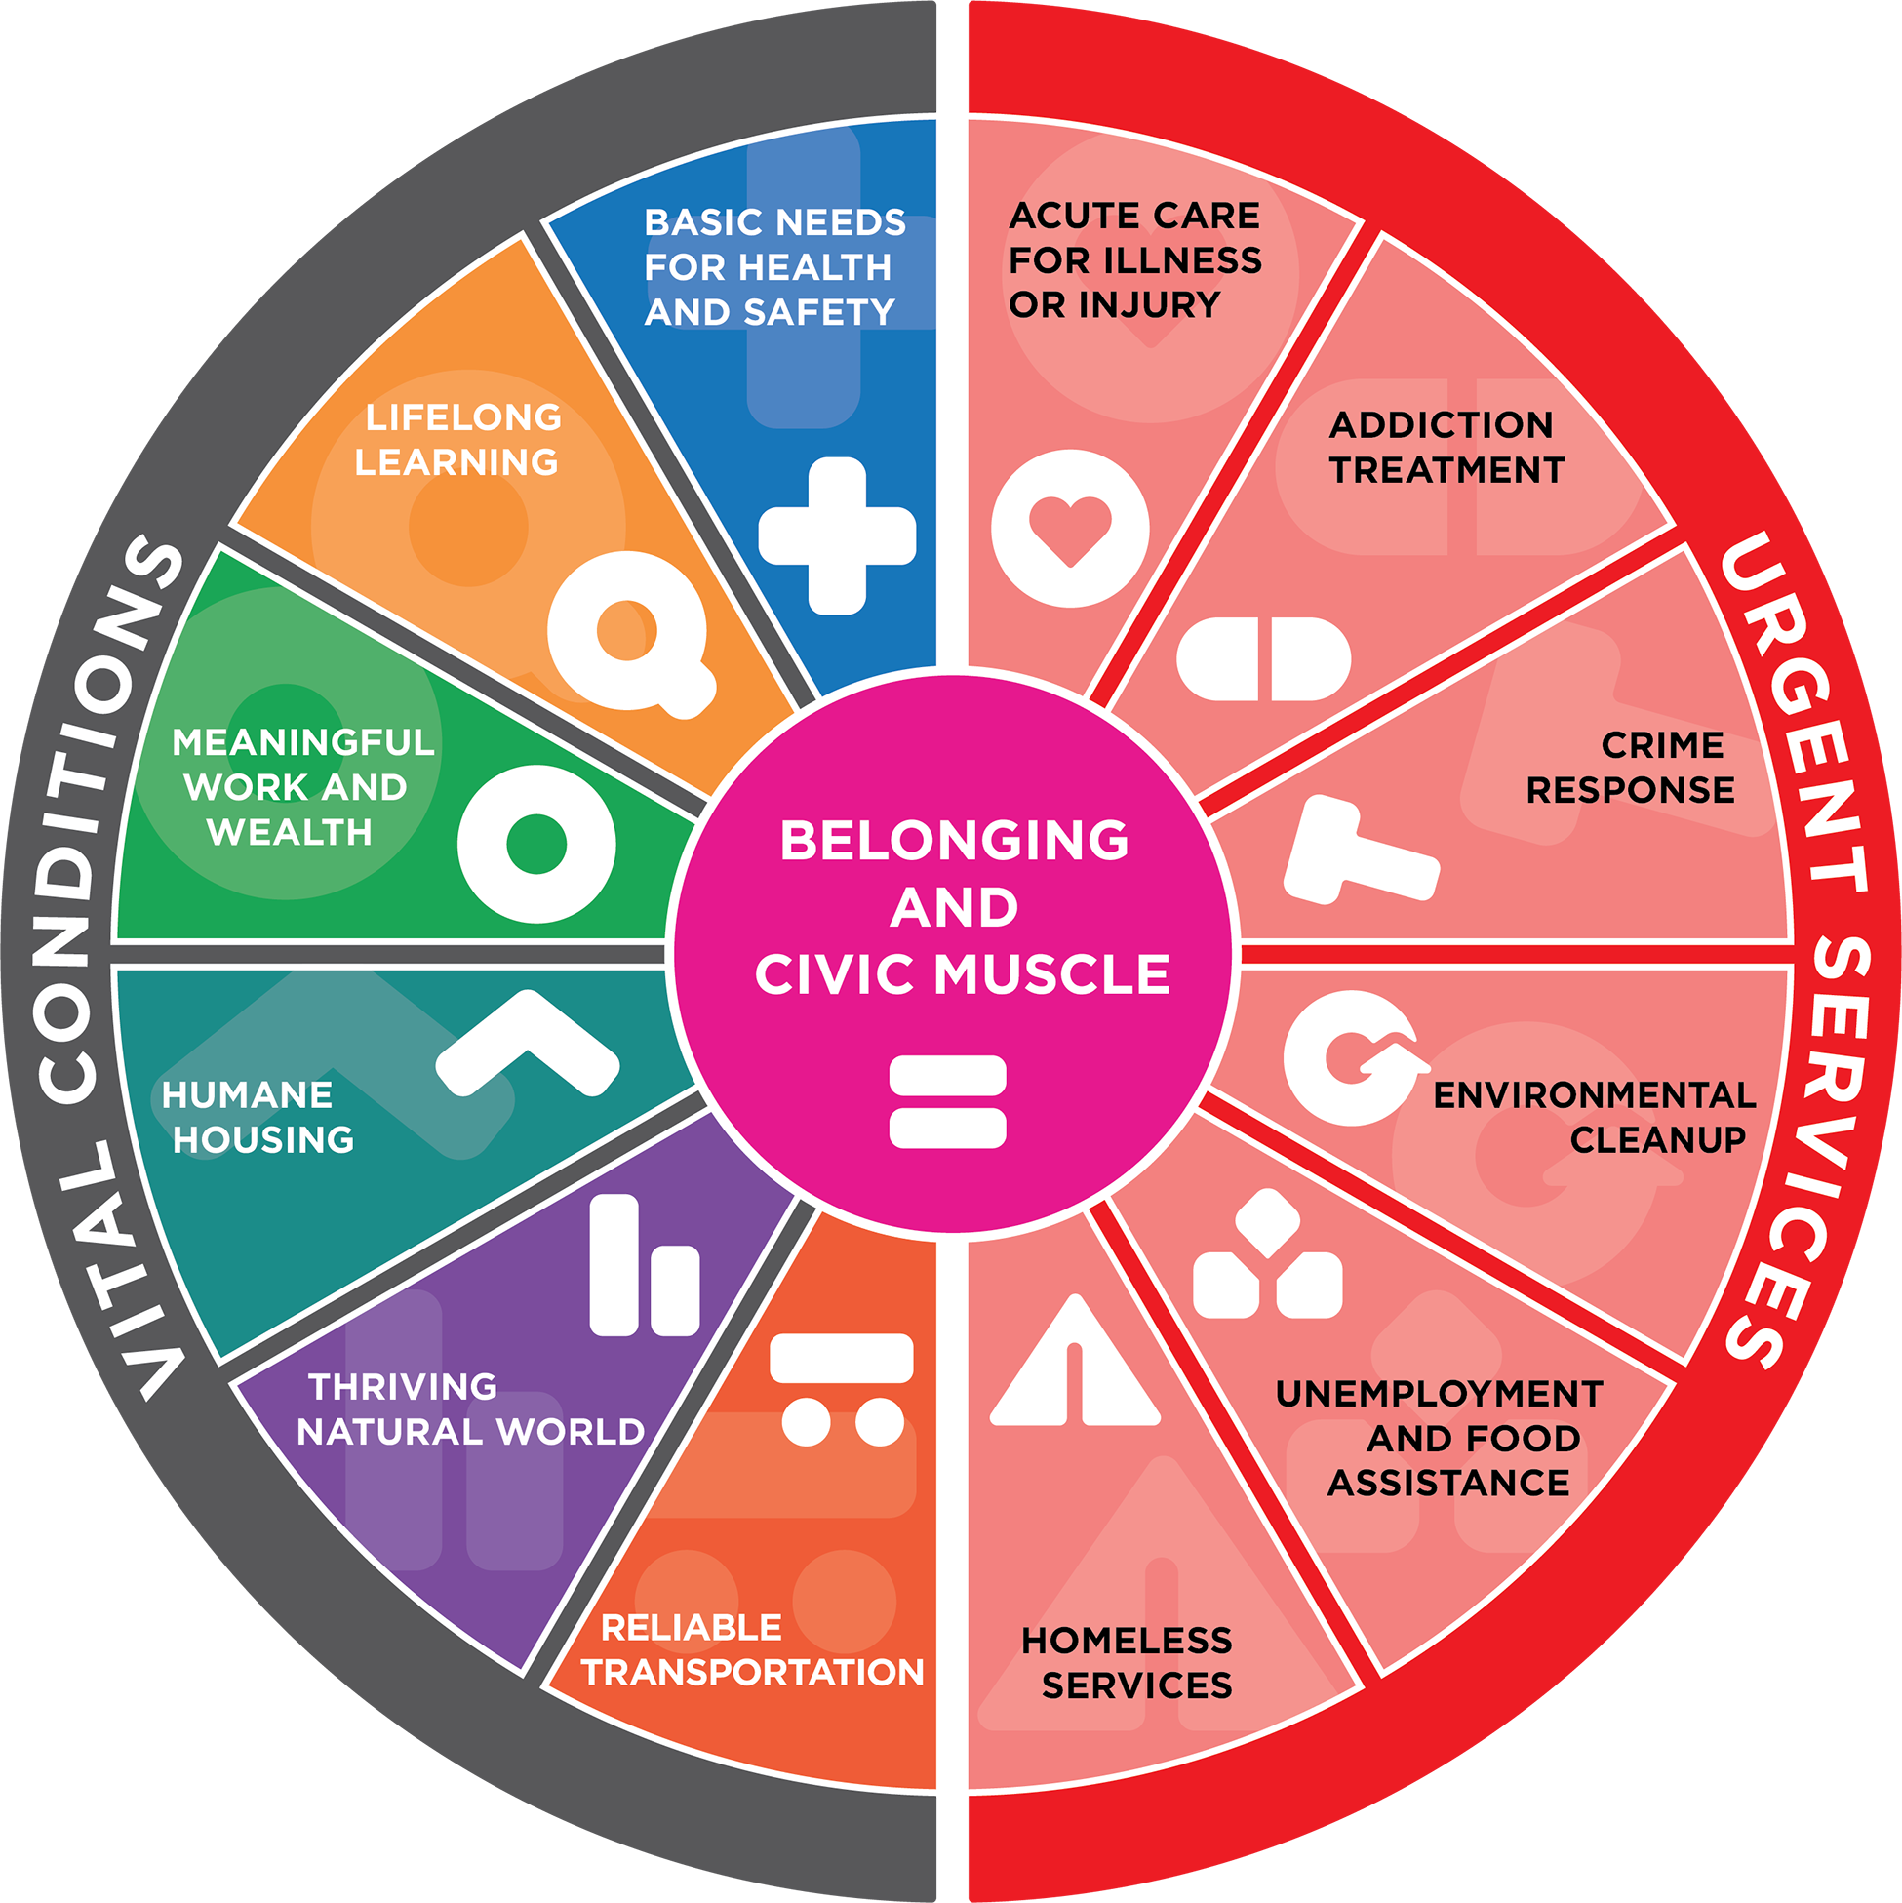
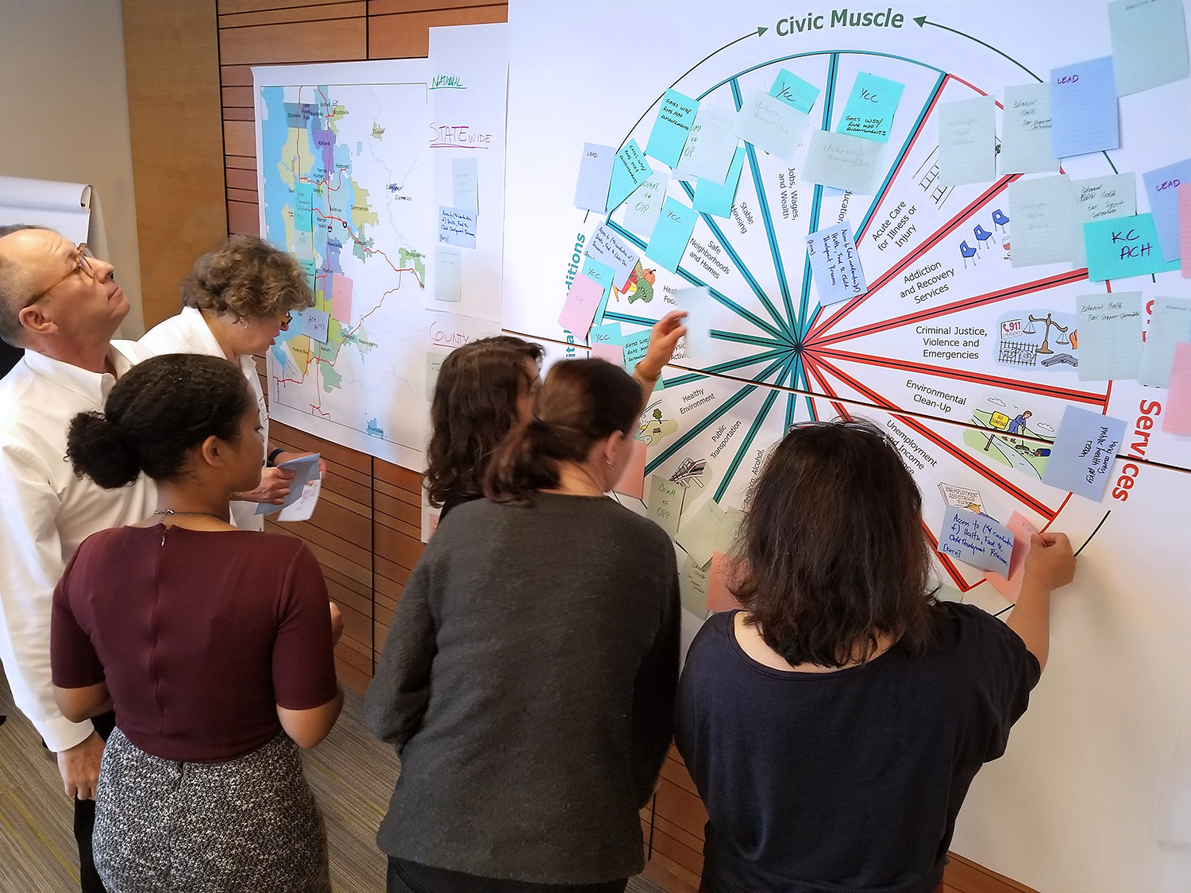
How can we use the whole portfolio to address systemic priorities?
Each part of the portfolio is distinct and indispensable. Together, they form an interdependent system that shapes the chances for people and places to thrive.
  Well-Being
  Resilience
  Food Security
  Racial Justice
  Mental Health
  Economic Mobility
  Others…
Vocabulary
(practical and normative)
System Stories
Shared Stewardship

Slide 4

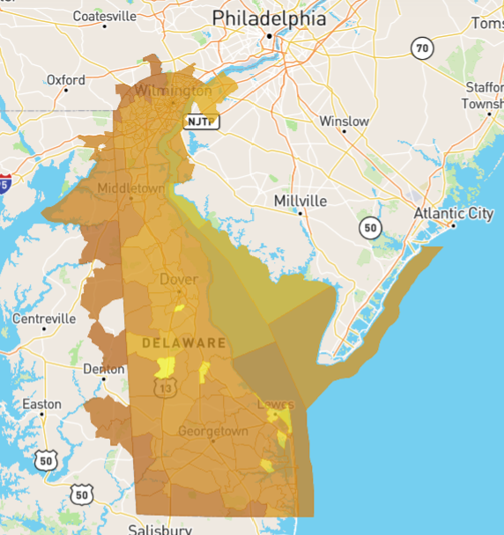
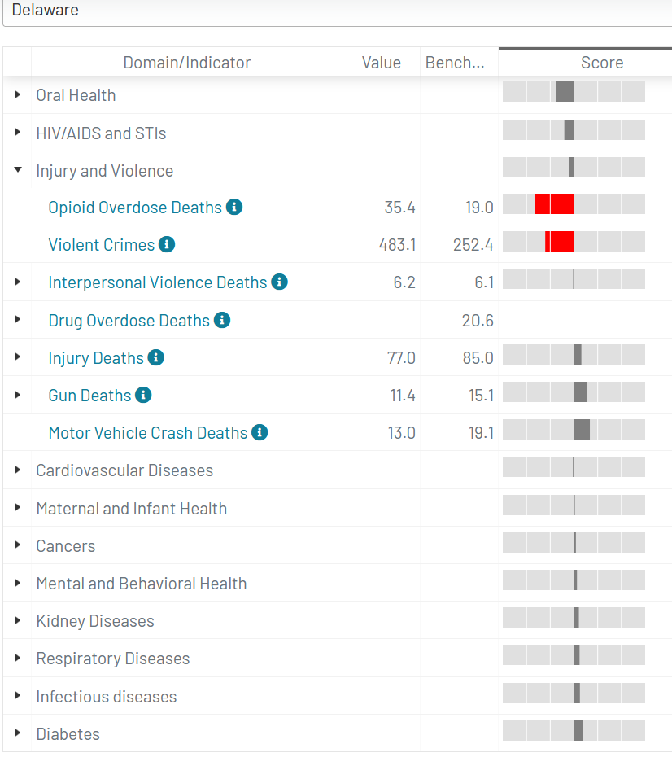
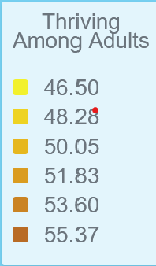
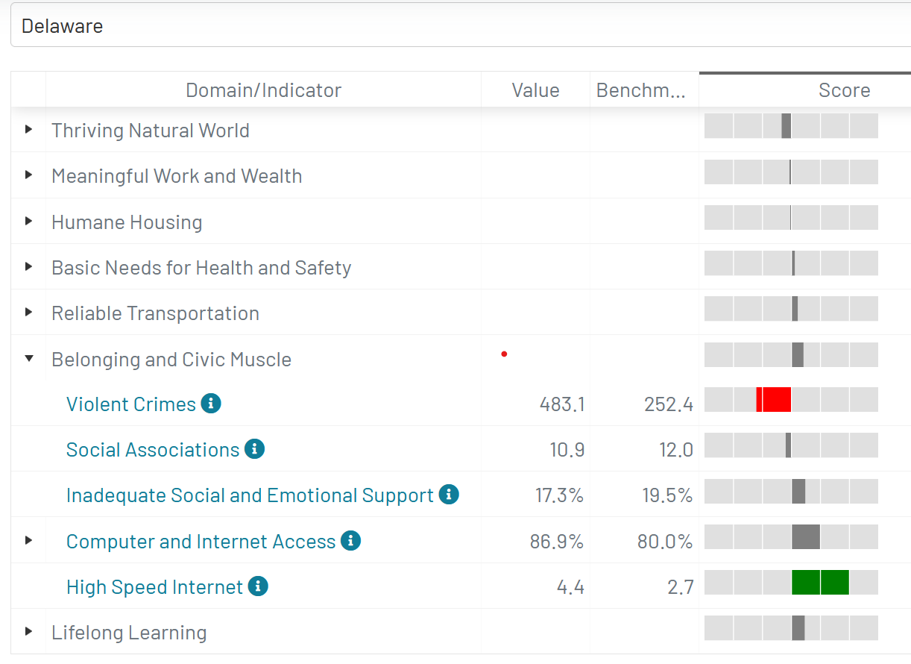
Wise investments could unlock immense potential
Burden of Disease
Vital Conditions
Delaware (2017)
Thriving = 53%
Struggling = 43%
Suffering = 4%
Data Source: https://www.i-p3.org/ip3assess

Slide 5
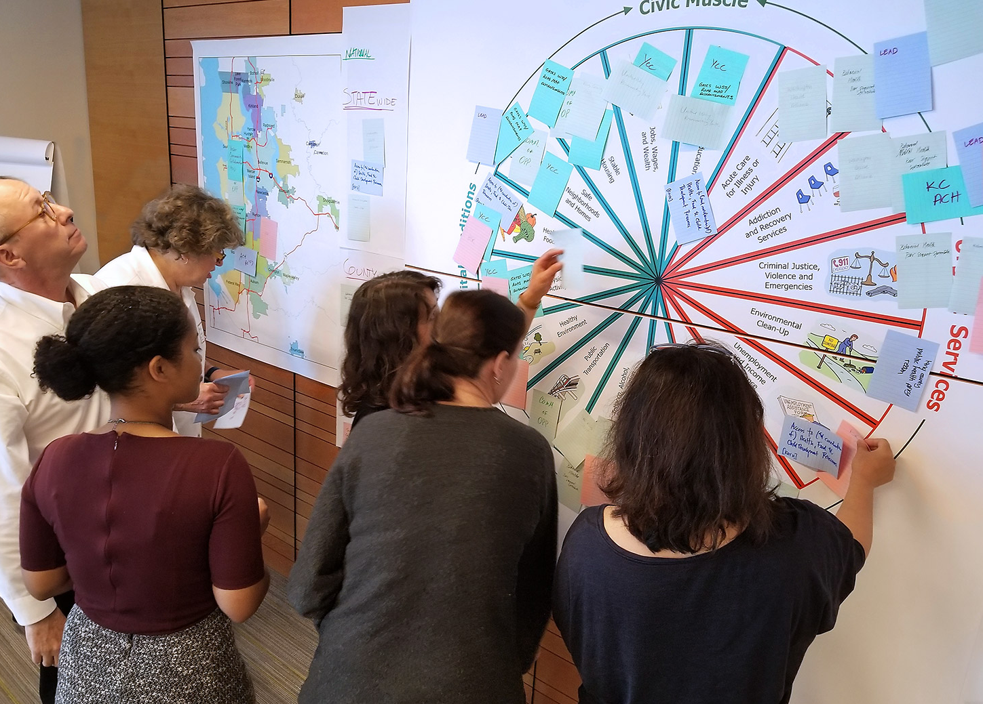
What is your portfolio for Delaware’s future?

Slide 6
Designing a Portfolio for
Delaware’s Future

Slide 7
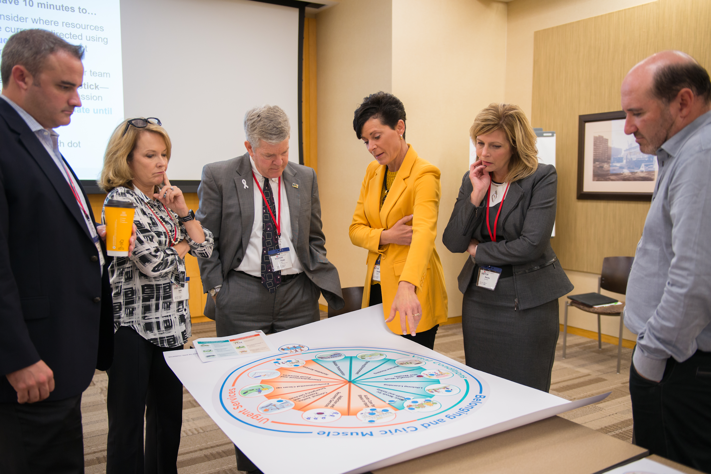
The Activity: Designing a Well-Being Portfolio
Why do we do this?
Think together about HOW to produce a thriving future
Weigh tradeoffs and look for multisolvers
Discover who else shares your values
Notes:
We’ll begin with an activity- negotiating a well-being portfolio. Some of you might be asking- why do we do this exercise. You’ll see from the poster on your table that we use a pie. This exercise is meant to help you see all the pieces of the pie. All the pieces of the pie are what contribute to health and well-being. This exercise will show how you and other stakeholder see the current and future priorities for health and well-being in your region. We also keep doing it because people tell us it’s FUN in addition to useful!

Slide 8
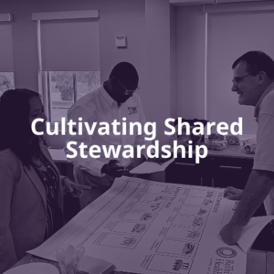
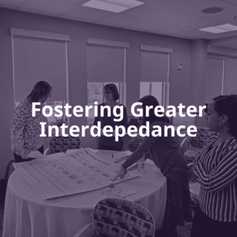
Who has used this exercise?
First developed in 2017
60+ uses, with multisector partnerships, philanthropy, businesses, universities, government officials,
service providers, middle, and high school students, etc.
Don’t need to be an expert or have detailed data.
First, think like an ordinary citizen.

Slide 9
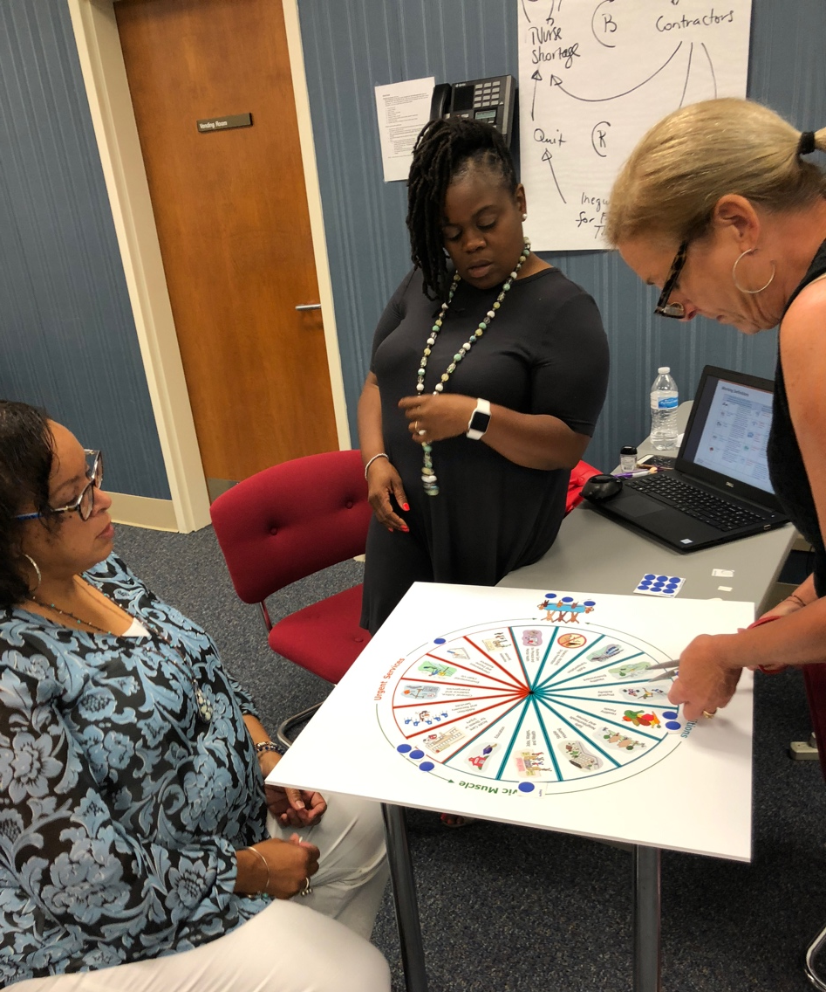
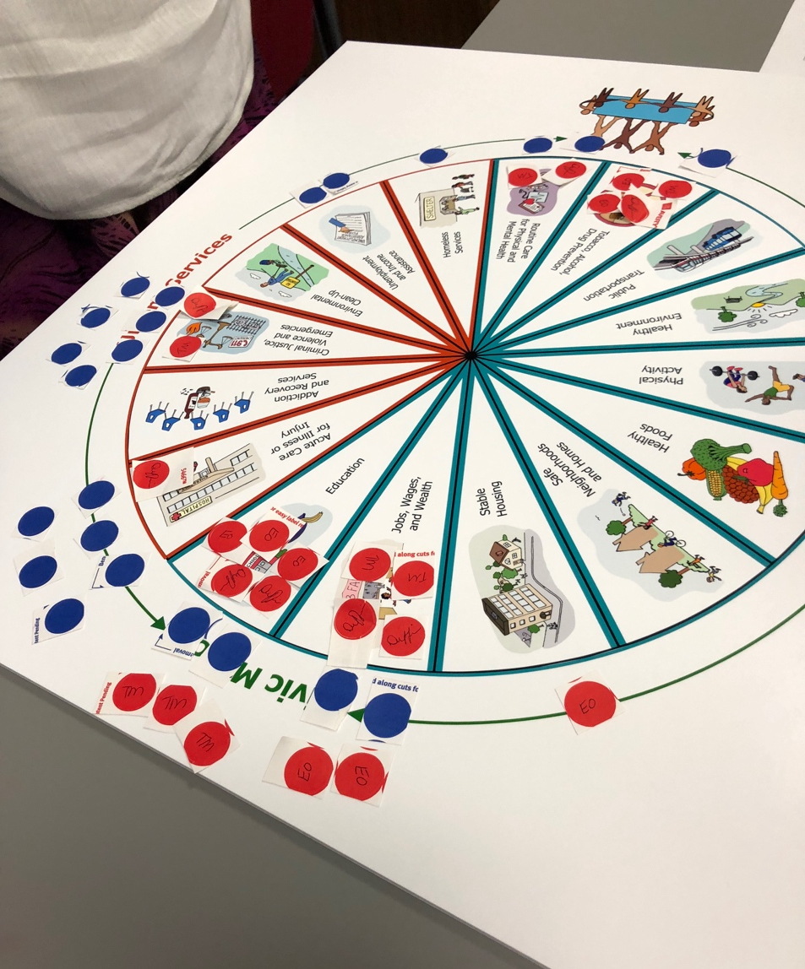
Sketch Current and Future Priorities Using the
Well-Being Portfolio

Slide 10
Your Task (45 min):
Sketch Current & Future Portfolios for Delaware
Step 1: Discuss current allocations (20m)
Allocate 20 votes to reflect current priorities
Step 2: Discuss future allocations (15m)
Allocate 20 votes to reflect future priorities
Step 3: Discuss your story (10m)
What’s the headline?
Notes:
This is for facilitators to follow (you know who you are), but for reference for everyone else)

Slide 11
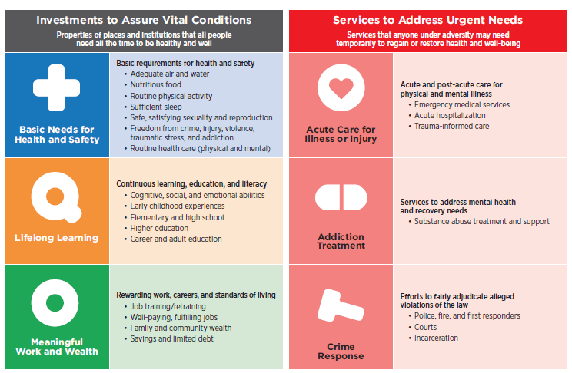
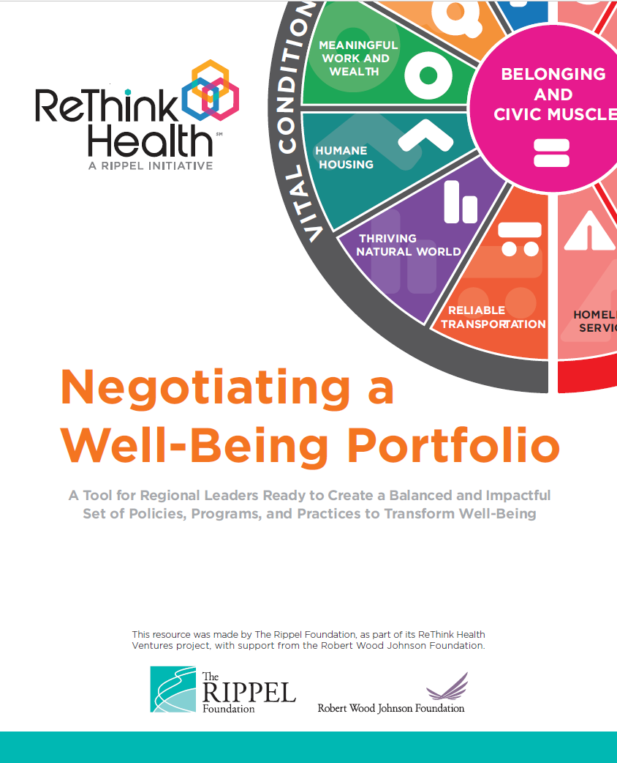
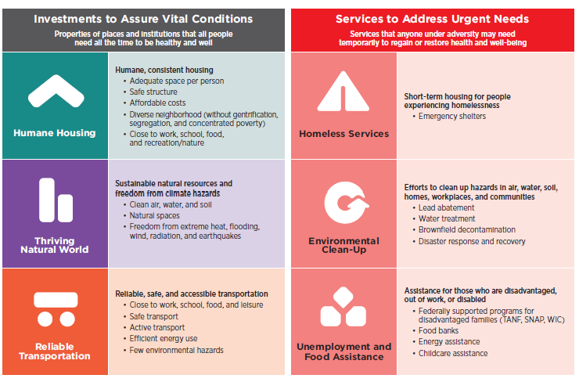
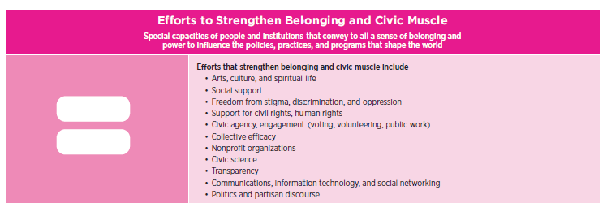
Brief Definitions
https://www.dropbox.com/s/oopljq58d6hgqca/RTH-WellBeingPortfolio_Definitions_372022.pdf?dl=0
Notes:
Of all of these…which are the top 3 and why?

Slide 12
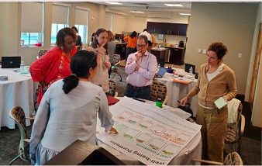
Step 3: What’s the Story?
Prepare to share a headline…
How should
Delaware’s portfolio
evolve over time?
Why?
What does our portfolio say about the kind life we could create together with combined investment?
12
Notes:
Ella
FACILITATOR INSTRUCTIONS:
. Katherine would send them off with an instruction to nominate a spokesperson to share their story – not all of the specific details, just the main headline about how they see the state’s portfolio evolving over time.
When they come back, ask for one volunteer to share their story --- and then elicit similarities and differences from other groups. There will likely be too many groups to hear from everyone. So the main goal is to listen for a common storyline or perhaps a few different visions. None are right or wrong. But with a common language around portfolio design, we might be better able to negotiate priorities together.

Slide 13
Breakout Groups
45 minutes

Slide 14
Comparing Stories
What do your stories say about…
How should
Delaware’s portfolio
evolve over time?
Why?
What do your portfolios say about the kind life we could create together with combined investment?
14
Notes:
Ella
FACILITATOR INSTRUCTIONS:
. Katherine would send them off with an instruction to nominate a spokesperson to share their story – not all of the specific details, just the main headline about how they see the state’s portfolio evolving over time.
When they come back, ask for one volunteer to share their story --- and then elicit similarities and differences from other groups. There will likely be too many groups to hear from everyone. So the main goal is to listen for a common storyline or perhaps a few different visions. None are right or wrong. But with a common language around portfolio design, we might be better able to negotiate priorities together.

Slide 15
Reflections from Key Stakeholders
Philanthropy
Stuart Comstock-Gay
President & CEO, Delaware Community Foundation
Community
Jen Fuqua
Executive Director, La Esperanza
State
Lisa Henry
Director, Community Health, Division of Public Health

Slide 16
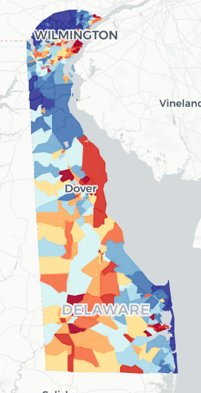
Investing to Create Thriving Communities
Call for Interest in Multi-Year Collaboration
for Thriving Communities
Applications due by April 30th
Place-based, community-driven, addressing vital conditions/SDOH
Community/geographic eligibility: data-driven
More information at healthycommunitiesDE.org
We invite additional investors to join us!

Slide 17
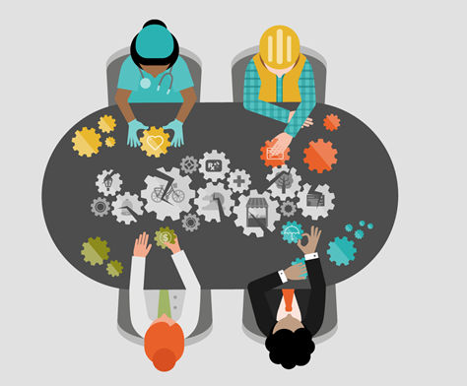
May 13: Negotiating with Fellow Stewards
What will you experience?
Consider the long-term effects of joint investment decisions
Experience the tension of expanding opportunity in times of great adversity and injustice
Learn the importance of multisolving and deep investment in equity, belonging and civic muscle

Slide 18
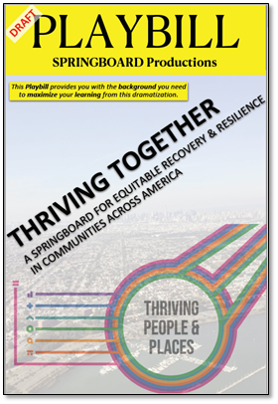
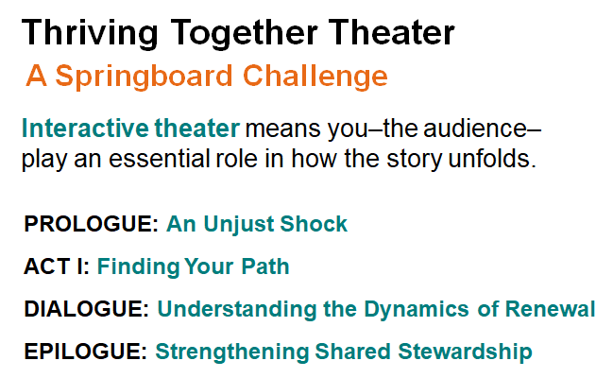
May 13: Negotiating with Fellow Stewards

Slide 19
Invitation for Reflection
How do I/ my organization steward resources to support
well-being and equity?
What is the balance of effort between urgent services and community vital conditions/social determinants?
Where are there opportunities to steward resources toward community vital conditions/social determinants to expand opportunities for all people and places to thrive?

Slide 20
Thank you!
Please join us at the next series event:
May 13 2022, 1pm- 3pm
Negotiating with Fellow Stewards
Notes:
Thank you so much for joining us.
There are two more virtual events for 2022.
If you registered for today's event, you should also be registered for March 11 and May 13, 2022 from 1:00 p.m. to 3:00 p.m.
Feel free to invite others you think may be interested. The meeting information is on our website under Events.
Also be on the lookout for the meeting evaluation to give us feedback on this program
With that, we will conclude today's program. Thank you so much for sharing your time with us!

Slide 21
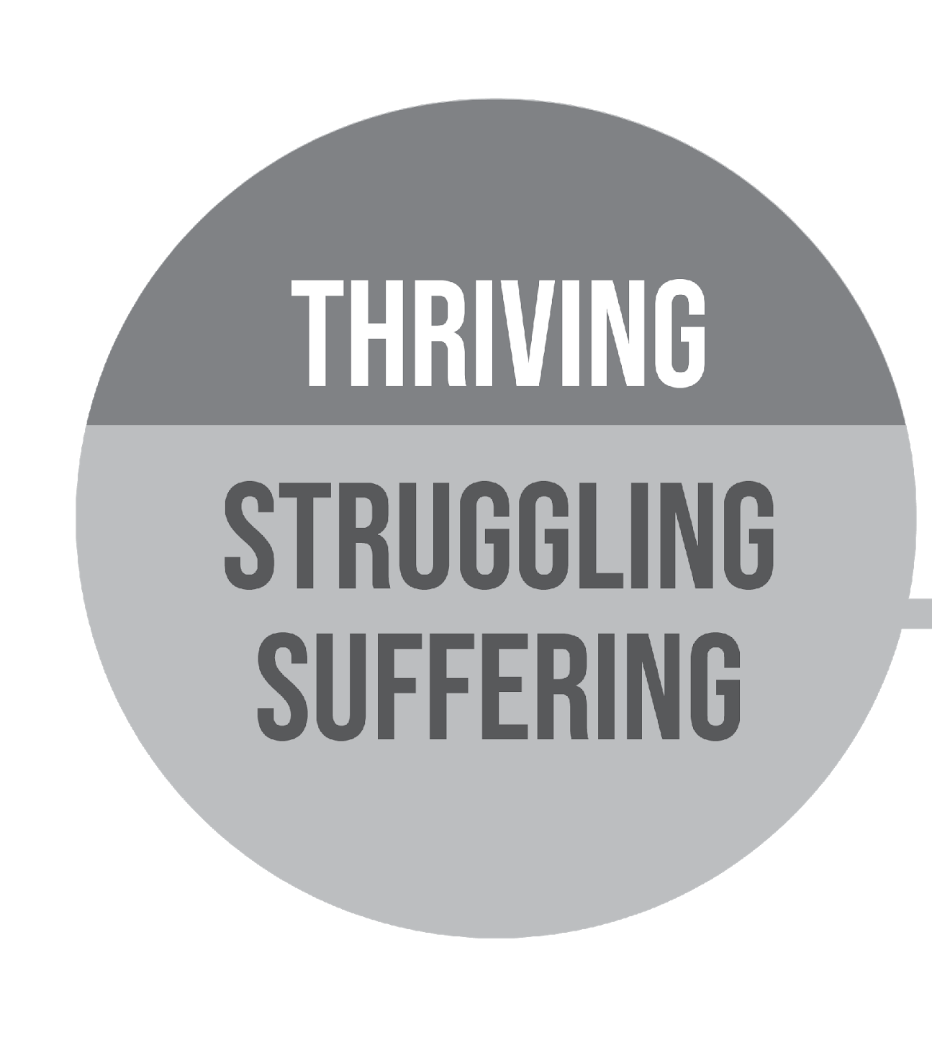

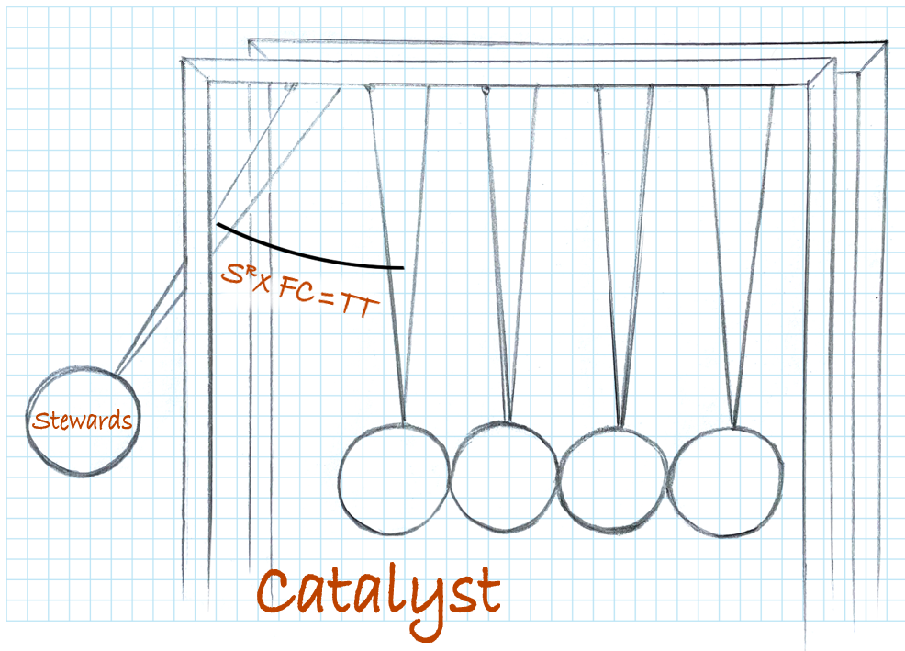
About the Shared Stewardship Learning Series
https://healthycommunitiesde.org/events
October 29
March 11
May 13
June 10
Thriving Together Through Shared Stewardship
Designing
Well-Being Portfolios
Negotiating
with Fellow Stewards
Strengthening
Shared
Stewardship
Videos
Materials

Slide 22
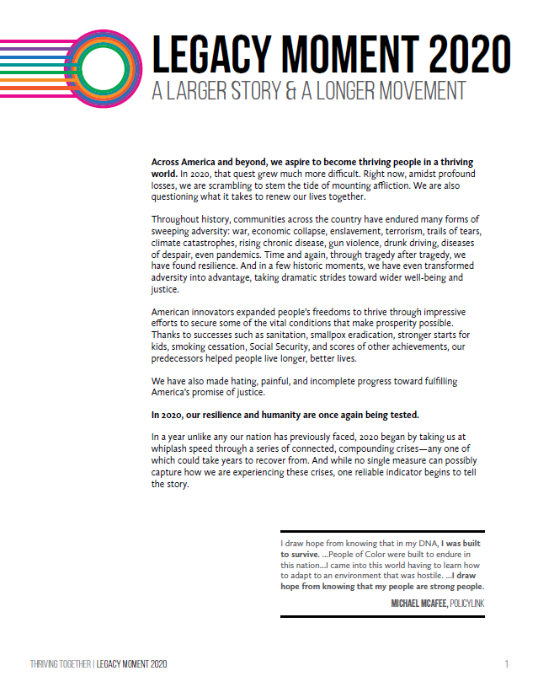

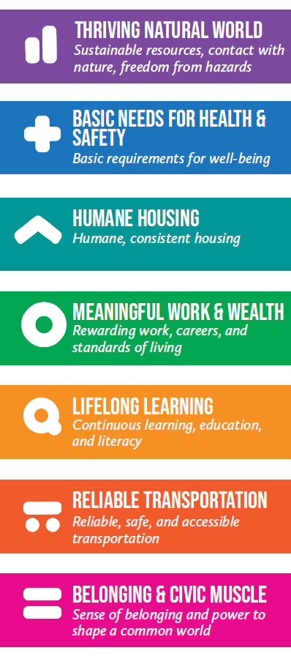
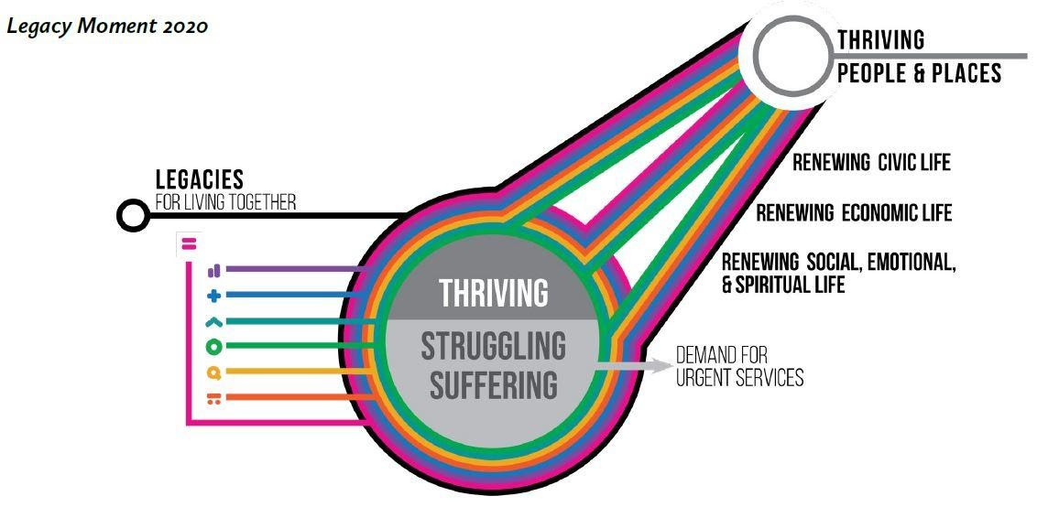
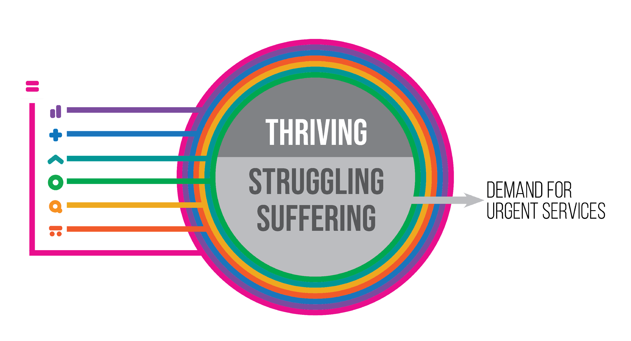

Belonging & Civic Muscle wraps around the others because it is both a vital condition and a practical capacity that is necessary for equitable success in every other kind of work
http://Thriving.US

