Slide 1
Healthy Communities Delaware
Shared Stewardship Learning Series, Part 1
October 29, 2021

Slide 2
ReThink Health Team Members
Ella Davila Auchincloss
Director, Coaching and Guided Practice
Bobby Milstein
Director, System Strategy
Lindsey Alexander
Director, Philanthropic Stewardship Practice

Slide 3
At ReThink Health, a Rippel initiative, we work with innovators in regions and across the country to discover and share what it takes to thrive together through shared stewardship.
Our best hypothesis is that as stewards mature in their ability to facilitate multisector collaboration and alignment, they are able to create a new ecosystem for health and well-being in their regions; an ecosystem that is built for equity and racial justice, by design.
But what does it take to strengthen shared stewardship? Figuring that out is the reason for ReThink Health.

Slide 4
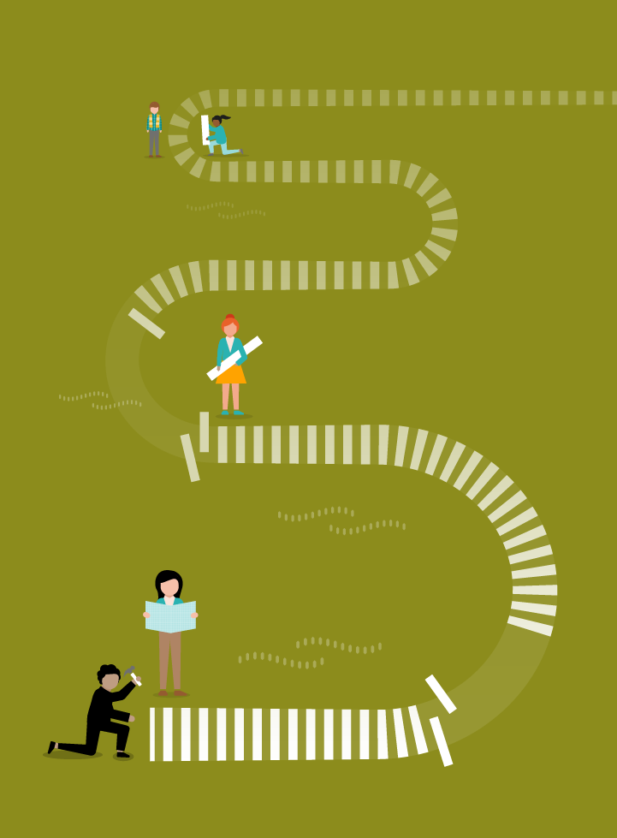
Goal of this Series
To deepen your capacity as stewards of Delaware’s future for health, well-being, and racial justice
STEWARDSHIP JOURNEY

Slide 5
About the Shared Stewardship Learning Series
Date | Topic
Oct 29 | Thriving Together Through Shared Stewardship
Jan 14 | Designing Regional Well-Being Portfolios
Mar 11 | Negotiating with Fellow Stewards
May 13 | Strengthening Shared Stewardship

Slide 6
OCTOBER: Thriving Together Through Shared Stewardship
Defining the movement for thriving together
Shared stewardship as a path
Stories of stewards in action
Identifying fellow stewards

Slide 7
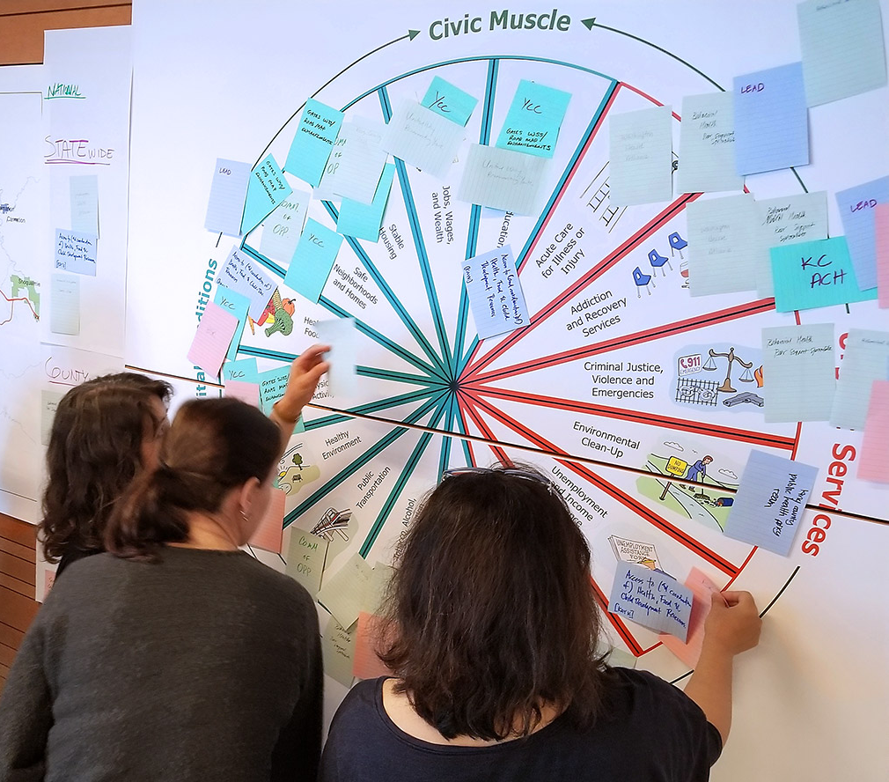
JANUARY: Designing a Well-Being Portfolio
What will you experience?
Visualize region’s current and future priorities for health and well-being
Understand the contours of a regional portfolio
Identify areas of your portfolio that need more resources
Identify stakeholders that ought to be involved
Surface mental models and transition plans

Slide 8
JANUARY: Designing a Well-Being Portfolio
Vital Conditions
Properties of places and institutions that we all need all the time to reach our full potential
Thriving natural world Basic needs for health & safety Lifelong learning Meaningful work & wealth Humane housing Reliable transportation Belonging & civic muscle
Urgent Services
Services that anyone under adversity might need temporarily to regain their best possible well-being
Acute care for illness or injury Addiction treatment Crime response Environmental cleanup Homeless services Unemployment and food assistance
If vital conditions are not fulfilled, or if there is a disruptive shock, demand for urgent services will grow
Notes:
Personal health and well-being may rise or fall, from birth to death. Vital conditions, however, persist over generations.
We have no say in the choices that our predecessors made—their legacies are the starting points for our lives. However, we possess an enormous capacity to transform those conditions—for better and for worse—for ourselves and for those who follow.

Slide 9
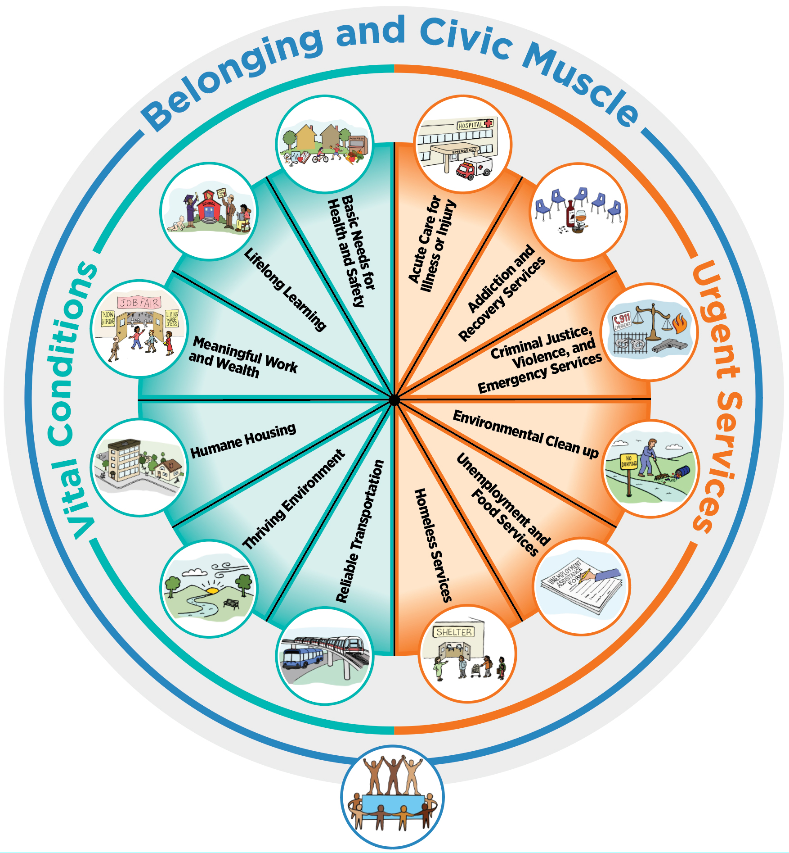
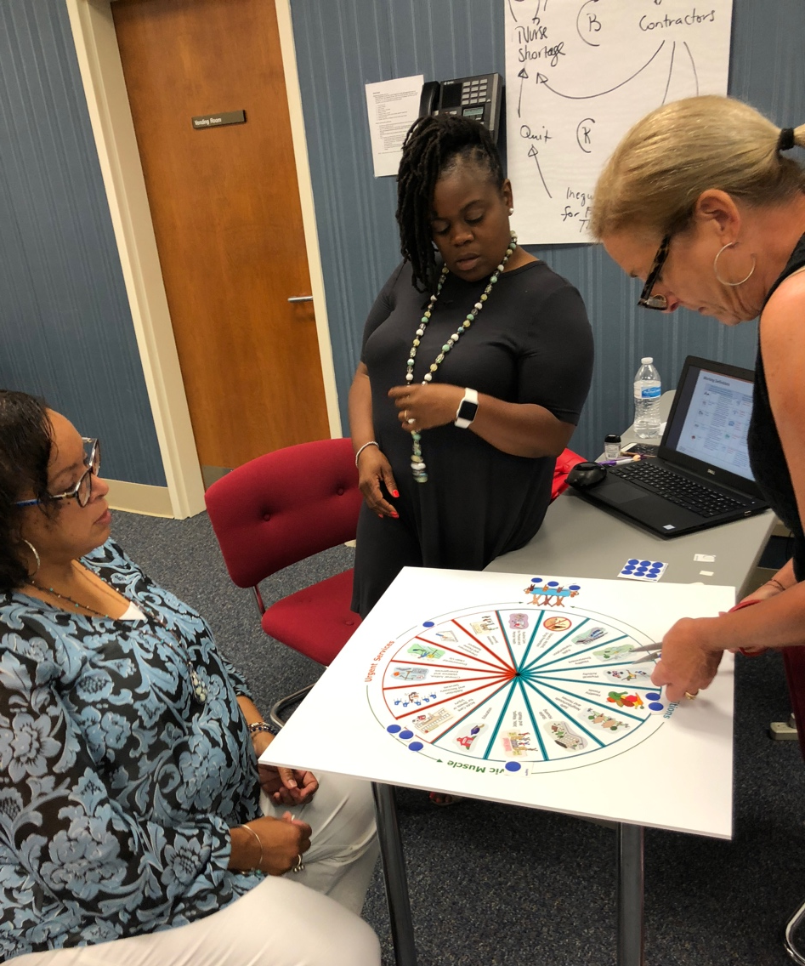
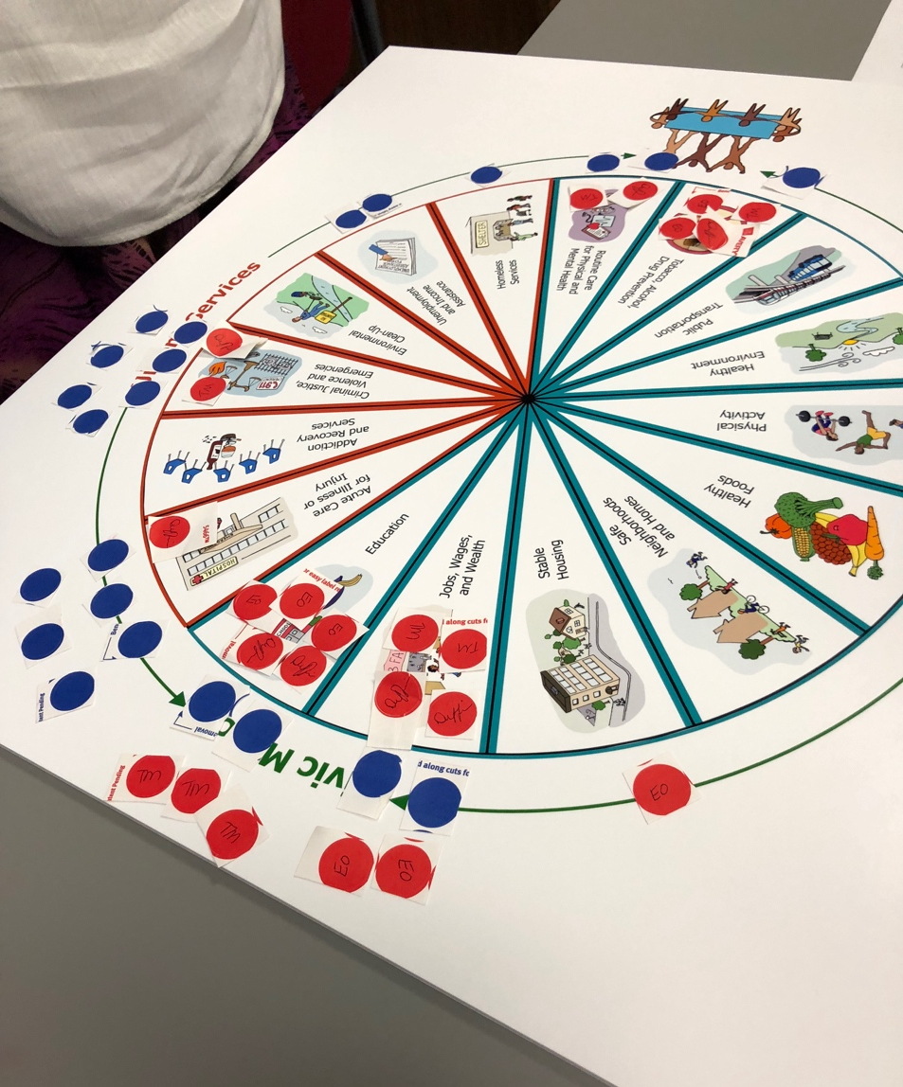
JANUARY: Designing a Well-Being Portfolio

Slide 10
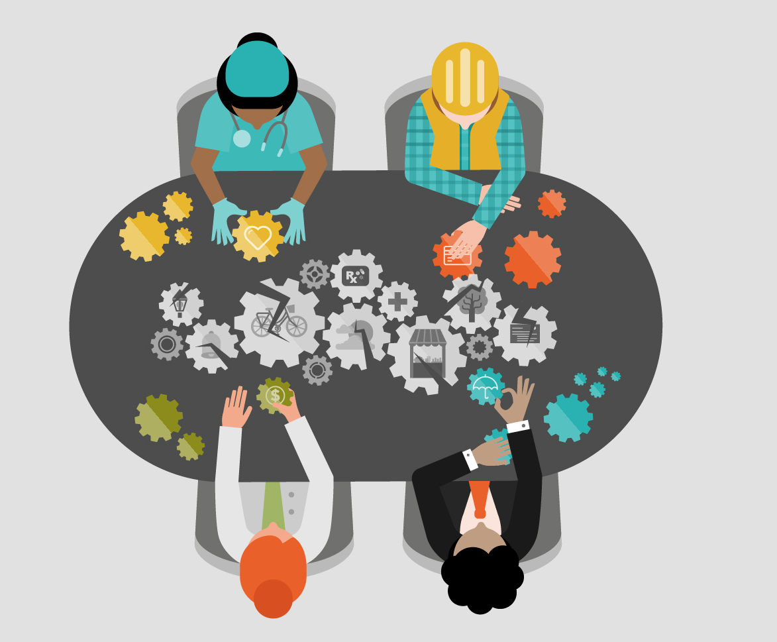
MARCH: Negotiating with Fellow Stewards
What will you experience?
Consider the long-term effects of your joint investment decisions
Experience the tension of acting in times of great adversity and injustice
Learn the importance of multisolving interventions and deep investment in equity, belonging and civic muscle

Slide 11
Thriving Together Theater
MARCH: Negotiating with Fellow Stewards
A Springboard Challenge
Interactive theater means you–the audience–play an essential role in how the story unfolds.
PROLOGUE: An Unjust Shock
ACT I: Finding Your Path
DIALOGUE: Understanding the Dynamics of Renewal
EPILOGUE: Strengthening Shared Stewardship
http://tiny.cc/Thriving-Playbill
Notes:
Bobby

Slide 12
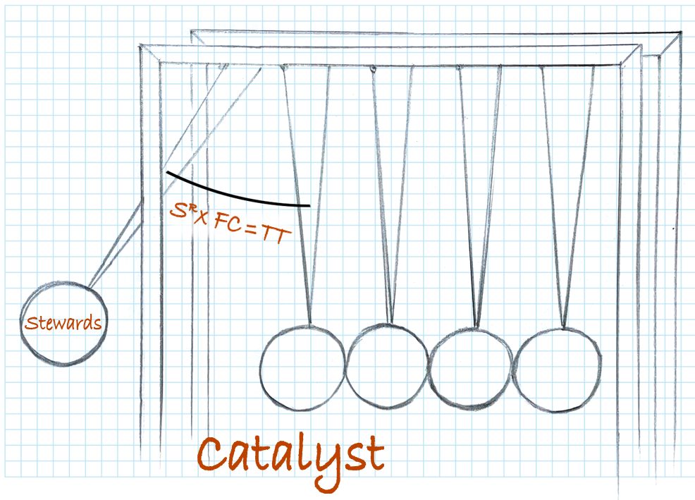
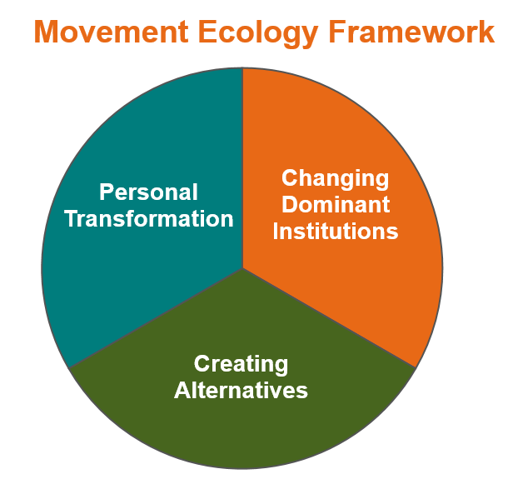
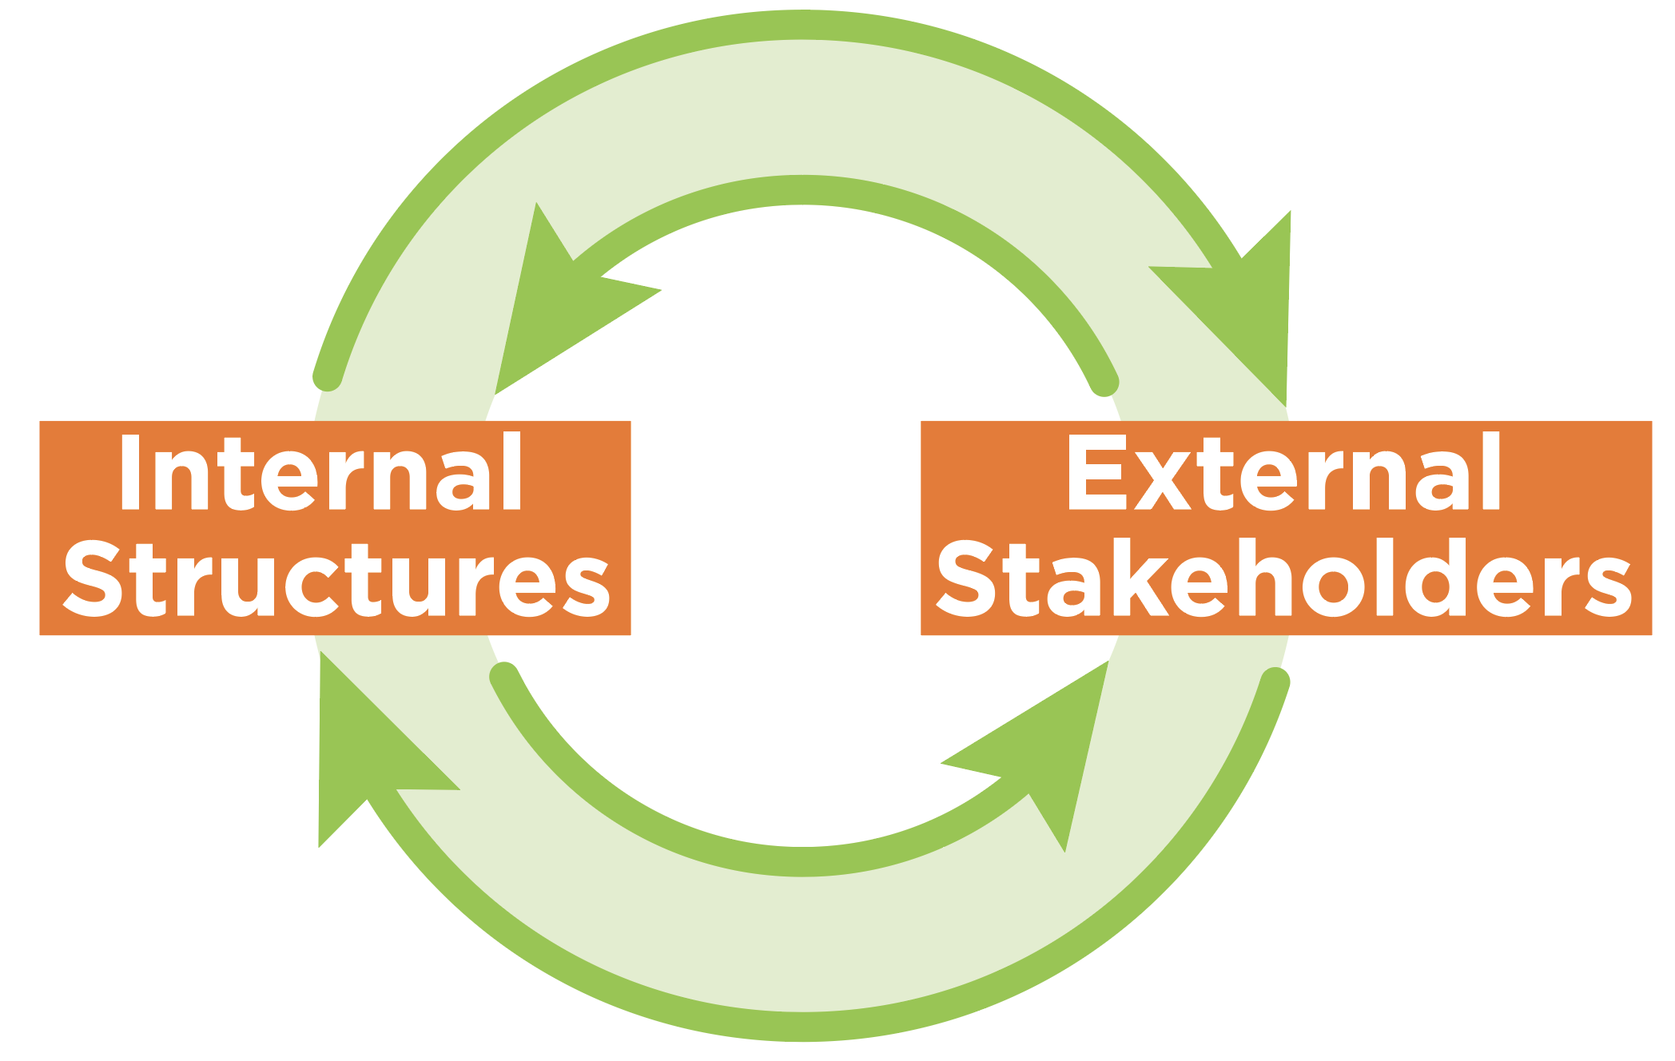
MAY: Strengthening Shared Stewardship
What will you experience?
Assess your organization’s capacity for shared stewardship
Reflect together on what can be done together than cannot be done by only one actor
Develop a clear, compelling story of shared stewardship that can be used to invite others to join the thriving together movement.
Notes:
Stewards with a deep practice, powered by strong relationships, and multiplied by how well they fit conditions, can enhance the prospects for thriving together.

Slide 13
Questions?

Slide 14
Expectations
In order to get the most out of these sessions, please…
Attend
Complete
Short assignments between sessions
Avoid
Multi-tasking
Share
What you experience with others
Make Space
For others to speak
Remember
Nothing will change if we keep to the old patterns…so dive in!
All sessions (or watch recording)

