Slide 1
“
Dare to imagine that problems might be easier to solve together rather than one by one.
– Elizabeth Sawin
Sawin E. The Magic of “Multisolving”. Stanford Social Innovation Review https://ssir.org/articles/entry/the_magic_of_multisolving

Slide 2
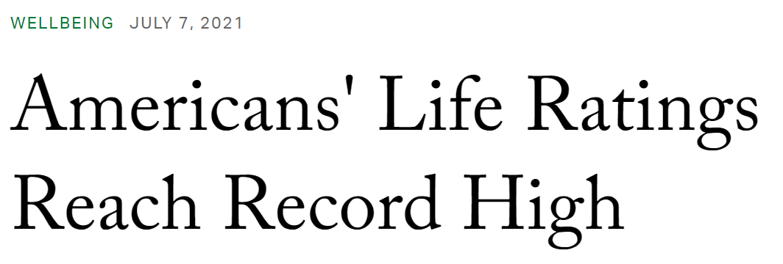

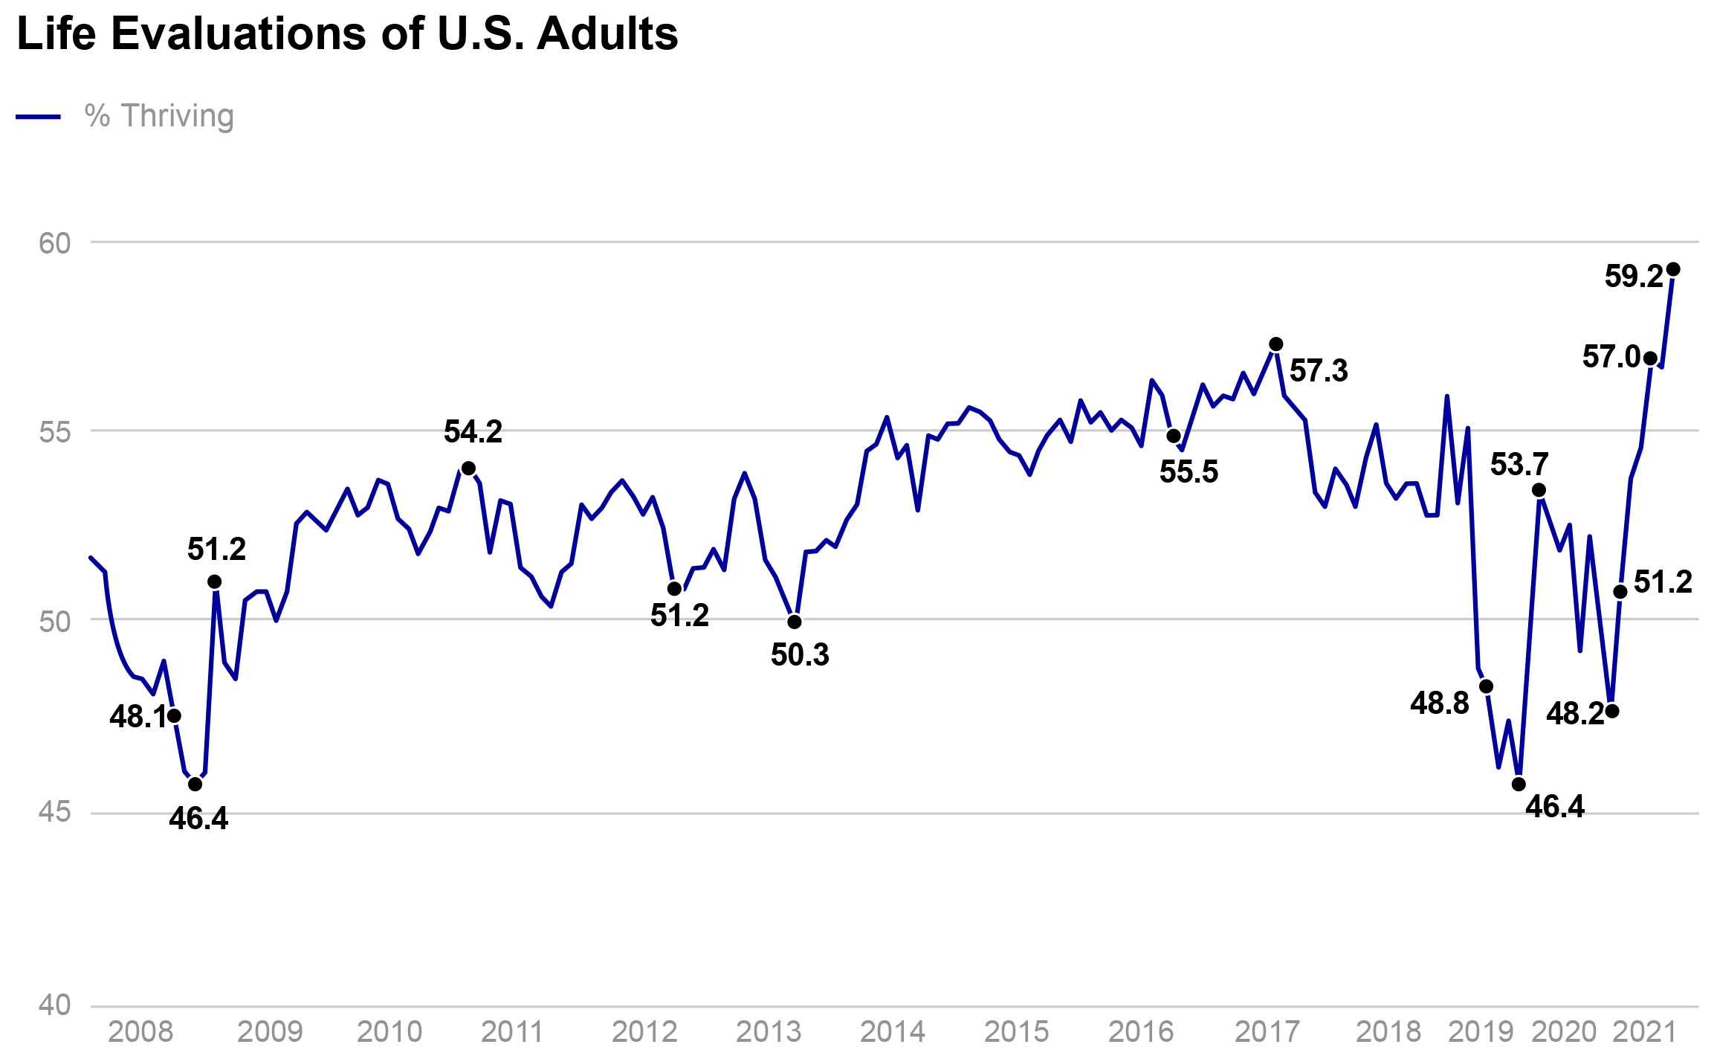
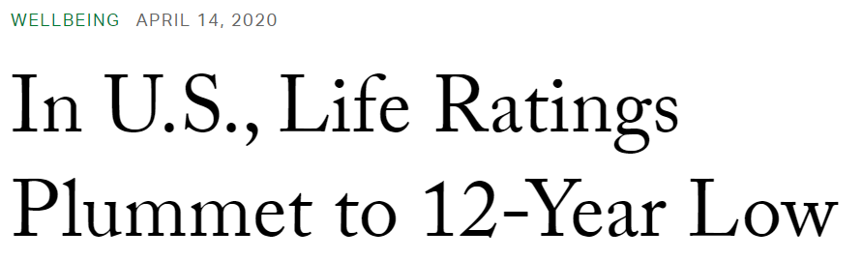
The Quest to Thrive Together
Life Evaluations of U.S. Adults
June 2021
% Thriving
What will it take to reach even greater heights of well-being, equity, and resilience?
April 2020
COVID-19
2030
SOURCE: Gallup https://news.gallup.com/poll/351932/americans-life-ratings-reach-record-high.aspx; https://news.gallup.com/poll/308276/life-ratings-plummet-year-low.aspx
https://news.gallup.com/poll/351932/americans-life-ratings-reach-record-high.aspx;
https://news.gallup.com/poll/308276/life-ratings-plummet-year-low.aspx

Slide 3
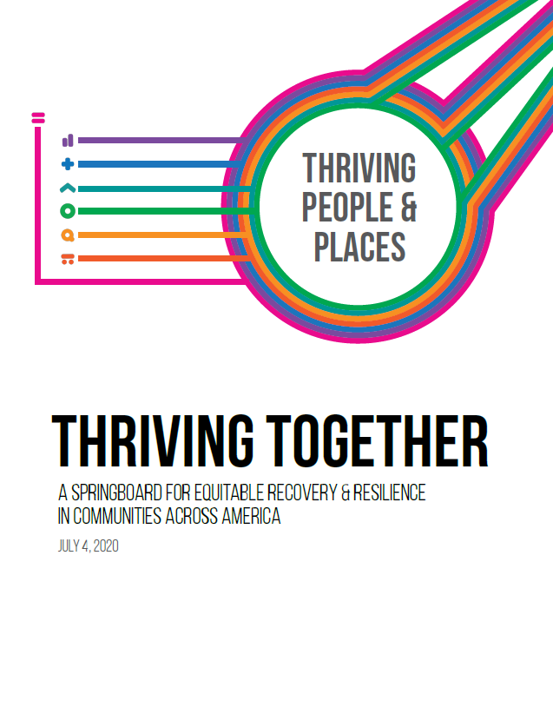

The Thriving Together Springboard shows how we can convert loss into renewal
The immense resilience in America’s communities can propel us to organize local and nationwide action around
one unifying and measurable expectation: All people and places thriving—no exceptions.
http://Thriving.US
Notes:
America’s movement for well-being and justice can never be codified in
a single playbook. Yet, it can spring forward with great force and direction

Slide 4
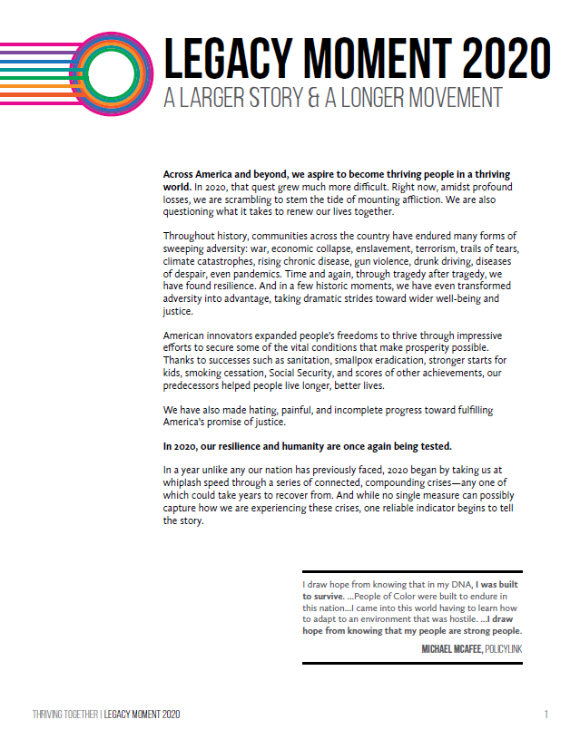

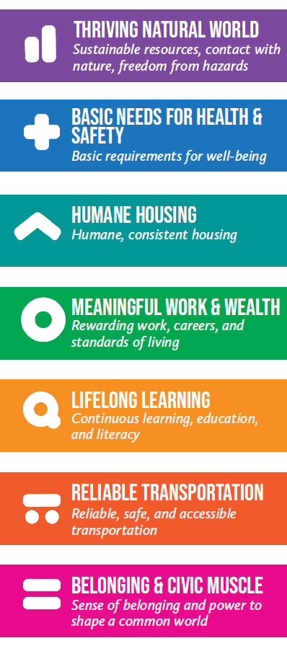
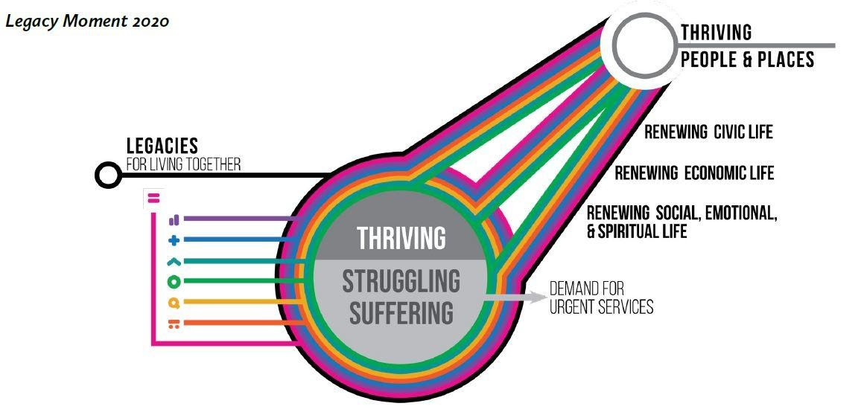
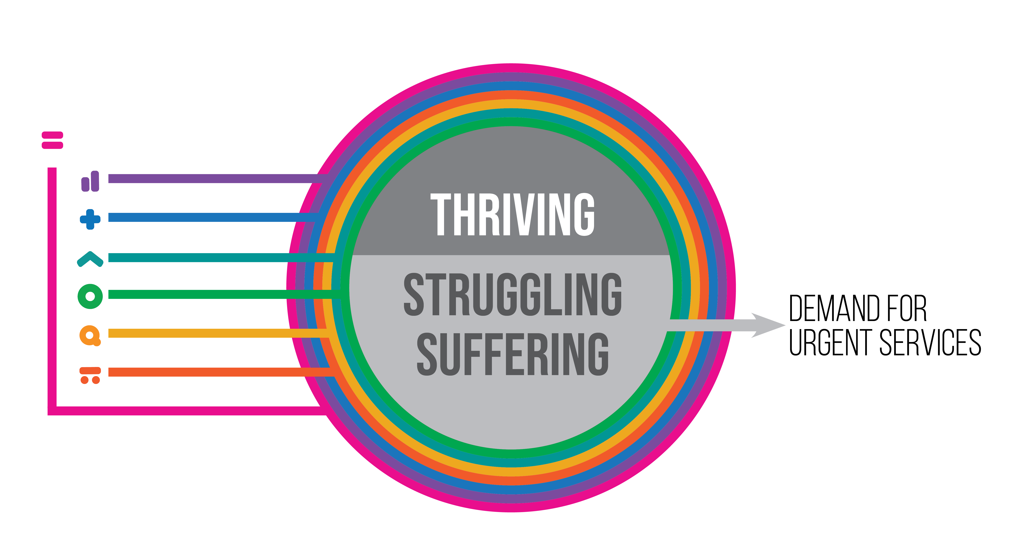
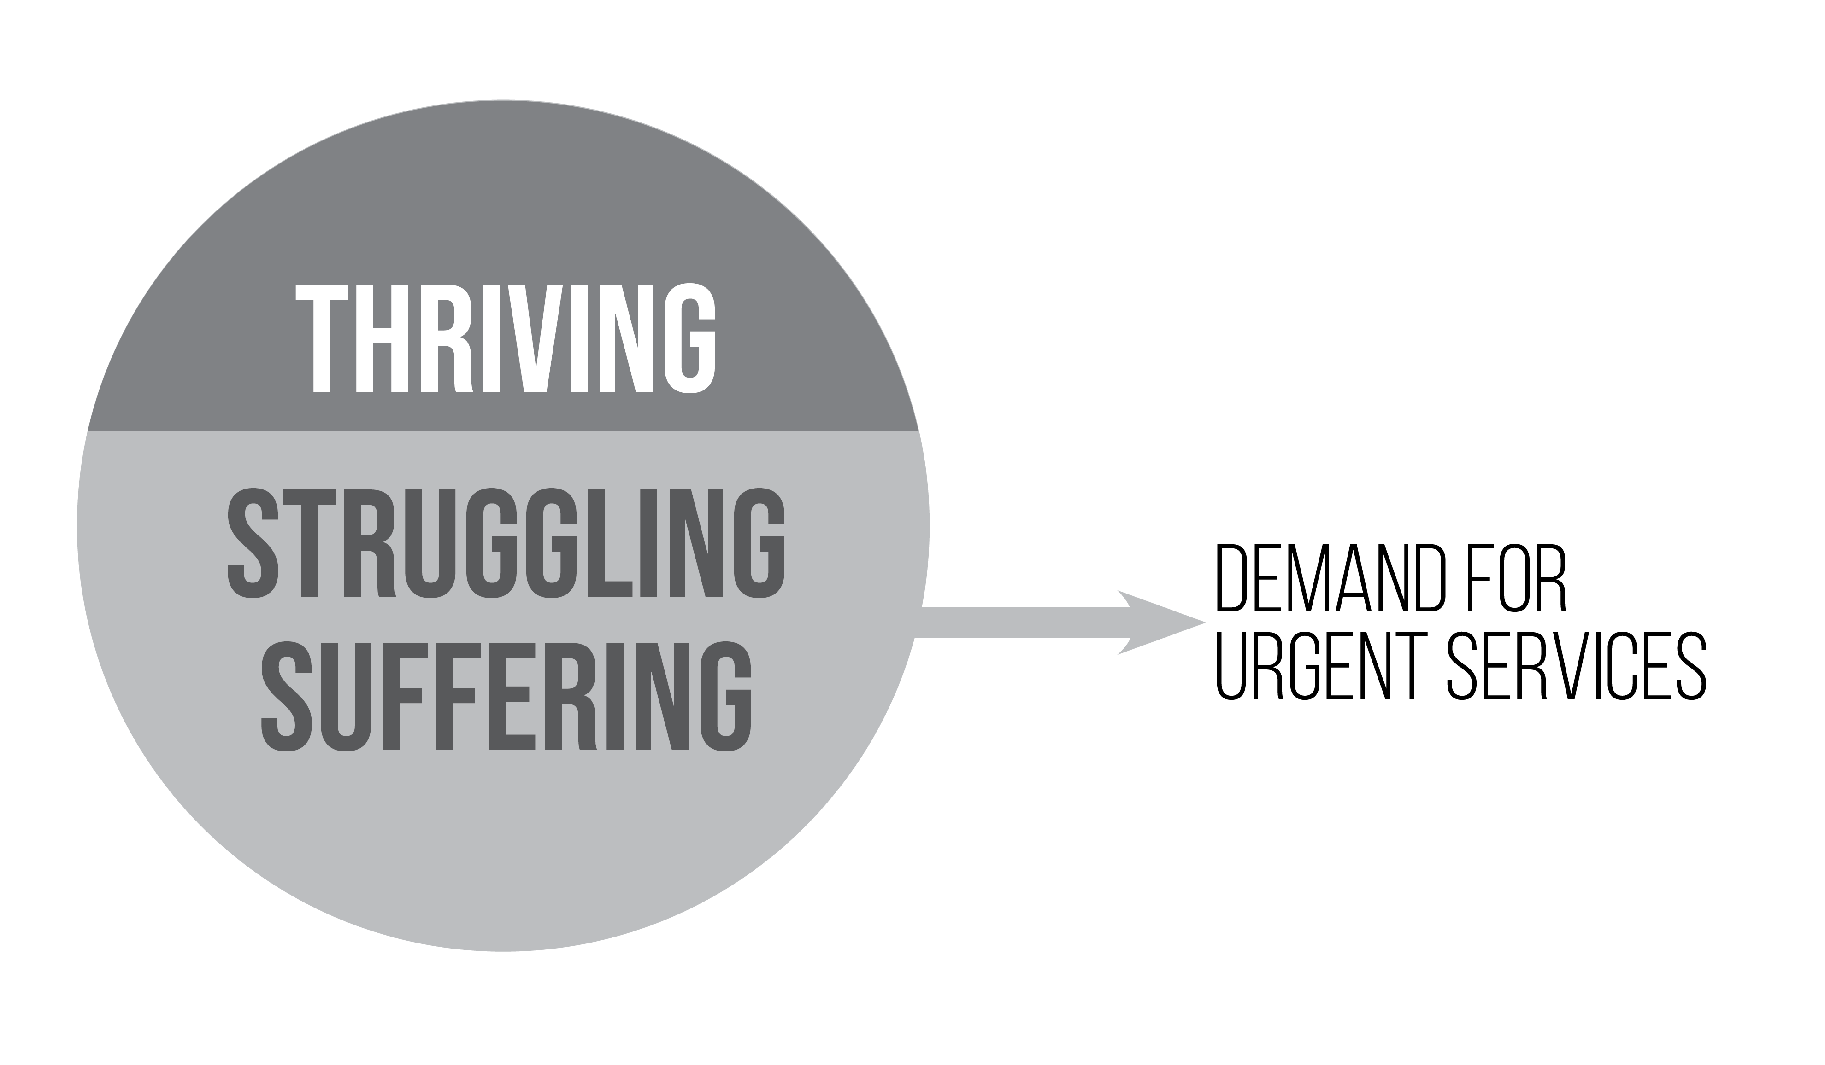
Belonging & Civic Muscle wraps around the others because it is both a vital condition and a practical capacity that is necessary for success in every other kind of work
http://Thriving.US

Slide 5

The necessary transformation
Fragmentation: Org boundaries, decision authority, performance standards, resources, and prestige are held by different individuals, groups, and institutions

Slide 6
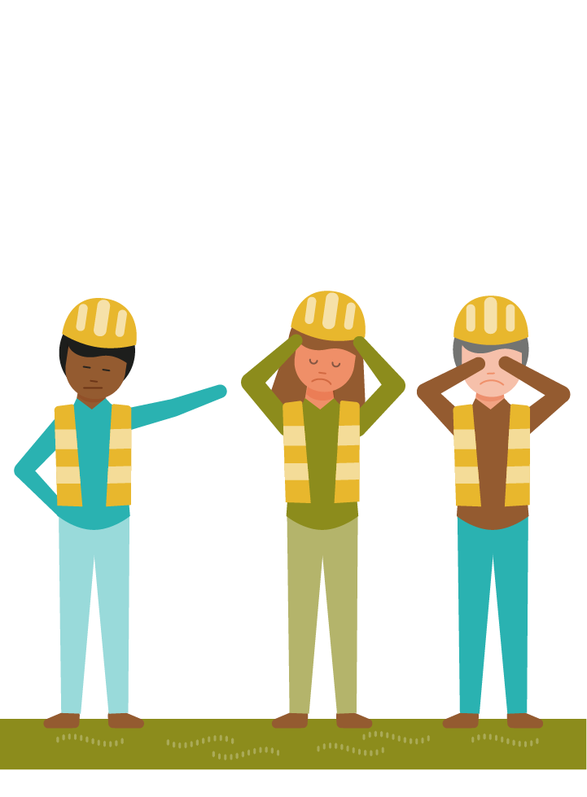
The necessary transformation
Stuckness: Genuine progress requires interdependent action among disconnected, disenfranchised,…and sometimes competitive or hostile actors

Slide 7
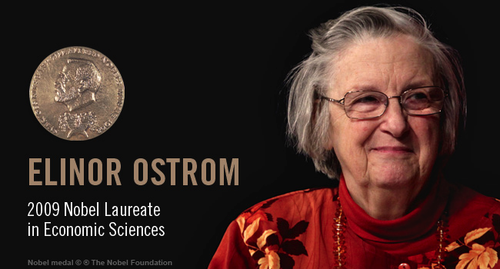
Inspiration from successful stewards
Some communities fall prey to the “Tragedy of the Commons” – as families, companies, or sub-groups each harvest as much as they can for their own gain
Some communities do not. Instead, they negotiate—and live by—local norms and practices, acting as interdependent stewards
of a common world
Source: https://www.shareable.net/remembering-elinor-ostrom/
Ostrom E. Beyond Markets and States: Polycentric Governance of Complex Economic Systems.
The Sveriges Riksbank Prize in Economic Sciences in Memory of Alfred Nobel; Stockholm; 2009 December 8.
Available at http://www.nobelprize.org/nobel_prizes/economic-sciences/laureates/2009/ostrom-lecture.html

Slide 8
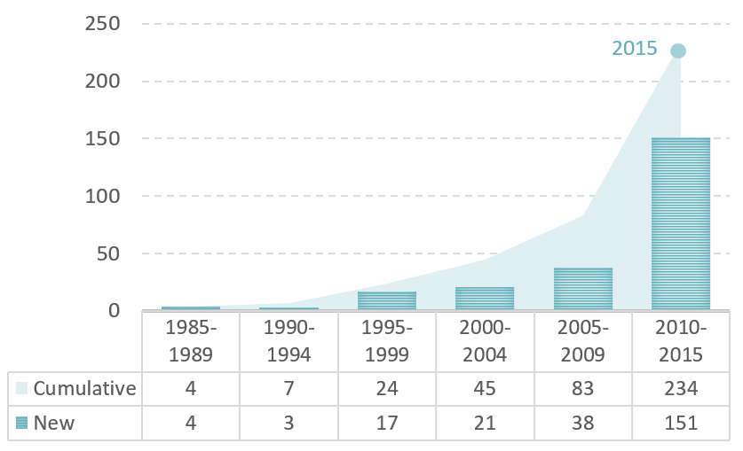
Multisector partnerships are on the rise
“We are witnessing the growth of a new organizational layer across the U.S. health landscape.”
Multi-sector partnerships for health: 2016 pulse check findings. Cambridge, MA. ReThink Health, 2017. Available from http://www.rethinkhealth.org/pulsecheck.

Slide 9
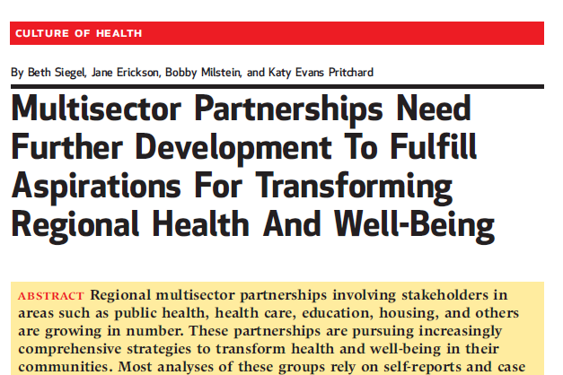
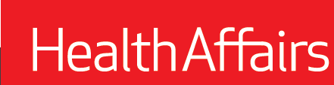
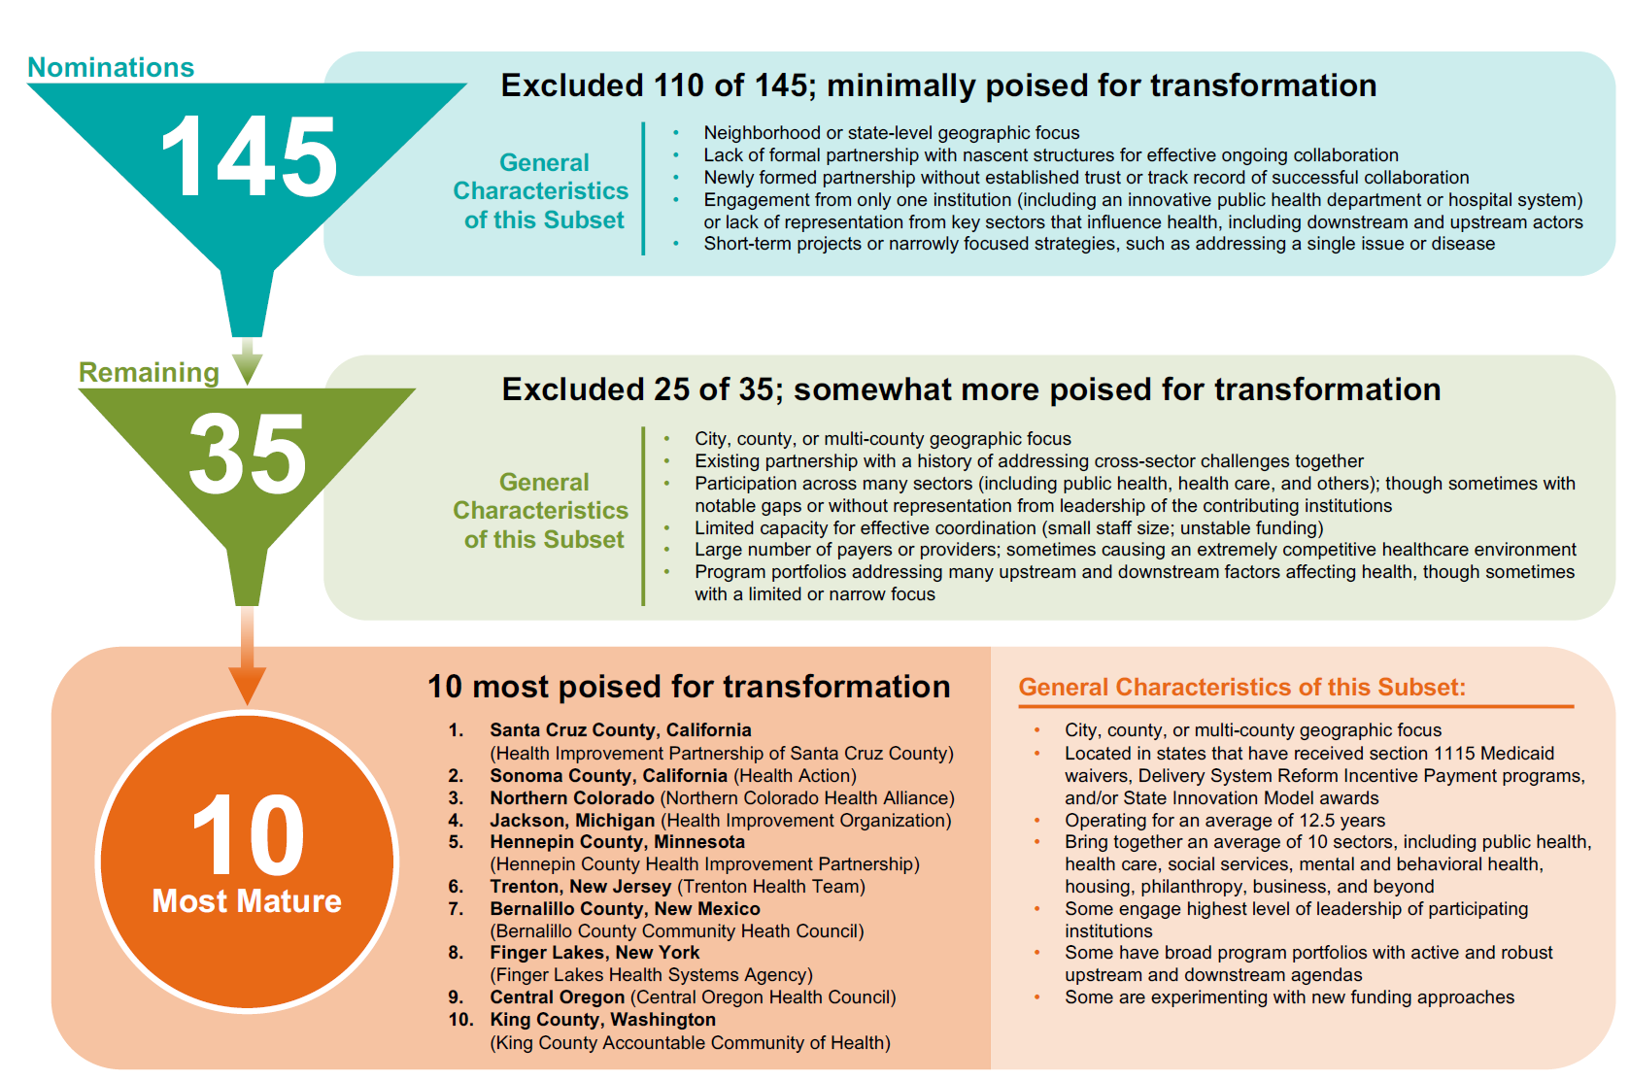



A closer look at partnership maturity
N = 145 noteworthy multisector ventures
Selected Shortcomings
Fragile governance, capacity
Limited diversity, weak resident leadership
Missing econ dev orgs, top health care execs, payers,
Lopsided strategy
Neutral conveners prioritize harmony over vested interests
Rarely paid fully for the value they create
N = 110 minimally poised
for transformation
N = 25 somewhat more poised
for transformation
N = 10 most poised
for transformation
Siegel B, Erickson J, Milstein B, Evans Pritchard K. Multisector partnerships need further development to fulfill aspirations for regional system change. Health Affairs. 2018;37(1):30-7.

Slide 10
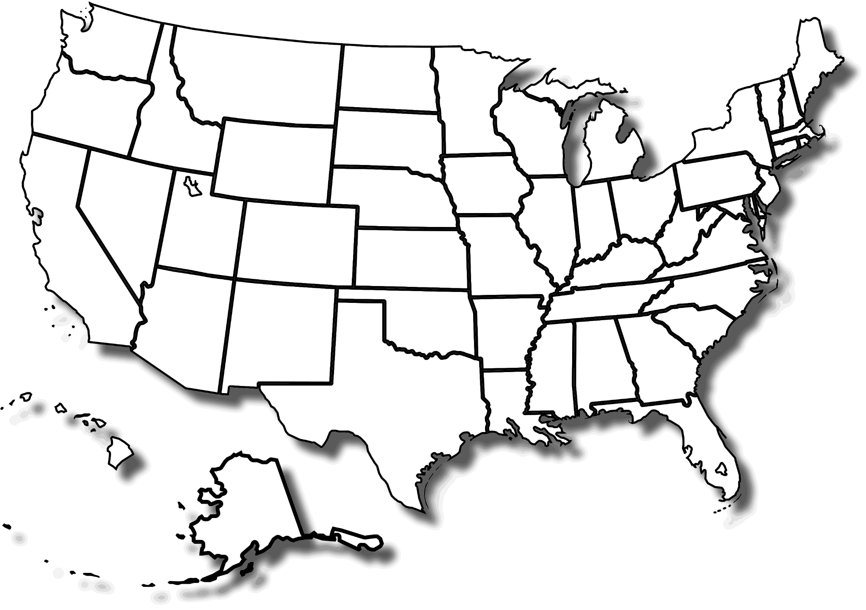
Healthy Commnities Delaware
https://www.imaginefoxcities.com/
https://www.communitycommons.org/entities/e8ab9b13-a47d-438d-a18f-4aed7bb6d2d6
10

Slide 11
THRIVE Great
Lakes Bay
North Sound ACH
Common Ground Health
We Belong Here
&
Civic Commons
Imagine
Fox Cities
Trenton Health Team
Five Healthy Towns
Philadelphia Collaborative for Health Equity
Mālama Honua
ARCHI
BeWellPBC
Southcentral Foundation
https://www.imaginefoxcities.com/
https://www.communitycommons.org/entities/e8ab9b13-a47d-438d-a18f-4aed7bb6d2d6
11

Slide 12
Similarities
Differences
What practices are involved?

Slide 13
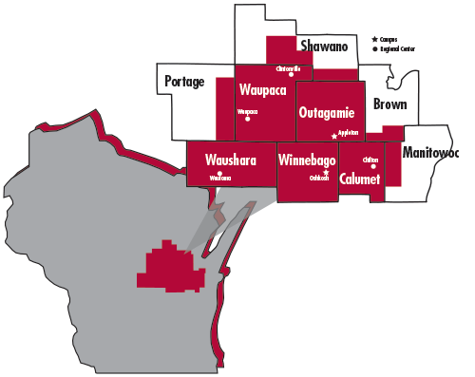
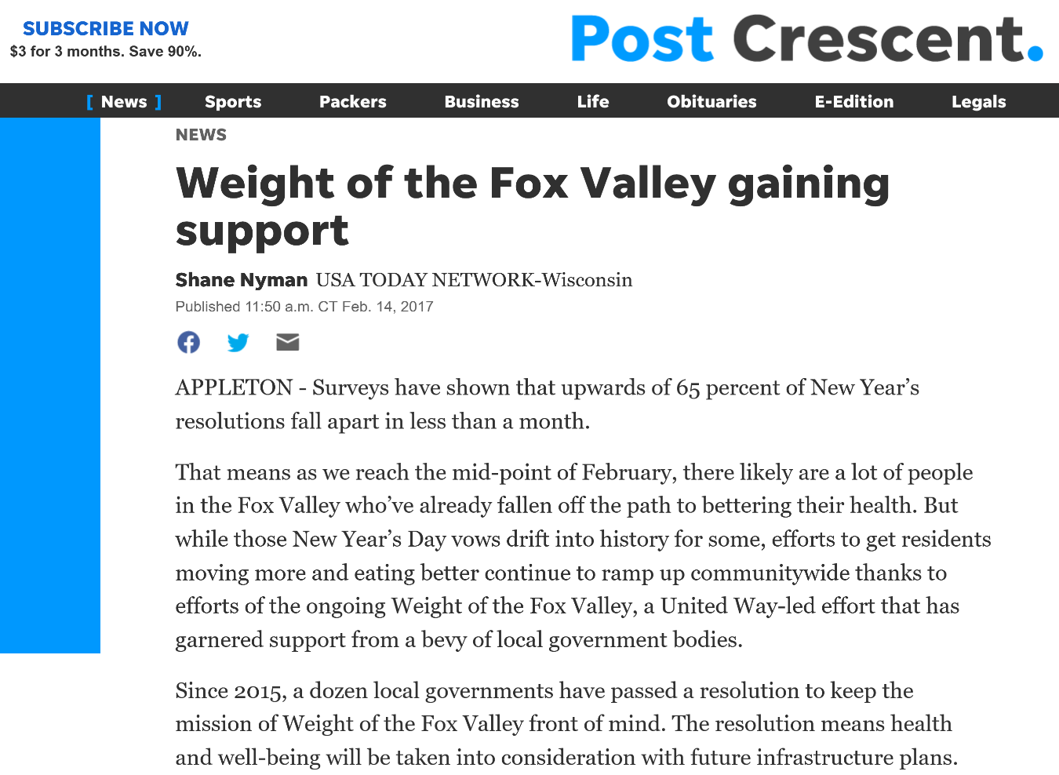
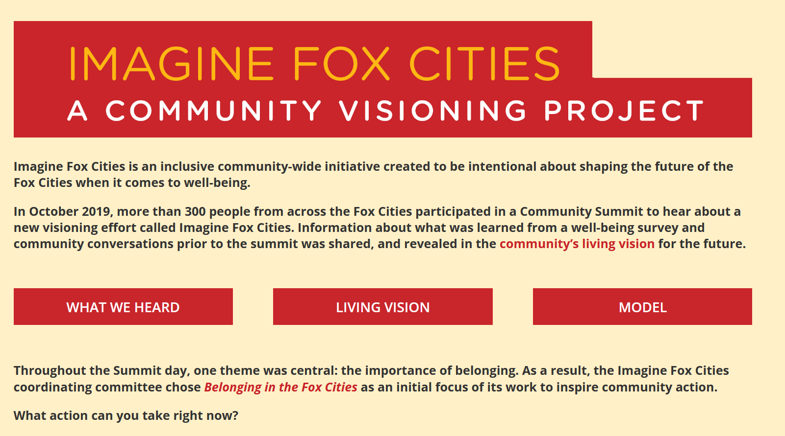
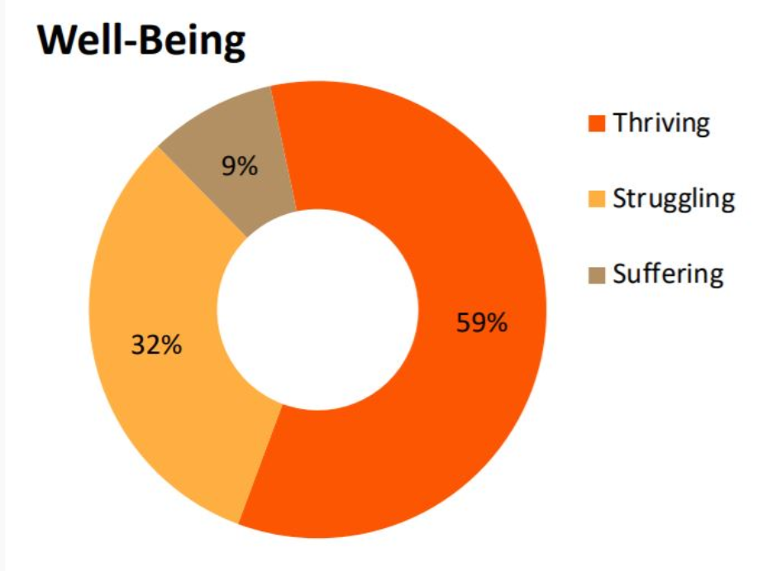
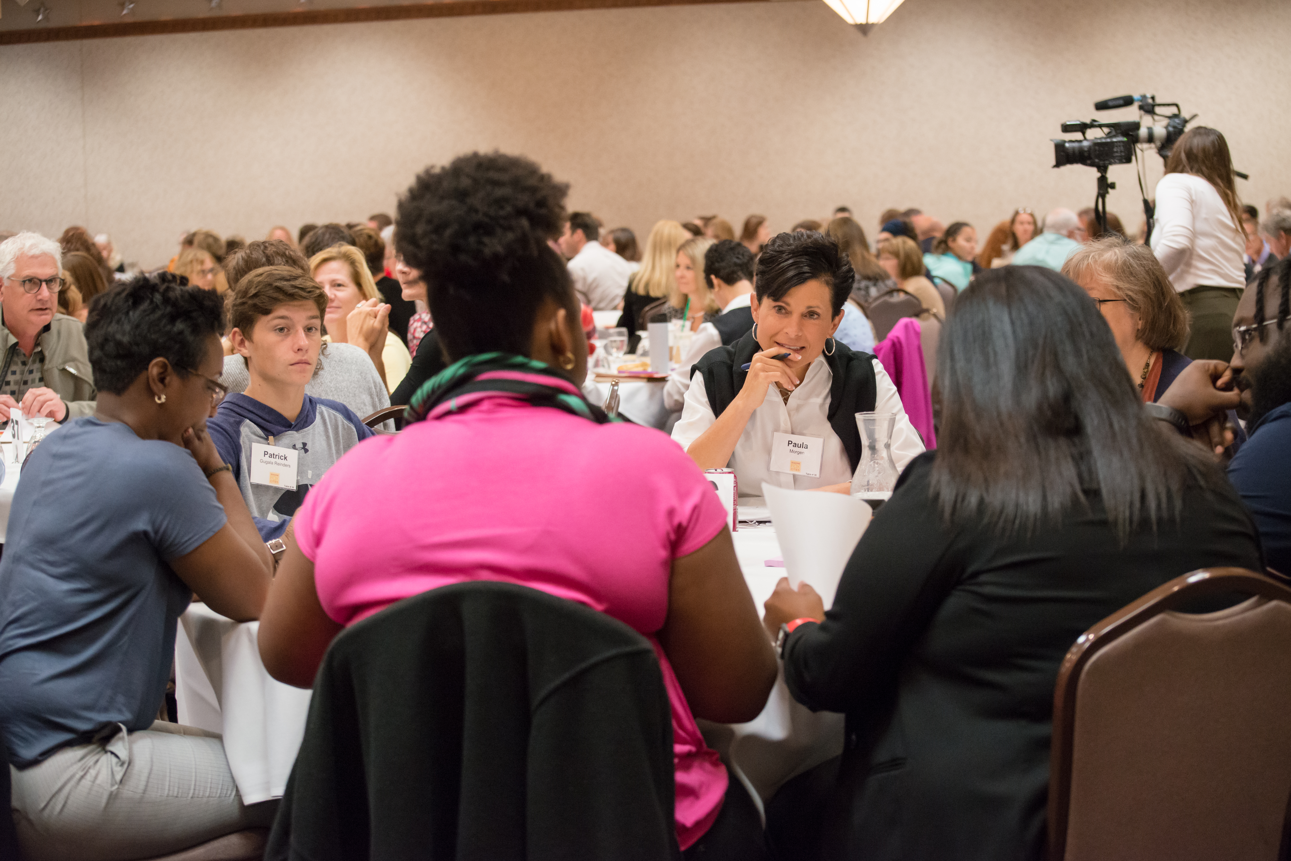

Expanding Aspirations:
Fox Cities, Wisconsin
Well-Being in Fox Cities (2019)
Source: Community Commons
https://www.imaginefoxcities.com/; http://www.communitycommons.org/entities/e8ab9b13-a47d-438d-a18f-4aed7bb6d2d6

Slide 14
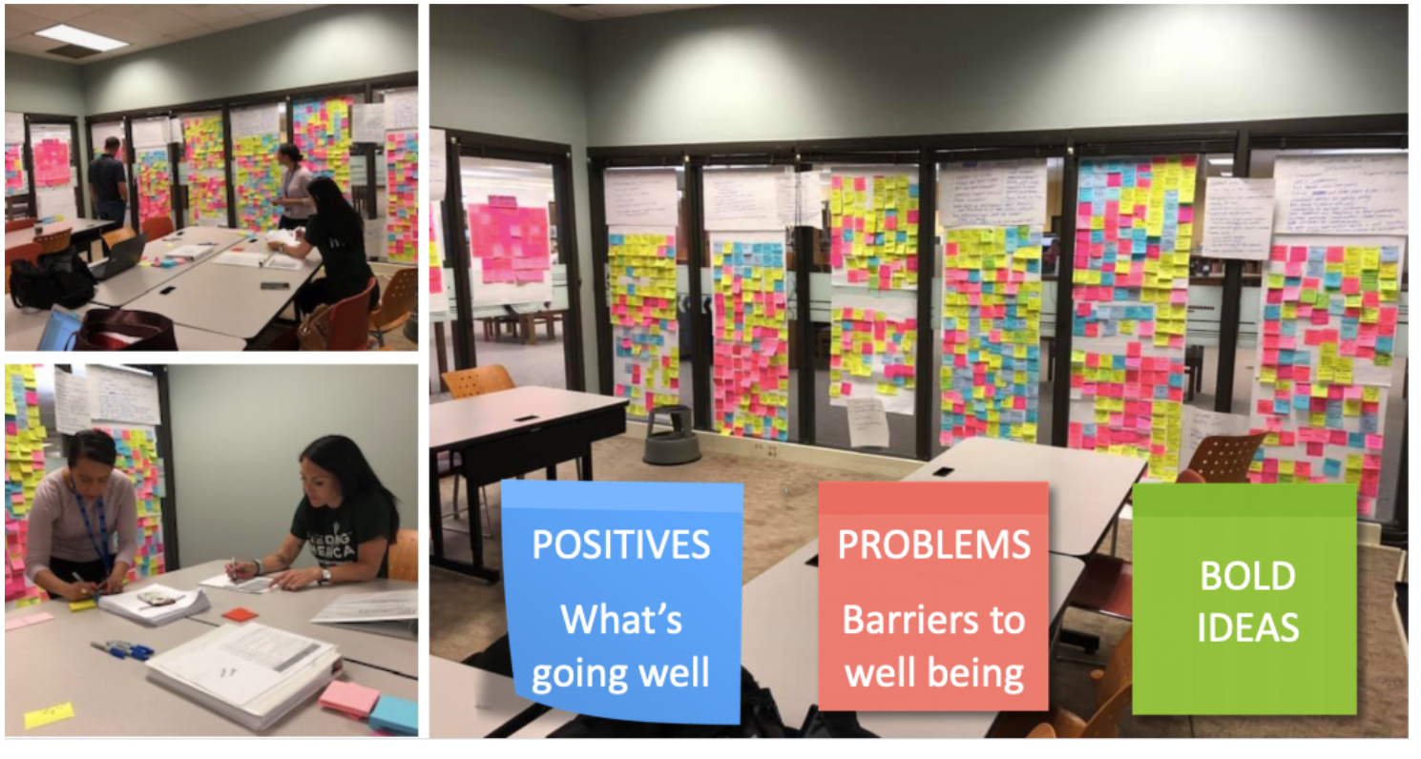
“What do we want for our children and grandchildren
as they live their lives in this place?”
.
Image: https://www.communityinitiatives.com/imagine-fox-cities
https://www.cffoxvalley.org/loop/2019/10/03/next-steps-for-imagine-fox-cities/

Slide 15

.
Community Initiatives Network: https://www.youtube.com/watch```?v=MvtWHOiU24s&t=97s

