Slide 1
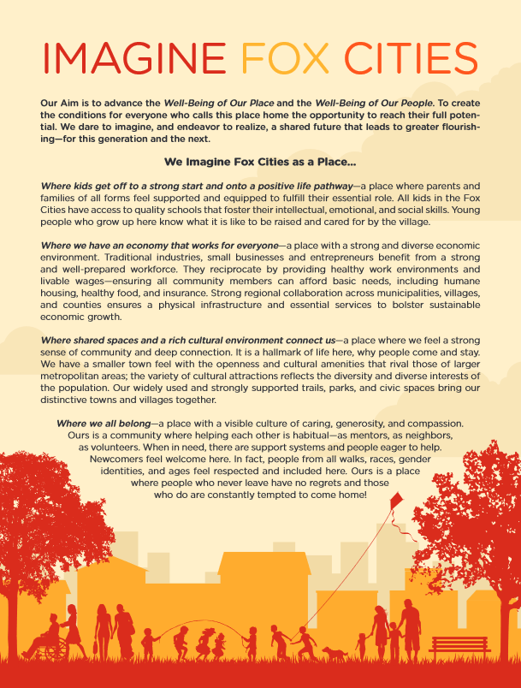
Living Vision
We Imagine Fox Cities as a Place…
Where kids get off to a strong start and onto a positive life pathway.
Where we have an economy that works for everyone.
Where shared spaces and a rich cultural environment connect us.
Where we all belong.
We commit: To sustain what makes this place special, to foster innovation, to be inclusive, to measure what matters, to build on and align efforts, to offer gracious space and to act with the next generations in mind
https://imaginefoxcities.com/wp-content/uploads/2019/10/IFC_Summit_LivingVision_8.5x11.pdf
https://www.cffoxvalley.org/loop/2020/06/22/community-conversations-aim-to-understand-race-racism-antiracism/
https://www.cffoxvalley.org/loop/2019/10/03/next-steps-for-imagine-fox-cities/
Notes:
How could Fox Cities benefit from looking ahead a generation or two to imagine what kind of community we might want to be.
Support for Imagine Fox Cities has been provided by grants from the Bright Idea Fund and David L. and Rita E. Nelson Family Fund, both within the Community Foundation, as well as major contributions from Bank of Kaukauna, Boldt, Community First Credit Union,Galloway, SECURA, ThedaCare, and Thrivent. Additional support came from Kimberly-Clark, Miller Electric, NAI Pfefferle and United Way.

Slide 2
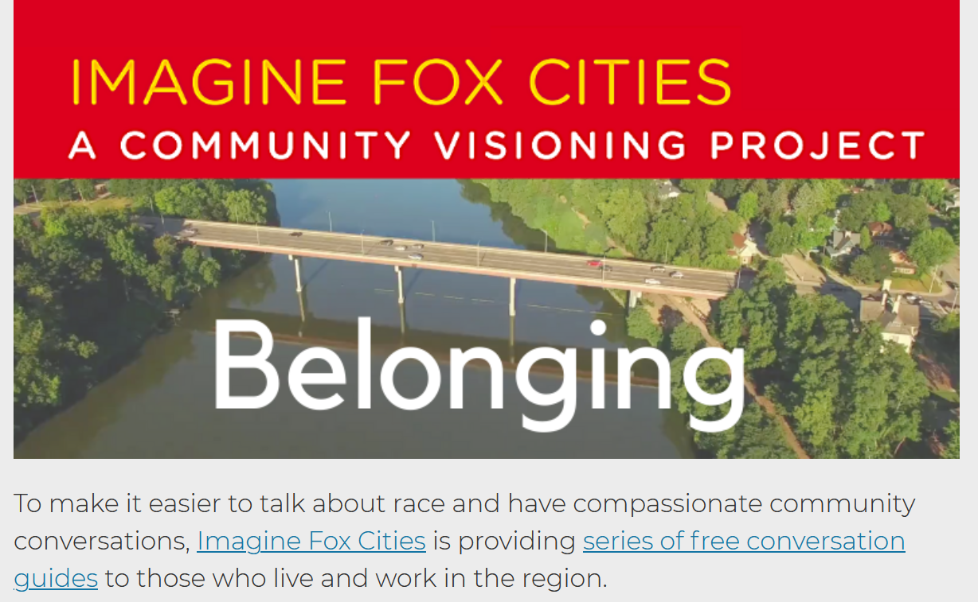
The place in which I’ll fit
will not exist until I make it.
– James Baldwin
Belonging is feeling part of a community, embraced for who you are and valued for what you bring
https://www.cffoxvalley.org/loop/2020/06/22/community-conversations-aim-to-understand-race-racism-antiracism/

Slide 3
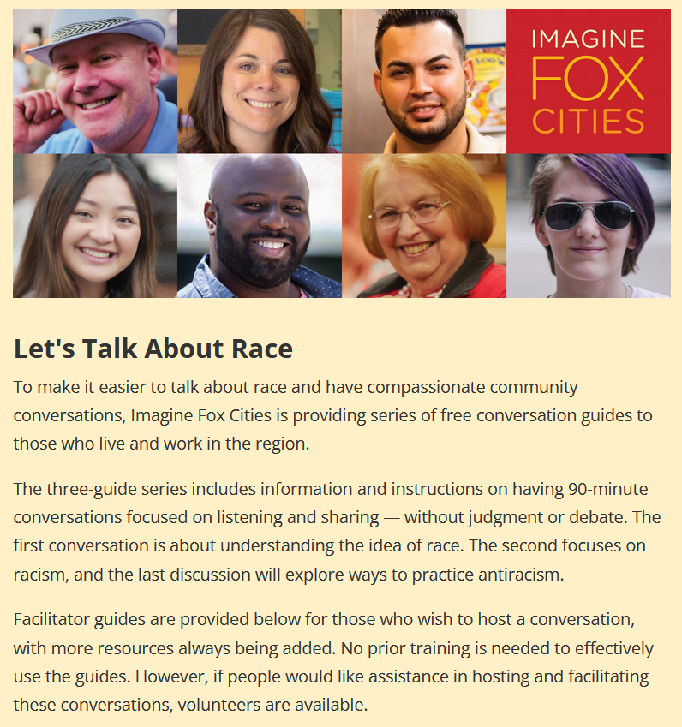
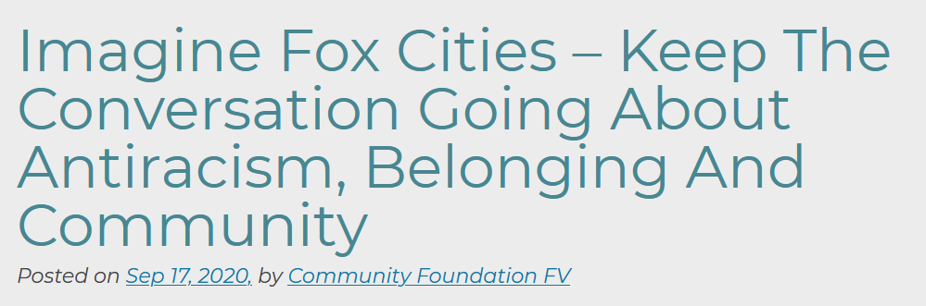
Launched on Juneteenth (2020)
Living Room Conversations
Three-part, self-organized dialogues to listen and share
Large Community Convening
More than 550 community members joined together virtually for Imagine Fox Cities’ convening on: Antiracism, Belonging and Community.
https://www.imaginefoxcities.com/conversations-on-race /
https://www.cffoxvalley.org/loop/2020/09/11/placeholder-imagine-fox-cities-keep-the-conversation-going-about-antiracism-belonging-and-community/

Slide 4



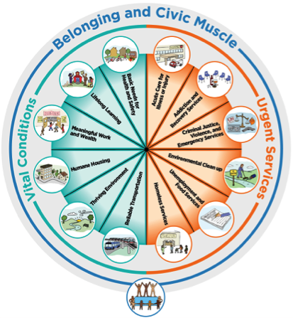




Stewardship Investors Lab: Fox Cities Team
New flows of federal and state money:
Stewarding Fox City’s path from recovery-to-renewal

Slide 5
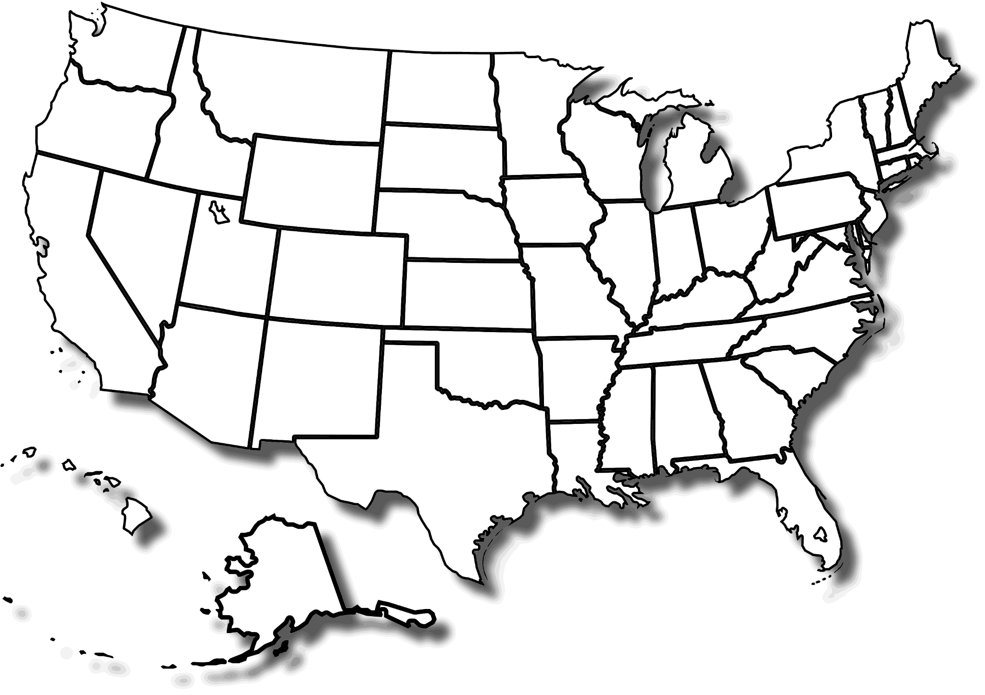
THRIVE Great
Lakes Bay
North Sound ACH
Common Ground Health
We Belong Here
&
Civic Commons
Imagine
Fox Cities
Trenton Health Team
Five Healthy Towns
Philadelphia Collaborative for Health Equity
Mālama Honua
ARCHI
Palm Beach County
Southcentral Foundation
x
5

Slide 6

Re-Shaping Investments with Community’s Voice:
Palm Beach County
2021 Winner of Robert Wood Johnson’s Culture of Health Prize
Robert Wood Johnson Foundation: https://www.youtube.com/watch```?v=MvtWHOiU24s&t=97s

Slide 7
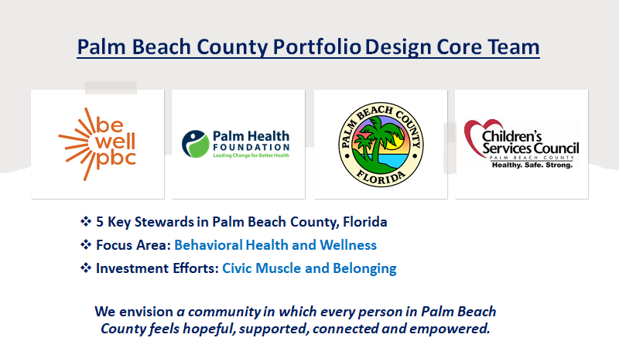
Re-Shaping Investments with Community’s Voice:
Palm Beach County
2021 Winner of Robert Wood Johnson’s Culture of Health Prize
Four major resource holders combined to rethink youth mental health:
  Palm Health Foundation
  Palm Beach County Youth Services
  Palm Beach County Community Services
  Children’s Services Council
Used BeWell PBC to build a routinized mechanisms for capturing community voice
Developed the leadership of community context matter experts
Directed investment into building civic muscle and belonging, using the Well-being Portfolio framework.
Demonstrated shifts in resource alignment

Slide 8
THRIVE Great
Lakes Bay
North Sound ACH
Common Ground Health
We Belong Here
&
Civic Commons
Imagine
Fox Cities
Trenton Health Team
Five Healthy Towns
Philadelphia Collaborative for Health Equity
Mālama Honua
ARCHI
BeWellPBC
Southcentral Foundation
8

Slide 9

Developing Organizational Stewardship:
Jefferson’s Philadelphia Collaborative for Health Equity
Stewardship Ambition:
CEO pegged his compensation to health of people in Philadelphia
Simultaneously, he has directed a massive philanthropic effort towards addressing the city’s significant health disparities
Stewardship Move:
Created the Philadelphia Collaborative for Health Equity – to channel philanthropy towards addressing the underlying drivers of health disparities, as opposed to traditional hospital philanthropy
Raised $40 million of $100 million goal that will sustain new site partnerships for primary care, community health workers and a grants to CBO partners

Slide 10
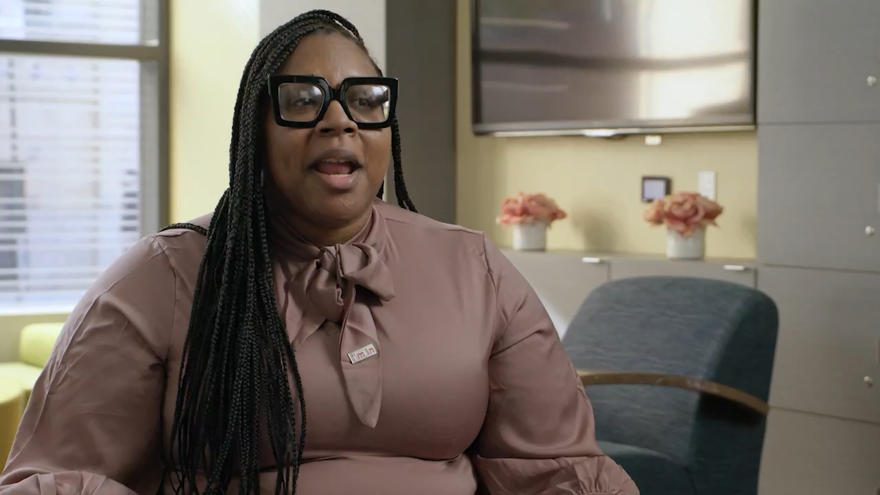
Stewardship Voices:
Erin Morton, Sr. Director of Strategic Partnerships
Jefferson’s Philadelphia Collaborative for Health Equity

Slide 11
Similarities
Differences
What practices are involved?

Slide 12
Questions
&
Observations

Slide 13
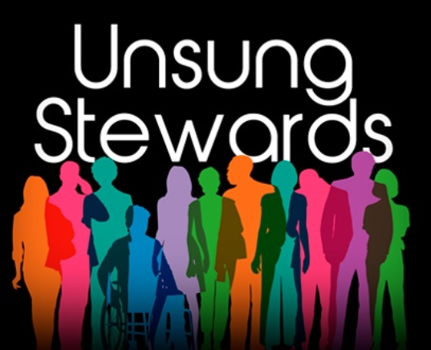
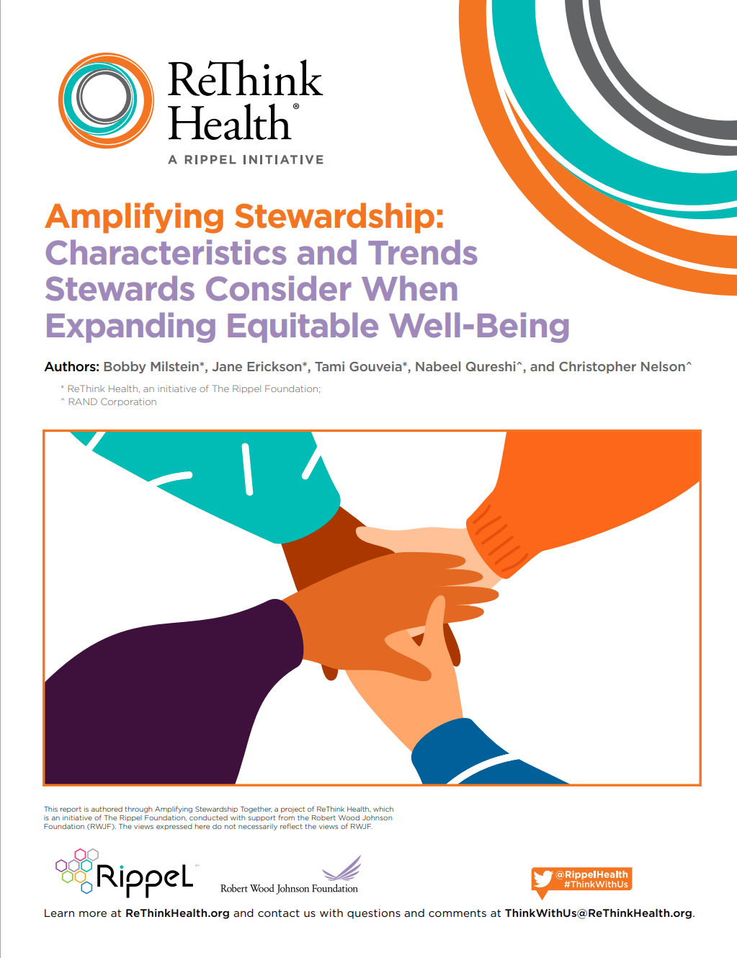
Amplifying Stewardship as a Field of Practice
Stewardship is becoming a more prominent practice, but those who do this work remain largely disparate, disconnected, and outmatched by the forces of injustice and systemic crises.
The stakes could hardly be higher
The strength of our shared stewardship will likely determine whether we sink deeper into an adversity spiral, or whether we find pragmatic ways to create the vital conditions that all people need to thrive.
Amplifying Stewardship: http://bit.ly/AmplifyingStewardship; Unsung Stewards Podcast https://rethinkhealth.org/podcasts/

Slide 14
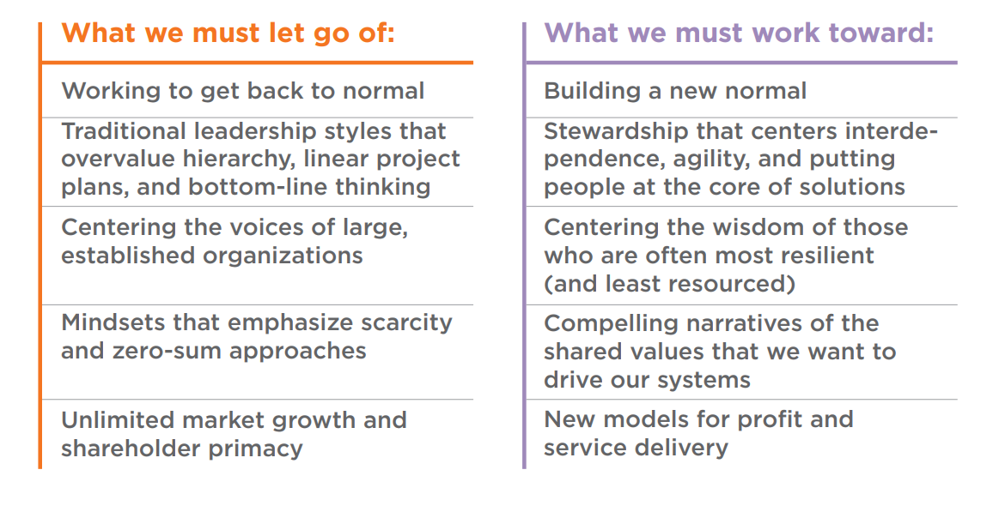
Stewards note that we must let go of certain norms, practices,
and structures—and work to let others emerge
Amplifying Stewardship: http://bit.ly/AmplifyingStewardship

Slide 15
Approaches to Change
Transactional
Impacts
Health &
Well-Being
Interventions
(programs, projects)
Outcomes
Equity
Transformational
North Star
Mindsets & Actions,
Shared Stewardship
System Designed
for Well-Being, Equity, and
Racial Justice
Practices affecting…
• Aspirations
• Mutual Accountabilities
• Interdependent Networks
• Policies & Incentives
• Learning & Adapting
• Other frontiers…
Devoted to equitable…
• Processes (i.e., lived experiences)
• Agency (i.e., belonging and civic muscle)
• Opportunities (i.e., vital conditions)
• Outcomes (i.e., WIN measures, HP2030)
Thriving People and Places—
No Exceptions
Anderson T, et.al. Shared Stewardship and Prospects for Thriving Together. ReThink Health. 2021

Slide 16

Assessing Your Organization’s Stewardship Journey
Polling Questions
Four Essential Practices (among others)
Aspirations
Interdependence
Resources
Resident Voices

Slide 17
Assessing Your Organization’s Stewardship Journey
Polling Questions
Aspirations
To what extent is your organization committed to an equitable future for community health and well-being?
  Not at all (we focus on specific, short-term aims)
  Somewhat
  Moderately
  Extremely

Slide 18
Assessing Your Organization’s Stewardship Journey
Polling Questions
Interdependence
To what extent does your organization make decisions based on interdependencies with organizations in other sectors?
  Not at all (our decisions are independent)
  Somewhat
  Moderately
  Extremely

Slide 19
Assessing Your Organization’s Stewardship Journey
Polling Questions
Resources
To what extent does your organization channel resources for equitable health and well-being?
  Not at all (our resources focus on specific org aims)
  Somewhat
  Moderately
  Extremely

Slide 20
Assessing Your Organization’s Stewardship Journey
Polling Questions
Resident Voices
To what extent does your organization co-design priorities with resident leaders who are usually unheard?
  Not at all (we design our own priorities, with occasional input from residents)
  Somewhat
  Moderately
  Extremely

Slide 21
What is next
for you?
Who do you
need to bring along?

Slide 22
Quiet Reflection (2.5 mins):
What is next for me and
my organization?
Group Huddle (10 mins):
Who do we need to join
us in this journey?

