Slide 1

Shared Stewardship Series, Session 3:
Thriving Together Theater
May 13, 2022
Notes:
Kate
Good afternoon. I'm Kate Dupont Phillips, Executive Director of Healthy Communities Delaware.
We welcome you to the second event in our series about Shared Stewardship for Thriving People and Places.
This four-part series is designed to energize and inspire collaboration to improve health, well-being, and equity in Delaware. Together, we are exploring the roles that each of us can take in moving towards a Delaware where all people and places are thriving, no exceptions.

Slide 2
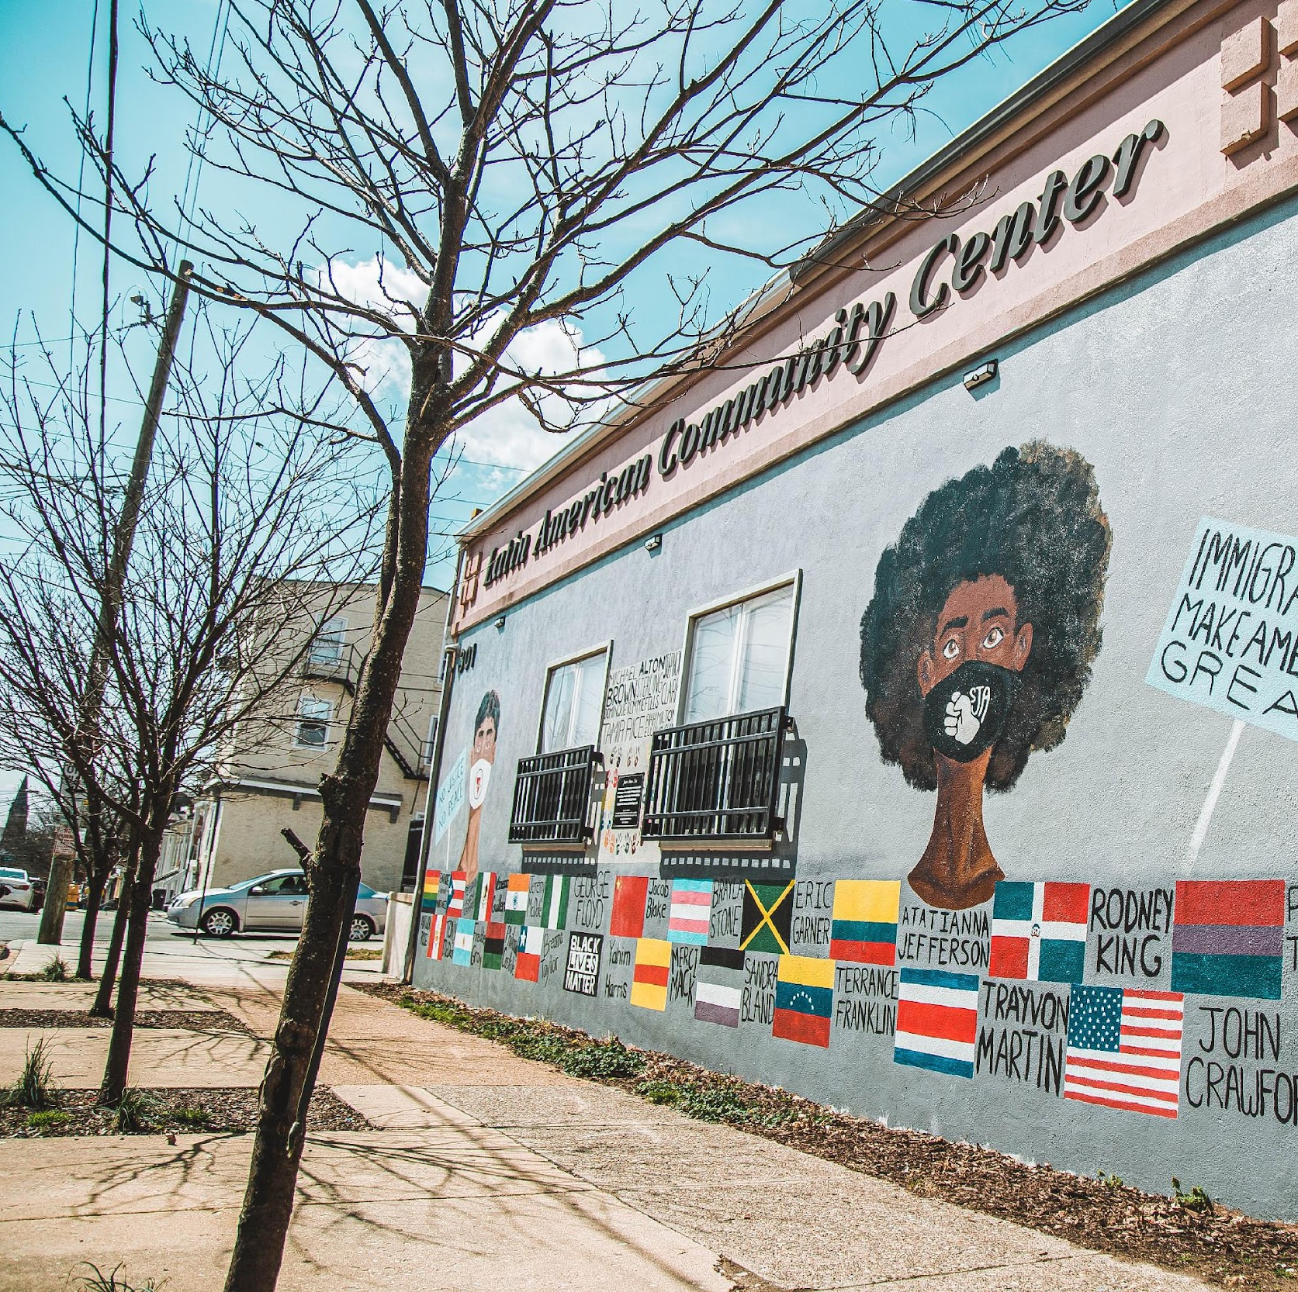
Vision
Healthy, safe and vibrant communities where all people are thriving.
Photo: WestSide, Wilmington. Latin American Community Center.
Notes:
We envision a Delaware full of healthy, safe and vibrant communities that support people to thrive.
To us, thriving means that all people should have a fair chance to participate, to prosper, and reach their full potential.
We are shared stewards of this vision for Delaware.
It will take all of us, working together, to make this vision a reality.

Slide 3
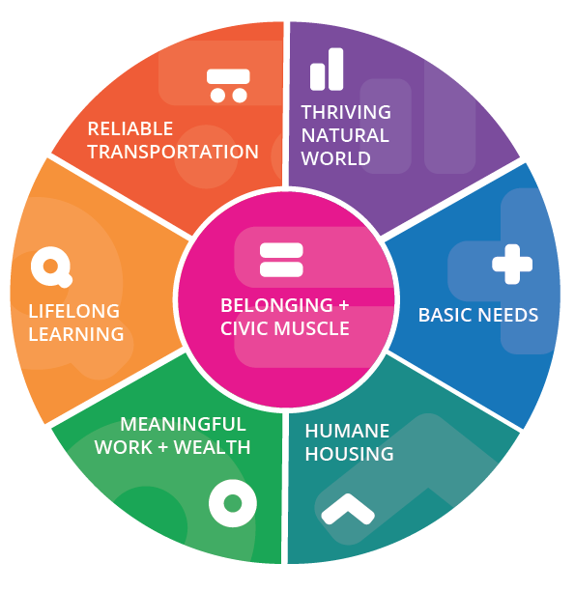

Thriving Together through Shared Stewardship Series
Session 1: Thriving Together through Shared Stewardship
Session 2: Negotiating a Well-Being Portfolio
Session 3: Thriving Together Theater
Session 4: Strengthening Shared Stewardship
How will we work together to invest for
a different future?
Notes:
This four-part series is designed to energize and inspire collaboration to improve health, well-being, and equity in Delaware. Together, we are exploring the roles that each of us can take in moving towards a Delaware where all people and places are thriving, no exceptions.

Slide 4
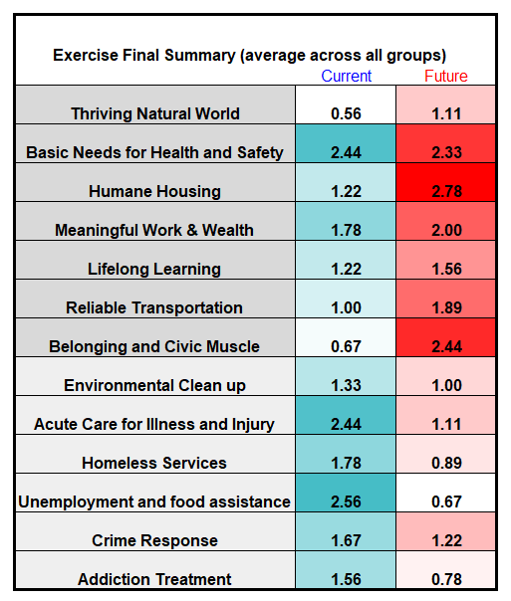
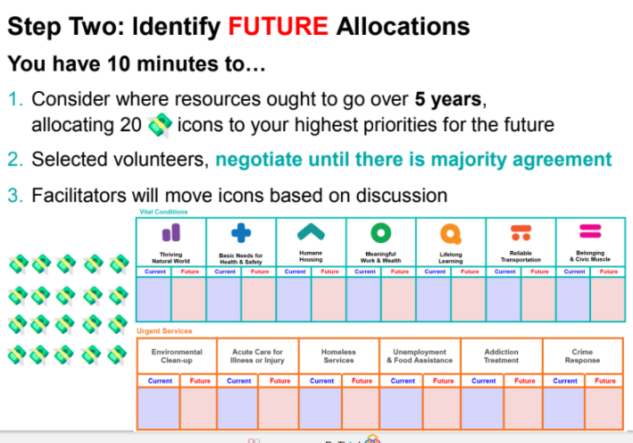
Recap of Session Two:
Negotiating a Well-Being Portfolio
Notes:
What were the takeaways from session 2?

Slide 5
Thriving Together Theater
Learning Objectives
  Understand four interconnected drivers that together affect who thrives, struggles, and suffers
  Negotiate with fellow participants to find a path from crisis to renewal
  Explore how different investment strategies alter trajectories of community well-being and equity over time.
Together, you will figure out how to expand thriving through:
  Vital conditions
  Equitable policies and practices
  Urgent service capacity
  Belonging and civic muscle
Notes:
The Thriving Together Theater is a creative space where participants learn for themselves how to weigh tradeoffs and navigate the dynamics of equitable well-being in a community experiencing unjust adversity.
Vital conditions (to expand conditions that everyone needs to thrive, such as humane housing, etc.)
Equitable policies and practices (to assure just inclusion across color, class, gender, and other differences)
Urgent service capacity (to alleviate life crises among those who are struggling and suffering)
Belonging and civic muscle (to assure everyone feels they belong and build strength in every other area

Slide 6
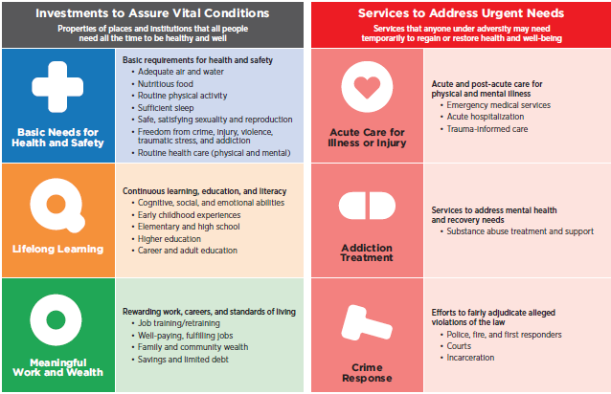
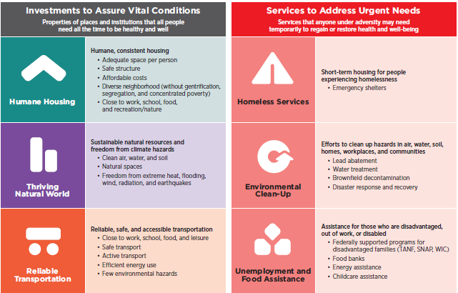

Slide 8
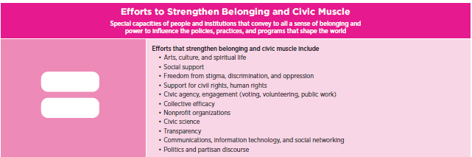
Equity: Focusing investments not universally, but to improve conditions for those who are struggling and suffering

Slide 9
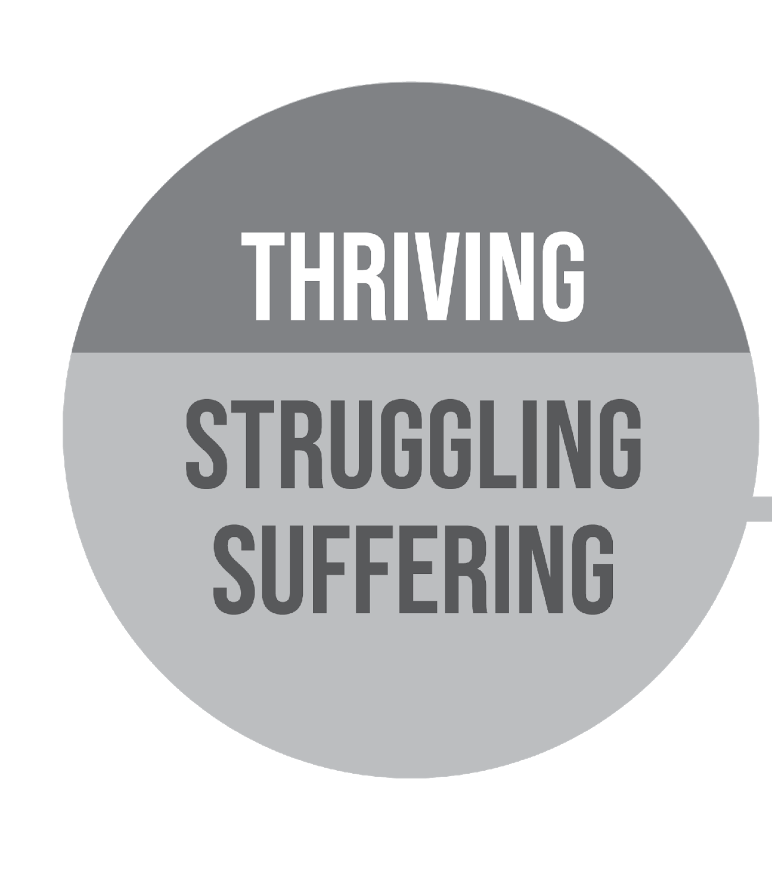
What are we aiming for?
What is Delaware’s path to increasing thriving while alleviating struggling and suffering?

Slide 10
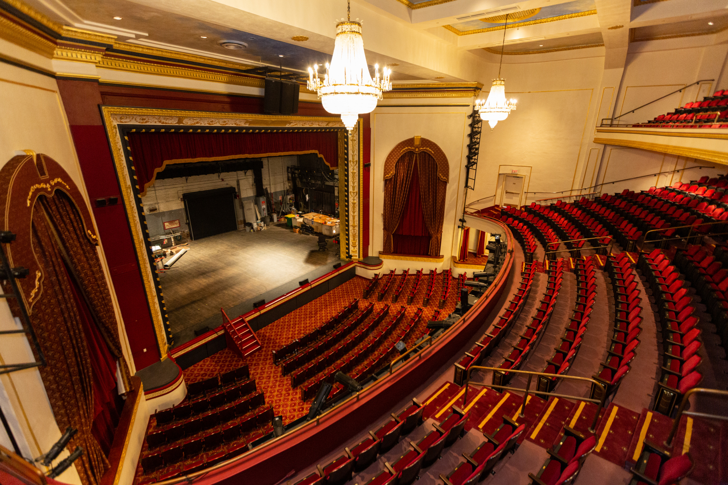
We’re off to the Theater
Notes:
We’re off to the theater—picture the Grand in Wilmington

Slide 11
INSERT THEATER

Slide 12
Invitation for Reflection
What do we have to do in Delaware as stewards to make the most of this moment of possibility?
HCD is an investment in long-term, equity-focused, vital conditions work
  How can we use HCD as an infrastructure or forum to move this work forward?

Slide 13
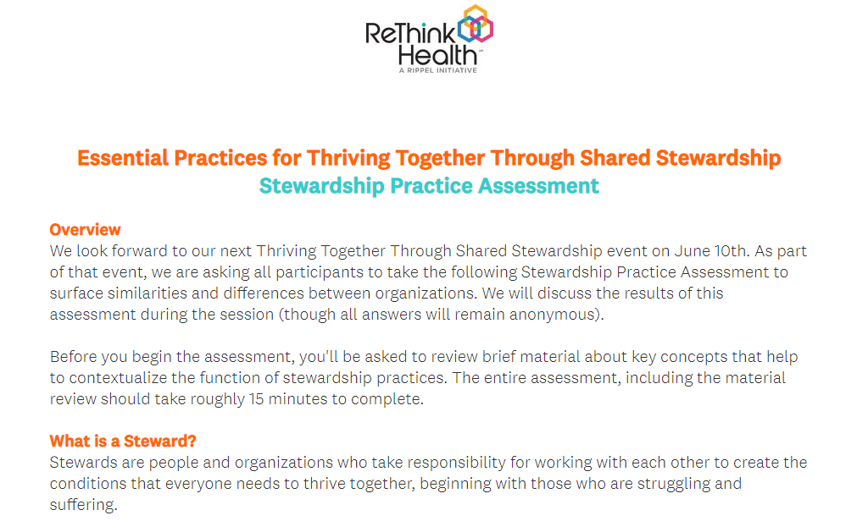
Next Session
June 10th, 1-3pm:
Strengthening Shared Stewardship
Action Step:
Your input on Stewardship Practice Assessment by 5/27

Slide 14
Thank you!
Notes:
Kate
Good afternoon. I'm Kate Dupont Phillips, Executive Director of Healthy Communities Delaware.
We welcome you to the second event in our series about Shared Stewardship for Thriving People and Places.
This four-part series is designed to energize and inspire collaboration to improve health, well-being, and equity in Delaware. Together, we are exploring the roles that each of us can take in moving towards a Delaware where all people and places are thriving, no exceptions.

