Slide 1
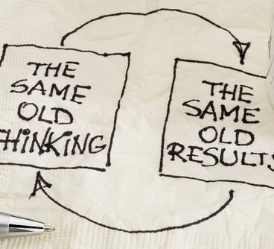
3 Things to Increase Sales-TODAY

Slide 2
Gut Check Moment
Read
Evaluate
I am excellent at handling prospects and converting them into customers.
I can say that this is my situation today
I wish I could say this is my situation today
This statement doesn’t apply to my situation

Slide 4
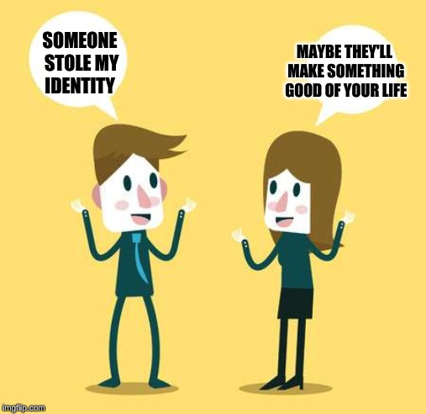
CHANGE YOUR LANGUAGE

Slide 5
Everything is Input
Your Brain cannot process the Negative in Language

Slide 7
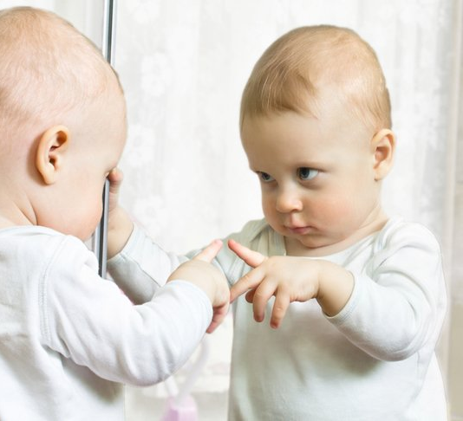
Mirroring
Matching and Mirroring is key
Physical movements (3-5 seconds)
Posture
Volume
Speed
Wording

Slide 10
Personality Types – Selling Guides
H | E | R | O
Habitual | Expressive | Respected | Objective
Permission Based | Enthusiastic | Assertive | Cautious
Dependable | Likeable | Demanding | Organized
Resistant to Change | Non-Committal | Effective | Analytical
Hard Working | Inconsistent | Leader | Statistical

Slide 11
What does each one want / fear
Personality | Wants | Fears
H | No Pressure Guidance / To feel heard | Losing Security
E | Compliment / Attention | Being Rejected (un-liked)
R | To be the decision maker / You to hurry Up | Being taken advantage of
0 | Details / Patience | Criticism

Slide 12
www.thegeniuslinks.com

Slide 13
TEXT EVERYONE
BONUS
Psychology behind the Call/text
Why Texting works better?
To emoji or not?

