Slide 1



Welcome To Leadership-Live-In-45!
Introduction:
Series Host: Leadership Variations, www.Leadershipvariations.com
  Today’s host: Gail Anderson
  Facilitators: Drs. Amy Bladen Shatto / Charley Morrow
LL45 Agenda 11.11.24
  35 min facilitators present on topic: Assessment for Team Development
  10 min group reflect on questions/share
  (nuggets & networking)
  Please put your name/email in chatbox, how you are using (challenged with) with team assessments
Notes: This will be a recorded session
  Please share. Your views and opinions matter!
LL45 – Nuggets and Networking with Leaders
www.leadershipvariations.com
Copyright 2024 by Leadership Variations. All rights reserved
Notes:
Invitation for name, role, email and how they use or struggle with building high performance teams

Slide 2
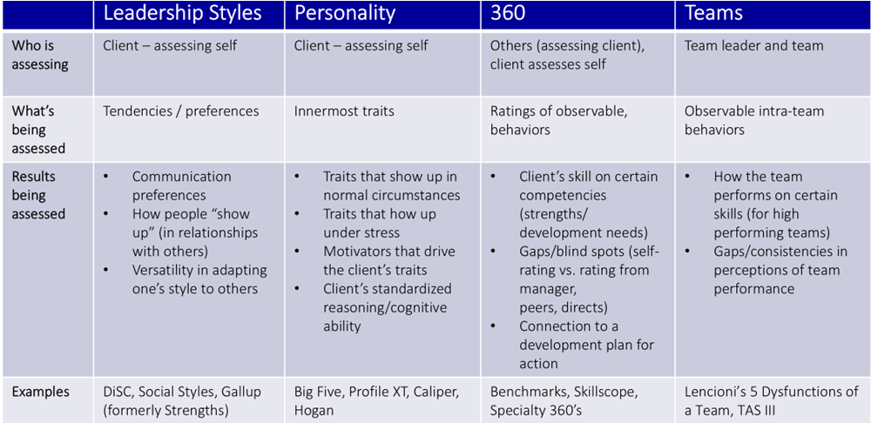
Refresh – We Went Over 4 Basic Types of Assessments
Today’s Focus - Teams
Notes:
Lots of ways to think of teams – we are looking at company-organized (intentional) groups of people evaluating the performance of the team as a whole – presumably for the purpose of becoming “high performing” – often times “teams” assessments are used in combination with styles, or personality assessments to combine the measure of the whole team with the measure of the individuals contributing to the performance of the team as a whole.

Slide 3
Scenario
A top leader asks:
    “Can you help me assess and develop my team?”
  Write in the chat – the first thing that comes to mind
Notes:
Put in the chatbox -

Slide 4
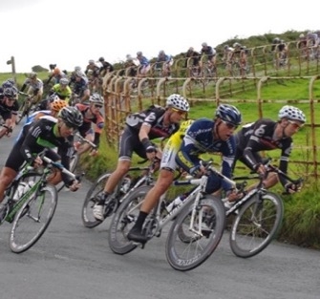
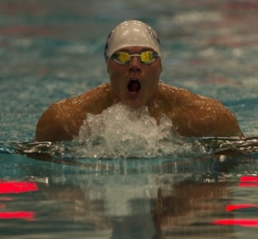


An Observation – Teams are complex - context and purpose matters!
We are often imprecise in how we talk about teams and team development.
Bike Racing | Swim | Rowing | Volleyball
Fixed roles, hierarchy Success = execution to support the leader to succeed and share the reward | Fixed roles Success = sum of individual performances | Fixed roles Success = coordinated group effort | Primary, not fixed roles Success = flexible, collaborative response
Notes:
Bike racing member of the team serves as its leader, and the others do everything they can to help him win. In the major races, each team leader works with eight other riders, called “domestiques,” who don’t have much chance of winning the race themselves. Top teams typically have 20 or more cyclists on their rosters, from which team managers can choose a nine-person team suited for each event. By tradition, the winner of a race like the Tour de France splits his cash prize with the members of the team and its staff.

Slide 5
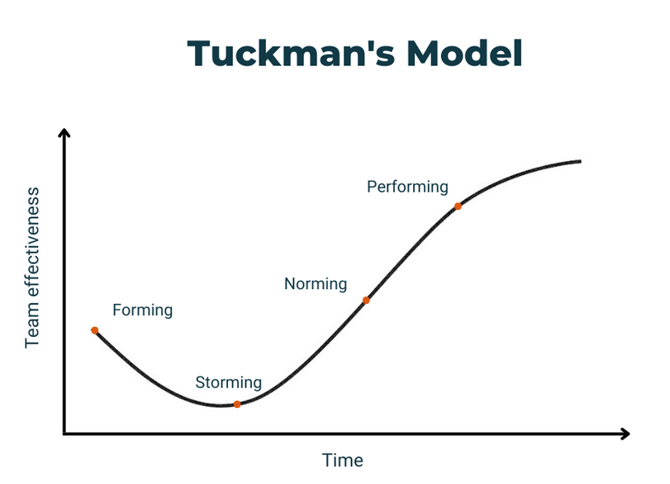
The “When” For Team Asssessments
Help to Identify Skills & People
Help to Resolve Interpersonal Issues
Notes:
Note – assessment at end

Slide 6
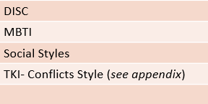
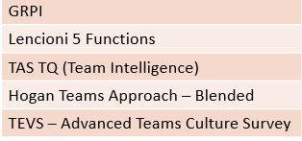
Focus Today: Team As a Whole – Are We A High Performing Team?
Are We A High Performing Team - TQ
Do we demonstrate:
  Sustained superior results
  Adaptability and resilience
  Increased capacity as a whole
We are focusing here!
Understand Own & Teammates’ Styles
Understand Team Culture & Teamwork
Individual Team Members as Unit of Evaluation
Do we understand each other?
Do we flex styles?
Can we enhance communications?
Team (as a whole) as Unit of Evaluation
Structure
Context
Dynamic as team
Often the individual team members assessments are used to support a holistic look at the full team (they are used together)
Notes:
What % are really high performing – says research?
Do we have right people/ team skills and competencies/

Slide 7

Understanding Team Culture and Teamwork
Main Idea:
Teams are interdependent and teams develop “norms” for coordinating actions
Understanding and adapting to these norms enhances coordination and results
Committing to a unified approach accelerates team to performance and better results
A framework and gauge of norms for dimensions of teamwork allows discussion and commitment
Notes:
The Main Idea:
Behavior is affected by context
Understanding, and then adapting, the team context in which behaviors happen can improve results and interactions
Individual commitment to adhere to the desired team approach will make interactions easier and more effective
And, in this way, the team is accelerated to performance

Slide 8
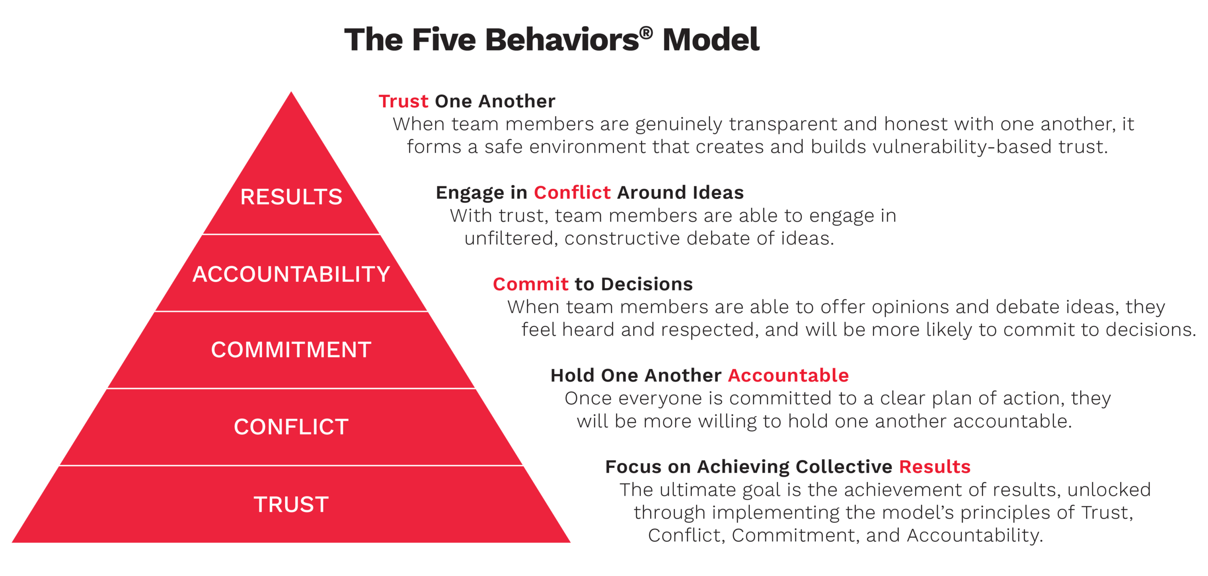
Lencioni’s Team Assessment: Interpersonal Norms
Results
Accounta-bility
Commitment
Conflict
Trust

Slide 9
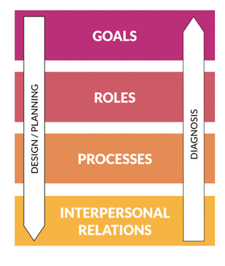
GRPI: A Simple and Broad Model of Team Development
Social science shows teams form around clear goals. GRPI focuses beyond interpersonal dynamics to elements like goals, roles, and processes that facilitate smooth interactions. Start with a unified understanding of these goals to streamline team development
Shared objectives
Agreement on “how”
Team Considered important
Understand accountabilities & interests
Decision authority and scope
Autonomy
Schedule & rhythm
Rules for interacting / deciding
Communication & Conflict management
Trust
Mutual support
Safe to speak up
Notes:
See resources for a contact us

Slide 10
The Team Assessmen Survey (TAS) – TQ, Team Effectiveness Quotient
Context The business situation/challenge in which a team operates
Mission The team’s purpose, goals (and strategy for achieving)
Talent The right people/skills to do work; clarity of team roles
Norms The team’s formal/informal work processes for running the team (meetings, making decisions, getting work done)
Buy-in Motivation and optimisms of team members about the team’s goals and chances of “winning”
Resources The team’s assets (physical, monetary, political)
Courage The team’s approach to managing conflict
Results Is the team delivering on commitments?
Results
Mission & Talent – The first stage of the Rocket has to do with the alignment between the talent and the job at hand or getting it “off the ground.”
3. Cruising
Norms & Buy-In – Acceleration– what really puts the Rocket into orbit is based on how the team works together; their rules, roles and expectations and what allows teams to become high performing.
2. Accelerating
Context
1. Liftoff
Resources & Courage – The Cruise Controls of the Rocket is based in the team’s reliance on itself, and its ability to have full authority in decision-making.
Context
The hallmark of a high performing team is its’ ability to exceed expectations on outcomes and results.

Slide 11
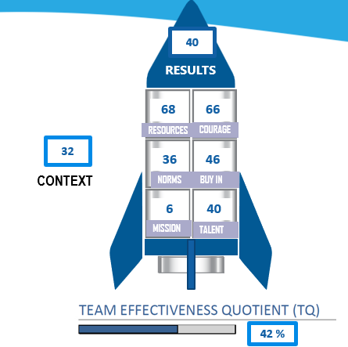
Clear Feedback: Where’s the gap? How to Improve?
Why the TAS?
Reliable/valid tool (35 years research in orgs.)
Includes assessment of team context
Simple (business language/ 20 min. to fill out)
Easy to use in combination with personality measures
Only tool to distinguish between “group vs. team”
Provides clear actions to improve after identifying team gaps (multiple exercise options)
  With team & leader accountabilities
Percentile score interpretation:
            <25 Low/ 26-50 Below average/
            51-75 Above average/ >75 High

Slide 12
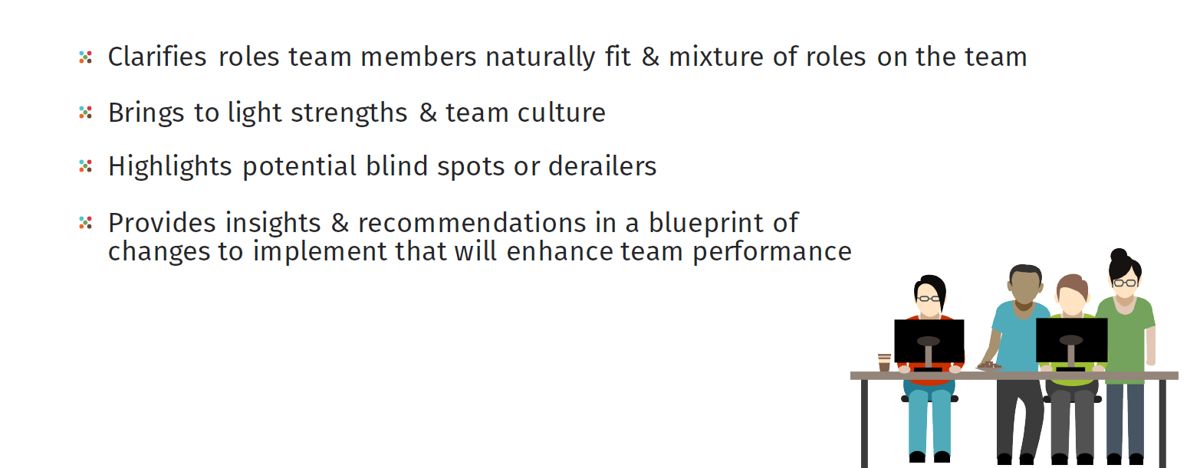
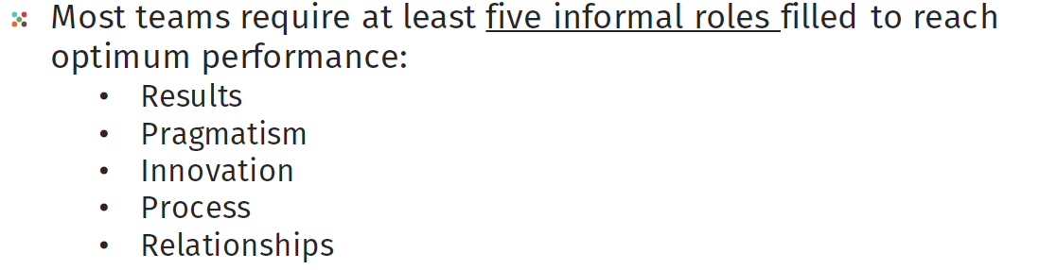

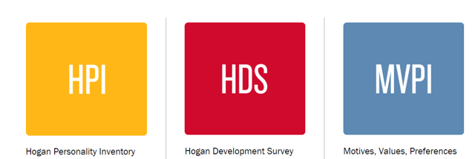
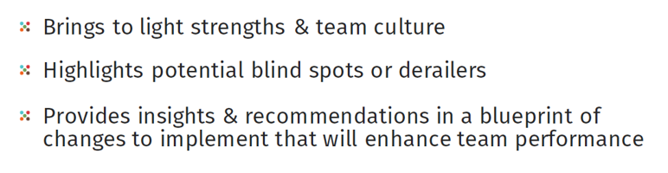
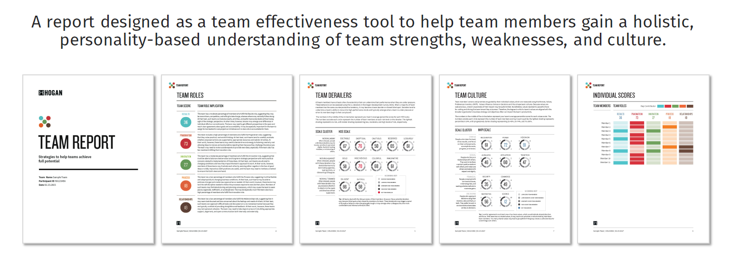
Introduction to the Hogan Team Assessment
The Hogan Team Report combines the assessment results (HPI; HDS; MVPI) of all the individuals on the team from the three assessment to bring additional clarity:
Notes:
Pragmatism - People who provide practical, hard-headed evaluations of ideas and proposals. They advocate pragmatic solutions, and their views are not influenced by the need to maintain harmony. They are direct and grounded in reality.
Innovation - People who recognize when conditions have changed and when the team needs to adapt. They spot emerging trends and patterns quickly, enjoy solving problems, and generate creative solutions.
Process - People who are concerned with implementation, the details of execution, and the use of processes and systems to complete tasks. They are reliable, organized, and conscientious about following procedures.
Relationships - People who are concerned about morale and how team members are getting along. They are positive and optimistic, attuned to people’s feelings, and good at building cohesive relationships.
Results - People who organize work, clarify roles, coordinate, and provide direction for others. They enjoy taking charge and pushing for results.
Most teams require at least five informal roles to reach optimum performance
An unfilled role may lead to a team performance gap
Over-represented roles suggest a lack of diversity can also lead to a team performance gap

Slide 13
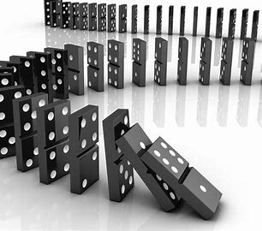
Four Ingredients to Building High Performing Teams:
Blending Individual & Team Assessment: Example – The Domino Derailer Effect
  It is an interpersonal trigger and diminisher reaction
  When a colleague has a vulnerability moment and derails, people often pull away creating distance.
  People often personalize the colleague’s actions and respond emotionally themselves, triggering their own derailers. Hence the domino reaction.
  Later, there can be distance, awkwardness, or conflict. We call this a diminisher effect.
  It doesn’t have to be this way…..
Hogan Derailers (HDS)
 | Excitable
 | Skeptical
 | Cautious
 | Reserved
 | Leisurely
 | Bold
 | Mischievous
 | Colorful
 | Imaginative
 | Diligent
 | Dutiful
Example:
Excitable: Intense→ Volatile
Bold: Confident → Arrogant
Skeptical: Perceptive → Distrustful
Leisurely: Agreeable→ Passive Agressive

Slide 14
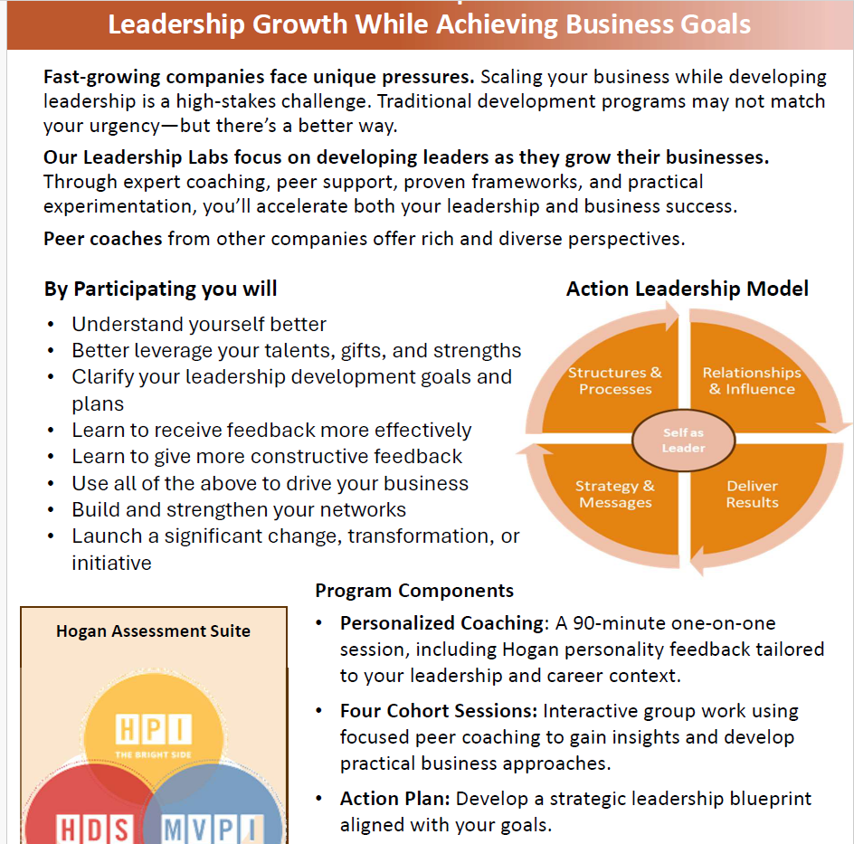
Resources & More Resources!
Introducing “The Lab” for senior leaders
Additional resources available: Click HERE and request any or all below:
  Information Guide on most commonly used assessments (how to use, how we rate them, are they valid and more)
  Free introductory GRPI assessment
  Free article on your team’s high performance “TQ –“Team Intelligence”
  Free consultation with Amy & Charley on team development needs/”The Lab”
  Click Link to last session Sept assessment ll45: on individual assessments
Condenses typical exec coaching engagement while maximizing learning
  Individual Hogan Personality Feedback
  Four 90 min. coaching sessions with (sr. peers)
  Strategic tools, business-based problem solving
  Click HERE to request information

Slide 15
Discussion
Can we measure which phase (Form, Storm, Norm, Perform) your team is in?
How do you distinguish between groups and teams? Do you think this is important?
Do you know of any other valid and reliable team assessments?

Slide 16
Thank you!
Amy Bladen Shatto, PhD, PCC, BCC
LEADERSHIP DEVELOPMENT CONSULTANT & COACH
609.413.3704
www.leadershipvariations.com
abladen@leadershipvariations.com
Copyright 2024 by Leadership Variations. All rights reserved

Slide 17
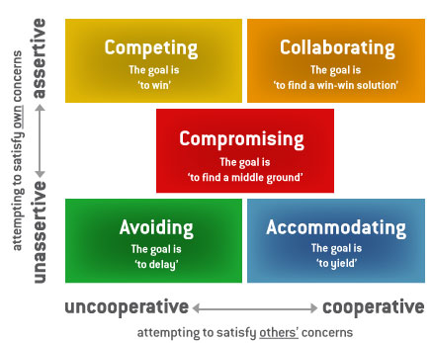
Appendix: Thomas-Kilmann Conflict Mode Instrument (TKI®): Individual Tool Not Covered in Sept Session
The Thomas-Kilmann Conflict Mode Instrument (TKI®) helps leadership teams understand how different conflict-handling styles affect interpersonal and group dynamics—and for empowering them to choose the appropriate style for any situation.
The TKI tool assesses an individual’s typical behavior in conflict situations and describes it along two dimensions: assertiveness and cooperativeness. It provides detailed information about how that individual can effectively use five different conflict-handling modes, or styles.
Has rock-solid reliability and validity, with built-in control for social desirability.
Demonstrates that different behaviors are neither good nor bad but simply different ways of dealing with conflict.
Can be used with other assessment for deeper insights into personality and conflict management.

Slide 18
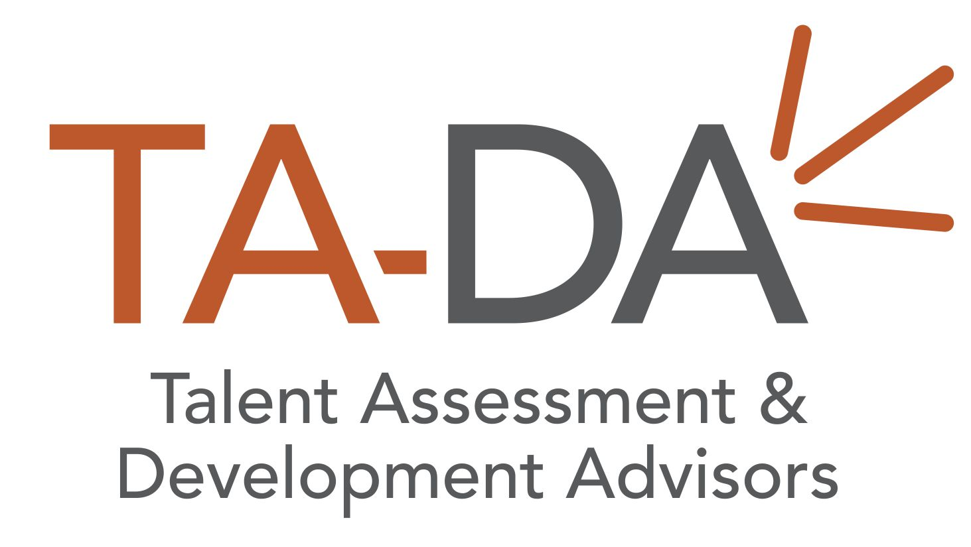
Appendix: Talent-Equity Valuation Survey™
TEVS™ Heatmap
TALENT EQUITIES | CEO | CFO | COO | CIO | CHRO | TEAM
Leadership
Teamwork
Execution
Financial
Market
Technical
Network
Business Dev.
TADA’s proprietary Talent Equity Valuation Survey™ (TEVS) provides a dynamic snapshot estimation of the strengths and distribution of key skills, core knowledge, and the competencies necessary on a leadership team.
Using a forced-point distribution methodology, TEVS provides heat maps of talent equity distribution, highlighting areas of strength and identifying key gaps.
TA-DA Human Capital Equities™
Leadership
Articulate direction and inspire followers
Teamwork
Form and maintain internal working relationships and trust
Execution
Manage processes, projects, operations and teams to “get things done” efficiently
Market Innovation
Apply knowledge of competitor/customer needs to adapt, improve & invent
Technical
Utilize mastery of the core disciplines of the business to gain competitive advantage
Network
Develop and maintain critical external relationships and positive awareness in the market
Business Development
Bring in new revenue, business, or capital
Financial
Understand, predict, and control revenue, costs, profits and growth

Slide 19

Assessment For Team Development
Leadership Live in 45
November 2024

