Slide 1
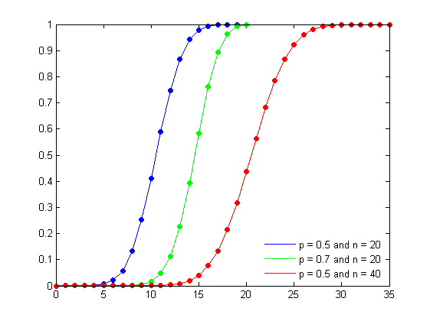
Statistical Distributions
AS
CUMULATIVE PROBABILITIES
Notes:
Welcome to the unit on ‘Statistical Distributions: CUMULATIVE PROBABILITIES’

Slide 2
Objectives
The objectives for this session are to:
Calculate cumulative probabilities for the binomial distribution.
CUMULATIVE PROBABILITIES

Slide 3
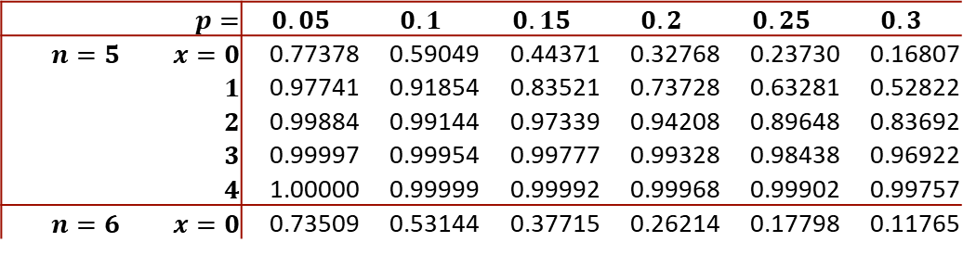

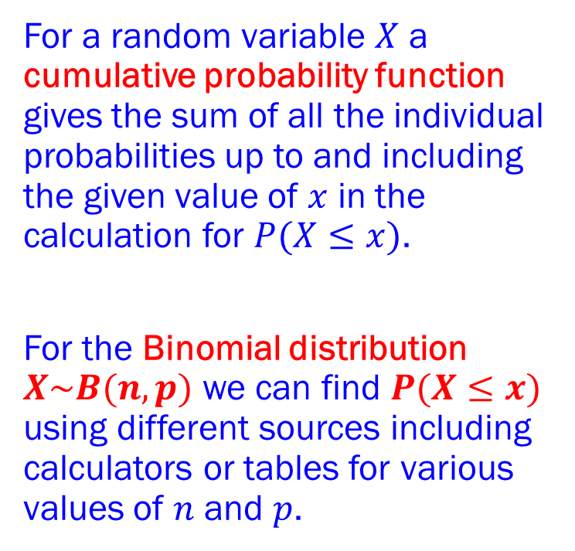
The Binomial Distribution
CUMULATIVE PROBABILITIES
Binomial Tables
An extract from the Binomial tables:
Using the extract from the Binomial table (above), find:
$P(X≤3)$ for the Binomial distribution $X\sim B(5,0.2)$;
$P(X≤2)$ for the Binomial distribution $X\sim B(5,0.15)$;
$P(X≤0)$ for the Binomial distribution $X\sim B(6,0.3)$
 | $p=$ | $$0.05$$ | $$0.1$$ | $$0.15$$ | $$0.2$$ | $$0.25$$ | $$0.3$$
$n=5$ | $x=0$ | 0.77378 | 0.59049 | 0.44371 | 0.32768 | 0.23730 | 0.16807
 | $1$ | 0.97741 | 0.91854 | 0.83521 | 0.73728 | 0.63281 | 0.52822
 | $2$ | 0.99884 | 0.99144 | 0.97339 | 0.94208 | 0.89648 | 0.83692
 | $3$ | 0.99997 | 0.99954 | 0.99777 | 0.99328 | 0.98438 | 0.96922
 | $4$ | 1.00000 | 0.99999 | 0.99992 | 0.99968 | 0.99902 | 0.99757
$n=6$ | $x=0$ | 0.73509 | 0.53144 | 0.37715 | 0.26214 | 0.17798 | 0.11765
For a random variable $X$ a cumulative probability function gives the sum of all the individual probabilities up to and including the given value of $x$ in the calculation for $P(X≤x)$.
For the Binomial distribution $X\sim B(n,p)$ we can find $P(X≤x)$ using different sources including calculators or tables for various values of $n$ and $p$.
Example 1

Slide 4

The Binomial Distribution
CUMULATIVE PROBABILITIES
Binomial Tables
An extract from the Binomial tables:
Using the extract from the Binomial table (above), find $P(X≤3)$ for the Binomial distribution $X\sim B(5,0.2)$.
 | $p=$ | $$0.05$$ | $$0.1$$ | $$0.15$$ | $$0.2$$ | $$0.25$$ | $$0.3$$
$n=5$ | $x=0$ | 0.77378 | 0.59049 | 0.44371 | 0.32768 | 0.23730 | 0.16807
 | $1$ | 0.97741 | 0.91854 | 0.83521 | 0.73728 | 0.63281 | 0.52822
 | $2$ | 0.99884 | 0.99144 | 0.97339 | 0.94208 | 0.89648 | 0.83692
 | $3$ | 0.99997 | 0.99954 | 0.99777 | 0.99328 | 0.98438 | 0.96922
 | $4$ | 1.00000 | 0.99999 | 0.99992 | 0.99968 | 0.99902 | 0.99757
$n=6$ | $x=0$ | 0.73509 | 0.53144 | 0.37715 | 0.26214 | 0.17798 | 0.11765
For a random variable $X$ a cumulative probability function gives the sum of all the individual probabilities up to and including the given value of $x$ in the calculation for $P(X≤x)$.
For the Binomial distribution $X\sim B(n,p)$ we can find $P(X≤x)$ using different sources including calculators or tables for various values of $n$ and $p$.
Example 1a
Solution Example 1a

Slide 5
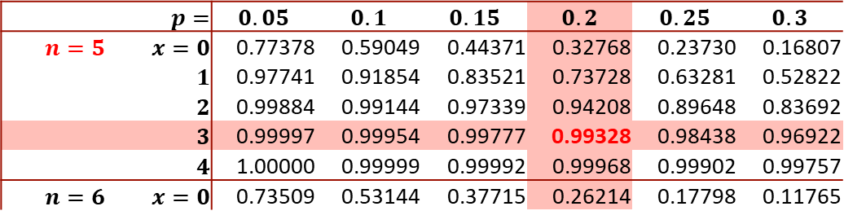

The Binomial Distribution
CUMULATIVE PROBABILITIES
Binomial Tables
An extract from the Binomial tables:
Using the extract from the Binomial table (above), find $P(X≤3)$ for the Binomial distribution $X\sim B(5,0.2)$.
From the table we have that: $P\left(X≤3\right)=0.99328$
 | $p=$ | $$0.05$$ | $$0.1$$ | $$0.15$$ | $$0.2$$ | $$0.25$$ | $$0.3$$
$n=5$ | $x=0$ | 0.77378 | 0.59049 | 0.44371 | 0.32768 | 0.23730 | 0.16807
 | $1$ | 0.97741 | 0.91854 | 0.83521 | 0.73728 | 0.63281 | 0.52822
 | $2$ | 0.99884 | 0.99144 | 0.97339 | 0.94208 | 0.89648 | 0.83692
 | $3$ | 0.99997 | 0.99954 | 0.99777 | 0.99328 | 0.98438 | 0.96922
 | $4$ | 1.00000 | 0.99999 | 0.99992 | 0.99968 | 0.99902 | 0.99757
$n=6$ | $x=0$ | 0.73509 | 0.53144 | 0.37715 | 0.26214 | 0.17798 | 0.11765
For a random variable $X$ a cumulative probability function gives the sum of all the individual probabilities up to and including the given value of $x$ in the calculation for $P(X≤x)$.
For the Binomial distribution $X\sim B(n,p)$ we can find $P(X≤x)$ using different sources including calculators or tables for various values of $n$ and $p$.
Example 1a
Solution Example 1a

Slide 6

The Binomial Distribution
CUMULATIVE PROBABILITIES
Binomial Tables
An extract from the Binomial tables:
Using the extract from the Binomial table (above), find $P(X≤2)$ for the Binomial distribution $X\sim B(5,0.15)$.
 | $p=$ | $$0.05$$ | $$0.1$$ | $$0.15$$ | $$0.2$$ | $$0.25$$ | $$0.3$$
$n=5$ | $x=0$ | 0.77378 | 0.59049 | 0.44371 | 0.32768 | 0.23730 | 0.16807
 | $1$ | 0.97741 | 0.91854 | 0.83521 | 0.73728 | 0.63281 | 0.52822
 | $2$ | 0.99884 | 0.99144 | 0.97339 | 0.94208 | 0.89648 | 0.83692
 | $3$ | 0.99997 | 0.99954 | 0.99777 | 0.99328 | 0.98438 | 0.96922
 | $4$ | 1.00000 | 0.99999 | 0.99992 | 0.99968 | 0.99902 | 0.99757
$n=6$ | $x=0$ | 0.73509 | 0.53144 | 0.37715 | 0.26214 | 0.17798 | 0.11765
For a random variable $X$ a cumulative probability function gives the sum of all the individual probabilities up to and including the given value of $x$ in the calculation for $P(X≤x)$.
For the Binomial distribution $X\sim B(n,p)$ we can find $P(X≤x)$ using different sources including calculators or tables for various values of $n$ and $p$.
Example 1b
Solution Example 1b

Slide 7
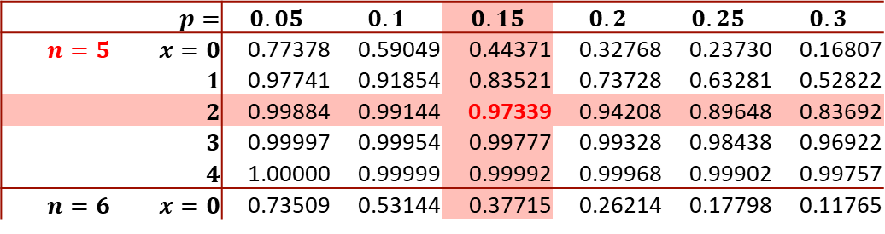

The Binomial Distribution
CUMULATIVE PROBABILITIES
Binomial Tables
An extract from the Binomial tables:
Using the extract from the Binomial table (above), find $P(X≤2)$ for the Binomial distribution $X\sim B(5,0.15)$.
From the table we have that: $P\left(X≤2\right)=0.97339$
 | $p=$ | $$0.05$$ | $$0.1$$ | $$0.15$$ | $$0.2$$ | $$0.25$$ | $$0.3$$
$n=5$ | $x=0$ | 0.77378 | 0.59049 | 0.44371 | 0.32768 | 0.23730 | 0.16807
 | $1$ | 0.97741 | 0.91854 | 0.83521 | 0.73728 | 0.63281 | 0.52822
 | $2$ | 0.99884 | 0.99144 | 0.97339 | 0.94208 | 0.89648 | 0.83692
 | $3$ | 0.99997 | 0.99954 | 0.99777 | 0.99328 | 0.98438 | 0.96922
 | $4$ | 1.00000 | 0.99999 | 0.99992 | 0.99968 | 0.99902 | 0.99757
$n=6$ | $x=0$ | 0.73509 | 0.53144 | 0.37715 | 0.26214 | 0.17798 | 0.11765
For a random variable $X$ a cumulative probability function gives the sum of all the individual probabilities up to and including the given value of $x$ in the calculation for $P(X≤x)$.
For the Binomial distribution $X\sim B(n,p)$ we can find $P(X≤x)$ using different sources including calculators or tables for various values of $n$ and $p$.
Example 1b
Solution Example 1b

Slide 8

The Binomial Distribution
CUMULATIVE PROBABILITIES
Binomial Tables
An extract from the Binomial tables:
Using the extract from the Binomial table (above), find $P(X≤0)$ for the Binomial distribution $X\sim B(6,0.3)$.
 | $p=$ | $$0.05$$ | $$0.1$$ | $$0.15$$ | $$0.2$$ | $$0.25$$ | $$0.3$$
$n=5$ | $x=0$ | 0.77378 | 0.59049 | 0.44371 | 0.32768 | 0.23730 | 0.16807
 | $1$ | 0.97741 | 0.91854 | 0.83521 | 0.73728 | 0.63281 | 0.52822
 | $2$ | 0.99884 | 0.99144 | 0.97339 | 0.94208 | 0.89648 | 0.83692
 | $3$ | 0.99997 | 0.99954 | 0.99777 | 0.99328 | 0.98438 | 0.96922
 | $4$ | 1.00000 | 0.99999 | 0.99992 | 0.99968 | 0.99902 | 0.99757
$n=6$ | $x=0$ | 0.73509 | 0.53144 | 0.37715 | 0.26214 | 0.17798 | 0.11765
For a random variable $X$ a cumulative probability function gives the sum of all the individual probabilities up to and including the given value of $x$ in the calculation for $P(X≤x)$.
For the Binomial distribution $X\sim B(n,p)$ we can find $P(X≤x)$ using different sources including calculators or tables for various values of $n$ and $p$.
Example 1c
Solution Example 1c

Slide 9
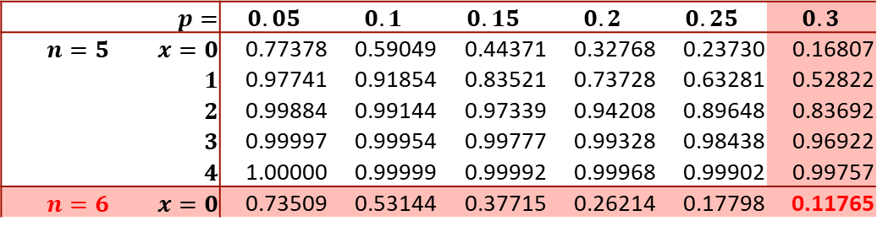

The Binomial Distribution
CUMULATIVE PROBABILITIES
Binomial Tables
An extract from the Binomial tables:
Using the extract from the Binomial table (above), find $P(X≤0)$ for the Binomial distribution $X\sim B(6,0.3)$.
From the table we have that: $P\left(X≤0\right)=0.11765$
 | $p=$ | $$0.05$$ | $$0.1$$ | $$0.15$$ | $$0.2$$ | $$0.25$$ | $$0.3$$
$n=5$ | $x=0$ | 0.77378 | 0.59049 | 0.44371 | 0.32768 | 0.23730 | 0.16807
 | $1$ | 0.97741 | 0.91854 | 0.83521 | 0.73728 | 0.63281 | 0.52822
 | $2$ | 0.99884 | 0.99144 | 0.97339 | 0.94208 | 0.89648 | 0.83692
 | $3$ | 0.99997 | 0.99954 | 0.99777 | 0.99328 | 0.98438 | 0.96922
 | $4$ | 1.00000 | 0.99999 | 0.99992 | 0.99968 | 0.99902 | 0.99757
$n=6$ | $x=0$ | 0.73509 | 0.53144 | 0.37715 | 0.26214 | 0.17798 | 0.11765
For a random variable $X$ a cumulative probability function gives the sum of all the individual probabilities up to and including the given value of $x$ in the calculation for $P(X≤x)$.
For the Binomial distribution $X\sim B(n,p)$ we can find $P(X≤x)$ using different sources including calculators or tables for various values of $n$ and $p$.
Example 1c
Solution Example 1c

Slide 10

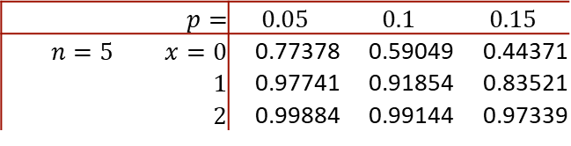
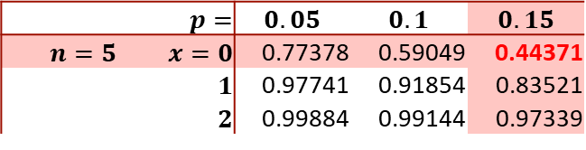
The Binomial Distribution
CUMULATIVE PROBABILITIES
Binomial Cumulative Probabilities in Excel
An extract from the Binomial tables:
These probabilities can also be found in Excel.
To find $P(X≤0)$ for $X\sim B(5,0.15)$ type:
=BINOM.DIST(0,5,0.15,0)
This will give you a value of 0.443705 in Excel.
Some calculators have a binomial distribution function labelled ‘Binomial CD’.
See if you can find $P(X≤0)$for $X\sim B(5,0.15)$ on your calculator.
 | $p=$ | $$0.05$$ | $$0.1$$ | $$0.15$$
$n=5$ | $x=0$ | 0.77378 | 0.59049 | 0.44371
 | $1$ | 0.97741 | 0.91854 | 0.83521
 | $2$ | 0.99884 | 0.99144 | 0.97339
 | $p=$ | $$0.05$$ | $$0.1$$ | $$0.15$$
$n=5$ | $x=0$ | 0.77378 | 0.59049 | 0.44371
 | $1$ | 0.97741 | 0.91854 | 0.83521
 | $2$ | 0.99884 | 0.99144 | 0.97339
For a random variable $X$ a cumulative probability function gives the sum of all the individual probabilities up to and including the given value of $x$ in the calculation for $P(X≤x)$.
For the Binomial distribution $X\sim B(n,p)$ we can find $P(X≤x)$ using different sources including calculators or tables for various values of $n$ and $p$.
Binomial Cumulative Prob on Calculator

Slide 11

The Binomial Distribution
CUMULATIVE PROBABILITIES
Binomial Cumulative Probabilities in Excel
In Excel, to find $P(X≤x)$ for $X\sim B(n,p)$ type:
=BINOM.DIST($x,n,p,x$)
The random variable $X\sim B(25,0.45)$. Find:
$P(X≤9)$
$P(X<8)$
$P(X≥12)$
For a random variable $X$ a cumulative probability function gives the sum of all the individual probabilities up to and including the given value of $x$ in the calculation for $P(X≤x)$.
For the Binomial distribution $X\sim B(n,p)$ we can find $P(X≤x)$ using different sources including calculators or tables for various values of $n$ and $p$.
Example 2

Slide 12

The Binomial Distribution
CUMULATIVE PROBABILITIES
Binomial Cumulative Probabilities in Excel
In Excel, to find $P(X≤x)$ for $X\sim B(n,p)$ type:
=BINOM.DIST($x,n,p,x$)
The random variable $X\sim B(25,0.45)$. Find $P\left(X≤9\right).$
In Excel, type =BINOM.DIST($9,25,0.45,9$)
This gives:
$$P\left(X≤9\right)=0.242371$$
Is this value consistent with your calculator (if your calculator is able to calculate this)?
For a random variable $X$ a cumulative probability function gives the sum of all the individual probabilities up to and including the given value of $x$ in the calculation for $P(X≤x)$.
For the Binomial distribution $X\sim B(n,p)$ we can find $P(X≤x)$ using different sources including calculators or tables for various values of $n$ and $p$.
Example 2a
Solution Example 2a

Slide 13

The Binomial Distribution
CUMULATIVE PROBABILITIES
Binomial Cumulative Probabilities in Excel
In Excel, to find $P(X≤x)$ for $X\sim B(n,p)$ type:
=BINOM.DIST($x,n,p,x$)
The random variable $X\sim B(25,0.45)$. Find $P\left(X<8\right).$
Now $P\left(X<8\right)=P(X≤7).$
In Excel, type =BINOM.DIST($7,25,0.45,7$)
This gives:
$$P\left(X≤7\right)=0.242371$$
Is this value consistent with your calculator (if your calculator is able to calculate this)?
For a random variable $X$ a cumulative probability function gives the sum of all the individual probabilities up to and including the given value of $x$ in the calculation for $P(X≤x)$.
For the Binomial distribution $X\sim B(n,p)$ we can find $P(X≤x)$ using different sources including calculators or tables for various values of $n$ and $p$.
Example 2b
Solution Example 2b

Slide 14

The Binomial Distribution
CUMULATIVE PROBABILITIES
Binomial Cumulative Probabilities in Excel
In Excel, to find $P(X≤x)$ for $X\sim B(n,p)$ type:
=BINOM.DIST($x,n,p,x$)
The random variable $X\sim B(25,0.45)$. Find $P\left(X≥12\right).$
Now $P\left(X≥12\right)=1−P(X<12)=1−P(X≤11).$
In Excel, type =BINOM.DIST($11,25,0.45,11$)
This gives:
$P\left(X≥12\right)=1−P\left(X≤11\right)$
$=1−0.54257$
$=0.45743$
For a random variable $X$ a cumulative probability function gives the sum of all the individual probabilities up to and including the given value of $x$ in the calculation for $P(X≤x)$.
For the Binomial distribution $X\sim B(n,p)$ we can find $P(X≤x)$ using different sources including calculators or tables for various values of $n$ and $p$.
Example 2c
Solution Example 2c

Slide 15
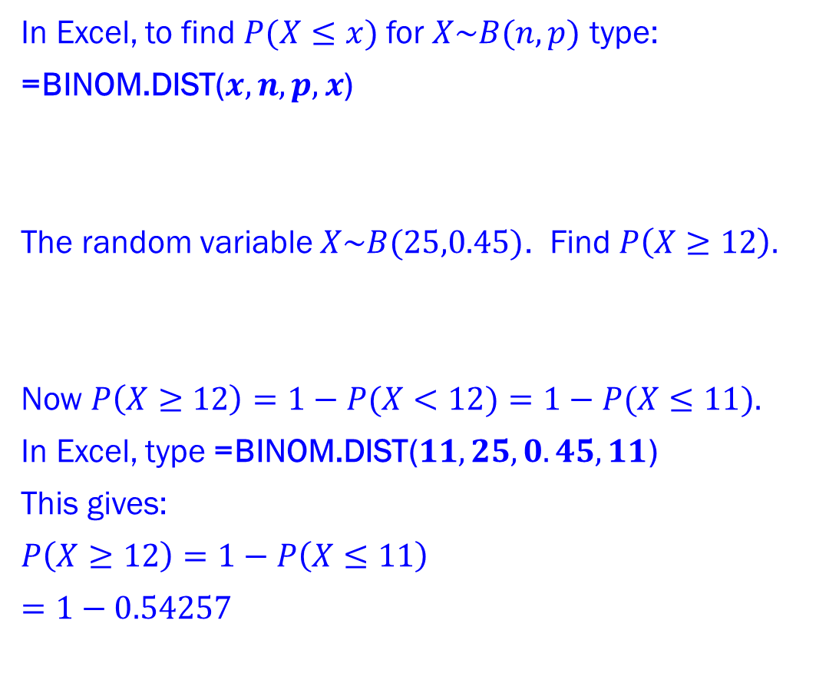
The Binomial Distribution
CUMULATIVE PROBABILITIES
Binomial Cumulative Probabilities in Excel
In Excel, to find $P(X≤x)$ for $X\sim B(n,p)$ type:
=BINOM.DIST($x,n,p,x$)
The random variable $X\sim B(25,0.45)$. Find $P\left(X≥12\right).$
Now $P\left(X≥12\right)=1−P(X<12)=1−P(X≤11).$
In Excel, type =BINOM.DIST($11,25,0.45,11$)
This gives:
$P\left(X≥12\right)=1−P\left(X≤11\right)$
$=1−0.54257$
For a random variable $X$ a cumulative probability function gives the sum of all the individual probabilities up to and including the given value of $x$ in the calculation for $P(X≤x)$.
For the Binomial distribution $X\sim B(n,p)$ we can find $P(X≤x)$ using different sources including calculators or tables for various values of $n$ and $p$.
Example 2c
Solution Example 2c

Slide 16
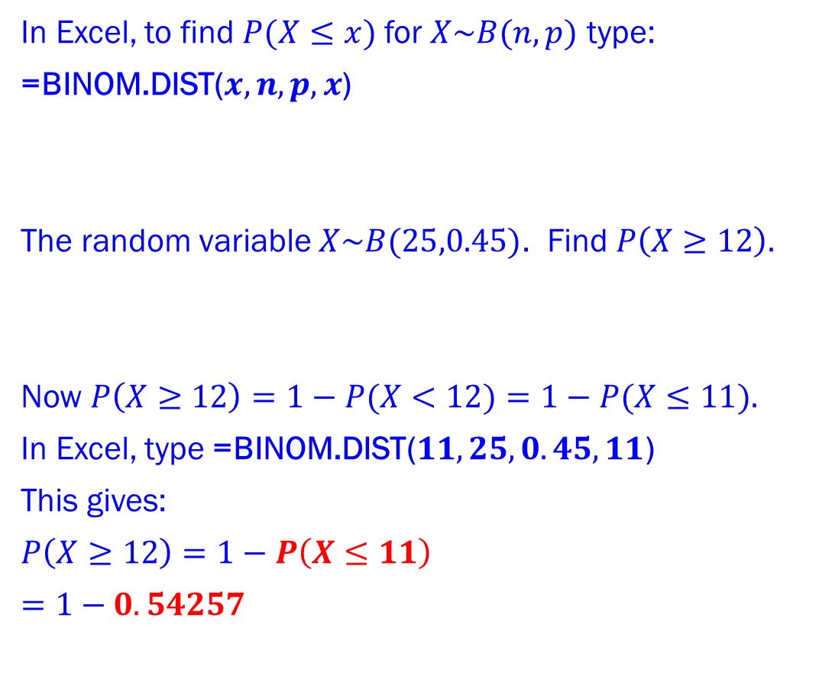
The Binomial Distribution
CUMULATIVE PROBABILITIES
Binomial Cumulative Probabilities in Excel
In Excel, to find $P(X≤x)$ for $X\sim B(n,p)$ type:
=BINOM.DIST($x,n,p,x$)
The random variable $X\sim B(25,0.45)$. Find $P\left(X≥12\right).$
Now $P\left(X≥12\right)=1−P(X<12)=1−P(X≤11).$
In Excel, type =BINOM.DIST($11,25,0.45,11$)
This gives:
$P\left(X≥12\right)=1−P\left(X≤11\right)$
$=1−0.54257$
$=0.45743$
For a random variable $X$ a cumulative probability function gives the sum of all the individual probabilities up to and including the given value of $x$ in the calculation for $P(X≤x)$.
For the Binomial distribution $X\sim B(n,p)$ we can find $P(X≤x)$ using different sources including calculators or tables for various values of $n$ and $p$.
Example 2c
Solution Example 2c

Slide 17
The Binomial Distribution
CUMULATIVE PROBABILITIES
Binomial Cumulative Probabilities in Excel
In Excel, to find $P(X≤x)$ for $X\sim B(n,p)$ type:
=BINOM.DIST($x,n,p,x$)
The random variable $X\sim B(25,0.45)$. Find $P\left(X≥12\right).$
Now $P\left(X≥12\right)=1−P(X<12)=1−P(X≤11).$
In Excel, type =BINOM.DIST($11,25,0.45,11$)
This gives:
$P\left(X≥12\right)=1−P\left(X≤11\right)$
$=1−0.54257$
For a random variable $X$ a cumulative probability function gives the sum of all the individual probabilities up to and including the given value of $x$ in the calculation for $P(X≤x)$.
For the Binomial distribution $X\sim B(n,p)$ we can find $P(X≤x)$ using different sources including calculators or tables for various values of $n$ and $p$.
Example 2c
Solution Example 2c

Slide 18
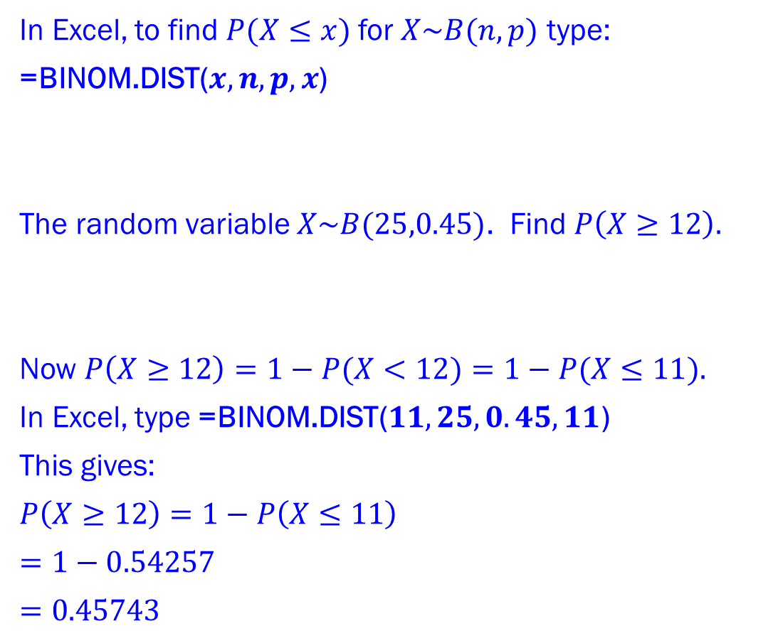
The Binomial Distribution
CUMULATIVE PROBABILITIES
Binomial Cumulative Probabilities in Excel
In Excel, to find $P(X≤x)$ for $X\sim B(n,p)$ type:
=BINOM.DIST($x,n,p,x$)
The random variable $X\sim B(25,0.45)$. Find $P\left(X≥12\right).$
Now $P\left(X≥12\right)=1−P(X<12)=1−P(X≤11).$
In Excel, type =BINOM.DIST($11,25,0.45,11$)
This gives:
$P\left(X≥12\right)=1−P\left(X≤11\right)$
$=1−0.54257$
$=0.45743$
For a random variable $X$ a cumulative probability function gives the sum of all the individual probabilities up to and including the given value of $x$ in the calculation for $P(X≤x)$.
For the Binomial distribution $X\sim B(n,p)$ we can find $P(X≤x)$ using different sources including calculators or tables for various values of $n$ and $p$.
Example 2c
Solution Example 2c

Slide 19
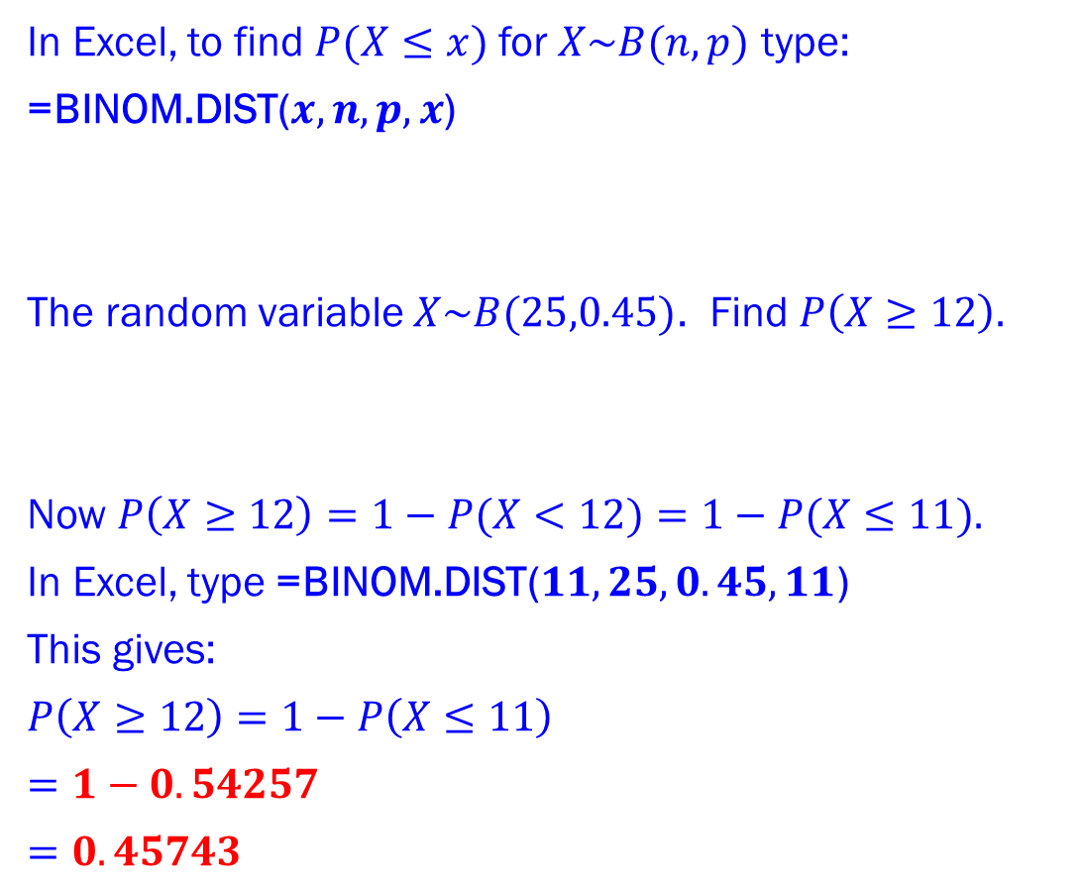
The Binomial Distribution
CUMULATIVE PROBABILITIES
Binomial Cumulative Probabilities in Excel
In Excel, to find $P(X≤x)$ for $X\sim B(n,p)$ type:
=BINOM.DIST($x,n,p,x$)
The random variable $X\sim B(25,0.45)$. Find $P\left(X≥12\right).$
Now $P\left(X≥12\right)=1−P(X<12)=1−P(X≤11).$
In Excel, type =BINOM.DIST($11,25,0.45,11$)
This gives:
$P\left(X≥12\right)=1−P\left(X≤11\right)$
$=1−0.54257$
$=0.45743$
For a random variable $X$ a cumulative probability function gives the sum of all the individual probabilities up to and including the given value of $x$ in the calculation for $P(X≤x)$.
For the Binomial distribution $X\sim B(n,p)$ we can find $P(X≤x)$ using different sources including calculators or tables for various values of $n$ and $p$.
Example 2c
Solution Example 2c

Slide 20
The Binomial Distribution
CUMULATIVE PROBABILITIES
Binomial Cumulative Probabilities in Excel
In Excel, to find $P(X≤x)$ for $X\sim B(n,p)$ type:
=BINOM.DIST($x,n,p,x$)
The random variable $X\sim B(25,0.45)$. Find $P\left(X≥12\right).$
Now $P\left(X≥12\right)=1−P(X<12)=1−P(X≤11).$
In Excel, type =BINOM.DIST($11,25,0.45,11$)
This gives:
$P\left(X≥12\right)=1−P\left(X≤11\right)$
$=1−0.54257$
$=0.45743$
For a random variable $X$ a cumulative probability function gives the sum of all the individual probabilities up to and including the given value of $x$ in the calculation for $P(X≤x)$.
For the Binomial distribution $X\sim B(n,p)$ we can find $P(X≤x)$ using different sources including calculators or tables for various values of $n$ and $p$.
Example 2c
Solution Example 2c

Slide 21
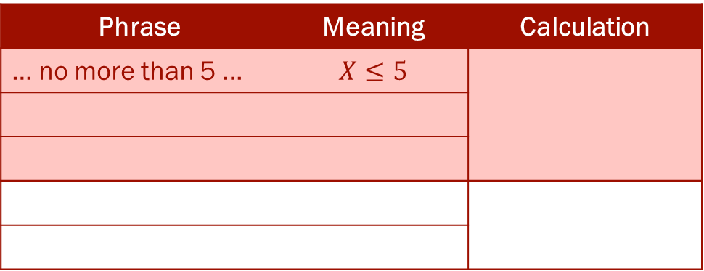
The Binomial Distribution
CUMULATIVE PROBABILITIES
Phrase Interpretation
It is crucial, when answering probability questions, to interpret phrases correctly.
The following table gives a few examples:
For a random variable $X$ a cumulative probability function gives the sum of all the individual probabilities up to and including the given value of $x$ in the calculation for $P(X≤x)$.
For the Binomial distribution $X\sim B(n,p)$ we can find $P(X≤x)$ using different sources including calculators or tables for various values of $n$ and $p$.
Phrase | Meaning | Calculation
… no more than 5 … | $$X≤5$$
 |  | $$P(X≤5)$$
 |  | $$P(X≤5)$$
 |  | $$1−P(X≤9)$$

Slide 22
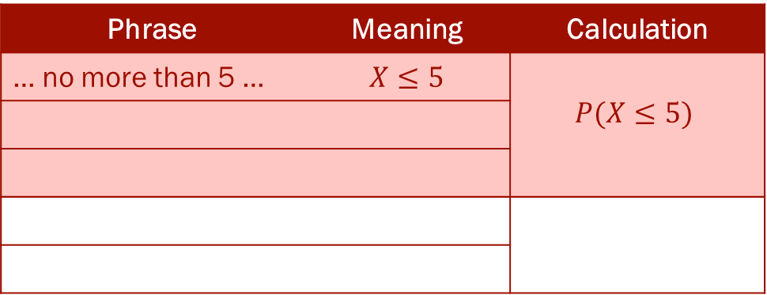
The Binomial Distribution
CUMULATIVE PROBABILITIES
Phrase Interpretation
It is crucial, when answering probability questions, to interpret phrases correctly.
The following table gives a few examples:
For a random variable $X$ a cumulative probability function gives the sum of all the individual probabilities up to and including the given value of $x$ in the calculation for $P(X≤x)$.
For the Binomial distribution $X\sim B(n,p)$ we can find $P(X≤x)$ using different sources including calculators or tables for various values of $n$ and $p$.
Phrase | Meaning | Calculation
… no more than 5 … | $$X≤5$$ | $$P(X≤5)$$
 |  | $$P(X≤5)$$
 |  | $$P(X≤5)$$
 |  | $$1−P(X≤9)$$

Slide 23
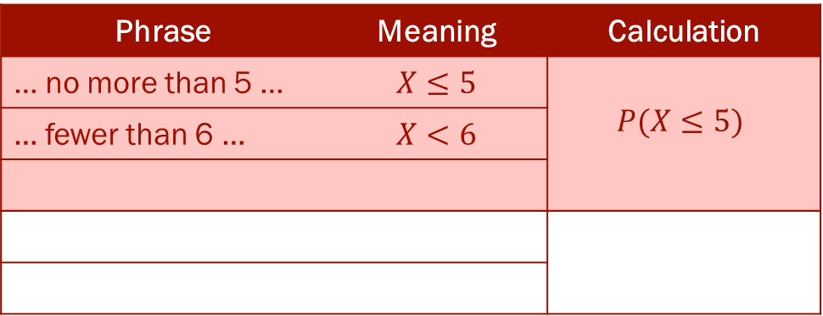
The Binomial Distribution
CUMULATIVE PROBABILITIES
Phrase Interpretation
It is crucial, when answering probability questions, to interpret phrases correctly.
The following table gives a few examples:
For a random variable $X$ a cumulative probability function gives the sum of all the individual probabilities up to and including the given value of $x$ in the calculation for $P(X≤x)$.
For the Binomial distribution $X\sim B(n,p)$ we can find $P(X≤x)$ using different sources including calculators or tables for various values of $n$ and $p$.
Phrase | Meaning | Calculation
… no more than 5 … | $$X≤5$$ | $$P(X≤5)$$
… fewer than 6 … | $$X<6$$ | $$P(X≤5)$$
 |  | $$P(X≤5)$$
 |  | $$1−P(X≤9)$$

Slide 24
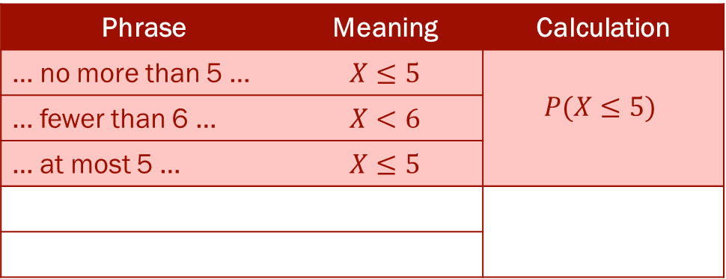
The Binomial Distribution
CUMULATIVE PROBABILITIES
Phrase Interpretation
It is crucial, when answering probability questions, to interpret phrases correctly.
The following table gives a few examples:
For a random variable $X$ a cumulative probability function gives the sum of all the individual probabilities up to and including the given value of $x$ in the calculation for $P(X≤x)$.
For the Binomial distribution $X\sim B(n,p)$ we can find $P(X≤x)$ using different sources including calculators or tables for various values of $n$ and $p$.
Phrase | Meaning | Calculation
… no more than 5 … | $$X≤5$$ | $$P(X≤5)$$
… fewer than 6 … | $$X<6$$ | $$P(X≤5)$$
… at most 5 … | $$X≤5$$ | $$P(X≤5)$$
 |  | $$1−P(X≤9)$$

Slide 25
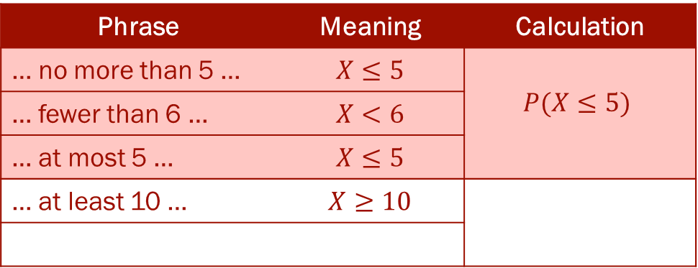
The Binomial Distribution
CUMULATIVE PROBABILITIES
Phrase Interpretation
It is crucial, when answering probability questions, to interpret phrases correctly.
The following table gives a few examples:
For a random variable $X$ a cumulative probability function gives the sum of all the individual probabilities up to and including the given value of $x$ in the calculation for $P(X≤x)$.
For the Binomial distribution $X\sim B(n,p)$ we can find $P(X≤x)$ using different sources including calculators or tables for various values of $n$ and $p$.
Phrase | Meaning | Calculation
… no more than 5 … | $$X≤5$$ | $$P(X≤5)$$
… fewer than 6 … | $$X<6$$ | $$P(X≤5)$$
… at most 5 … | $$X≤5$$ | $$P(X≤5)$$
… at least 10 … | $$X≥10$$
 |  | $$1−P(X≤9)$$

Slide 26
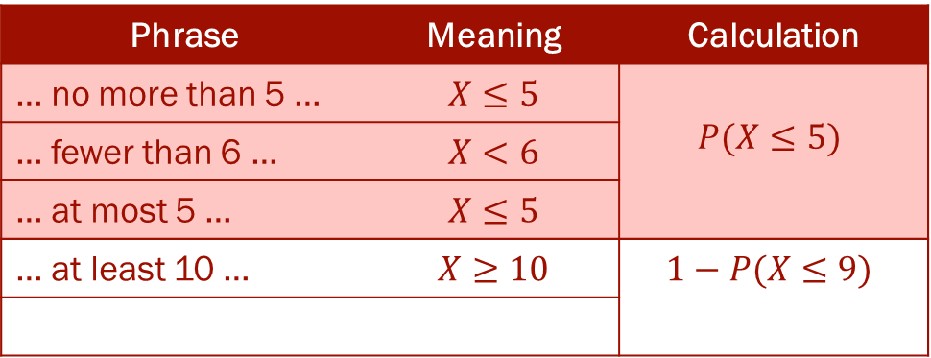
The Binomial Distribution
CUMULATIVE PROBABILITIES
Phrase Interpretation
It is crucial, when answering probability questions, to interpret phrases correctly.
The following table gives a few examples:
For a random variable $X$ a cumulative probability function gives the sum of all the individual probabilities up to and including the given value of $x$ in the calculation for $P(X≤x)$.
For the Binomial distribution $X\sim B(n,p)$ we can find $P(X≤x)$ using different sources including calculators or tables for various values of $n$ and $p$.
Phrase | Meaning | Calculation
… no more than 5 … | $$X≤5$$ | $$P(X≤5)$$
… fewer than 6 … | $$X<6$$ | $$P(X≤5)$$
… at most 5 … | $$X≤5$$ | $$P(X≤5)$$
… at least 10 … | $$X≥10$$ | $$1−P(X≤9)$$
 |  | $$1−P(X≤9)$$

Slide 27
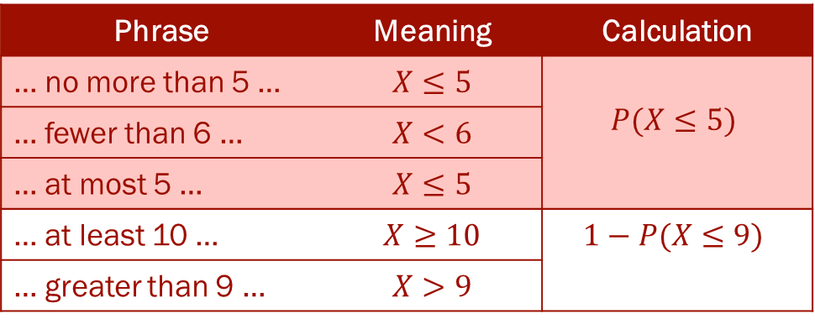
The Binomial Distribution
CUMULATIVE PROBABILITIES
Phrase Interpretation
It is crucial, when answering probability questions, to interpret phrases correctly.
The following table gives a few examples:
For a random variable $X$ a cumulative probability function gives the sum of all the individual probabilities up to and including the given value of $x$ in the calculation for $P(X≤x)$.
For the Binomial distribution $X\sim B(n,p)$ we can find $P(X≤x)$ using different sources including calculators or tables for various values of $n$ and $p$.
Phrase | Meaning | Calculation
… no more than 5 … | $$X≤5$$ | $$P(X≤5)$$
… fewer than 6 … | $$X<6$$ | $$P(X≤5)$$
… at most 5 … | $$X≤5$$ | $$P(X≤5)$$
… at least 10 … | $$X≥10$$ | $$1−P(X≤9)$$
… greater than 9 … | $$X>9$$ | $$1−P(X≤9)$$

Slide 28

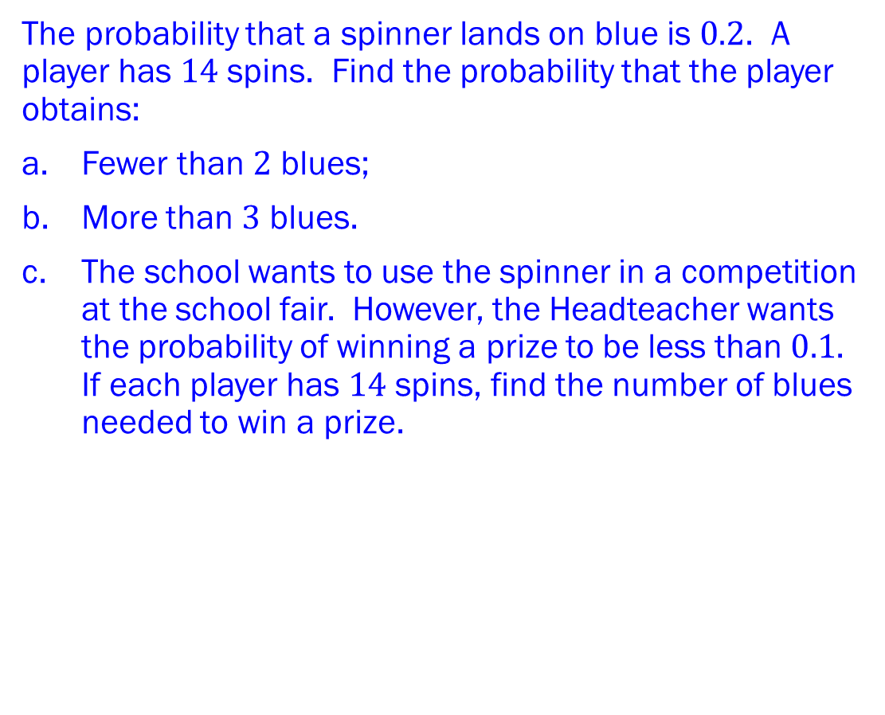
The Binomial Distribution
CUMULATIVE PROBABILITIES
Example 3
The probability that a spinner lands on blue is $0.2$. A player has $14$ spins. Find the probability that the player obtains:
Fewer than $2$ blues;
More than $3$ blues.
The school wants to use the spinner in a competition at the school fair. However, the Headteacher wants the probability of winning a prize to be less than $0.1$. If each player has $14$ spins, find the number of blues needed to win a prize.
For a random variable $X$ a cumulative probability function gives the sum of all the individual probabilities up to and including the given value of $x$ in the calculation for $P(X≤x)$.
For the Binomial distribution $X\sim B(n,p)$ we can find $P\left(X≤x\right).$
In Excel, to find $P(X≤x)$ for $X\sim B(n,p)$ type: =BINOM.DIST($x,n,p,x$)
In Excel, to find smallest $r$ with $P\left(X≥r\right)<α$ for $X\sim B(n,p)$ type:
=BINOM.INV($n,p,1−α$) then add 1.

Slide 29
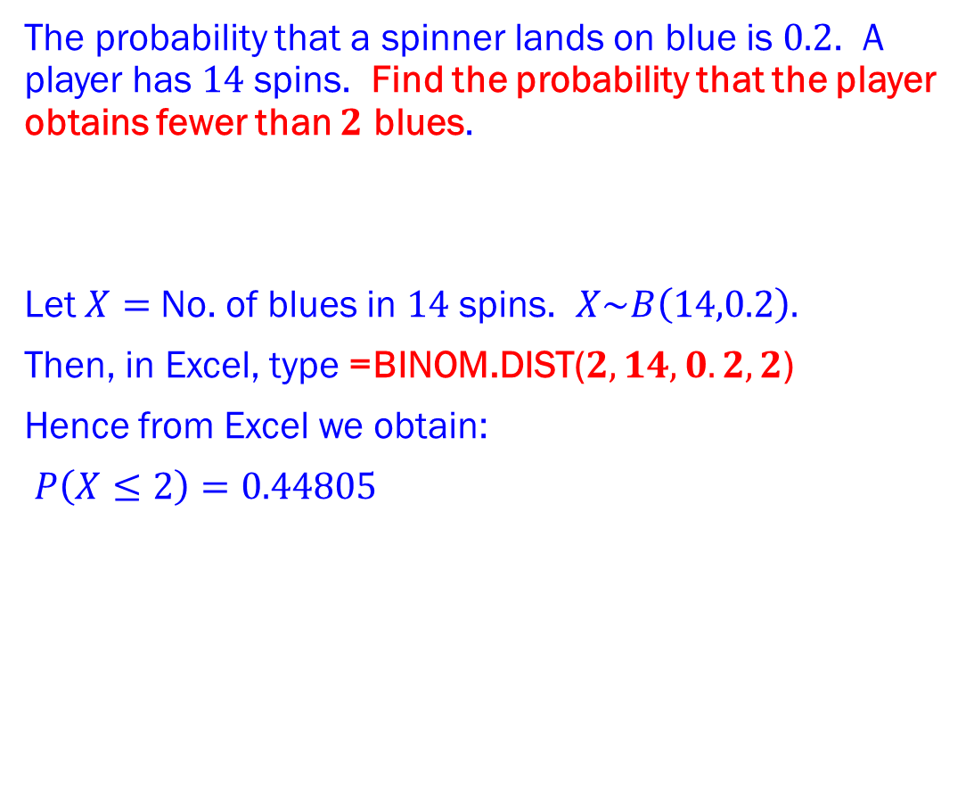
The Binomial Distribution
CUMULATIVE PROBABILITIES
Example 3a
The probability that a spinner lands on blue is $0.2$. A player has $14$ spins. Find the probability that the player obtains fewer than $2$ blues.
Let $X=$ No. of blues in $14$ spins. $X\sim B\left(14,0.2\right).$
Then, in Excel, type =BINOM.DIST($2,14,0.2,2$)
Hence from Excel we obtain:
$P\left(X≤2\right)=0.44805$
For a random variable $X$ a cumulative probability function gives the sum of all the individual probabilities up to and including the given value of $x$ in the calculation for $P(X≤x)$.
For the Binomial distribution $X\sim B(n,p)$ we can find $P\left(X≤x\right).$
In Excel, to find $P(X≤x)$ for $X\sim B(n,p)$ type: =BINOM.DIST($x,n,p,x$)
In Excel, to find smallest $r$ with $P\left(X≥r\right)<α$ for $X\sim B(n,p)$ type:
=BINOM.INV($n,p,1−α$) then add 1.
Solution Example 3a

Slide 30
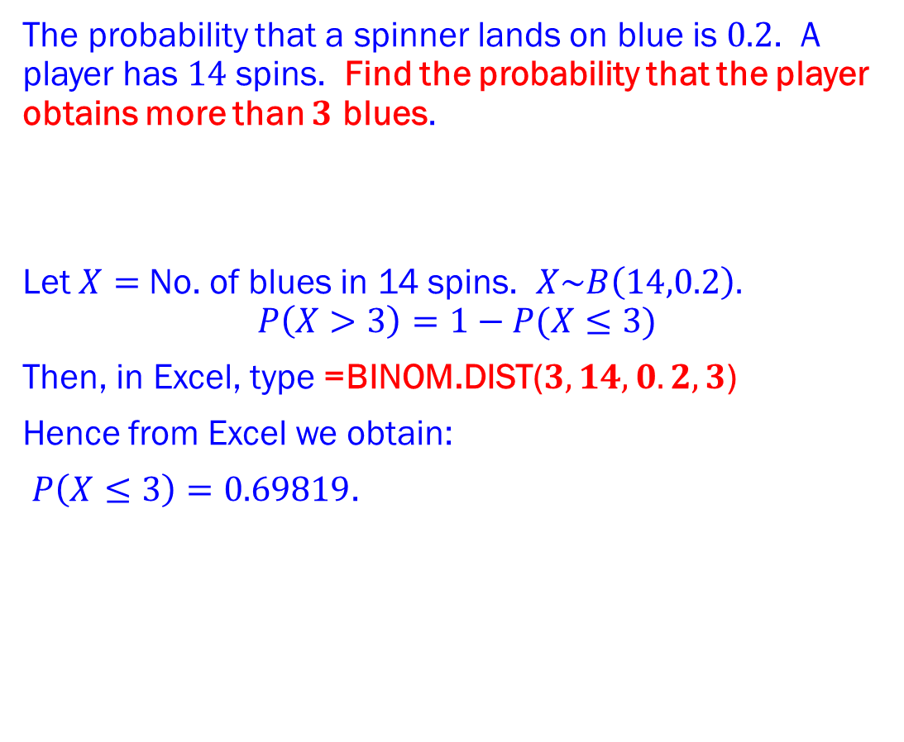
The Binomial Distribution
CUMULATIVE PROBABILITIES
Example 3b
The probability that a spinner lands on blue is $0.2$. A player has $14$ spins. Find the probability that the player obtains more than $3$ blues.
Let $X=$ No. of blues in 14 spins. $X\sim B\left(14,0.2\right).$
$$P\left(X>3\right)=1−P(X≤3)$$
Then, in Excel, type =BINOM.DIST($3,14,0.2,3$)
Hence from Excel we obtain:
$P\left(X≤3\right)=0.69819$.
For a random variable $X$ a cumulative probability function gives the sum of all the individual probabilities up to and including the given value of $x$ in the calculation for $P(X≤x)$.
For the Binomial distribution $X\sim B(n,p)$ we can find $P\left(X≤x\right).$
In Excel, to find $P(X≤x)$ for $X\sim B(n,p)$ type: =BINOM.DIST($x,n,p,x$)
In Excel, to find smallest $r$ with $P\left(X≥r\right)<α$ for $X\sim B(n,p)$ type:
=BINOM.INV($n,p,1−α$) then add 1.
Solution Example 3b

Slide 31
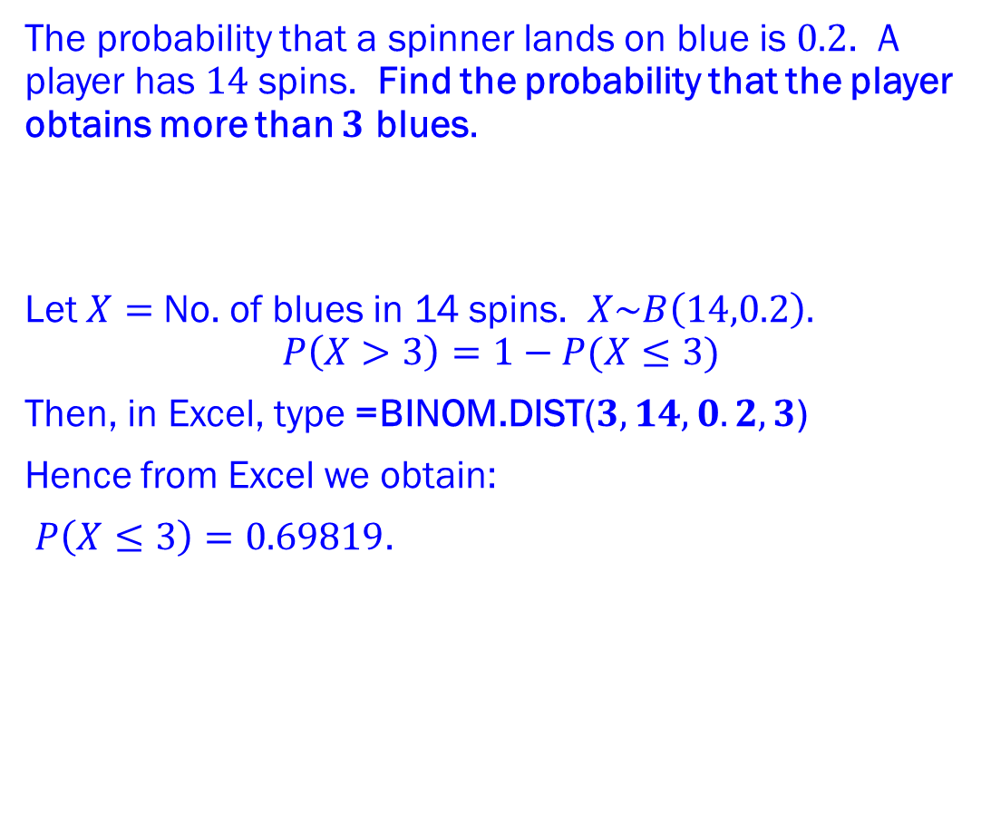
The Binomial Distribution
CUMULATIVE PROBABILITIES
Example 3b
The probability that a spinner lands on blue is $0.2$. A player has $14$ spins. Find the probability that the player obtains more than $3$ blues.
Let $X=$ No. of blues in 14 spins. $X\sim B\left(14,0.2\right).$
$$P\left(X>3\right)=1−P(X≤3)$$
Then, in Excel, type =BINOM.DIST($3,14,0.2,3$)
Hence from Excel we obtain:
$P\left(X≤3\right)=0.69819$.
For a random variable $X$ a cumulative probability function gives the sum of all the individual probabilities up to and including the given value of $x$ in the calculation for $P(X≤x)$.
For the Binomial distribution $X\sim B(n,p)$ we can find $P\left(X≤x\right).$
In Excel, to find $P(X≤x)$ for $X\sim B(n,p)$ type: =BINOM.DIST($x,n,p,x$)
In Excel, to find smallest $r$ with $P\left(X≥r\right)<α$ for $X\sim B(n,p)$ type:
=BINOM.INV($n,p,1−α$) then add 1.
Solution Example 3b

Slide 32
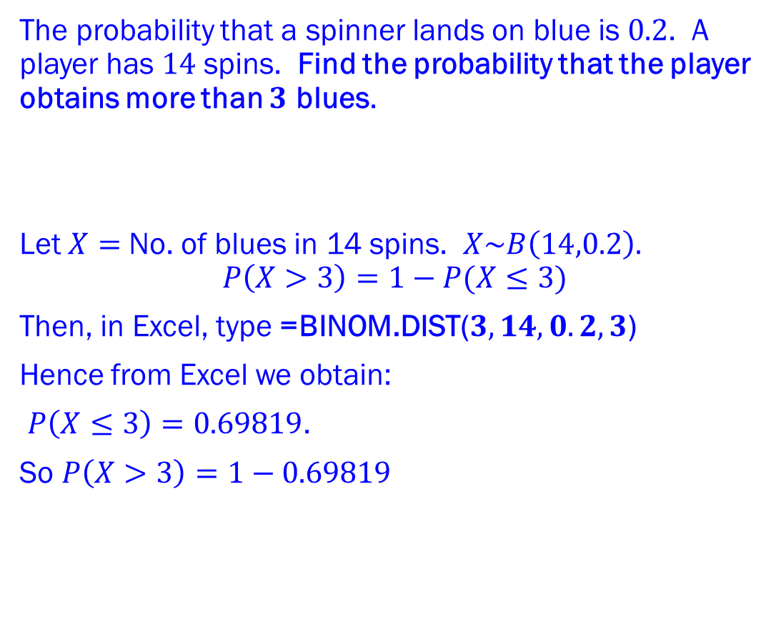
The Binomial Distribution
CUMULATIVE PROBABILITIES
Example 3b
The probability that a spinner lands on blue is $0.2$. A player has $14$ spins. Find the probability that the player obtains more than $3$ blues.
Let $X=$ No. of blues in 14 spins. $X\sim B\left(14,0.2\right).$
$$P\left(X>3\right)=1−P(X≤3)$$
Then, in Excel, type =BINOM.DIST($3,14,0.2,3$)
Hence from Excel we obtain:
$P\left(X≤3\right)=0.69819$.
So $P\left(X>3\right)=1−0.69819$
For a random variable $X$ a cumulative probability function gives the sum of all the individual probabilities up to and including the given value of $x$ in the calculation for $P(X≤x)$.
For the Binomial distribution $X\sim B(n,p)$ we can find $P\left(X≤x\right).$
In Excel, to find $P(X≤x)$ for $X\sim B(n,p)$ type: =BINOM.DIST($x,n,p,x$)
In Excel, to find smallest $r$ with $P\left(X≥r\right)<α$ for $X\sim B(n,p)$ type:
=BINOM.INV($n,p,1−α$) then add 1.
Solution Example 3b

Slide 33
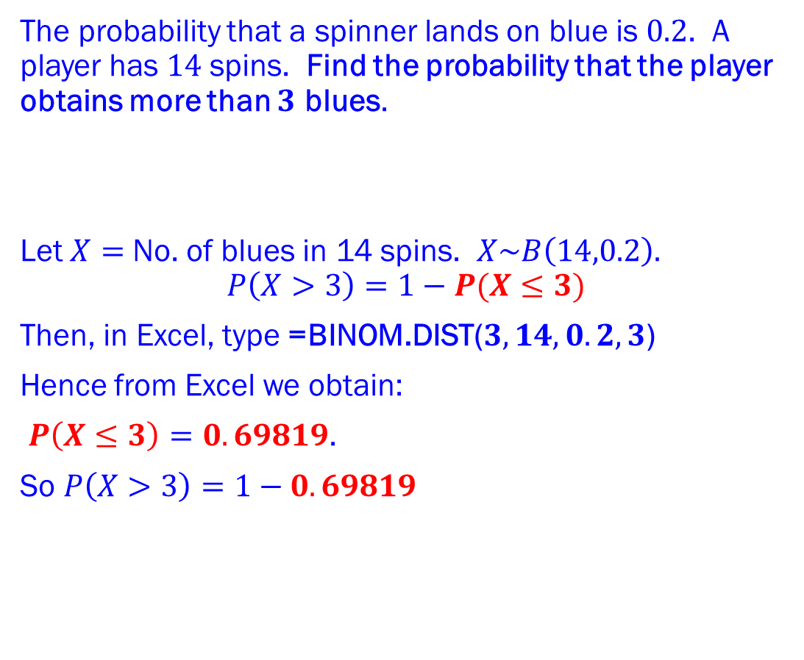
The Binomial Distribution
CUMULATIVE PROBABILITIES
Example 3b
The probability that a spinner lands on blue is $0.2$. A player has $14$ spins. Find the probability that the player obtains more than $3$ blues.
Let $X=$ No. of blues in 14 spins. $X\sim B\left(14,0.2\right).$
$$P\left(X>3\right)=1−P(X≤3)$$
Then, in Excel, type =BINOM.DIST($3,14,0.2,3$)
Hence from Excel we obtain:
$P\left(X≤3\right)=0.69819$.
So $P\left(X>3\right)=1−0.69819$
For a random variable $X$ a cumulative probability function gives the sum of all the individual probabilities up to and including the given value of $x$ in the calculation for $P(X≤x)$.
For the Binomial distribution $X\sim B(n,p)$ we can find $P\left(X≤x\right).$
In Excel, to find $P(X≤x)$ for $X\sim B(n,p)$ type: =BINOM.DIST($x,n,p,x$)
In Excel, to find smallest $r$ with $P\left(X≥r\right)<α$ for $X\sim B(n,p)$ type:
=BINOM.INV($n,p,1−α$) then add 1.
Solution Example 3b

Slide 34
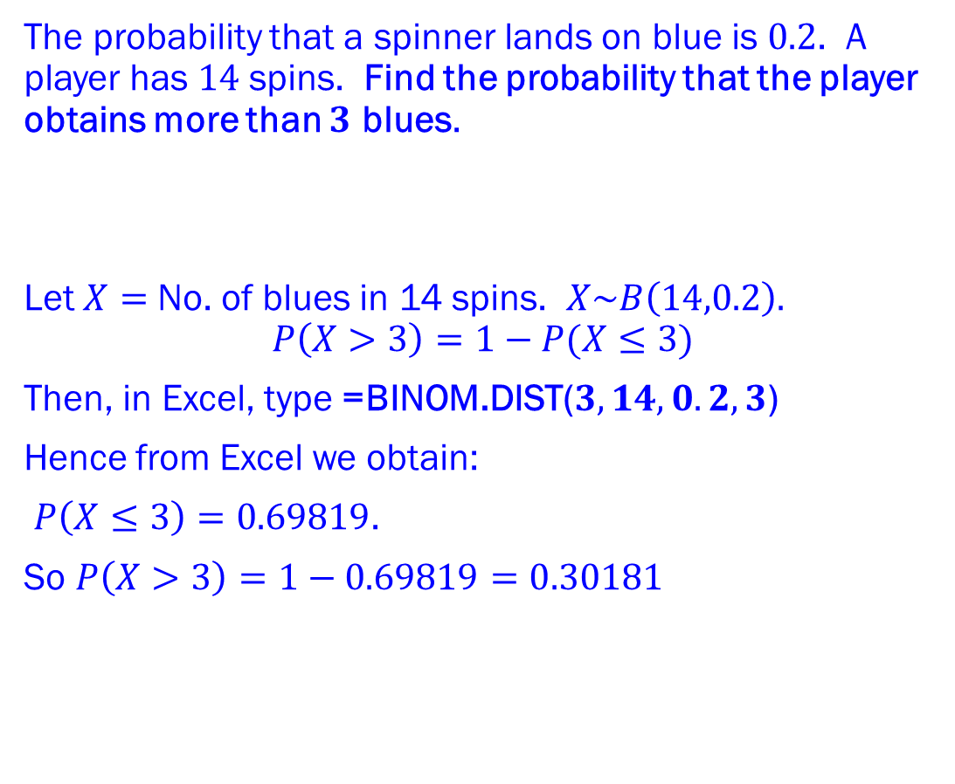
The Binomial Distribution
CUMULATIVE PROBABILITIES
Example 3b
The probability that a spinner lands on blue is $0.2$. A player has $14$ spins. Find the probability that the player obtains more than $3$ blues.
Let $X=$ No. of blues in 14 spins. $X\sim B\left(14,0.2\right).$
$$P\left(X>3\right)=1−P(X≤3)$$
Then, in Excel, type =BINOM.DIST($3,14,0.2,3$)
Hence from Excel we obtain:
$P\left(X≤3\right)=0.69819$.
So $P\left(X>3\right)=1−0.69819=0.30181$
For a random variable $X$ a cumulative probability function gives the sum of all the individual probabilities up to and including the given value of $x$ in the calculation for $P(X≤x)$.
For the Binomial distribution $X\sim B(n,p)$ we can find $P\left(X≤x\right).$
In Excel, to find $P(X≤x)$ for $X\sim B(n,p)$ type: =BINOM.DIST($x,n,p,x$)
In Excel, to find smallest $r$ with $P\left(X≥r\right)<α$ for $X\sim B(n,p)$ type:
=BINOM.INV($n,p,1−α$) then add 1.
Solution Example 3b

Slide 35
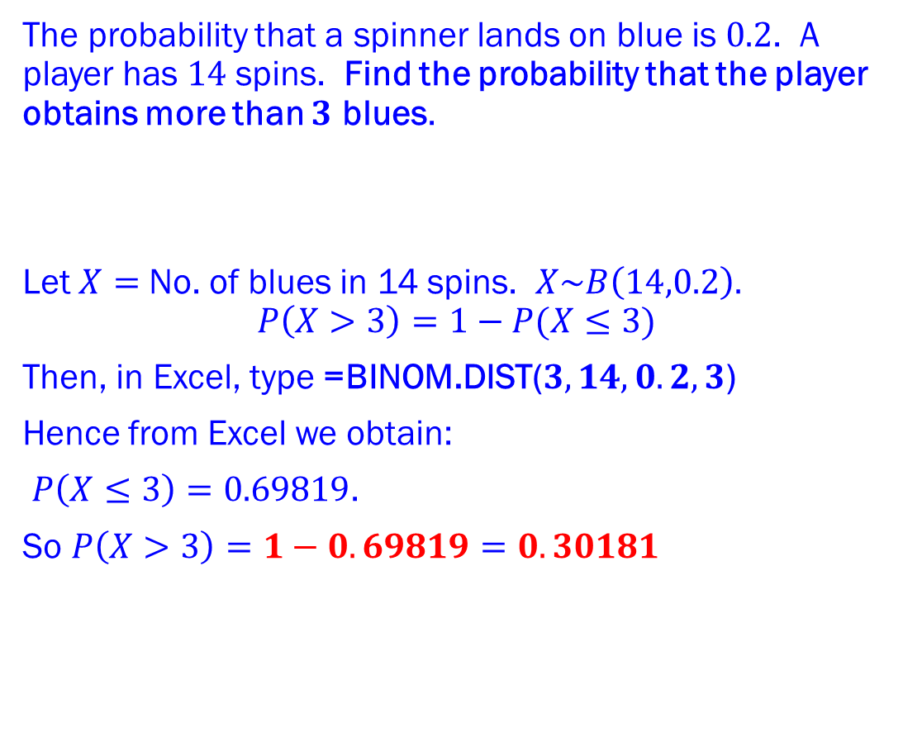
The Binomial Distribution
CUMULATIVE PROBABILITIES
Example 3b
The probability that a spinner lands on blue is $0.2$. A player has $14$ spins. Find the probability that the player obtains more than $3$ blues.
Let $X=$ No. of blues in 14 spins. $X\sim B\left(14,0.2\right).$
$$P\left(X>3\right)=1−P(X≤3)$$
Then, in Excel, type =BINOM.DIST($3,14,0.2,3$)
Hence from Excel we obtain:
$P\left(X≤3\right)=0.69819$.
So $P\left(X>3\right)=1−0.69819=0.30181$
For a random variable $X$ a cumulative probability function gives the sum of all the individual probabilities up to and including the given value of $x$ in the calculation for $P(X≤x)$.
For the Binomial distribution $X\sim B(n,p)$ we can find $P\left(X≤x\right).$
In Excel, to find $P(X≤x)$ for $X\sim B(n,p)$ type: =BINOM.DIST($x,n,p,x$)
In Excel, to find smallest $r$ with $P\left(X≥r\right)<α$ for $X\sim B(n,p)$ type:
=BINOM.INV($n,p,1−α$) then add 1.
Solution Example 3b

Slide 36
The Binomial Distribution
CUMULATIVE PROBABILITIES
Example 3b
The probability that a spinner lands on blue is $0.2$. A player has $14$ spins. Find the probability that the player obtains more than $3$ blues.
Let $X=$ No. of blues in 14 spins. $X\sim B\left(14,0.2\right).$
$$P\left(X>3\right)=1−P(X≤3)$$
Then, in Excel, type =BINOM.DIST($3,14,0.2,3$)
Hence from Excel we obtain:
$P\left(X≤3\right)=0.69819$.
So $P\left(X>3\right)=1−0.69819=0.30181$
For a random variable $X$ a cumulative probability function gives the sum of all the individual probabilities up to and including the given value of $x$ in the calculation for $P(X≤x)$.
For the Binomial distribution $X\sim B(n,p)$ we can find $P\left(X≤x\right).$
In Excel, to find $P(X≤x)$ for $X\sim B(n,p)$ type: =BINOM.DIST($x,n,p,x$)
In Excel, to find smallest $r$ with $P\left(X≥r\right)<α$ for $X\sim B(n,p)$ type:
=BINOM.INV($n,p,1−α$) then add 1.
Solution Example 3b

Slide 37
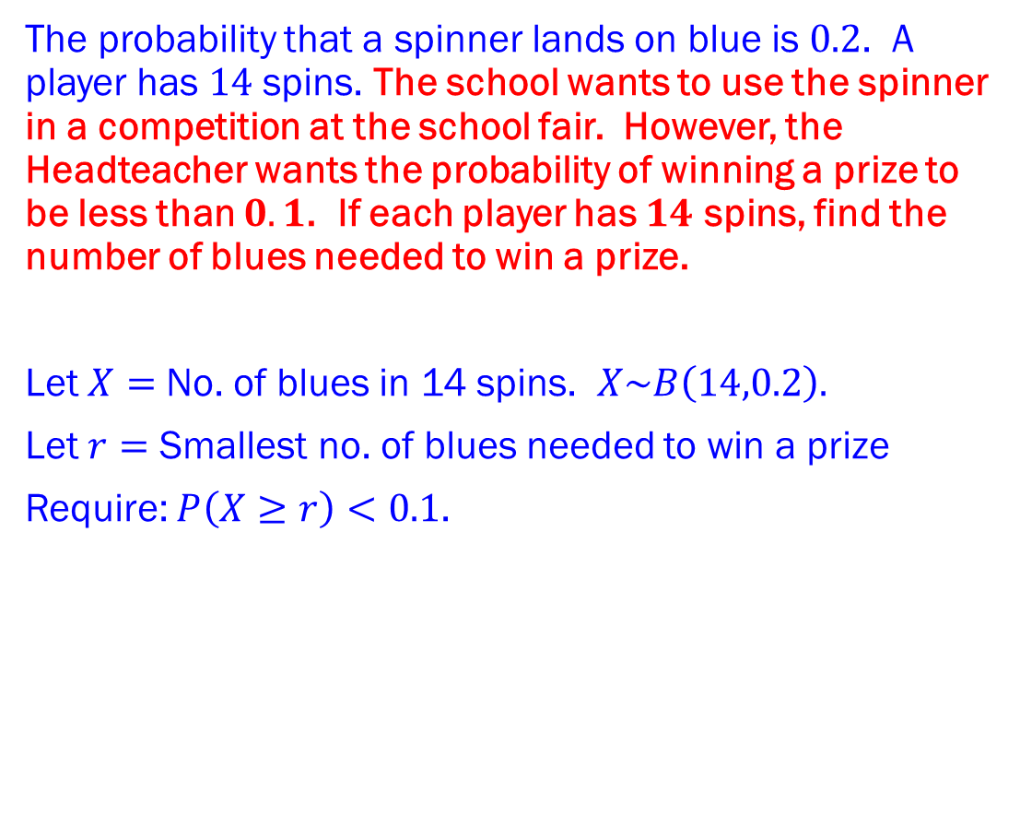
The Binomial Distribution
CUMULATIVE PROBABILITIES
Example 3c
The probability that a spinner lands on blue is $0.2$. A player has $14$ spins. The school wants to use the spinner in a competition at the school fair. However, the Headteacher wants the probability of winning a prize to be less than $0.1$. If each player has $14$ spins, find the number of blues needed to win a prize.
Let $X=$ No. of blues in 14 spins. $X\sim B\left(14,0.2\right).$
Let $r=$ Smallest no. of blues needed to win a prize
Require: $P\left(X≥r\right)<0.1$.
For a random variable $X$ a cumulative probability function gives the sum of all the individual probabilities up to and including the given value of $x$ in the calculation for $P(X≤x)$.
For the Binomial distribution $X\sim B(n,p)$ we can find $P\left(X≤x\right).$
In Excel, to find $P(X≤x)$ for $X\sim B(n,p)$ type: =BINOM.DIST($x,n,p,x$)
In Excel, to find smallest $r$ with $P\left(X≥r\right)<α$ for $X\sim B(n,p)$ type:
=BINOM.INV($n,p,1−α$) then add 1.
Solution Example 3c

Slide 38
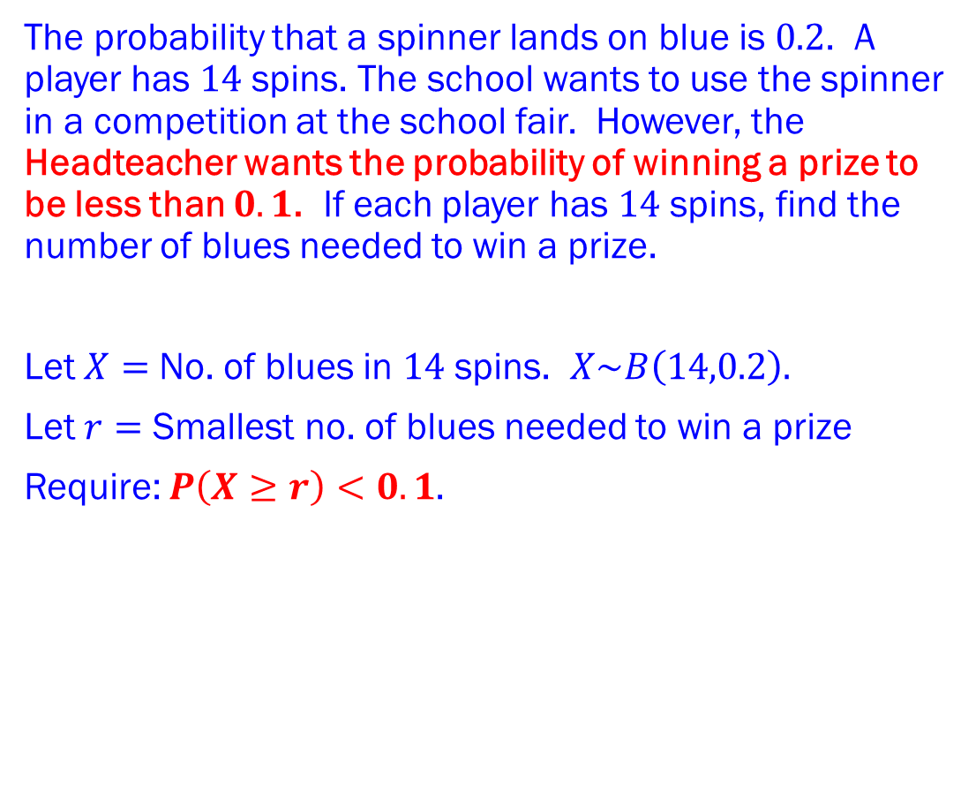
The Binomial Distribution
CUMULATIVE PROBABILITIES
Example 3c
The probability that a spinner lands on blue is $0.2$. A player has $14$ spins. The school wants to use the spinner in a competition at the school fair. However, the Headteacher wants the probability of winning a prize to be less than $0.1$. If each player has $14$ spins, find the number of blues needed to win a prize.
Let $X=$ No. of blues in $14$ spins. $X\sim B\left(14,0.2\right).$
Let $r=$ Smallest no. of blues needed to win a prize
Require: $P\left(X≥r\right)<0.1$.
For a random variable $X$ a cumulative probability function gives the sum of all the individual probabilities up to and including the given value of $x$ in the calculation for $P(X≤x)$.
For the Binomial distribution $X\sim B(n,p)$ we can find $P\left(X≤x\right).$
In Excel, to find $P(X≤x)$ for $X\sim B(n,p)$ type: =BINOM.DIST($x,n,p,x$)
In Excel, to find smallest $r$ with $P\left(X≥r\right)<α$ for $X\sim B(n,p)$ type:
=BINOM.INV($n,p,1−α$) then add 1.
Solution Example 3c

Slide 39
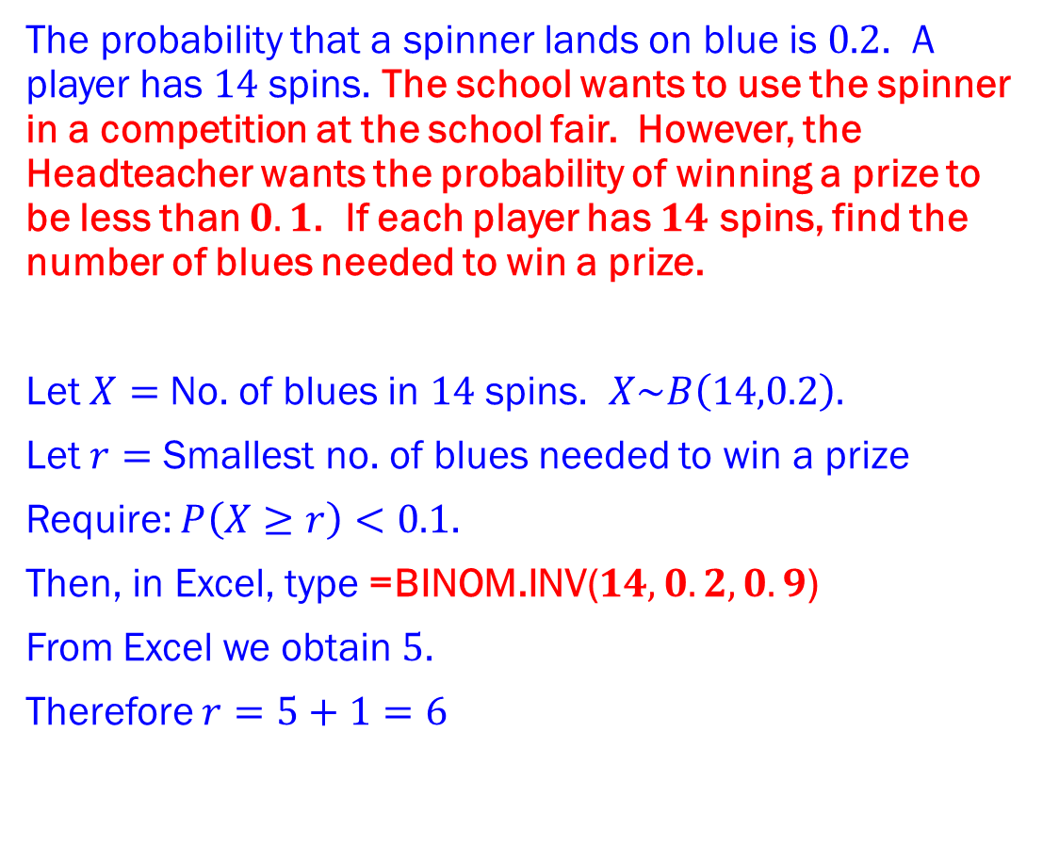
The Binomial Distribution
CUMULATIVE PROBABILITIES
Example 3c
The probability that a spinner lands on blue is $0.2$. A player has $14$ spins. The school wants to use the spinner in a competition at the school fair. However, the Headteacher wants the probability of winning a prize to be less than $0.1$. If each player has $14$ spins, find the number of blues needed to win a prize.
Let $X=$ No. of blues in $14$ spins. $X\sim B\left(14,0.2\right).$
Let $r=$ Smallest no. of blues needed to win a prize
Require: $P\left(X≥r\right)<0.1$.
Then, in Excel, type =BINOM.INV($14,0.2,0.9$)
From Excel we obtain $5$.
Therefore $r=5+1=6$
For a random variable $X$ a cumulative probability function gives the sum of all the individual probabilities up to and including the given value of $x$ in the calculation for $P(X≤x)$.
For the Binomial distribution $X\sim B(n,p)$ we can find $P\left(X≤x\right).$
In Excel, to find $P(X≤x)$ for $X\sim B(n,p)$ type: =BINOM.DIST($x,n,p,x$)
In Excel, to find smallest $r$ with $P\left(X≥r\right)<α$ for $X\sim B(n,p)$ type:
=BINOM.INV($n,p,1−α$) then add 1.
Solution Example 3c

Slide 40
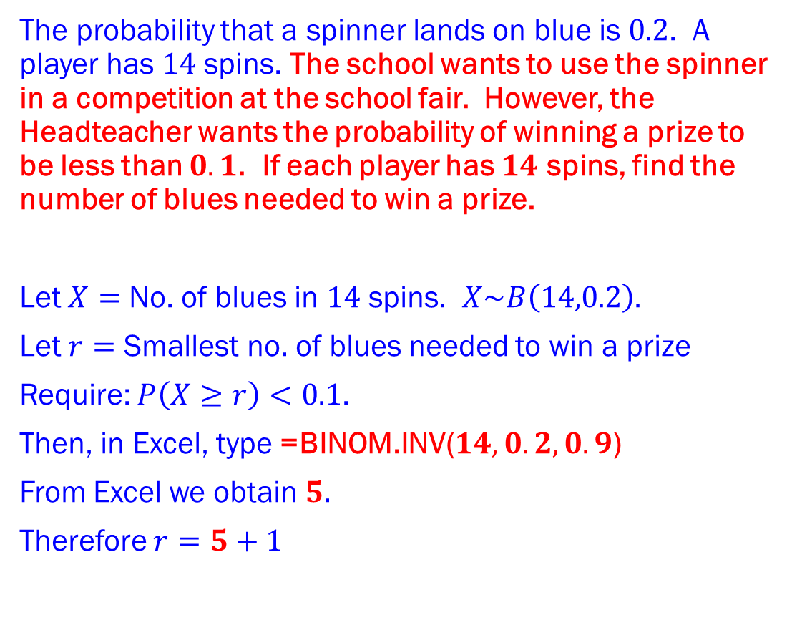
The Binomial Distribution
CUMULATIVE PROBABILITIES
Example 3c
The probability that a spinner lands on blue is $0.2$. A player has $14$ spins. The school wants to use the spinner in a competition at the school fair. However, the Headteacher wants the probability of winning a prize to be less than $0.1$. If each player has $14$ spins, find the number of blues needed to win a prize.
Let $X=$ No. of blues in $14$ spins. $X\sim B\left(14,0.2\right).$
Let $r=$ Smallest no. of blues needed to win a prize
Require: $P\left(X≥r\right)<0.1$.
Then, in Excel, type =BINOM.INV($14,0.2,0.9$)
From Excel we obtain $5$.
Therefore $r=5+1$
For a random variable $X$ a cumulative probability function gives the sum of all the individual probabilities up to and including the given value of $x$ in the calculation for $P(X≤x)$.
For the Binomial distribution $X\sim B(n,p)$ we can find $P\left(X≤x\right).$
In Excel, to find $P(X≤x)$ for $X\sim B(n,p)$ type: =BINOM.DIST($x,n,p,x$)
In Excel, to find smallest $r$ with $P\left(X≥r\right)<α$ for $X\sim B(n,p)$ type:
=BINOM.INV($n,p,1−α$) then add 1.
Solution Example 3c

Slide 41
The Binomial Distribution
CUMULATIVE PROBABILITIES
Example 3c
The probability that a spinner lands on blue is $0.2$. A player has $14$ spins. The school wants to use the spinner in a competition at the school fair. However, the Headteacher wants the probability of winning a prize to be less than $0.1$. If each player has $14$ spins, find the number of blues needed to win a prize.
Let $X=$ No. of blues in $14$ spins. $X\sim B\left(14,0.2\right).$
Let $r=$ Smallest no. of blues needed to win a prize
Require: $P\left(X≥r\right)<0.1$.
Then, in Excel, type =BINOM.INV($14,0.2,0.9$)
From Excel we obtain $5$.
Therefore $r=5+1=6$
For a random variable $X$ a cumulative probability function gives the sum of all the individual probabilities up to and including the given value of $x$ in the calculation for $P(X≤x)$.
For the Binomial distribution $X\sim B(n,p)$ we can find $P\left(X≤x\right).$
In Excel, to find $P(X≤x)$ for $X\sim B(n,p)$ type: =BINOM.DIST($x,n,p,x$)
In Excel, to find smallest $r$ with $P\left(X≥r\right)<α$ for $X\sim B(n,p)$ type:
=BINOM.INV($n,p,1−α$) then add 1.
Solution Example 3c

Slide 42
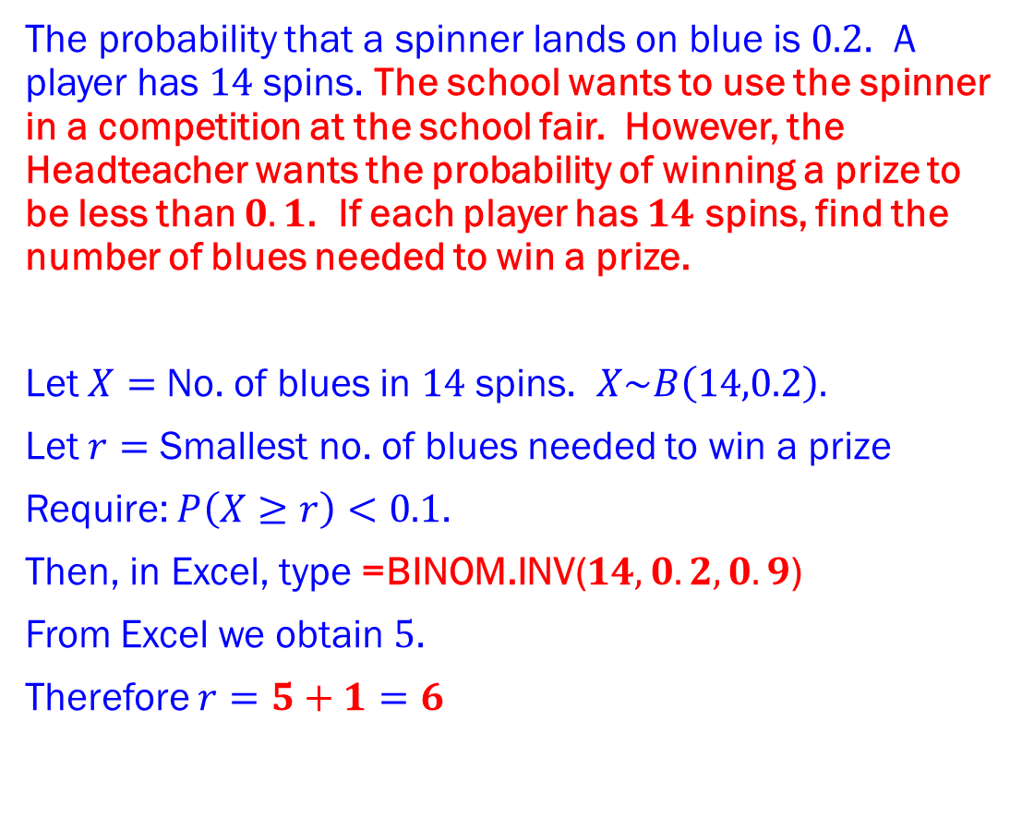
The Binomial Distribution
CUMULATIVE PROBABILITIES
Example 3c
The probability that a spinner lands on blue is $0.2$. A player has $14$ spins. The school wants to use the spinner in a competition at the school fair. However, the Headteacher wants the probability of winning a prize to be less than $0.1$. If each player has $14$ spins, find the number of blues needed to win a prize.
Let $X=$ No. of blues in $14$ spins. $X\sim B\left(14,0.2\right).$
Let $r=$ Smallest no. of blues needed to win a prize
Require: $P\left(X≥r\right)<0.1$.
Then, in Excel, type =BINOM.INV($14,0.2,0.9$)
From Excel we obtain $5$.
Therefore $r=5+1=6$
For a random variable $X$ a cumulative probability function gives the sum of all the individual probabilities up to and including the given value of $x$ in the calculation for $P(X≤x)$.
For the Binomial distribution $X\sim B(n,p)$ we can find $P\left(X≤x\right).$
In Excel, to find $P(X≤x)$ for $X\sim B(n,p)$ type: =BINOM.DIST($x,n,p,x$)
In Excel, to find smallest $r$ with $P\left(X≥r\right)<α$ for $X\sim B(n,p)$ type:
=BINOM.INV($n,p,1−α$) then add 1.
Solution Example 3c

Slide 43
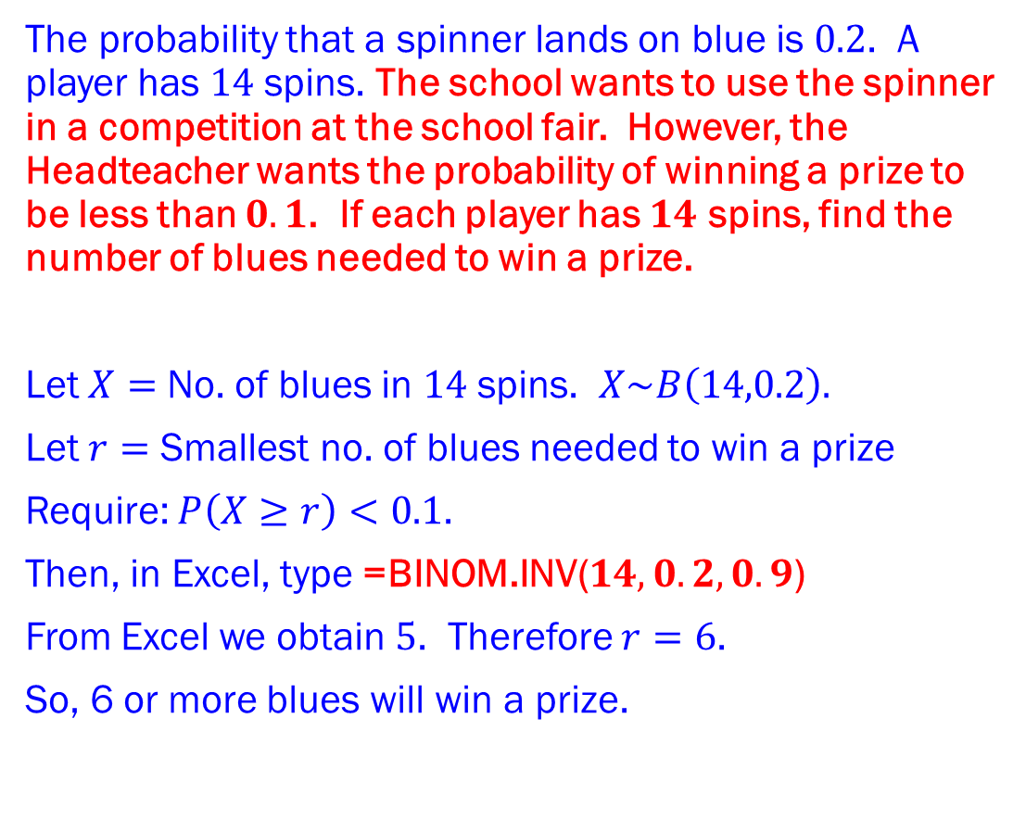
The Binomial Distribution
CUMULATIVE PROBABILITIES
Example 3c
The probability that a spinner lands on blue is $0.2$. A player has $14$ spins. The school wants to use the spinner in a competition at the school fair. However, the Headteacher wants the probability of winning a prize to be less than $0.1$. If each player has $14$ spins, find the number of blues needed to win a prize.
Let $X=$ No. of blues in $14$ spins. $X\sim B\left(14,0.2\right).$
Let $r=$ Smallest no. of blues needed to win a prize
Require: $P\left(X≥r\right)<0.1$.
Then, in Excel, type =BINOM.INV($14,0.2,0.9$)
From Excel we obtain $5$. Therefore $r=6$.
So, 6 or more blues will win a prize.
For a random variable $X$ a cumulative probability function gives the sum of all the individual probabilities up to and including the given value of $x$ in the calculation for $P(X≤x)$.
For the Binomial distribution $X\sim B(n,p)$ we can find $P\left(X≤x\right).$
In Excel, to find $P(X≤x)$ for $X\sim B(n,p)$ type: =BINOM.DIST($x,n,p,x$)
In Excel, to find smallest $r$ with $P\left(X≥r\right)<α$ for $X\sim B(n,p)$ type:
=BINOM.INV($n,p,1−α$) then add 1.
Solution Example 3c

Slide 44
The Binomial Distribution
CUMULATIVE PROBABILITIES
Example 3c
The probability that a spinner lands on blue is $0.2$. A player has $14$ spins. The school wants to use the spinner in a competition at the school fair. However, the Headteacher wants the probability of winning a prize to be less than $0.1$. If each player has $14$ spins, find the number of blues needed to win a prize.
Let $X=$ No. of blues in $14$ spins. $X\sim B\left(14,0.2\right).$
Let $r=$ Smallest no. of blues needed to win a prize
Require: $P\left(X≥r\right)<0.1$.
Then, in Excel, type =BINOM.INV($14,0.2,0.9$)
From Excel we obtain $5$. Therefore $r=6$.
So, 6 or more blues will win a prize.
For a random variable $X$ a cumulative probability function gives the sum of all the individual probabilities up to and including the given value of $x$ in the calculation for $P(X≤x)$.
For the Binomial distribution $X\sim B(n,p)$ we can find $P\left(X≤x\right).$
In Excel, to find $P(X≤x)$ for $X\sim B(n,p)$ type: =BINOM.DIST($x,n,p,x$)
In Excel, to find smallest $r$ with $P\left(X≥r\right)<α$ for $X\sim B(n,p)$ type:
=BINOM.INV($n,p,1−α$) then add 1.
Solution Example 3c

Slide 45
Recap
If you have understood the content of this session, you should be able to:
Calculate cumulative probabilities for the binomial distribution.
REVIEW

Slide 46
Exercises
Questions
Now attempt the exercises in your text book related to this topic.
Notes:
Now attempt the exercises in your text book related to this topic.

Slide 47
Copyright
© Z. Ali 2020

