Slide 1
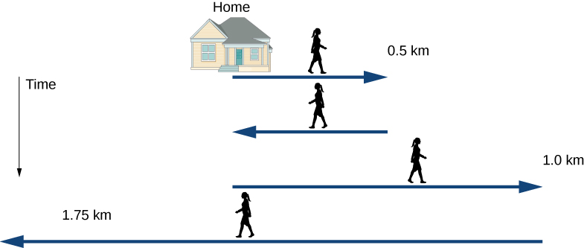
Constant Acceleration
AS
CONSTANT ACCELERATION FORMULAE PART 2
Notes:
Welcome to the unit on ‘Constant Acceleration’. In this unit we will be looking at CONSTANT ACCELERATION FORMULAE PART 2

Slide 2
Objectives
The objectives for this session are to:
Derive the formulae for constant acceleration and use them in order to solve problems.
CONSTANT ACCELERATION FORMULAE PART 2

Slide 3




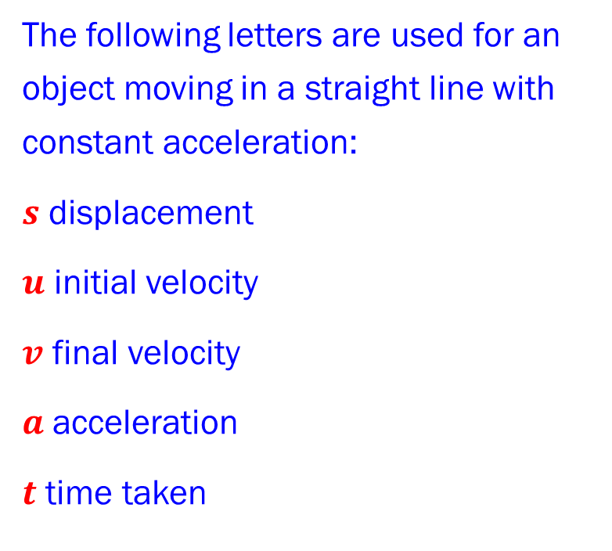



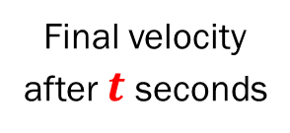

Constant Acceleration
CONSTANT ACCELERATION FORMULAE PART 2
Deriving Formulas
At time 0
Constant acceleration
Final velocity after $t$ seconds
Standard Notation
Initial velocity
$$u$$
$$a$$
$$v$$
The following letters are used for an object moving in a straight line with constant acceleration:
$s$ displacement
$u$ initial velocity
$v$ final velocity
$a$ acceleration
$t$ time taken
FORMULAE
$v=u+at$
$s=\left(\frac{u+v}{2}\right)t$
$$s$$
Displacement
1
There is no displacement $s$ in this formula
2
There is no acceleration $a$ in this formula
Now derive a formula which eliminates $t$ from the formula for constant acceleration.

Slide 4


Constant Acceleration
CONSTANT ACCELERATION FORMULAE PART 2
Deriving Formulas
At time 0
Constant acceleration
Final velocity after $t$ seconds
Standard Notation
Initial velocity
$$u$$
$$a$$
$$v$$
The following letters are used for an object moving in a straight line with constant acceleration:
$s$ displacement
$u$ initial velocity
$v$ final velocity
$a$ acceleration
$t$ time taken
FORMULAE
$v=u+at$
$s=\left(\frac{u+v}{2}\right)t$
$v^{2}=u^{2}+2as$
$$s$$
Displacement
1
Use existing two formulas to derive three more.
Rearranging $⟹$ $t=\frac{v−u}{a}$
Substituting this in $⟹$ $s=\left(\frac{u+v}{2}\right)\left(\frac{v−u}{a}\right)$
Multiplying out and rearranging $⟹$ $2as=v^{2}−u^{2}$
Hence $v^{2}=u^{2}+2as$.
2
1
2

Slide 5


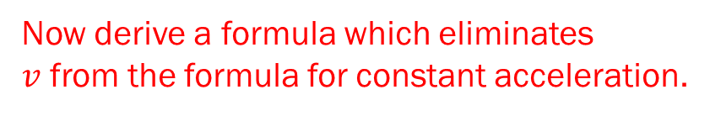


Constant Acceleration
CONSTANT ACCELERATION FORMULAE PART 2
Deriving Formulas
At time 0
Constant acceleration
Final velocity after $t$ seconds
Standard Notation
Initial velocity
$$u$$
$$a$$
$$v$$
The following letters are used for an object moving in a straight line with constant acceleration:
$s$ displacement
$u$ initial velocity
$v$ final velocity
$a$ acceleration
$t$ time taken
FORMULAE
$v=u+at$
$s=\left(\frac{u+v}{2}\right)t$
$v^{2}=u^{2}+2as$
$$s$$
Displacement
There is no displacement $s$ in this formula
There is no acceleration $a$ in this formula
There is no time $t$ in this formula
Now derive a formula which eliminates $v$ from the formula for constant acceleration.

Slide 6
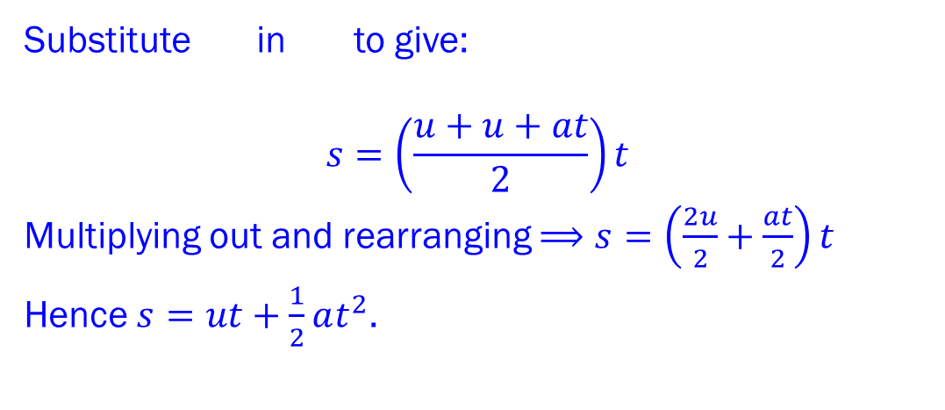

Constant Acceleration
CONSTANT ACCELERATION FORMULAE PART 2
Deriving Formulas
Substitute in to give:
$$s=\left(\frac{u+u+at}{2}\right)t$$
Multiplying out and rearranging $⟹$ $s=\left(\frac{2u}{2}+\frac{at}{2}\right)t$
Hence $s=ut+\frac{1}{2}at^{2}$.
1
2
Standard Notation
The following letters are used for an object moving in a straight line with constant acceleration:
$s$ displacement
$u$ initial velocity
$v$ final velocity
$a$ acceleration
$t$ time taken
FORMULAE
$v=u+at$
$s=\left(\frac{u+v}{2}\right)t$
$v^{2}=u^{2}+2as$
1
2

Slide 7

Constant Acceleration
CONSTANT ACCELERATION FORMULAE PART 2
Deriving Formulas
Substitute in to give:
$$s=\left(\frac{u+u+at}{2}\right)t$$
Multiplying out and rearranging $⟹$ $s=\left(\frac{2u}{2}+\frac{at}{2}\right)t$
Hence $s=ut+\frac{1}{2}at^{2}$.
1
2
Standard Notation
The following letters are used for an object moving in a straight line with constant acceleration:
$s$ displacement
$u$ initial velocity
$v$ final velocity
$a$ acceleration
$t$ time taken
FORMULAE
$v=u+at$
$s=\left(\frac{u+v}{2}\right)t$
$v^{2}=u^{2}+2as$
$s=ut+\frac{1}{2}at^{2}$
1
2

Slide 8




Constant Acceleration
CONSTANT ACCELERATION FORMULAE PART 2
Deriving Formulas
Standard Notation
The following letters are used for an object moving in a straight line with constant acceleration:
$s$ displacement
$u$ initial velocity
$v$ final velocity
$a$ acceleration
$t$ time taken
FORMULAE
$v=u+at$
$s=\left(\frac{u+v}{2}\right)t$
$v^{2}=u^{2}+2as$
$s=ut+\frac{1}{2}at^{2}$
1
There is no displacement $s$ in this formula
2
There is no acceleration $a$ in this formula
There is no time $t$ in this formula
There is no final velocity $v$ in this formula
Now derive a formula which eliminates $u$ from the formula for constant acceleration.

Slide 9


Constant Acceleration
CONSTANT ACCELERATION FORMULAE PART 2
Deriving Formulas
Rearranging equation gives: $$u=v−at$$
Substituting this in Equation gives:
$$s=\left(v−at\right)t+\frac{1}{2}at^{2}$$
Rearranging gives:
$$s=vt−\frac{1}{2}at^{2}$$
1
Standard Notation
The following letters are used for an object moving in a straight line with constant acceleration:
$s$ displacement
$u$ initial velocity
$v$ final velocity
$a$ acceleration
$t$ time taken
4
FORMULAE
$v=u+at$
$s=\left(\frac{u+v}{2}\right)t$
$v^{2}=u^{2}+2as$
$s=ut+\frac{1}{2}at^{2}$
1
4

Slide 10

Constant Acceleration
CONSTANT ACCELERATION FORMULAE PART 2
Deriving Formulas
Rearranging equation gives: $$u=v−at$$
Substituting this in Equation gives:
$$s=\left(v−at\right)t+\frac{1}{2}at^{2}$$
Rearranging gives:
$$s=vt−\frac{1}{2}at^{2}$$
1
Standard Notation
The following letters are used for an object moving in a straight line with constant acceleration:
$s$ displacement
$u$ initial velocity
$v$ final velocity
$a$ acceleration
$t$ time taken
4
FORMULAE
$v=u+at$
$s=\left(\frac{u+v}{2}\right)t$
$v^{2}=u^{2}+2as$
$s=ut+\frac{1}{2}at^{2}$
$s=vt−\frac{1}{2}at^{2}$
1
4

Slide 11

Constant Acceleration
CONSTANT ACCELERATION FORMULAE PART 2
Standard Notation
The following letters are used for an object moving in a straight line with constant acceleration:
$s$ displacement
$u$ initial velocity
$v$ final velocity
$a$ acceleration
$t$ time taken
FORMULAE
$v=u+at$
$s=\left(\frac{u+v}{2}\right)t$
$v^{2}=u^{2}+2as$
$s=ut+\frac{1}{2}at^{2}$
$s=vt−\frac{1}{2}at^{2}$

Slide 12




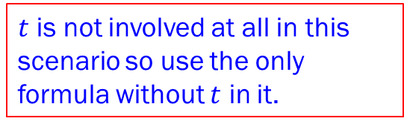




Constant Acceleration
CONSTANT ACCELERATION FORMULAE PART 2
Example 1
An object moves from $A$ to $B$ in a straight line with constant acceleration $7ms^{−2}$ in direction $\vec{AB}$, and velocity $4ms^{−1}$ at $A$. If the velocity of the object at $B$ is $25ms^{−1}$, find the distance between $A$ and $B$.
Standard Notation
The following letters are used for an object moving in a straight line with constant acceleration:
$s$ displacement
$u$ initial velocity
$v$ final velocity
$a$ acceleration
$t$ time taken
FORMULAE
$v=u+at$
$s=\left(\frac{u+v}{2}\right)t$
$v^{2}=u^{2}+2as$
$s=ut+\frac{1}{2}at^{2}$
$s=vt−\frac{1}{2}at^{2}$
Solution Example 1
FIND
$$a=7ms^{−2}$$
$$u=4ms^{−1}$$
$$v=25ms^{−1}$$
$$A$$
$$s$$
$$B$$
$t$ is not involved at all in this scenario so use the only formula without $t$ in it.

Slide 13


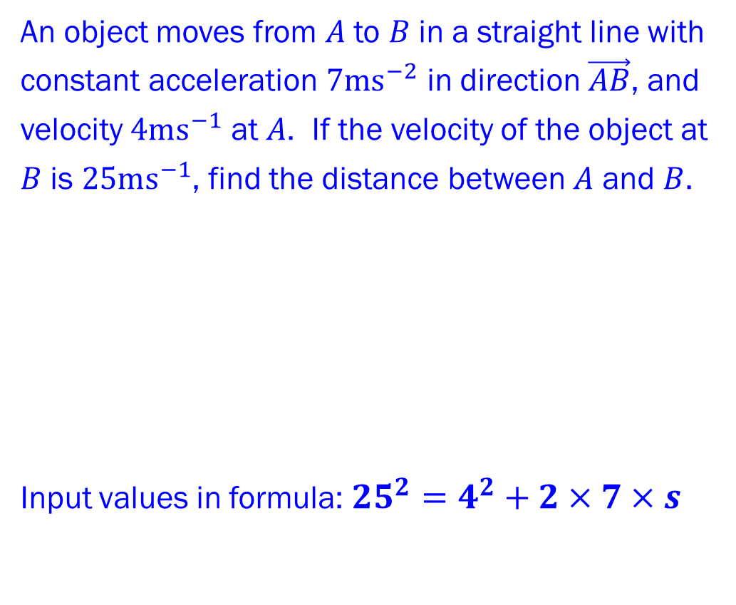



Constant Acceleration
CONSTANT ACCELERATION FORMULAE PART 2
Example 1
An object moves from $A$ to $B$ in a straight line with constant acceleration $7ms^{−2}$ in direction $\vec{AB}$, and velocity $4ms^{−1}$ at $A$. If the velocity of the object at $B$ is $25ms^{−1}$, find the distance between $A$ and $B$.
Input values in formula:${25}^{2}=4^{2}+2×7×s$
Standard Notation
The following letters are used for an object moving in a straight line with constant acceleration:
$s$ displacement
$u$ initial velocity
$v$ final velocity
$a$ acceleration
$t$ time taken
FORMULAE
$v=u+at$
$s=\left(\frac{u+v}{2}\right)t$
$v^{2}=u^{2}+2as$
$s=ut+\frac{1}{2}at^{2}$
$s=vt−\frac{1}{2}at^{2}$
Solution Example 1
$$a=7ms^{−2}$$
$$u=4ms^{−1}$$
$$v=25ms^{−1}$$
$$A$$
$$s$$
$$B$$

Slide 14

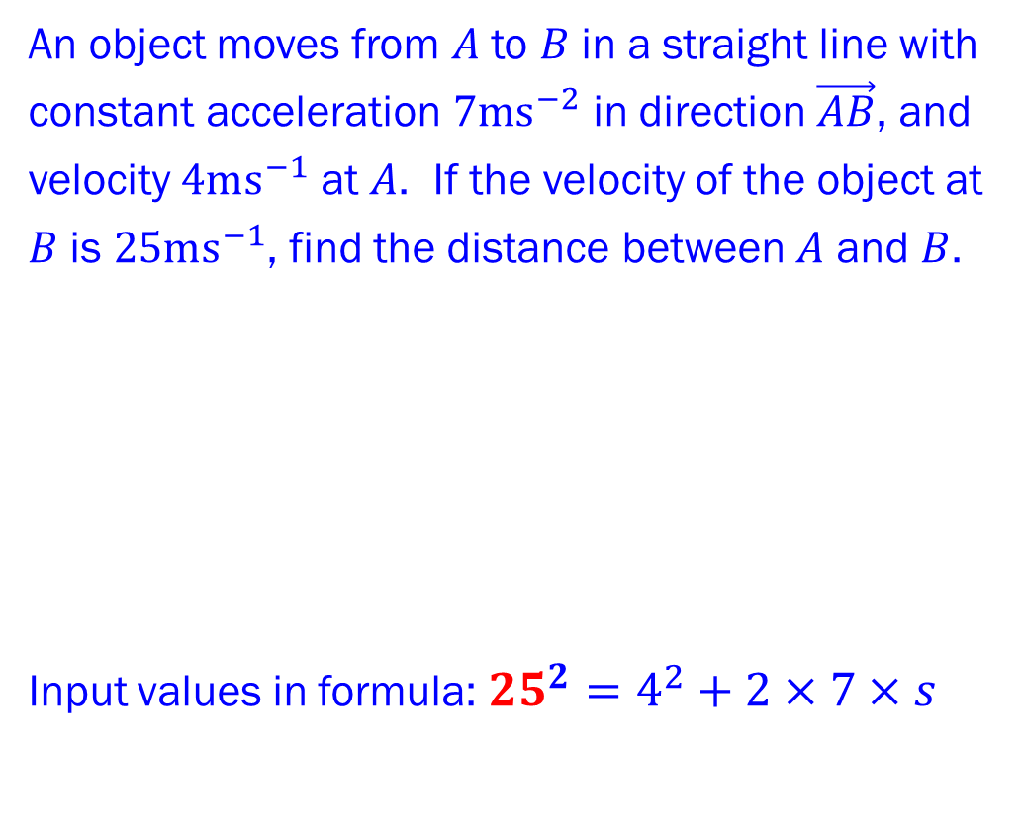

Constant Acceleration
CONSTANT ACCELERATION FORMULAE PART 2
Example 1
An object moves from $A$ to $B$ in a straight line with constant acceleration $7ms^{−2}$ in direction $\vec{AB}$, and velocity $4ms^{−1}$ at $A$. If the velocity of the object at $B$ is $25ms^{−1}$, find the distance between $A$ and $B$.
Input values in formula:${25}^{2}=4^{2}+2×7×s$
Standard Notation
The following letters are used for an object moving in a straight line with constant acceleration:
$s$ displacement
$u$ initial velocity
$v$ final velocity
$a$ acceleration
$t$ time taken
FORMULAE
$v=u+at$
$s=\left(\frac{u+v}{2}\right)t$
$v^{2}=u^{2}+2as$
$s=ut+\frac{1}{2}at^{2}$
$s=vt−\frac{1}{2}at^{2}$
Solution Example 1
$$a=7ms^{−2}$$
$$u=4ms^{−1}$$
$$v=25ms^{−1}$$
$$A$$
$$s$$
$$B$$

Slide 15

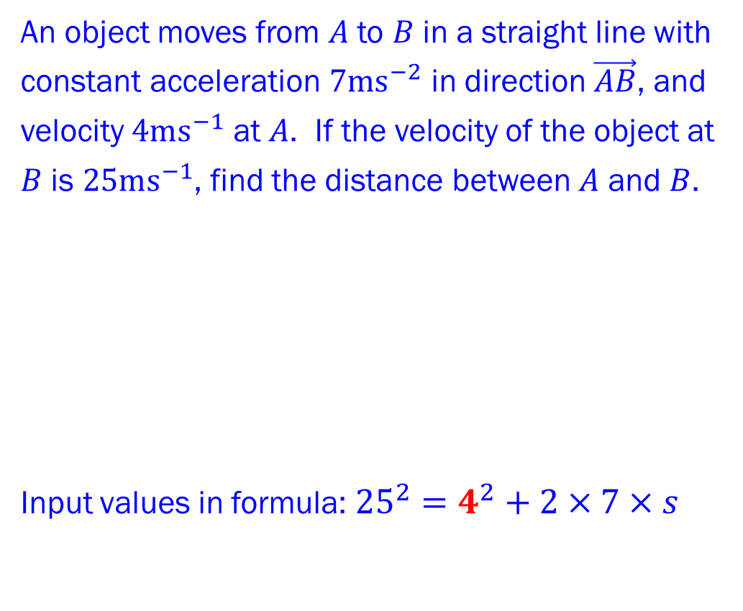

Constant Acceleration
CONSTANT ACCELERATION FORMULAE PART 2
Example 1
An object moves from $A$ to $B$ in a straight line with constant acceleration $7ms^{−2}$ in direction $\vec{AB}$, and velocity $4ms^{−1}$ at $A$. If the velocity of the object at $B$ is $25ms^{−1}$, find the distance between $A$ and $B$.
Input values in formula:${25}^{2}=4^{2}+2×7×s$
Standard Notation
The following letters are used for an object moving in a straight line with constant acceleration:
$s$ displacement
$u$ initial velocity
$v$ final velocity
$a$ acceleration
$t$ time taken
FORMULAE
$v=u+at$
$s=\left(\frac{u+v}{2}\right)t$
$v^{2}=u^{2}+2as$
$s=ut+\frac{1}{2}at^{2}$
$s=vt−\frac{1}{2}at^{2}$
Solution Example 1
$$a=7ms^{−2}$$
$$u=4ms^{−1}$$
$$v=25ms^{−1}$$
$$A$$
$$s$$
$$B$$

Slide 16

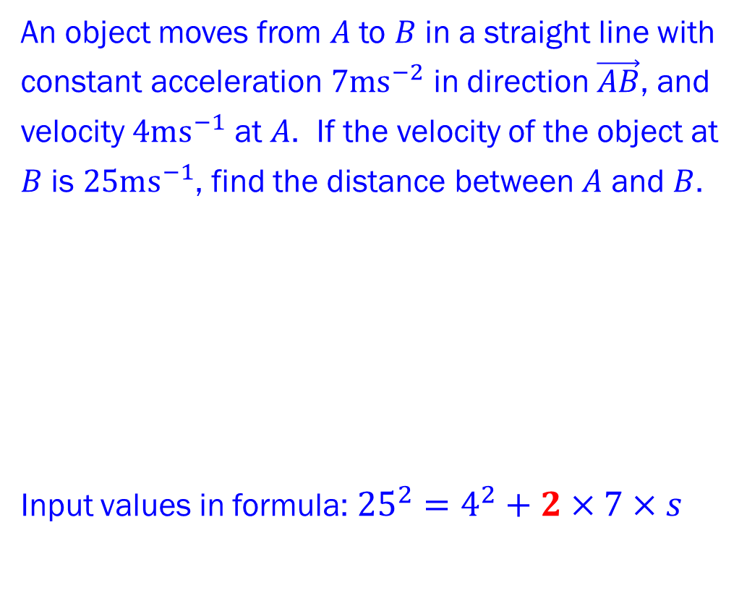
Constant Acceleration
CONSTANT ACCELERATION FORMULAE PART 2
Example 1
An object moves from $A$ to $B$ in a straight line with constant acceleration $7ms^{−2}$ in direction $\vec{AB}$, and velocity $4ms^{−1}$ at $A$. If the velocity of the object at $B$ is $25ms^{−1}$, find the distance between $A$ and $B$.
Input values in formula:${25}^{2}=4^{2}+2×7×s$
Standard Notation
The following letters are used for an object moving in a straight line with constant acceleration:
$s$ displacement
$u$ initial velocity
$v$ final velocity
$a$ acceleration
$t$ time taken
FORMULAE
$v=u+at$
$s=\left(\frac{u+v}{2}\right)t$
$v^{2}=u^{2}+2as$
$s=ut+\frac{1}{2}at^{2}$
$s=vt−\frac{1}{2}at^{2}$
Solution Example 1
$$a=7ms^{−2}$$
$$u=4ms^{−1}$$
$$v=25ms^{−1}$$
$$A$$
$$s$$
$$B$$

Slide 17


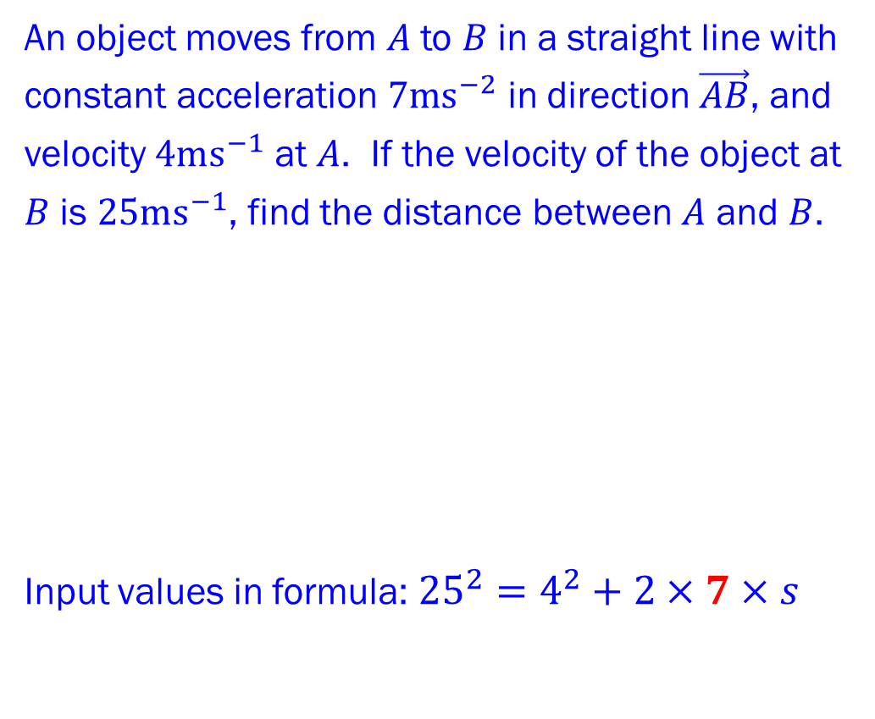
Constant Acceleration
CONSTANT ACCELERATION FORMULAE PART 2
Example 1
An object moves from $A$ to $B$ in a straight line with constant acceleration $7ms^{−2}$ in direction $\vec{AB}$, and velocity $4ms^{−1}$ at $A$. If the velocity of the object at $B$ is $25ms^{−1}$, find the distance between $A$ and $B$.
Input values in formula:${25}^{2}=4^{2}+2×7×s$
Standard Notation
The following letters are used for an object moving in a straight line with constant acceleration:
$s$ displacement
$u$ initial velocity
$v$ final velocity
$a$ acceleration
$t$ time taken
FORMULAE
$v=u+at$
$s=\left(\frac{u+v}{2}\right)t$
$v^{2}=u^{2}+2as$
$s=ut+\frac{1}{2}at^{2}$
$s=vt−\frac{1}{2}at^{2}$
Solution Example 1
$$a=7ms^{−2}$$
$$u=4ms^{−1}$$
$$v=25ms^{−1}$$
$$A$$
$$s$$
$$B$$

Slide 18

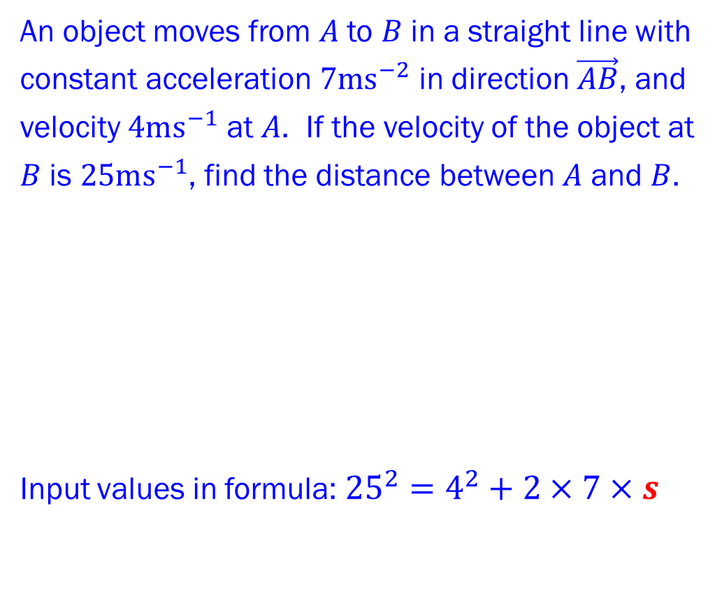
Constant Acceleration
CONSTANT ACCELERATION FORMULAE PART 2
Example 1
An object moves from $A$ to $B$ in a straight line with constant acceleration $7ms^{−2}$ in direction $\vec{AB}$, and velocity $4ms^{−1}$ at $A$. If the velocity of the object at $B$ is $25ms^{−1}$, find the distance between $A$ and $B$.
Input values in formula:${25}^{2}=4^{2}+2×7×s$
Standard Notation
The following letters are used for an object moving in a straight line with constant acceleration:
$s$ displacement
$u$ initial velocity
$v$ final velocity
$a$ acceleration
$t$ time taken
FORMULAE
$v=u+at$
$s=\left(\frac{u+v}{2}\right)t$
$v^{2}=u^{2}+2as$
$s=ut+\frac{1}{2}at^{2}$
$s=vt−\frac{1}{2}at^{2}$
Solution Example 1
$$a=7ms^{−2}$$
$$u=4ms^{−1}$$
$$v=25ms^{−1}$$
$$A$$
$$s$$
$$B$$

Slide 19
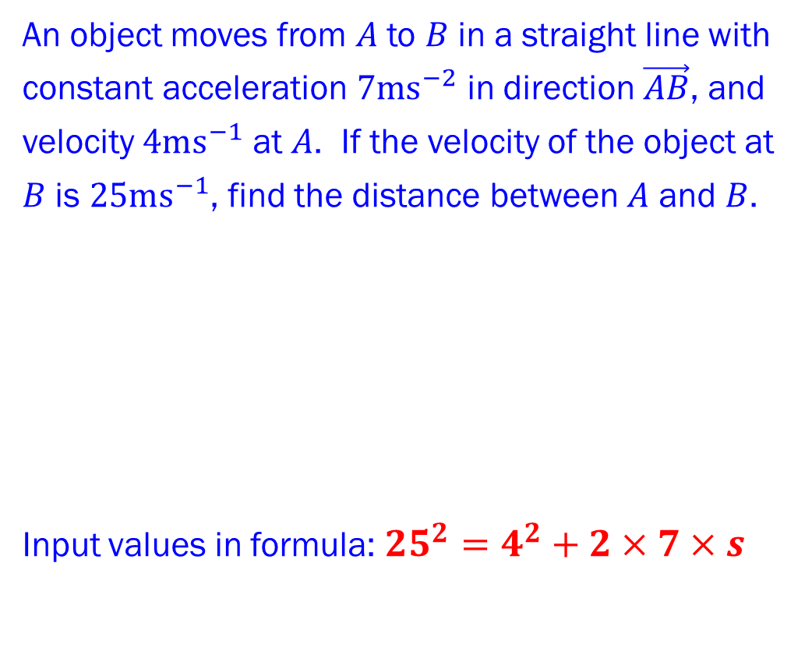
Constant Acceleration
CONSTANT ACCELERATION FORMULAE PART 2
Example 1
An object moves from $A$ to $B$ in a straight line with constant acceleration $7ms^{−2}$ in direction $\vec{AB}$, and velocity $4ms^{−1}$ at $A$. If the velocity of the object at $B$ is $25ms^{−1}$, find the distance between $A$ and $B$.
Input values in formula:${25}^{2}=4^{2}+2×7×s$
Standard Notation
The following letters are used for an object moving in a straight line with constant acceleration:
$s$ displacement
$u$ initial velocity
$v$ final velocity
$a$ acceleration
$t$ time taken
FORMULAE
$v=u+at$
$s=\left(\frac{u+v}{2}\right)t$
$v^{2}=u^{2}+2as$
$s=ut+\frac{1}{2}at^{2}$
$s=vt−\frac{1}{2}at^{2}$
Solution Example 1
$$a=7ms^{−2}$$
$$u=4ms^{−1}$$
$$v=25ms^{−1}$$
$$A$$
$$s$$
$$B$$

Slide 20
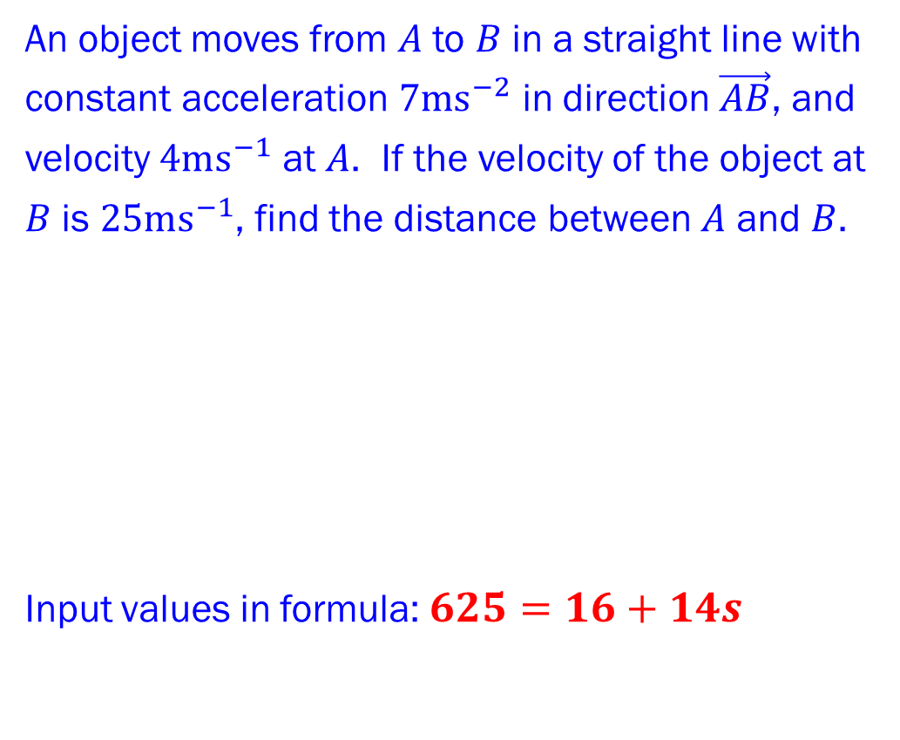
Constant Acceleration
CONSTANT ACCELERATION FORMULAE PART 2
Example 1
An object moves from $A$ to $B$ in a straight line with constant acceleration $7ms^{−2}$ in direction $\vec{AB}$, and velocity $4ms^{−1}$ at $A$. If the velocity of the object at $B$ is $25ms^{−1}$, find the distance between $A$ and $B$.
Input values in formula: $625=16+14s$
Standard Notation
The following letters are used for an object moving in a straight line with constant acceleration:
$s$ displacement
$u$ initial velocity
$v$ final velocity
$a$ acceleration
$t$ time taken
FORMULAE
$v=u+at$
$s=\left(\frac{u+v}{2}\right)t$
$v^{2}=u^{2}+2as$
$s=ut+\frac{1}{2}at^{2}$
$s=vt−\frac{1}{2}at^{2}$
Solution Example 1
$$a=7ms^{−2}$$
$$u=4ms^{−1}$$
$$v=25ms^{−1}$$
$$A$$
$$s$$
$$B$$

Slide 21
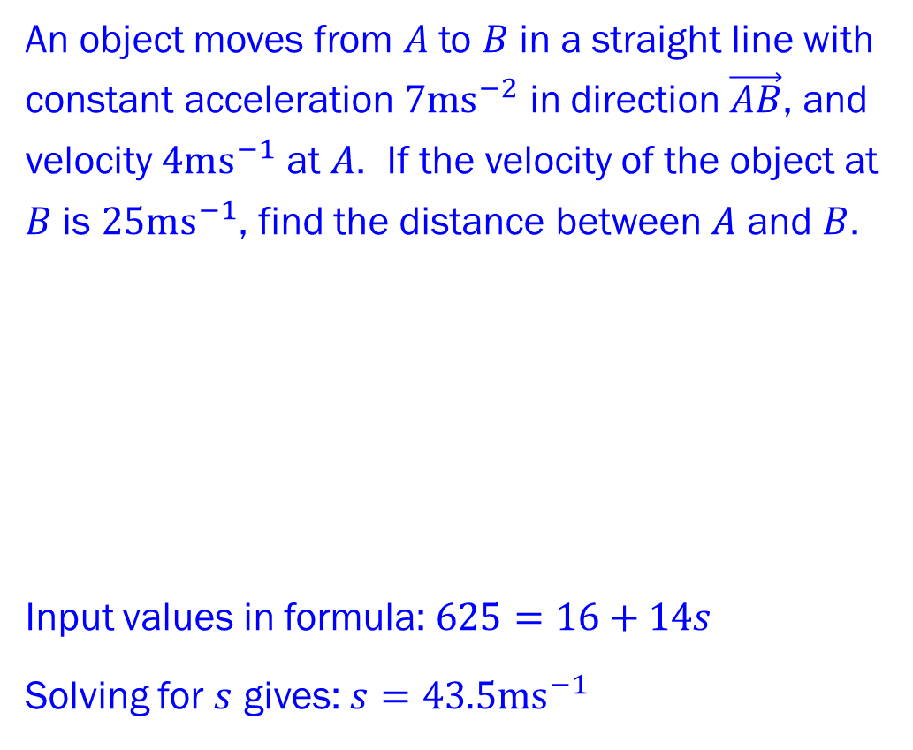
Constant Acceleration
CONSTANT ACCELERATION FORMULAE PART 2
Example 1
An object moves from $A$ to $B$ in a straight line with constant acceleration $7ms^{−2}$ in direction $\vec{AB}$, and velocity $4ms^{−1}$ at $A$. If the velocity of the object at $B$ is $25ms^{−1}$, find the distance between $A$ and $B$.
Input values in formula: $625=16+14s$
Solving for $s$ gives: $s=43.5ms^{−1}$
Standard Notation
The following letters are used for an object moving in a straight line with constant acceleration:
$s$ displacement
$u$ initial velocity
$v$ final velocity
$a$ acceleration
$t$ time taken
FORMULAE
$v=u+at$
$s=\left(\frac{u+v}{2}\right)t$
$v^{2}=u^{2}+2as$
$s=ut+\frac{1}{2}at^{2}$
$s=vt−\frac{1}{2}at^{2}$
Solution Example 1
$$a=7ms^{−2}$$
$$u=4ms^{−1}$$
$$v=25ms^{−1}$$
$$A$$
$$s$$
$$B$$

Slide 22
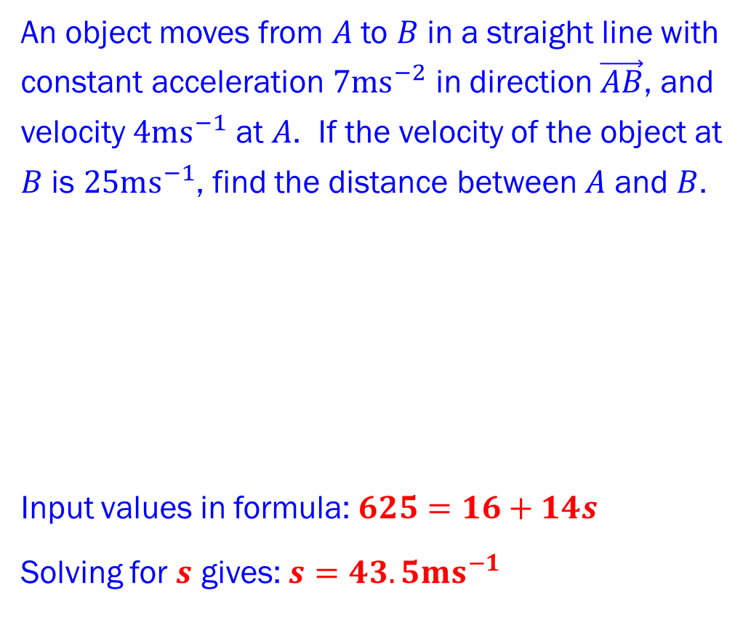
Constant Acceleration
CONSTANT ACCELERATION FORMULAE PART 2
Example 1
An object moves from $A$ to $B$ in a straight line with constant acceleration $7ms^{−2}$ in direction $\vec{AB}$, and velocity $4ms^{−1}$ at $A$. If the velocity of the object at $B$ is $25ms^{−1}$, find the distance between $A$ and $B$.
Input values in formula:$625=16+14s$
Solving for $s$ gives: $s=43.5ms^{−1}$
Standard Notation
The following letters are used for an object moving in a straight line with constant acceleration:
$s$ displacement
$u$ initial velocity
$v$ final velocity
$a$ acceleration
$t$ time taken
FORMULAE
$v=u+at$
$s=\left(\frac{u+v}{2}\right)t$
$v^{2}=u^{2}+2as$
$s=ut+\frac{1}{2}at^{2}$
$s=vt−\frac{1}{2}at^{2}$
Solution Example 1
$$a=7ms^{−2}$$
$$u=4ms^{−1}$$
$$v=25ms^{−1}$$
$$A$$
$$s$$
$$B$$

Slide 23

Constant Acceleration
CONSTANT ACCELERATION FORMULAE PART 2
Example 1
An object moves from $A$ to $B$ in a straight line with constant acceleration $7ms^{−2}$ in direction $\vec{AB}$, and velocity $4ms^{−1}$ at $A$. If the velocity of the object at $B$ is $25ms^{−1}$, find the distance between $A$ and $B$.
Input values in formula:$625=16+14s$
Solving for $s$ gives: $s=43.5ms^{−1}$
Standard Notation
The following letters are used for an object moving in a straight line with constant acceleration:
$s$ displacement
$u$ initial velocity
$v$ final velocity
$a$ acceleration
$t$ time taken
FORMULAE
$v=u+at$
$s=\left(\frac{u+v}{2}\right)t$
$v^{2}=u^{2}+2as$
$s=ut+\frac{1}{2}at^{2}$
$s=vt−\frac{1}{2}at^{2}$
Solution Example 1
$$a=7ms^{−2}$$
$$u=4ms^{−1}$$
$$v=25ms^{−1}$$
$$A$$
$$s$$
$$B$$

Slide 24





Constant Acceleration
CONSTANT ACCELERATION FORMULAE PART 2
Example 2
A penguin is sliding across a frozen lake in a straight line. His initial speed is $6ms^{−1}$. Friction causes him to decelerate at a constant rate of $1.5ms^{−2}$. Find:
a. distance penguin has moved before coming to rest;
b. the time when he is at half the total distance.
Standard Notation
The following letters are used for an object moving in a straight line with constant acceleration:
$s$ displacement
$u$ initial velocity
$v$ final velocity
$a$ acceleration
$t$ time taken
FORMULAE
$v=u+at$
$s=\left(\frac{u+v}{2}\right)t$
$v^{2}=u^{2}+2as$
$s=ut+\frac{1}{2}at^{2}$
$s=vt−\frac{1}{2}at^{2}$
FIND
$$a=−1.5ms^{−2}$$
$$u=6ms^{−1}$$
$$v=0$$
$$s$$
$t$ is not involved at all in this scenario so use the only formula without $t$ in it.

Slide 25




Constant Acceleration
CONSTANT ACCELERATION FORMULAE PART 2
Example 2a
A penguin is sliding across a frozen lake in a straight line. His initial speed is $6ms^{−1}$. Friction causes him to decelerate at a constant rate of $1.5ms^{−2}$.
Find distance penguin has moved before coming to rest.
Standard Notation
The following letters are used for an object moving in a straight line with constant acceleration:
$s$ displacement
$u$ initial velocity
$v$ final velocity
$a$ acceleration
$t$ time taken
FORMULAE
$v=u+at$
$s=\left(\frac{u+v}{2}\right)t$
$v^{2}=u^{2}+2as$
$s=ut+\frac{1}{2}at^{2}$
$s=vt−\frac{1}{2}at^{2}$
$$u=6ms^{−1}$$
$$a=−1.5ms^{−2}$$
$$v=0$$
$$s$$

Slide 26

Constant Acceleration
CONSTANT ACCELERATION FORMULAE PART 2
Example 2a
A penguin is sliding across a frozen lake in a straight line. His initial speed is $6ms^{−1}$. Friction causes him to decelerate at a constant rate of $1.5ms^{−2}$.
Find distance penguin has moved before coming to rest.
Input values in formula:$0^{2}=6^{2}+2(−1.5)s$
Standard Notation
The following letters are used for an object moving in a straight line with constant acceleration:
$s$ displacement
$u$ initial velocity
$v$ final velocity
$a$ acceleration
$t$ time taken
FORMULAE
$v=u+at$
$s=\left(\frac{u+v}{2}\right)t$
$v^{2}=u^{2}+2as$
$s=ut+\frac{1}{2}at^{2}$
$s=vt−\frac{1}{2}at^{2}$
Solution Example 2a
$$u=6ms^{−1}$$
$$a=−1.5ms^{−2}$$
$$v=0$$
$$s$$

Slide 27


Constant Acceleration
CONSTANT ACCELERATION FORMULAE PART 2
Example 2a
A penguin is sliding across a frozen lake in a straight line. His initial speed is $6ms^{−1}$. Friction causes him to decelerate at a constant rate of $1.5ms^{−2}$.
Find distance penguin has moved before coming to rest.
Input values in formula:$0^{2}=6^{2}+2(−1.5)s$
Standard Notation
The following letters are used for an object moving in a straight line with constant acceleration:
$s$ displacement
$u$ initial velocity
$v$ final velocity
$a$ acceleration
$t$ time taken
FORMULAE
$v=u+at$
$s=\left(\frac{u+v}{2}\right)t$
$v^{2}=u^{2}+2as$
$s=ut+\frac{1}{2}at^{2}$
$s=vt−\frac{1}{2}at^{2}$
Solution Example 2a
$$u=6ms^{−1}$$
$$a=−1.5ms^{−2}$$
$$v=0$$
$$s$$

Slide 28


Constant Acceleration
CONSTANT ACCELERATION FORMULAE PART 2
Example 2a
A penguin is sliding across a frozen lake in a straight line. His initial speed is $6ms^{−1}$. Friction causes him to decelerate at a constant rate of $1.5ms^{−2}$.
Find distance penguin has moved before coming to rest.
Input values in formula:$0^{2}=6^{2}+2(−1.5)s$
Standard Notation
The following letters are used for an object moving in a straight line with constant acceleration:
$s$ displacement
$u$ initial velocity
$v$ final velocity
$a$ acceleration
$t$ time taken
FORMULAE
$v=u+at$
$s=\left(\frac{u+v}{2}\right)t$
$v^{2}=u^{2}+2as$
$s=ut+\frac{1}{2}at^{2}$
$s=vt−\frac{1}{2}at^{2}$
Solution Example 2a
$$u=6ms^{−1}$$
$$a=−1.5ms^{−2}$$
$$v=0$$
$$s$$

Slide 29

Constant Acceleration
CONSTANT ACCELERATION FORMULAE PART 2
Example 2a
A penguin is sliding across a frozen lake in a straight line. His initial speed is $6ms^{−1}$. Friction causes him to decelerate at a constant rate of $1.5ms^{−2}$.
Find distance penguin has moved before coming to rest.
Input values in formula:$0^{2}=6^{2}+2(−1.5)s$
Standard Notation
The following letters are used for an object moving in a straight line with constant acceleration:
$s$ displacement
$u$ initial velocity
$v$ final velocity
$a$ acceleration
$t$ time taken
FORMULAE
$v=u+at$
$s=\left(\frac{u+v}{2}\right)t$
$v^{2}=u^{2}+2as$
$s=ut+\frac{1}{2}at^{2}$
$s=vt−\frac{1}{2}at^{2}$
Solution Example 2a
$$u=6ms^{−1}$$
$$a=−1.5ms^{−2}$$
$$v=0$$
$$s$$

Slide 30


Constant Acceleration
CONSTANT ACCELERATION FORMULAE PART 2
Example 2a
A penguin is sliding across a frozen lake in a straight line. His initial speed is $6ms^{−1}$. Friction causes him to decelerate at a constant rate of $1.5ms^{−2}$.
Find distance penguin has moved before coming to rest.
Input values in formula:$0^{2}=6^{2}+2(−1.5)s$
Standard Notation
The following letters are used for an object moving in a straight line with constant acceleration:
$s$ displacement
$u$ initial velocity
$v$ final velocity
$a$ acceleration
$t$ time taken
FORMULAE
$v=u+at$
$s=\left(\frac{u+v}{2}\right)t$
$v^{2}=u^{2}+2as$
$s=ut+\frac{1}{2}at^{2}$
$s=vt−\frac{1}{2}at^{2}$
Solution Example 2a
$$u=6ms^{−1}$$
$$a=−1.5ms^{−2}$$
$$v=0$$
$$s$$

Slide 31


Constant Acceleration
CONSTANT ACCELERATION FORMULAE PART 2
Example 2a
A penguin is sliding across a frozen lake in a straight line. His initial speed is $6ms^{−1}$. Friction causes him to decelerate at a constant rate of $1.5ms^{−2}$.
Find distance penguin has moved before coming to rest.
Input values in formula:$0^{2}=6^{2}+2(−1.5)s$
Standard Notation
The following letters are used for an object moving in a straight line with constant acceleration:
$s$ displacement
$u$ initial velocity
$v$ final velocity
$a$ acceleration
$t$ time taken
FORMULAE
$v=u+at$
$s=\left(\frac{u+v}{2}\right)t$
$v^{2}=u^{2}+2as$
$s=ut+\frac{1}{2}at^{2}$
$s=vt−\frac{1}{2}at^{2}$
Solution Example 2a
$$u=6ms^{−1}$$
$$a=−1.5ms^{−2}$$
$$v=0$$
$$s$$

Slide 32

Constant Acceleration
CONSTANT ACCELERATION FORMULAE PART 2
Example 2a
A penguin is sliding across a frozen lake in a straight line. His initial speed is $6ms^{−1}$. Friction causes him to decelerate at a constant rate of $1.5ms^{−2}$.
Find distance penguin has moved before coming to rest.
Input values in formula:$0^{2}=6^{2}+2(−1.5)s$
Standard Notation
The following letters are used for an object moving in a straight line with constant acceleration:
$s$ displacement
$u$ initial velocity
$v$ final velocity
$a$ acceleration
$t$ time taken
FORMULAE
$v=u+at$
$s=\left(\frac{u+v}{2}\right)t$
$v^{2}=u^{2}+2as$
$s=ut+\frac{1}{2}at^{2}$
$s=vt−\frac{1}{2}at^{2}$
Solution Example 2a
$$u=6ms^{−1}$$
$$a=−1.5ms^{−2}$$
$$v=0$$
$$s$$

Slide 33
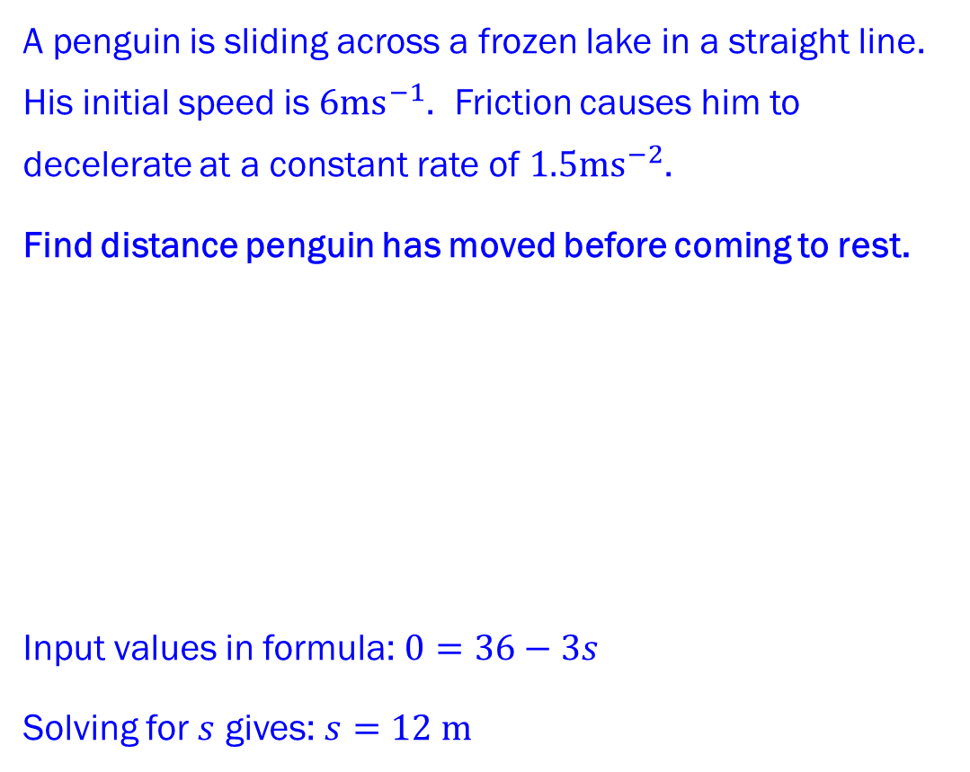
Constant Acceleration
CONSTANT ACCELERATION FORMULAE PART 2
Example 2a
A penguin is sliding across a frozen lake in a straight line. His initial speed is $6ms^{−1}$. Friction causes him to decelerate at a constant rate of $1.5ms^{−2}$.
Find distance penguin has moved before coming to rest.
Input values in formula:$0=36−3s$
Solving for $s$ gives: $s=12 m$
Standard Notation
The following letters are used for an object moving in a straight line with constant acceleration:
$s$ displacement
$u$ initial velocity
$v$ final velocity
$a$ acceleration
$t$ time taken
FORMULAE
$v=u+at$
$s=\left(\frac{u+v}{2}\right)t$
$v^{2}=u^{2}+2as$
$s=ut+\frac{1}{2}at^{2}$
$s=vt−\frac{1}{2}at^{2}$
Solution Example 2a
$$u=6ms^{−1}$$
$$a=−1.5ms^{−2}$$
$$v=0$$
$$s$$

Slide 34
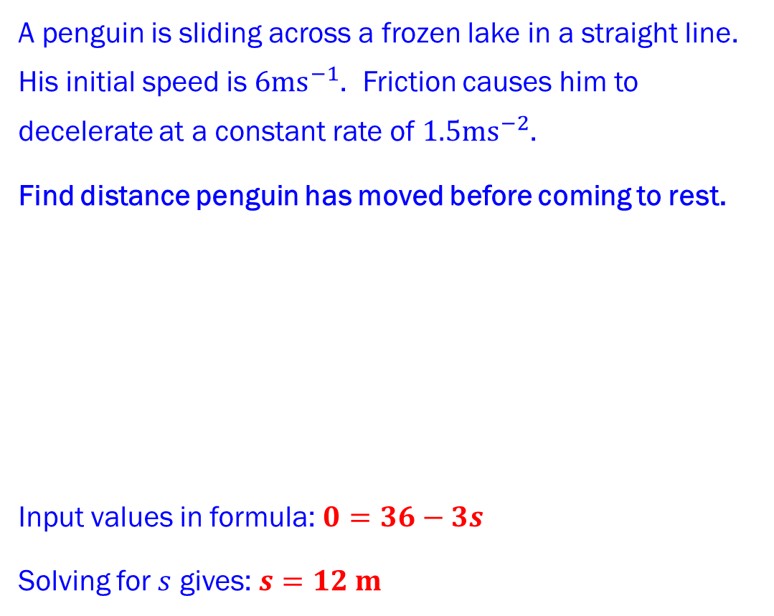
Constant Acceleration
CONSTANT ACCELERATION FORMULAE PART 2
Example 2a
A penguin is sliding across a frozen lake in a straight line. His initial speed is $6ms^{−1}$. Friction causes him to decelerate at a constant rate of $1.5ms^{−2}$.
Find distance penguin has moved before coming to rest.
Input values in formula:$0=36−3s$
Solving for $s$ gives: $s=12 m$
Standard Notation
The following letters are used for an object moving in a straight line with constant acceleration:
$s$ displacement
$u$ initial velocity
$v$ final velocity
$a$ acceleration
$t$ time taken
FORMULAE
$v=u+at$
$s=\left(\frac{u+v}{2}\right)t$
$v^{2}=u^{2}+2as$
$s=ut+\frac{1}{2}at^{2}$
$s=vt−\frac{1}{2}at^{2}$
Solution Example 2a
$$u=6ms^{−1}$$
$$a=−1.5ms^{−2}$$
$$v=0$$
$$s$$

Slide 35
Constant Acceleration
CONSTANT ACCELERATION FORMULAE PART 2
Example 2a
A penguin is sliding across a frozen lake in a straight line. His initial speed is $6ms^{−1}$. Friction causes him to decelerate at a constant rate of $1.5ms^{−2}$.
Find distance penguin has moved before coming to rest.
Input values in formula:$0=36−3s$
Solving for $s$ gives: $s=12 m$
Standard Notation
The following letters are used for an object moving in a straight line with constant acceleration:
$s$ displacement
$u$ initial velocity
$v$ final velocity
$a$ acceleration
$t$ time taken
FORMULAE
$v=u+at$
$s=\left(\frac{u+v}{2}\right)t$
$v^{2}=u^{2}+2as$
$s=ut+\frac{1}{2}at^{2}$
$s=vt−\frac{1}{2}at^{2}$
Solution Example 2a
$$u=6ms^{−1}$$
$$a=−1.5ms^{−2}$$
$$v=0$$
$$s$$

Slide 36
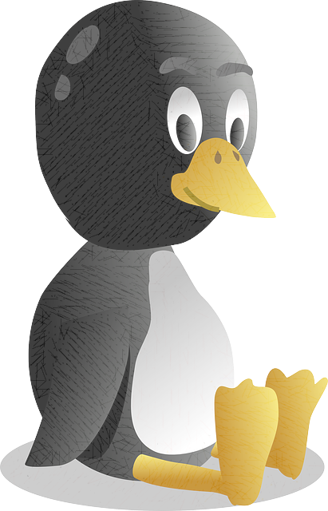





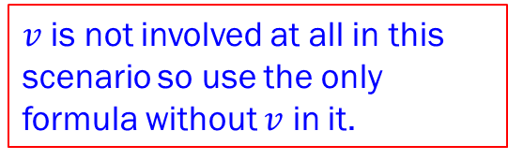



Constant Acceleration
CONSTANT ACCELERATION FORMULAE PART 2
Example 2b
A penguin is sliding across a frozen lake in a straight line. His initial speed is $6ms^{−1}$. Friction causes him to decelerate at a constant rate of $1.5ms^{−2}$. From part 1a, distance penguin has moved before coming to rest is $12m$.
Find the time when he is at half the total distance.
Standard Notation
The following letters are used for an object moving in a straight line with constant acceleration:
$s$ displacement
$u$ initial velocity
$v$ final velocity
$a$ acceleration
$t$ time taken
FORMULAE
$v=u+at$
$s=\left(\frac{u+v}{2}\right)t$
$v^{2}=u^{2}+2as$
$s=ut+\frac{1}{2}at^{2}$
$s=vt−\frac{1}{2}at^{2}$
$$t$$
$$v=0$$
$$u=6ms^{−1}$$
$$v=0$$
$$a=−1.5ms^{−2}$$
$$6m$$
$$12m$$
$$12m$$
$v$ is not involved at all in this scenario so use the only formula without $v$ in it.
FIND

Slide 37

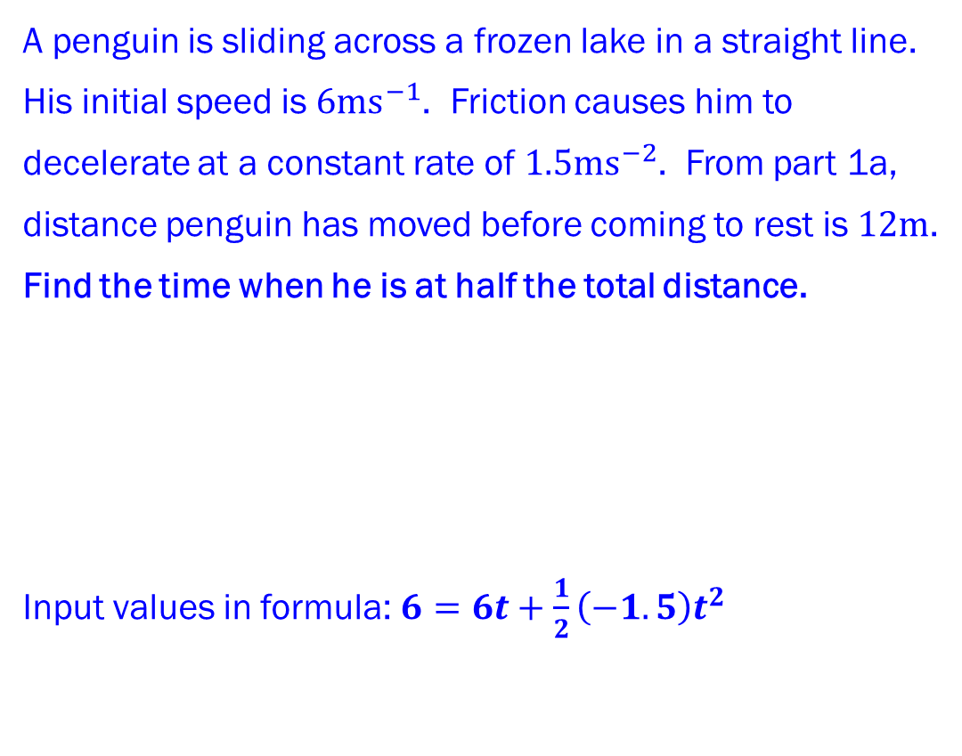





Constant Acceleration
CONSTANT ACCELERATION FORMULAE PART 2
Example 2b
A penguin is sliding across a frozen lake in a straight line. His initial speed is $6ms^{−1}$. Friction causes him to decelerate at a constant rate of $1.5ms^{−2}$. From part 1a, distance penguin has moved before coming to rest is $12m$. Find the time when he is at half the total distance.
Input values in formula:$6=6t+\frac{1}{2}\left(−1.5\right)t^{2}$
Standard Notation
The following letters are used for an object moving in a straight line with constant acceleration:
$s$ displacement
$u$ initial velocity
$v$ final velocity
$a$ acceleration
$t$ time taken
FORMULAE
$v=u+at$
$s=\left(\frac{u+v}{2}\right)t$
$v^{2}=u^{2}+2as$
$s=ut+\frac{1}{2}at^{2}$
$s=vt−\frac{1}{2}at^{2}$
Solution Example 2b
$$u=6ms^{−1}$$
$$t$$
$$v=0$$
$$a=−1.5ms^{−2}$$
$$6m$$
$$12m$$
FIND

Slide 38



Constant Acceleration
CONSTANT ACCELERATION FORMULAE PART 2
Example 2b
A penguin is sliding across a frozen lake in a straight line. His initial speed is $6ms^{−1}$. Friction causes him to decelerate at a constant rate of $1.5ms^{−2}$. From part 1a, distance penguin has moved before coming to rest is $12m$. Find the time when he is at half the total distance.
Input values in formula:$6=6t+\frac{1}{2}\left(−1.5\right)t^{2}$
Standard Notation
The following letters are used for an object moving in a straight line with constant acceleration:
$s$ displacement
$u$ initial velocity
$v$ final velocity
$a$ acceleration
$t$ time taken
FORMULAE
$v=u+at$
$s=\left(\frac{u+v}{2}\right)t$
$v^{2}=u^{2}+2as$
$s=ut+\frac{1}{2}at^{2}$
$s=vt−\frac{1}{2}at^{2}$
Solution Example 2b
$$u=6ms^{−1}$$
$$t$$
$$v=0$$
$$a=−1.5ms^{−2}$$
$$6m$$
$$12m$$
FIND

Slide 39


Constant Acceleration
CONSTANT ACCELERATION FORMULAE PART 2
Example 2b
A penguin is sliding across a frozen lake in a straight line. His initial speed is $6ms^{−1}$. Friction causes him to decelerate at a constant rate of $1.5ms^{−2}$. From part 1a, distance penguin has moved before coming to rest is $12m$. Find the time when he is at half the total distance.
Input values in formula:$6=6t+\frac{1}{2}\left(−1.5\right)t^{2}$
Standard Notation
The following letters are used for an object moving in a straight line with constant acceleration:
$s$ displacement
$u$ initial velocity
$v$ final velocity
$a$ acceleration
$t$ time taken
FORMULAE
$v=u+at$
$s=\left(\frac{u+v}{2}\right)t$
$v^{2}=u^{2}+2as$
$s=ut+\frac{1}{2}at^{2}$
$s=vt−\frac{1}{2}at^{2}$
Solution Example 2b
$$u=6ms^{−1}$$
$$t$$
$$v=0$$
$$a=−1.5ms^{−2}$$
$$6m$$
$$12m$$
FIND

Slide 40



Constant Acceleration
CONSTANT ACCELERATION FORMULAE PART 2
Example 2b
A penguin is sliding across a frozen lake in a straight line. His initial speed is $6ms^{−1}$. Friction causes him to decelerate at a constant rate of $1.5ms^{−2}$. From part 1a, distance penguin has moved before coming to rest is $12m$. Find the time when he is at half the total distance.
Input values in formula:$6=6t+\frac{1}{2}\left(−1.5\right)t^{2}$
Standard Notation
The following letters are used for an object moving in a straight line with constant acceleration:
$s$ displacement
$u$ initial velocity
$v$ final velocity
$a$ acceleration
$t$ time taken
FORMULAE
$v=u+at$
$s=\left(\frac{u+v}{2}\right)t$
$v^{2}=u^{2}+2as$
$s=ut+\frac{1}{2}at^{2}$
$s=vt−\frac{1}{2}at^{2}$
Solution Example 2b
$$u=6ms^{−1}$$
$$t$$
$$v=0$$
$$a=−1.5ms^{−2}$$
$$6m$$
$$12m$$
FIND

Slide 41


Constant Acceleration
CONSTANT ACCELERATION FORMULAE PART 2
Example 2b
A penguin is sliding across a frozen lake in a straight line. His initial speed is $6ms^{−1}$. Friction causes him to decelerate at a constant rate of $1.5ms^{−2}$. From part 1a, distance penguin has moved before coming to rest is $12m$. Find the time when he is at half the total distance.
Input values in formula:$6=6t+\frac{1}{2}\left(−1.5\right)t^{2}$
Standard Notation
The following letters are used for an object moving in a straight line with constant acceleration:
$s$ displacement
$u$ initial velocity
$v$ final velocity
$a$ acceleration
$t$ time taken
FORMULAE
$v=u+at$
$s=\left(\frac{u+v}{2}\right)t$
$v^{2}=u^{2}+2as$
$s=ut+\frac{1}{2}at^{2}$
$s=vt−\frac{1}{2}at^{2}$
Solution Example 2b
$$u=6ms^{−1}$$
$$t$$
$$v=0$$
$$a=−1.5ms^{−2}$$
$$6m$$
$$12m$$
FIND

Slide 42


Constant Acceleration
CONSTANT ACCELERATION FORMULAE PART 2
Example 2b
A penguin is sliding across a frozen lake in a straight line. His initial speed is $6ms^{−1}$. Friction causes him to decelerate at a constant rate of $1.5ms^{−2}$. From part 1a, distance penguin has moved before coming to rest is $12m$. Find the time when he is at half the total distance.
Input values in formula:$6=6t+\frac{1}{2}\left(−1.5\right)t^{2}$
Standard Notation
The following letters are used for an object moving in a straight line with constant acceleration:
$s$ displacement
$u$ initial velocity
$v$ final velocity
$a$ acceleration
$t$ time taken
FORMULAE
$v=u+at$
$s=\left(\frac{u+v}{2}\right)t$
$v^{2}=u^{2}+2as$
$s=ut+\frac{1}{2}at^{2}$
$s=vt−\frac{1}{2}at^{2}$
Solution Example 2b
$$u=6ms^{−1}$$
$$t$$
$$v=0$$
$$a=−1.5ms^{−2}$$
$$6m$$
$$12m$$
FIND

Slide 43

Constant Acceleration
CONSTANT ACCELERATION FORMULAE PART 2
Example 2b
A penguin is sliding across a frozen lake in a straight line. His initial speed is $6ms^{−1}$. Friction causes him to decelerate at a constant rate of $1.5ms^{−2}$. From part 1a, distance penguin has moved before coming to rest is $12m$. Find the time when he is at half the total distance.
Input values in formula:$6=6t+\frac{1}{2}\left(−1.5\right)t^{2}$
Standard Notation
The following letters are used for an object moving in a straight line with constant acceleration:
$s$ displacement
$u$ initial velocity
$v$ final velocity
$a$ acceleration
$t$ time taken
FORMULAE
$v=u+at$
$s=\left(\frac{u+v}{2}\right)t$
$v^{2}=u^{2}+2as$
$s=ut+\frac{1}{2}at^{2}$
$s=vt−\frac{1}{2}at^{2}$
Solution Example 2b
$$u=6ms^{−1}$$
$$t$$
$$v=0$$
$$a=−1.5ms^{−2}$$
$$6m$$
$$12m$$
FIND

Slide 44

Constant Acceleration
CONSTANT ACCELERATION FORMULAE PART 2
Example 2b
A penguin is sliding across a frozen lake in a straight line. His initial speed is $6ms^{−1}$. Friction causes him to decelerate at a constant rate of $1.5ms^{−2}$. From part 1a, distance penguin has moved before coming to rest is $12m$. Find the time when he is at half the total distance.
Input values in formula:$6=6t−0.75t^{2}$ multiply by 4
Standard Notation
The following letters are used for an object moving in a straight line with constant acceleration:
$s$ displacement
$u$ initial velocity
$v$ final velocity
$a$ acceleration
$t$ time taken
FORMULAE
$v=u+at$
$s=\left(\frac{u+v}{2}\right)t$
$v^{2}=u^{2}+2as$
$s=ut+\frac{1}{2}at^{2}$
$s=vt−\frac{1}{2}at^{2}$
Solution Example 2b
$$u=6ms^{−1}$$
$$t$$
$$v=0$$
$$a=−1.5ms^{−2}$$
$$6m$$
$$12m$$
FIND

Slide 45

Constant Acceleration
CONSTANT ACCELERATION FORMULAE PART 2
Example 2b
A penguin is sliding across a frozen lake in a straight line. His initial speed is $6ms^{−1}$. Friction causes him to decelerate at a constant rate of $1.5ms^{−2}$. From part 1a, distance penguin has moved before coming to rest is $12m$. Find the time when he is at half the total distance.
Input values in formula: $24=24t−3t^{2}$
Standard Notation
The following letters are used for an object moving in a straight line with constant acceleration:
$s$ displacement
$u$ initial velocity
$v$ final velocity
$a$ acceleration
$t$ time taken
FORMULAE
$v=u+at$
$s=\left(\frac{u+v}{2}\right)t$
$v^{2}=u^{2}+2as$
$s=ut+\frac{1}{2}at^{2}$
$s=vt−\frac{1}{2}at^{2}$
Solution Example 2b
$$u=6ms^{−1}$$
$$t$$
$$v=0$$
$$a=−1.5ms^{−2}$$
$$6m$$
$$12m$$
FIND

Slide 46

Constant Acceleration
CONSTANT ACCELERATION FORMULAE PART 2
Example 2b
A penguin is sliding across a frozen lake in a straight line. His initial speed is $6ms^{−1}$. Friction causes him to decelerate at a constant rate of $1.5ms^{−2}$. From part 1a, distance penguin has moved before coming to rest is $12m$. Find the time when he is at half the total distance.
Input values in formula: $24=24t−3t^{2}$ divide by 3
Standard Notation
The following letters are used for an object moving in a straight line with constant acceleration:
$s$ displacement
$u$ initial velocity
$v$ final velocity
$a$ acceleration
$t$ time taken
FORMULAE
$v=u+at$
$s=\left(\frac{u+v}{2}\right)t$
$v^{2}=u^{2}+2as$
$s=ut+\frac{1}{2}at^{2}$
$s=vt−\frac{1}{2}at^{2}$
Solution Example 2b
$$u=6ms^{−1}$$
$$t$$
$$v=0$$
$$a=−1.5ms^{−2}$$
$$6m$$
$$12m$$
FIND

Slide 47

Constant Acceleration
CONSTANT ACCELERATION FORMULAE PART 2
Example 2b
A penguin is sliding across a frozen lake in a straight line. His initial speed is $6ms^{−1}$. Friction causes him to decelerate at a constant rate of $1.5ms^{−2}$. From part 1a, distance penguin has moved before coming to rest is $12m$. Find the time when he is at half the total distance.
Input values in formula: $8=8t−t^{2}$ divide by 3
Standard Notation
The following letters are used for an object moving in a straight line with constant acceleration:
$s$ displacement
$u$ initial velocity
$v$ final velocity
$a$ acceleration
$t$ time taken
FORMULAE
$v=u+at$
$s=\left(\frac{u+v}{2}\right)t$
$v^{2}=u^{2}+2as$
$s=ut+\frac{1}{2}at^{2}$
$s=vt−\frac{1}{2}at^{2}$
Solution Example 2b
$$u=6ms^{−1}$$
$$t$$
$$v=0$$
$$a=−1.5ms^{−2}$$
$$6m$$
$$12m$$
FIND

Slide 48

Constant Acceleration
CONSTANT ACCELERATION FORMULAE PART 2
Example 2b
A penguin is sliding across a frozen lake in a straight line. His initial speed is $6ms^{−1}$. Friction causes him to decelerate at a constant rate of $1.5ms^{−2}$. From part 1a, distance penguin has moved before coming to rest is $12m$. Find the time when he is at half the total distance.
Input values in formula: $8=8t−t^{2}.$ Solve quadratic.
Standard Notation
The following letters are used for an object moving in a straight line with constant acceleration:
$s$ displacement
$u$ initial velocity
$v$ final velocity
$a$ acceleration
$t$ time taken
FORMULAE
$v=u+at$
$s=\left(\frac{u+v}{2}\right)t$
$v^{2}=u^{2}+2as$
$s=ut+\frac{1}{2}at^{2}$
$s=vt−\frac{1}{2}at^{2}$
Solution Example 2b
$$u=6ms^{−1}$$
$$t$$
$$v=0$$
$$a=−1.5ms^{−2}$$
$$6m$$
$$12m$$
FIND

Slide 49

Constant Acceleration
CONSTANT ACCELERATION FORMULAE PART 2
Example 2b
A penguin is sliding across a frozen lake in a straight line. His initial speed is $6ms^{−1}$. Friction causes him to decelerate at a constant rate of $1.5ms^{−2}$. From part 1a, distance penguin has moved before coming to rest is $12m$. Find the time when he is at half the total distance.
Input values in formula: $8=8t−t^{2}.$ Rearranging gives $t^{2}−8t+8=0$.
Standard Notation
The following letters are used for an object moving in a straight line with constant acceleration:
$s$ displacement
$u$ initial velocity
$v$ final velocity
$a$ acceleration
$t$ time taken
FORMULAE
$v=u+at$
$s=\left(\frac{u+v}{2}\right)t$
$v^{2}=u^{2}+2as$
$s=ut+\frac{1}{2}at^{2}$
$s=vt−\frac{1}{2}at^{2}$
Solution Example 2b
$$u=6ms^{−1}$$
$$t$$
$$v=0$$
$$a=−1.5ms^{−2}$$
$$6m$$
$$12m$$
FIND

Slide 50

Constant Acceleration
CONSTANT ACCELERATION FORMULAE PART 2
Example 2b
A penguin is sliding across a frozen lake in a straight line. His initial speed is $6ms^{−1}$. Friction causes him to decelerate at a constant rate of $1.5ms^{−2}$. From part 1a, distance penguin has moved before coming to rest is $12m$. Find the time when he is at half the total distance.
Input values in formula: $8=8t−t^{2}.$ Rearranging gives $t^{2}−8t+8=0$. Solving quadratic gives $t=6.83$ or $1.17$ seconds.
Standard Notation
The following letters are used for an object moving in a straight line with constant acceleration:
$s$ displacement
$u$ initial velocity
$v$ final velocity
$a$ acceleration
$t$ time taken
FORMULAE
$v=u+at$
$s=\left(\frac{u+v}{2}\right)t$
$v^{2}=u^{2}+2as$
$s=ut+\frac{1}{2}at^{2}$
$s=vt−\frac{1}{2}at^{2}$
Solution Example 2b
$$u=6ms^{−1}$$
$$t$$
$$v=0$$
$$a=−1.5ms^{−2}$$
$$6m$$
$$12m$$
FIND

Slide 51

Constant Acceleration
CONSTANT ACCELERATION FORMULAE PART 2
Example 2b
A penguin is sliding across a frozen lake in a straight line. His initial speed is $6ms^{−1}$. Friction causes him to decelerate at a constant rate of $1.5ms^{−2}$. From part 1a, distance penguin has moved before coming to rest is $12m$. Find the time when he is at half the total distance.
Input values in formula: $8=8t−t^{2}.$ Rearranging gives $t^{2}−8t+8=0$. Solving quadratic gives $t=6.83$ or $1.17$ seconds.
Standard Notation
The following letters are used for an object moving in a straight line with constant acceleration:
$s$ displacement
$u$ initial velocity
$v$ final velocity
$a$ acceleration
$t$ time taken
FORMULAE
$v=u+at$
$s=\left(\frac{u+v}{2}\right)t$
$v^{2}=u^{2}+2as$
$s=ut+\frac{1}{2}at^{2}$
$s=vt−\frac{1}{2}at^{2}$
Solution Example 2b
$$u=6ms^{−1}$$
$$t$$
$$v=0$$
$$a=−1.5ms^{−2}$$
$$6m$$
$$12m$$
FIND

Slide 52
Constant Acceleration
CONSTANT ACCELERATION FORMULAE PART 2
Example 2b
A penguin is sliding across a frozen lake in a straight line. His initial speed is $6ms^{−1}$. Friction causes him to decelerate at a constant rate of $1.5ms^{−2}$. From part 1a, distance penguin has moved before coming to rest is $12m$. Find the time when he is at half the total distance.
Input values in formula: $8=8t−t^{2}.$ Rearranging gives $t^{2}−8t+8=0$. Solving quadratic gives $t=6.83$ or $1.17$ seconds.
Standard Notation
The following letters are used for an object moving in a straight line with constant acceleration:
$s$ displacement
$u$ initial velocity
$v$ final velocity
$a$ acceleration
$t$ time taken
FORMULAE
$v=u+at$
$s=\left(\frac{u+v}{2}\right)t$
$v^{2}=u^{2}+2as$
$s=ut+\frac{1}{2}at^{2}$
$s=vt−\frac{1}{2}at^{2}$
Solution Example 2b
$$u=6ms^{−1}$$
$$t$$
$$v=0$$
$$a=−1.5ms^{−2}$$
$$6m$$
$$12m$$
FIND

Slide 53
Recap
If you have understood the content of this session, you should be able to:
Derive the formulae for constant acceleration and use them in order to solve problems.
REVIEW

Slide 54
Exercises
Questions
Now attempt the exercises in your text book related to this topic.
Notes:
Now attempt the exercises in your text book related to this topic.

Slide 55
Copyright
© Z. Ali 2020

