Slide 1
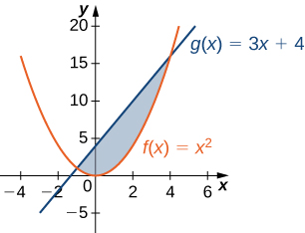
Integration
AS
AREA BETWEEN CURVES AND LINES
Notes:
Welcome to the unit on ‘Integration: AREA BETWEEN CURVES AND LINES‘

Slide 2
Objectives
The objectives for this session are to:
Find the area bounded by curves and straight lines.
AREA BETWEEN CURVES AND LINES

Slide 3

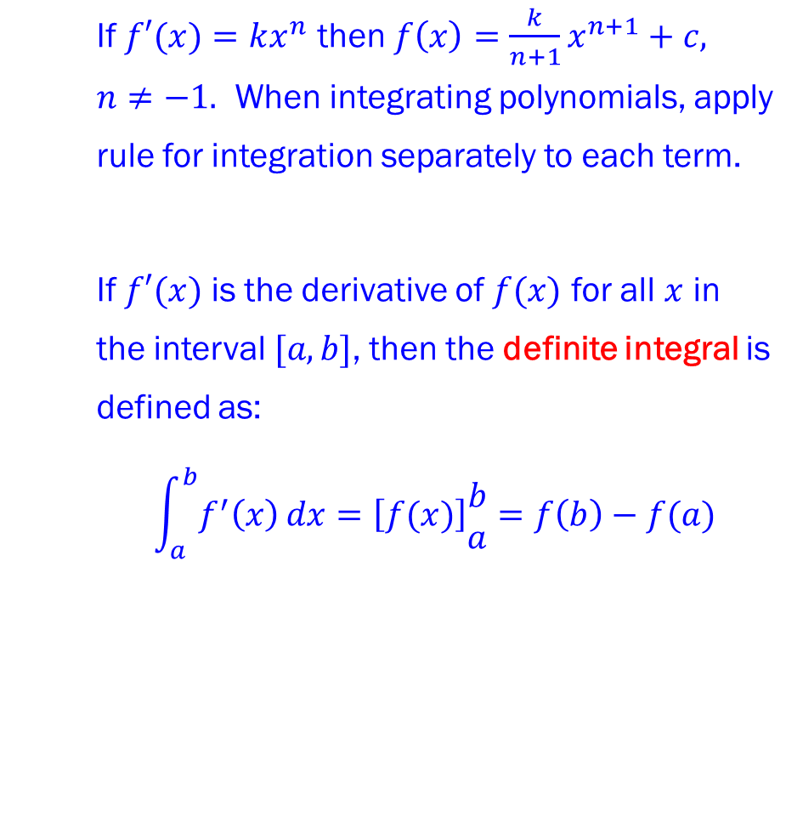

Integration
DEFINITE INTEGRALS
Steps for Integrating Definite Integrals
1. Write definite integral statement with its limits: $\int_{a}^{b}{f^{′}\left(x\right)}$.
2. Integrate and write the integral in square brackets: $\left[f(x)\right]\begin{matrix}b \\ a\end{matrix}$.
3. Evaluate the integral by working out $f\left(b\right)−f(a)$.
Rule for Integrating ${kx}^{n}$
If $f′(x)=kx^{n}$ then $f\left(x\right)=\frac{k}{n+1}x^{n+1}+c,$ $n≠−1.$ When integrating polynomials, apply rule for integration separately to each term.
If $f′(x)$ is the derivative of $f(x)$ for all $x$ in the interval $[a,b]$, then the definite integral is defined as:
$$\int_{a}^{b}{f^{′}\left(x\right)}dx=\left[f(x)\right]\begin{matrix}b \\ a\end{matrix}=f\left(b\right)−f(a)$$
Definite Integrals

Slide 4
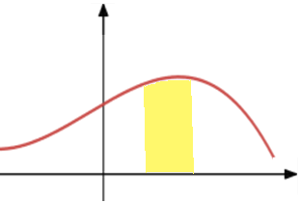






Integration
AREAS UNDER CURVES
Area Under a Curve
Area between a positive curve, $x$-axis and lines $x=a$ and $x=b$ is:
$$Area=\int_{a}^{b}{y}dx$$
where $y=f(x)$ is the equation of the curve.
$$y$$
$$y=f(x)$$
$$a$$
$$b$$
$$x$$

Slide 5
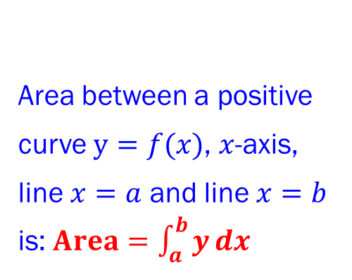



Integration
AREAS UNDER CURVES
Area Under a Curve
Area between a positive curve $y=f(x)$, $x$-axis, line $x=a$ and line $x=b$ is:$Area=\int_{a}^{b}{y}dx$
$$y$$
$$y=f(x)$$
$$a$$
$$b$$
$$x$$

Slide 6
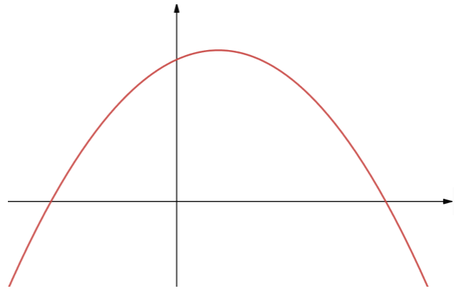
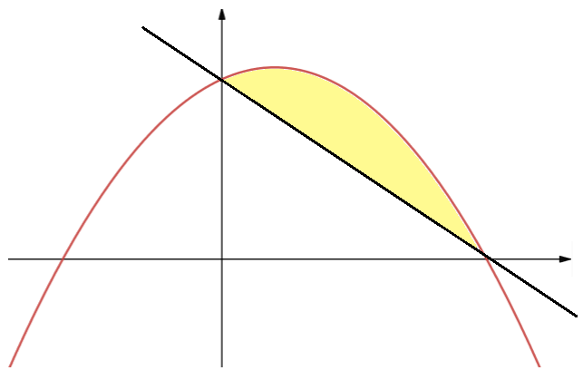
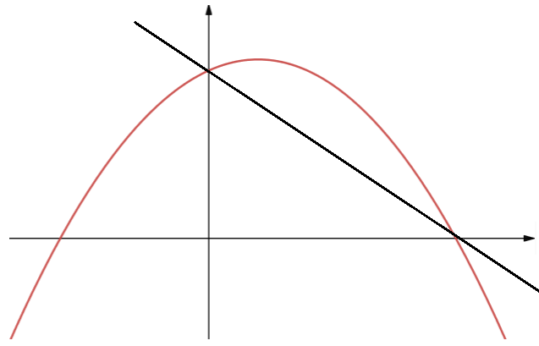
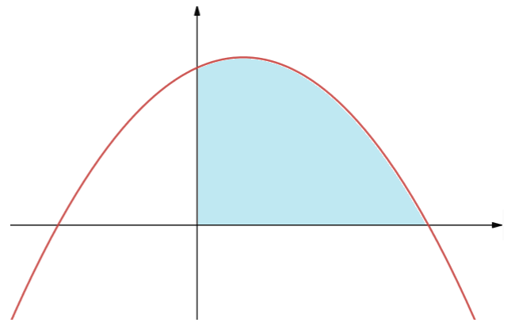
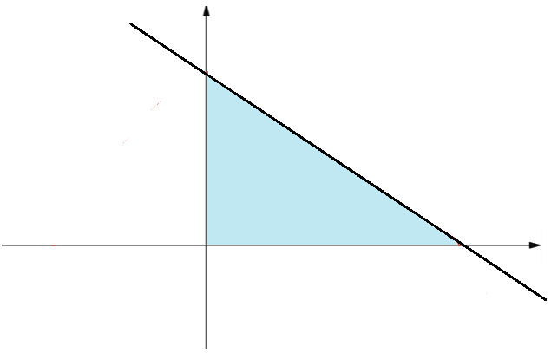


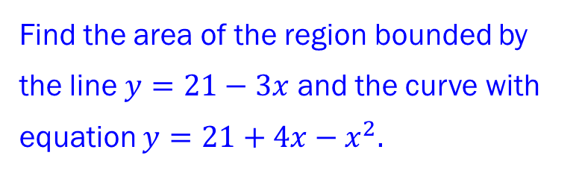

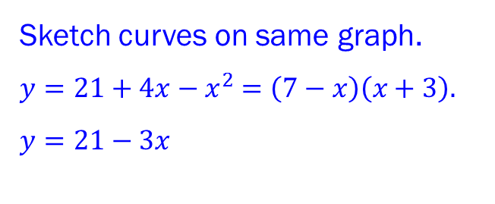






Integration
AREAS UNDER CURVES
Solution Example 1
Sketch curves on same graph. $y=21+4x−x^{2}$ $=\left(7−x\right)\left(x+3\right).$ $y=21−3x$
$$y=21−3x$$
$$21$$
Area Under a Curve
Area between a positive curve $y=f(x)$, $x$-axis, line $x=a$ and line $x=b$ is:$Area=\int_{a}^{b}{y}dx$
$$y$$
$$−3$$
$$7$$
$$y=f(x)$$
$$y=21+4x−x^{2}$$
_
=
$$a$$
$$b$$
$$x$$
Area 1
Area 2
$$0$$
$$7$$
$$0$$
$$7$$
Example 1
Find the area of the region bounded by the line $y=21−3x$ and the curve with equation $y=21+4x−x^{2}.$

Slide 7
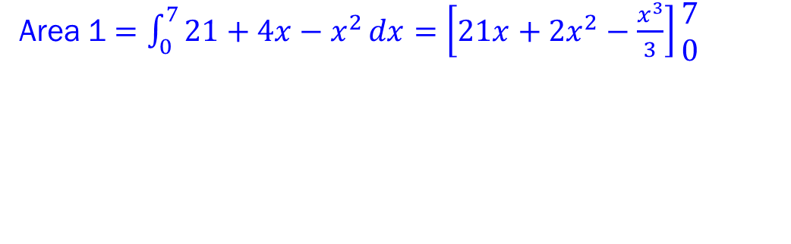
Integration
AREAS UNDER CURVES
Solution Example 1
Sketch curves on same graph. $y=21+4x−x^{2}$ $=\left(7−x\right)\left(x+3\right).$ $y=21−3x$
$$y=21−3x$$
$$21$$
Area
Area Under a Curve
Area between a positive curve $y=f(x)$, $x$-axis, line $x=a$ and line $x=b$ is:$Area=\int_{a}^{b}{y}dx$
$$y$$
$$−3$$
$$7$$
$$y=f(x)$$
$$y=21+4x−x^{2}$$
_
=
$$a$$
$$b$$
$$x$$
Area 1
Area 2
$$0$$
$$7$$
$$0$$
$$7$$
Example 1
Area 1 $=\int_{0}^{7}{21+4x−x^{2}}dx=\left[21x+2x^{2}−\frac{x^{3}}{3}\right]\begin{matrix}7 \\ 0\end{matrix}$
Find the area of the region bounded by the line $y=21−3x$ and the curve with equation $y=21+4x−x^{2}.$

Slide 8
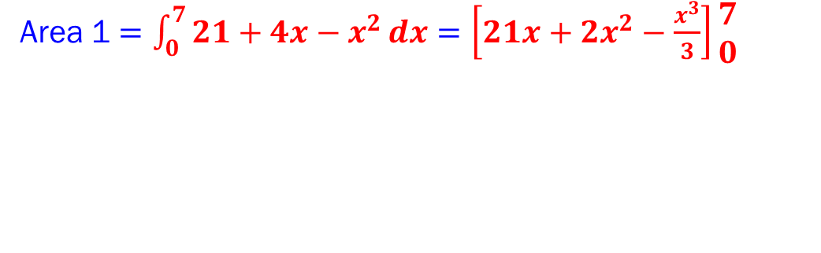
Integration
AREAS UNDER CURVES
Solution Example 1
Sketch curves on same graph. $y=21+4x−x^{2}$ $=\left(7−x\right)\left(x+3\right).$ $y=21−3x$
$$y=21−3x$$
$$21$$
Area
Area Under a Curve
Area between a positive curve $y=f(x)$, $x$-axis, line $x=a$ and line $x=b$ is:$Area=\int_{a}^{b}{y}dx$
$$y$$
$$−3$$
$$7$$
$$y=f(x)$$
$$y=21+4x−x^{2}$$
_
=
$$a$$
$$b$$
$$x$$
Area 1
Area 2
$$0$$
$$7$$
$$0$$
$$7$$
Example 1
Area 1 $=\int_{0}^{7}{21+4x−x^{2}}dx=\left[21x+2x^{2}−\frac{x^{3}}{3}\right]\begin{matrix}7 \\ 0\end{matrix}$
Find the area of the region bounded by the line $y=21−3x$ and the curve with equation $y=21+4x−x^{2}.$

Slide 9
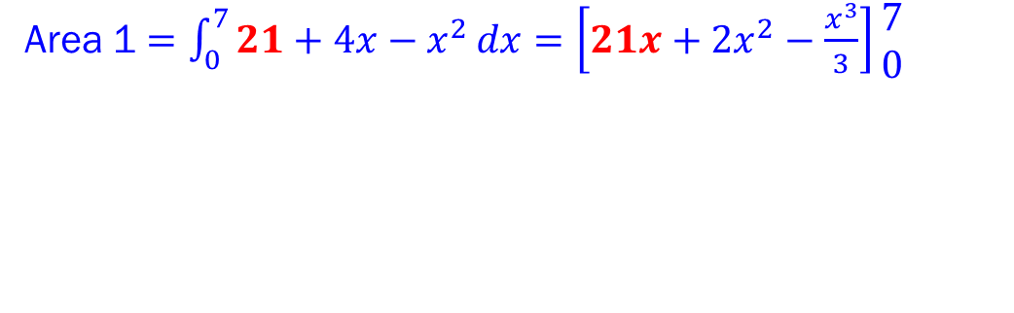
Integration
AREAS UNDER CURVES
Solution Example 1
Sketch curves on same graph. $y=21+4x−x^{2}$ $=\left(7−x\right)\left(x+3\right).$ $y=21−3x$
$$y=21−3x$$
$$21$$
Area
Area Under a Curve
Area between a positive curve $y=f(x)$, $x$-axis, line $x=a$ and line $x=b$ is:$Area=\int_{a}^{b}{y}dx$
$$y$$
$$−3$$
$$7$$
$$y=f(x)$$
$$y=21+4x−x^{2}$$
_
=
$$a$$
$$b$$
$$x$$
Area 1
Area 2
$$0$$
$$7$$
$$0$$
$$7$$
Example 1
Area 1 $=\int_{0}^{7}{21+4x−x^{2}}dx=\left[21x+2x^{2}−\frac{x^{3}}{3}\right]\begin{matrix}7 \\ 0\end{matrix}$
Find the area of the region bounded by the line $y=21−3x$ and the curve with equation $y=21+4x−x^{2}.$

Slide 10
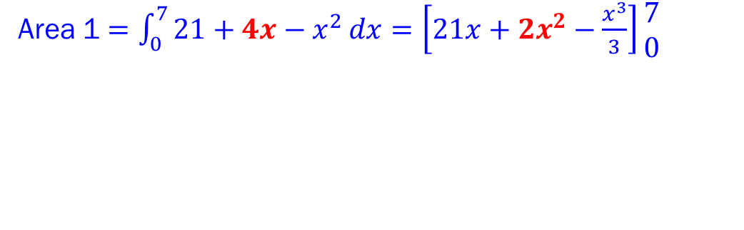
Integration
AREAS UNDER CURVES
Solution Example 1
Sketch curves on same graph. $y=21+4x−x^{2}$ $=\left(7−x\right)\left(x+3\right).$ $y=21−3x$
$$y=21−3x$$
$$21$$
Area
Area Under a Curve
Area between a positive curve $y=f(x)$, $x$-axis, line $x=a$ and line $x=b$ is:$Area=\int_{a}^{b}{y}dx$
$$y$$
$$−3$$
$$7$$
$$y=f(x)$$
$$y=21+4x−x^{2}$$
_
=
$$a$$
$$b$$
$$x$$
Area 1
Area 2
$$0$$
$$7$$
$$0$$
$$7$$
Example 1
Area 1 $=\int_{0}^{7}{21+4x−x^{2}}dx=\left[21x+2x^{2}−\frac{x^{3}}{3}\right]\begin{matrix}7 \\ 0\end{matrix}$
Find the area of the region bounded by the line $y=21−3x$ and the curve with equation $y=21+4x−x^{2}.$

Slide 11
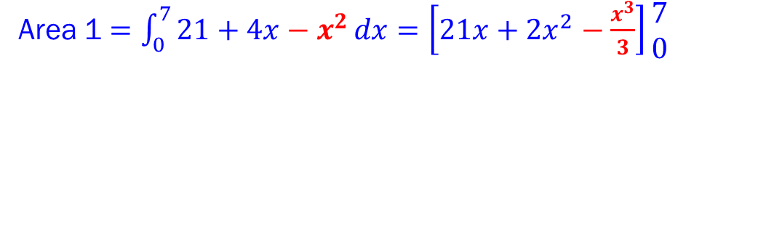
Integration
AREAS UNDER CURVES
Solution Example 1
Sketch curves on same graph. $y=21+4x−x^{2}$ $=\left(7−x\right)\left(x+3\right).$ $y=21−3x$
$$y=21−3x$$
$$21$$
Area
Area Under a Curve
Area between a positive curve $y=f(x)$, $x$-axis, line $x=a$ and line $x=b$ is:$Area=\int_{a}^{b}{y}dx$
$$y$$
$$−3$$
$$7$$
$$y=f(x)$$
$$y=21+4x−x^{2}$$
_
=
$$a$$
$$b$$
$$x$$
Area 1
Area 2
$$0$$
$$7$$
$$0$$
$$7$$
Example 1
Area 1 $=\int_{0}^{7}{21+4x−x^{2}}dx=\left[21x+2x^{2}−\frac{x^{3}}{3}\right]\begin{matrix}7 \\ 0\end{matrix}$
Find the area of the region bounded by the line $y=21−3x$ and the curve with equation $y=21+4x−x^{2}.$

Slide 12
Integration
AREAS UNDER CURVES
Solution Example 1
Sketch curves on same graph. $y=21+4x−x^{2}$ $=\left(7−x\right)\left(x+3\right).$ $y=21−3x$
$$y=21−3x$$
$$21$$
Area
Area Under a Curve
Area between a positive curve $y=f(x)$, $x$-axis, line $x=a$ and line $x=b$ is:$Area=\int_{a}^{b}{y}dx$
$$y$$
$$−3$$
$$7$$
$$y=f(x)$$
$$y=21+4x−x^{2}$$
_
=
$$a$$
$$b$$
$$x$$
Area 1
Area 2
$$0$$
$$7$$
$$0$$
$$7$$
Example 1
Area 1 $=\int_{0}^{7}{21+4x−x^{2}}dx=\left[21x+2x^{2}−\frac{x^{3}}{3}\right]\begin{matrix}7 \\ 0\end{matrix}$
Find the area of the region bounded by the line $y=21−3x$ and the curve with equation $y=21+4x−x^{2}.$

Slide 13
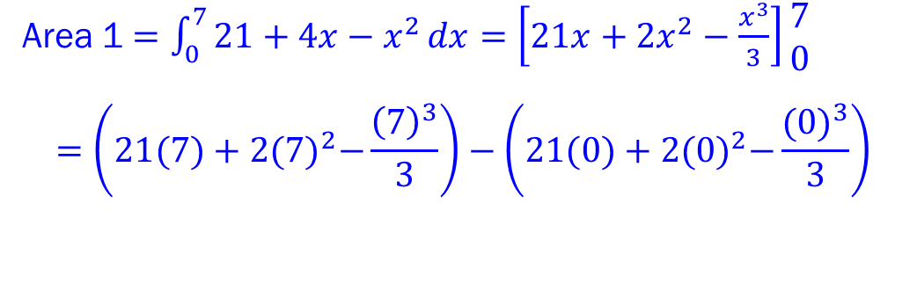
Integration
AREAS UNDER CURVES
Solution Example 1
Sketch curves on same graph. $y=21+4x−x^{2}$ $=\left(7−x\right)\left(x+3\right).$ $y=21−3x$
$$y=21−3x$$
$$21$$
Area
Area Under a Curve
Area between a positive curve $y=f(x)$, $x$-axis, line $x=a$ and line $x=b$ is:$Area=\int_{a}^{b}{y}dx$
$$y$$
$$−3$$
$$7$$
$$y=f(x)$$
$$y=21+4x−x^{2}$$
_
=
$$a$$
$$b$$
$$x$$
Area 1
Area 2
$$0$$
$$7$$
$$0$$
$$7$$
Example 1
Area 1 $=\int_{0}^{7}{21+4x−x^{2}}dx=\left[21x+2x^{2}−\frac{x^{3}}{3}\right]\begin{matrix}7 \\ 0\end{matrix}$ $$=\left(21(7)+2{(7)}^{2}−\frac{{\left(7\right)}^{3}}{3}\right)−\left(21(0)+2{(0)}^{2}−\frac{{(0)}^{3}}{3}\right)$$
Find the area of the region bounded by the line $y=21−3x$ and the curve with equation $y=21+4x−x^{2}.$

Slide 14
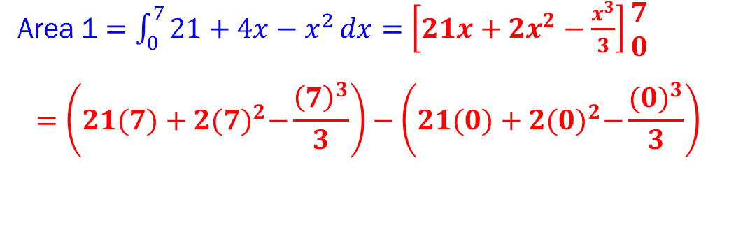
Integration
AREAS UNDER CURVES
Solution Example 1
Sketch curves on same graph. $y=21+4x−x^{2}$ $=\left(7−x\right)\left(x+3\right).$ $y=21−3x$
$$y=21−3x$$
$$21$$
Area
Area Under a Curve
Area between a positive curve $y=f(x)$, $x$-axis, line $x=a$ and line $x=b$ is:$Area=\int_{a}^{b}{y}dx$
$$y$$
$$−3$$
$$7$$
$$y=f(x)$$
$$y=21+4x−x^{2}$$
_
=
$$a$$
$$b$$
$$x$$
Area 1
Area 2
$$0$$
$$7$$
$$0$$
$$7$$
Example 1
Area 1 $=\int_{0}^{7}{21+4x−x^{2}}dx=\left[21x+2x^{2}−\frac{x^{3}}{3}\right]\begin{matrix}7 \\ 0\end{matrix}$ $$=\left(21(7)+2{(7)}^{2}−\frac{{\left(7\right)}^{3}}{3}\right)−\left(21(0)+2{(0)}^{2}−\frac{{(0)}^{3}}{3}\right)$$
Find the area of the region bounded by the line $y=21−3x$ and the curve with equation $y=21+4x−x^{2}.$

Slide 15
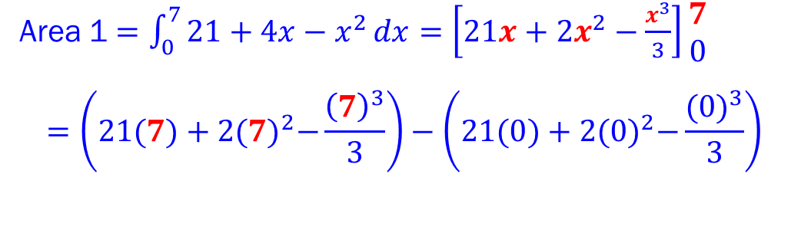
Integration
AREAS UNDER CURVES
Solution Example 1
Sketch curves on same graph. $y=21+4x−x^{2}$ $=\left(7−x\right)\left(x+3\right).$ $y=21−3x$
$$y=21−3x$$
$$21$$
Area
Area Under a Curve
Area between a positive curve $y=f(x)$, $x$-axis, line $x=a$ and line $x=b$ is:$Area=\int_{a}^{b}{y}dx$
$$y$$
$$−3$$
$$7$$
$$y=f(x)$$
$$y=21+4x−x^{2}$$
_
=
$$a$$
$$b$$
$$x$$
Area 1
Area 2
$$0$$
$$7$$
$$0$$
$$7$$
Example 1
Area 1 $=\int_{0}^{7}{21+4x−x^{2}}dx=\left[21x+2x^{2}−\frac{x^{3}}{3}\right]\begin{matrix}7 \\ 0\end{matrix}$ $$=\left(21(7)+2{(7)}^{2}−\frac{{\left(7\right)}^{3}}{3}\right)−\left(21(0)+2{(0)}^{2}−\frac{{(0)}^{3}}{3}\right)$$
Find the area of the region bounded by the line $y=21−3x$ and the curve with equation $y=21+4x−x^{2}.$

Slide 16
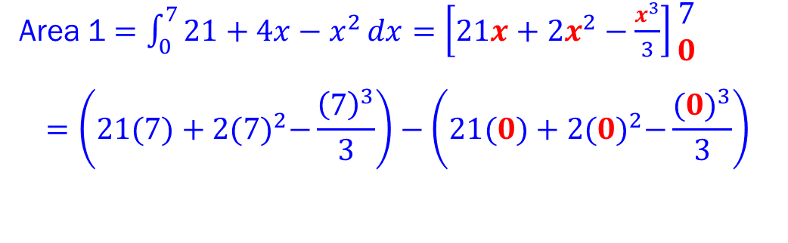
Integration
AREAS UNDER CURVES
Solution Example 1
Sketch curves on same graph. $y=21+4x−x^{2}$ $=\left(7−x\right)\left(x+3\right).$ $y=21−3x$
$$y=21−3x$$
$$21$$
Area
Area Under a Curve
Area between a positive curve $y=f(x)$, $x$-axis, line $x=a$ and line $x=b$ is:$Area=\int_{a}^{b}{y}dx$
$$y$$
$$−3$$
$$7$$
$$y=f(x)$$
$$y=21+4x−x^{2}$$
_
=
$$a$$
$$b$$
$$x$$
Area 1
Area 2
$$0$$
$$7$$
$$0$$
$$7$$
Example 1
Area 1 $=\int_{0}^{7}{21+4x−x^{2}}dx=\left[21x+2x^{2}−\frac{x^{3}}{3}\right]\begin{matrix}7 \\ 0\end{matrix}$ $$=\left(21(7)+2{(7)}^{2}−\frac{{\left(7\right)}^{3}}{3}\right)−\left(21(0)+2{(0)}^{2}−\frac{{(0)}^{3}}{3}\right)$$
Find the area of the region bounded by the line $y=21−3x$ and the curve with equation $y=21+4x−x^{2}.$

Slide 17
Integration
AREAS UNDER CURVES
Solution Example 1
Sketch curves on same graph. $y=21+4x−x^{2}$ $=\left(7−x\right)\left(x+3\right).$ $y=21−3x$
$$y=21−3x$$
$$21$$
Area
Area Under a Curve
Area between a positive curve $y=f(x)$, $x$-axis, line $x=a$ and line $x=b$ is:$Area=\int_{a}^{b}{y}dx$
$$y$$
$$−3$$
$$7$$
$$y=f(x)$$
$$y=21+4x−x^{2}$$
_
=
$$a$$
$$b$$
$$x$$
Area 1
Area 2
$$0$$
$$7$$
$$0$$
$$7$$
Example 1
Area 1 $=\int_{0}^{7}{21+4x−x^{2}}dx=\left[21x+2x^{2}−\frac{x^{3}}{3}\right]\begin{matrix}7 \\ 0\end{matrix}$ $$=\left(21(7)+2{(7)}^{2}−\frac{{\left(7\right)}^{3}}{3}\right)−\left(21(0)+2{(0)}^{2}−\frac{{(0)}^{3}}{3}\right)$$
Find the area of the region bounded by the line $y=21−3x$ and the curve with equation $y=21+4x−x^{2}.$

Slide 18
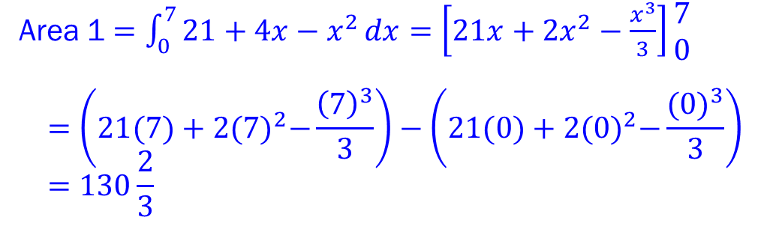
Integration
AREAS UNDER CURVES
Solution Example 1
Sketch curves on same graph. $y=21+4x−x^{2}$ $=\left(7−x\right)\left(x+3\right).$ $y=21−3x$
$$y=21−3x$$
$$21$$
Area
Area Under a Curve
Area between a positive curve $y=f(x)$, $x$-axis, line $x=a$ and line $x=b$ is:$Area=\int_{a}^{b}{y}dx$
$$y$$
$$−3$$
$$7$$
$$y=f(x)$$
$$y=21+4x−x^{2}$$
_
=
$$a$$
$$b$$
$$x$$
Area 1
Area 2
$$0$$
$$7$$
$$0$$
$$7$$
Example 1
Area 1 $=\int_{0}^{7}{21+4x−x^{2}}dx=\left[21x+2x^{2}−\frac{x^{3}}{3}\right]\begin{matrix}7 \\ 0\end{matrix}$ $$=\left(21(7)+2{(7)}^{2}−\frac{{\left(7\right)}^{3}}{3}\right)−\left(21(0)+2{(0)}^{2}−\frac{{(0)}^{3}}{3}\right) \\ =130\frac{2}{3}$$
Find the area of the region bounded by the line $y=21−3x$ and the curve with equation $y=21+4x−x^{2}.$

Slide 19
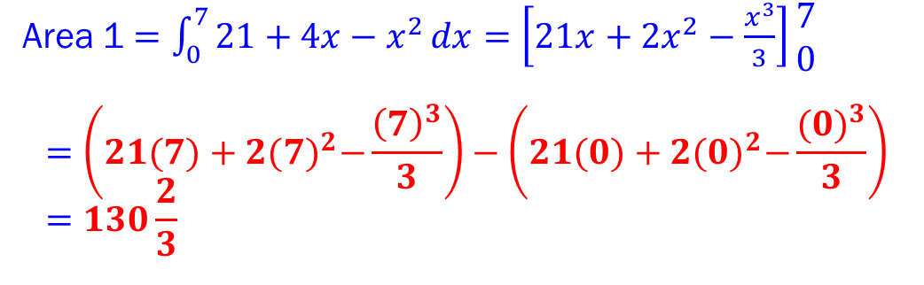
Integration
AREAS UNDER CURVES
Solution Example 1
Sketch curves on same graph. $y=21+4x−x^{2}$ $=\left(7−x\right)\left(x+3\right).$ $y=21−3x$
$$y=21−3x$$
$$21$$
Area
Area Under a Curve
Area between a positive curve $y=f(x)$, $x$-axis, line $x=a$ and line $x=b$ is:$Area=\int_{a}^{b}{y}dx$
$$y$$
$$−3$$
$$7$$
$$y=f(x)$$
$$y=21+4x−x^{2}$$
_
=
$$a$$
$$b$$
$$x$$
Area 1
Area 2
$$0$$
$$7$$
$$0$$
$$7$$
Example 1
Area 1 $=\int_{0}^{7}{21+4x−x^{2}}dx=\left[21x+2x^{2}−\frac{x^{3}}{3}\right]\begin{matrix}7 \\ 0\end{matrix}$ $$=\left(21(7)+2{(7)}^{2}−\frac{{\left(7\right)}^{3}}{3}\right)−\left(21(0)+2{(0)}^{2}−\frac{{(0)}^{3}}{3}\right) \\ =130\frac{2}{3}$$
Find the area of the region bounded by the line $y=21−3x$ and the curve with equation $y=21+4x−x^{2}.$

Slide 20
Integration
AREAS UNDER CURVES
Solution Example 1
Sketch curves on same graph. $y=21+4x−x^{2}$ $=\left(7−x\right)\left(x+3\right).$ $y=21−3x$
$$y=21−3x$$
$$21$$
Area
Area Under a Curve
Area between a positive curve $y=f(x)$, $x$-axis, line $x=a$ and line $x=b$ is:$Area=\int_{a}^{b}{y}dx$
$$y$$
$$−3$$
$$7$$
$$y=f(x)$$
$$y=21+4x−x^{2}$$
_
=
$$a$$
$$b$$
$$x$$
Area 1
Area 2
$$0$$
$$7$$
$$0$$
$$7$$
Example 1
Area 1 $=\int_{0}^{7}{21+4x−x^{2}}dx=\left[21x+2x^{2}−\frac{x^{3}}{3}\right]\begin{matrix}7 \\ 0\end{matrix}$ $$=\left(21(7)+2{(7)}^{2}−\frac{{\left(7\right)}^{3}}{3}\right)−\left(21(0)+2{(0)}^{2}−\frac{{(0)}^{3}}{3}\right) \\ =130\frac{2}{3}$$
Find the area of the region bounded by the line $y=21−3x$ and the curve with equation $y=21+4x−x^{2}.$

Slide 21
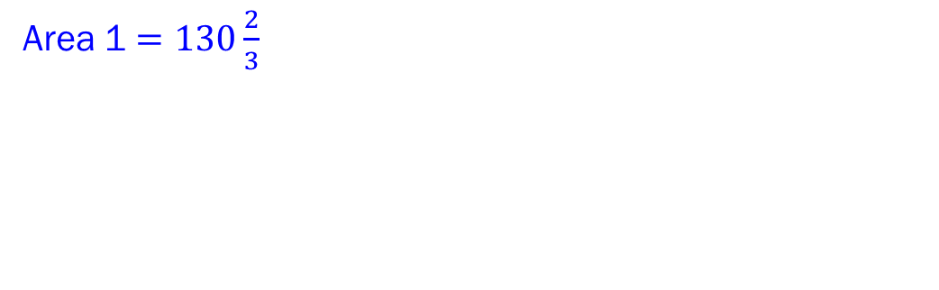
Integration
AREAS UNDER CURVES
Solution Example 1
Sketch curves on same graph. $y=21+4x−x^{2}$ $=\left(7−x\right)\left(x+3\right).$ $y=21−3x$
$$y=21−3x$$
$$21$$
Area
Area Under a Curve
Area between a positive curve $y=f(x)$, $x$-axis, line $x=a$ and line $x=b$ is:$Area=\int_{a}^{b}{y}dx$
$$y$$
$$−3$$
$$7$$
$$y=f(x)$$
$$y=21+4x−x^{2}$$
_
=
$$a$$
$$b$$
$$x$$
Area 1
Area 2
$$0$$
$$7$$
$$0$$
$$7$$
Example 1
Area 1 $=130\frac{2}{3}$
Find the area of the region bounded by the line $y=21−3x$ and the curve with equation $y=21+4x−x^{2}.$

Slide 22
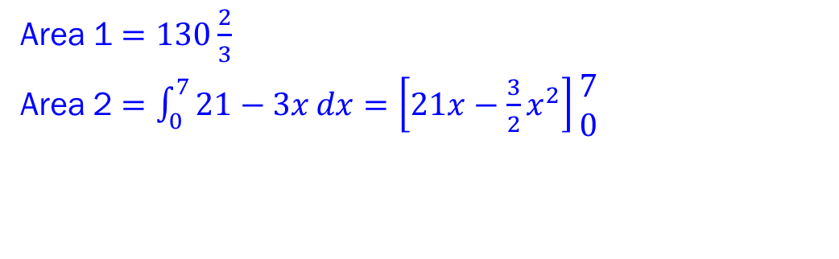
Integration
AREAS UNDER CURVES
Solution Example 1
Sketch curves on same graph. $y=21+4x−x^{2}$ $=\left(7−x\right)\left(x+3\right).$ $y=21−3x$
$$y=21−3x$$
$$21$$
Area
Area Under a Curve
Area between a positive curve $y=f(x)$, $x$-axis, line $x=a$ and line $x=b$ is:$Area=\int_{a}^{b}{y}dx$
$$y$$
$$−3$$
$$7$$
$$y=f(x)$$
$$y=21+4x−x^{2}$$
_
=
$$a$$
$$b$$
$$x$$
Area 1
Area 2
$$0$$
$$7$$
$$0$$
$$7$$
Example 1
Area 1 $=130\frac{2}{3}$
Area 2 $=\int_{0}^{7}{21−3x}dx=\left[21x−\frac{3}{2}x^{2}\right]\begin{matrix}7 \\ 0\end{matrix}$
Find the area of the region bounded by the line $y=21−3x$ and the curve with equation $y=21+4x−x^{2}.$

Slide 23
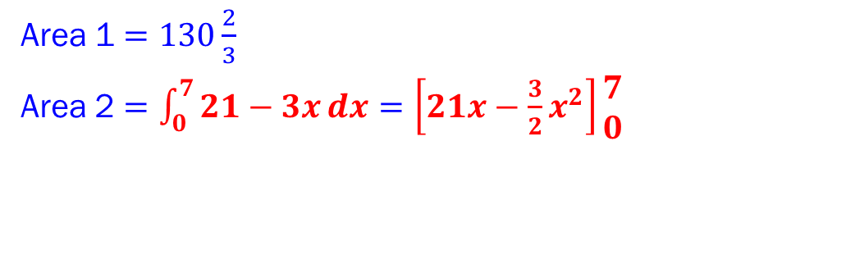
Integration
AREAS UNDER CURVES
Solution Example 1
Sketch curves on same graph. $y=21+4x−x^{2}$ $=\left(7−x\right)\left(x+3\right).$ $y=21−3x$
$$y=21−3x$$
$$21$$
Area
Area Under a Curve
Area between a positive curve $y=f(x)$, $x$-axis, line $x=a$ and line $x=b$ is:$Area=\int_{a}^{b}{y}dx$
$$y$$
$$−3$$
$$7$$
$$y=f(x)$$
$$y=21+4x−x^{2}$$
_
=
$$a$$
$$b$$
$$x$$
Area 1
Area 2
$$0$$
$$7$$
$$0$$
$$7$$
Example 1
Area 1 $=130\frac{2}{3}$
Area 2 $=\int_{0}^{7}{21−3x}dx=\left[21x−\frac{3}{2}x^{2}\right]\begin{matrix}7 \\ 0\end{matrix}$
Find the area of the region bounded by the line $y=21−3x$ and the curve with equation $y=21+4x−x^{2}.$

Slide 24
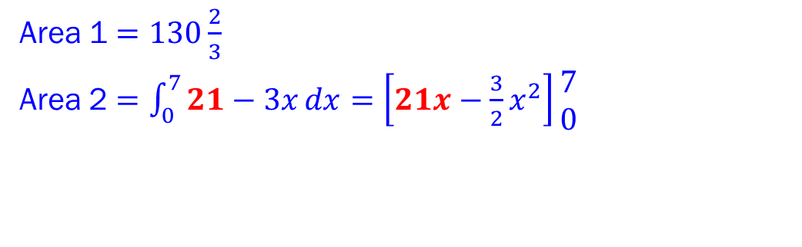
Integration
AREAS UNDER CURVES
Solution Example 1
Sketch curves on same graph. $y=21+4x−x^{2}$ $=\left(7−x\right)\left(x+3\right).$ $y=21−3x$
$$y=21−3x$$
$$21$$
Area
Area Under a Curve
Area between a positive curve $y=f(x)$, $x$-axis, line $x=a$ and line $x=b$ is:$Area=\int_{a}^{b}{y}dx$
$$y$$
$$−3$$
$$7$$
$$y=f(x)$$
$$y=21+4x−x^{2}$$
_
=
$$a$$
$$b$$
$$x$$
Area 1
Area 2
$$0$$
$$7$$
$$0$$
$$7$$
Example 1
Area 1 $=130\frac{2}{3}$
Area 2 $=\int_{0}^{7}{21−3x}dx=\left[21x−\frac{3}{2}x^{2}\right]\begin{matrix}7 \\ 0\end{matrix}$
Find the area of the region bounded by the line $y=21−3x$ and the curve with equation $y=21+4x−x^{2}.$

Slide 25
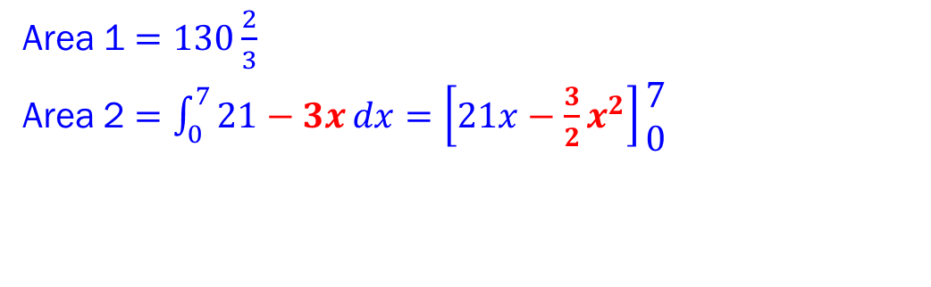
Integration
AREAS UNDER CURVES
Solution Example 1
Sketch curves on same graph. $y=21+4x−x^{2}$ $=\left(7−x\right)\left(x+3\right).$ $y=21−3x$
$$y=21−3x$$
$$21$$
Area
Area Under a Curve
Area between a positive curve $y=f(x)$, $x$-axis, line $x=a$ and line $x=b$ is:$Area=\int_{a}^{b}{y}dx$
$$y$$
$$−3$$
$$7$$
$$y=f(x)$$
$$y=21+4x−x^{2}$$
_
=
$$a$$
$$b$$
$$x$$
Area 1
Area 2
$$0$$
$$7$$
$$0$$
$$7$$
Example 1
Area 1 $=130\frac{2}{3}$
Area 2 $=\int_{0}^{7}{21−3x}dx=\left[21x−\frac{3}{2}x^{2}\right]\begin{matrix}7 \\ 0\end{matrix}$
Find the area of the region bounded by the line $y=21−3x$ and the curve with equation $y=21+4x−x^{2}.$

Slide 26
Integration
AREAS UNDER CURVES
Solution Example 1
Sketch curves on same graph. $y=21+4x−x^{2}$ $=\left(7−x\right)\left(x+3\right).$ $y=21−3x$
$$y=21−3x$$
$$21$$
Area
Area Under a Curve
Area between a positive curve $y=f(x)$, $x$-axis, line $x=a$ and line $x=b$ is:$Area=\int_{a}^{b}{y}dx$
$$y$$
$$−3$$
$$7$$
$$y=f(x)$$
$$y=21+4x−x^{2}$$
_
=
$$a$$
$$b$$
$$x$$
Area 1
Area 2
$$0$$
$$7$$
$$0$$
$$7$$
Example 1
Area 1 $=130\frac{2}{3}$
Area 2 $=\int_{0}^{7}{21−3x}dx=\left[21x−\frac{3}{2}x^{2}\right]\begin{matrix}7 \\ 0\end{matrix}$
Find the area of the region bounded by the line $y=21−3x$ and the curve with equation $y=21+4x−x^{2}.$

Slide 27
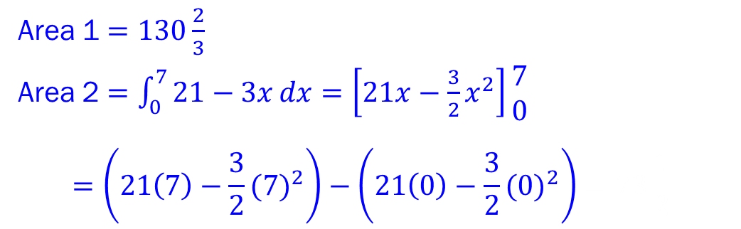
Integration
AREAS UNDER CURVES
Solution Example 1
Sketch curves on same graph. $y=21+4x−x^{2}$ $=\left(7−x\right)\left(x+3\right).$ $y=21−3x$
$$y=21−3x$$
$$21$$
Area
Area Under a Curve
Area between a positive curve $y=f(x)$, $x$-axis, line $x=a$ and line $x=b$ is:$Area=\int_{a}^{b}{y}dx$
$$y$$
$$−3$$
$$7$$
$$y=f(x)$$
$$y=21+4x−x^{2}$$
_
=
$$a$$
$$b$$
$$x$$
Area 1
Area 2
$$0$$
$$7$$
$$0$$
$$7$$
Example 1
Area 1 $=130\frac{2}{3}$
Area 2 $=\int_{0}^{7}{21−3x}dx=\left[21x−\frac{3}{2}x^{2}\right]\begin{matrix}7 \\ 0\end{matrix}$ $$=\left(21\left(7\right)−\frac{3}{2}{(7)}^{2}\right)−\left(21\left(0\right)−\frac{3}{2}{(0)}^{2}\right)=73\frac{1}{2}$$
Find the area of the region bounded by the line $y=21−3x$ and the curve with equation $y=21+4x−x^{2}.$

Slide 28
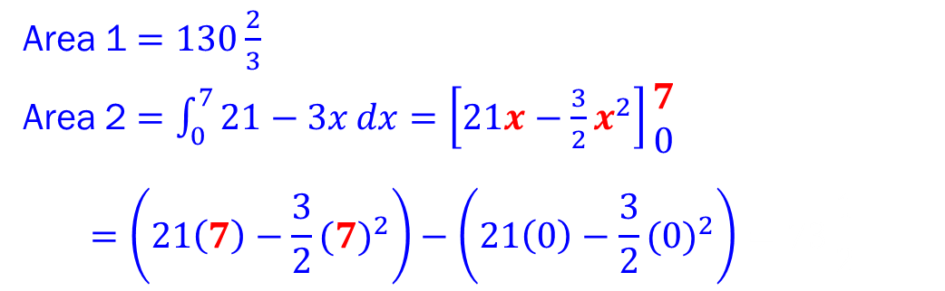
Integration
AREAS UNDER CURVES
Solution Example 1
Sketch curves on same graph. $y=21+4x−x^{2}$ $=\left(7−x\right)\left(x+3\right).$ $y=21−3x$
$$y=21−3x$$
$$21$$
Area
Area Under a Curve
Area between a positive curve $y=f(x)$, $x$-axis, line $x=a$ and line $x=b$ is:$Area=\int_{a}^{b}{y}dx$
$$y$$
$$−3$$
$$7$$
$$y=f(x)$$
$$y=21+4x−x^{2}$$
_
=
$$a$$
$$b$$
$$x$$
Area 1
Area 2
$$0$$
$$7$$
$$0$$
$$7$$
Example 1
Area 1 $=130\frac{2}{3}$
Area 2 $=\int_{0}^{7}{21−3x}dx=\left[21x−\frac{3}{2}x^{2}\right]\begin{matrix}7 \\ 0\end{matrix}$ $$=\left(21\left(7\right)−\frac{3}{2}{(7)}^{2}\right)−\left(21\left(0\right)−\frac{3}{2}{(0)}^{2}\right)=73\frac{1}{2}$$
Find the area of the region bounded by the line $y=21−3x$ and the curve with equation $y=21+4x−x^{2}.$

Slide 29
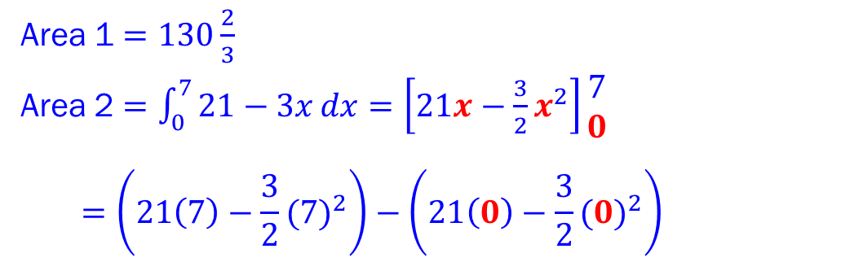
Integration
AREAS UNDER CURVES
Solution Example 1
Sketch curves on same graph. $y=21+4x−x^{2}$ $=\left(7−x\right)\left(x+3\right).$ $y=21−3x$
$$y=21−3x$$
$$21$$
Area
Area Under a Curve
Area between a positive curve $y=f(x)$, $x$-axis, line $x=a$ and line $x=b$ is:$Area=\int_{a}^{b}{y}dx$
$$y$$
$$−3$$
$$7$$
$$y=f(x)$$
$$y=21+4x−x^{2}$$
_
=
$$a$$
$$b$$
$$x$$
Area 1
Area 2
$$0$$
$$7$$
$$0$$
$$7$$
Example 1
Area 1 $=130\frac{2}{3}$
Area 2 $=\int_{0}^{7}{21−3x}dx=\left[21x−\frac{3}{2}x^{2}\right]\begin{matrix}7 \\ 0\end{matrix}$ $$=\left(21\left(7\right)−\frac{3}{2}{(7)}^{2}\right)−\left(21\left(0\right)−\frac{3}{2}{(0)}^{2}\right)=73\frac{1}{2}$$
Find the area of the region bounded by the line $y=21−3x$ and the curve with equation $y=21+4x−x^{2}.$

Slide 30
Integration
AREAS UNDER CURVES
Solution Example 1
Sketch curves on same graph. $y=21+4x−x^{2}$ $=\left(7−x\right)\left(x+3\right).$ $y=21−3x$
$$y=21−3x$$
$$21$$
Area
Area Under a Curve
Area between a positive curve $y=f(x)$, $x$-axis, line $x=a$ and line $x=b$ is:$Area=\int_{a}^{b}{y}dx$
$$y$$
$$−3$$
$$7$$
$$y=f(x)$$
$$y=21+4x−x^{2}$$
_
=
$$a$$
$$b$$
$$x$$
Area 1
Area 2
$$0$$
$$7$$
$$0$$
$$7$$
Example 1
Area 1 $=130\frac{2}{3}$
Area 2 $=\int_{0}^{7}{21−3x}dx=\left[21x−\frac{3}{2}x^{2}\right]\begin{matrix}7 \\ 0\end{matrix}$ $$=\left(21\left(7\right)−\frac{3}{2}{(7)}^{2}\right)−\left(21\left(0\right)−\frac{3}{2}{(0)}^{2}\right)=73\frac{1}{2}$$
Find the area of the region bounded by the line $y=21−3x$ and the curve with equation $y=21+4x−x^{2}.$

Slide 31
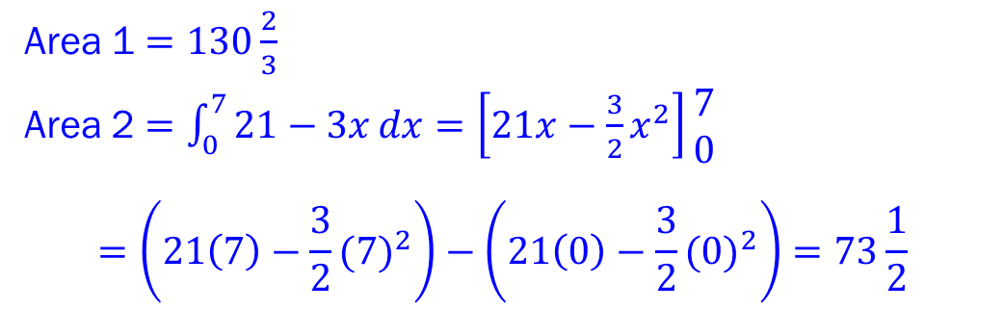
Integration
AREAS UNDER CURVES
Solution Example 1
Sketch curves on same graph. $y=21+4x−x^{2}$ $=\left(7−x\right)\left(x+3\right).$ $y=21−3x$
$$y=21−3x$$
$$21$$
Area
Area Under a Curve
Area between a positive curve $y=f(x)$, $x$-axis, line $x=a$ and line $x=b$ is:$Area=\int_{a}^{b}{y}dx$
$$y$$
$$−3$$
$$7$$
$$y=f(x)$$
$$y=21+4x−x^{2}$$
_
=
$$a$$
$$b$$
$$x$$
Area 1
Area 2
$$0$$
$$7$$
$$0$$
$$7$$
Example 1
Area 1 $=130\frac{2}{3}$
Area 2 $=\int_{0}^{7}{21−3x}dx=\left[21x−\frac{3}{2}x^{2}\right]\begin{matrix}7 \\ 0\end{matrix}$ $$=\left(21\left(7\right)−\frac{3}{2}{(7)}^{2}\right)−\left(21\left(0\right)−\frac{3}{2}{(0)}^{2}\right)=73\frac{1}{2}$$
Find the area of the region bounded by the line $y=21−3x$ and the curve with equation $y=21+4x−x^{2}.$

Slide 32
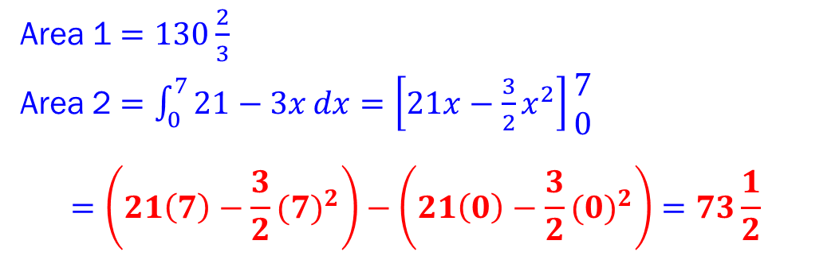
Integration
AREAS UNDER CURVES
Solution Example 1
Sketch curves on same graph. $y=21+4x−x^{2}$ $=\left(7−x\right)\left(x+3\right).$ $y=21−3x$
$$y=21−3x$$
$$21$$
Area
Area Under a Curve
Area between a positive curve $y=f(x)$, $x$-axis, line $x=a$ and line $x=b$ is:$Area=\int_{a}^{b}{y}dx$
$$y$$
$$−3$$
$$7$$
$$y=f(x)$$
$$y=21+4x−x^{2}$$
_
=
$$a$$
$$b$$
$$x$$
Area 1
Area 2
$$0$$
$$7$$
$$0$$
$$7$$
Example 1
Area 1 $=130\frac{2}{3}$
Area 2 $=\int_{0}^{7}{21−3x}dx=\left[21x−\frac{3}{2}x^{2}\right]\begin{matrix}7 \\ 0\end{matrix}$ $$=\left(21\left(7\right)−\frac{3}{2}{(7)}^{2}\right)−\left(21\left(0\right)−\frac{3}{2}{(0)}^{2}\right)=73\frac{1}{2}$$
Find the area of the region bounded by the line $y=21−3x$ and the curve with equation $y=21+4x−x^{2}.$

Slide 33
Integration
AREAS UNDER CURVES
Solution Example 1
Sketch curves on same graph. $y=21+4x−x^{2}$ $=\left(7−x\right)\left(x+3\right).$ $y=21−3x$
$$y=21−3x$$
$$21$$
Area
Area Under a Curve
Area between a positive curve $y=f(x)$, $x$-axis, line $x=a$ and line $x=b$ is:$Area=\int_{a}^{b}{y}dx$
$$y$$
$$−3$$
$$7$$
$$y=f(x)$$
$$y=21+4x−x^{2}$$
_
=
$$a$$
$$b$$
$$x$$
Area 1
Area 2
$$0$$
$$7$$
$$0$$
$$7$$
Example 1
Area 1 $=130\frac{2}{3}$
Area 2 $=\int_{0}^{7}{21−3x}dx=\left[21x−\frac{3}{2}x^{2}\right]\begin{matrix}7 \\ 0\end{matrix}$ $$=\left(21\left(7\right)−\frac{3}{2}{(7)}^{2}\right)−\left(21\left(0\right)−\frac{3}{2}{(0)}^{2}\right)=73\frac{1}{2}$$
Find the area of the region bounded by the line $y=21−3x$ and the curve with equation $y=21+4x−x^{2}.$

Slide 34
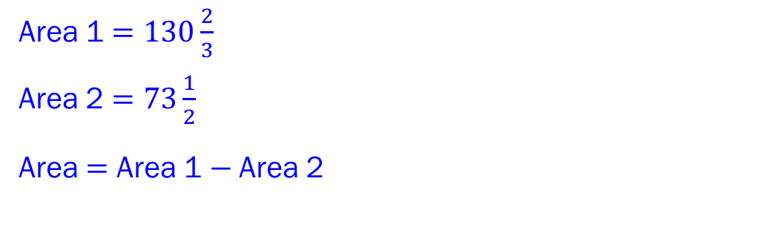
Integration
AREAS UNDER CURVES
Solution Example 1
Sketch curves on same graph. $y=21+4x−x^{2}$ $=\left(7−x\right)\left(x+3\right).$ $y=21−3x$
$$y=21−3x$$
$$21$$
Area
Area Under a Curve
Area between a positive curve $y=f(x)$, $x$-axis, line $x=a$ and line $x=b$ is:$Area=\int_{a}^{b}{y}dx$
$$y$$
$$−3$$
$$7$$
$$y=f(x)$$
$$y=21+4x−x^{2}$$
_
=
$$a$$
$$b$$
$$x$$
Area 1
Area 2
$$0$$
$$7$$
$$0$$
$$7$$
Example 1
Area 1 $=130\frac{2}{3}$
Area 2 $=73\frac{1}{2}$
Area $=$ Area 1 $−$Area 2
Find the area of the region bounded by the line $y=21−3x$ and the curve with equation $y=21+4x−x^{2}.$

Slide 35
Integration
AREAS UNDER CURVES
Solution Example 1
Sketch curves on same graph. $y=21+4x−x^{2}$ $=\left(7−x\right)\left(x+3\right).$ $y=21−3x$
$$y=21−3x$$
$$21$$
Area
Area Under a Curve
Area between a positive curve $y=f(x)$, $x$-axis, line $x=a$ and line $x=b$ is:$Area=\int_{a}^{b}{y}dx$
$$y$$
$$−3$$
$$7$$
$$y=f(x)$$
$$y=21+4x−x^{2}$$
_
=
$$a$$
$$b$$
$$x$$
Area 1
Area 2
$$0$$
$$7$$
$$0$$
$$7$$
Example 1
Area 1 $=130\frac{2}{3}$
Area 2 $=73\frac{1}{2}$
Area $=$ Area 1 $−$Area 2
Find the area of the region bounded by the line $y=21−3x$ and the curve with equation $y=21+4x−x^{2}.$

Slide 36
Integration
AREAS UNDER CURVES
Solution Example 1
Sketch curves on same graph. $y=21+4x−x^{2}$ $=\left(7−x\right)\left(x+3\right).$ $y=21−3x$
$$y=21−3x$$
$$21$$
Area
Area Under a Curve
Area between a positive curve $y=f(x)$, $x$-axis, line $x=a$ and line $x=b$ is:$Area=\int_{a}^{b}{y}dx$
$$y$$
$$−3$$
$$7$$
$$y=f(x)$$
$$y=21+4x−x^{2}$$
_
=
$$a$$
$$b$$
$$x$$
Area 1
Area 2
$$0$$
$$7$$
$$0$$
$$7$$
Example 1
Area 1 $=130\frac{2}{3}$
Area 2 $=73\frac{1}{2}$
Area $=$ Area 1 $−$Area 2
Find the area of the region bounded by the line $y=21−3x$ and the curve with equation $y=21+4x−x^{2}.$

Slide 37
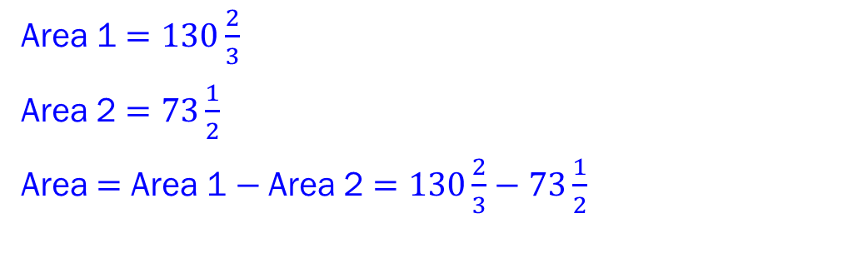
Integration
AREAS UNDER CURVES
Solution Example 1
Sketch curves on same graph. $y=21+4x−x^{2}$ $=\left(7−x\right)\left(x+3\right).$ $y=21−3x$
$$y=21−3x$$
$$21$$
Area
Area Under a Curve
Area between a positive curve $y=f(x)$, $x$-axis, line $x=a$ and line $x=b$ is:$Area=\int_{a}^{b}{y}dx$
$$y$$
$$−3$$
$$7$$
$$y=f(x)$$
$$y=21+4x−x^{2}$$
_
=
$$a$$
$$b$$
$$x$$
Area 1
Area 2
$$0$$
$$7$$
$$0$$
$$7$$
Example 1
Area 1 $=130\frac{2}{3}$
Area 2 $=73\frac{1}{2}$
Area $=$ Area 1 $−$Area 2 $=130\frac{2}{3}−73\frac{1}{2}$
Find the area of the region bounded by the line $y=21−3x$ and the curve with equation $y=21+4x−x^{2}.$

Slide 38
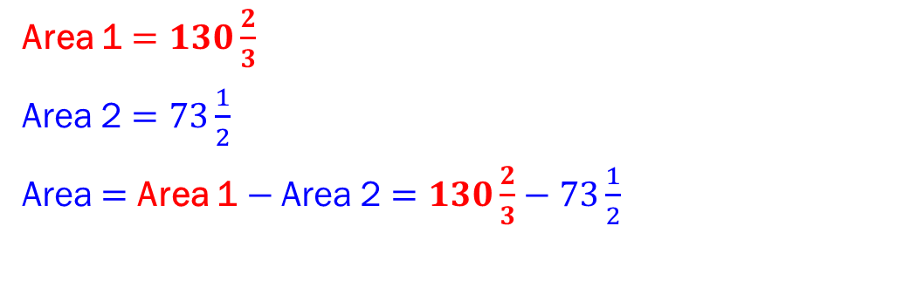
Integration
AREAS UNDER CURVES
Solution Example 1
Sketch curves on same graph. $y=21+4x−x^{2}$ $=\left(7−x\right)\left(x+3\right).$ $y=21−3x$
$$y=21−3x$$
$$21$$
Area
Area Under a Curve
Area between a positive curve $y=f(x)$, $x$-axis, line $x=a$ and line $x=b$ is:$Area=\int_{a}^{b}{y}dx$
$$y$$
$$−3$$
$$7$$
$$y=f(x)$$
$$y=21+4x−x^{2}$$
_
=
$$a$$
$$b$$
$$x$$
Area 1
Area 2
$$0$$
$$7$$
$$0$$
$$7$$
Example 1
Area 1 $=130\frac{2}{3}$
Area 2 $=73\frac{1}{2}$
Area $=$ Area 1 $−$Area 2 $=130\frac{2}{3}−73\frac{1}{2}$
Find the area of the region bounded by the line $y=21−3x$ and the curve with equation $y=21+4x−x^{2}.$

Slide 39
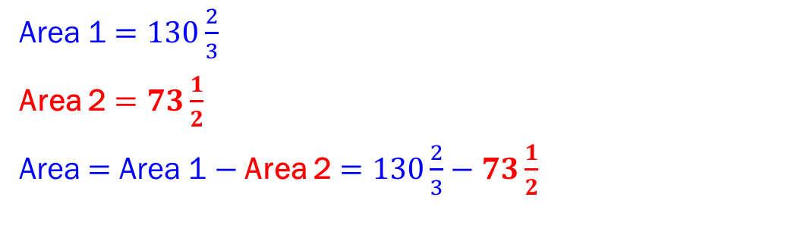
Integration
AREAS UNDER CURVES
Solution Example 1
Sketch curves on same graph. $y=21+4x−x^{2}$ $=\left(7−x\right)\left(x+3\right).$ $y=21−3x$
$$y=21−3x$$
$$21$$
Area
Area Under a Curve
Area between a positive curve $y=f(x)$, $x$-axis, line $x=a$ and line $x=b$ is:$Area=\int_{a}^{b}{y}dx$
$$y$$
$$−3$$
$$7$$
$$y=f(x)$$
$$y=21+4x−x^{2}$$
_
=
$$a$$
$$b$$
$$x$$
Area 1
Area 2
$$0$$
$$7$$
$$0$$
$$7$$
Example 1
Area 1 $=130\frac{2}{3}$
Area 2 $=73\frac{1}{2}$
Area $=$ Area 1 $−$Area 2 $=130\frac{2}{3}−73\frac{1}{2}$
Find the area of the region bounded by the line $y=21−3x$ and the curve with equation $y=21+4x−x^{2}.$

Slide 40
Integration
AREAS UNDER CURVES
Solution Example 1
Sketch curves on same graph. $y=21+4x−x^{2}$ $=\left(7−x\right)\left(x+3\right).$ $y=21−3x$
$$y=21−3x$$
$$21$$
Area
Area Under a Curve
Area between a positive curve $y=f(x)$, $x$-axis, line $x=a$ and line $x=b$ is:$Area=\int_{a}^{b}{y}dx$
$$y$$
$$−3$$
$$7$$
$$y=f(x)$$
$$y=21+4x−x^{2}$$
_
=
$$a$$
$$b$$
$$x$$
Area 1
Area 2
$$0$$
$$7$$
$$0$$
$$7$$
Example 1
Area 1 $=130\frac{2}{3}$
Area 2 $=73\frac{1}{2}$
Area $=$ Area 1 $−$Area 2 $=130\frac{2}{3}−73\frac{1}{2}$
Find the area of the region bounded by the line $y=21−3x$ and the curve with equation $y=21+4x−x^{2}.$

Slide 41
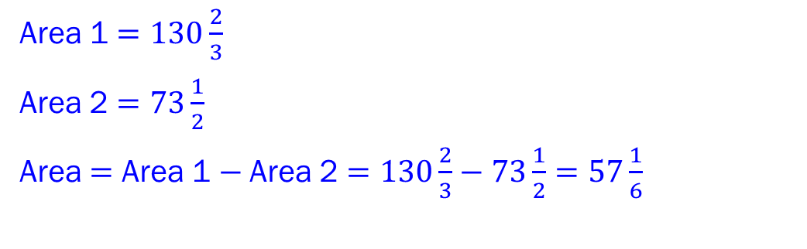
Integration
AREAS UNDER CURVES
Solution Example 1
Sketch curves on same graph. $y=21+4x−x^{2}$ $=\left(7−x\right)\left(x+3\right).$ $y=21−3x$
$$y=21−3x$$
$$21$$
Area
Area Under a Curve
Area between a positive curve $y=f(x)$, $x$-axis, line $x=a$ and line $x=b$ is:$Area=\int_{a}^{b}{y}dx$
$$y$$
$$−3$$
$$7$$
$$y=f(x)$$
$$y=21+4x−x^{2}$$
_
=
$$a$$
$$b$$
$$x$$
Area 1
Area 2
$$0$$
$$7$$
$$0$$
$$7$$
Example 1
Area 1 $=130\frac{2}{3}$
Area 2 $=73\frac{1}{2}$
Area $=$ Area 1 $−$Area 2 $=130\frac{2}{3}−73\frac{1}{2}=57\frac{1}{6}$
Find the area of the region bounded by the line $y=21−3x$ and the curve with equation $y=21+4x−x^{2}.$

Slide 42
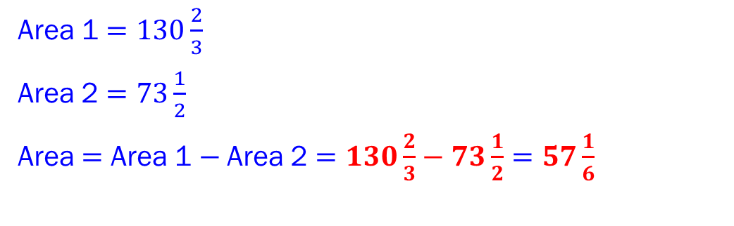
Integration
AREAS UNDER CURVES
Solution Example 1
Sketch curves on same graph. $y=21+4x−x^{2}$ $=\left(7−x\right)\left(x+3\right).$ $y=21−3x$
$$y=21−3x$$
$$21$$
Area
Area Under a Curve
Area between a positive curve $y=f(x)$, $x$-axis, line $x=a$ and line $x=b$ is:$Area=\int_{a}^{b}{y}dx$
$$y$$
$$−3$$
$$7$$
$$y=f(x)$$
$$y=21+4x−x^{2}$$
_
=
$$a$$
$$b$$
$$x$$
Area 1
Area 2
$$0$$
$$7$$
$$0$$
$$7$$
Example 1
Area 1 $=130\frac{2}{3}$
Area 2 $=73\frac{1}{2}$
Area $=$ Area 1 $−$Area 2 $=130\frac{2}{3}−73\frac{1}{2}=57\frac{1}{6}$
Find the area of the region bounded by the line $y=21−3x$ and the curve with equation $y=21+4x−x^{2}.$

Slide 43
Integration
AREAS UNDER CURVES
Solution Example 1
Sketch curves on same graph. $y=21+4x−x^{2}$ $=\left(7−x\right)\left(x+3\right).$ $y=21−3x$
$$y=21−3x$$
$$21$$
Area
Area Under a Curve
Area between a positive curve $y=f(x)$, $x$-axis, line $x=a$ and line $x=b$ is:$Area=\int_{a}^{b}{y}dx$
$$y$$
$$−3$$
$$7$$
$$y=f(x)$$
$$y=21+4x−x^{2}$$
_
=
$$a$$
$$b$$
$$x$$
Area 1
Area 2
$$0$$
$$7$$
$$0$$
$$7$$
Example 1
Area 1 $=130\frac{2}{3}$
Area 2 $=73\frac{1}{2}$
Area $=$ Area 1 $−$Area 2 $=130\frac{2}{3}−73\frac{1}{2}=57\frac{1}{6}$
Find the area of the region bounded by the line $y=21−3x$ and the curve with equation $y=21+4x−x^{2}.$

Slide 44
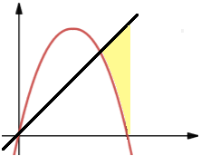







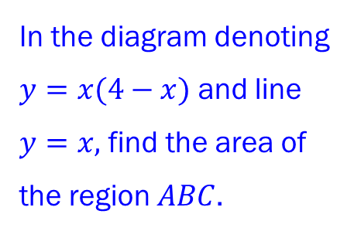

Integration
AREAS UNDER CURVES
Area Under a Curve
Area between a positive curve $y=f(x)$, $x$-axis, line $x=a$ and line $x=b$ is:$Area=\int_{a}^{b}{y}dx$
$$y$$
$$y=f(x)$$
$$a$$
$$b$$
$$x$$
Example 2
$$y=x$$
$$y=x(4−x)$$
$$C$$
In the diagram denoting $y=x(4−x)$ and line $y=x,$ find the area of the region $ABC$.
$$A$$
$$B$$
$$0$$
$$(a,0)$$
$$(4,0)$$

Slide 45
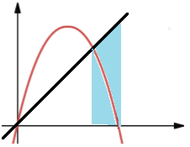
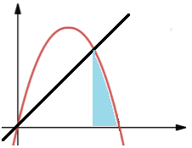













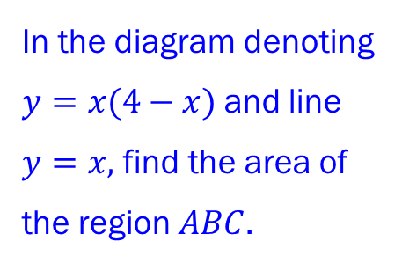






Integration
AREAS UNDER CURVES
Solution Example 2
We can express this region in terms of regions we can calculate.
To find these regions, find $a$, the $x$ value at the intersection point.
$$y=x$$
$$y=x$$
$$y=x(4−x)$$
$$C$$
$$C$$
_
$$y=x(4−x)$$
Area Under a Curve
$$A$$
Area between a positive curve $y=f(x)$, $x$-axis, line $x=a$ and line $x=b$ is:$Area=\int_{a}^{b}{y}dx$
$$A$$
$$A$$
$$y$$
Area
=
Area 1
Area 2
$$y=f(x)$$
$$(a,0)$$
$$B$$
$$(a,0)$$
$$B$$
$$(a,0)$$
$$B$$
$$0$$
$$(4,0)$$
$$0$$
$$(4,0)$$
$$0$$
$$(4,0)$$
$$a$$
$$b$$
$$x$$
Example 2
$$y=x$$
$$y=x(4−x)$$
$$C$$
In the diagram denoting $y=x(4−x)$and line $y=x,$ find the area of the region $ABC$.
$$A$$
$$B$$
$$0$$
$$(a,0)$$
$$(4,0)$$

Slide 46

Integration
AREAS UNDER CURVES
Solution Example 2
We can express this region in terms of regions we can calculate.
To find these regions, find $a$, the $x$ value at the intersection point.
$$y=x$$
$$y=x$$
$$y=x(4−x)$$
$$C$$
$$C$$
_
$$y=x(4−x)$$
Area Under a Curve
$$A$$
Area between a positive curve $y=f(x)$, $x$-axis, line $x=a$ and line $x=b$ is:$Area=\int_{a}^{b}{y}dx$
$$A$$
$$A$$
$$y$$
Area
=
Area 1
Area 2
$$y=f(x)$$
$$(a,0)$$
$$B$$
$$(a,0)$$
$$B$$
$$(a,0)$$
$$B$$
$$0$$
$$(4,0)$$
$$0$$
$$(4,0)$$
$$0$$
$$(4,0)$$
$$a$$
$$b$$
$$x$$
Example 2
$$y=x$$
$$y=x(4−x)$$
$$C$$
In the diagram denoting $y=x(4−x)$and line $y=x,$ find the area of the region $ABC$.
$$A$$
$$B$$
$$0$$
$$(a,0)$$
$$(4,0)$$

Slide 47
Integration
AREAS UNDER CURVES
Solution Example 2
We can express this region in terms of regions we can calculate.
To find these regions, find $a$, the $x$ value at the intersection point.
$$y=x$$
$$y=x$$
$$y=x(4−x)$$
$$C$$
$$C$$
_
$$y=x(4−x)$$
Area Under a Curve
$$A$$
Area between a positive curve $y=f(x)$, $x$-axis, line $x=a$ and line $x=b$ is:$Area=\int_{a}^{b}{y}dx$
$$A$$
$$A$$
$$y$$
Area
=
Area 1
Area 2
$$y=f(x)$$
$$(a,0)$$
$$B$$
$$(a,0)$$
$$B$$
$$(a,0)$$
$$B$$
$$0$$
$$(4,0)$$
$$0$$
$$(4,0)$$
$$0$$
$$(4,0)$$
$$a$$
$$b$$
$$x$$
Example 2
$$y=x$$
$$y=x(4−x)$$
$$C$$
In the diagram denoting $y=x(4−x)$and line $y=x,$ find the area of the region $ABC$.
$$A$$
$$B$$
$$0$$
$$(a,0)$$
$$(4,0)$$

Slide 48

Integration
AREAS UNDER CURVES
Solution Example 2
We can express this region in terms of regions we can calculate.
To find these regions, find $a$, the $x$ value at the intersection point. Now $x\left(x−4\right)=x$
$$y=x$$
$$y=x$$
$$y=x(4−x)$$
$$C$$
$$C$$
_
$$y=x(4−x)$$
Area Under a Curve
$$A$$
Area between a positive curve $y=f(x)$, $x$-axis, line $x=a$ and line $x=b$ is:$Area=\int_{a}^{b}{y}dx$
$$A$$
$$A$$
$$y$$
Area
=
Area 1
Area 2
$$y=f(x)$$
$$(a,0)$$
$$B$$
$$(a,0)$$
$$B$$
$$(a,0)$$
$$B$$
$$0$$
$$(4,0)$$
$$0$$
$$(4,0)$$
$$0$$
$$(4,0)$$
$$a$$
$$b$$
$$x$$
Example 2
$$y=x$$
$$y=x(4−x)$$
$$C$$
In the diagram denoting $y=x(4−x)$and line $y=x,$ find the area of the region $ABC$.
$$A$$
$$B$$
$$0$$
$$(a,0)$$
$$(4,0)$$

Slide 49


Integration
AREAS UNDER CURVES
Solution Example 2
We can express this region in terms of regions we can calculate.
To find these regions, find $a$, the $x$ value at the intersection point. Now $x\left(x−4\right)=x$
$$y=x$$
$$y=x$$
$$y=x(4−x)$$
$$C$$
$$C$$
_
$$y=x(4−x)$$
Area Under a Curve
$$A$$
Area between a positive curve $y=f(x)$, $x$-axis, line $x=a$ and line $x=b$ is:$Area=\int_{a}^{b}{y}dx$
$$A$$
$$A$$
$$y$$
Area
=
Area 1
Area 2
$$y=f(x)$$
$$(a,0)$$
$$B$$
$$(a,0)$$
$$B$$
$$(a,0)$$
$$B$$
$$0$$
$$(4,0)$$
$$0$$
$$(4,0)$$
$$0$$
$$(4,0)$$
$$a$$
$$b$$
$$x$$
Example 2
$$y=x$$
$$y=x(4−x)$$
$$C$$
In the diagram denoting $y=x(4−x)$and line $y=x,$ find the area of the region $ABC$.
$$A$$
$$B$$
$$0$$
$$(a,0)$$
$$(4,0)$$

Slide 50
Integration
AREAS UNDER CURVES
Solution Example 2
We can express this region in terms of regions we can calculate.
To find these regions, find $a$, the $x$ value at the intersection point. Now $x\left(x−4\right)=x$
$$y=x$$
$$y=x$$
$$y=x(4−x)$$
$$C$$
$$C$$
_
$$y=x(4−x)$$
Area Under a Curve
$$A$$
Area between a positive curve $y=f(x)$, $x$-axis, line $x=a$ and line $x=b$ is:$Area=\int_{a}^{b}{y}dx$
$$A$$
$$A$$
$$y$$
Area
=
Area 1
Area 2
$$y=f(x)$$
$$(a,0)$$
$$B$$
$$(a,0)$$
$$B$$
$$(a,0)$$
$$B$$
$$0$$
$$(4,0)$$
$$0$$
$$(4,0)$$
$$0$$
$$(4,0)$$
$$a$$
$$b$$
$$x$$
Example 2
$$y=x$$
$$y=x(4−x)$$
$$C$$
In the diagram denoting $y=x(4−x)$and line $y=x,$ find the area of the region $ABC$.
$$A$$
$$B$$
$$0$$
$$(a,0)$$
$$(4,0)$$

Slide 51

Integration
AREAS UNDER CURVES
Solution Example 2
We can express this region in terms of regions we can calculate.
To find these regions, find $a$, the $x$ value at the intersection point. Now $x\left(x−4\right)=x⟹x\left(x−3\right)=0$.
$$y=x$$
$$y=x$$
$$y=x(4−x)$$
$$C$$
$$C$$
_
$$y=x(4−x)$$
Area Under a Curve
$$A$$
Area between a positive curve $y=f(x)$, $x$-axis, line $x=a$ and line $x=b$ is:$Area=\int_{a}^{b}{y}dx$
$$A$$
$$A$$
$$y$$
Area
=
Area 1
Area 2
$$y=f(x)$$
$$(a,0)$$
$$B$$
$$(a,0)$$
$$B$$
$$(a,0)$$
$$B$$
$$0$$
$$(4,0)$$
$$0$$
$$(4,0)$$
$$0$$
$$(4,0)$$
$$a$$
$$b$$
$$x$$
Example 2
$$y=x$$
$$y=x(4−x)$$
$$C$$
In the diagram denoting $y=x(4−x)$and line $y=x,$ find the area of the region $ABC$.
$$A$$
$$B$$
$$0$$
$$(a,0)$$
$$(4,0)$$

Slide 52

Integration
AREAS UNDER CURVES
Solution Example 2
We can express this region in terms of regions we can calculate.
To find these regions, find $a$, the $x$ value at the intersection point. Now $x\left(x−4\right)=x⟹x\left(x−3\right)=0$.
$$y=x$$
$$y=x$$
$$y=x(4−x)$$
$$C$$
$$C$$
_
$$y=x(4−x)$$
Area Under a Curve
$$A$$
Area between a positive curve $y=f(x)$, $x$-axis, line $x=a$ and line $x=b$ is:$Area=\int_{a}^{b}{y}dx$
$$A$$
$$A$$
$$y$$
Area
=
Area 1
Area 2
$$y=f(x)$$
$$(a,0)$$
$$B$$
$$(a,0)$$
$$B$$
$$(a,0)$$
$$B$$
$$0$$
$$(4,0)$$
$$0$$
$$(4,0)$$
$$0$$
$$(4,0)$$
$$a$$
$$b$$
$$x$$
Example 2
$$y=x$$
$$y=x(4−x)$$
$$C$$
In the diagram denoting $y=x(4−x)$and line $y=x,$ find the area of the region $ABC$.
$$A$$
$$B$$
$$0$$
$$(a,0)$$
$$(4,0)$$

Slide 53
Integration
AREAS UNDER CURVES
Solution Example 2
We can express this region in terms of regions we can calculate.
To find these regions, find $a$, the $x$ value at the intersection point. Now $x\left(x−4\right)=x⟹x\left(x−3\right)=0$.
$$y=x$$
$$y=x$$
$$y=x(4−x)$$
$$C$$
$$C$$
_
$$y=x(4−x)$$
Area Under a Curve
$$A$$
Area between a positive curve $y=f(x)$, $x$-axis, line $x=a$ and line $x=b$ is:$Area=\int_{a}^{b}{y}dx$
$$A$$
$$A$$
$$y$$
Area
=
Area 1
Area 2
$$y=f(x)$$
$$(a,0)$$
$$B$$
$$(a,0)$$
$$B$$
$$(a,0)$$
$$B$$
$$0$$
$$(4,0)$$
$$0$$
$$(4,0)$$
$$0$$
$$(4,0)$$
$$a$$
$$b$$
$$x$$
Example 2
$$y=x$$
$$y=x(4−x)$$
$$C$$
In the diagram denoting $y=x(4−x)$and line $y=x,$ find the area of the region $ABC$.
$$A$$
$$B$$
$$0$$
$$(a,0)$$
$$(4,0)$$

Slide 54

Integration
AREAS UNDER CURVES
Solution Example 2
We can express this region in terms of regions we can calculate.
To find these regions, find $a$, the $x$ value at the intersection point. Now $x\left(x−4\right)=x⟹x\left(x−3\right)=0$. Hence $a=3$.
$$y=x$$
$$y=x$$
$$y=x(4−x)$$
$$C$$
$$C$$
_
$$y=x(4−x)$$
Area Under a Curve
$$A$$
Area between a positive curve $y=f(x)$, $x$-axis, line $x=a$ and line $x=b$ is:$Area=\int_{a}^{b}{y}dx$
$$A$$
$$A$$
$$y$$
Area
=
Area 1
Area 2
$$y=f(x)$$
$$(a,0)$$
$$B$$
$$(a,0)$$
$$B$$
$$(a,0)$$
$$B$$
$$0$$
$$(4,0)$$
$$0$$
$$(4,0)$$
$$0$$
$$(4,0)$$
$$a$$
$$b$$
$$x$$
Example 2
$$y=x$$
$$y=x(4−x)$$
$$C$$
In the diagram denoting $y=x(4−x)$and line $y=x,$ find the area of the region $ABC$.
$$A$$
$$B$$
$$0$$
$$(a,0)$$
$$(4,0)$$

Slide 55

Integration
AREAS UNDER CURVES
Solution Example 2
We can express this region in terms of regions we can calculate.
To find these regions, find $a$, the $x$ value at the intersection point. Now $x\left(x−4\right)=x⟹x\left(x−3\right)=0$. Hence $a=3$.
$$y=x$$
$$y=x$$
$$y=x(4−x)$$
$$C$$
$$C$$
_
$$y=x(4−x)$$
Area Under a Curve
$$A$$
Area between a positive curve $y=f(x)$, $x$-axis, line $x=a$ and line $x=b$ is:$Area=\int_{a}^{b}{y}dx$
$$A$$
$$A$$
$$y$$
Area
=
Area 1
Area 2
$$y=f(x)$$
$$(a,0)$$
$$B$$
$$(a,0)$$
$$B$$
$$(a,0)$$
$$B$$
$$0$$
$$(4,0)$$
$$0$$
$$(4,0)$$
$$0$$
$$(4,0)$$
$$a$$
$$b$$
$$x$$
Example 2
$$y=x$$
$$y=x(4−x)$$
$$C$$
In the diagram denoting $y=x(4−x)$and line $y=x,$ find the area of the region $ABC$.
$$A$$
$$B$$
$$0$$
$$(a,0)$$
$$(4,0)$$

Slide 56
Integration
AREAS UNDER CURVES
Solution Example 2
We can express this region in terms of regions we can calculate.
To find these regions, find $a$, the $x$ value at the intersection point. Now $x\left(x−4\right)=x⟹x\left(x−3\right)=0$. Hence $a=3$.
$$y=x$$
$$y=x$$
$$y=x(4−x)$$
$$C$$
$$C$$
_
$$y=x(4−x)$$
Area Under a Curve
$$A$$
Area between a positive curve $y=f(x)$, $x$-axis, line $x=a$ and line $x=b$ is:$Area=\int_{a}^{b}{y}dx$
$$A$$
$$A$$
$$y$$
Area
=
Area 1
Area 2
$$y=f(x)$$
$$(a,0)$$
$$B$$
$$(a,0)$$
$$B$$
$$(a,0)$$
$$B$$
$$0$$
$$(4,0)$$
$$0$$
$$(4,0)$$
$$0$$
$$(4,0)$$
$$a$$
$$b$$
$$x$$
Example 2
$$y=x$$
$$y=x(4−x)$$
$$C$$
In the diagram denoting $y=x(4−x)$and line $y=x,$ find the area of the region $ABC$.
$$A$$
$$B$$
$$0$$
$$(a,0)$$
$$(4,0)$$

Slide 57

Integration
AREAS UNDER CURVES
Solution Example 2
We can express this region in terms of regions we can calculate.
To find these regions, find $a$, the $x$ value at the intersection point. Now $x\left(x−4\right)=x⟹x\left(x−3\right)=0$. Hence $a=3$. Area 1 $=\int_{3}^{4}{x}dx=\left[\frac{x^{2}}{2}\right]\begin{matrix}4 \\ 3\end{matrix}$
$$y=x$$
v
$$y=x$$
v
$$y=x(4−x)$$
$$C$$
$$C$$
_
$$y=x(4−x)$$
Area Under a Curve
$$A$$
Area between a positive curve $y=f(x)$, $x$-axis, line $x=a$ and line $x=b$ is:$Area=\int_{a}^{b}{y}dx$
$$A$$
$$A$$
$$y$$
Area
=
Area 1
Area 2
$$y=f(x)$$
$$(a,0)$$
$$B$$
$$(a,0)$$
$$B$$
$$(a,0)$$
$$B$$
$$0$$
$$(4,0)$$
$$0$$
$$(4,0)$$
$$0$$
$$(4,0)$$
$$a$$
$$b$$
$$x$$
Example 2
$$y=x$$
$$y=x(4−x)$$
$$C$$
In the diagram denoting $y=x(4−x)$and line $y=x,$ find the area of the region $ABC$.
$$A$$
$$B$$
$$0$$
$$(a,0)$$
$$(4,0)$$

Slide 58

Integration
AREAS UNDER CURVES
Solution Example 2
We can express this region in terms of regions we can calculate.
To find these regions, find $a$, the $x$ value at the intersection point. Now $x\left(x−4\right)=x⟹x\left(x−3\right)=0$. Hence $a=3$. Area 1 $=\int_{3}^{4}{x}dx=\left[\frac{x^{2}}{2}\right]\begin{matrix}4 \\ 3\end{matrix}$
$$y=x$$
v
$$y=x$$
v
$$y=x(4−x)$$
$$C$$
$$C$$
_
$$y=x(4−x)$$
Area Under a Curve
$$A$$
Area between a positive curve $y=f(x)$, $x$-axis, line $x=a$ and line $x=b$ is:$Area=\int_{a}^{b}{y}dx$
$$A$$
$$A$$
$$y$$
Area
=
Area 1
Area 2
$$y=f(x)$$
$$(a,0)$$
$$B$$
$$(a,0)$$
$$B$$
$$(a,0)$$
$$B$$
$$0$$
$$(4,0)$$
$$0$$
$$(4,0)$$
$$0$$
$$(4,0)$$
$$a$$
$$b$$
$$x$$
Example 2
$$y=x$$
$$y=x(4−x)$$
$$C$$
In the diagram denoting $y=x(4−x)$and line $y=x,$ find the area of the region $ABC$.
$$A$$
$$B$$
$$0$$
$$(a,0)$$
$$(4,0)$$

Slide 59

Integration
AREAS UNDER CURVES
Solution Example 2
We can express this region in terms of regions we can calculate.
To find these regions, find $a$, the $x$ value at the intersection point. Now $x\left(x−4\right)=x⟹x\left(x−3\right)=0$. Hence $a=3$. Area 1 $=\int_{3}^{4}{x}dx=\left[\frac{x^{2}}{2}\right]\begin{matrix}4 \\ 3\end{matrix}$
$$y=x$$
v
$$y=x$$
v
$$y=x(4−x)$$
$$C$$
$$C$$
_
$$y=x(4−x)$$
Area Under a Curve
$$A$$
Area between a positive curve $y=f(x)$, $x$-axis, line $x=a$ and line $x=b$ is:$Area=\int_{a}^{b}{y}dx$
$$A$$
$$A$$
$$y$$
Area
=
Area 1
Area 2
$$y=f(x)$$
$$(a,0)$$
$$B$$
$$(a,0)$$
$$B$$
$$(a,0)$$
$$B$$
$$0$$
$$(4,0)$$
$$0$$
$$(4,0)$$
$$0$$
$$(4,0)$$
$$a$$
$$b$$
$$x$$
Example 2
$$y=x$$
$$y=x(4−x)$$
$$C$$
In the diagram denoting $y=x(4−x)$and line $y=x,$ find the area of the region $ABC$.
$$A$$
$$B$$
$$0$$
$$(a,0)$$
$$(4,0)$$

Slide 60
Integration
AREAS UNDER CURVES
Solution Example 2
We can express this region in terms of regions we can calculate.
To find these regions, find $a$, the $x$ value at the intersection point. Now $x\left(x−4\right)=x⟹x\left(x−3\right)=0$. Hence $a=3$. Area 1 $=\int_{3}^{4}{x}dx=\left[\frac{x^{2}}{2}\right]\begin{matrix}4 \\ 3\end{matrix}$
$$y=x$$
v
$$y=x$$
v
$$y=x(4−x)$$
$$C$$
$$C$$
_
$$y=x(4−x)$$
Area Under a Curve
$$A$$
Area between a positive curve $y=f(x)$, $x$-axis, line $x=a$ and line $x=b$ is:$Area=\int_{a}^{b}{y}dx$
$$A$$
$$A$$
$$y$$
Area
=
Area 1
Area 2
$$y=f(x)$$
$$(a,0)$$
$$B$$
$$(a,0)$$
$$B$$
$$(a,0)$$
$$B$$
$$0$$
$$(4,0)$$
$$0$$
$$(4,0)$$
$$0$$
$$(4,0)$$
$$a$$
$$b$$
$$x$$
Example 2
$$y=x$$
$$y=x(4−x)$$
$$C$$
In the diagram denoting $y=x(4−x)$and line $y=x,$ find the area of the region $ABC$.
$$A$$
$$B$$
$$0$$
$$(a,0)$$
$$(4,0)$$

Slide 61

Integration
AREAS UNDER CURVES
Solution Example 2
We can express this region in terms of regions we can calculate.
To find these regions, find $a$, the $x$ value at the intersection point. Now $x\left(x−4\right)=x⟹x\left(x−3\right)=0$. Hence $a=3$. Area 1 $=\int_{3}^{4}{x}dx=\left[\frac{x^{2}}{2}\right]\begin{matrix}4 \\ 3\end{matrix}=\frac{4^{2}}{2}−\frac{3^{2}}{2}$
$$y=x$$
v
$$y=x$$
v
$$y=x(4−x)$$
$$C$$
$$C$$
_
$$y=x(4−x)$$
Area Under a Curve
$$A$$
Area between a positive curve $y=f(x)$, $x$-axis, line $x=a$ and line $x=b$ is:$Area=\int_{a}^{b}{y}dx$
$$A$$
$$A$$
$$y$$
Area
=
Area 1
Area 2
$$y=f(x)$$
$$(a,0)$$
$$B$$
$$(a,0)$$
$$B$$
$$(a,0)$$
$$B$$
$$0$$
$$(4,0)$$
$$0$$
$$(4,0)$$
$$0$$
$$(4,0)$$
$$a$$
$$b$$
$$x$$
Example 2
$$y=x$$
$$y=x(4−x)$$
$$C$$
In the diagram denoting $y=x(4−x)$and line $y=x,$ find the area of the region $ABC$.
$$A$$
$$B$$
$$0$$
$$(a,0)$$
$$(4,0)$$

Slide 62

Integration
AREAS UNDER CURVES
Solution Example 2
We can express this region in terms of regions we can calculate.
To find these regions, find $a$, the $x$ value at the intersection point. Now $x\left(x−4\right)=x⟹x\left(x−3\right)=0$. Hence $a=3$. Area 1 $=\int_{3}^{4}{x}dx=\left[\frac{x^{2}}{2}\right]\begin{matrix}4 \\ 3\end{matrix}=\frac{4^{2}}{2}−\frac{3^{2}}{2}$
$$y=x$$
v
$$y=x$$
v
$$y=x(4−x)$$
$$C$$
$$C$$
_
$$y=x(4−x)$$
Area Under a Curve
$$A$$
Area between a positive curve $y=f(x)$, $x$-axis, line $x=a$ and line $x=b$ is:$Area=\int_{a}^{b}{y}dx$
$$A$$
$$A$$
$$y$$
Area
=
Area 1
Area 2
$$y=f(x)$$
$$(a,0)$$
$$B$$
$$(a,0)$$
$$B$$
$$(a,0)$$
$$B$$
$$0$$
$$(4,0)$$
$$0$$
$$(4,0)$$
$$0$$
$$(4,0)$$
$$a$$
$$b$$
$$x$$
Example 2
$$y=x$$
$$y=x(4−x)$$
$$C$$
In the diagram denoting $y=x(4−x)$and line $y=x,$ find the area of the region $ABC$.
$$A$$
$$B$$
$$0$$
$$(a,0)$$
$$(4,0)$$

Slide 63

Integration
AREAS UNDER CURVES
Solution Example 2
We can express this region in terms of regions we can calculate.
To find these regions, find $a$, the $x$ value at the intersection point. Now $x\left(x−4\right)=x⟹x\left(x−3\right)=0$. Hence $a=3$. Area 1 $=\int_{3}^{4}{x}dx=\left[\frac{x^{2}}{2}\right]\begin{matrix}4 \\ 3\end{matrix}=\frac{4^{2}}{2}−\frac{3^{2}}{2}$
$$y=x$$
v
$$y=x$$
v
$$y=x(4−x)$$
$$C$$
$$C$$
_
$$y=x(4−x)$$
Area Under a Curve
$$A$$
Area between a positive curve $y=f(x)$, $x$-axis, line $x=a$ and line $x=b$ is:$Area=\int_{a}^{b}{y}dx$
$$A$$
$$A$$
$$y$$
Area
=
Area 1
Area 2
$$y=f(x)$$
$$(a,0)$$
$$B$$
$$(a,0)$$
$$B$$
$$(a,0)$$
$$B$$
$$0$$
$$(4,0)$$
$$0$$
$$(4,0)$$
$$0$$
$$(4,0)$$
$$a$$
$$b$$
$$x$$
Example 2
$$y=x$$
$$y=x(4−x)$$
$$C$$
In the diagram denoting $y=x(4−x)$and line $y=x,$ find the area of the region $ABC$.
$$A$$
$$B$$
$$0$$
$$(a,0)$$
$$(4,0)$$

Slide 64

Integration
AREAS UNDER CURVES
Solution Example 2
We can express this region in terms of regions we can calculate.
To find these regions, find $a$, the $x$ value at the intersection point. Now $x\left(x−4\right)=x⟹x\left(x−3\right)=0$. Hence $a=3$. Area 1 $=\int_{3}^{4}{x}dx=\left[\frac{x^{2}}{2}\right]\begin{matrix}4 \\ 3\end{matrix}=\frac{4^{2}}{2}−\frac{3^{2}}{2}$
$$y=x$$
v
$$y=x$$
v
$$y=x(4−x)$$
$$C$$
$$C$$
_
$$y=x(4−x)$$
Area Under a Curve
$$A$$
Area between a positive curve $y=f(x)$, $x$-axis, line $x=a$ and line $x=b$ is:$Area=\int_{a}^{b}{y}dx$
$$A$$
$$A$$
$$y$$
Area
=
Area 1
Area 2
$$y=f(x)$$
$$(a,0)$$
$$B$$
$$(a,0)$$
$$B$$
$$(a,0)$$
$$B$$
$$0$$
$$(4,0)$$
$$0$$
$$(4,0)$$
$$0$$
$$(4,0)$$
$$a$$
$$b$$
$$x$$
Example 2
$$y=x$$
$$y=x(4−x)$$
$$C$$
In the diagram denoting $y=x(4−x)$and line $y=x,$ find the area of the region $ABC$.
$$A$$
$$B$$
$$0$$
$$(a,0)$$
$$(4,0)$$

Slide 65
Integration
AREAS UNDER CURVES
Solution Example 2
We can express this region in terms of regions we can calculate.
To find these regions, find $a$, the $x$ value at the intersection point. Now $x\left(x−4\right)=x⟹x\left(x−3\right)=0$. Hence $a=3$. Area 1 $=\int_{3}^{4}{x}dx=\left[\frac{x^{2}}{2}\right]\begin{matrix}4 \\ 3\end{matrix}=\frac{4^{2}}{2}−\frac{3^{2}}{2}$
$$y=x$$
v
$$y=x$$
v
$$y=x(4−x)$$
$$C$$
$$C$$
_
$$y=x(4−x)$$
Area Under a Curve
$$A$$
Area between a positive curve $y=f(x)$, $x$-axis, line $x=a$ and line $x=b$ is:$Area=\int_{a}^{b}{y}dx$
$$A$$
$$A$$
$$y$$
Area
=
Area 1
Area 2
$$y=f(x)$$
$$(a,0)$$
$$B$$
$$(a,0)$$
$$B$$
$$(a,0)$$
$$B$$
$$0$$
$$(4,0)$$
$$0$$
$$(4,0)$$
$$0$$
$$(4,0)$$
$$a$$
$$b$$
$$x$$
Example 2
$$y=x$$
$$y=x(4−x)$$
$$C$$
In the diagram denoting $y=x(4−x)$and line $y=x,$ find the area of the region $ABC$.
$$A$$
$$B$$
$$0$$
$$(a,0)$$
$$(4,0)$$

Slide 66

Integration
AREAS UNDER CURVES
Solution Example 2
We can express this region in terms of regions we can calculate.
To find these regions, find $a$, the $x$ value at the intersection point. Now $x\left(x−4\right)=x⟹x\left(x−3\right)=0$. Hence $a=3$. Area 1 $=\int_{3}^{4}{x}dx=\left[\frac{x^{2}}{2}\right]\begin{matrix}4 \\ 3\end{matrix}=\frac{4^{2}}{2}−\frac{3^{2}}{2}=\frac{7}{2}$
$$y=x$$
v
$$y=x$$
v
$$y=x(4−x)$$
$$C$$
$$C$$
_
$$y=x(4−x)$$
Area Under a Curve
$$A$$
Area between a positive curve $y=f(x)$, $x$-axis, line $x=a$ and line $x=b$ is:$Area=\int_{a}^{b}{y}dx$
$$A$$
$$A$$
$$y$$
Area
=
Area 1
Area 2
$$y=f(x)$$
$$(a,0)$$
$$B$$
$$(a,0)$$
$$B$$
$$(a,0)$$
$$B$$
$$0$$
$$(4,0)$$
$$0$$
$$(4,0)$$
$$0$$
$$(4,0)$$
$$a$$
$$b$$
$$x$$
Example 2
$$y=x$$
$$y=x(4−x)$$
$$C$$
In the diagram denoting $y=x(4−x)$and line $y=x,$ find the area of the region $ABC$.
$$A$$
$$B$$
$$0$$
$$(a,0)$$
$$(4,0)$$

Slide 67

Integration
AREAS UNDER CURVES
Solution Example 2
We can express this region in terms of regions we can calculate.
To find these regions, find $a$, the $x$ value at the intersection point. Now $x\left(x−4\right)=x⟹x\left(x−3\right)=0$. Hence $a=3$. Area 1 $=\int_{3}^{4}{x}dx=\left[\frac{x^{2}}{2}\right]\begin{matrix}4 \\ 3\end{matrix}=\frac{4^{2}}{2}−\frac{3^{2}}{2}=\frac{7}{2}$
$$y=x$$
v
$$y=x$$
v
$$y=x(4−x)$$
$$C$$
$$C$$
_
$$y=x(4−x)$$
Area Under a Curve
$$A$$
Area between a positive curve $y=f(x)$, $x$-axis, line $x=a$ and line $x=b$ is:$Area=\int_{a}^{b}{y}dx$
$$A$$
$$A$$
$$y$$
Area
=
Area 1
Area 2
$$y=f(x)$$
$$(a,0)$$
$$B$$
$$(a,0)$$
$$B$$
$$(a,0)$$
$$B$$
$$0$$
$$(4,0)$$
$$0$$
$$(4,0)$$
$$0$$
$$(4,0)$$
$$a$$
$$b$$
$$x$$
Example 2
$$y=x$$
$$y=x(4−x)$$
$$C$$
In the diagram denoting $y=x(4−x)$and line $y=x,$ find the area of the region $ABC$.
$$A$$
$$B$$
$$0$$
$$(a,0)$$
$$(4,0)$$

Slide 68
Integration
AREAS UNDER CURVES
Solution Example 2
We can express this region in terms of regions we can calculate.
To find these regions, find $a$, the $x$ value at the intersection point. Now $x\left(x−4\right)=x⟹x\left(x−3\right)=0$. Hence $a=3$. Area 1 $=\int_{3}^{4}{x}dx=\left[\frac{x^{2}}{2}\right]\begin{matrix}4 \\ 3\end{matrix}=\frac{4^{2}}{2}−\frac{3^{2}}{2}=\frac{7}{2}$
$$y=x$$
v
$$y=x$$
v
$$y=x(4−x)$$
$$C$$
$$C$$
_
$$y=x(4−x)$$
Area Under a Curve
$$A$$
Area between a positive curve $y=f(x)$, $x$-axis, line $x=a$ and line $x=b$ is:$Area=\int_{a}^{b}{y}dx$
$$A$$
$$A$$
$$y$$
Area
=
Area 1
Area 2
$$y=f(x)$$
$$(a,0)$$
$$B$$
$$(a,0)$$
$$B$$
$$(a,0)$$
$$B$$
$$0$$
$$(4,0)$$
$$0$$
$$(4,0)$$
$$0$$
$$(4,0)$$
$$a$$
$$b$$
$$x$$
Example 2
$$y=x$$
$$y=x(4−x)$$
$$C$$
In the diagram denoting $y=x(4−x)$and line $y=x,$ find the area of the region $ABC$.
$$A$$
$$B$$
$$0$$
$$(a,0)$$
$$(4,0)$$

Slide 69

Integration
AREAS UNDER CURVES
Solution Example 2
We can express this region in terms of regions we can calculate.
To find these regions, find $a$, the $x$ value at the intersection point. Now $x\left(x−4\right)=x⟹x\left(x−3\right)=0$. Hence $a=3$. Area 1 $=\frac{7}{2}$
$$y=x$$
v
$$y=x$$
v
$$y=x(4−x)$$
$$C$$
$$C$$
_
$$y=x(4−x)$$
Area Under a Curve
$$A$$
Area between a positive curve $y=f(x)$, $x$-axis, line $x=a$ and line $x=b$ is:$Area=\int_{a}^{b}{y}dx$
$$A$$
$$A$$
$$y$$
Area
=
Area 1
Area 2
$$y=f(x)$$
$$(a,0)$$
$$B$$
$$(a,0)$$
$$B$$
$$(a,0)$$
$$B$$
$$0$$
$$(4,0)$$
$$0$$
$$(4,0)$$
$$0$$
$$(4,0)$$
$$a$$
$$b$$
$$x$$
Example 2
$$y=x$$
$$y=x(4−x)$$
$$C$$
In the diagram denoting $y=x(4−x)$and line $y=x,$ find the area of the region $ABC$.
$$A$$
$$B$$
$$0$$
$$(a,0)$$
$$(4,0)$$

Slide 70

Integration
AREAS UNDER CURVES
Solution Example 2
We can express this region in terms of regions we can calculate.
To find these regions, find $a$, the $x$ value at the intersection point. Now $x\left(x−4\right)=x⟹x\left(x−3\right)=0$. Hence $a=3$. Area 1 $=\frac{7}{2}$
$$y=x$$
v
$$y=x$$
v
$$y=x(4−x)$$
$$C$$
$$C$$
_
$$y=x(4−x)$$
Area Under a Curve
$$A$$
Area between a positive curve $y=f(x)$, $x$-axis, line $x=a$ and line $x=b$ is:$Area=\int_{a}^{b}{y}dx$
$$A$$
$$A$$
$$y$$
Area
=
Area 1
Area 2
$$y=f(x)$$
$$(a,0)$$
$$B$$
$$(a,0)$$
$$B$$
$$(a,0)$$
$$B$$
$$0$$
$$(4,0)$$
$$0$$
$$(4,0)$$
$$0$$
$$(4,0)$$
$$a$$
$$b$$
$$x$$
Example 2
$$y=x$$
$$y=x(4−x)$$
$$C$$
In the diagram denoting $y=x(4−x)$and line $y=x,$ find the area of the region $ABC$.
$$A$$
$$B$$
$$0$$
$$(a,0)$$
$$(4,0)$$

Slide 71
Integration
AREAS UNDER CURVES
Solution Example 2
We can express this region in terms of regions we can calculate.
To find these regions, find $a$, the $x$ value at the intersection point. Now $x\left(x−4\right)=x⟹x\left(x−3\right)=0$. Hence $a=3$. Area 1 $=\frac{7}{2}$
$$y=x$$
$$y=x$$
$$y=x(4−x)$$
$$C$$
$$C$$
_
$$y=x(4−x)$$
Area Under a Curve
$$A$$
Area between a positive curve $y=f(x)$, $x$-axis, line $x=a$ and line $x=b$ is:$Area=\int_{a}^{b}{y}dx$
$$A$$
$$A$$
$$y$$
Area
=
Area 1
Area 2
$$y=f(x)$$
$$(a,0)$$
$$B$$
$$(a,0)$$
$$B$$
$$(a,0)$$
$$B$$
$$0$$
$$(4,0)$$
$$0$$
$$(4,0)$$
$$0$$
$$(4,0)$$
$$a$$
$$b$$
$$x$$
Example 2
$$y=x$$
$$y=x(4−x)$$
$$C$$
In the diagram denoting $y=x(4−x)$and line $y=x,$ find the area of the region $ABC$.
$$A$$
$$B$$
$$0$$
$$(a,0)$$
$$(4,0)$$

Slide 72

Integration
AREAS UNDER CURVES
Solution Example 2
We can express this region in terms of regions we can calculate.
To find these regions, find $a$, the $x$ value at the intersection point. Now $x\left(x−4\right)=x⟹x\left(x−3\right)=0$. Hence $a=3$. Area 1 $=\frac{7}{2}$ Area 2 $=\int_{3}^{4}{x(4−x)}dx=\int_{3}^{4}{4x−x^{2}}dx$
$$y=x$$
v
$$y=x(4−x)$$
$$y=x$$
$$y=x(4−x)$$
Area Under a Curve
$$C$$
$$C$$
_
Area between a positive curve $y=f(x)$, $x$-axis, line $x=a$ and line $x=b$ is:$Area=\int_{a}^{b}{y}dx$
$$A$$
$$A$$
$$A$$
$$y$$
Area
=
Area 1
Area 2
$$y=f(x)$$
$$(a,0)$$
$$B$$
$$(a,0)$$
$$B$$
$$(a,0)$$
$$B$$
$$0$$
$$(4,0)$$
$$0$$
$$(4,0)$$
$$0$$
$$(4,0)$$
$$a$$
$$b$$
$$x$$
Example 2
$$y=x$$
$$y=x(4−x)$$
$$C$$
In the diagram denoting $y=x(4−x)$and line $y=x,$ find the area of the region $ABC$.
$$A$$
$$B$$
$$0$$
$$(a,0)$$
$$(4,0)$$

Slide 73

Integration
AREAS UNDER CURVES
Solution Example 2
We can express this region in terms of regions we can calculate.
To find these regions, find $a$, the $x$ value at the intersection point. Now $x\left(x−4\right)=x⟹x\left(x−3\right)=0$. Hence $a=3$. Area 1 $=\frac{7}{2}$ Area 2 $=\int_{3}^{4}{x(4−x)}dx=\int_{3}^{4}{4x−x^{2}}dx$
$$y=x$$
v
$$y=x(4−x)$$
$$y=x$$
$$y=x(4−x)$$
Area Under a Curve
$$C$$
$$C$$
_
Area between a positive curve $y=f(x)$, $x$-axis, line $x=a$ and line $x=b$ is:$Area=\int_{a}^{b}{y}dx$
$$A$$
$$A$$
$$A$$
$$y$$
Area
=
Area 1
Area 2
$$y=f(x)$$
$$(a,0)$$
$$B$$
$$(a,0)$$
$$B$$
$$(a,0)$$
$$B$$
$$0$$
$$(4,0)$$
$$0$$
$$(4,0)$$
$$0$$
$$(4,0)$$
$$a$$
$$b$$
$$x$$
Example 2
$$y=x$$
$$y=x(4−x)$$
$$C$$
In the diagram denoting $y=x(4−x)$and line $y=x,$ find the area of the region $ABC$.
$$A$$
$$B$$
$$0$$
$$(a,0)$$
$$(4,0)$$

Slide 74

Integration
AREAS UNDER CURVES
Solution Example 2
We can express this region in terms of regions we can calculate.
To find these regions, find $a$, the $x$ value at the intersection point. Now $x\left(x−4\right)=x⟹x\left(x−3\right)=0$. Hence $a=3$. Area 1 $=\frac{7}{2}$ Area 2 $=\int_{3}^{4}{x(4−x)}dx=\int_{3}^{4}{4x−x^{2}}dx$
$$y=x$$
v
$$y=x(4−x)$$
$$y=x$$
$$y=x(4−x)$$
Area Under a Curve
$$C$$
$$C$$
_
Area between a positive curve $y=f(x)$, $x$-axis, line $x=a$ and line $x=b$ is:$Area=\int_{a}^{b}{y}dx$
$$A$$
$$A$$
$$A$$
$$y$$
Area
=
Area 1
Area 2
$$y=f(x)$$
$$(a,0)$$
$$B$$
$$(a,0)$$
$$B$$
$$(a,0)$$
$$B$$
$$0$$
$$(4,0)$$
$$0$$
$$(4,0)$$
$$0$$
$$(4,0)$$
$$a$$
$$b$$
$$x$$
Example 2
$$y=x$$
$$y=x(4−x)$$
$$C$$
In the diagram denoting $y=x(4−x)$and line $y=x,$ find the area of the region $ABC$.
$$A$$
$$B$$
$$0$$
$$(a,0)$$
$$(4,0)$$

Slide 75
Integration
AREAS UNDER CURVES
Solution Example 2
We can express this region in terms of regions we can calculate.
To find these regions, find $a$, the $x$ value at the intersection point. Now $x\left(x−4\right)=x⟹x\left(x−3\right)=0$. Hence $a=3$. Area 1 $=\frac{7}{2}$ Area 2 $=\int_{3}^{4}{x(4−x)}dx=\int_{3}^{4}{4x−x^{2}}dx$
$$y=x$$
v
$$y=x(4−x)$$
$$y=x$$
$$y=x(4−x)$$
Area Under a Curve
$$C$$
$$C$$
_
Area between a positive curve $y=f(x)$, $x$-axis, line $x=a$ and line $x=b$ is:$Area=\int_{a}^{b}{y}dx$
$$A$$
$$A$$
$$A$$
$$y$$
Area
=
Area 1
Area 2
$$y=f(x)$$
$$(a,0)$$
$$B$$
$$(a,0)$$
$$B$$
$$(a,0)$$
$$B$$
$$0$$
$$(4,0)$$
$$0$$
$$(4,0)$$
$$0$$
$$(4,0)$$
$$a$$
$$b$$
$$x$$
Example 2
$$y=x$$
$$y=x(4−x)$$
$$C$$
In the diagram denoting $y=x(4−x)$and line $y=x,$ find the area of the region $ABC$.
$$A$$
$$B$$
$$0$$
$$(a,0)$$
$$(4,0)$$

Slide 76

Integration
AREAS UNDER CURVES
Solution Example 2
We can express this region in terms of regions we can calculate.
To find these regions, find $a$, the $x$ value at the intersection point. Now $x\left(x−4\right)=x⟹x\left(x−3\right)=0$. Hence $a=3$. Area 1 $=\frac{7}{2}$ Area 2 $=\int_{3}^{4}{x(4−x)}dx=\int_{3}^{4}{4x−x^{2}}dx$ $$=\left[2x^{2}−\frac{x^{3}}{3}\right]\begin{matrix}4 \\ 3\end{matrix}=\left(2{\left(4\right)}^{2}−\frac{{\left(4\right)}^{3}}{3}\right)−\left(2{\left(3\right)}^{2}−\frac{{\left(3\right)}^{3}}{3}\right)=\frac{5}{3}$$
$$y=x$$
v
$$y=x(4−x)$$
$$y=x$$
$$y=x(4−x)$$
Area Under a Curve
$$C$$
$$C$$
_
Area between a positive curve $y=f(x)$, $x$-axis, line $x=a$ and line $x=b$ is:$Area=\int_{a}^{b}{y}dx$
$$A$$
$$A$$
$$A$$
$$y$$
Area
=
Area 1
Area 2
$$y=f(x)$$
$$(a,0)$$
$$B$$
$$(a,0)$$
$$B$$
$$(a,0)$$
$$B$$
$$0$$
$$(4,0)$$
$$0$$
$$(4,0)$$
$$0$$
$$(4,0)$$
$$a$$
$$b$$
$$x$$
Example 2
$$y=x$$
$$y=x(4−x)$$
$$C$$
In the diagram denoting $y=x(4−x)$and line $y=x,$ find the area of the region $ABC$.
$$A$$
$$B$$
$$0$$
$$(a,0)$$
$$(4,0)$$

Slide 77

Integration
AREAS UNDER CURVES
Solution Example 2
We can express this region in terms of regions we can calculate.
To find these regions, find $a$, the $x$ value at the intersection point. Now $x\left(x−4\right)=x⟹x\left(x−3\right)=0$. Hence $a=3$. Area 1 $=\frac{7}{2}$ Area 2 $=\int_{3}^{4}{x(4−x)}dx=\int_{3}^{4}{4x−x^{2}}dx$ $$=\left[2x^{2}−\frac{x^{3}}{3}\right]\begin{matrix}4 \\ 3\end{matrix}=\left(2{\left(4\right)}^{2}−\frac{{\left(4\right)}^{3}}{3}\right)−\left(2{\left(3\right)}^{2}−\frac{{\left(3\right)}^{3}}{3}\right)=\frac{5}{3}$$
$$y=x$$
$$y=x$$
$$y=x(4−x)$$
$$C$$
$$C$$
_
$$y=x(4−x)$$
Area Under a Curve
$$A$$
Area between a positive curve $y=f(x)$, $x$-axis, line $x=a$ and line $x=b$ is:$Area=\int_{a}^{b}{y}dx$
$$A$$
$$A$$
$$y$$
Area
=
Area 1
Area 2
$$y=f(x)$$
$$(a,0)$$
$$B$$
$$(a,0)$$
$$B$$
$$(a,0)$$
$$B$$
$$0$$
$$(4,0)$$
$$0$$
$$(4,0)$$
$$0$$
$$(4,0)$$
$$a$$
$$b$$
$$x$$
Example 2
$$y=x$$
$$y=x(4−x)$$
$$C$$
In the diagram denoting $y=x(4−x)$and line $y=x,$ find the area of the region $ABC$.
$$A$$
$$B$$
$$0$$
$$(a,0)$$
$$(4,0)$$

Slide 78

Integration
AREAS UNDER CURVES
Solution Example 2
We can express this region in terms of regions we can calculate.
To find these regions, find $a$, the $x$ value at the intersection point. Now $x\left(x−4\right)=x⟹x\left(x−3\right)=0$. Hence $a=3$. Area 1 $=\frac{7}{2}$ Area 2 $=\int_{3}^{4}{x(4−x)}dx=\int_{3}^{4}{4x−x^{2}}dx$ $$=\left[2x^{2}−\frac{x^{3}}{3}\right]\begin{matrix}4 \\ 3\end{matrix}=\left(2{\left(4\right)}^{2}−\frac{{\left(4\right)}^{3}}{3}\right)−\left(2{\left(3\right)}^{2}−\frac{{\left(3\right)}^{3}}{3}\right)=\frac{5}{3}$$
$$y=x$$
$$y=x$$
$$y=x(4−x)$$
$$C$$
$$C$$
_
$$y=x(4−x)$$
Area Under a Curve
$$A$$
Area between a positive curve $y=f(x)$, $x$-axis, line $x=a$ and line $x=b$ is:$Area=\int_{a}^{b}{y}dx$
$$A$$
$$A$$
$$y$$
Area
=
Area 1
Area 2
$$y=f(x)$$
$$(a,0)$$
$$B$$
$$(a,0)$$
$$B$$
$$(a,0)$$
$$B$$
$$0$$
$$(4,0)$$
$$0$$
$$(4,0)$$
$$0$$
$$(4,0)$$
$$a$$
$$b$$
$$x$$
Example 2
$$y=x$$
$$y=x(4−x)$$
$$C$$
In the diagram denoting $y=x(4−x)$and line $y=x,$ find the area of the region $ABC$.
$$A$$
$$B$$
$$0$$
$$(a,0)$$
$$(4,0)$$

Slide 79

Integration
AREAS UNDER CURVES
Solution Example 2
We can express this region in terms of regions we can calculate.
To find these regions, find $a$, the $x$ value at the intersection point. Now $x\left(x−4\right)=x⟹x\left(x−3\right)=0$. Hence $a=3$. Area 1 $=\frac{7}{2}$ Area 2 $=\int_{3}^{4}{x(4−x)}dx=\int_{3}^{4}{4x−x^{2}}dx$ $$=\left[2x^{2}−\frac{x^{3}}{3}\right]\begin{matrix}4 \\ 3\end{matrix}=\left(2{\left(4\right)}^{2}−\frac{{\left(4\right)}^{3}}{3}\right)−\left(2{\left(3\right)}^{2}−\frac{{\left(3\right)}^{3}}{3}\right)=\frac{5}{3}$$
$$y=x$$
$$y=x$$
$$y=x(4−x)$$
$$C$$
$$C$$
_
$$y=x(4−x)$$
Area Under a Curve
$$A$$
Area between a positive curve $y=f(x)$, $x$-axis, line $x=a$ and line $x=b$ is:$Area=\int_{a}^{b}{y}dx$
$$A$$
$$A$$
$$y$$
Area
=
Area 1
Area 2
$$y=f(x)$$
$$(a,0)$$
$$B$$
$$(a,0)$$
$$B$$
$$(a,0)$$
$$B$$
$$0$$
$$(4,0)$$
$$0$$
$$(4,0)$$
$$0$$
$$(4,0)$$
$$a$$
$$b$$
$$x$$
Example 2
$$y=x$$
$$y=x(4−x)$$
$$C$$
In the diagram denoting $y=x(4−x)$and line $y=x,$ find the area of the region $ABC$.
$$A$$
$$B$$
$$0$$
$$(a,0)$$
$$(4,0)$$

Slide 80
Integration
AREAS UNDER CURVES
Solution Example 2
We can express this region in terms of regions we can calculate.
To find these regions, find $a$, the $x$ value at the intersection point. Now $x\left(x−4\right)=x⟹x\left(x−3\right)=0$. Hence $a=3$. Area 1 $=\frac{7}{2}$ Area 2 $=\int_{3}^{4}{x(4−x)}dx=\int_{3}^{4}{4x−x^{2}}dx$ $$=\left[2x^{2}−\frac{x^{3}}{3}\right]\begin{matrix}4 \\ 3\end{matrix}=\left(2{\left(4\right)}^{2}−\frac{{\left(4\right)}^{3}}{3}\right)−\left(2{\left(3\right)}^{2}−\frac{{\left(3\right)}^{3}}{3}\right)=\frac{5}{3}$$
$$y=x$$
$$y=x$$
$$y=x(4−x)$$
$$C$$
$$C$$
_
$$y=x(4−x)$$
Area Under a Curve
$$A$$
Area between a positive curve $y=f(x)$, $x$-axis, line $x=a$ and line $x=b$ is:$Area=\int_{a}^{b}{y}dx$
$$A$$
$$A$$
$$y$$
Area
=
Area 1
Area 2
$$y=f(x)$$
$$(a,0)$$
$$B$$
$$(a,0)$$
$$B$$
$$(a,0)$$
$$B$$
$$0$$
$$(4,0)$$
$$0$$
$$(4,0)$$
$$0$$
$$(4,0)$$
$$a$$
$$b$$
$$x$$
Example 2
$$y=x$$
$$y=x(4−x)$$
$$C$$
In the diagram denoting $y=x(4−x)$and line $y=x,$ find the area of the region $ABC$.
$$A$$
$$B$$
$$0$$
$$(a,0)$$
$$(4,0)$$

Slide 81

Integration
AREAS UNDER CURVES
Solution Example 2
We can express this region in terms of regions we can calculate.
To find these regions, find $a$, the $x$ value at the intersection point. Now $x\left(x−4\right)=x⟹x\left(x−3\right)=0$. Hence $a=3$. Area 1 $=\frac{7}{2}$ Area 2 $=\int_{3}^{4}{x(4−x)}dx=\int_{3}^{4}{4x−x^{2}}dx$ $$=\left[2x^{2}−\frac{x^{3}}{3}\right]\begin{matrix}4 \\ 3\end{matrix}=\left(2{\left(4\right)}^{2}−\frac{{\left(4\right)}^{3}}{3}\right)−\left(2{\left(3\right)}^{2}−\frac{{\left(3\right)}^{3}}{3}\right)=\frac{5}{3}$$
$$y=x$$
$$y=x$$
$$y=x(4−x)$$
$$C$$
$$C$$
_
$$y=x(4−x)$$
Area Under a Curve
$$A$$
Area between a positive curve $y=f(x)$, $x$-axis, line $x=a$ and line $x=b$ is:$Area=\int_{a}^{b}{y}dx$
$$A$$
$$A$$
$$y$$
Area
=
Area 1
Area 2
$$y=f(x)$$
$$(a,0)$$
$$B$$
$$(a,0)$$
$$B$$
$$(a,0)$$
$$B$$
$$0$$
$$(4,0)$$
$$0$$
$$(4,0)$$
$$0$$
$$(4,0)$$
$$a$$
$$b$$
$$x$$
Example 2
$$y=x$$
$$y=x(4−x)$$
$$C$$
In the diagram denoting $y=x(4−x)$and line $y=x,$ find the area of the region $ABC$.
$$A$$
$$B$$
$$0$$
$$(a,0)$$
$$(4,0)$$

Slide 82

Integration
AREAS UNDER CURVES
Solution Example 2
We can express this region in terms of regions we can calculate.
To find these regions, find $a$, the $x$ value at the intersection point. Now $x\left(x−4\right)=x⟹x\left(x−3\right)=0$. Hence $a=3$. Area 1 $=\frac{7}{2}$ Area 2 $=\int_{3}^{4}{x(4−x)}dx=\int_{3}^{4}{4x−x^{2}}dx$ $$=\left[2x^{2}−\frac{x^{3}}{3}\right]\begin{matrix}4 \\ 3\end{matrix}=\left(2{\left(4\right)}^{2}−\frac{{\left(4\right)}^{3}}{3}\right)−\left(2{\left(3\right)}^{2}−\frac{{\left(3\right)}^{3}}{3}\right)=\frac{5}{3}$$
$$y=x$$
$$y=x$$
$$y=x(4−x)$$
$$C$$
$$C$$
_
$$y=x(4−x)$$
Area Under a Curve
$$A$$
Area between a positive curve $y=f(x)$, $x$-axis, line $x=a$ and line $x=b$ is:$Area=\int_{a}^{b}{y}dx$
$$A$$
$$A$$
$$y$$
Area
=
Area 1
Area 2
$$y=f(x)$$
$$(a,0)$$
$$B$$
$$(a,0)$$
$$B$$
$$(a,0)$$
$$B$$
$$0$$
$$(4,0)$$
$$0$$
$$(4,0)$$
$$0$$
$$(4,0)$$
$$a$$
$$b$$
$$x$$
Example 2
$$y=x$$
$$y=x(4−x)$$
$$C$$
In the diagram denoting $y=x(4−x)$and line $y=x,$ find the area of the region $ABC$.
$$A$$
$$B$$
$$0$$
$$(a,0)$$
$$(4,0)$$

Slide 83

Integration
AREAS UNDER CURVES
Solution Example 2
We can express this region in terms of regions we can calculate.
To find these regions, find $a$, the $x$ value at the intersection point. Now $x\left(x−4\right)=x⟹x\left(x−3\right)=0$. Hence $a=3$. Area 1 $=\frac{7}{2}$ Area 2 $=\int_{3}^{4}{x(4−x)}dx=\int_{3}^{4}{4x−x^{2}}dx$ $$=\left[2x^{2}−\frac{x^{3}}{3}\right]\begin{matrix}4 \\ 3\end{matrix}=\left(2{\left(4\right)}^{2}−\frac{{\left(4\right)}^{3}}{3}\right)−\left(2{\left(3\right)}^{2}−\frac{{\left(3\right)}^{3}}{3}\right)=\frac{5}{3}$$
$$y=x$$
$$y=x$$
$$y=x(4−x)$$
$$C$$
$$C$$
_
$$y=x(4−x)$$
Area Under a Curve
$$A$$
Area between a positive curve $y=f(x)$, $x$-axis, line $x=a$ and line $x=b$ is:$Area=\int_{a}^{b}{y}dx$
$$A$$
$$A$$
$$y$$
Area
=
Area 1
Area 2
$$y=f(x)$$
$$(a,0)$$
$$B$$
$$(a,0)$$
$$B$$
$$(a,0)$$
$$B$$
$$0$$
$$(4,0)$$
$$0$$
$$(4,0)$$
$$0$$
$$(4,0)$$
$$a$$
$$b$$
$$x$$
Example 2
$$y=x$$
$$y=x(4−x)$$
$$C$$
In the diagram denoting $y=x(4−x)$and line $y=x,$ find the area of the region $ABC$.
$$A$$
$$B$$
$$0$$
$$(a,0)$$
$$(4,0)$$

Slide 84

Integration
AREAS UNDER CURVES
Solution Example 2
We can express this region in terms of regions we can calculate.
To find these regions, find $a$, the $x$ value at the intersection point. Now $x\left(x−4\right)=x⟹x\left(x−3\right)=0$. Hence $a=3$. Area 1 $=\frac{7}{2}$ Area 2 $=\int_{3}^{4}{x(4−x)}dx=\int_{3}^{4}{4x−x^{2}}dx$ $$=\left[2x^{2}−\frac{x^{3}}{3}\right]\begin{matrix}4 \\ 3\end{matrix}=\left(2{\left(4\right)}^{2}−\frac{{\left(4\right)}^{3}}{3}\right)−\left(2{\left(3\right)}^{2}−\frac{{\left(3\right)}^{3}}{3}\right)=\frac{5}{3}$$
$$y=x$$
$$y=x$$
$$y=x(4−x)$$
$$C$$
$$C$$
_
$$y=x(4−x)$$
Area Under a Curve
$$A$$
Area between a positive curve $y=f(x)$, $x$-axis, line $x=a$ and line $x=b$ is:$Area=\int_{a}^{b}{y}dx$
$$A$$
$$A$$
$$y$$
Area
=
Area 1
Area 2
$$y=f(x)$$
$$(a,0)$$
$$B$$
$$(a,0)$$
$$B$$
$$(a,0)$$
$$B$$
$$0$$
$$(4,0)$$
$$0$$
$$(4,0)$$
$$0$$
$$(4,0)$$
$$a$$
$$b$$
$$x$$
Example 2
$$y=x$$
$$y=x(4−x)$$
$$C$$
In the diagram denoting $y=x(4−x)$and line $y=x,$ find the area of the region $ABC$.
$$A$$
$$B$$
$$0$$
$$(a,0)$$
$$(4,0)$$

Slide 85
Integration
AREAS UNDER CURVES
Solution Example 2
We can express this region in terms of regions we can calculate.
To find these regions, find $a$, the $x$ value at the intersection point. Now $x\left(x−4\right)=x⟹x\left(x−3\right)=0$. Hence $a=3$. Area 1 $=\frac{7}{2}$ Area 2 $=\int_{3}^{4}{x(4−x)}dx=\int_{3}^{4}{4x−x^{2}}dx$ $$=\left[2x^{2}−\frac{x^{3}}{3}\right]\begin{matrix}4 \\ 3\end{matrix}=\left(2{\left(4\right)}^{2}−\frac{{\left(4\right)}^{3}}{3}\right)−\left(2{\left(3\right)}^{2}−\frac{{\left(3\right)}^{3}}{3}\right)=\frac{5}{3}$$
$$y=x$$
$$y=x$$
$$y=x(4−x)$$
$$C$$
$$C$$
_
$$y=x(4−x)$$
Area Under a Curve
$$A$$
Area between a positive curve $y=f(x)$, $x$-axis, line $x=a$ and line $x=b$ is:$Area=\int_{a}^{b}{y}dx$
$$A$$
$$A$$
$$y$$
Area
=
Area 1
Area 2
$$y=f(x)$$
$$(a,0)$$
$$B$$
$$(a,0)$$
$$B$$
$$(a,0)$$
$$B$$
$$0$$
$$(4,0)$$
$$0$$
$$(4,0)$$
$$0$$
$$(4,0)$$
$$a$$
$$b$$
$$x$$
Example 2
$$y=x$$
$$y=x(4−x)$$
$$C$$
In the diagram denoting $y=x(4−x)$and line $y=x,$ find the area of the region $ABC$.
$$A$$
$$B$$
$$0$$
$$(a,0)$$
$$(4,0)$$

Slide 86

Integration
AREAS UNDER CURVES
Solution Example 2
We can express this region in terms of regions we can calculate.
To find these regions, find $a$, the $x$ value at the intersection point. Now $x\left(x−4\right)=x⟹x\left(x−3\right)=0$. Hence $a=3$. Area 1 $=\frac{7}{2}$ Area 2 $=\int_{3}^{4}{x(4−x)}dx=\int_{3}^{4}{4x−x^{2}}dx$ $$=\left[2x^{2}−\frac{x^{3}}{3}\right]\begin{matrix}4 \\ 3\end{matrix}=\left(2{\left(4\right)}^{2}−\frac{{\left(4\right)}^{3}}{3}\right)−\left(2{\left(3\right)}^{2}−\frac{{\left(3\right)}^{3}}{3}\right)=\frac{5}{3}$$
$$y=x$$
$$y=x$$
$$y=x(4−x)$$
$$C$$
$$C$$
_
$$y=x(4−x)$$
Area Under a Curve
$$A$$
Area between a positive curve $y=f(x)$, $x$-axis, line $x=a$ and line $x=b$ is:$Area=\int_{a}^{b}{y}dx$
$$A$$
$$A$$
$$y$$
Area
=
Area 1
Area 2
$$y=f(x)$$
$$(a,0)$$
$$B$$
$$(a,0)$$
$$B$$
$$(a,0)$$
$$B$$
$$0$$
$$(4,0)$$
$$0$$
$$(4,0)$$
$$0$$
$$(4,0)$$
$$a$$
$$b$$
$$x$$
Example 2
$$y=x$$
$$y=x(4−x)$$
$$C$$
In the diagram denoting $y=x(4−x)$and line $y=x,$ find the area of the region $ABC$.
$$A$$
$$B$$
$$0$$
$$(a,0)$$
$$(4,0)$$

Slide 87

Integration
AREAS UNDER CURVES
Solution Example 2
We can express this region in terms of regions we can calculate.
To find these regions, find $a$, the $x$ value at the intersection point. Now $x\left(x−4\right)=x⟹x\left(x−3\right)=0$. Hence $a=3$. Area 1 $=\frac{7}{2}$ Area 2 $=\int_{3}^{4}{x(4−x)}dx=\int_{3}^{4}{4x−x^{2}}dx$ $$=\left[2x^{2}−\frac{x^{3}}{3}\right]\begin{matrix}4 \\ 3\end{matrix}=\left(2{\left(4\right)}^{2}−\frac{{\left(4\right)}^{3}}{3}\right)−\left(2{\left(3\right)}^{2}−\frac{{\left(3\right)}^{3}}{3}\right)=\frac{5}{3}$$
$$y=x$$
$$y=x$$
$$y=x(4−x)$$
$$C$$
$$C$$
_
$$y=x(4−x)$$
Area Under a Curve
$$A$$
Area between a positive curve $y=f(x)$, $x$-axis, line $x=a$ and line $x=b$ is:$Area=\int_{a}^{b}{y}dx$
$$A$$
$$A$$
$$y$$
Area
=
Area 1
Area 2
$$y=f(x)$$
$$(a,0)$$
$$B$$
$$(a,0)$$
$$B$$
$$(a,0)$$
$$B$$
$$0$$
$$(4,0)$$
$$0$$
$$(4,0)$$
$$0$$
$$(4,0)$$
$$a$$
$$b$$
$$x$$
Example 2
$$y=x$$
$$y=x(4−x)$$
$$C$$
In the diagram denoting $y=x(4−x)$and line $y=x,$ find the area of the region $ABC$.
$$A$$
$$B$$
$$0$$
$$(a,0)$$
$$(4,0)$$

Slide 88

Integration
AREAS UNDER CURVES
Solution Example 2
We can express this region in terms of regions we can calculate.
To find these regions, find $a$, the $x$ value at the intersection point. Now $x\left(x−4\right)=x⟹x\left(x−3\right)=0$. Hence $a=3$. Area 1 $=\frac{7}{2}$ Area 2 $=\int_{3}^{4}{x(4−x)}dx=\int_{3}^{4}{4x−x^{2}}dx$ $$=\left[2x^{2}−\frac{x^{3}}{3}\right]\begin{matrix}4 \\ 3\end{matrix}=\left(2{\left(4\right)}^{2}−\frac{{\left(4\right)}^{3}}{3}\right)−\left(2{\left(3\right)}^{2}−\frac{{\left(3\right)}^{3}}{3}\right)=\frac{5}{3}$$
$$y=x$$
$$y=x$$
$$y=x(4−x)$$
$$C$$
$$C$$
_
$$y=x(4−x)$$
Area Under a Curve
$$A$$
Area between a positive curve $y=f(x)$, $x$-axis, line $x=a$ and line $x=b$ is:$Area=\int_{a}^{b}{y}dx$
$$A$$
$$A$$
$$y$$
Area
=
Area 1
Area 2
$$y=f(x)$$
$$(a,0)$$
$$B$$
$$(a,0)$$
$$B$$
$$(a,0)$$
$$B$$
$$0$$
$$(4,0)$$
$$0$$
$$(4,0)$$
$$0$$
$$(4,0)$$
$$a$$
$$b$$
$$x$$
Example 2
$$y=x$$
$$y=x(4−x)$$
$$C$$
In the diagram denoting $y=x(4−x)$and line $y=x,$ find the area of the region $ABC$.
$$A$$
$$B$$
$$0$$
$$(a,0)$$
$$(4,0)$$

Slide 89
Integration
AREAS UNDER CURVES
Solution Example 2
We can express this region in terms of regions we can calculate.
To find these regions, find $a$, the $x$ value at the intersection point. Now $x\left(x−4\right)=x⟹x\left(x−3\right)=0$. Hence $a=3$. Area 1 $=\frac{7}{2}$ Area 2 $=\int_{3}^{4}{x(4−x)}dx=\int_{3}^{4}{4x−x^{2}}dx$ $$=\left[2x^{2}−\frac{x^{3}}{3}\right]\begin{matrix}4 \\ 3\end{matrix}=\left(2{\left(4\right)}^{2}−\frac{{\left(4\right)}^{3}}{3}\right)−\left(2{\left(3\right)}^{2}−\frac{{\left(3\right)}^{3}}{3}\right)=\frac{5}{3}$$
$$y=x$$
$$y=x$$
$$y=x(4−x)$$
$$C$$
$$C$$
_
$$y=x(4−x)$$
Area Under a Curve
$$A$$
Area between a positive curve $y=f(x)$, $x$-axis, line $x=a$ and line $x=b$ is:$Area=\int_{a}^{b}{y}dx$
$$A$$
$$A$$
$$y$$
Area
=
Area 1
Area 2
$$y=f(x)$$
$$(a,0)$$
$$B$$
$$(a,0)$$
$$B$$
$$(a,0)$$
$$B$$
$$0$$
$$(4,0)$$
$$0$$
$$(4,0)$$
$$0$$
$$(4,0)$$
$$a$$
$$b$$
$$x$$
Example 2
$$y=x$$
$$y=x(4−x)$$
$$C$$
In the diagram denoting $y=x(4−x)$and line $y=x,$ find the area of the region $ABC$.
$$A$$
$$B$$
$$0$$
$$(a,0)$$
$$(4,0)$$

Slide 90

Integration
AREAS UNDER CURVES
Solution Example 2
We can express this region in terms of regions we can calculate.
To find these regions, find $a$, the $x$ value at the intersection point. Now $x\left(x−4\right)=x⟹x\left(x−3\right)=0$. Hence $a=3$. Area 1 $=\frac{7}{2}$ Area 2 $=\frac{5}{3}$
$$y=x$$
$$y=x$$
$$y=x(4−x)$$
$$C$$
$$C$$
_
$$y=x(4−x)$$
Area Under a Curve
$$A$$
Area between a positive curve $y=f(x)$, $x$-axis, line $x=a$ and line $x=b$ is:$Area=\int_{a}^{b}{y}dx$
$$A$$
$$A$$
$$y$$
Area
=
Area 1
Area 2
$$y=f(x)$$
$$(a,0)$$
$$B$$
$$(a,0)$$
$$B$$
$$(a,0)$$
$$B$$
$$0$$
$$(4,0)$$
$$0$$
$$(4,0)$$
$$0$$
$$(4,0)$$
$$a$$
$$b$$
$$x$$
Example 2
$$y=x$$
$$y=x(4−x)$$
$$C$$
In the diagram denoting $y=x(4−x)$and line $y=x,$ find the area of the region $ABC$.
$$A$$
$$B$$
$$0$$
$$(a,0)$$
$$(4,0)$$

Slide 91

Integration
AREAS UNDER CURVES
Solution Example 2
We can express this region in terms of regions we can calculate.
To find these regions, find $a$, the $x$ value at the intersection point. Now $x\left(x−4\right)=x⟹x\left(x−3\right)=0$. Hence $a=3$. Area 1 $=\frac{7}{2}$ Area 2 $=\frac{5}{3}$
Area = Area 1 – Area 2 $=\frac{7}{2}−\frac{5}{3}$
$$y=x$$
$$y=x$$
$$y=x(4−x)$$
$$C$$
$$C$$
_
$$y=x(4−x)$$
Area Under a Curve
$$A$$
Area between a positive curve $y=f(x)$, $x$-axis, line $x=a$ and line $x=b$ is:$Area=\int_{a}^{b}{y}dx$
$$A$$
$$A$$
$$y$$
Area
=
Area 1
Area 2
$$y=f(x)$$
$$(a,0)$$
$$B$$
$$(a,0)$$
$$B$$
$$(a,0)$$
$$B$$
$$0$$
$$(4,0)$$
$$0$$
$$(4,0)$$
$$0$$
$$(4,0)$$
$$a$$
$$b$$
$$x$$
Example 2
$$y=x$$
$$y=x(4−x)$$
$$C$$
In the diagram denoting $y=x(4−x)$and line $y=x,$ find the area of the region $ABC$.
$$A$$
$$B$$
$$0$$
$$(a,0)$$
$$(4,0)$$

Slide 92

Integration
AREAS UNDER CURVES
Solution Example 2
We can express this region in terms of regions we can calculate.
To find these regions, find $a$, the $x$ value at the intersection point. Now $x\left(x−4\right)=x⟹x\left(x−3\right)=0$. Hence $a=3$. Area 1 $=\frac{7}{2}$ Area 2 $=\frac{5}{3}$
Area = Area 1 – Area 2 $=\frac{7}{2}−\frac{5}{3}$
$$y=x$$
$$y=x$$
$$y=x(4−x)$$
$$C$$
$$C$$
_
$$y=x(4−x)$$
Area Under a Curve
$$A$$
Area between a positive curve $y=f(x)$, $x$-axis, line $x=a$ and line $x=b$ is:$Area=\int_{a}^{b}{y}dx$
$$A$$
$$A$$
$$y$$
Area
=
Area 1
Area 2
$$y=f(x)$$
$$(a,0)$$
$$B$$
$$(a,0)$$
$$B$$
$$(a,0)$$
$$B$$
$$0$$
$$(4,0)$$
$$0$$
$$(4,0)$$
$$0$$
$$(4,0)$$
$$a$$
$$b$$
$$x$$
Example 2
$$y=x$$
$$y=x(4−x)$$
$$C$$
In the diagram denoting $y=x(4−x)$and line $y=x,$ find the area of the region $ABC$.
$$A$$
$$B$$
$$0$$
$$(a,0)$$
$$(4,0)$$

Slide 93

Integration
AREAS UNDER CURVES
Solution Example 2
We can express this region in terms of regions we can calculate.
To find these regions, find $a$, the $x$ value at the intersection point. Now $x\left(x−4\right)=x⟹x\left(x−3\right)=0$. Hence $a=3$. Area 1 $=\frac{7}{2}$ Area 2 $=\frac{5}{3}$
Area = Area 1 – Area 2 $=\frac{7}{2}−\frac{5}{3}$
$$y=x$$
$$y=x$$
$$y=x(4−x)$$
$$C$$
$$C$$
_
$$y=x(4−x)$$
Area Under a Curve
$$A$$
Area between a positive curve $y=f(x)$, $x$-axis, line $x=a$ and line $x=b$ is:$Area=\int_{a}^{b}{y}dx$
$$A$$
$$A$$
$$y$$
Area
=
Area 1
Area 2
$$y=f(x)$$
$$(a,0)$$
$$B$$
$$(a,0)$$
$$B$$
$$(a,0)$$
$$B$$
$$0$$
$$(4,0)$$
$$0$$
$$(4,0)$$
$$0$$
$$(4,0)$$
$$a$$
$$b$$
$$x$$
Example 2
$$y=x$$
$$y=x(4−x)$$
$$C$$
In the diagram denoting $y=x(4−x)$and line $y=x,$ find the area of the region $ABC$.
$$A$$
$$B$$
$$0$$
$$(a,0)$$
$$(4,0)$$

Slide 94

Integration
AREAS UNDER CURVES
Solution Example 2
We can express this region in terms of regions we can calculate.
To find these regions, find $a$, the $x$ value at the intersection point. Now $x\left(x−4\right)=x⟹x\left(x−3\right)=0$. Hence $a=3$. Area 1 $=\frac{7}{2}$ Area 2 $=\frac{5}{3}$
Area = Area 1 – Area 2 $=\frac{7}{2}−\frac{5}{3}$
$$y=x$$
$$y=x$$
$$y=x(4−x)$$
$$C$$
$$C$$
_
$$y=x(4−x)$$
Area Under a Curve
$$A$$
Area between a positive curve $y=f(x)$, $x$-axis, line $x=a$ and line $x=b$ is:$Area=\int_{a}^{b}{y}dx$
$$A$$
$$A$$
$$y$$
Area
=
Area 1
Area 2
$$y=f(x)$$
$$(a,0)$$
$$B$$
$$(a,0)$$
$$B$$
$$(a,0)$$
$$B$$
$$0$$
$$(4,0)$$
$$0$$
$$(4,0)$$
$$0$$
$$(4,0)$$
$$a$$
$$b$$
$$x$$
Example 2
$$y=x$$
$$y=x(4−x)$$
$$C$$
In the diagram denoting $y=x(4−x)$and line $y=x,$ find the area of the region $ABC$.
$$A$$
$$B$$
$$0$$
$$(a,0)$$
$$(4,0)$$

Slide 95
Integration
AREAS UNDER CURVES
Solution Example 2
We can express this region in terms of regions we can calculate.
To find these regions, find $a$, the $x$ value at the intersection point. Now $x\left(x−4\right)=x⟹x\left(x−3\right)=0$. Hence $a=3$. Area 1 $=\frac{7}{2}$ Area 2 $=\frac{5}{3}$
Area = Area 1 – Area 2 $=\frac{7}{2}−\frac{5}{3}$
$$y=x$$
$$y=x$$
$$y=x(4−x)$$
$$C$$
$$C$$
_
$$y=x(4−x)$$
Area Under a Curve
$$A$$
Area between a positive curve $y=f(x)$, $x$-axis, line $x=a$ and line $x=b$ is:$Area=\int_{a}^{b}{y}dx$
$$A$$
$$A$$
$$y$$
Area
=
Area 1
Area 2
$$y=f(x)$$
$$(a,0)$$
$$B$$
$$(a,0)$$
$$B$$
$$(a,0)$$
$$B$$
$$0$$
$$(4,0)$$
$$0$$
$$(4,0)$$
$$0$$
$$(4,0)$$
$$a$$
$$b$$
$$x$$
Example 2
$$y=x$$
$$y=x(4−x)$$
$$C$$
In the diagram denoting $y=x(4−x)$and line $y=x,$ find the area of the region $ABC$.
$$A$$
$$B$$
$$0$$
$$(a,0)$$
$$(4,0)$$

Slide 96

Integration
AREAS UNDER CURVES
Solution Example 2
We can express this region in terms of regions we can calculate.
To find these regions, find $a$, the $x$ value at the intersection point. Now $x\left(x−4\right)=x⟹x\left(x−3\right)=0$. Hence $a=3$. Area 1 $=\frac{7}{2}$ Area 2 $=\frac{5}{3}$
Area = Area 1 – Area 2 $=\frac{7}{2}−\frac{5}{3}=\frac{21−10}{6}$
$$y=x$$
$$y=x$$
$$y=x(4−x)$$
$$C$$
$$C$$
_
$$y=x(4−x)$$
Area Under a Curve
$$A$$
Area between a positive curve $y=f(x)$, $x$-axis, line $x=a$ and line $x=b$ is:$Area=\int_{a}^{b}{y}dx$
$$A$$
$$A$$
$$y$$
Area
=
Area 1
Area 2
$$y=f(x)$$
$$(a,0)$$
$$B$$
$$(a,0)$$
$$B$$
$$(a,0)$$
$$B$$
$$0$$
$$(4,0)$$
$$0$$
$$(4,0)$$
$$0$$
$$(4,0)$$
$$a$$
$$b$$
$$x$$
Example 2
$$y=x$$
$$y=x(4−x)$$
$$C$$
In the diagram denoting $y=x(4−x)$and line $y=x,$ find the area of the region $ABC$.
$$A$$
$$B$$
$$0$$
$$(a,0)$$
$$(4,0)$$

Slide 97

Integration
AREAS UNDER CURVES
Solution Example 2
We can express this region in terms of regions we can calculate.
To find these regions, find $a$, the $x$ value at the intersection point. Now $x\left(x−4\right)=x⟹x\left(x−3\right)=0$. Hence $a=3$. Area 1 $=\frac{7}{2}$ Area 2 $=\frac{5}{3}$
Area = Area 1 – Area 2 $=\frac{7}{2}−\frac{5}{3}=\frac{21−10}{6}$
$$y=x$$
$$y=x$$
$$y=x(4−x)$$
$$C$$
$$C$$
_
$$y=x(4−x)$$
Area Under a Curve
$$A$$
Area between a positive curve $y=f(x)$, $x$-axis, line $x=a$ and line $x=b$ is:$Area=\int_{a}^{b}{y}dx$
$$A$$
$$A$$
$$y$$
Area
=
Area 1
Area 2
$$y=f(x)$$
$$(a,0)$$
$$B$$
$$(a,0)$$
$$B$$
$$(a,0)$$
$$B$$
$$0$$
$$(4,0)$$
$$0$$
$$(4,0)$$
$$0$$
$$(4,0)$$
$$a$$
$$b$$
$$x$$
Example 2
$$y=x$$
$$y=x(4−x)$$
$$C$$
In the diagram denoting $y=x(4−x)$and line $y=x,$ find the area of the region $ABC$.
$$A$$
$$B$$
$$0$$
$$(a,0)$$
$$(4,0)$$

Slide 98
Integration
AREAS UNDER CURVES
Solution Example 2
We can express this region in terms of regions we can calculate.
To find these regions, find $a$, the $x$ value at the intersection point. Now $x\left(x−4\right)=x⟹x\left(x−3\right)=0$. Hence $a=3$. Area 1 $=\frac{7}{2}$ Area 2 $=\frac{5}{3}$
Area = Area 1 – Area 2 $=\frac{7}{2}−\frac{5}{3}=\frac{21−10}{6}$
$$y=x$$
$$y=x$$
$$y=x(4−x)$$
$$C$$
$$C$$
_
$$y=x(4−x)$$
Area Under a Curve
$$A$$
Area between a positive curve $y=f(x)$, $x$-axis, line $x=a$ and line $x=b$ is:$Area=\int_{a}^{b}{y}dx$
$$A$$
$$A$$
$$y$$
Area
=
Area 1
Area 2
$$y=f(x)$$
$$(a,0)$$
$$B$$
$$(a,0)$$
$$B$$
$$(a,0)$$
$$B$$
$$0$$
$$(4,0)$$
$$0$$
$$(4,0)$$
$$0$$
$$(4,0)$$
$$a$$
$$b$$
$$x$$
Example 2
$$y=x$$
$$y=x(4−x)$$
$$C$$
In the diagram denoting $y=x(4−x)$and line $y=x,$ find the area of the region $ABC$.
$$A$$
$$B$$
$$0$$
$$(a,0)$$
$$(4,0)$$

Slide 99

Integration
AREAS UNDER CURVES
Solution Example 2
We can express this region in terms of regions we can calculate.
To find these regions, find $a$, the $x$ value at the intersection point. Now $x\left(x−4\right)=x⟹x\left(x−3\right)=0$. Hence $a=3$. Area 1 $=\frac{7}{2}$ Area 2 $=\frac{5}{3}$
Area = Area 1 – Area 2 $=\frac{7}{2}−\frac{5}{3}=\frac{21−10}{6}=\frac{11}{6}$
$$y=x$$
$$y=x$$
$$y=x(4−x)$$
$$C$$
$$C$$
_
$$y=x(4−x)$$
Area Under a Curve
$$A$$
Area between a positive curve $y=f(x)$, $x$-axis, line $x=a$ and line $x=b$ is:$Area=\int_{a}^{b}{y}dx$
$$A$$
$$A$$
$$y$$
Area
=
Area 1
Area 2
$$y=f(x)$$
$$(a,0)$$
$$B$$
$$(a,0)$$
$$B$$
$$(a,0)$$
$$B$$
$$0$$
$$(4,0)$$
$$0$$
$$(4,0)$$
$$0$$
$$(4,0)$$
$$a$$
$$b$$
$$x$$
Example 2
$$y=x$$
$$y=x(4−x)$$
$$C$$
In the diagram denoting $y=x(4−x)$and line $y=x,$ find the area of the region $ABC$.
$$A$$
$$B$$
$$0$$
$$(a,0)$$
$$(4,0)$$

Slide 100

Integration
AREAS UNDER CURVES
Solution Example 2
We can express this region in terms of regions we can calculate.
To find these regions, find $a$, the $x$ value at the intersection point. Now $x\left(x−4\right)=x⟹x\left(x−3\right)=0$. Hence $a=3$. Area 1 $=\frac{7}{2}$ Area 2 $=\frac{5}{3}$
Area = Area 1 – Area 2 $=\frac{7}{2}−\frac{5}{3}=\frac{21−10}{6}=\frac{11}{6}=1\frac{5}{6}$
$$y=x$$
$$y=x$$
$$y=x(4−x)$$
$$C$$
$$C$$
_
$$y=x(4−x)$$
Area Under a Curve
$$A$$
Area between a positive curve $y=f(x)$, $x$-axis, line $x=a$ and line $x=b$ is:$Area=\int_{a}^{b}{y}dx$
$$A$$
$$A$$
$$y$$
Area
=
Area 1
Area 2
$$y=f(x)$$
$$(a,0)$$
$$B$$
$$(a,0)$$
$$B$$
$$(a,0)$$
$$B$$
$$0$$
$$(4,0)$$
$$0$$
$$(4,0)$$
$$0$$
$$(4,0)$$
$$a$$
$$b$$
$$x$$
Example 2
$$y=x$$
$$y=x(4−x)$$
$$C$$
In the diagram denoting $y=x(4−x)$and line $y=x,$ find the area of the region $ABC$.
$$A$$
$$B$$
$$0$$
$$(a,0)$$
$$(4,0)$$

Slide 101

Integration
AREAS UNDER CURVES
Solution Example 2
We can express this region in terms of regions we can calculate.
To find these regions, find $a$, the $x$ value at the intersection point. Now $x\left(x−4\right)=x⟹x\left(x−3\right)=0$. Hence $a=3$. Area 1 $=\frac{7}{2}$ Area 2 $=\frac{5}{3}$
Area = Area 1 – Area 2 $=\frac{7}{2}−\frac{5}{3}=\frac{21−10}{6}=\frac{11}{6}=1\frac{5}{6}$
$$y=x$$
$$y=x$$
$$y=x(4−x)$$
$$C$$
$$C$$
_
$$y=x(4−x)$$
Area Under a Curve
$$A$$
Area between a positive curve $y=f(x)$, $x$-axis, line $x=a$ and line $x=b$ is:$Area=\int_{a}^{b}{y}dx$
$$A$$
$$A$$
$$y$$
Area
=
Area 1
Area 2
$$y=f(x)$$
$$(a,0)$$
$$B$$
$$(a,0)$$
$$B$$
$$(a,0)$$
$$B$$
$$0$$
$$(4,0)$$
$$0$$
$$(4,0)$$
$$0$$
$$(4,0)$$
$$a$$
$$b$$
$$x$$
Example 2
$$y=x$$
$$y=x(4−x)$$
$$C$$
In the diagram denoting $y=x(4−x)$and line $y=x,$ find the area of the region $ABC$.
$$A$$
$$B$$
$$0$$
$$(a,0)$$
$$(4,0)$$

Slide 102

Integration
AREAS UNDER CURVES
Solution Example 2
We can express this region in terms of regions we can calculate.
To find these regions, find $a$, the $x$ value at the intersection point. Now $x\left(x−4\right)=x⟹x\left(x−3\right)=0$. Hence $a=3$. Area 1 $=\frac{7}{2}$ Area 2 $=\frac{5}{3}$
Area = Area 1 – Area 2 $=\frac{7}{2}−\frac{5}{3}=\frac{21−10}{6}=\frac{11}{6}=1\frac{5}{6}$
$$y=x$$
$$y=x$$
$$y=x(4−x)$$
$$C$$
$$C$$
_
$$y=x(4−x)$$
Area Under a Curve
$$A$$
Area between a positive curve $y=f(x)$, $x$-axis, line $x=a$ and line $x=b$ is:$Area=\int_{a}^{b}{y}dx$
$$A$$
$$A$$
$$y$$
Area
=
Area 1
Area 2
$$y=f(x)$$
$$(a,0)$$
$$B$$
$$(a,0)$$
$$B$$
$$(a,0)$$
$$B$$
$$0$$
$$(4,0)$$
$$0$$
$$(4,0)$$
$$0$$
$$(4,0)$$
$$a$$
$$b$$
$$x$$
Example 2
$$y=x$$
$$y=x(4−x)$$
$$C$$
In the diagram denoting $y=x(4−x)$and line $y=x,$ find the area of the region $ABC$.
$$A$$
$$B$$
$$0$$
$$(a,0)$$
$$(4,0)$$

Slide 103
Integration
AREAS UNDER CURVES
Solution Example 2
We can express this region in terms of regions we can calculate.
To find these regions, find $a$, the $x$ value at the intersection point. Now $x\left(x−4\right)=x⟹x\left(x−3\right)=0$. Hence $a=3$. Area 1 $=\frac{7}{2}$ Area 2 $=\frac{5}{3}$
Area = Area 1 – Area 2 $=\frac{7}{2}−\frac{5}{3}=\frac{21−10}{6}=\frac{11}{6}=1\frac{5}{6}$
$$y=x$$
$$y=x$$
$$y=x(4−x)$$
$$C$$
$$C$$
_
$$y=x(4−x)$$
Area Under a Curve
$$A$$
Area between a positive curve $y=f(x)$, $x$-axis, line $x=a$ and line $x=b$ is:$Area=\int_{a}^{b}{y}dx$
$$A$$
$$A$$
$$y$$
Area
=
Area 1
Area 2
$$y=f(x)$$
$$(a,0)$$
$$B$$
$$(a,0)$$
$$B$$
$$(a,0)$$
$$B$$
$$0$$
$$(4,0)$$
$$0$$
$$(4,0)$$
$$0$$
$$(4,0)$$
$$a$$
$$b$$
$$x$$
Example 2
$$y=x$$
$$y=x(4−x)$$
$$C$$
In the diagram denoting $y=x(4−x)$and line $y=x,$ find the area of the region $ABC$.
$$A$$
$$B$$
$$0$$
$$(a,0)$$
$$(4,0)$$

Slide 104
Recap
If you have understood the content of this session, you should be able to:
Find areas bounded by curves and straight lines.
REVIEW

Slide 105
Exercises
Questions
Now attempt the exercises in your text book related to this topic.
Notes:
Now attempt the exercises in your text book related to this topic.

Slide 106
Copyright
© Z. Ali 2020

