Slide 1
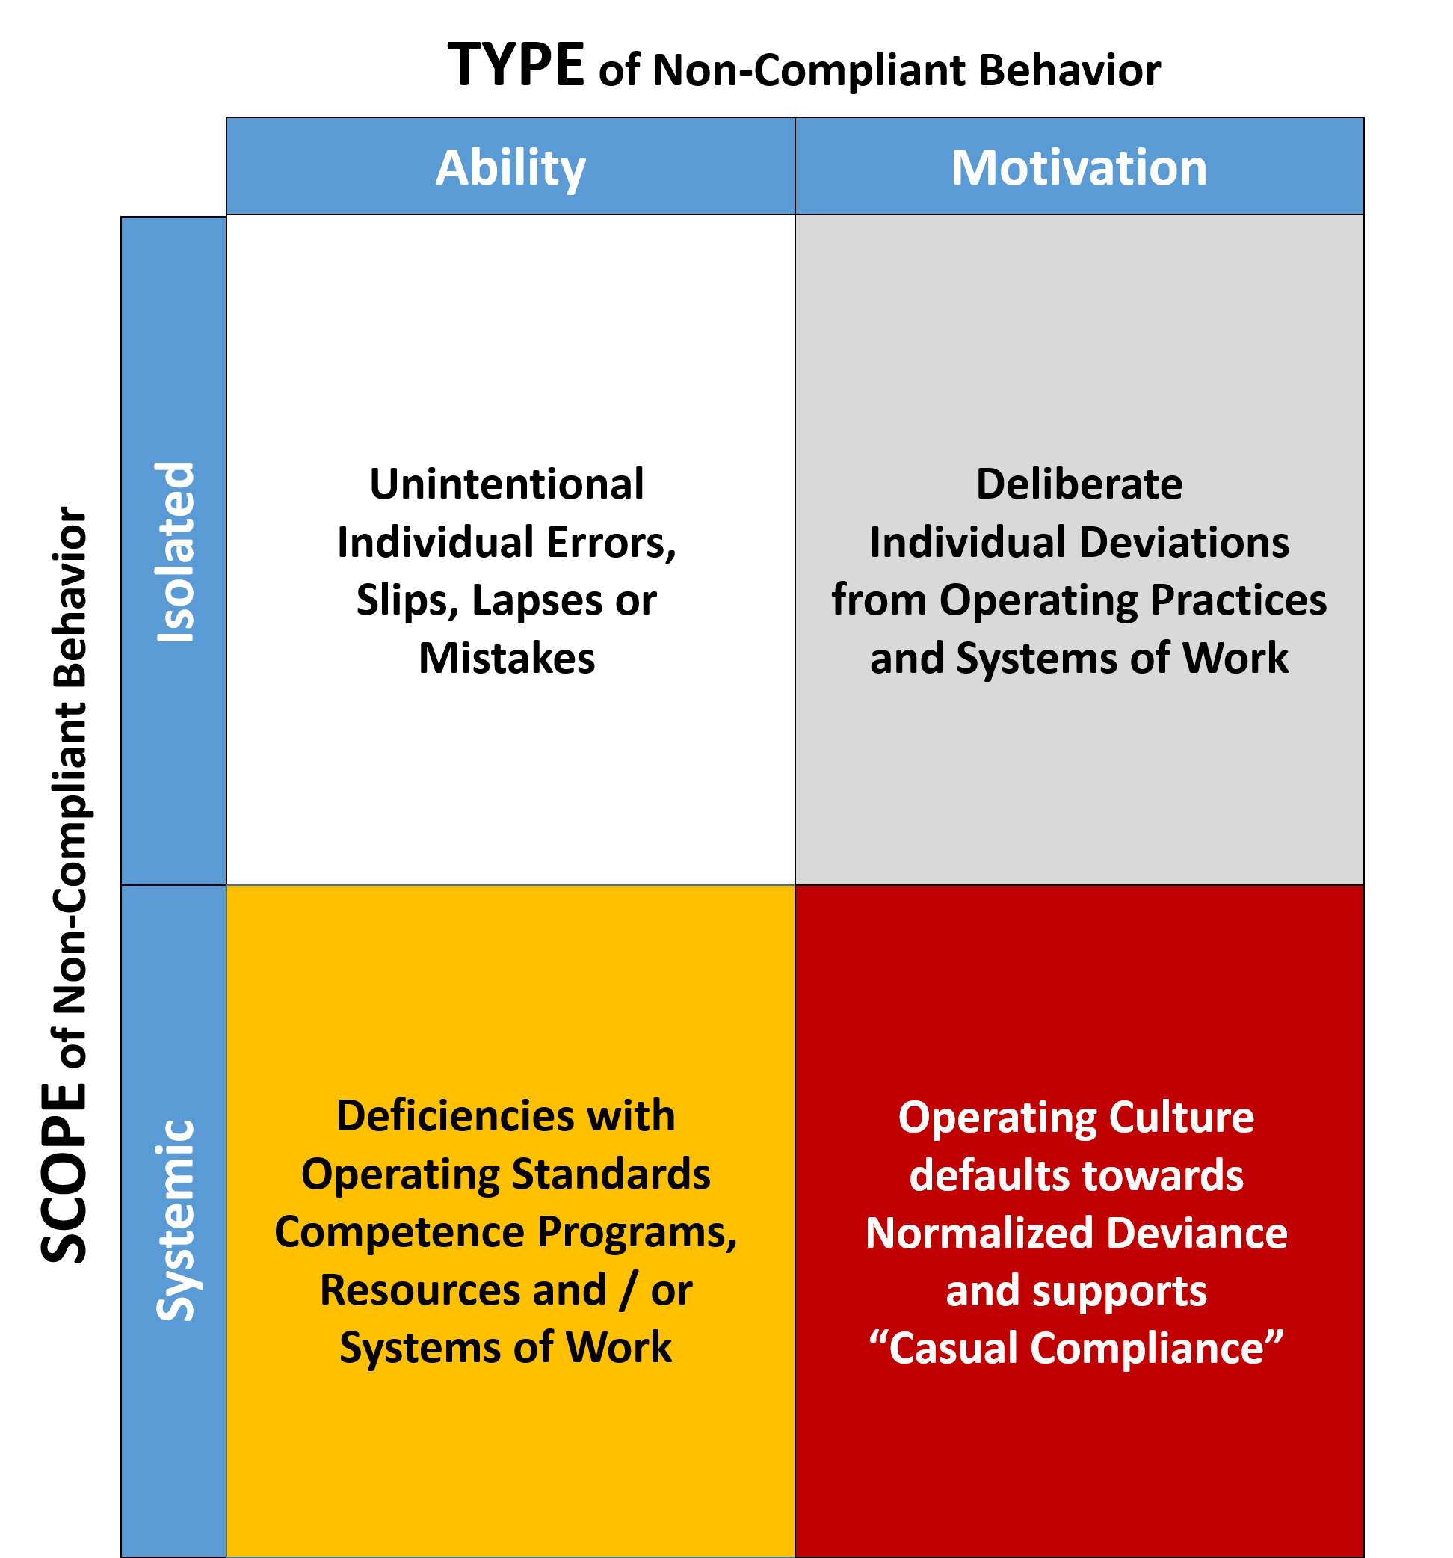
The 2 x 2 Matrix: Understanding Why People Do Something Different
The 2 x 2 Matrix
Non-Compliant Actions and Behaviors can be distilled down to one (or more) of four main underlying causes:
Isolated Ability
Isolated Motivation
Systemic Ability
Systemic Motivation
Notes:
So, in order to develop more effective and more reliable corrective actions to tackle stubborn Human Performance Challenges - such as non-compliant actions and behaviors - we first need to better understand the underlying causes in each instance.
To do this, Pegasus has developed a 2 x 2 matrix consisting of two columns and two rows.
The two columns are labeled: Ability and Motivation.
Simply stated, this essentially means people either knew or did not know the right way to do things…
Animation 1: Ability infers such things as a lack of knowledge, training, understanding or even physical capability.
Animation 2: Motivation on the other hand, suggests that people knew the right way but simply chose to take a short cut or risk believing that saving time (and ultimately saving money) may be the most important thing.
Animation 3: Distinguishing between Ability and Motivation is known as the TYPE of non-compliance.
Animation 4: The two rows are split between Isolated meaning that non-compliance likely starts and ends with just a few individuals - perhaps residing at the worksite….
Animation 5: …..or Systemic meaning that what happens at the worksite is just a symptom of a much wider problem - likely stemming from deep within the operating culture of the organization.
Animation 6: Distinguishing between Isolated and Systemic is known as the SCOPE of non-compliance.
So then, that leaves us with four categories….
Animation 7 - Isolated Ability in the form of individual slips, lapses, errors and mistakes - but mostly due to a lack of understanding or the way certain individuals go about executing the work
Animation 8 - Isolated Motivation - which is in the form of one or two people taking short cuts and risks - and by the way, this is the only category in which discipline adds any value
Animation 9 - Systemic Ability - which normally infers that a policy, procedure or other systems of work are simply not fit for purpose
Animation 10 - And finally, Systemic Motivation - where the overall operating culture is such that many people routinely take shorts cuts and risks and where such things are not considered exceptions but more, simply accepted as the way things simply get done.

Slide 2
The 2 x 2 Matrix: Example 1 - Isolated Ability
TYPE of Non-Compliant Behavior
Human Performance Challenge Example 1:
Ability
Motivation
Isolated Ability
$$√$$
An unplanned event occurs because two individuals did not receive the required LO/TO training (when everyone else did).
X
Isolated
(Individuals are scheduled to attend the LO/TO training course)
SCOPE of Non-Compliant Behavior
X
X
Systemic
Notes:
So, to get a feel for how the 2 x 2 works, lets quickly look at a couple of basic examples using a similar situation in each case.
Animation 1: Example 1: An unplanned event occurs because two individuals did not receive the required LO/TO training.
The first step here is to determine whether we have an Ability or a Motivation problem.
Because this sounds like a training gap, it suggests we’re looking at an Ability shortfall. Animation 2.
Secondly, because we may only be talking about two individuals and not the entire workforce, it is most likely to be an Isolated - Animation 3 - rather than a Systemic problem. Note though in this case that although the training gap appears limited to these two individuals, we would most likely also want to know the reason why they didn’t receive the training when everyone else did.
Animation 3: But for the most part, we likely have an Isolated Ability gap. Knowing this will result in a specific kind of corrective action.

Slide 3
The 2 x 2 Matrix: Example 2 - Systemic Motivation
TYPE of Non-Compliant Behavior
Human Performance Challenge Example 2:
Ability
Motivation
Systemic Motivation
X
X
An unplanned event occurs because company employees are routinely choosing not to follow company LO/TO procedures.
Isolated
SCOPE of Non-Compliant Behavior
$$√$$
X
Systemic
(Methods and metrics for recognizing / rewarding work must reflect actions and behaviors rather than outputs and results)
Notes:
Animation 1: Example 2: An unplanned event occurs because company employees are routinely choosing not to follow company LO/TO procedures.
In this example, it doesn’t sound like an Ability shortfall because employees do not necessarily lack an understanding of how to do the work. So, it sounds more like a perception exists that makes taking short cuts and risks appear to be the unspoken, desired way of doing things. And so, in this case, we’re most likely in the Motivation rather than the Ability column. Animation 2. And because we’re not talking about one or two individuals this time, but company employees in general, this sounds like a Systemic issue - Animation 3 - that potentially is impacting the whole organization.
Animation 4: So, in this example we likely have a Systemic Motivation gap.
Of particular note here is that a Systemic Motivation gap may be product of something called a “casual compliant” operating culture where employees routinely do not adhere to operating procedures and the organization’s systems of work. Left undetected or even ignored, this can lead to very dangerous situations arising with potentially catastrophic consequences.

Slide 4
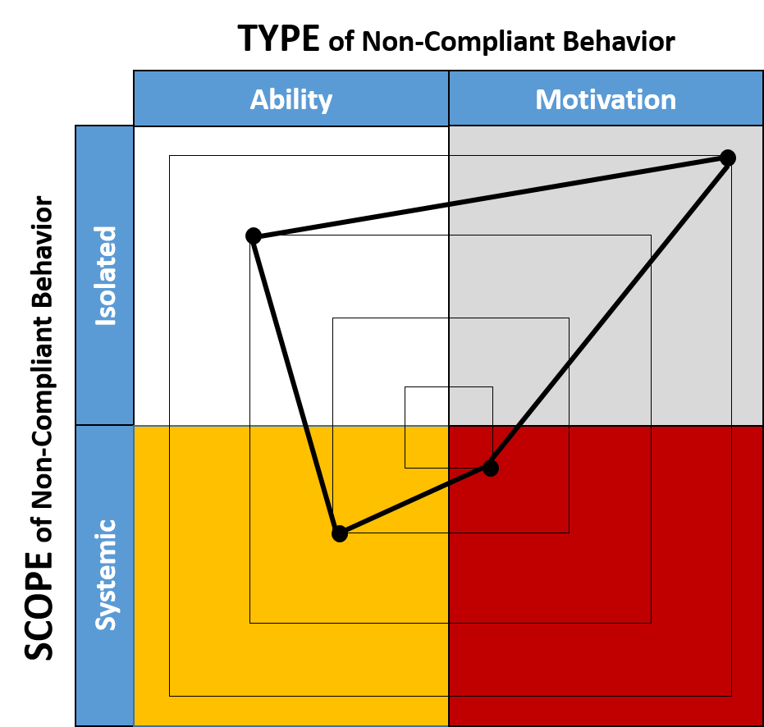
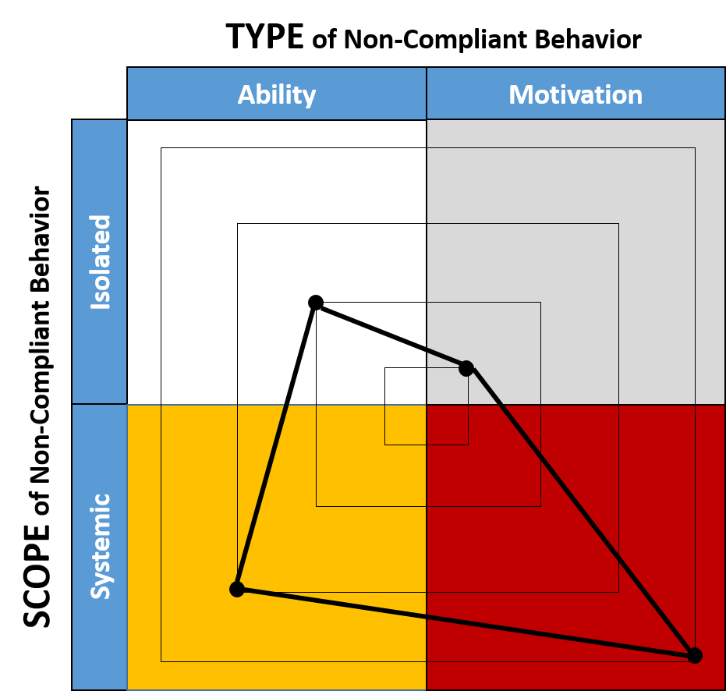
The 2 x 2 Matrix: A Reality Check
Perceived underlying causes for non-compliant actions and behaviors
Actual underlying causes for non-compliant actions and behaviors
Note: Where the SCOPE of non-compliance is Systemic, solutions will likely reside within the top-half (rather than the bottom-half) of the organization
Notes:
Being able to determine the underlying causes of non-complaint actions and behaviors in terms of the 2 x 2 matrix is a very powerful way of understanding and communicating what is really going on inside an organization and helping to better predict future events - and by the way, irrespective of what other metrics and KPI’s based on outputs and results are indicating at the time.
And a side point here, when Pegasus first starts working with organizations, they almost always presume that their challenges are a result of a few so-called rogue employees who simply don’t get it - in other words, Isolated Motivation.
Animation 1 - However, once they start correctly capturing data around actions and behaviors, they soon come to realize that their problems are often far from Isolated and in many cases actually originate much further up the organization than originally thought.
Animation 2 - Read out (so as it says here…..)

