Slide 1


CYBERSECURITY'S ORIGINAL SIN
The Cybersecurity Industrial Complex
Part 1: The EULA as a
Liability Shield
A 25-Year Audit of Structural Incentive Failures
Randy Marchany
Virginia Tech CISO · June 2026
Virginia Tech

Slide 2



Who Am I?
Primary Source
Virginia Tech CISO Since 2010
Inside the Institutions
SANS instructor #2 (1992). First-listed co-author, SANS Top 10 Internet Threats (2001). Co-presenter of the 1996 email attachment attack paper, Co-author CIS Controls v8, Co-author SANS Consensus Roadmap for Defeating DDOS Attacks (2000)
35 years in cybersecurity. 50 years in IT. Virginia Tech is an NSA Center of Academic Excellence in Cyber Defense, Research & Operations. Co-founder, VASCAN & Virginia Cyber Range. 3 cybersecurity patents including MT6D.
White House Partnership for Critical Infrastructure Security. Founding volunteer, Center for Internet Security. Former REN-ISAC Board member, Founding member, US Cyber Challenge.
Recognition
Beyond Cybersecurity
OnCon 2025 Top 10 CISO
Composed the original theme song for NPR's World Cafe
No Strings Attached — INDIE nominated 4×,
won 1988 (independent music's Grammy equivalent)
CISO Connect Top 10 CISO · 2024 Capital ORBIE Finalist
3 Cybersecurity Patents · Co-author CIS Controls v8
Full bio: randymarchany.com/biography

Slide 3
3 Documents Set the Stage in 2000
SANS Consensus Roadmap for Defeating Distributed Denial of Service Attacks (February 23, 2000)
May 2000 SANS Security Alert newsletter
DDOS Roadmap
Vendor insecurity as a structural problem appears in the DDoS Roadmap explicitly.
The document states: "User demand for new software features resulted in speed to market.
The "Longer Term Efforts" section anticipates the series' reform argument by 26 years. The DDoS Roadmap calls for: "Consider changes in government procurement policy to emphasize security and safety rather than simply cost while still providing critical functionality."
The May 2000 SANS Security Alert newsletter is the publication vehicle for the earliest version of 2 key documents simultaneously
  The Ten Most Critical Internet Security Threats — the vendor list
  Mistakes People Make That Lead to Security Breaches which contains "The Ten Worst Security Mistakes Information Technology People Make“, "The Five Worst Security Mistakes End Users Make" AND "The Seven Worst Security Mistakes Senior Executives Make"

Slide 4

3 Documents Set the Stage in 2000
We Had a Plan
We identified the dominant vulnerability classes in 2000. We developed training, benchmarks, controls, incident response frameworks, certifications, and awareness programs. Yet many of the same root causes remain visible in major incidents. Therefore the limiting factor is unlikely to be technical knowledge. The more plausible explanation is economic incentives.
The Open Source Counterargument May Be Becoming Obsolete
Critics of accountability arguments often say:
Open source proves liability can't be the answer because there is no vendor to sue.
But Glasswing-class systems potentially change the economics completely.

Slide 5
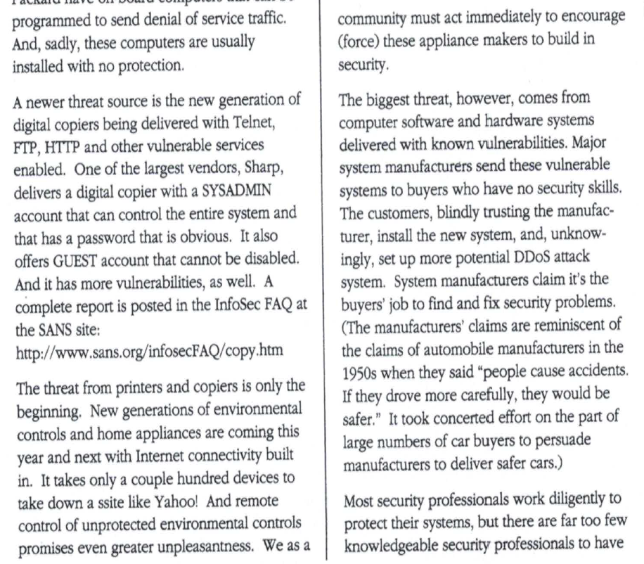
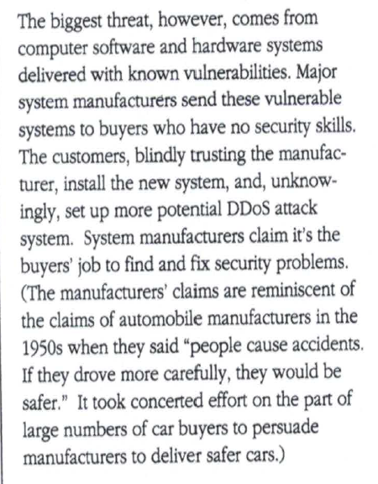
We Said this in 2001
(SANS Security Alert Jan 2001 circular)

Slide 6
The 25-Year Audit Finding
9
Broken Economic Incentives
Insecurity is profitable. Every unpatched system, every breach, every phishing attack creates a market — for patch management, awareness training, incident response, cyber insurance.
of 10 SANS Top 10 problems
remain largely unsolved
after 25 years
The EULA Liability Shield
A legal framework built around End User License Agreements that systematically shields software vendors from liability for insecure products — constructed deliberately in the 1990s.
This is not a technical mystery. It is the predictable result of two interlocking failures.

Slide 7
The SANS Top 10: 25-Year Status
SANS Mistake | 25-Year Status | Primary Driver
1. Default Passwords | ⚠ Partial — consumer IoT only | Regulatory mandate + Mirai damage
2. Unpatched Software | ✗ Negligible improvement | Advisory norm entrenched by EULA
3. Open Ports/Services | ⚠ Partial — cloud-native only | Cloud arch (on-prem unchanged)
4. Lack of Auditing | ✗ Negligible — premium gating persists | Congressional pressure (2023)
5. Excessive Privilege | ✗ Negligible — credential abuse #1 | PAM cost & cloud identity sprawl
6. No Incident Response | ⚠ Moderate — compliance-driven | SEC/CIRCIA mandate
7. Email/Phishing | ✗ Negligible — still #1 vector | Reclassified as 'user error'
8. No Written Policy | ✗ Nominal — policy-behavior gap | Checkbox compliance culture
9. No Backups/DR | ⚠ Partial — cloud-driven | Ransomware now targets backups
10. Physical Security | ? Insufficient data | Data center up / remote work down
7 of 10 failure classes show negligible improvement in exploitation rate — despite massive defensive investment.

Slide 8
Two Interlocking Failures
As software became critical infrastructure, the industry faced a choice: Accept infrastructure-grade liability ala aircraft, pharma, auto industries OR build a legal argument for categorical exemption. They chose the latter.
A legal framework built around End User License Agreements (EULAs) that systematically shields software vendors from liability for insecure products.
The EULA is therefore not merely a legal document. It is an economic instrument.
A broken economic incentive structure that shifts the cost of insecurity onto victims rather than the vendor who’s best positioned to fix the problem
Once those costs are transferred, security becomes a business/economic decision rather than a technical necessity.

Slide 9
Two Duty Chains — Not One
Vendor design failures and operator negligence are separate chains. Conflating them lets vendors point at operators — obscuring who is responsible for what.
A
Exploit Causation
B
Operational Exposure
VENDOR
OPERATOR
The defect that made the attack possible. SQL injection, shared credentials, unsafe defaults — embedded before deployment. Operator compensating controls reduce exposure; they don't erase the origin.
Conditions determining whether a vendor defect becomes exploitable: internet exposure, disabled controls, absent segmentation, inadequate logging. Does not create the defect.
C
Operator Negligence
D
Vendor Remediation Failure
OPERATOR (conditional)
VENDOR
Failure to apply a timely, effective, deployable patch. Applies only where all three conditions are met — the exception, not the default. OT narrows this significantly.
Vendor shipped the defect, issued advisory-only patches, withheld premium logging, used EULAs to transfer all cost downstream. 7 of 10 SANS items carry primary D assignments.

Slide 10



The EULA Shield: Four Legal Pillars
"THE SOFTWARE IS PROVIDED "AS IS," WITHOUT WARRANTY OF ANY KIND, EXPRESS OR IMPLIED."
Intangibility Defense
AS-IS Warranty Disclaimer
Product liability applies to tangible goods. Courts treated software failures as service defects, not manufacturing defects. The industry didn't create this ambiguity — it exploited it systematically in every license written.
UCC § 2-316 permits disclaimer of implied merchantability. Standard commercial risk allocation — but applied to public infrastructure, consequences fall on third parties who agreed to nothing.
Advisory Patch Norm
Compliance as Substitute
Security advisories are legally non-binding recommendations. Vendor discloses, issues patch, bears zero liability for harm during the remediation window. Equifax (2017): patch available 2 months early. Vendor liability: $0.
PCI-DSS, HIPAA, SOX mandated control presence — not security outcomes. A web app firewall satisfies PCI audit whether or not the application has SQL injection. Compliance became the goal; security became incidental.

Slide 11
How the Shield Was Built: 1994–2001
The EULA liability shield was not an accident of legal history. It was constructed deliberately.
1994
ProCD v. Zeidenberg (7th Cir. 1996)
Shrink-wrap / click-wrap license terms — including warranty disclaimers — confirmed binding on users. EULA structure legally established.
1996
UCITA Proposed (1999)
Uniform Computer Information Transactions Act provided statutory framework permitting damage caps and disclaimers the industry had already adopted contractually.
1999
Courts Decline Strict Liability
Judicial treatment consistently declined to extend strict liability to software — reducing plaintiffs to negligence theories vendors' own documentation was structured to defeat.
2001
SANS Top 10 Published
The list arrived at the end of the shield-hardening period — into a legal environment that had already largely resolved vendor accountability in vendors' favor.

Slide 12
Security by MBA: The Incentive Engine
The Profitable Insecurity Cycle
The cybersecurity industry is more analogous to a pharmaceutical industry that profits from managing chronic conditions than to the sanitation industry, which profits from eliminating disease vectors.
1
Vendor ships insecure product
2
Breach / incident occurs
3
Patch management, IR, insurance market grows
Root-cause solutions commoditize or destroy adjacent revenue streams.
4
Compliance framework mandates controls (not root-cause fixes)
5
Vendor sells premium features to address gaps they created

Slide 13
Security as a Premium Feature
Storm-0558 (2023) — The Defining Illustration
Microsoft gated audit logs behind a premium license tier. Organizations affected by a nation-state intrusion lacked the logs to investigate it. Microsoft expanded default logging access only after Congressional and CISA pressure — not market forces.
Withheld Until External Pressure
The Compliance Illusion
Advanced audit logging (base tier)
WAF satisfies PCI audit — SQL injection still present
Privileged access management enforcement
HIPAA training satisfies — behavior unchanged
MFA enforcement tooling
Compensating controls counted as root-cause fixes
Threat detection capabilities
Compliance mandated control presence, not outcomes
Security analytics at scale
Vendors profited from mandatory procurement cycles

Slide 14
What Actually Moves the Needle (OT?)
Default credential improvement is the single SANS item with meaningful progress — and it teaches a precise lesson.
Harm Undeniable
Regulatory Mandate
Victims Blameless
Mirai infected 600,000 consumer IoT devices via default credentials — the exact credentials the vendor shipped. The EULA defense collapsed: households deployed devices exactly as intended.
California SB-327 (2018). UK PSTI Act. NIST SP 800-63B. Binding obligations the EULA could not override. No improvement occurred before external compulsion.
The victim class changed from enterprises with legal capacity to households with none. No IT department. No patch management. Whatever the vendor shipped became the security model.
Structural finding: in categories where vendors bear primary responsibility, improvement requires external compulsion. Every time.

Slide 15
Operational Tech (OT) Changes Everything
"The 'AS IS' clause does not survive the sentence: 'your home was surveilled by someone you never consented to.'"
Smart Lock
Baby Monitor
Installed by a domestic violence survivor for safety. Opens for someone it should not — because the vendor shipped with a remotely exploitable default credential.
An unauthorized actor speaks to a child in their room at night. The EULA clause claiming 'as-is' provision preceded the product the parent purchased for safety.
My Friend Cayla
Mirai Botnet
No Bluetooth pairing PIN. Anyone within range could connect and play audio. Germany banned it as an espionage device. Three EULAs, one unlocked front door.
600,000 devices infected simultaneously via a single error class: default credentials. Each household had no IT department, no security budget, no ability to redesign insecure architecture.

Slide 16


Key Takeaways
The SANS Top 10 persists not because the problems are hard — but because a legal and economic architecture was built to make insecurity profitable and consequence-free.
The EULA shield rests on four pillars: intangibility, AS-IS disclaimer, advisory-only patches, and compliance theater. Each was deliberately constructed and maintained.
Improvement occurs only under external compulsion — regulatory mandate or reputational damage from undeniable visible harm. No voluntary vendor action produced any SANS improvement.
The accountability structure broke when the victim class changed: from enterprises with legal capacity to households with none — and from data records to physical harm.
▶ Part 2 examines the economics of insecurity — why the cybersecurity industry profits from the problem it was built to solve.

Slide 17
CYBERSECURITY'S ORIGINAL SIN
The SANS Top 10 Internet Threats list of 2001 is not a monument to the difficulty of cybersecurity.
It is a monument to the success of a legal and economic strategy that made insecurity profitable and consequence-free for the parties best positioned to fix it.
Randy Marchany
Virginia Tech CISO
marchany@vt.edu · Cybersecurity’s Original Sin series at https://vtrandy.substack.com/p/cybersecuritys-original-sin-executive
randymarchany.com/biography
Security.vt.edu
Virginia Tech

