Slide 1
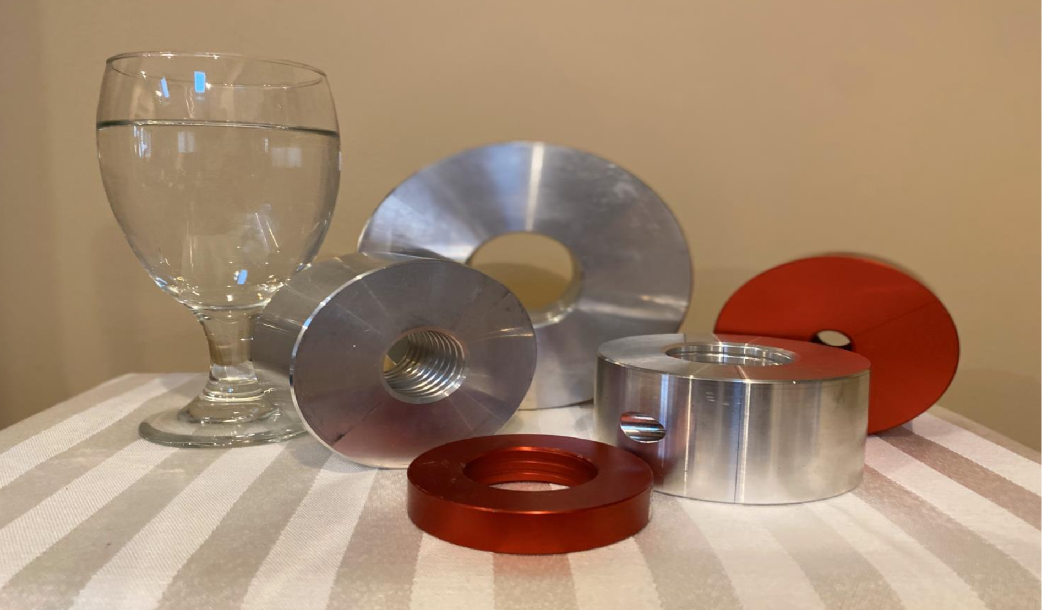
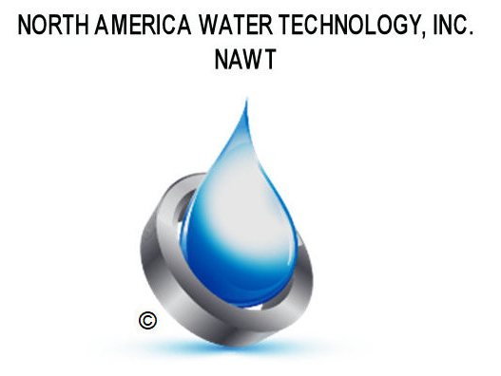
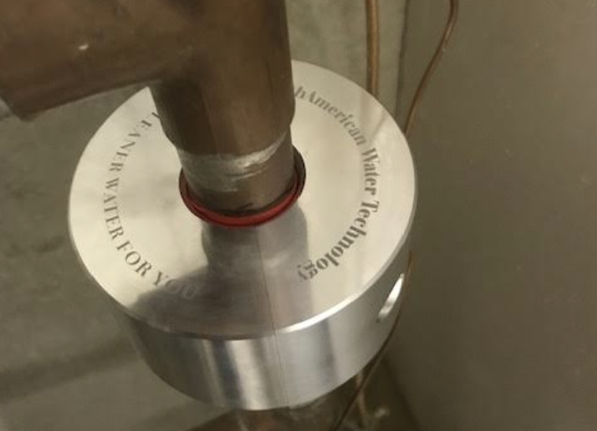
NORTH AMERICAN WATER TECHNOLOGY
“BIOFILMS”
DEADLY INTRUDERS
Exclusive Distributor for North America
271 Skip Lane
Bay Shore, NY 11706
888-821-9211 www.nawatertech.net

Slide 2
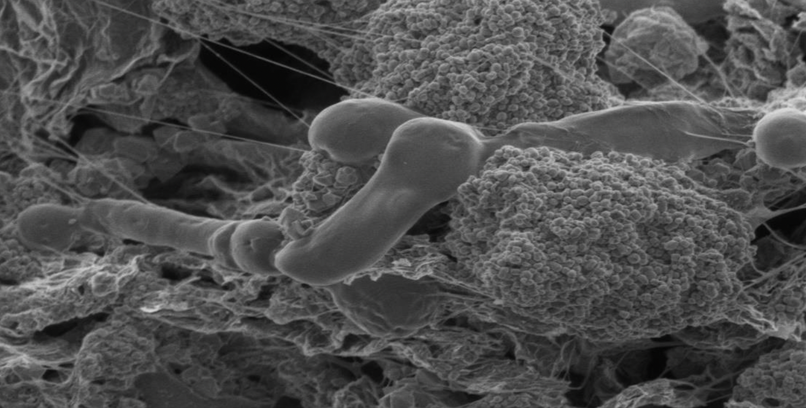
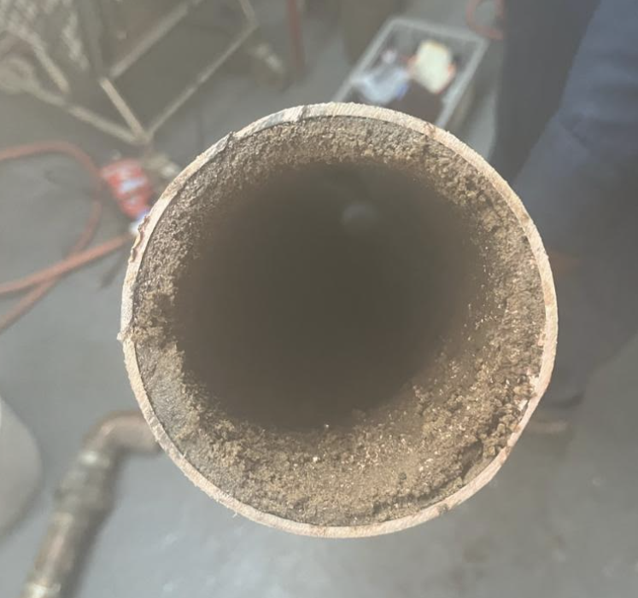
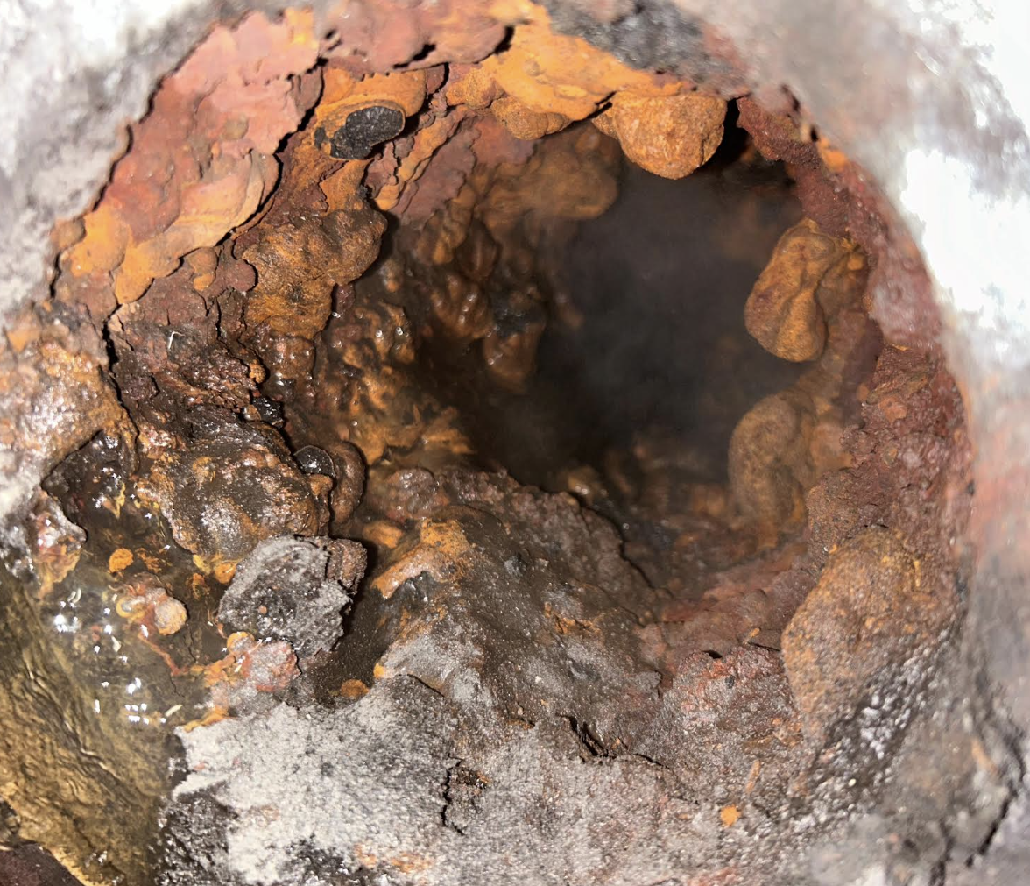
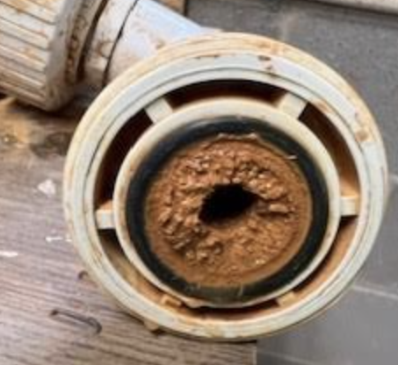
“You wouldn’t lick the inside of this pipe. But you drink, bathe shower, brush teeth and wash with water that has passed through this pipe.”
Our water supply…7 million illnesses and 6,000 deaths every year!*
*https://www.cnn.com/2020/12/16/health/waterborne-diseases-cdc-study-wellness/index.html

Slide 3
Mission:
Promote the Progress of Environmentally Friendly Water Treatment Processes through Innovative Technology
Eliminate Harsh & Toxic Chemicals from the Building Environment
Protect Families from the Scourge of Biofilms
Vision: Become the Leading North American Brand for the
"Emerald Standard"
Values: Sincerity, Diligence, Professionalism, Dedication,
Diversity & Equity
MISSION STATEMENT

Slide 4
Definition:
A complex aggregation of microorganisms marked by the excretion of a protective and adhesive matrix known as extracellular polymeric (EPS). This matrix can include polysaccharides, proteins, lipids and nucleic acids, which together create a structured community of bacteria.
Characteristics:
Complex structures
Resistance to disinfectants
Adherence and attachment
Slow growth and dormancy
Detection challenges
WHAT ARE BIOFILMS?
Diffusion limitations
Adaptation and generation exchange
Environmental persistence
Regrowth potential
Has a communication system

Slide 5
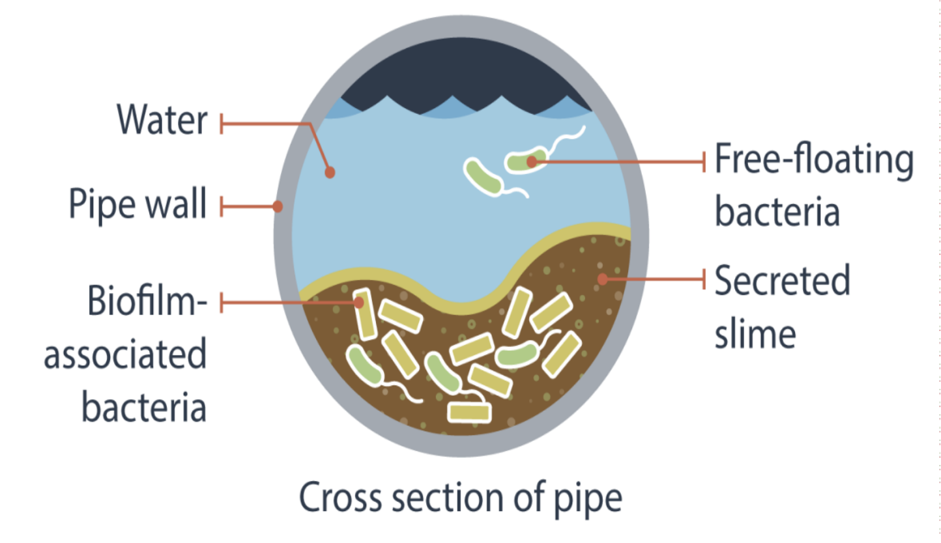
PATHOGENS CAN LIVE AND GROW IN BIOFILM

Slide 6
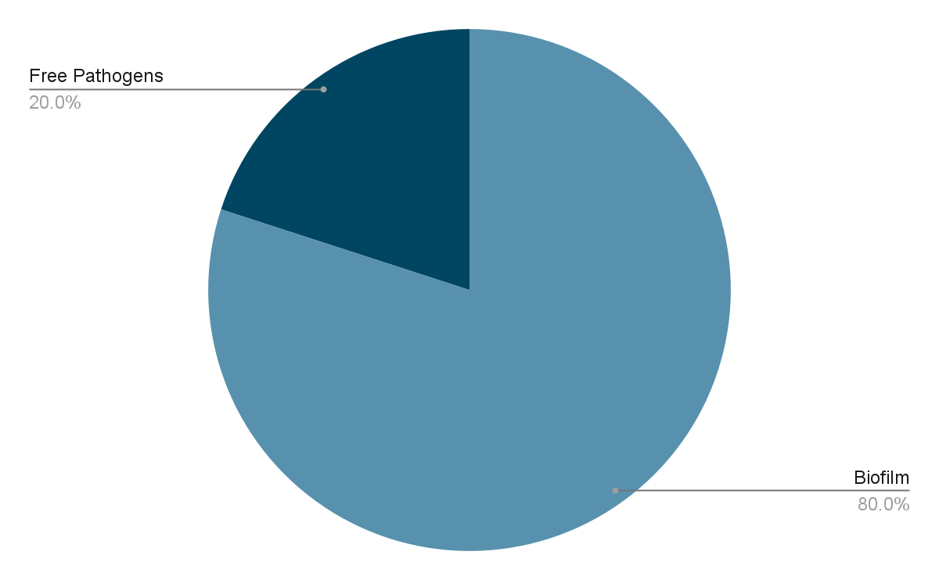
POPULATION OF PATHOGENS

Slide 7
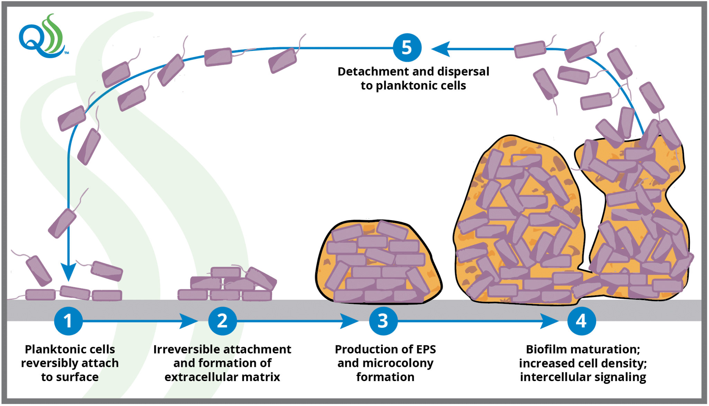
BIOFILM FORMATION

Slide 8
Partial List of Pathogens Commonly Protected Within a Biofilm:
Escherichia coli - Diarrhea, infections, sepsis, stomach pains, cramps, loss of appetite
Klebsiella pneumoniae - pneumonia, lung infections, antibiotic resistant
Enterococcus faecalis - UTI, wound, infections, heart inflammation, blood infections, meningitis
Streptococcus viridians - inner heart lining, brain and liver abscesses, scarlet fever, rheumatic fever
Listeria monocytogenes - Intestinal illness, flu like symptoms, loss of balance, headaches, seizures, confusion
Candida albicans - Fungal infections
Staphylococcus - Staph infections, infections leading to fatal outomces
Streptococcus - Pneumonia, sepsis, skin infections, toxic shock syndrome
CARRIED IN BIOFILMS

Slide 9
Common Locations
Pipes
Faucets / Shower heads
Hot Water Systems
Filters
Dead Legs / Low Flow
Cooling Towers
System Design and Residences
Incoming Water Lines
Hot Tubs, Spas, Therapeutic Baths
Ice + Beverage Machines
BIOFILMS IN WATER SYSTEMS

Slide 10
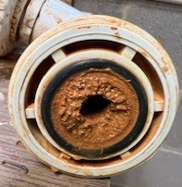
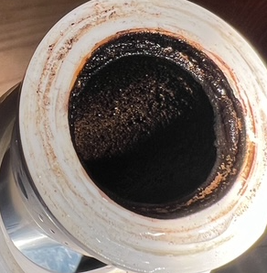
OPERATIONAL ISSUES
Corrosion: Biofilms can cause or accelerate corrosion of pipes, leading to leads and infrastructure damage
Reduced water quality: they contribute to taste, odor, and clarity issues in water, making it less palatable or suitable for use
Flow obstruction: biofilms clog systems, reducing water flow and system efficiency, which might necessitate more frequent maintenance
Increased costs: managing biofilms involves additional costs for treatment, cleaning, and potentially replacing affected parts of the water system

Slide 11
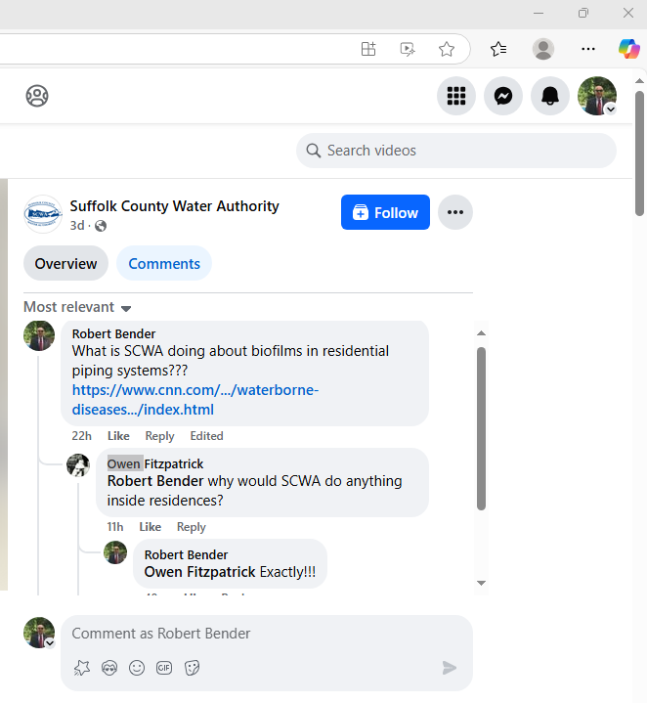

Slide 12
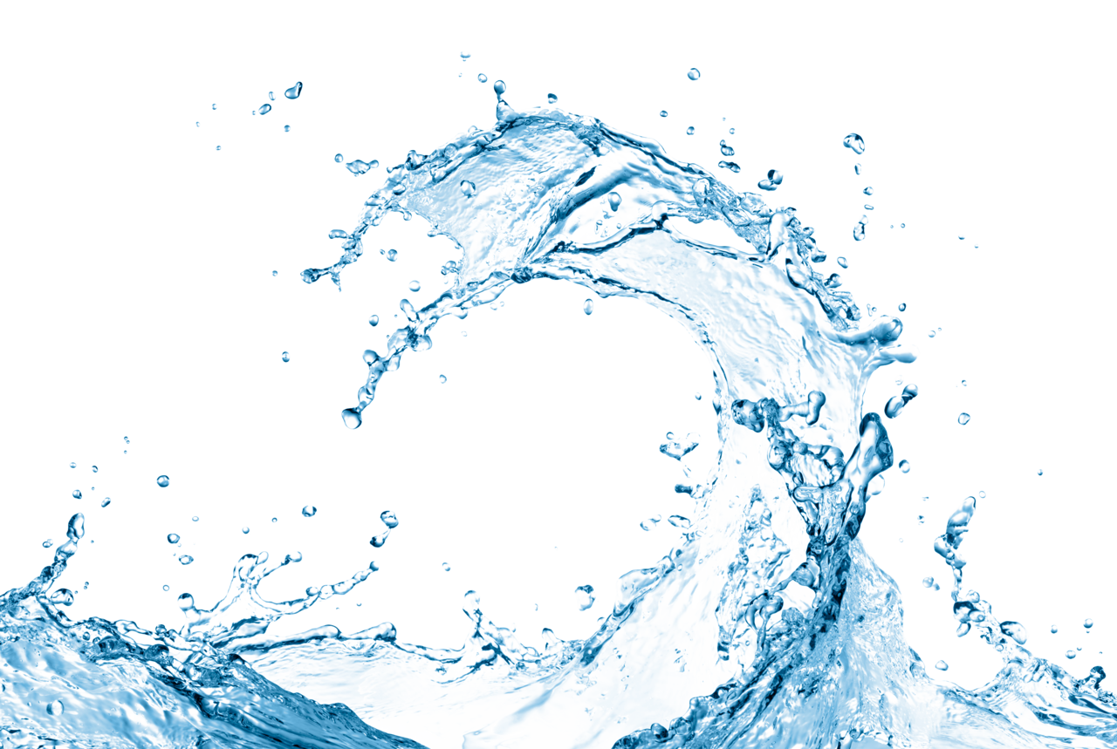
How it Works:
No Electricity
No Chemicals
No Magnets
No Maintenance
The NAWT Collar is 100% Emerald Standard!!
NAWT COLLAR

Slide 13
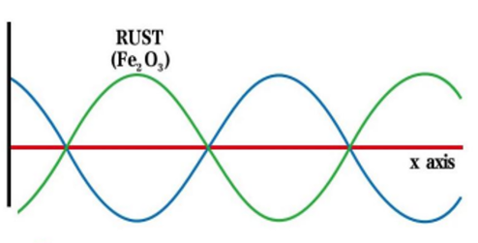
QUANTUM MECHANICS
NAWT COLLAR
HOW IT WORKS
The blue line and the green line in Fig 2 are in phase opposition because they cross the x-axis in the same spots but then valley and peak are the opposite side of it. The amplitudes are subtracted. In this case the amplitudes are identical, so that the resulting red line is the mathematical result of natural oscillation of rust (green line) or Lime Scale (or any element that needs to be modified) and the interfering active oscillation (blue line from the Collar) which results in a flatline or zero. The physical properties of this element has been modified.

Slide 14
Residential:
Potable Water-Removes Biofilms
Keeps Heating Lines Clean
Commercial:
Problems in Piped Systems
HVAC Systems
Geothermal Systems
Sprinkler Systems
Industrial:
Boilers
Heat Exchangers - Plate & Tube
Valves
Chillers
Cooling Towers
APPLICATIONS

Slide 15
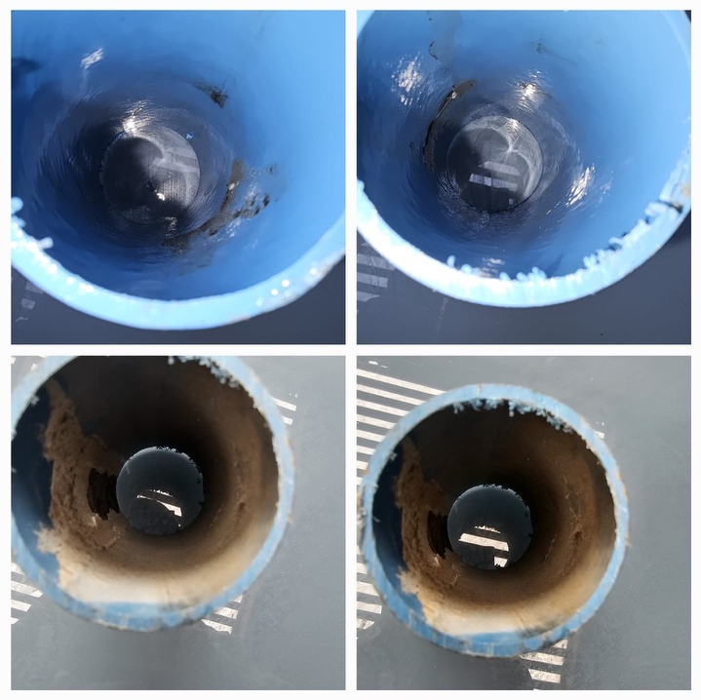
BEFORE & AFTER

Slide 16
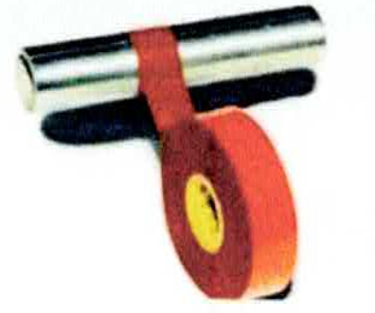
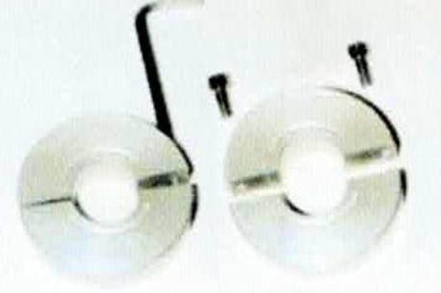
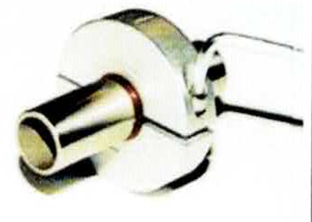
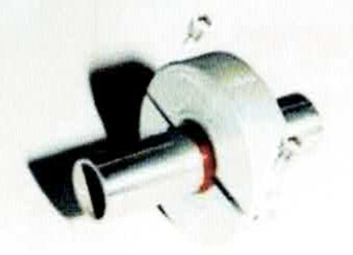
1.
Choose a suitable location for the collar (main line / water flow). Please contact NAWT Inc. for a complete assessment if unsure of the Collar’s placement.
Before placing the collar, wrap the pipe with double-layer red insulating tape to prevent any reaction of the metals. Please ensure that electrical devices or power lines are at least 1 foot away, otherwise the effectiveness of the collar may be influenced.
2.
3.
4.
Loosen both of the screws with an Allen key. The collar separates into two halves.
Set both of the ring halves onto the prepared section of the pipe. Make sure arrow on the ring is in the direction of the flow.
Retighten both halves of the collar. Do not over tighten.
INSTALLATION & MAINTENANCE
**NO MAINTENANCE REQUIRED***

Slide 17
Non-Magnetic
Non-UV
Non-Chemical
No energy source required
No Consumables or Materials Required
No Carbon Emissions are generated during use
Non-invasive deployments
No maintenance required
Reduce system operating costs
BENEFITS
Easy installation, Fast results
Proven performance
Advanced solid-state technology
Extends Life Of Service Equipment
Conserves Water
Efficient Scale Inhibition
Strong Scale Removal
Corrosion Inhibition
Inhibition of Bacteria & Algae

Slide 18
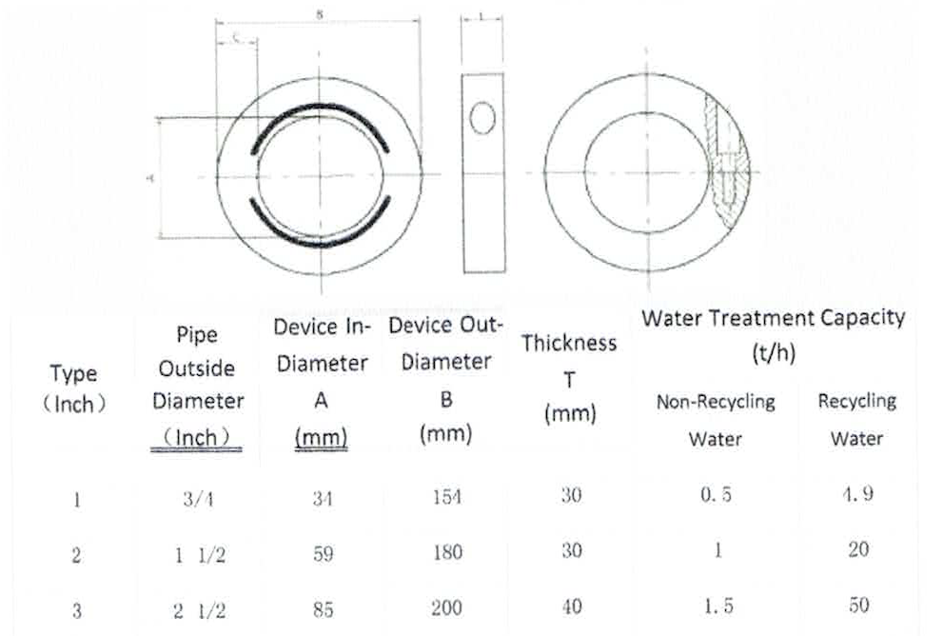
CONTACT: North American Water Technology
271 Skip Lane
Bay Shore, NY 11706
888-821-9211
INCLUDE: Dimensions of Pipe
Type of Problem Material
HOW TO ORDER

Slide 19
North American Water Technology
271 Skip Lane
Bay Shore, NY 11706
888-821-9211
THANK YOU.

