Slide 1
consumerism – Part 2
September 2026
Phil 1250 - Contemporary Moral Issues

Slide 2
Today’s Agenda
  Review of Kerryn Higgs, “A Brief History of Consumer Culture”
  Discuss Holt, “Do Americans Consume Too Much?”

Slide 3
Higgs’s Question
  Does consumer culture merely offer things to already morally formed individuals, or does consumer culture help them form their desires, identities, and understanding of a worthwhile life?

Slide 4
Higgs’s conclusions
  Our acquisitive tendencies are not wholly artificial: we naturally have needs and wants
  Consumption is not inherently objectionable
  ON THE OTHER HAND . . . .
  Modern acquisitiveness does not simply expresses an unchanging human nature
  Institutions instead help form the kinds of persons people become.

Slide 5

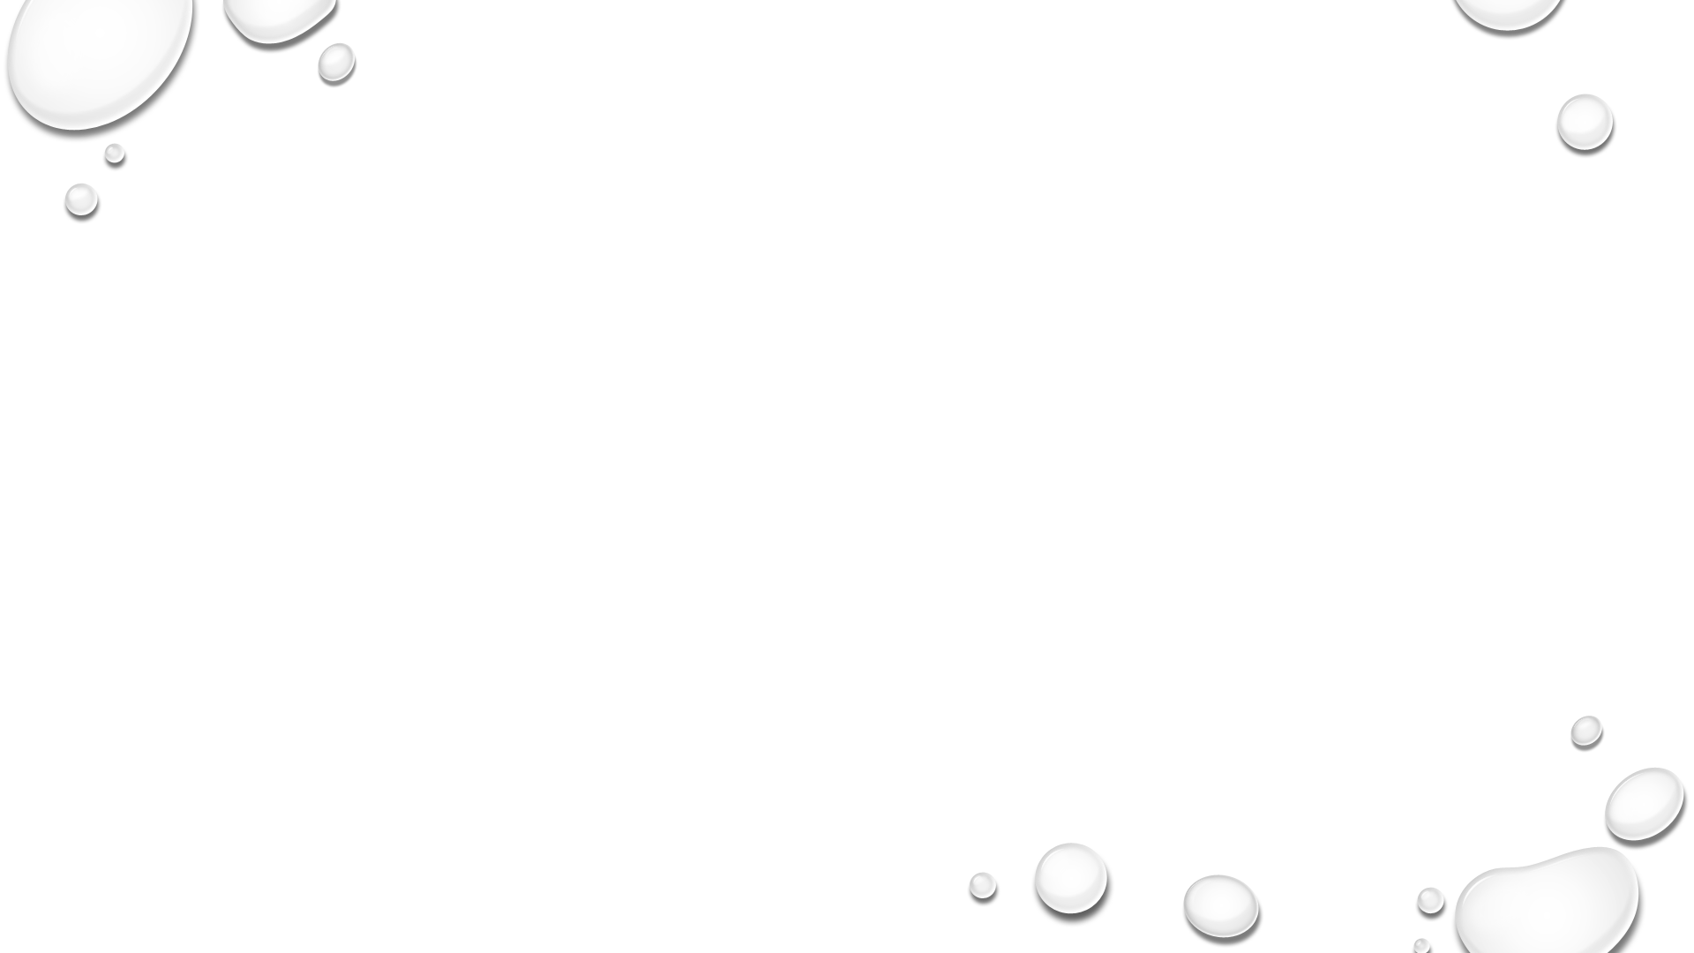
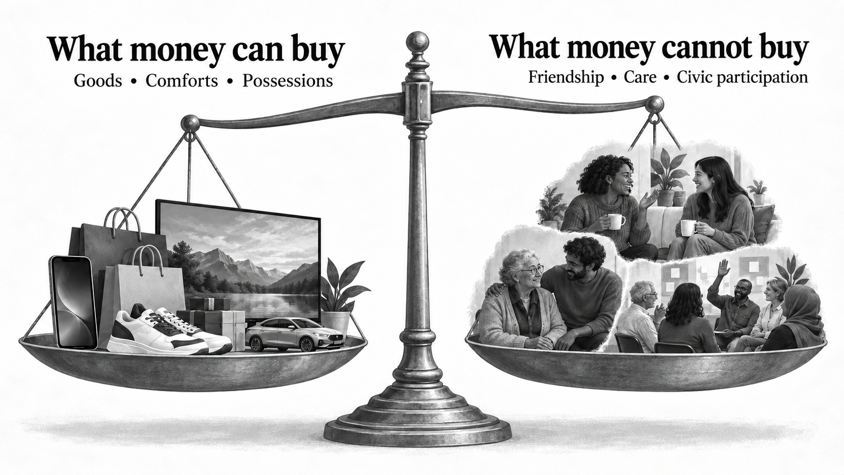
Trade-off: purchasable for the non-purchasable
  Conversion of Time:
    it into wage-time and then
    into commodities:
    PROPOSED CONCLUSION: not a neutral exchange of one good for another; conversion trades a constitutive condition for an instrumental one

Slide 6
Distinction between “normal” and “historically constructed”
Humans have always acquired and consumed necessities such as food, clothing, and shelter.
Yet the emergence of consumption as a principal social role and organizing purpose of life needs explanation and raises ethical questions
Consumer culture involves more than acquiring things: it establishes expectations about what people should desire and how they should pursue fulfillment

Slide 7
Can acquisition and consumption Satisfy?
Acquisition has come to be seen as a route to happiness (William Leach)
Consumption becomes a way of life through which people seek psychological and spiritual satisfaction
Not buying just convenience but meaning, social status, belonging, etc.

Slide 8
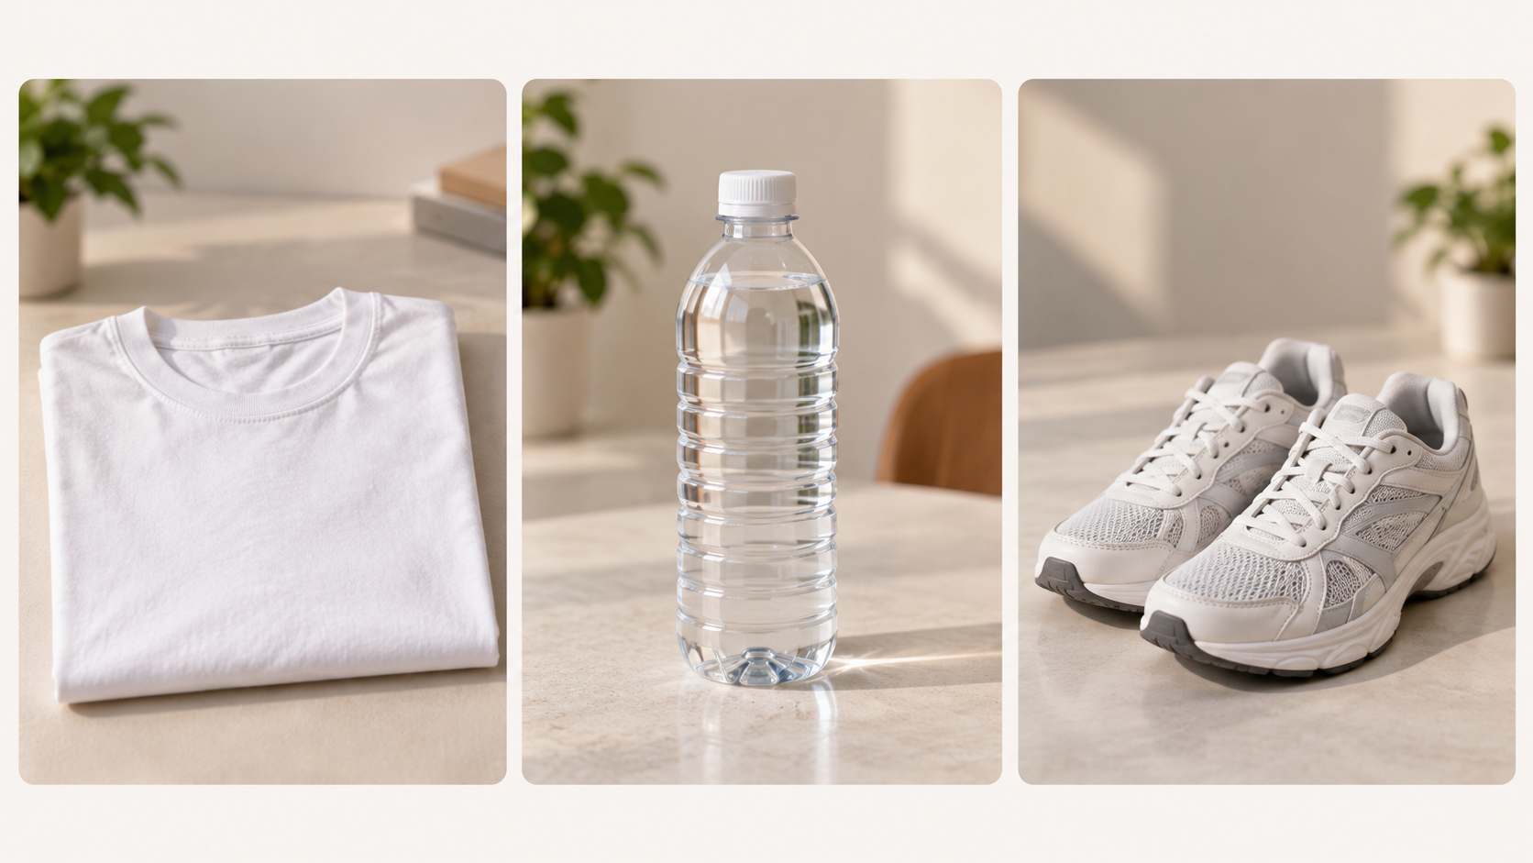
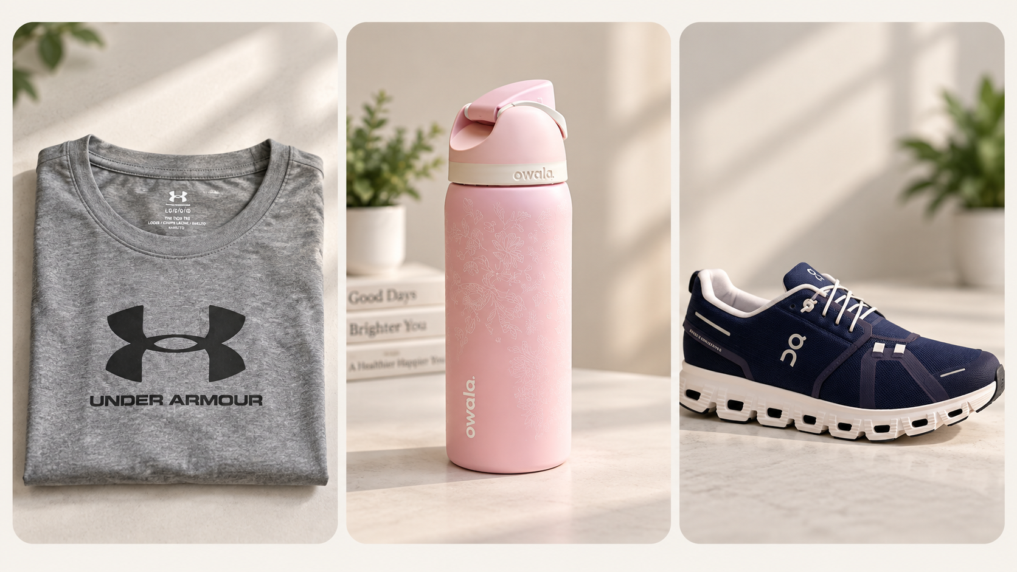
What are we actually buying?

Slide 9
Why would someone buy Under Armour shirts, Owala bottles, or On shoes rather than a functionally similar cheaper versions?
What might owning these communicate?
What can you tell, if anything, about a person from what they choose?
Which of these purchases feels most like an expression of “who I am”?
Is that expression really yours if millions of other people bought the same thing?
Essentially, these questions are what Holt reading is all about . . .

Slide 11
Holt’s Big Picture
Contrary to what the title suggests, Holt and Schor suggest that quantity isn't even the most interesting question.
Deeper questions:
  Why do we want what we want?
  What do commodities mean?
  How does consumption organize status and identity?
  What happens when nearly everything becomes something that can be bought and sold?
  Can consumer culture even turn rebellion against consumer culture into another product?

Slide 12
Holt’s Big Picture (cont.)
A Compelling criticism cannot focus merely on the quantity of consumption; it must ask what happens when class, race, gender, and other forms of social difference are channeled through commodities

Slide 13
Puzzle 1: Why do i suddenly “need” things I didn’t previously need?
Galbraith’s dependence effect
  mass production requires ever-growing consumer demand, while advertising and salesmanship help “create desires”
  companies therefore both stimulate the want and sell the means of satisfying it
    Example: your new phone

Slide 14
Puzzle 1: Why do i suddenly “need” things I didn’t previously need? (cont.)
Example: The Phone Problem
Your phone works. Battery life is okay. It texts, streams, takes pictures, and runs your apps. Then the new model comes out, with
Better camera.
Slightly thinner.
New finish.
Everyone online is comparing it.
Suddenly your old phone begins to feel old.
Did the new phone satisfy a preexisting need—or did its existence help create the need?

Slide 15
Puzzle 1- the Ethical question
I genuinely desire something, does it matter how I came to desire it?
  Was the desire induced, stimulated, or enhanced by a company (or other organization), at first for profit, and then by peers (FOMO)?
  Reflective reasoning?

Slide 16
https://www.pbs.org/wgbh/frontline/documentary/showspersuaders/

Slide 17
Puzzle 2 – What exactly are we buying?
  Goods carry symbolic meanings
  Functionally similar commodities can be differentiated by the meanings attached to them

Slide 18
Puzzle 2 – What exactly are we buying? (cont.)
  EXAMPLE:
  Three white T-shirts
  Sam’s Club T-shirt — $8
  Nike T-shirt — $30
  Designer minimalist T-shirt — $120
  -----------
  Assume, arguendo (for purpose of argument), that all three perform basically the same physical function.
  What does the extra $172 purchase?

Slide 19
Puzzle 2 – What exactly are we buying? (cont.)
quality (possibly a “use value”)
brand
status
taste
belonging
exclusivity
aesthetic
identity
The commodity has a use-value—but also a social meaning

Slide 20
Puzzle 2 – What exactly are we buying? (cont.)
Consumption becomes a way of accessing and communicating a “code” of distinctions
We don't just consume objects. We consume differences between objects. (Baudrillard)
We act creatively—but within systems of meanings, options, institutions, and inequalities we did not create

Slide 21
Puzzle 3 – Are our choices really individual?
Which one signals higher status?
Starbucks vs. gas-station coffee
craft beer vs. Bud Light
Taylor Swift vs. obscure indie band
chain restaurant vs. tiny, locally-sourced restaurant
large visible designer logo vs. expensive clothing with a tiny, or no, logo

Slide 22
Puzzle 3 – Are our choices really individual? (cont.)
Does status always mean “more expensive”?
Bourdieu argues that distinction can operate through taste itself, including music, food, art, decor, travel, and ways of consuming (Bourdieu)
Cultural capital allows elites to differentiate themselves even when cost isn't the obvious marker.
Once everybody can buy the expensive logo, the sophisticated status move may be to stop displaying the logo.
So, is your taste an expression of your individuality—or evidence of the social group that taught you what counts as good taste?

Slide 23
Disorientation
Jean Baudrillard
What happens when we can’t tell the difference between “real” and “unreal”??
not: Culture forms my preferences
Not even: The truth matters only as a means to my end (Frankfur

Slide 24
Class Exercise
Blue pill: You continue living in a constructed world. Your experiences are satisfying, your relationships seem meaningful, your pleasures feel real, and you never discover that much of what you experience is artificial.
Red pill: You learn what the world is really like—but the truth may be less pleasant, less meaningful, and less satisfying than the constructed world.
Which pill would you take, and why?

Slide 25
Class Exercise
More importantly: Why should reality matter to us? If an experience feels real and produces the same happiness, relationships, and satisfactions as the “real thing,” is anything morally or humanly important lost?

Slide 26
The progression . . .
The Matrix: Would you prefer truth to illusion?
Frankfurt: Do you care whether what you say corresponds to truth at all?
Baudrillard: What happens when the system of representations becomes so autonomous that the distinction between representation and reality itself starts breaking down?

Slide 27
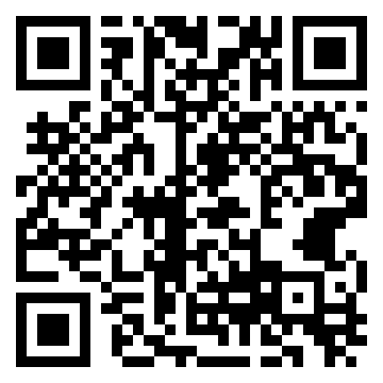
https://form.jotform.com/262467960213156

