Slide 1
Consumerism Part 2
Contemporary Moral Issues
Fall 2026
Jean Baudrillard’s The Consumer Society: Myths & Structures

Slide 2
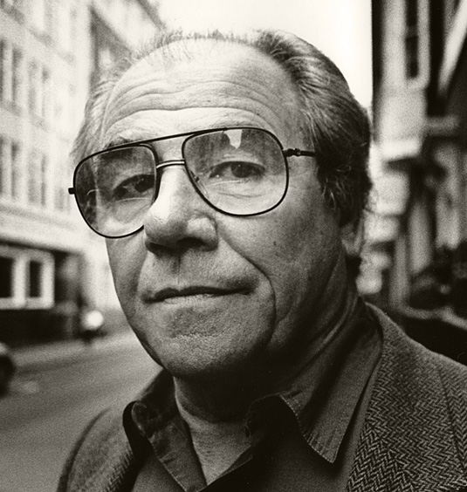
Jean Baudrillard - Bio
1929-2007
French sociologist
Postmodern theorist (questions our ideas of
progress, truth, and meaning)
Influenced by Karl Marx but disagrees with many of Marx’s ideas
Advocated for interdisciplinary study, rejecting
silo approach to academic study

Slide 3
Jean Baudrillard
Interview of Dr. Alan How

Slide 4
Jean Baudrillard – Big Ideas
Societal exchange – the quid pro quo – is firstly not economic (as Marx believed) but SYMBOLIC
Society is not dominated by modes of production but by INFORMATION from sources like TV, the Internet, and other knowledge industries
Society saturated by SIGNS that, taken together, destabilize meaning and render the question of meaning unintelligible
In postmodern (consumer) society, it is difficult to distinguish between the real and imaginary, in part because our daily experience is saturated with replicas, and simulations

Slide 5
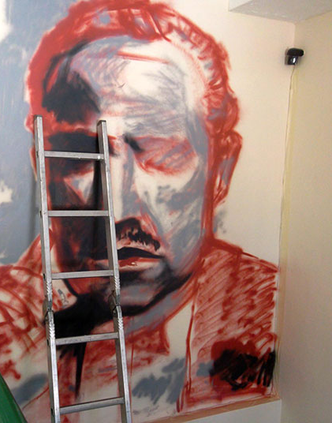
Jean Baudrillard – Big Ideas
Simulacra are the means by which a society simulates or “brings off” the real
Simulacra replace the real
Competing stories are all that exist, contributing to an intellectual vertigo
In popular culture, a parallel: humanity as trapped in The Matrix (but without knowing it)
Worse than disregard for the truth (Frankfurt
choloapolo.com

Slide 6

Jean Baudrillard – Big Ideas
In popular culture, a parallel: humanity as trapped in The Matrix (but without knowing it)
No longer a choice to be made between “real life” and “simulation” – the simulation is all there is
Worse than disregard for the truth (Harry Frankfurt’s idea of bullshit (On Bullshit, 2007)
choloapolo.com

Slide 7


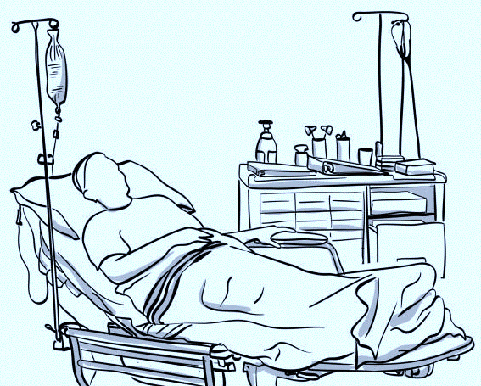

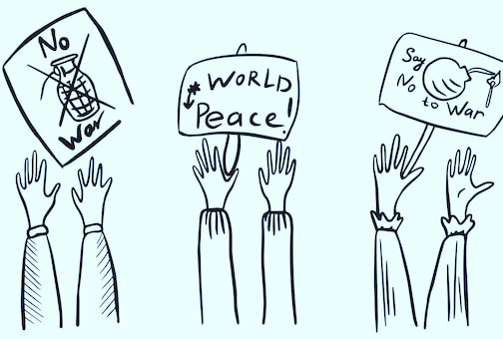
Jean Baudrillard – Big Ideas

Slide 8
Jean Baudrillard, The Consumer Society
For Baudrillard, consumerism is a MENTALITY and IDEOLOGY
The consumer mentality:
- mythic (a kind of story is created)
- magical (the true becomes truer than the true)
- primitive (appeals to our core values of belonging, identity with values)

Slide 9
What are We Really Consuming?
Are we buying objects because of what they do, or because of what they mean?
Consumer goods have use-value
  A shoe protects your foot
  A phone allows communication
  A car gets you from place to place
But goods also have symbolic or sign-value
  Status
  Taste
  Identity
  Group membership
Why would someone pay $100 for an object when a $20 version performs essentially the same function?

Slide 10
Consumption as Language
Are we buying objects because of what they do, or because of what they mean?
Consumer goods function somewhat like words in a language.
We communicate through what we own (through our clothing, cars, phones, food, music, etc.)
The meaning of an object often depends on its relationship to other objects.
  A Rolex does more than tell time, in can communicate . . .
    Wealth
    Success
    Taste
    Professional identity
    Social position

Slide 11
Buying Meanings, Not Just Objects
A traditional picture of consumption:
Need → Desire → Product
Example:
I am thirsty → I want something to drink → I buy water.
Baudrillard complicates this picture.
Consumer society may operate more like:
Product + Advertising + Culture → Desire → Perceived Need

Slide 12
Consumer Society Creates Needs
Think about:
  New phones
  Fashion cycles
  Skin-care routines
  Streaming subscriptions
  Fitness technology
  Food trends
Ask: Did people independently discover these needs?
Or: Did the availability of the product help create the perceived need?
Important distinction:
  Creating desire ≠ creating biological need
But desires can still become psychologically powerful.

Slide 13
Ethical Questions
Suppose Baudrillard is largely right. Consumer society:
  Creates or shapes desires
  Encourages comparison
  Uses objects to communicate identity
  Produces recurring dissatisfaction
  Turns identity into consumption
  Converts even rebellion into commodities
  Then the central ethical question becomes:
What, exactly, is morally wrong with any of this?

Slide 14
Ethical Questions
Possible concerns:
Autonomy
Manipulation
Inequality
Environmental cost
Psychological dissatisfaction
Loss of authentic individuality
Commodification of human relationships
Displacement of non-market goods

Slide 15
Ethical Questions
Does consumer society merely give people what they want—or does it help determine what kinds of people they become?

Slide 16
Ethical Questions
What happens when we lose track of the difference between the “real” and what symbolizes the real? When we’re in the Matrix without knowing it?

