Slide 1
MORAL ARGUMENTS
Phil 1250 – Contemporary Moral Issues
January 13, 2023

Slide 2
Claims vs. Arguments
Claims are like conclusions: they are assertions, not arguments,
and so they have no capacity to persuade.
Arguments involve reasoning towards (in support of) a conclusion. We often argue in favor of claims. To wit:
Johnny stole from Walmart on January 1.
Only shoppers whose first name starts with “J” could have stolen from Walmart.
Johnny is a first name that starts with “J.”
A shopper stole from Walmart on January 1.
Johnny was a shopper in Walmart on January 1.
Johnny was the only shopper in Walmart on January 1 whose first name starts with “J.”
---------------
Therefore, Johnny stole from Walmart on January 1.

Slide 3
Normative vs. Descriptive Claims
“Sally exited the dumpster covered in Chinese.”
Is this a normative or descriptive claim? Why or why not?

Slide 4
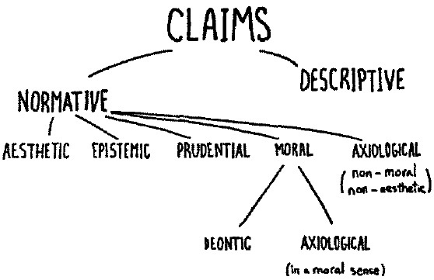


Moral vs. Descriptive Claims
Describe facts about the world – how the world is.
Walmart is big.
Conifers have needle-like foliage.
Most cars are white.

Slide 5
Normative vs. Descriptive Claims
“Johnny ought to feel bad about stealing the Twix.”
Is this a normative or descriptive claim? Why or why not?

Slide 6
Moral vs. Descriptive Claims
Normative claims assert that X
is right or wrong, good or bad, or that the world ought to be a certain way.

Slide 7
Moral vs. Descriptive Claims
Normative claims assert that X
is right or wrong, good or bad, or that the world ought to be a certain way.
The sunset is beautiful.
We should not believe things without good reason.
You should look both ways before crossing a street.

Slide 8
Moral vs. Descriptive Claims
Assert that X is right or wrong, moral or immoral, or that a person ought to X or refrain from X-ing.
---------------------
-------------
-------------
-------------
-------------
-------------
-------------

Slide 9
What’s distinctive about MORAL claims?
Moral claims assert that X is morally right or wrong,
or assert that we have an obligation to X or not X.
“It is always wrong to steal.”
    “It ought to be the case that no person ever steals.”
    “Every person has a duty to avoid stealing.”
    “Stealing is always wrong.”

Slide 10
What’s distinctive about MORAL claims?
Moral claims assert that X is morally right or wrong,
or assert that we have an obligation to X or not X.
“You should not lie just to avoid
an uncomfortable situation.”
    “It ought to be the case that no person lies merely to avoid an uncomfortable situation.”
    “We ought not to lye just to avoid an uncomfortable situation.”
    “Lying to avoid and uncomfortable situation is wrong.”

Slide 11
What’s distinctive about MORAL claims?
Moral claims assert that X is morally right or wrong,
or assert that we have an obligation to X or not X.
“Aborting a viable fetus
is never morally permissible.”
    “It ought to be the case that no person ever aborts a viable fetus.”
    “No person should ever abort a viable fetus.”
    “It is wrong to abort a viable fetus.”

Slide 12
Moral vs. Descriptive Claims
Describe facts about the world – how the world is.
Walmart is big.
Conifers have needle-like foliage.
Most cars are white.
Normative claims assert that X
is right or wrong, good or bad, or that the world ought to be a certain way.
The sunset is beautiful.
We should not believe things without good reason.
Assert that X is right or wrong, moral or immoral, or that a person ought to X or refrain from X-ing.
You should look both ways before crossing a street.

Slide 13

Moral vs. Descriptive Claims
Assert that X is right or wrong, moral or immoral, or that a person ought to X or refrain from X-ing.

Slide 14
Claims vs. Arguments
Claims are like conclusions: they are assertions, not arguments,
and so they have no capacity to persuade.
Arguments involve reasoning towards (in support of) a conclusion. We often argue in favor of claims. To wit:
Johnny stole from Walmart on January 1.
Only shoppers whose first name starts with “J” could have stolen from Walmart.
Johnny is a first name that starts with “J.”
A shopper stole from Walmart on January 1.
Johnny was a shopper in Walmart on January 1.
Johnny was the only shopper in Walmart on January 1 whose first name starts with “J.”
---------------
Therefore, Johnny stole from Walmart on January 1.
DESCRIPTIVE

Slide 15
Claims vs. Arguments
What is a moral argument? Example?
A moral argument is reasoning usually intended to persuade us of
of the moral rightness or wrongness of X (person, place, or thing).
Johnny stole from Walmart.
Stealing is always wrong.
---------------
Therefore, Johnny did something wrong when he stole from Walmart.

Slide 16
Reminder!
Quiz 2 due TODAY (9/6) at 11:59 PM. Good Luck!

Slide 17
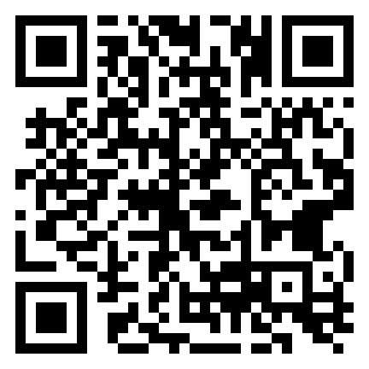
https://form.jotform.com/262432975257162

