Slide 1
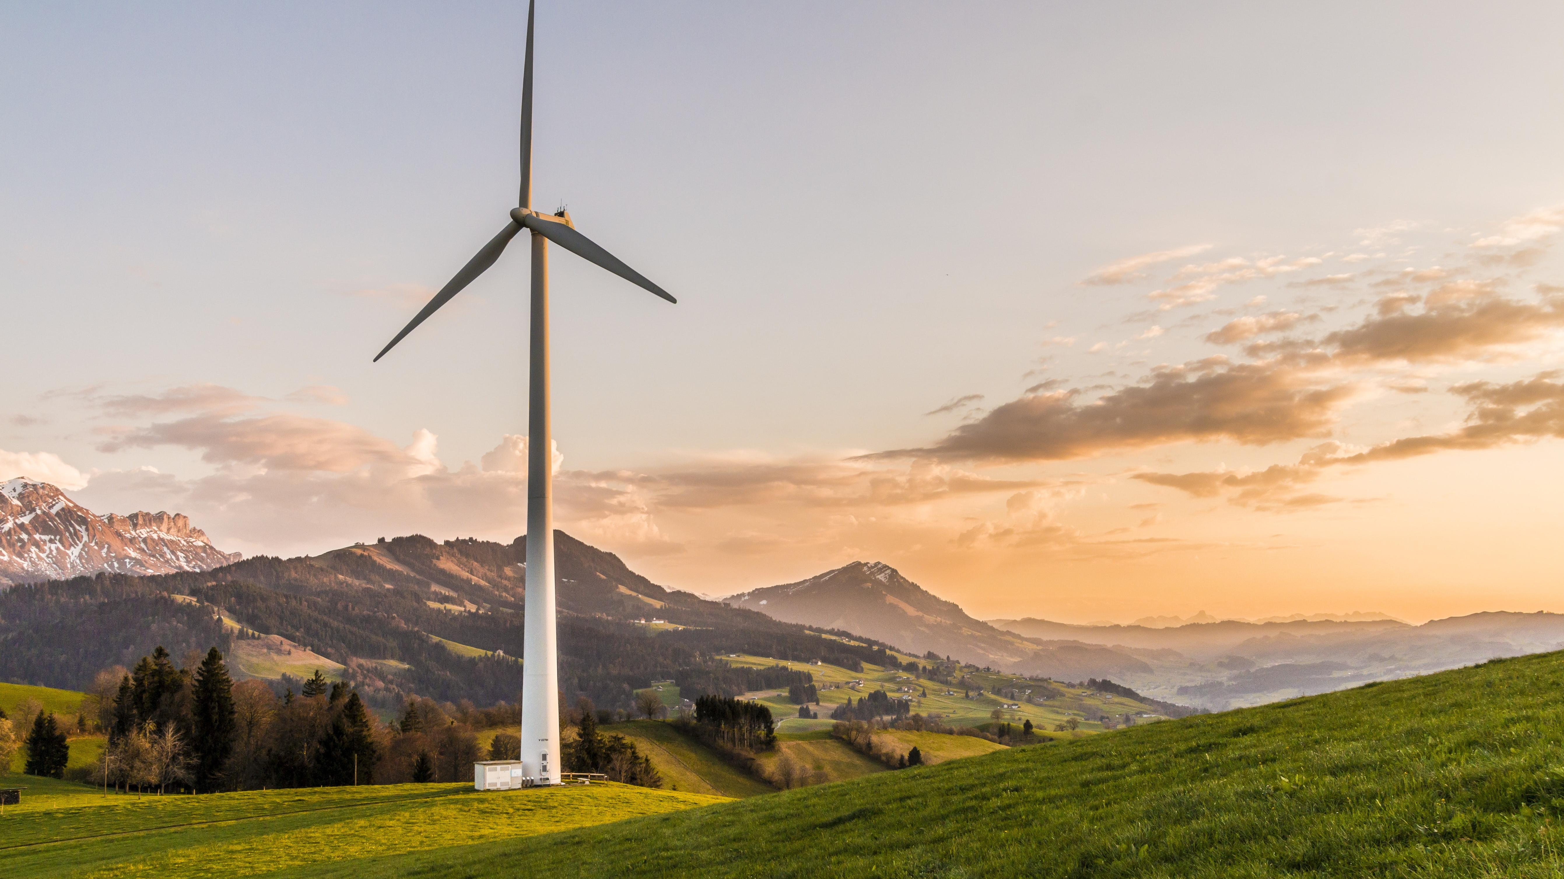
Environmental Ethics
Week 5

Slide 2

“LAST MAN” THOUGHT EXPERIMENT
https://youtu.be/TbtNdlCEqHk?si=4NJG-hbLy24lJyX8&t=465

Slide 3
ROUTLEY’S THOUGHT EXPERIEMENT (1973)
Imagine that humanity is about to disappear. The final human being knows that no other humans will ever exist. Before dying, she decides to destroy the remaining forests, kill the remaining animals, and poison the rivers—not because she needs to, but simply because she can.
Would she be doing something morally wrong? Why or why not? What moral principle did you use to arrive at your answer?

Slide 4
SOME RELEVENT QUESTIONS TO ASK
Who, if anyone, is being wronged?
Does something have to harm a human being in order to be morally wrong?
Can plants, animals, species, or ecosystems matter “for their own sake”?

Slide 5
WHERE DOES YOUR VIEW FIT IN?
Anthropocentrism: Nature matters morally because of its relationship to human beings.
Biocentrism: Individual living things can have moral importance in their own right.
Ecocentrism: Species, ecosystems, or ecological wholes may also have moral value in their own right.

Slide 6
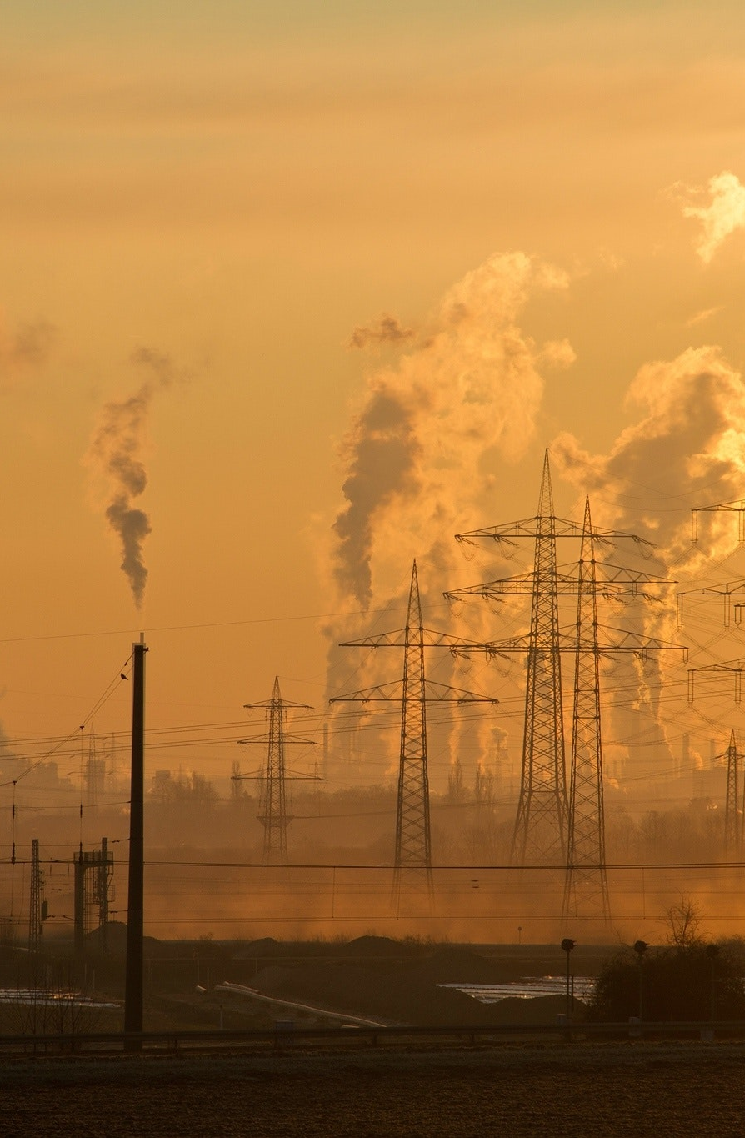
ENVIRONMENTAL ETHICS - OVERVIEW
Usually, ethics concerns questions about what actions are moral or immoral, good or bad, as they concern ourselves or other persons
Environmental ethics asks what moral obligations human beings have concerning the nonhuman world
Underneath familiar policy questions—pollution, climate change, endangered species, conservation—are more basic philosophical questions:
  What non-human things have moral standing, i.e., value for their own sakes or for the sakes of things or persons close to them?
  What has intrinsic value?
  Are species and ecosystems valuable independently of their usefulness to us?
  Do future beings count?

Slide 7
ENVIRONMENTAL ETHICS – a connection to what we know
Utilitarian question: Whose welfare gets counted? Humans only? Sentient animals? Future beings?
Deontological question: Can we have duties concerning things that cannot reciprocate duties? Could destroying a species be wrong even if no person's rights are violated?
Virtue ethics: What would the Last Man’s behavior reveal about his character? Could a virtuous person wantonly destroy the natural world even if no one else would ever suffer from it?

Slide 8
ENVIRONMENTAL ETHICS – why it matters
Most important decisions are made under pressure to ask:
Who counts?
What counts?
How far into the future do we have to care?
Questions about VALUE

Slide 9
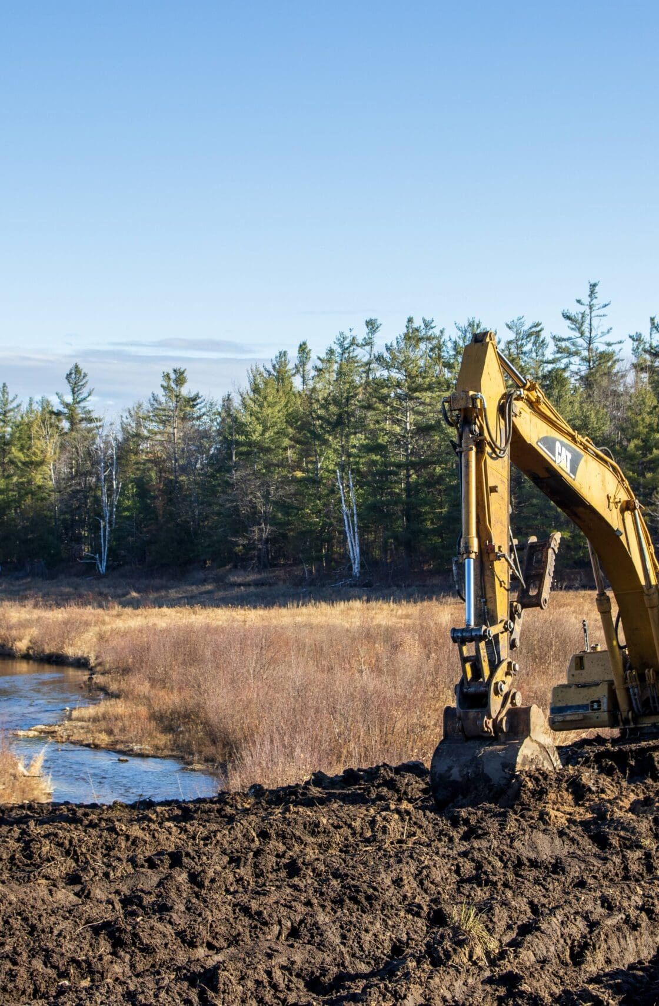
why it matters:
The development decision (Example 1)
Imagine you work for a company planning a new warehouse, manufacturing site, apartment complex, or retail center. There are two possible locations.
Location 1: cheaper but would destroy a wetland or wooded area
Location 2: eco-friendly but costs substantially more
Standing: Who belongs in the decision?
Shareholders?
Employees?
Nearby residents?
Wildlife?
Plants?
The ecosystem itself?
Intrinsic Value: Suppose the wetland provides no obvious recreational or economic benefit to humans. Is that relevant? If it has no human use, does that mean it has no value?

Slide 10
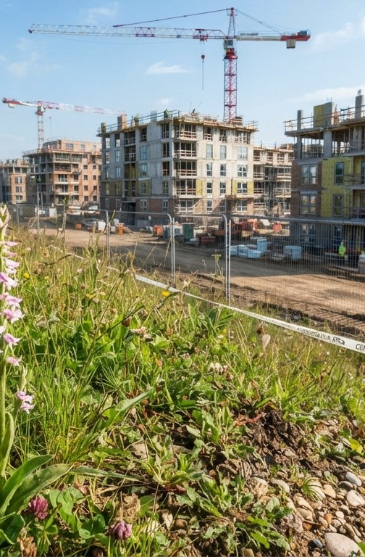
why it matters:
City council (Example 2)
Imagine your city wants to convert an undeveloped area into housing because the community badly needs affordable homes. The land is also habitat for a locally rare species of plant or animal.
Should the existence of the species itself count as a reason against development, or only the effects its disappearance would have on people?
Again, the moral standing question! Does the species have intrinsic value?
What if preserving the habitat means 200 families will have fewer affordable housing options?
Not “people who care about nature versus people who don’t”
Is a genuine moral conflict between different kinds of value
How do we decide?

Slide 11
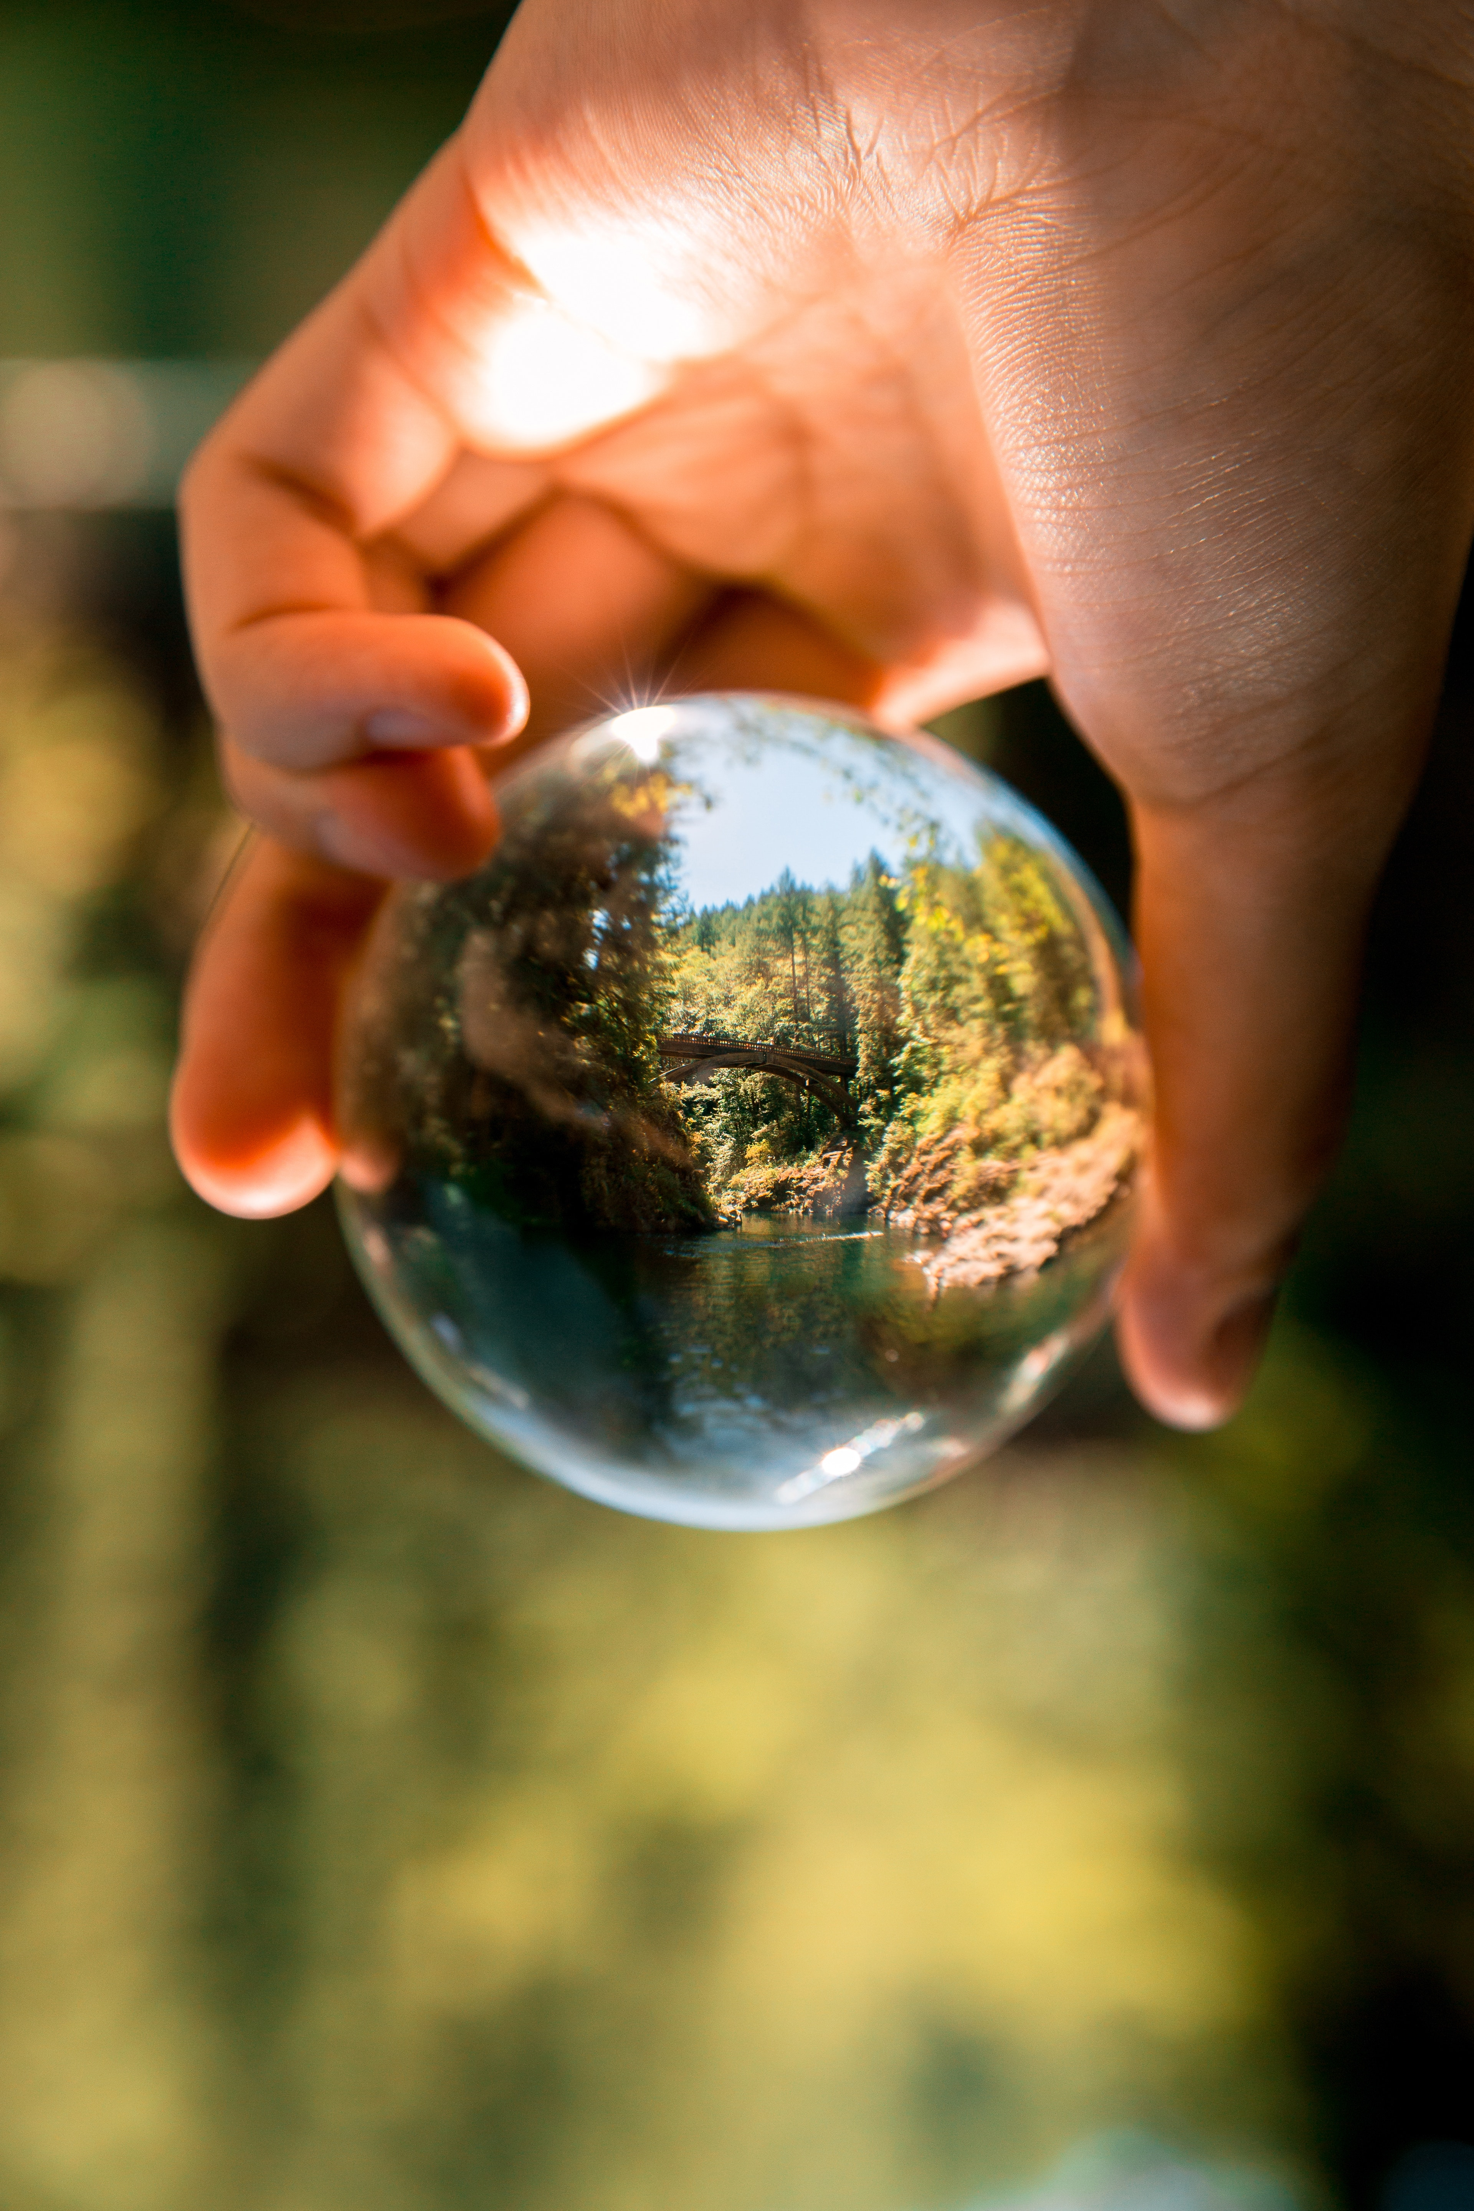
Attfield – Chapter 1 – Main Ideas
Environmental ethics emerged when human beings came to recognize
  the vulnerability of natural systems to human activity
  the inadequacy of an ethics concerned exclusively with human interests
Anthropocentrism—the idea that nature is valuable only for its contribution to human well-being—is challenged
Who, and what, has intrinsic value, and thus moral standing
Do ecosystems themselves possess moral value?
Do future interests count? To what degree?

Slide 12
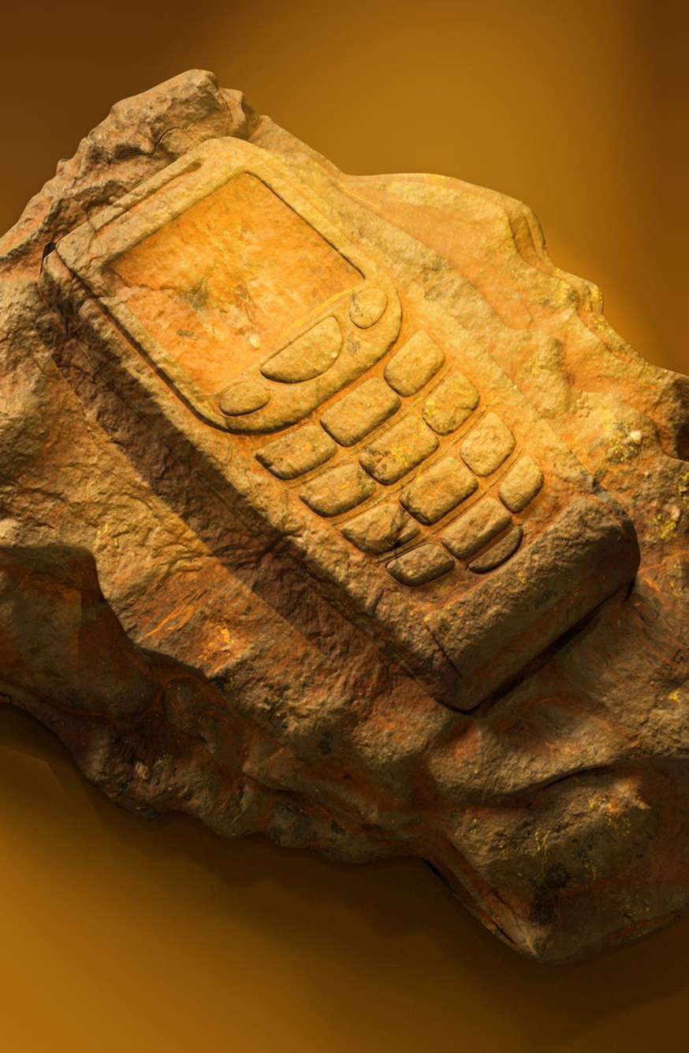
The Anthropocene
Human activity has become a predominant influence on Earth’s systems the
Disagreement about when the Anthropocene began
  seafaring and worldwide human dispersal?
  Industrial Revolution?
  twentieth-century warfare and industrial activity?
Disagreement too about its normative implications:
  Maybe nature can no longer meaningfully be preserved
  Maybe humans are now entitled to deliberately redesign the planet
  Maybe our technological abilities create responsibilities to restore damaged environments

Slide 13

https://form.jotform.com/262467673214158

