Slide 1
Roadmap to Financial Success for Entrepreneurs
By
Alex Barrón
& Jorge Zavala

Slide 2
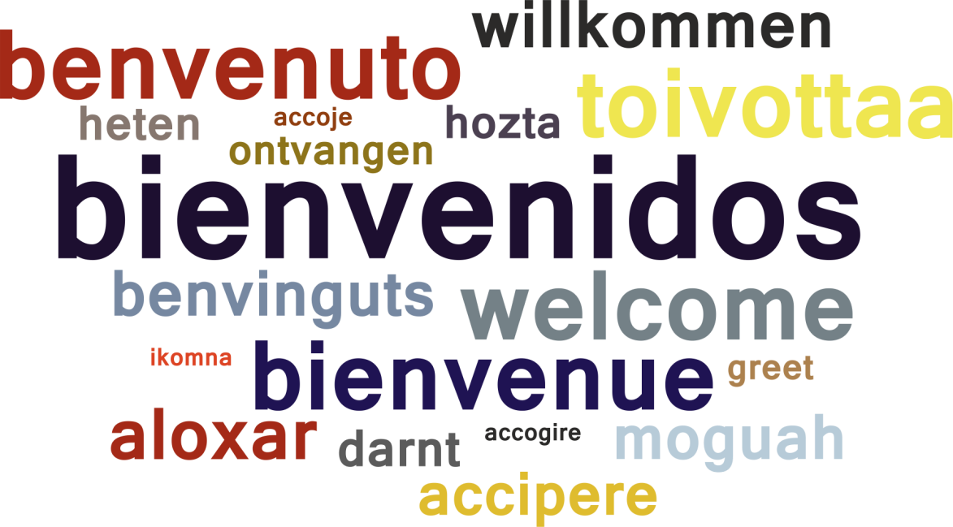
Welcome!
We want to welcome you to the Roadmap to Financial Success for Entrepreneurs!

Slide 3
Who is Alex Barrón?
Origin
Born in El Paso, TX 1973. Lived in Cd. Juárez, Mexico, El Paso, TX and Bay Area, CA
Education – 1990-2001
1990 – Agape Christian Academy
1995 – UTEP 4.0 GPA Civil Engineering, Top 10 Senior
1996 – Stanford University – M.S. Structural Engineering
2001 – Stanford University – Eng. Construction Mgmt
Wall Street Career – 2001-Present
2001-2003 - Franklin Templeton Investments
2004-2007 - JMP Securities
2007-2009 - Agency Trading Group
2010- Present - Housing Research Center LLC
2017 – Present – Diamond Crest Capital LLC
President & Founder
2013 - Dare to Dream Foundation
2014 - Options 12 Investment Club LLC
2014 - Financial Freedom & Success Institute LLC
Interests
Finances & Investments, Personal Development
Compassionate Capitalism, Financial Freedom,
Exotic Cars, Traveling, Music, Dancing
Personal Motto – “Dare to Dream!”

Slide 4
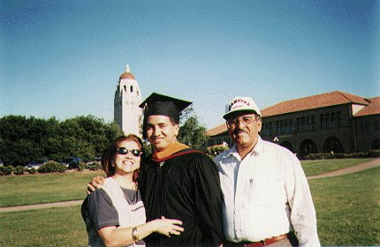
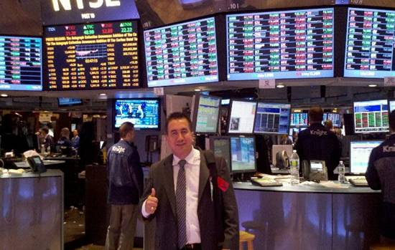
Alex Barrón’s Story
Graduate → Employee → Entrepreneur → Investor
Graduate at UTEP, Stanford
Wall Street Employee -> Entrepreneur
Born in El Paso, TX 1973.
Agape Christian Academy – High School, 1990
UTEP – Civil Engineering, Top 10 Senior, 4.0 GPA
Stanford University – Masters, 1996, Eng. 2001
Franklin Templeton Investments: 2001-2003
JMP Securities: 2004-2007
Agency Trading Group: 2007-2009
Housing Research Center: 2010 - Present
Diamond Crest Capital: 2017-Present

Slide 5
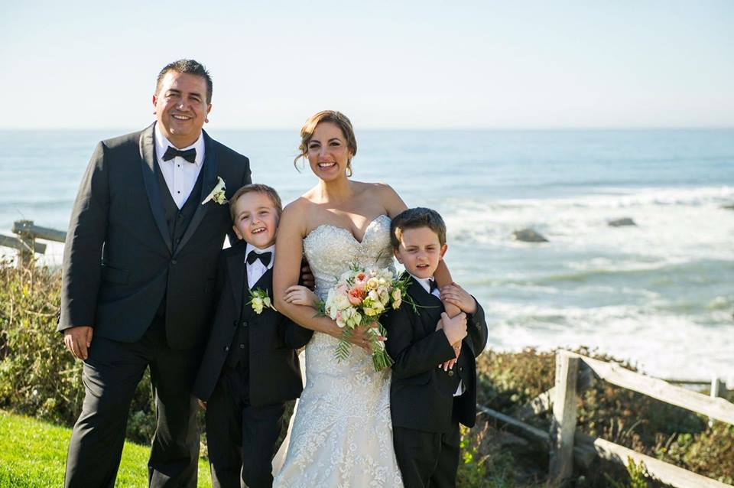
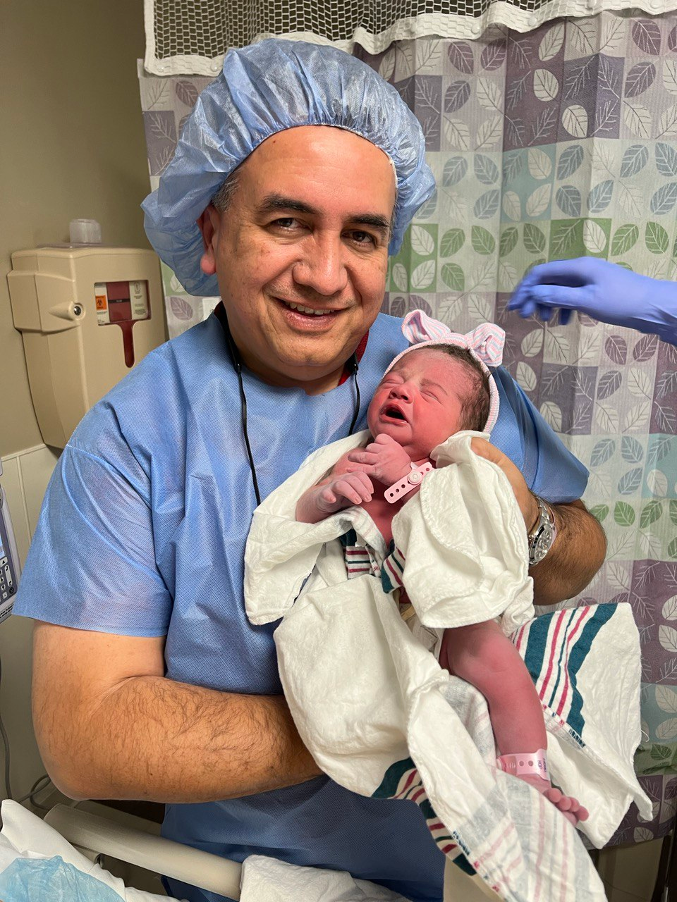
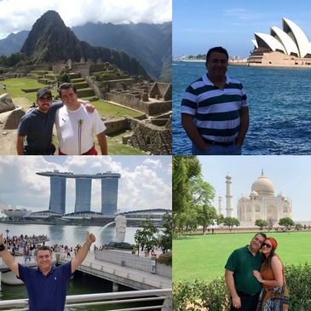
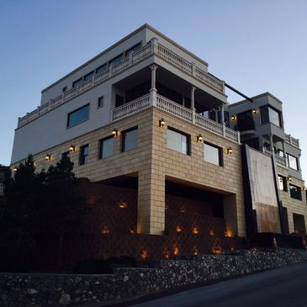
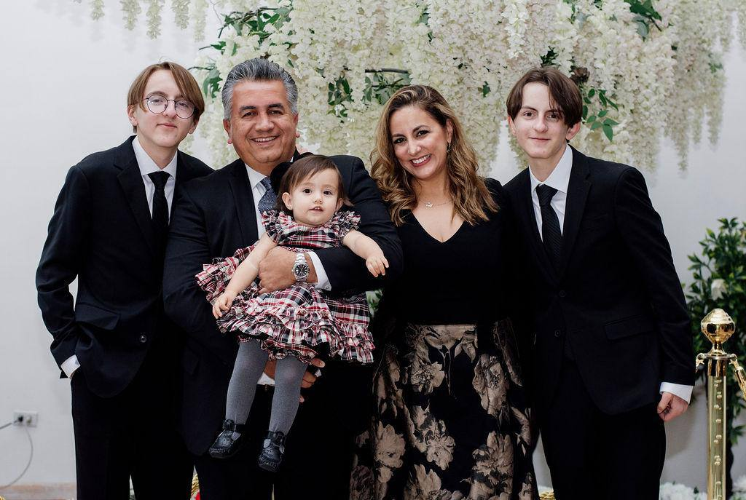
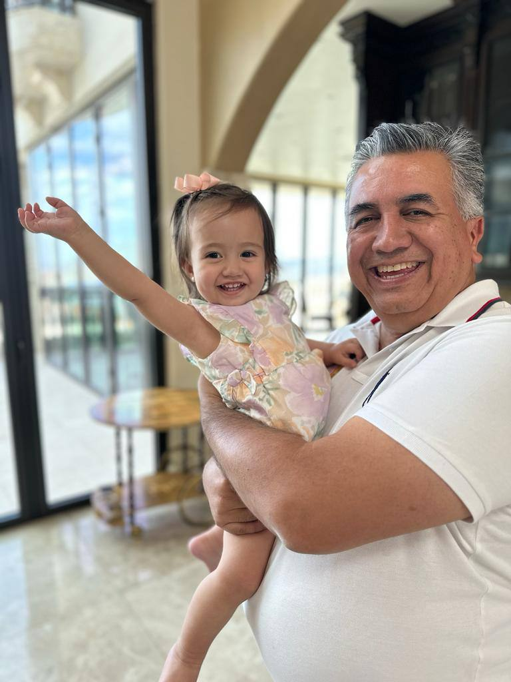
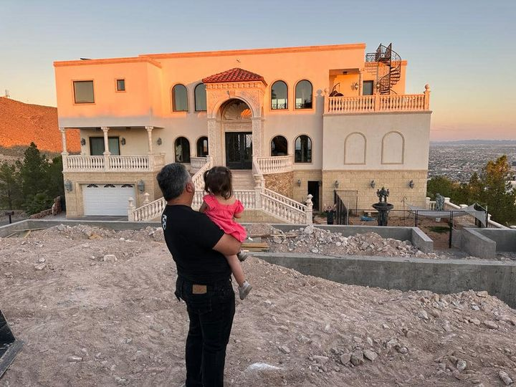
Alex Barrón’s Story
Family Man with a Great Vision to Reach Life Goals
Passions in Life, Goals Achieved
Family Man
Proud Son, Loving Husband, Happy Father
Travelled the World (over 50 countries), Own Exotic Cars since age 35, Built Dream Home at 40 – 10,000 SF

Slide 6
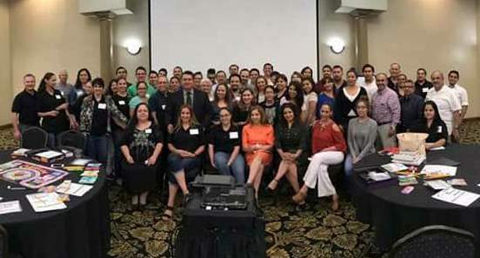
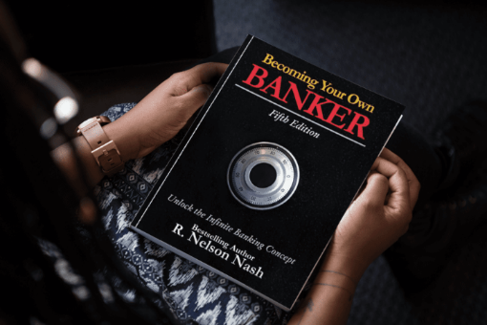
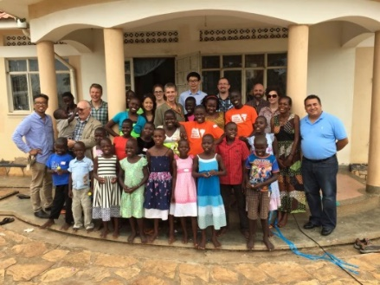
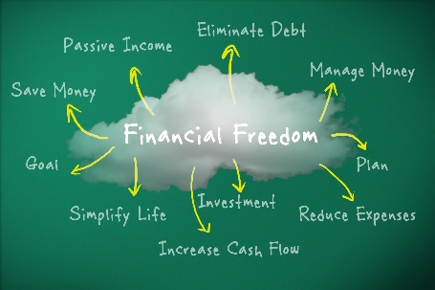
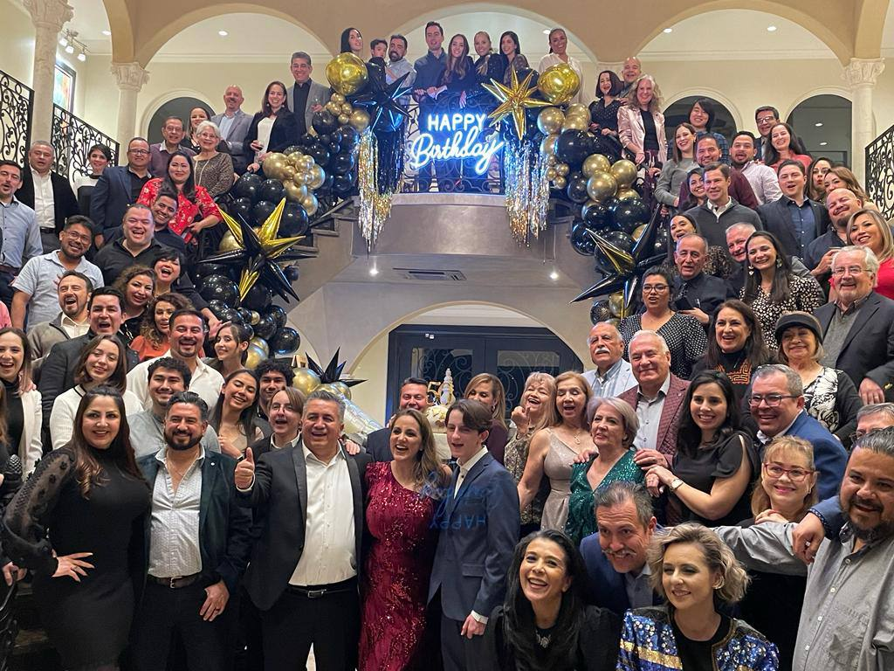
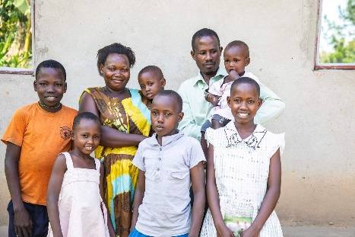
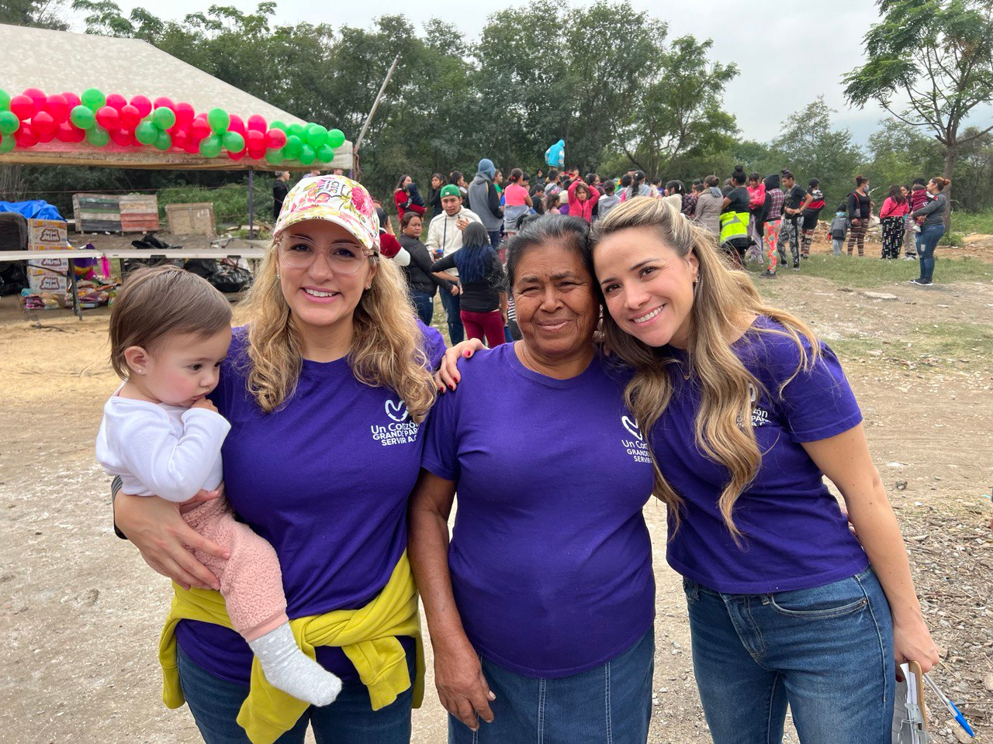
Alex Barrón’s Story
Christian Capitalist on a Mission and Destiny
Share Financial Freedom and Success Principles with the World
Fulfill the Great Commission and help Children Escape Poverty
Financial Freedom & Success Institute
Options 12 Investment Club
Bank on Yourself Professional, Wealth Heritage
Teach Financial Freedom, Teach Entrepreneurship
University of Success, Success Conference Cruise
Dare to Dream Foundation
Fulfill the Great Commission, Compassionate Capitalism,
Help Poor Children, Bring Education,
Personal Motto – “Dare to Dream!”

Slide 7
Who is Jorge Zavala?
Born in Mexico City, 1955. Lived in Cuernavaca, Morelos, Mexico - Waterloo, Ontario, Canada – San Jose, California
Education – 1974-1984
1977 – La Salle University -- Electronic Engineering
1984 – University of Waterloo – Master in Computer Science
Professional Career – 1977 - 2012
1977 – 1984 – Electrical Research Institute
1984 – 1986 – Sidetec Electronica
2005 – 2012 – TechBA Technology Business Accelerator
2015 – Professor, Hult International Business School
2016 – 2021 – Professor, Universidad Panamericana
President & Founder
1986 – Ingenieria Computacional para el ser Humano
1998 – Kiven
2012 – Kinnevo, Inc
2022 – Latteware, Inc
Interests
2013 – Red Global de Mexicanos
2020 – www.quieroaprendera.com
2015 – Mentoring in Stanford – LBAN/SLEI
2022 – Board Member Hacker Dojo

Slide 8
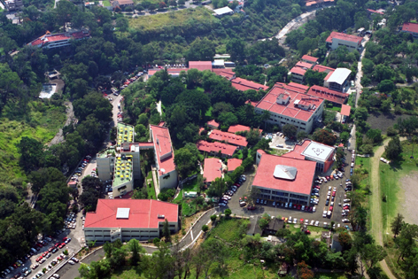
Jorge Zavala’s Story
Graduate → Employee → Entrepreneur → Mentor
Graduate at La Salle University, Mexico
Employee -> Entrepreneur
Born in Mexico City in 1955.
Lived in Cuernavaca, Morelos, Mexico.
1977 – La Salle University, Mexico -- Electronic Engineering
1984 – University of Waterloo – Master in Computer Science
1977 – 1984 – Electrical Research Institute
1984 – 1986 – Sidetec Electronica
1986 – 1998 – Ingenieria para el ser humano
1998 – 2003 – Kiven
2005 – 2012 – TechBA Technology Business Accelerator
2015 – Professor, Hult International Business School
2016 – 2021 – Professor, Universidad Panamericana

Slide 9
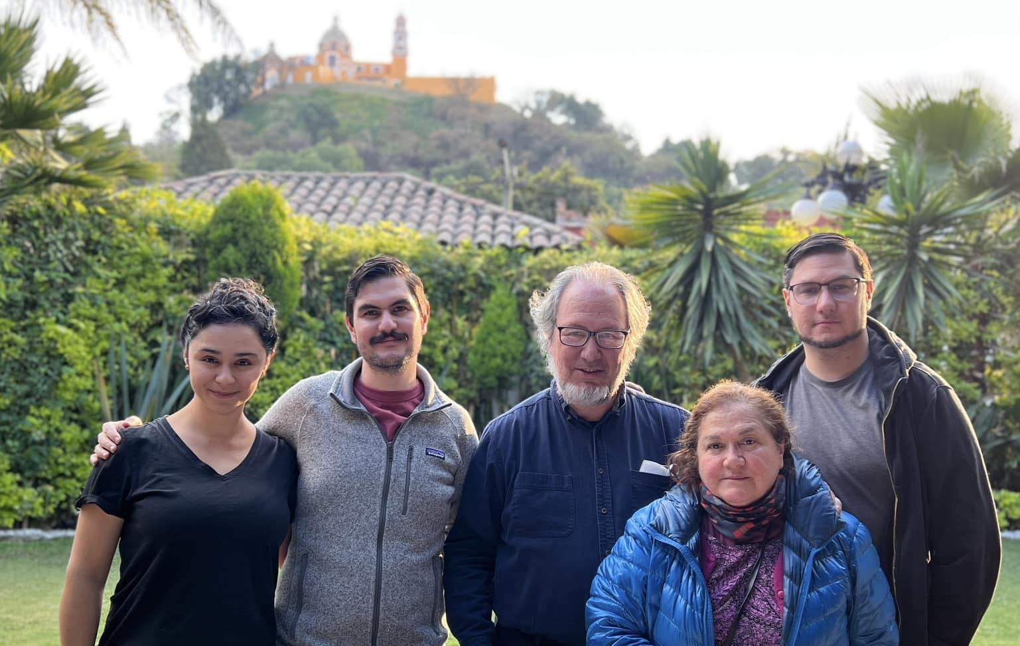
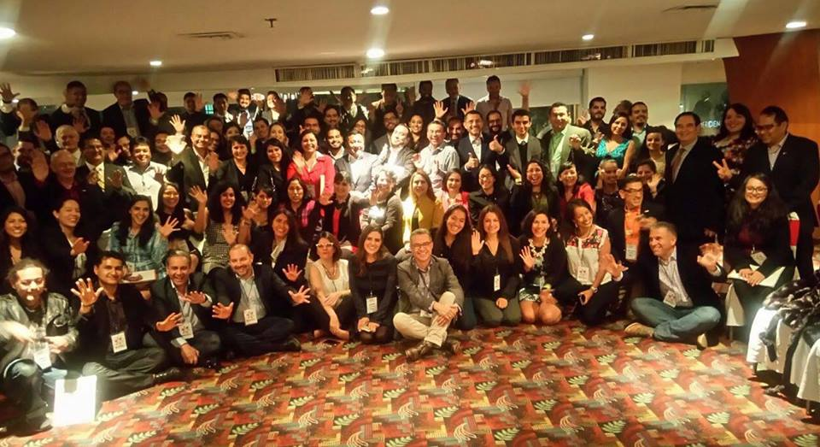
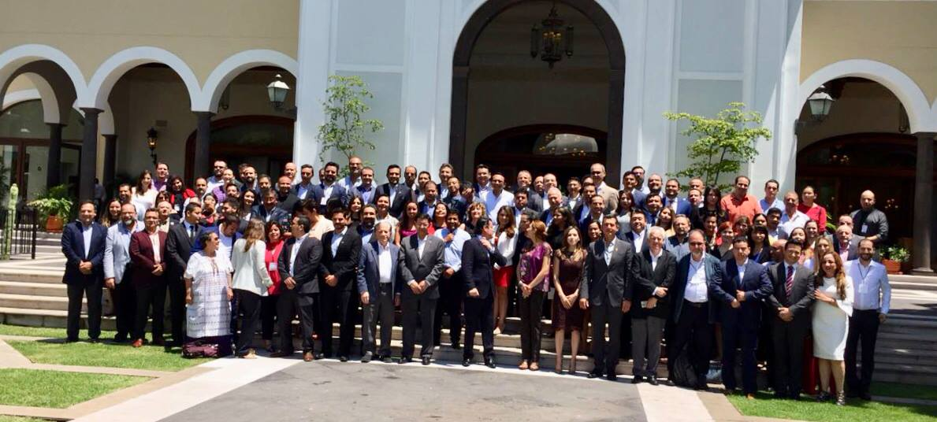
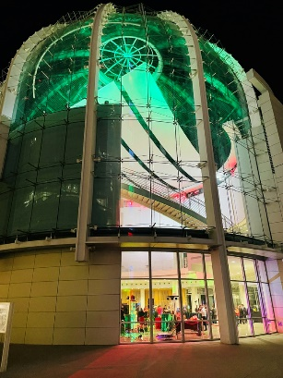
Jorge Zavala’s Story
Family Man with a Great Vision to Reach Life Goals
Passions in Life, Goals Achieved
Family Man
Son, Husband, Father
Mexican Diaspora Integration in 34 countries
Supporting 700+ companies in TechBA

Slide 10
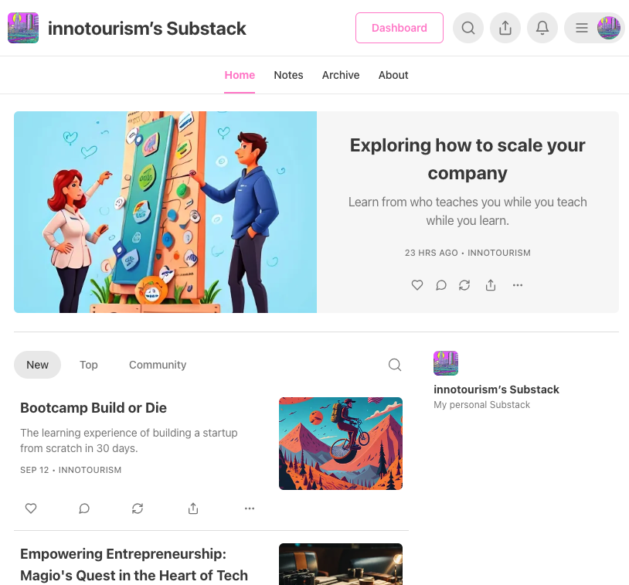
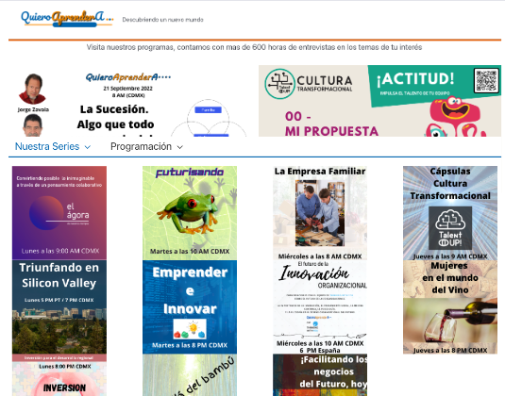
Jorge Zavala’s Story
Purpose and Goals
Sharing Worldwide experiences among entrepreneurs and innovators
Professionals converting ideas into a business.
Tourism of Innovation http://innotourism.co
www.quieroaprendera.com

Slide 11
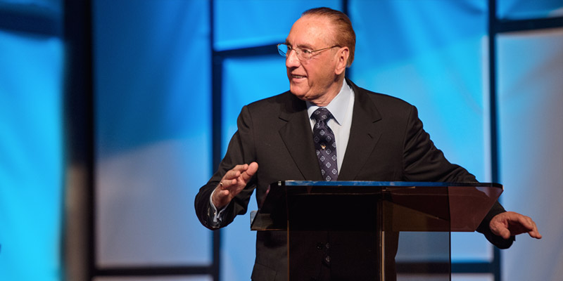
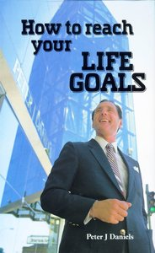
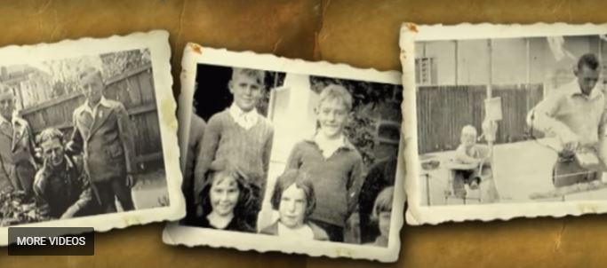
How it All Began?
Alex attended Success Seminar by Peter J. Daniels - 1994
From illiterate poor bricklayer at age 26 to multi millionaire real estate businessman at age 38!
How did he do it???
www.peterjdaniels.org

Slide 12
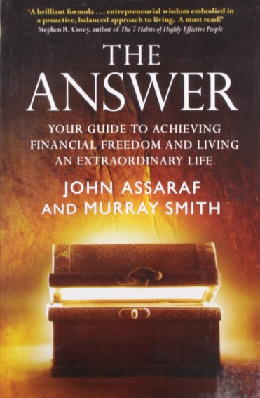
I Started Investing in Myself

Slide 13
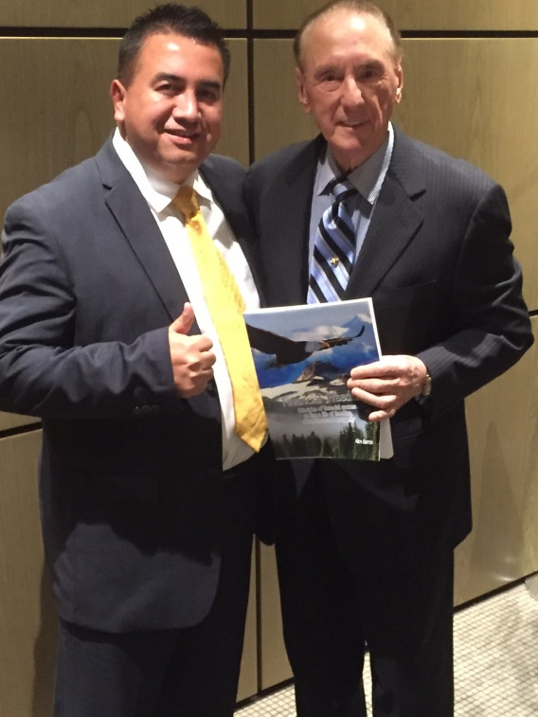
After 20 Years of Study

Slide 14
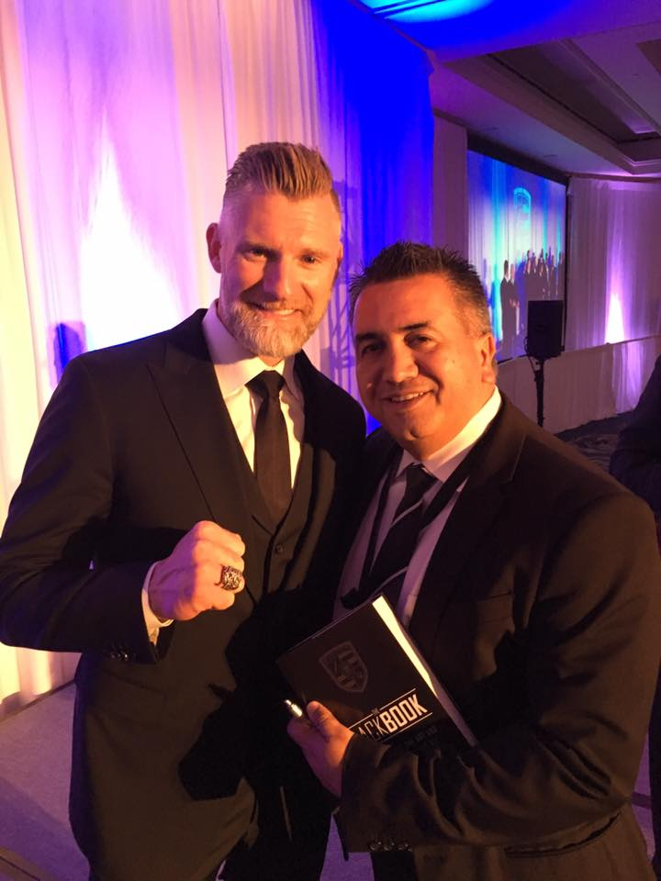
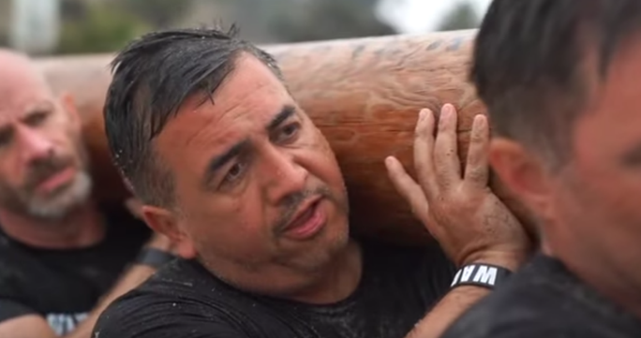
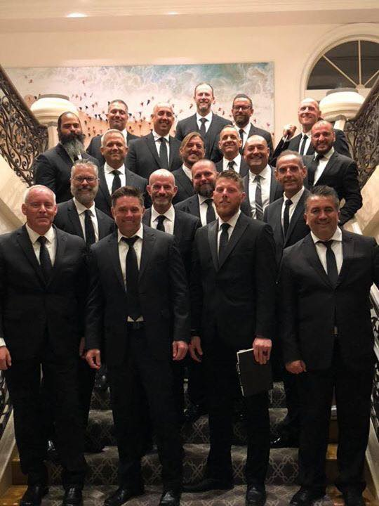
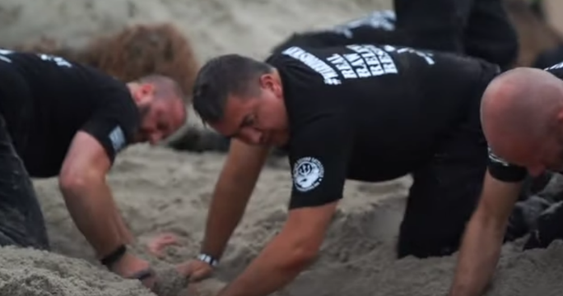
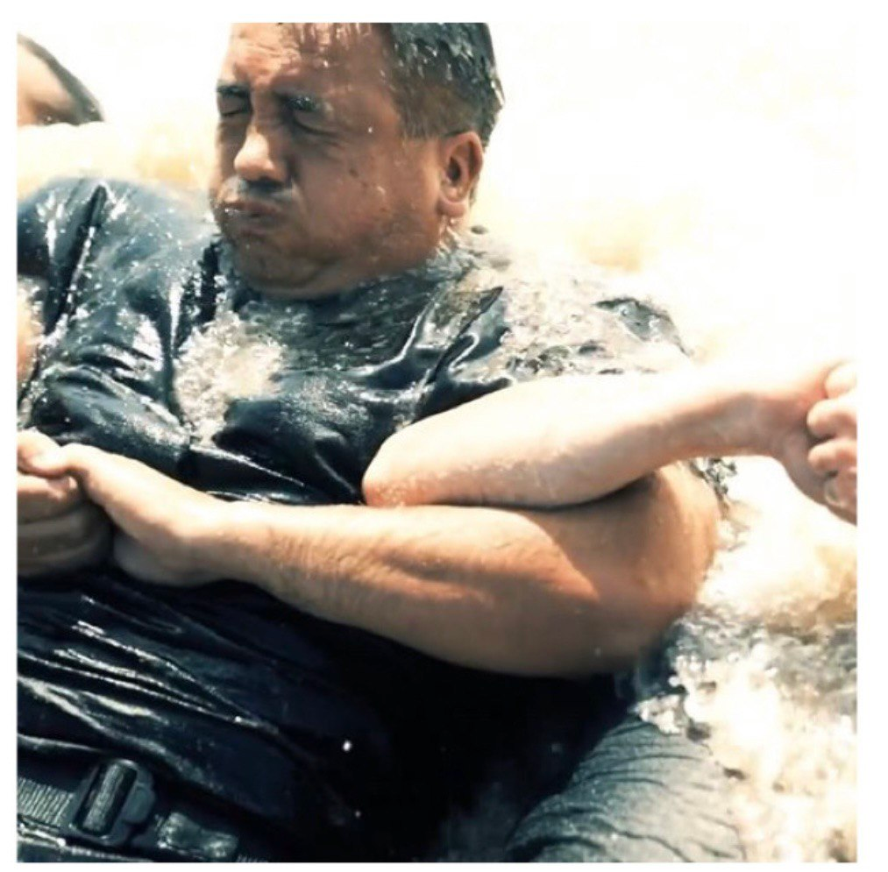
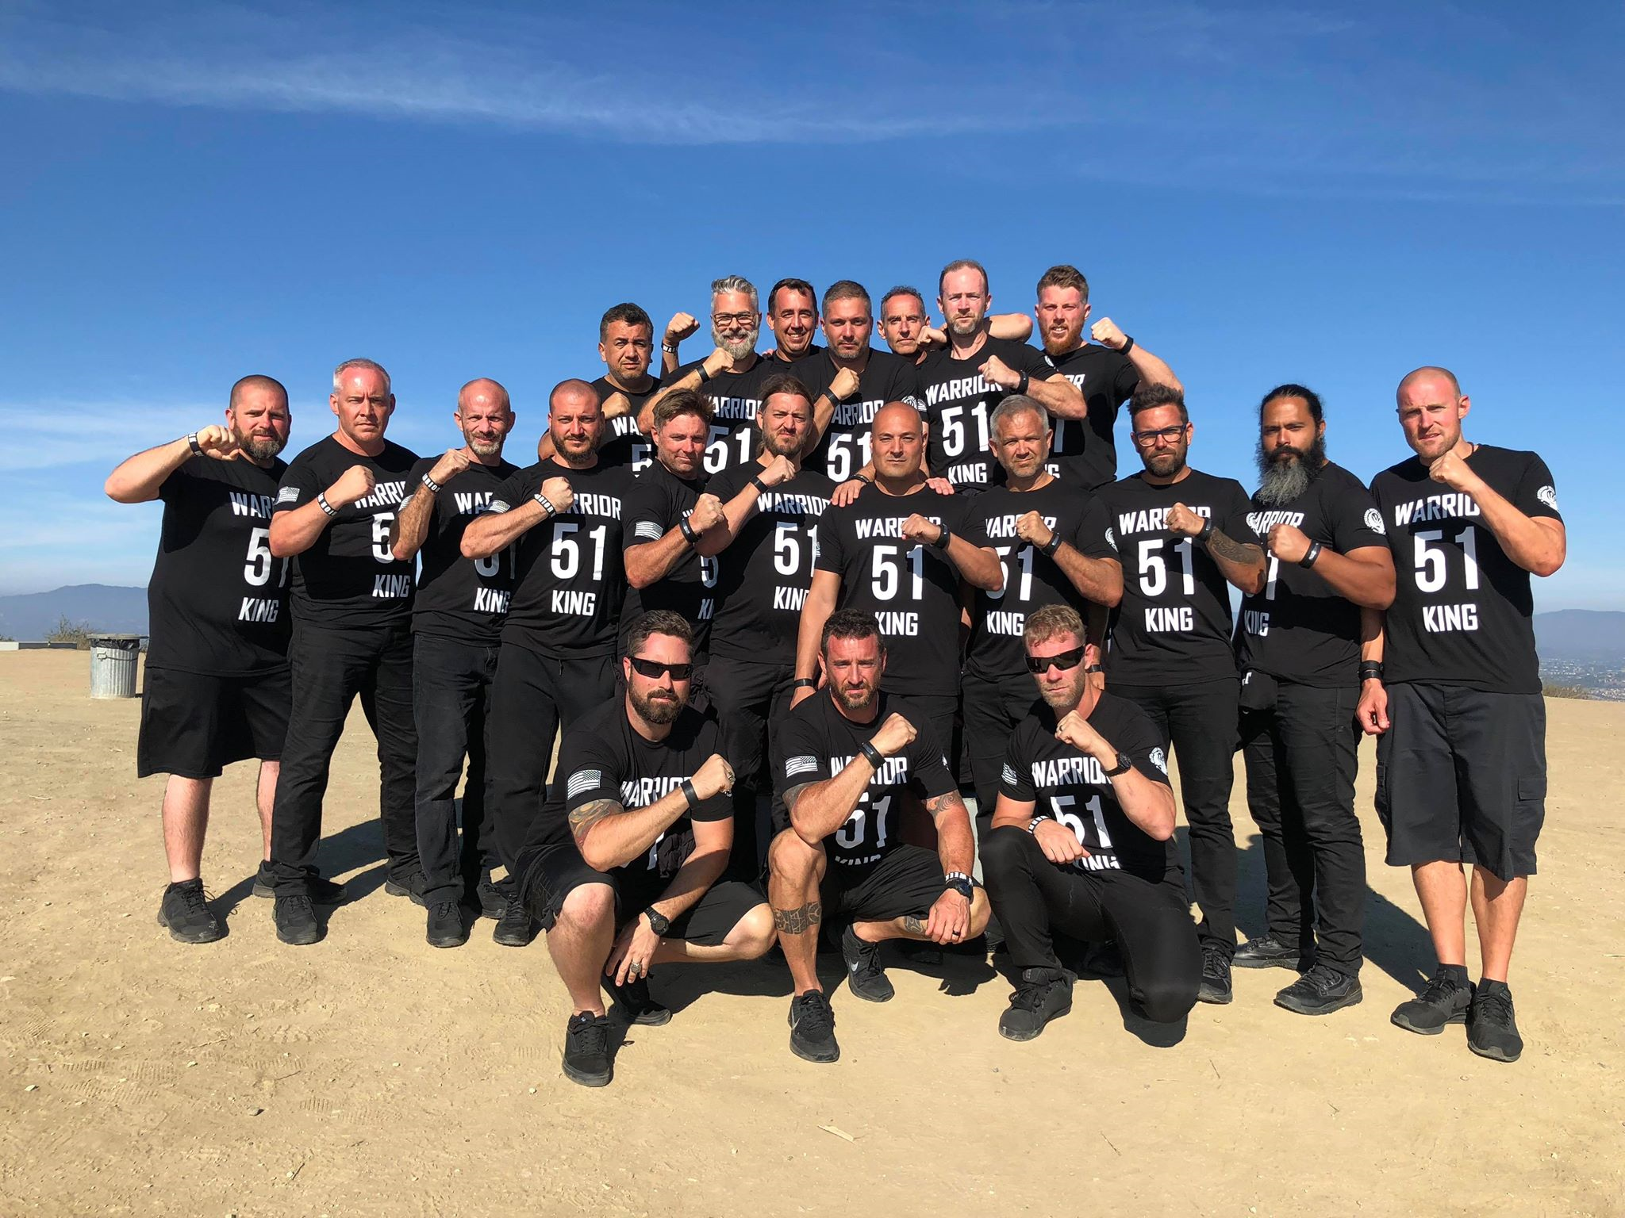
Warrior Week 51 Graduate

Slide 15
Financial Freedom Seminar Began in 2012

Slide 16
What is Roadmap to Financial Success for Entrepreneurs?
Roadmap to Financial Success for Entrepreneurs is:
A Manifesto of how Business and Entrepreneurship can help you achieve all your goals in life and enable you to change the world.
A Framework of how money works to help you manage your money better.
A System to help you take control of your finances.
A Mindset to help you make better financial decisions.
A Formula to help you Get out of Debt ASAP, Become Your Own Bank, and save you tens or hundreds of thousands of dollars!
A set of Tools to help you figure out how to achieve your financial goals and measure your progress.
A Roadmap of How to Achieve Financial Freedom and Financial Success, step by step!

Slide 17
Who is this For?
This course is for anyone who:
Wants to start a business
Has already started a business
Wants to maximize their chances of financial success and minimize chances of failure
Wants to reach their financial goals
Wants to exit the rat race of life
Wants to leave scarcity behind and wants to grow their wealth consistently to reach prosperity

Slide 18
How This Can Help You
Without Financial Education
No Control Over Money
Driving without a dashboard
Without a GPS, at random.
1.) Don’t know where you are.
2.) Don’t know where you are going.
3.) Don’t know how to get there.
4.) No idea how fast you are going.
5.) No idea how much gas you have left.
6.) Don’t know how far you have traveled.
7.) No visibility how much longer it will take to reach your destination.

Slide 19
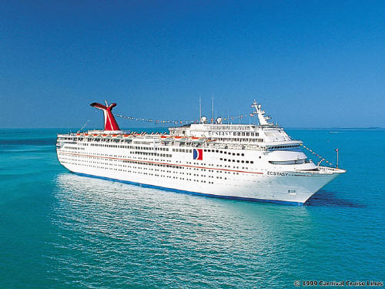
How This Will Help You
After Roadmap to
Financial Success
With Financial Education
Drive WITH a dashboard & GPS – You are the Captain of your Cruise ship.
1.) Know where you are.
2.) Know where you are going.
3.) Know how to get there.
4.) Know how fast you are going.
5.) Know how much gas is left.
6.) Know how long it will take to get there.
7.) Have greater clarity about your numbers and direction.

Slide 20
How This Will Help You
After Roadmap to
Financial Success
Without Financial Education

Slide 21
The Possibility RoadMap From Financial Slavery to Freedom & Success
+$
LEGACY!
Fundation
FREEDOM!
Enjoy it All, Share with Others
Impact
Wealth Heritage
PROSPERITY!
Become Your Own Bank
Risk and Grow
Business
Investments
Financial Freedom!
Passive Income > Expenses
The Debt Trap!
18
Critical Decisions!
65
time
ABUNDANCE!
Invest in Yourself
Save
Get out of Debt
Financial Security!
Debt Free!
Net Interest = 0
Financial Slavery!
Net Income < 0
Traditional Solution?
-$
The Pit of Desperation
Pay Yourself First!
Net Income > 0

Slide 22
What is the Value?
Upon completing this course you will receive the following:
Life lessons from 2 successful entrepreneurs learned over 50 years of combined business experience.
Clear Understanding of how Money works.
Frameworks to better manage your Business and ensure Success.
Ability to make better Decisions in life.
Certainty that you are exchanging your life for something of lasting value and permanence to leave a legacy.
Clarity of the Direction you are taking.
Confidence to achieve your Goals and Life Vision.
Happier personal, marriage, family and spiritual life.
Value: At least $10,000

Slide 23
What is the Investment?
There are 4 investments you need to be ready to make:
Time: 10 Weeks – 2 Hours of Class Time
Energy: Complete Homework Assignments – the more you put in, the more you get out
Money: $2,500 or 3 payments of $900/mo or 12 payments of $250/mo
Coaching: 3 x 1-Hour Coaching Sessions 1:1
The Return?: A minimum of 10X return in 1 year.

Slide 24
What is the Guarantee?
If you are not satisfied or feel at anytime that you did not get the value you expected, simply ask for a 100% refund for up to 1 year.
No questions asked.
100% Satisfaction guarantee.

Slide 25
Financial Freedom & Success Institute
Founded in 2014 by Alex Barrón
Slogan: “¡Dare to Prosper!”
Web: alexbarron.com/
Facebook: https://www.facebook.com/daretoprosper1/
Twitter: @daretoprosper
Telephone: (415) 425-6434
Email: abarron@alexbarron.com
Office: 15 Diamond Crest, El Paso TX 79902

Slide 26
Testimonials
“Very motivating – you think differently about how to manage your money to reach your goals”
“Worth the investment of time – 100% recommended.”
“Everyone should take this seminar.”
“Excellent seminar – very profound but practical.”
“The best investment of your time!! You will get a great return on your investment.”

Slide 27
Our Seminars
Our purpose is to share Financial Freedom thru Educational seminars to help people fulfill their calling and live the life they always dreamed of.
Financial Seminars
Personal Development
1.) Financial Freedom Seminar
2.) Financial Security Seminar
3.) Financial Success Seminar
4.) Wall Street Investments Seminar
1.) University of Success
2.) Annual Success Conference Cruise
3.) Destiny of the 3rd Millennium
4.) Millionaire with a Purpose

Slide 28
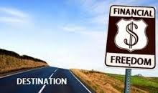
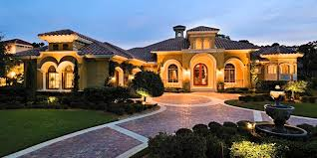
Are you Ready to Get on the Road to Your Financial Success?

Slide 29
Questions?

