Slide 1


Roadmap to Financial Success for Entrepreneurs
By
Alex Barrón
& Jorge Zavala

Slide 2

¡YOUR FINANCIAL STATEMENTS!

Slide 3
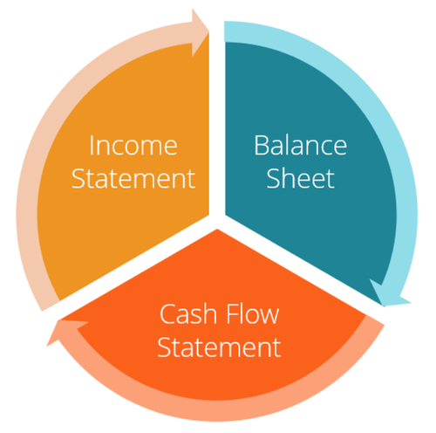
3 Key Financial Statements
There are 3 key financial statements::
1.) Balance Sheet
2.) Income Statement
3.) Cash Flow Statement

Slide 4
Balance Sheet
+ ASSETS (What I Have)
- LIABILITIES (What I Owe)
============
= NET WORTH (What I Own)

Slide 5
ASSETS – 3 Types
+ ASSETS (What I Have)
Intangible
Financial
Purchases

Slide 6
ASSETS – Intangible
+ ASSETS (What I Have)
Intangible
  My Self
    Formal Education
    Positive Attributes (personality, character, mentality, attitude, values, initiative, etc)
    Success Education (dreams, desires, vision, commitment, goals, purpose, plans, etc.)
    Financial Education (how money works, how to get out of debt, how to invest, etc)
    Business Education (promotion, marketing, sales, negotiating, managing, being a leader)
  My Family
    Spouse (life partner, love, harmony, trust, peace, support, etc)
    Children (love, motivation, inspiration, desire to provide, protect, inheritance, etc.)
Financial
Purchases

Slide 7
ASSETS – 3 Types
+ ASSETS (What I Have)
Intangible
Financial
  Job
  Bank accounts
  Reserves
  Life insurances
  Business
  Investments
  Real estate
Purchases

Slide 8
ASSETS – 3 Types
+ ASSETS (What I Have)
Intangibles
Financial
Purchases
  House
  Cars
  Furniture
  Clothing
  Jewelry
  Art
  Holidays
  Books
  Collectibles

Slide 9
LIABILITIES – 3 Types
- LIABILITIES (What I Owe)
Bad Debts
“Good” Debts
Debts “To Myself”

Slide 10
LIABILITIES – 3 Types
- LIABILITIES (What I Owe)
Bad Debts
  Personal loans
  Credit cards
  Car Loans
  Home Mortgage
“Good” Debts
Deuda “A Ti Mismo”

Slide 11
LIABILITIES – 3 Types
- LIABILITIES (What I Owe)
Bad Debts
“Good” Debts
  Student loan
  Business Loan
  Investment Loan
  Real Estate Loan
Debts “To Myself”

Slide 12
LIABILITIES – 3 Types
- LIABILITIES (What I Owe)
Bad Debts
“Good” Debts
Debts “To Myself”
  Policy Loans

Slide 13
Income Statement
+ INCOME (What I Make)
- EXPENSES (What I Spend)
============
= NET INCOME (What is Left)

Slide 14
INCOME – 3 Types
+ INCOME (What I Make)
Intangibles
Active Income
Passive Income

Slide 15
INCOME – Intangibles
+ INCOME (What I Make)
Intangibles
  My Self
    Formal Education
    Positive Attributes (personality, character, mentality, attitude, values, initiative, etc)
    Success Education (dreams, desires, vision, commitment, goals, purpose, plans, etc.)
    Financial Education (how money works, how to get out of debt, how to invest, etc)
    Business Education (promotion, marketing, sales, negotiating, managing, being a leader)
  My Family
    Spouse (life partner, love, harmony, trust, peace, support, etc)
    Children (love, motivation, inspiration, desire to provide, protect, inheritance, etc.)
Financials
Purchases

Slide 16
INCOME – 3 Types
+ INCOME (What I Make)
Intangible
Financial
  Job
  Bank accounts
  Reserves
  Life insurances
  Business
  Investments
  Real estate
Purchases

Slide 17
INCOME – 3 Types
+ INCOME (What I Make)
Intangibles
Financial
Purchases
  House: Roof, Home, Roots
  Cars: Transportation, Luxury, Fun
  Furniture: Comfort
  Clothing: Identity, Looks
  Jewelry: Luxury, Beauty, Prestige
  Art: Pleasure, Beauty, Inspiration
  Holidays: Fun, Adventure
  Books: Knowledge
  Collectibles: Satisfaction

Slide 18
EXPENSES – 9 Types
- EXPENSES (What I Spend)
Taxes – To the Government
Interest - To Banks
Premiums - Insurance Companies
Housing – To Businesses
Home - To Businesses
Utilities - To Businesses
Car - To Businesses
Discretionary - To Businesses
Giving - to the Church, Non-Profits (non-profit organizations)

Slide 19
EXPENSES – 9 Types
- EXPENSES (What I Spend)
Taxes – To the Government
Interest - To Banks
Premiums - Insurance Companies
Housing – To Businesses
Home - To Businesses
Utilities - To Businesses
Car - To Businesses
Discretionary - To Businesses
Giving - to the Church, Non-Profits (non-profit organizations)

Slide 20
EXPENSES – 9 Types
- EXPENSES (What I Spend)
Taxes – To the Government
Interest - To Banks
Premiums - Insurance Companies
Housing – To Businesses
Home - To Businesses
Utilities - To Businesses
Car - To Businesses
Discretionary - To Businesses
Giving - to the Church, Non-Profits (non-profit organizations)

Slide 21
The Relationship Between
Financial Statements
BALANCE SHEET
INCOME STATEMENT
+ ASSETS (What I Have)
- LIABILITIES (What I Owe)
============
= NET WORTH (What is Mine)
+ INCOME (What I Make)
- EXPENSES (What I Spend)
============
= NET INCOME (What is Left)

Slide 22



Questions? Comments?

