Slide 1

RetireMax Secure 5
The Security You Have Been Looking For

Slide 2



Typical Safe Money Options
Under the Mattress
Standard Savings Account
Certificate of Deposit (CD)
PROS
Location is known
Easily accessible
PROS
Many banks to choose from
Easily accessible
PROS
Better interest than savings account
CONS
Does not grow
Lower back issues from sleeping on a lump
CONS
Low or no interest earned
Easy to transfer to spending account
CONS
No liquidity without substantial penalty
Earned interest is taxable in each year

Slide 3

What the Customer is Looking For
Known Rate
Known Term
Known Outcome

Slide 4

RetireMax Secure 5 Delivers
5-Year Multi Year Guaranteed Annuity (MYGA)
Interest rate is guaranteed for first 5 years
          Renews annually thereafter, guaranteed no less than 1.8%¹
Complete safety, premium paid and interest earned is not exposed to the market
No fees
10% penalty free withdrawal beginning year 2
5.15%¹
Guaranteed!
Interest grows tax deferred
Nursing Care and Terminal Illness rider available
in approved states
1 Rates as of October 14, 2022. Subject to change without notice

Slide 5





5 Reasons to Have a Single Premium Deferred Annuity (SPDA) SPDA
1
Securing your retirement
2
Guaranteed rate for 5 years
3
Tax-deferred growth
4
Never lose a penny of your deposit!
5
Access to your money*
* Withdrawals in year 1 and above 10% of the accumulated value in years 2-5 are subject to withdrawal charges

Slide 6


Jumbo CD vs. RetireMax Secure 5
Growth of a $100,000 contribution after 5 years
RetireMax Secure 5
at 5.15%²
$128,543
Jumbo CD
at 3.5%¹
$113,514
1 Assumes a 5-year jumbo CD rate of 3.5% (best available rate as of October 2022 from a nationally known bank); net after taxes; 28% tax bracket
2 Assumes current rate of 5.15% for 5 years, tax-deferred, before tax value. Earnings in a non-qualified annuity are subject to ordinary income tax upon distribution. Withdrawals prior to age 59 ½ may be subject to a 10% Federal Tax Penalty.

Slide 7

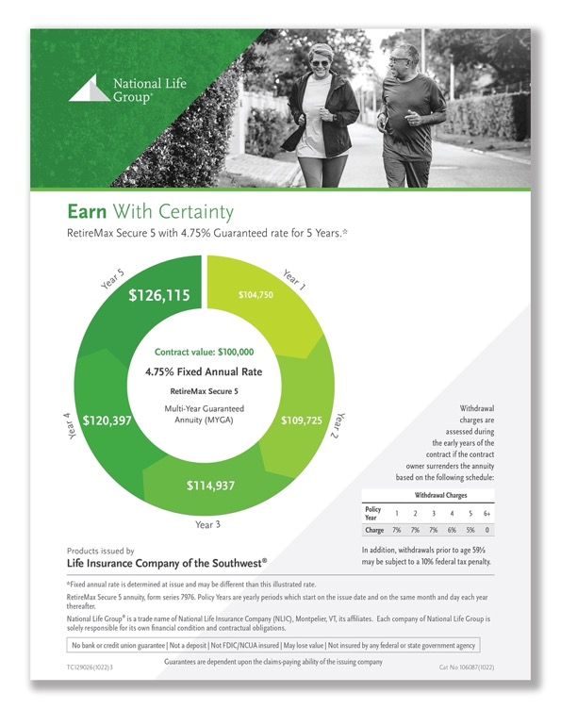
Marketing Materials
RetireMax Secure 5 Buyer’s Guide
Cat No 101299(1022)
RetireMax Secure 5 Customer Flyer
Cat No 106087(1022)
Available in all states except: AZ, MD, MT, NJ, NY NC, OK, OR, and WA

Slide 8
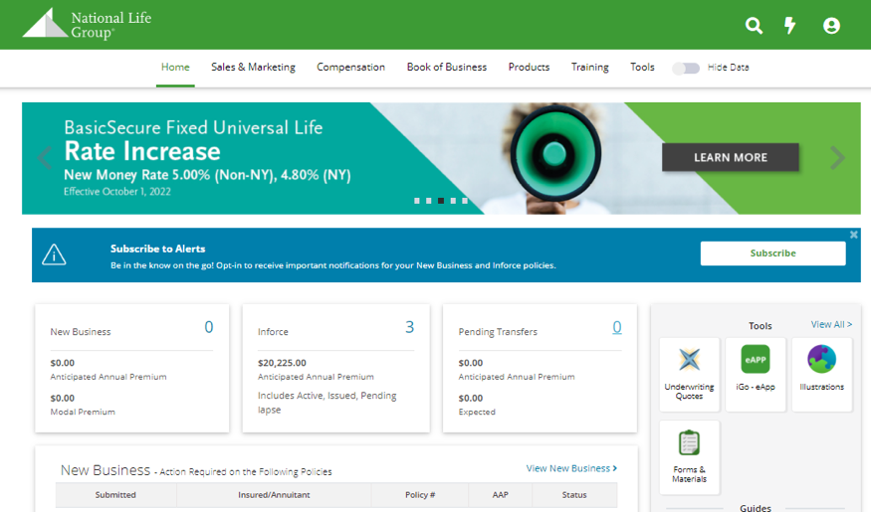
How to Submit Business
Applications are paper only
To download applications:
          Log into the agent portal
          Click on the Forms & Materials button
          Email applications to Imaging@NationalLife.com or mail to One National Life Drive, Montpelier, VT 05604
    Illustrations are not available.
Click on Forms & Materials button to submit applications.

Slide 9

Questions?
Copyright© 2022, National Life Group | 9

Slide 10
Product Specifications
Minimum Premium | $100,000 single sum
Max Premium | 0-70 $2,000,000; 71-75 $1,500,000; 76-80 $1,000,000; 81-85 $500,000
Issue Age | 0-85
Fixed Rate Guarantee Period | Rate guaranteed for 5 years renewing annually thereafter
Free Withdrawal | 10% of Accumulation Value beginning year 2 as available by law
Withdrawal Charges | 7%, 7%, 7%, 6%, 5%, 0%
MVA | No
Loans | Yes if 403(b)/457(b) plan permits; Multiple loans available
Riders | Nursing Care, Terminal Illness at no additional cost
Plan Types | Non-qualified, IRA, Roth IRA, 403(b), Roth 403(b), 457(b), Roth 457(b), Pension/Profit Sharing

