Slide 1
Stormy
Pauline Barns

Slide 2
Documentation & Signalment
CASE STUDY DOCUMENTATION FORM
Name of owner: Kelly Barns
Address of owner: 1 Bauhinia Street, Tieri Qld 4709, Australia
Telephone number of owner: 07 4984 8370
Email address of Owner: pbbarns@aapt.net.au
Date of Report Submission:
Name of Veterinarian: Dr Jo Smith, Maraboon Veterinary Clinic
Name of Farrier: Pauline Barns
SIGNALMENT
Name of Horse: Stormy
Year of Birth: 2003
Breed or type: QH
Color: Liver Chestnut
Gender: Gelding
Height: 15 hh
Occupation: Weekend trail riding and attends occasional horsemanship clinics

Slide 3
Rehabilitation Summary
15 June 2011 - Lowered lateral heels and walls, and thinned lateral walls to help medial/lateral imbalance on front hooves. Applied scoop to both hind hooves to assist the underslung heels. I also slightly lowered the RH toe (from underneath) as it was more underslung.
02 July 2011 - Tork Cowan, Equine chiropractor & massage therapist, found his pelvis to be lower on the right side. Alignments were given to his neck, back and hips.
19 July 2011 - Lowered heels a bit more on the fronts. Has been sore in the past from lowering heels, but he seemed ok. A little sensitive on rocks though.
7 August 2011 - Thinned lateral walls on the fronts and brought the toe further back. Small scoops to underun heels on hinds. Walked out ok, but not weighting the heel as well as I would like.

Slide 4
History & Symptomatology
HISTORY
Years shod: Unknown. Has been bare since age three.
Years stall kept: Unknown
Years showing lameness: None
Years with current owner: 4
How was horse raised? Unknown in the early years. Between the ages of 3 and 4 he was kept in a very small paddock. From age 5 he has lived in a 7 acre paddock during the day and a small paddock at night.
At what age first shod: Unknown
What was average time between trims and resetting of shoes? Unknown. Trimmed every 3 to 6 wks in the last 4 years.
How was the horse used (What discipline?)? Reining
At what age first ridden? Two
What 'treatments' had already been tried prior (orthopedic shoeing, etc.): Unknown
Additional history: Has only had light riding since the age of three.
SYMPTOMATOLOGY (Clinical signs)
Owner's observations: Loss of topline. In Sept ’10 an Equine Chiropractor found him to be sore in the back and hip areas. Topline improved a little bit after treatment from the Chiropractor.
Detail of symptomatology:
Farrier's observations: Clicking sound in the hocks as he walks.
Veterinarian's observations:
Other observations:

Slide 5
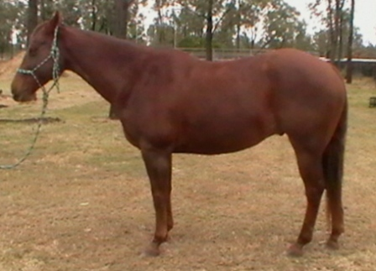
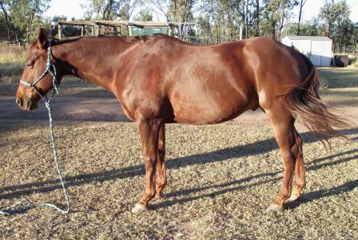
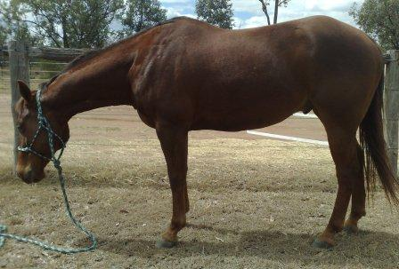
Body Pictures
Before First Trim 11 June 2011 | After First Trim 15 June 2011
7 August 2011 | Ca. 2 Months Later (Date)
Ca. 2 Months Later (Date) | Ca. 2 Months Later (Date)

Slide 6
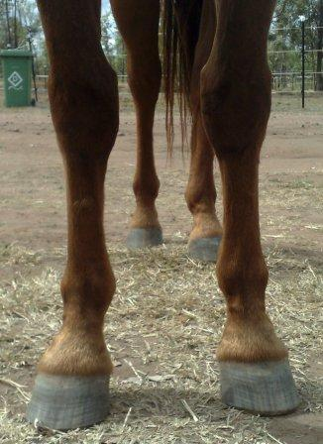
Front Pictures
Before First Trim *Missing | After First Trim *Missing
7 August 2011 | Ca. 2 Months Later (Date)
Ca. 2 Months Later (Date) | Ca. 2 Months Later (Date)

Slide 7
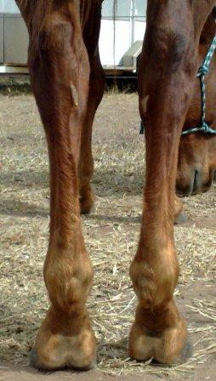
Rear Pictures
Before First Trim *Missing | After First Trim *Missing
7 August 2011 | Ca. 2 Months Later (Date)
Ca. 2 Months Later (Date) | Ca. 2 Months Later (Date)

Slide 8
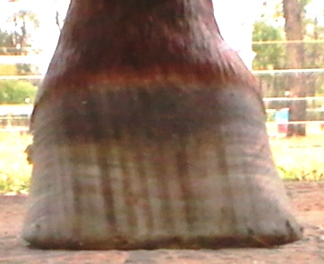
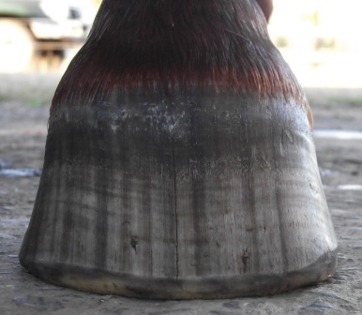
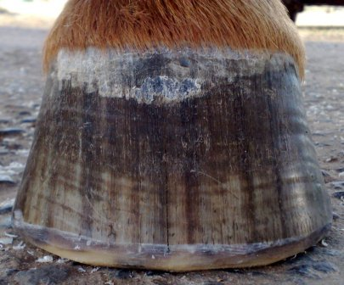
LF Frontal
Before First Trim 11 June 2011 | After First Trim 15 June 2011
7 August 2011 | Ca. 2 Months Later (Date)
Ca. 2 Months Later (Date) | Ca. 2 Months Later (Date)

Slide 9
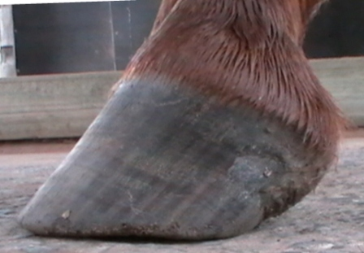
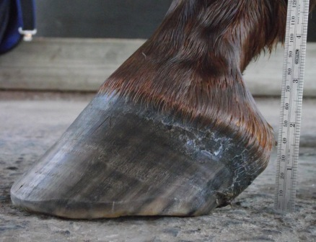
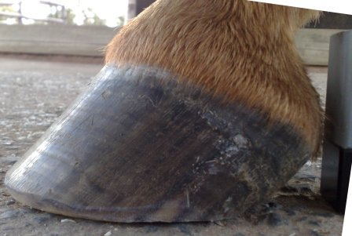
LF Lateral
Before First Trim 11 June 2011 | After First Trim 15 June 2011
7 August 2011 | Ca. 2 Months Later (Date)
Ca. 2 Months Later (Date) | Ca. 2 Months Later (Date)

Slide 10
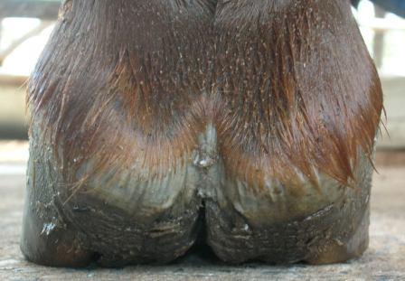
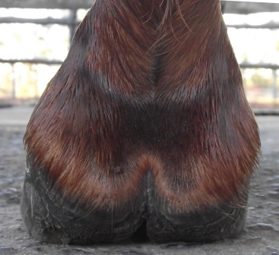
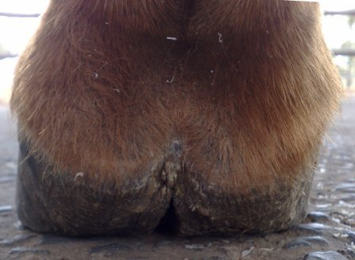
LF Heel (Weight Bearing)
Before First Trim 11 June 2011 | After First Trim 15 June 2011
7 August 2011 | Ca. 2 Months Later (Date)
Ca. 2 Months Later (Date) | Ca. 2 Months Later (Date)

Slide 11
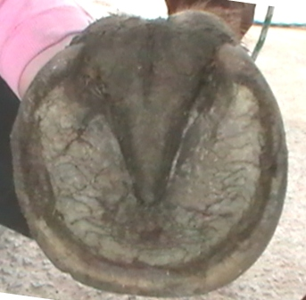
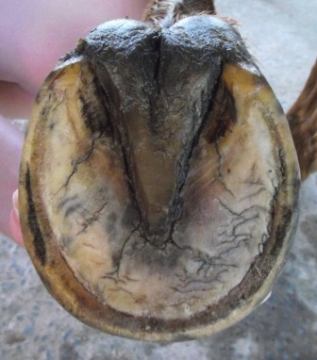
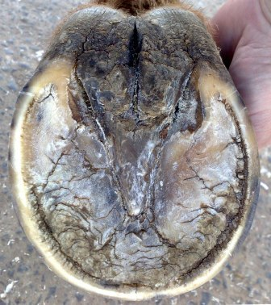
LF Sole
Before First Trim 11 June 2011 | After First Trim 15 June 2011
7 August 2011 | Ca. 2 Months Later (Date)
Ca. 2 Months Later (Date) | Ca. 2 Months Later (Date)

Slide 12
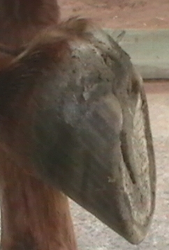
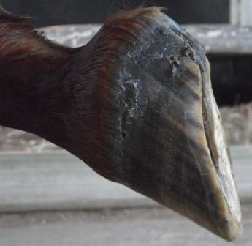
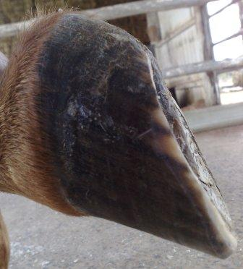
LF Lateral
(Non Weight Bearing)
Before First Trim 11 June 2011 | After First Trim 15 June 2011
7 August 2011 | Ca. 2 Months Later (Date)
Ca. 2 Months Later (Date) | Ca. 2 Months Later (Date)

Slide 13
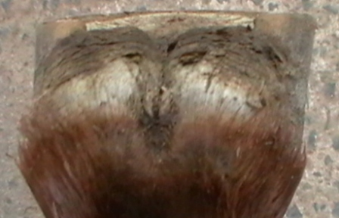
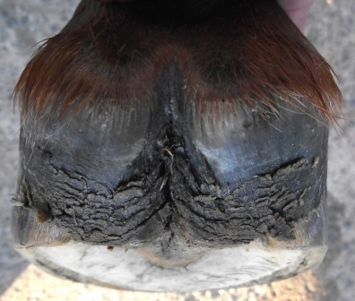
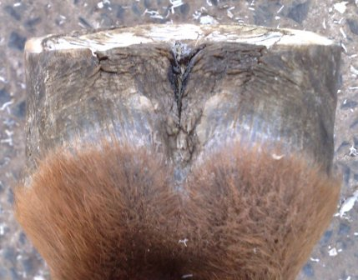
LF Heel (Non Weight Bearing)
Before First Trim 11 June 2011 | After First Trim 15 June 2011
7 August 2011 | Ca. 2 Months Later (Date)
Ca. 2 Months Later (Date) | Ca. 2 Months Later (Date)

Slide 14
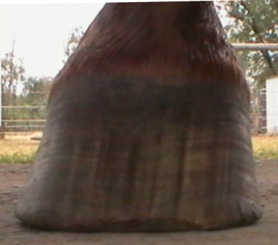
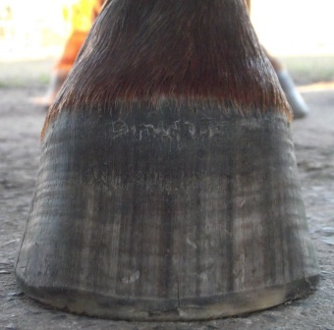
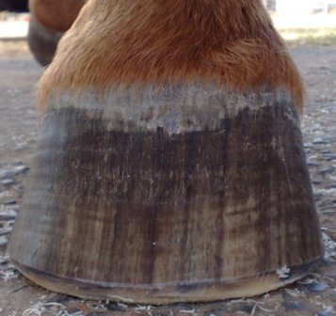
RF Frontal
Before First Trim 11 June 2011 | After First Trim 15 June 2011
7 August 2011 | Ca. 2 Months Later (Date)
Ca. 2 Months Later (Date) | Ca. 2 Months Later (Date)

Slide 15
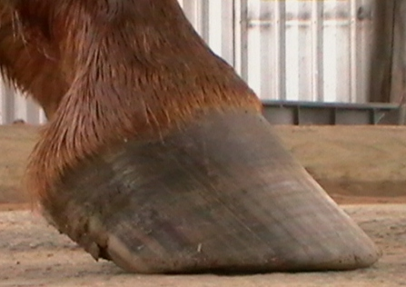
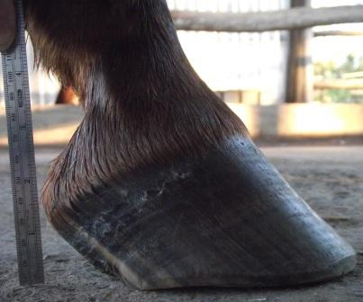
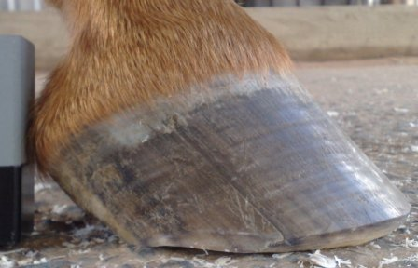
RF Lateral
Before First Trim 11 June 2011 | After First Trim 15 June 2011
7 August 2011 | Ca. 2 Months Later (Date)
Ca. 2 Months Later (Date) | Ca. 2 Months Later (Date)

Slide 16
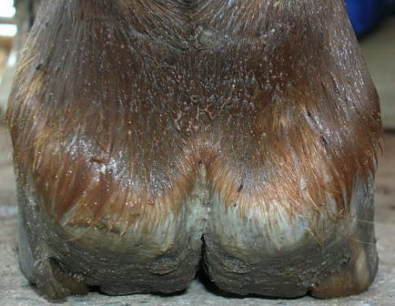
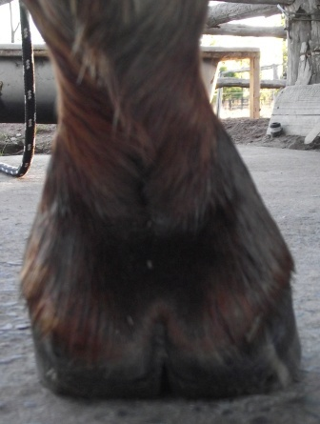
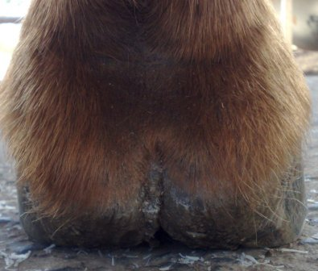
RF Heel (Weight Bearing)
Before First Trim 11 June 2011 | After First Trim 15 June 2011
7 August 2011 | Ca. 2 Months Later (Date)
Ca. 2 Months Later (Date) | Ca. 2 Months Later (Date)

Slide 17
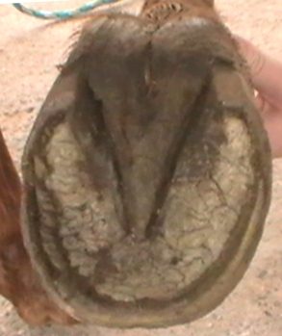
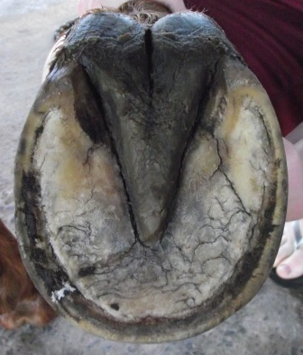
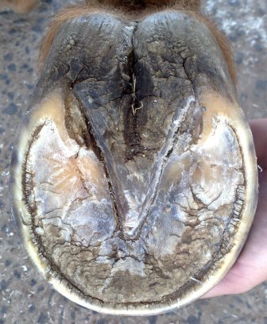
RF Sole
Before First Trim 11 June 2011 | After First Trim 15 June 2011
7 August 2011 | Ca. 2 Months Later (Date)
Ca. 2 Months Later (Date) | Ca. 2 Months Later (Date)

Slide 18
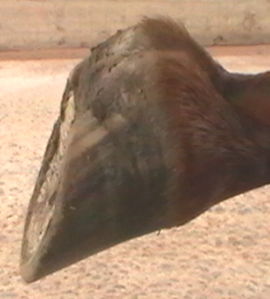
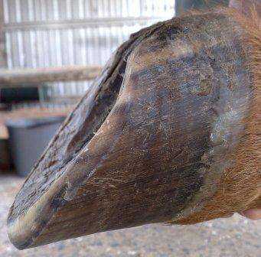
RF Lateral
(Non Weight Bearing)
Before First Trim 11 June 2011 | After First Trim *Missing
7 August 2011 | Ca. 2 Months Later (Date)
Ca. 2 Months Later (Date) | Ca. 2 Months Later (Date)

Slide 19
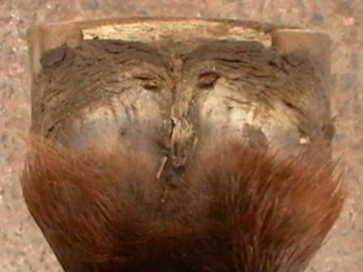
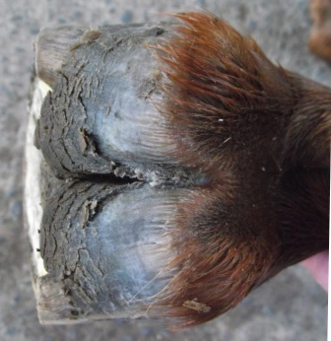
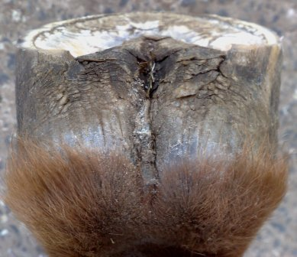
RF Heel (Non Weight Bearing)
Before First Trim 11 June 2011 | After First Trim 15 June 2011
7 August 2011 | Ca. 2 Months Later (Date)
Ca. 2 Months Later (Date) | Ca. 2 Months Later (Date)

Slide 20
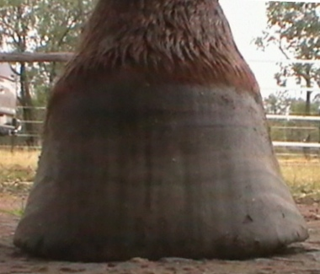
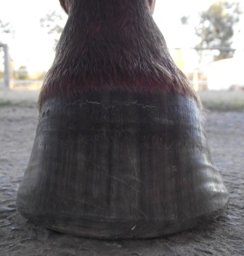
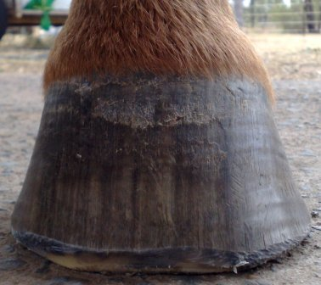
LH Frontal
Before First Trim 11 June 2011 | After First Trim 15 June 2011
7 August 2011 | Ca. 2 Months Later (Date)
Ca. 2 Months Later (Date) | Ca. 2 Months Later (Date)

Slide 21
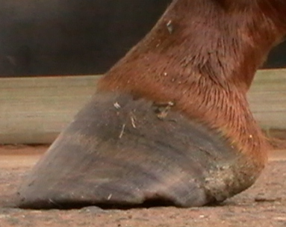
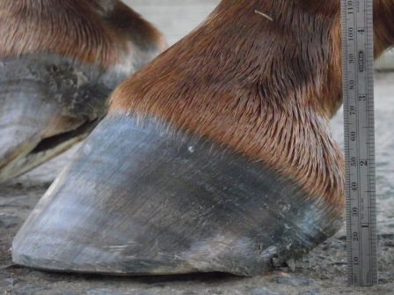
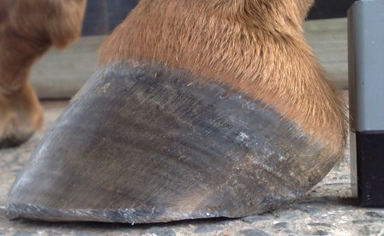
LH Lateral
Before First Trim 11 June 2011 | After First Trim 15 June 2011
7 August 2011 | Ca. 2 Months Later (Date)
Ca. 2 Months Later (Date) | Ca. 2 Months Later (Date)

Slide 22
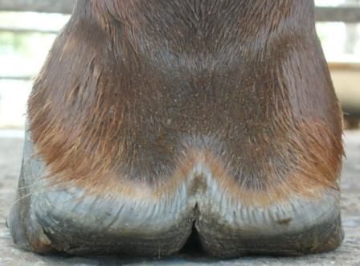
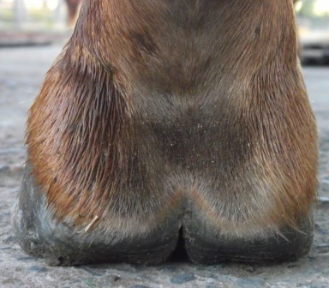
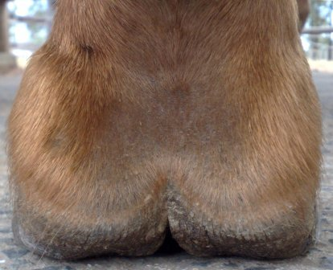
LH Heel (Weight Bearing)
Before First Trim 11 June 2011 | After First Trim 15 June 2011
7 August 2011 | Ca. 2 Months Later (Date)
Ca. 2 Months Later (Date) | Ca. 2 Months Later (Date)

Slide 23
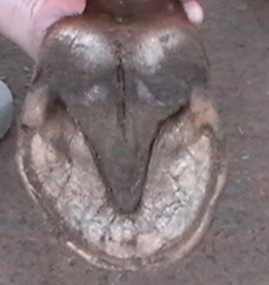


LH Sole
Before First Trim 11 June 2011 | After First Trim 15 June 2011
7 August 2011 | Ca. 2 Months Later (Date)
Ca. 2 Months Later (Date) | Ca. 2 Months Later (Date)

Slide 24



LH Lateral
(Non Weight Bearing)
Before First Trim 11 June 2011 | After First Trim 15 June 2011
7 August 2011 | Ca. 2 Months Later (Date)
Ca. 2 Months Later (Date) | Ca. 2 Months Later (Date)

Slide 25



LH Heel (Non Weight Bearing)
Before First Trim 11 June 2011 | After First Trim 15 June 2011
7 August 2011 | Ca. 2 Months Later (Date)
Ca. 2 Months Later (Date) | Ca. 2 Months Later (Date)

Slide 26



RH Frontal
Before First Trim 11 June 2011 | After First Trim 15 June 2011
7 August 2011 | Ca. 2 Months Later (Date)
Ca. 2 Months Later (Date) | Ca. 2 Months Later (Date)

Slide 27



RH Lateral
Before First Trim 11 June 2011 | After First Trim 15 June 2011
7 August 2011 | Ca. 2 Months Later (Date)
Ca. 2 Months Later (Date) | Ca. 2 Months Later (Date)

Slide 28



RH Heel (Weight Bearing)
Before First Trim 11 June 2011 | After First Trim 15 June 2011
7 August 2011 | Ca. 2 Months Later (Date)
Ca. 2 Months Later (Date) | Ca. 2 Months Later (Date)

Slide 29



RH Sole
Before First Trim 11 June 2011 | After First Trim 15 June 2011
7 August 2011 | Ca. 2 Months Later (Date)
Ca. 2 Months Later (Date) | Ca. 2 Months Later (Date)

Slide 30



RH Lateral
(Non Weight Bearing)
Before First Trim 11 June 2011 | After First Trim 15 June 2011
Ca. 2 Months Later (Date) | Ca. 2 Months Later (Date)
Ca. 2 Months Later (Date) | Ca. 2 Months Later (Date)

Slide 31



RH Heel (Non Weight Bearing)
Before First Trim 11 June 2011 | After First Trim 15 June 2011
7 August 2011 | Ca. 2 Months Later (Date)
Ca. 2 Months Later (Date) | Ca. 2 Months Later (Date)

