Slide 2
Joliet Firefighters Peer Support Group Firefighter and Family Mental Health
Joliet fire Department Training
March 2020
(855) JFD-PEER
Jfdpeersupport.com
info@jfdpeersupport.com

Slide 3
Introduction
Welcome
Brief Introductions
Please, keep an open mind… some don’t want to be here
I was one of you for a long time
This Photo by Unknown Author is licensed under CC BY-SA-NC

Slide 4
This Photo by Unknown Author is licensed under CC BY-NC-ND

Slide 5
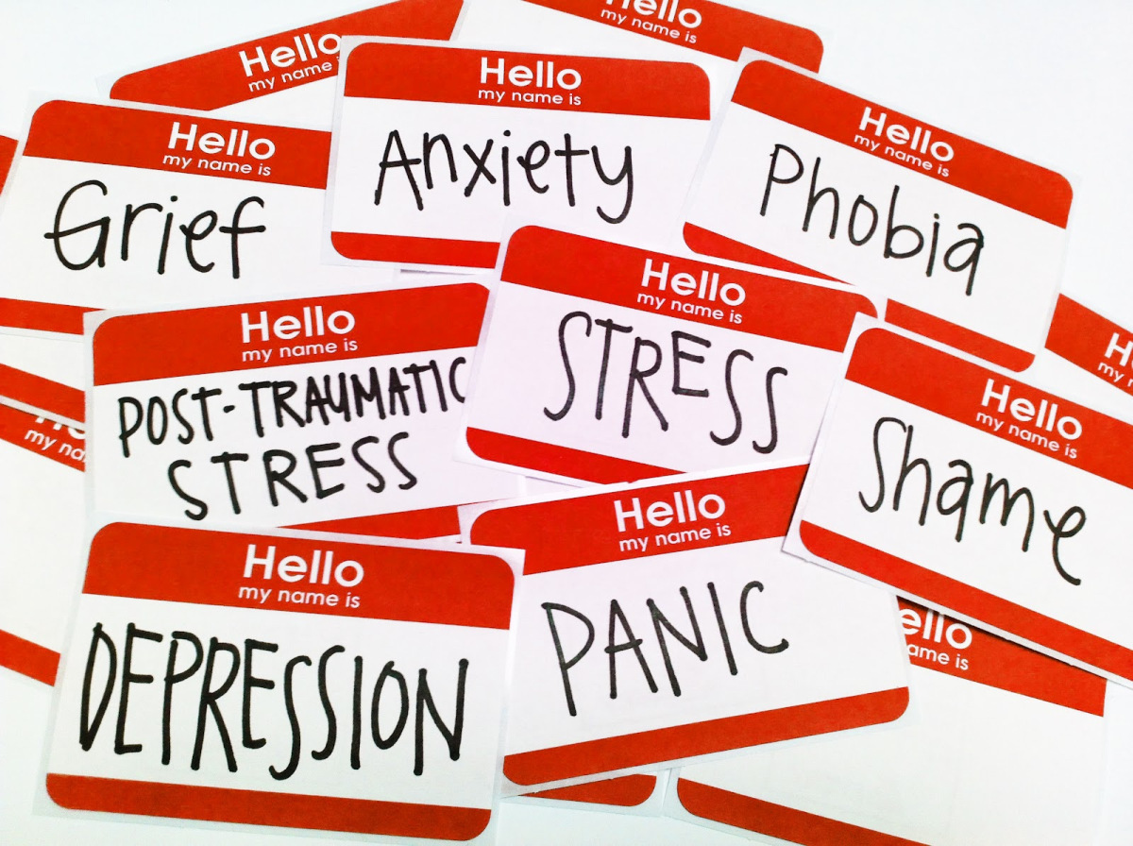
Firefighter/Emergency Responder Mental Health
History
Culture
Inconsistent Support
Major issue
1 in 5 will have some mental illness lifetime¹
Cultural impediments
92% see as weak¹
Prevents help seeking
Culture change needed!
This Photo by Unknown Author is licensed under CC BY-NC-ND

Slide 6
The problems
Suicide
Substance abuse
Post-traumatic stress disorder (PTSD)
Cancer
Divorce
Family Issues
Depression
Sleep disorders
This Photo by Unknown Author is licensed under CC BY-NC-ND
This Photo by Unknown Author is licensed under CC BY-SA
This Photo by Unknown Author is licensed under CC BY-NC-ND

Slide 7
Suicide
More suicide than LODD²
2015 68 LODD/94 suicide
2016 69 LODD/99 suicide
2017 60 LODD/91 suicide
EMS 12X national average³
Ideation⁴
5-13% general population
21% fire service
Plan⁴
5% public
7-12% fire service
Suicides⁴
21/100,000 fire
13/100,00 general
90% show signs before⁴
This Photo by Unknown Author is licensed under CC BY-SA-NC

Slide 8
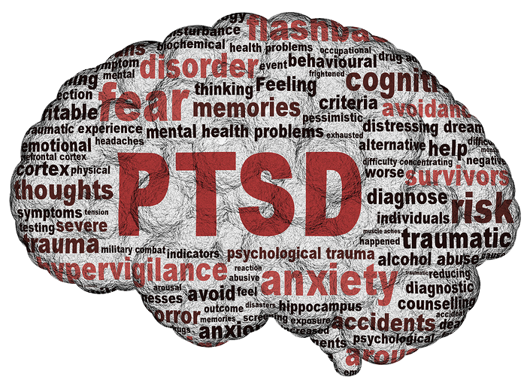
Post Traumatic Stress Disorder PTSD
Post traumatic stress (PTS) is normal reaction³
90% of adults suffer traumatic event, 8% PTSD in general public³
Organic brain damage³
6-13% Police
20% Ambulance
15-30% urban fire service³
Why do some people get PTSD and some do not?³
Resilience
Support
This Photo by Unknown Author is licensed under CC BY-NC-ND

Slide 9
Resilience and Support
Resilience
Coping mechanisms
Support
Interpersonal communication
This Photo by Unknown Author is licensed under CC BY-NC-ND

Slide 10
Substance abuse
Substance abuse
Binge drinking
23% general pop
50% fire service⁵
Believe it or not, energy drinks⁸
High risk behavior
This Photo by Unknown Author is licensed under CC BY-SA-NC

Slide 11
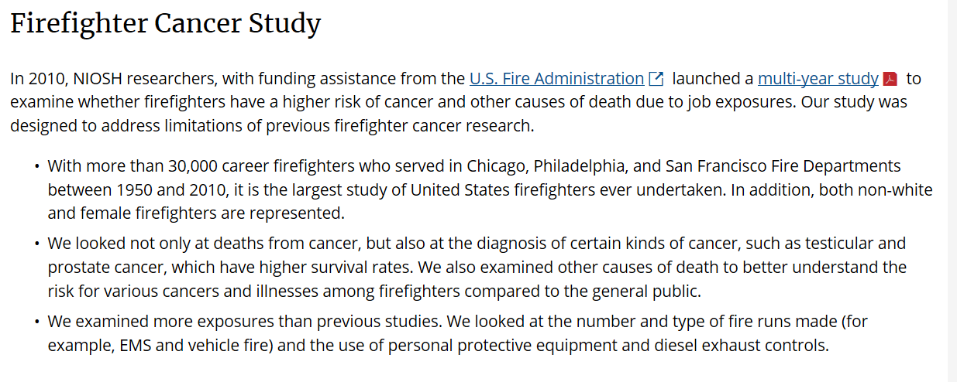
Cancer
Cancer Firefighter relationship – stress
Firefighters higher risk of all cancers than general public^{6,7}
This Photo by Unknown Author is licensed under CC BY-SA-NC

Slide 12
Divorce
Incidence
Male firefighter no higher odds
Female firefighter 3x higher odds⁹
This Photo by Unknown Author is licensed under CC BY-SA

Slide 13
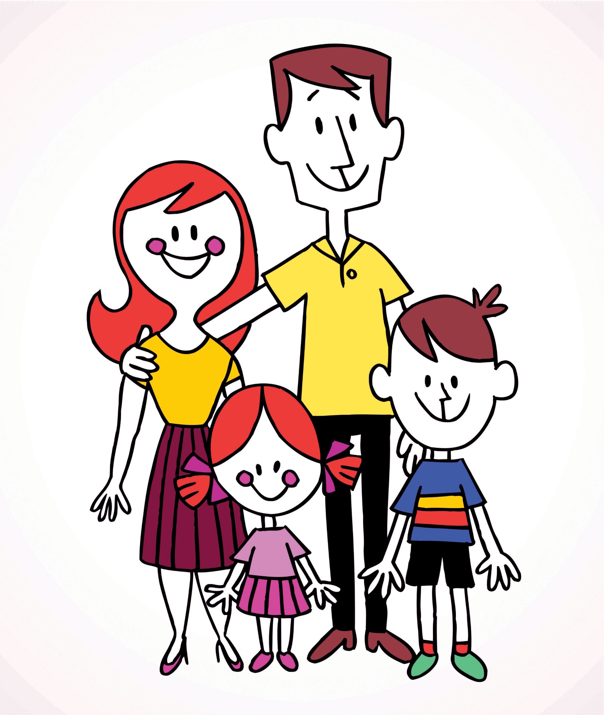
Family
Firefighter not only affected party
Spouse/significant other/partner
Kids
Friends
Parents
What happens at home is important
First signs of stress often seen here³
This Photo by Unknown Author is licensed under CC BY-SA-NC

Slide 14
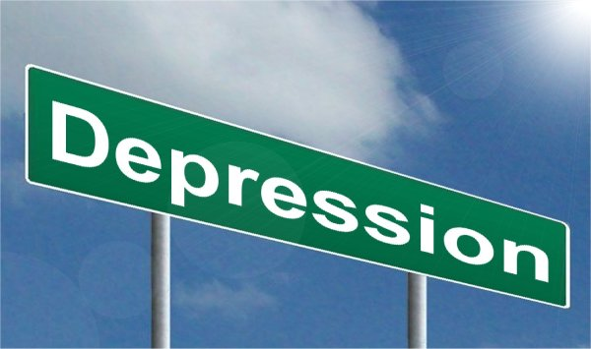
Depression
Depressive disorder
7% general population⁸
17% firefighter population¹⁰
This Photo by Unknown Author is licensed under CC BY-SA

Slide 15
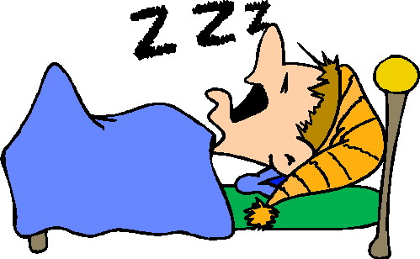
Sleep
Disorder
20% vs 37% ^{10,11}
Cancer¹²
Cardiovascular¹³
Obesity¹³
Diabetes¹³
This Photo by Unknown Author is licensed under CC BY-ND

Slide 16
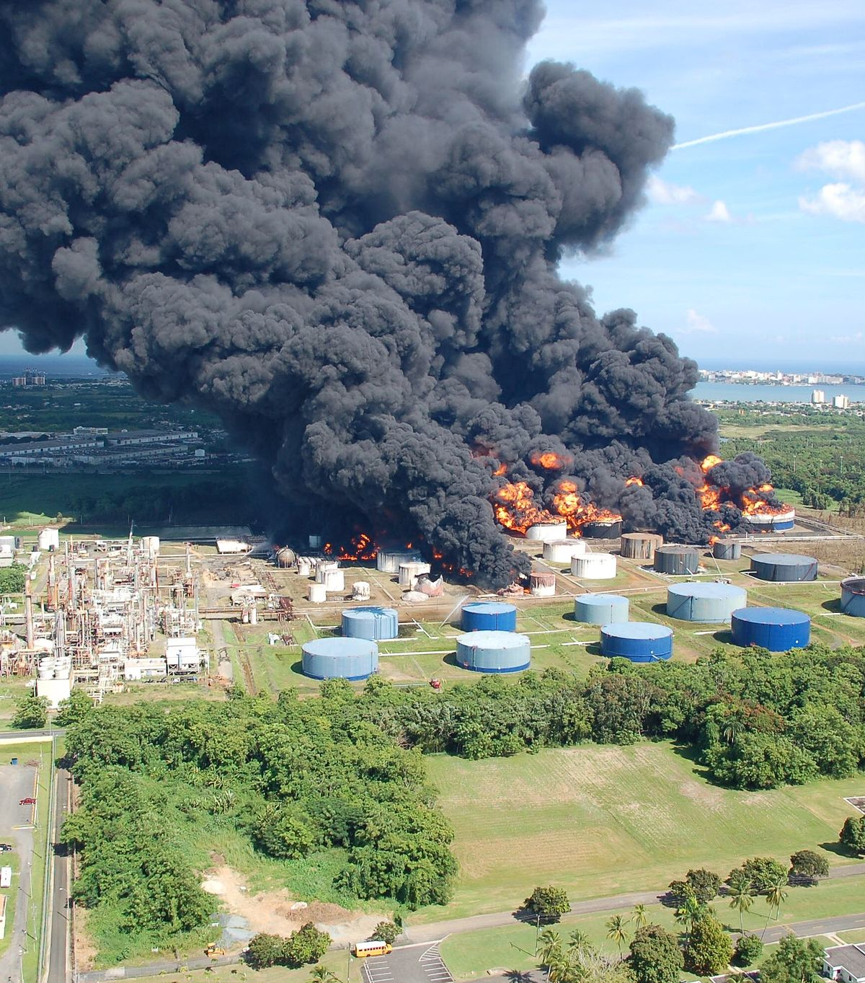
Critical Incidents
Critical Incident
Crisis Response
Resilience – coping
Crisis intervention
This Photo by Unknown Author is licensed under CC BY-SA

Slide 17
What is the solution?
Crisis intervention
Best single solution is Interpersonal support³
Coping and support

Slide 18
The Solutions: Continuum of Care
Awareness
Recognize the signs
Education
Learn more about the issues
Intervention
Psychological fist aid
Continued care⁴
Employee Assistance Program (EAP)
Peer Support
Critical Incident Stress Management
This Photo by Unknown Author is licensed under CC BY

Slide 19
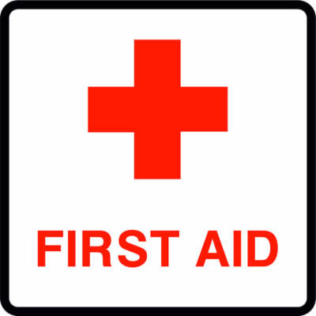
Psychological First Aid
Psychological first aid (PFA) – early psychological intervention reduces need for more
Compare to physical injury and physical first aid
IAFF
ICISF SAFER-R Model
Johns Hopkins University
Firefighter Hero Learning network
How long lasts
Study 20 years later (3)
This Photo by Unknown Author is licensed under CC BY-NC-ND

Slide 20
What can you do right now?
Solutions
Recognize the signs
Firefighter and family
What can you do right now?
Surveillance
How is your loved one acting
Anxious/depressed
Difficulty sleeping or focusing
Communication
Ask

Slide 21
Please remember
Like many illnesses, it is easier to treat when it is recognized more quickly.¹⁴
This Photo by Unknown Author is licensed under CC BY-SA-NC

Slide 22
Long Term, Consistent Solution
So how do we make things better long term and consistent for everyone?
Organized program

Slide 23
Remember…
Awareness
Recognize the signs
Education
Learn more about the issues
Teach coping skills
Intervention
Psychological fist aid
Continued care⁴
^{Clinical care if needed}

Slide 24
The Joliet Firefighters Peer Support Group
(855) JFD-PEER
info@jfdpeersupport.com
jfdpeersupport.com
Firefighters and Family

Slide 25
Department Policy
Amended policy
Not all we want, but better
Please…
After critical incident
Please request a CISD
You will be glad you did
It may not help you, but it may help someone else

Slide 26
A word on the EAP…
If you do not want to use us for help…
PLEASE USE SOMEONE!!
Lifeworks
Still the City of Joliet Employee Assistance Plan
888-267-8126
Username: Joliet
Password: city
They do offer the following help:
Family
Life
Health
Work
Do you use it?
Why or why not?
This Photo by Unknown Author is licensed under CC BY-SA

Slide 27
EAP Stats
According to HR
Studies show that social bonding may be protective to firefighters
Again, inconsistent
This is why

Slide 28
The Joliet Firefighters Peer Support Group

Slide 29
The Joliet Firefighters Peer Support Group
Vision
A Fire Department where all Joliet Firefighters and their families are holistically cared for by their peer network regarding all forms of mental and emotional health.
Mission
The Joliet Firefighter Peer Support Group believes that the path to Joliet Firefighter mental and emotional health begins with firefighters, clinicians, clergy, and public officials working together to provide support, education, and connection to resources to our firefighters and their families. The public can depend on firefighters. Firefighters can depend on their peer support network.
This Photo by Unknown Author is licensed under CC BY-NC

Slide 30
Our Partners
Partners
Aspire- Center for Positive Change: (815) 353-3339
The Upper Room Crisis Hotline (888) 808-8724
The Franciscan Friars, Province of the Sacred Heart of Jesus
NI Critical Incident Stress Management Team

Slide 31
Group Member Categories
Active Firefighters
Officers
Apparatus Operators
Firefighters
Retirees
Clinicians
Counselors
Social Workers
Religious
Elected Official

Slide 32
Active Firefighters
Chris Bay
James Boyd
Matt Christensen
Justin Farrar
Jeremy Hoffman
Aaron Kozlowski
Nate Kren
John Miller
Stan Nowicki
Chris O’Hara
Matt Pasteris
Dominick Perona
Burke Schuster
Mike Stapp
Pat Wojewoda
Floyd Woods

Slide 33
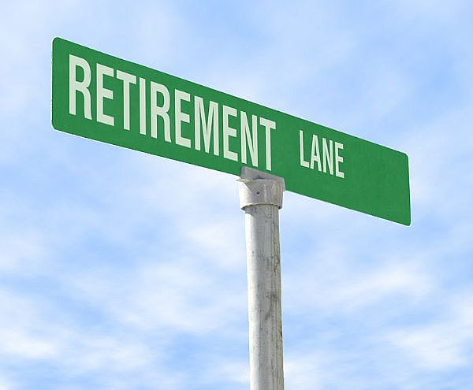
Retirees
Tom Douglas
Jim Larson
John Lukancic
Mike Nurczyk
Mike Stromberg
This Photo by Unknown Author is licensed under CC BY-SA

Slide 34
Clinicians
Aspire Center for Positive Change
Aspire-cpc.com; (815) 353-3122
Courtney Doyle-O’Brien, LPC
Nancy Nelson, LCSW
Carissa Silunas, LCSW
Comments

Slide 35
Religious
Ed Arambasich, OFM
Safe place to stay
Mary Frances Seeley, OSF, PhD.
Rev. Chris Groh
Looking for more…
Comments

Slide 36
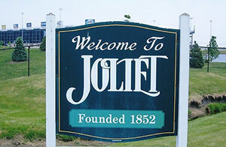
Elected Official
Councilwoman Jan Quillman
Experience
Elected official
Spouse of retired first responder
This Photo by Unknown Author is licensed under CC BY-NC-ND

Slide 37
Initial Selection
Selection
First class, 30 classroom spots available
Had over 40 people volunteer
Breakdown
Administration – 1
Local 44 – 14, selected by seniority
Local 2369 – 7, selected by seniority
Retiree – 5
Religious – 2
Other – 2

Slide 38
Initial Training
Master Instructors from the IAFF
The Joliet Foreign Fire Tax Board provided the funding
Joliet Fire Station 1 on September 12 and 13, 2019.
Initial training and certification included:
A 2-hour online Introduction to Peer Support training class;
All local members can log on and take the class
A 16-hour in-person classroom portion taught by instructors.
This Photo by Unknown Author is licensed under CC BY

Slide 39
Future Selection
Group Decision
This Photo by Unknown Author is licensed under CC BY-SA-NC

Slide 40
Group Structure

Slide 41
Monthly Meetings
At the Friary
404 N. Hickory St.
This Photo by Unknown Author is licensed under CC BY-SA

Slide 42
What we offer
Peer Support
Spiritual Support
Suicide Prevention
Individual Crisis Intervention
Spousal/referral Support
Please ask spouses

Slide 43
In the works
Spouse/family support network within the group
More robust CISM Group Intervention within the group
Trained
Debriefers
CISD group
JFD physicals
NFPA 1652 recommends basic assessment
Non punitive
Guide for post physical care, if needed

Slide 44
JFPSG Policy
In progress
Approved by group
Attorney/Legal review
Posted website

Slide 45
Illinois State Law 5 ILCS 840/1
First Responder Suicide Prevention Act
Confidentiality
Mandated reporting
Suicide
Homicide
Child abuse
Elder abuse
This Photo by Unknown Author is licensed under CC BY-SA

Slide 46
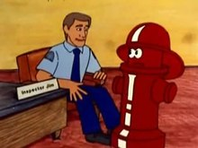
Ride-along Experience
Ride along visits
Site visits
Quarterly
This Photo by Unknown Author is licensed under CC BY-SA

Slide 47
Important Additions
Firefighter PFA
Fire Hero Learning Network
All Firefighters
Share with family
IAFF Online Awareness
Johns Hopkins
6 hour class
Free online class
$49 for certificate
Key is recognize early signs and get help fast

Slide 48
Information
Website
Please visit
Links, videos, annual report for 2019
Please inform spouse/significant other
Facebook
Up to date information
Spouse support
Newsletters
Letters
Survey
Please complete
Anonymous
This Photo by Unknown Author is licensed under CC BY-SA

Slide 49
Please call!
If you are in crisis or having difficulty, please call!
Please ask for help! Not everyone responds the same way to an event.
If not us, someone!
Encourage spouse/partner, friends and family to participate in our program to recognize signs of problems

Slide 50
What to expect when you call 855 JFD PEER
Brief welcome message – emergency dial 911
Extensions
0 - Operator
1 - Lukancic
2 - Brother Ed
If you stay on the line, you will get the operator automatically
Call anytime
You do not have to identify yourself
If in serious crisis (suicidal, homicidal), we will try to send
ambulance and police to get immediate help
We will also notify a clinician member

Slide 51
(855) JFD-PEER
jfdpeersupport.com
info@jfdpeersupport.com
Firefighters and Family

Slide 52
References
1. https://www.iaffrecoverycenter.com/blog/silent-suffering-firefighting-depression/
2. https://www.nfpa.org/-/media/Files/News-and-Research/Fire-statistics-and-reports/Emergency- responders/Old-FFF-and-FF-Injuries/2016fff.ashx?la=en
https://www.nfpa.org/-/media/Files/News-and-Research/Fire-statistics-and- reports/Emergency-r responders/Old-FFF-and-FF-Injuries/2017FFF.ashx?la=en
https://www.nfpa.org/-/media/Files/News-and-Research/Fire-statistics-and-reports/Emergency- responders/Old-FFF-and-FF-Injuries/2018FFF.ashx?la=en
3. Everly, George S. ICISF Training. Pittsburgh, PA
4. Caulkins, Chris. Illinois Peer Support Symposium. Naperville, IL
Miskowiec, Brittany. Illinois Peer Support Symposium. Naperville, IL
5. Jahnke, Sarah. Fire Rescue 1 Online. April 7, 2015. https://www.firerescue1.com/fire- chief/articles/firefighters-and-alcohol-what-the-data-says-EEmQCV9ztxdv60BH/
6. https://www.worksitemed.com/firefighter-cancer/
7. https://www.cdc.gov/niosh/firefighters/pdfs/Daniels-et-al-(2015)-508.pdf
https://edmdigest.com/news/energy-drinks-hazardous/

Slide 53
References
8. https://www.cdc.gov/nchs/products/databriefs/db172.htm
9. https://firedeptfamily.com/firefighter-divorce-rates/
10. https://www.ncbi.nlm.nih.gov/pmc/articles/PMC3486736/
11. https://www.ncbi.nlm.nih.gov/pmc/articles/PMC3486736/
12. https://www.hopkinsmedicine.org/health/wellness-and-prevention/lack-of-sleep-and-cancer-is-there-a-connection
13. https://www.cdc.gov/sleep/about_sleep/chronic_disease.html
14. https://www.ncbi.nlm.nih.gov/books/NBK201092/

