Slide 1


Slide 2
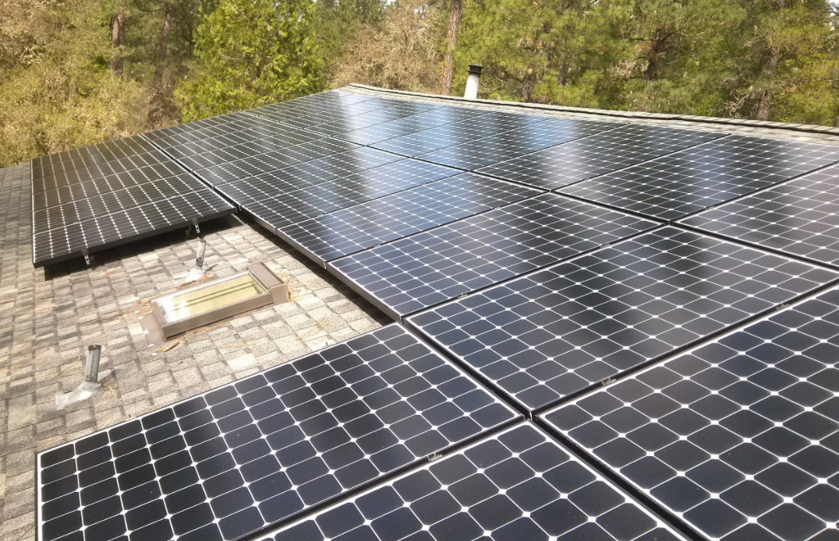
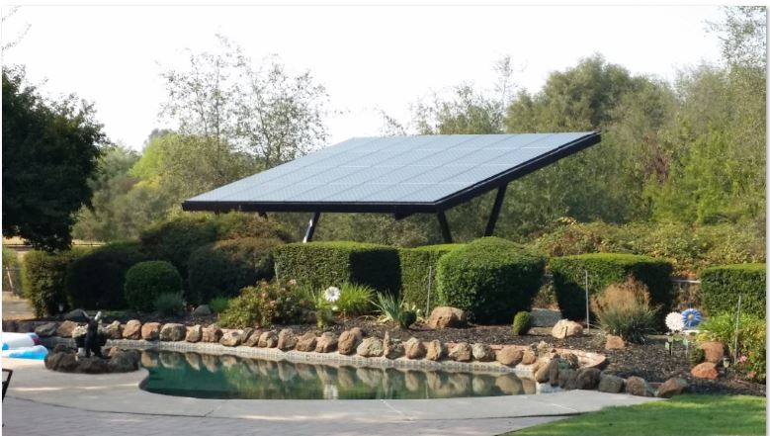
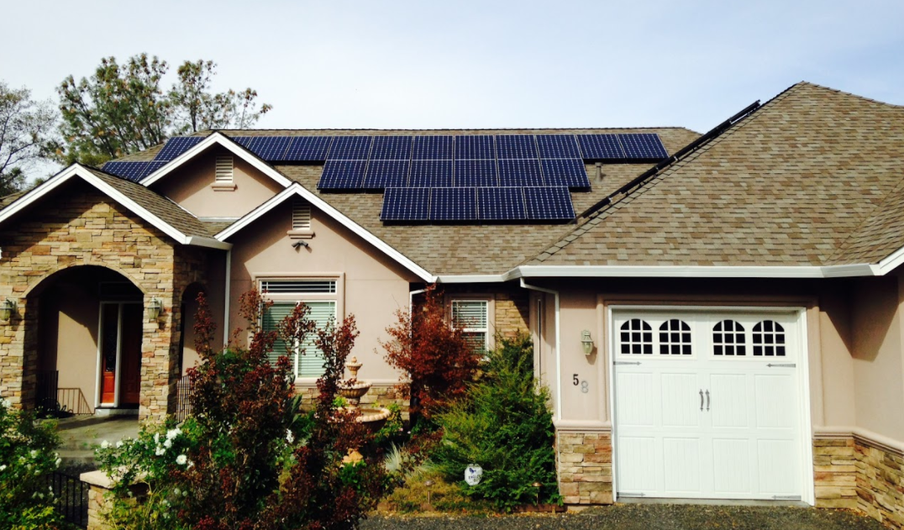
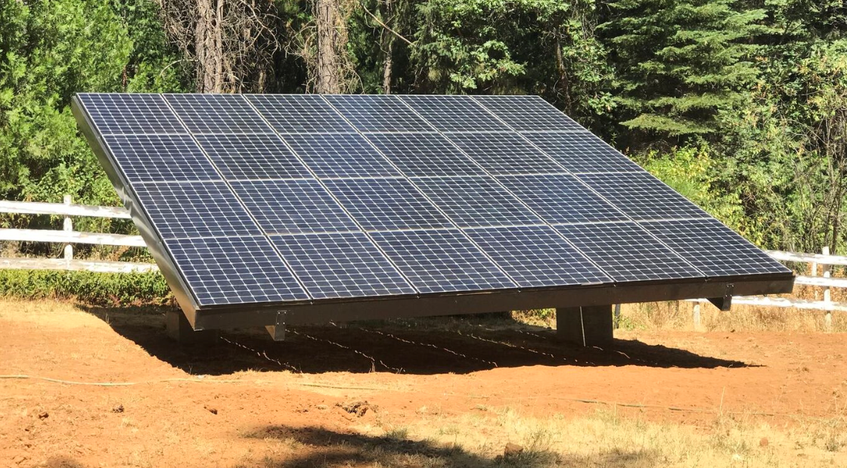
Uncompromising Design & Installation Quality

Slide 3


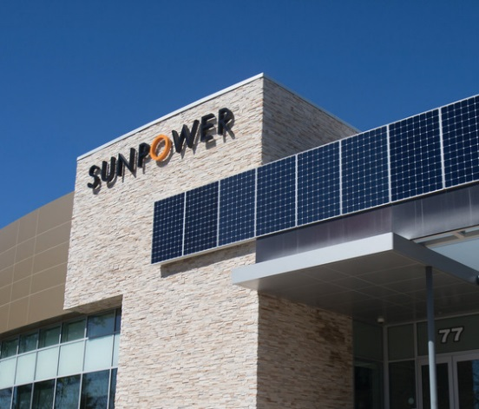
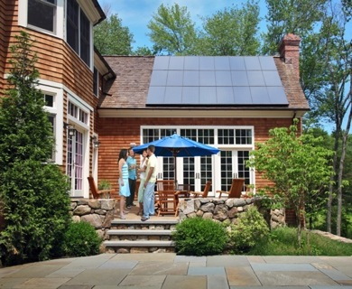
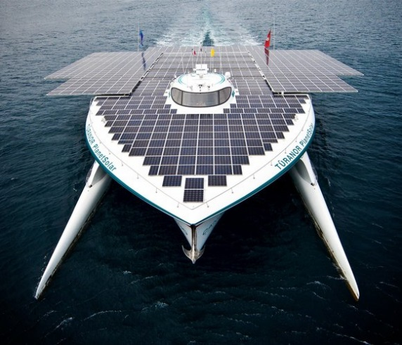
SunPower - The Company
San Jose, CA global headquarters
American innovation and quality
30+ years of building customer trust
Publicly traded on NASDAQ (SPWR)
“Solar only” company – not a conglomerate
Financially stable & strong balance sheet
Majority owned by 15th largest global company
  Total Energy (Paris Global HQ)
750+ solar industry patents

Slide 4

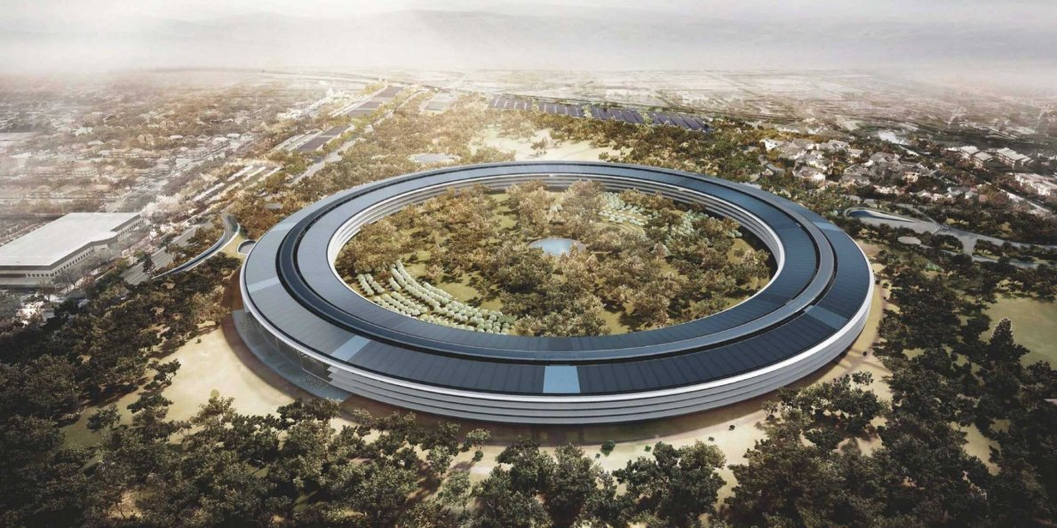
Apple New HQ – 7MW of

Slide 5
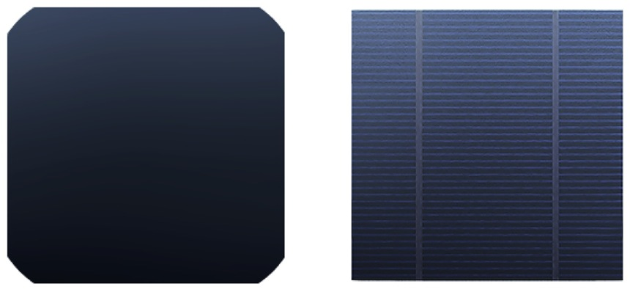
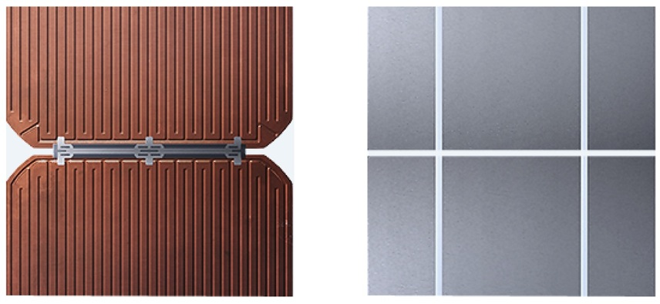
SunPower – Solar Cell Comparison
SunPower Cell
Conventional Cell
No Grid Lines on Front of Cell
Maxeon cells absorb more sunlight and look incredible on your roof.
Lines of Metal Paste on front of Cell
Power output drops as the thin paste reflects light and corrodes.
VS
Solid Copper Backing
Our thick copper foundation adds massive strength and is almost impervious to corrosion.
Even More Metal Paste on Back of Cell
Offers no strength. Cell can crack and lose power when exposed to temperature swings.
Thick Connectors
Expanding and contracting from daily temperature swings are no problem with our built-in strain relief.
VS
Thin, Weak Connections
Lose just one of these narrow ribbons and the entire cell fails.

Slide 6
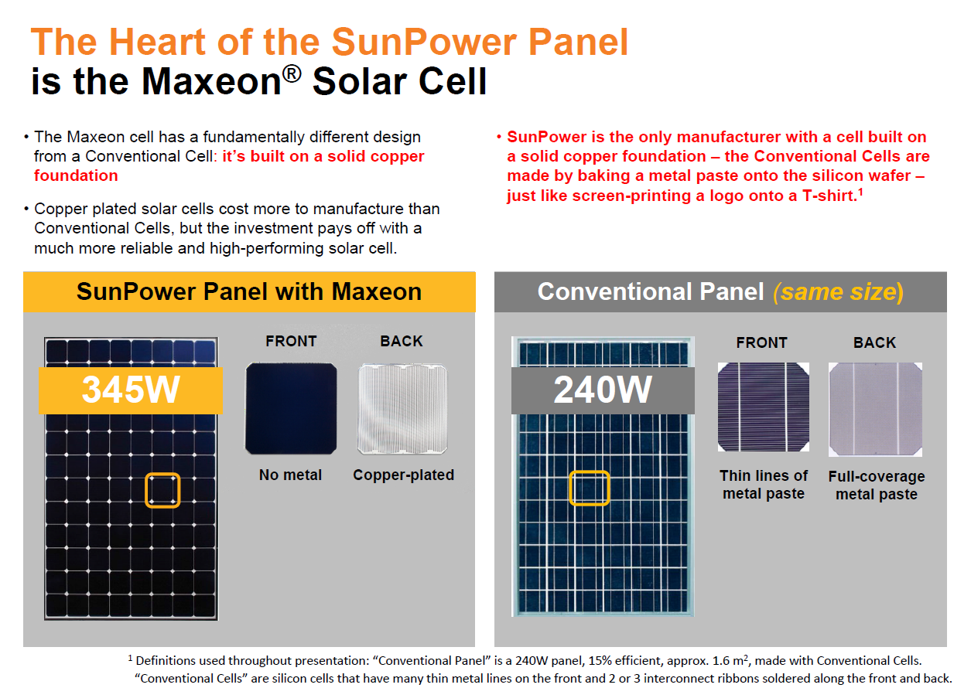
360W

Slide 7
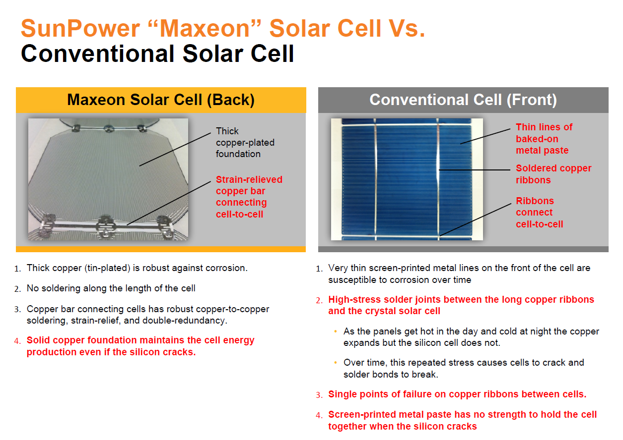

Slide 8
Real world independent degradation testing - NREL
National Renewable Energy Lab (NREL) has been measuring
SunPower panel degradation in Colorado for 10+ years : -0.10%/yr.
Large research studies of conventional Panels indicate
a degradation rate of approximately -1.0%/yr.
SunPower NREL¹
1 Jordan, Dirk “SunPower Test Report,” National Renewable Energy Laboratory, Q1 2015
2 Sample, T. “Failure modes and degradation rates from field-aged crystalline,” 2011
3 Jordan, D., et al. “Photovoltaic Degradation Rates – an Analytical Review,” Progress in Photovoltaics. 2013. Vol 21, p 12-29. Average degradation rate show in plot.
4 Suleske, A. “Performance Degradation of Grid-Tied Photovoltaic Modules in a Desert Climatic Condition,” 2010.
5 Pulver, S. “Measuring Degradation Rates
without Irradiance Data,” 2010
6 Vazquez, M. “Photovoltaic Module
Reliability” 2008
T Sample²
D Jordan³
A Suleske⁴
S Pulver⁵
M Vasquez⁶
0.00%
-0.25%
SunPower = .10% year
-0.50%
Annual Power Degradation
-0.75%
-1.00%
-1.25%
-1.50%
Average Conventional Panel degradation rate = 1.0% / year
^{10X SunPower degradation}

Slide 9
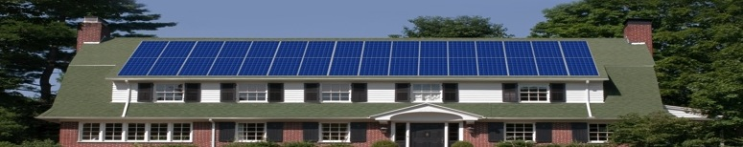
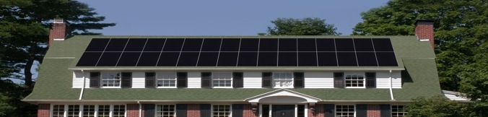
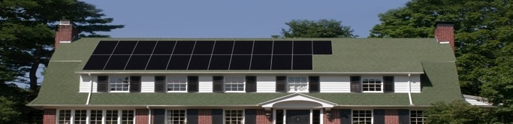

High efficiency = More power, fewer panels, less space
8.3 kW: Fills up the roof
11.5 kW: Offsets more/all of the customer’s usage
Low Efficiency
SunPower
8.3 kW: More power means fewer panels
SunPower

Slide 10
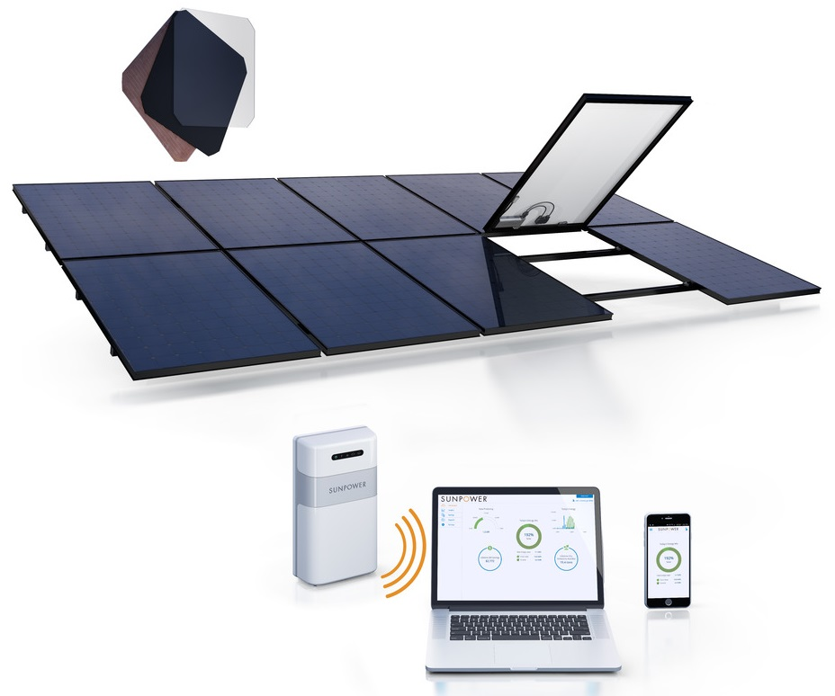

Everything from one company
Full system warranty
from one company
Engineered together for
maximum performance
Designed without compromise
on system aesthetics

Slide 11
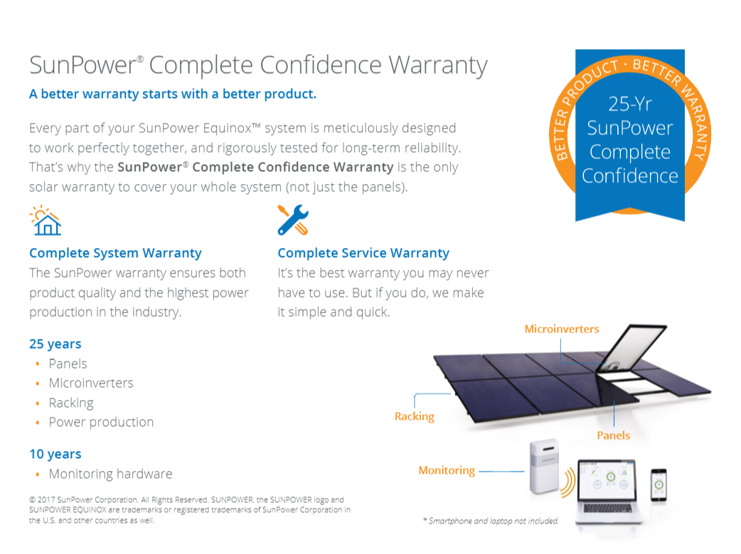

Slide 12
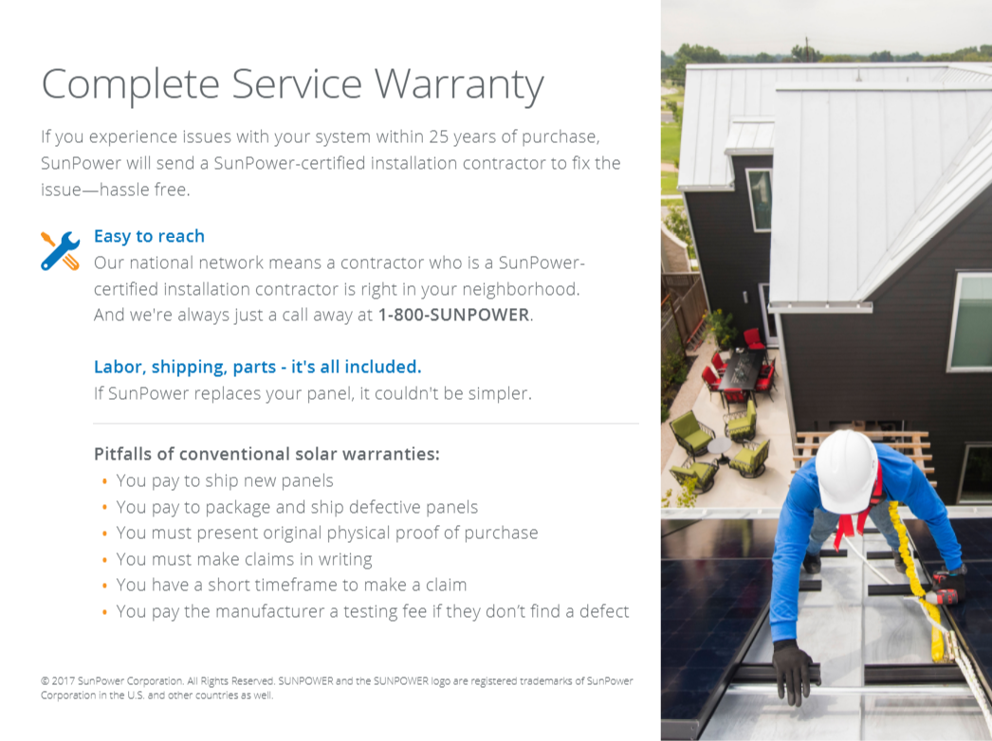

Slide 13
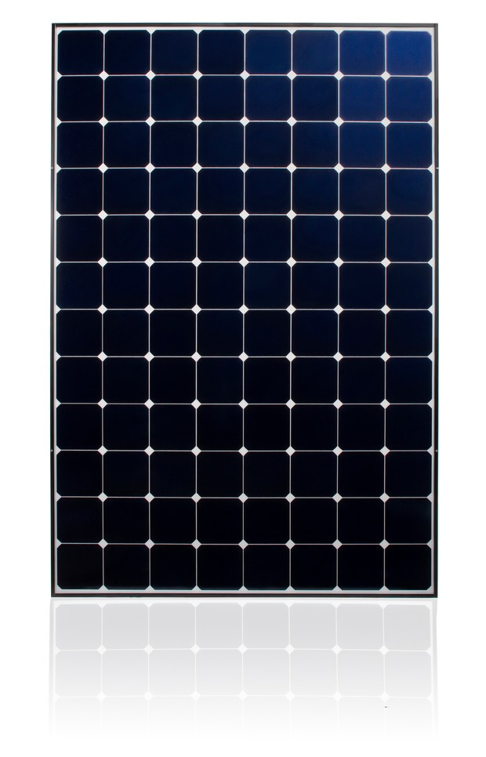
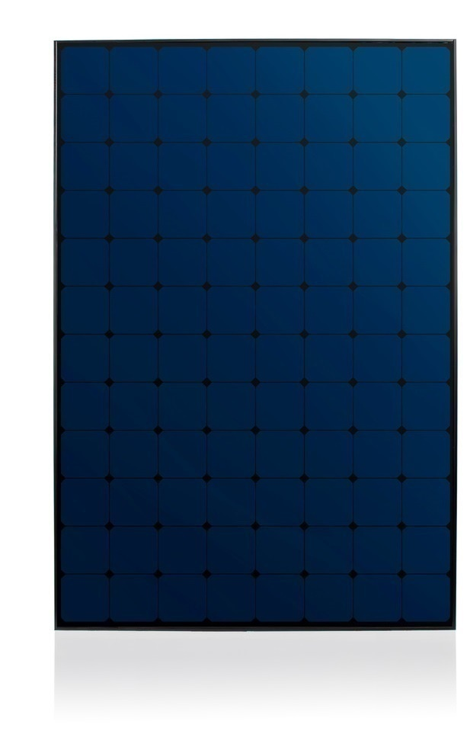
SunPower Modules
E-Series
  E20 – 327-WHT (AC)
X-Series
  X21 – 335-BLK (AC)
  X21 – 345-WHT (AC)
  X21 – 350 BLK (AC)
  X22 – 360-WHT (AC)
  X22 – 370-WHT (AC)

Slide 14
SunPower is the #1 preferred brand of solar in the United States and California
Source: Green Tech Media and California Net Energy Metering Program Applications 2018

