Slide 1
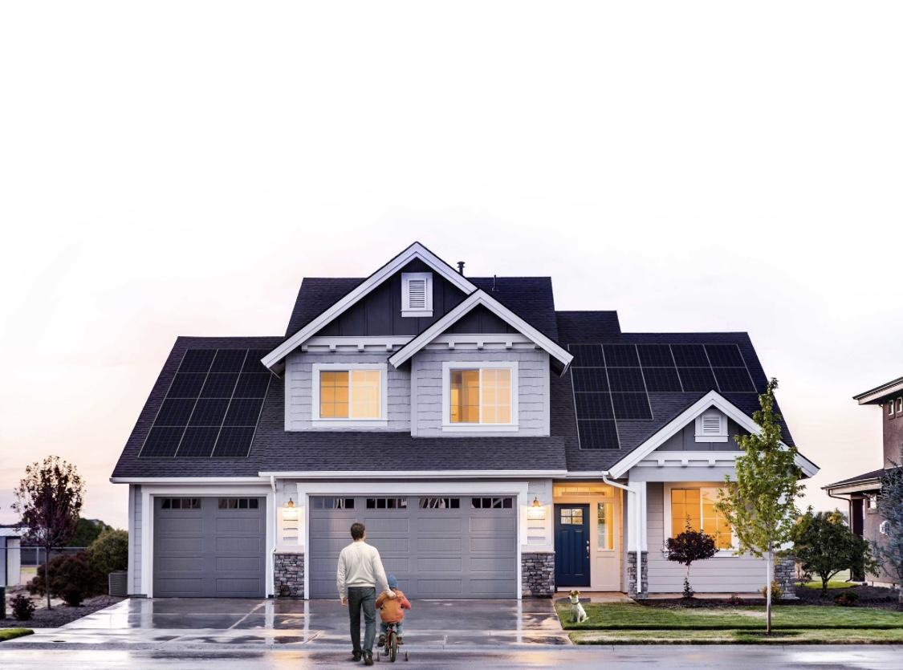

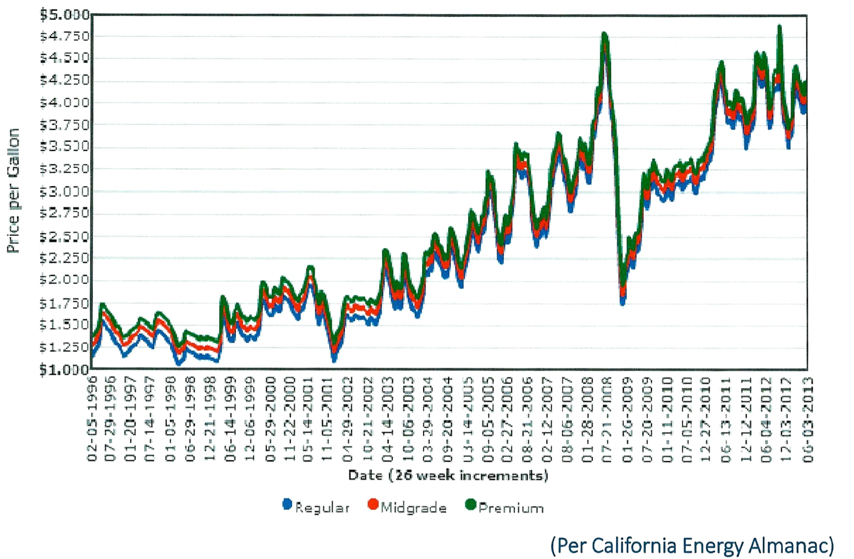
California Gasoline Prices
(from February 1996 to present)

Slide 2
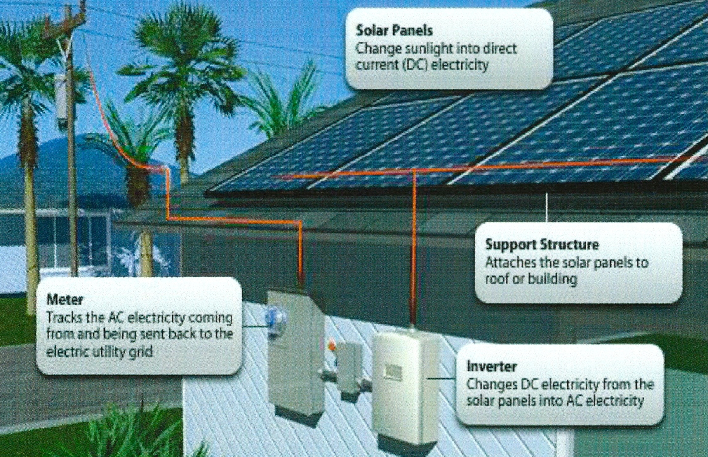
How Solar Works

Slide 3
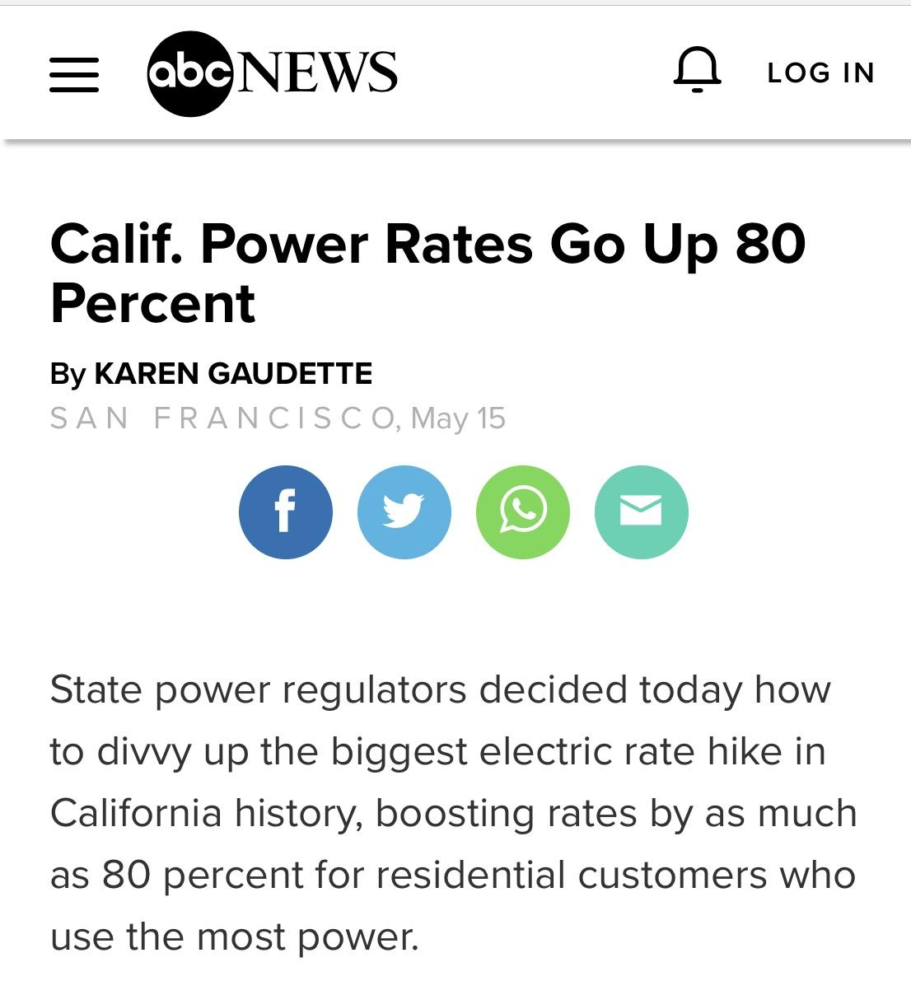

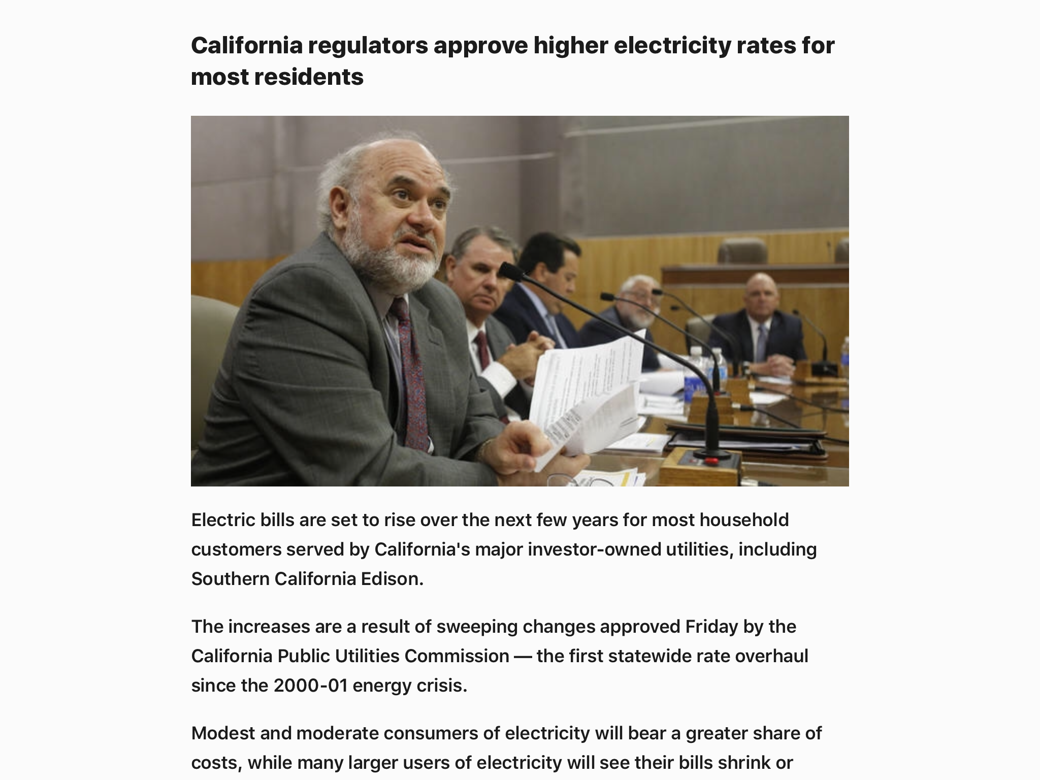

Slide 4
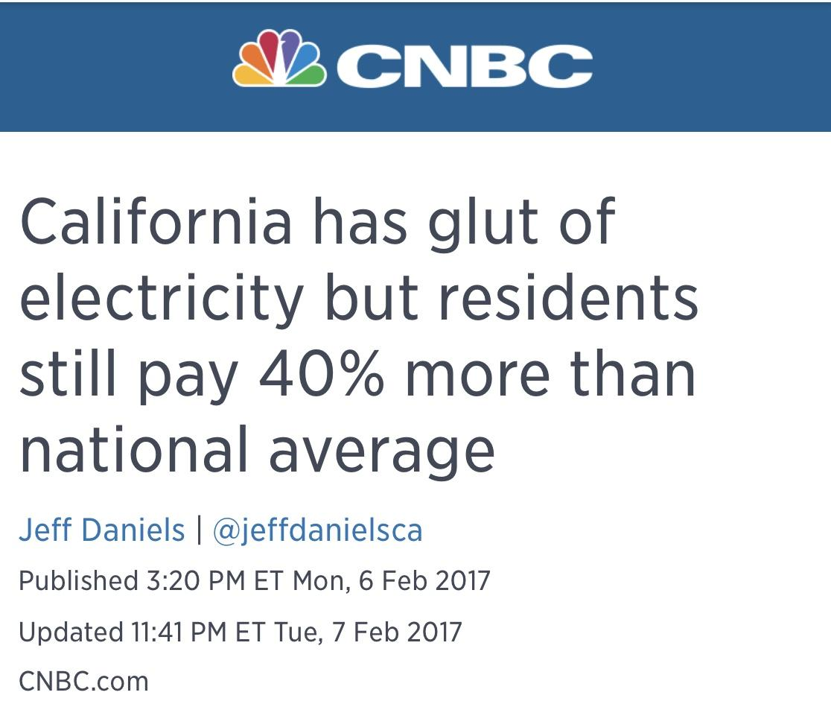
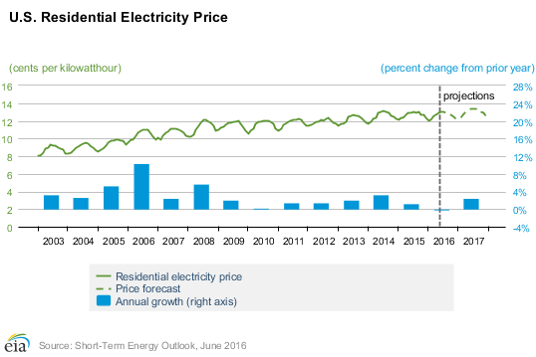

Slide 5
Why Increase?
Big Picture
    Supply / Demand
    Cap & Trade
    Old Infrastructure
    Lose of Income
No Control
    Non-Electricity charges
    PG&E force changes at their timing
Time of Use
    Higher rates during the day (This year
YOUR BILL TODAY IS NOT YOUR BILL TOMORROW

Slide 6
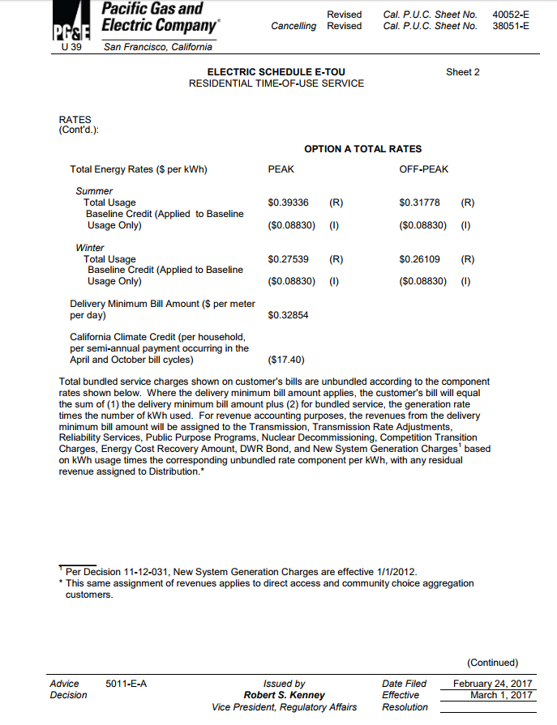

Slide 7
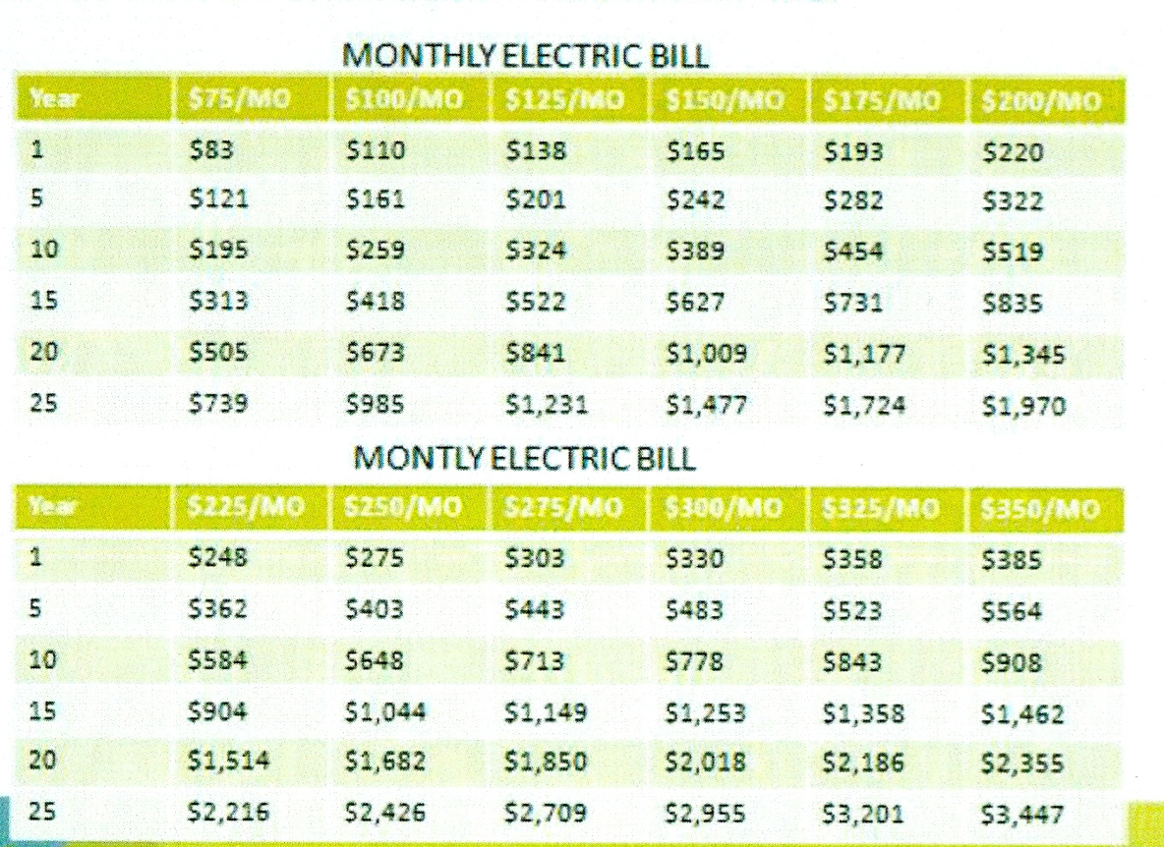
Utility Bill with
Annual 10% Increase

Slide 8
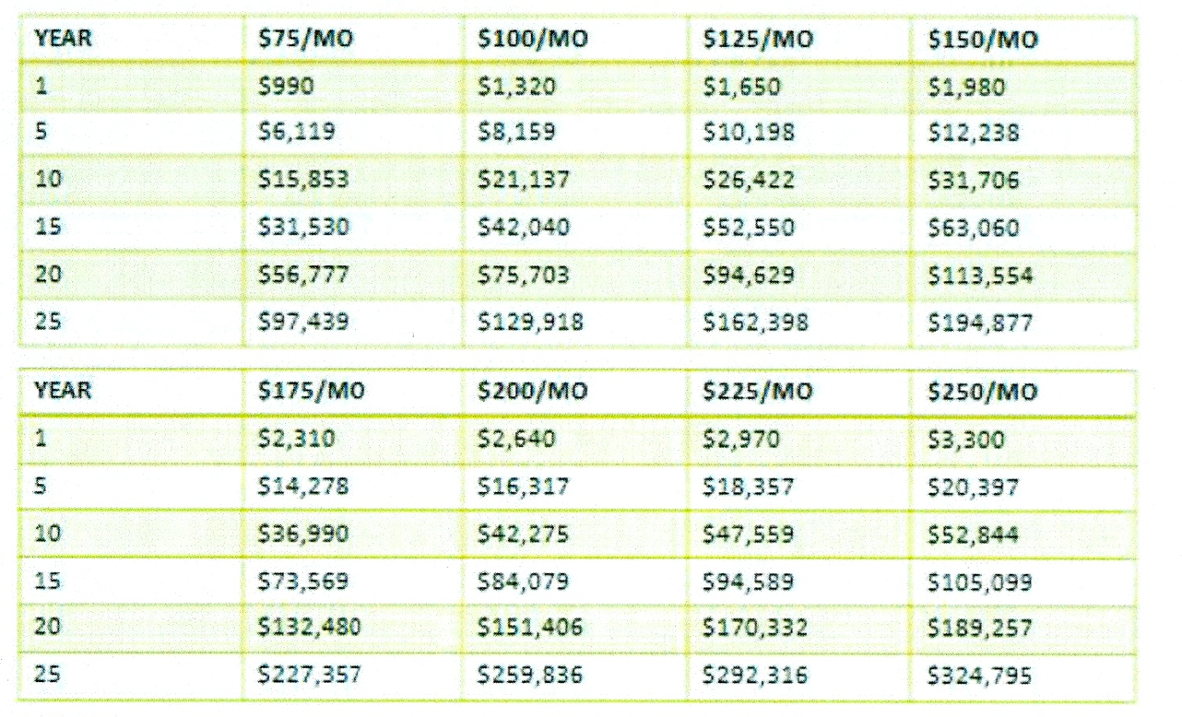
Cumulative Utility Bill with
Annual 10% Increase

Slide 9
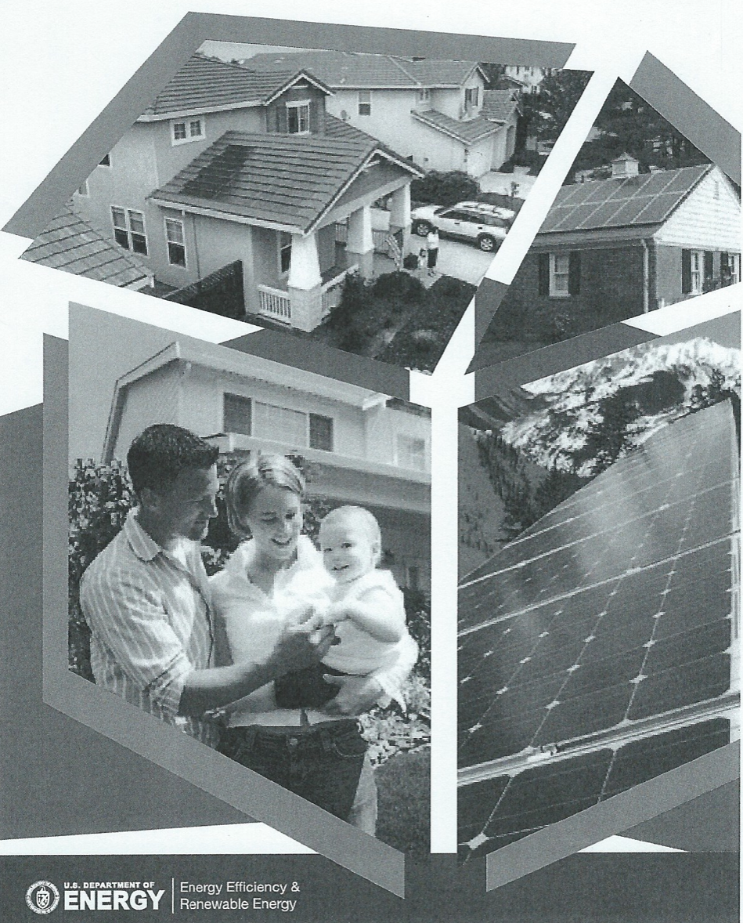
Own Your Power!
The Choice
is
Yours

Slide 10
The Benefits of Going Solar
Facts
Saves Money from day one - $100/m →$120K
Fixed Payment (for limited time) to OWN
Great Investment with very high ROI
Increase Property Value by ~$20/annual watt
Good for the Environment (saves trees & pollution)
Take Control / Become Energy Independent
Use as much as you want…when you want

Slide 11

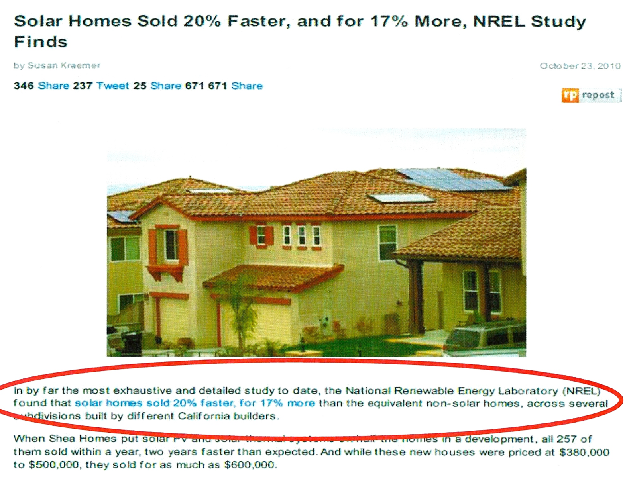
Solar Homes Sold
20% Faster for 17% More

Slide 12
Incentives of Switching
ZERO Out of Pocket & ZERO Down Payment
30% Federal Tax Credit
Financing programs with:
    Subsidized interest (Below market rates)
    Not on personal credit (“goes” with the house)
    Tax deduction (PACE)
    No payment for 6-18 months (attached to Property Tax)
    18 months Same As Cash
WE WILL FIND YOU THE BEST PROGRAM

Slide 13
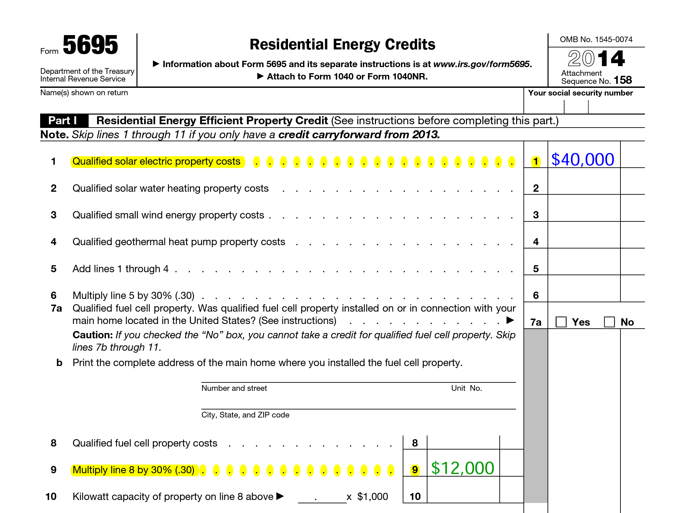
Residential Energy Credits

