Slide 1

Unlock Your Creative Potential in the Exhibition and Events Industry
MF

Slide 2

Curate Unforgettable Experiences
1
Concept Development
Brainstorm innovative ideas. Blend client goals with cutting-edge trends to create unique event concepts.
2
Design and Planning
Transform concepts into reality. Coordinate with vendors, artists, and tech experts to bring your vision to life.
3
Execution and Management
Oversee the event from start to finish. Ensure smooth operations and quick problem-solving during the big day.
4
Post-Event Analysis
Gather feedback and analyze results. Use insights to refine and improve future events.
Notes:
I’m so pumped to be here with you all as we dive into the exciting world of Exhibitions and Events! Whether you've hit up a trade show, an exhibition, or some epic event, you know it takes serious planning and teamwork to make the magic happen. Every event is a mix of creativity and strategy, giving businesses a stage to shine, professionals a chance to vibe, and ideas a space to spark. Today, we’re gonna break down this booming industry, from the awesome career opportunities to the behind-the-scenes action that makes it all work. We’ll talk roles, associations, and what it’s really like to be part of the event world. I hope you’re as stoked as I am to explore Exhibitions & Events together. There’s so much to uncover, and I can't wait to share the ride with you!

Slide 3

Thrive in a High-Energy Environment
1
Fast-Paced Decision Making
Develop quick thinking skills. Learn to make effective decisions under pressure and tight deadlines.
2
Adrenaline-Fueled Atmosphere
Experience the rush of live events. Feel the excitement as months of planning come to life.
3
Continuous Learning
Stay ahead of industry trends. Constantly update your skills in technology, design, and event management.
4
Team Collaboration
Work with diverse professionals. Build strong relationships with vendors, artists, and clients.
Notes:
Forget the daily grind! In the exhibitions and events world, no two days look alike. One minute you’re organizing a sleek, high-tech conference for industry moguls, and the next, you’re planning a wild pop-culture expo with cosplay contests and live DJs. The variety is endless, and every event has its own vibe, theme, and crowd—so you’ll never feel stuck doing the same thing. You’re not just an event planner; you’re a hype creator. Your job is to curate unforgettable experiences, blending epic visuals, cool tech, and just the right mood to give attendees something to talk about for years. Whether you’re designing futuristic LED displays or creating immersive social media-worthy moments, you’re setting the scene for people to have their minds blown. Here, creativity isn’t an afterthought—it’s at the core of everything.

Slide 4





Master the Art of Problem-Solving
Anticipate Challenges
Develop foresight to predict potential issues. Create detailed contingency plans for various scenarios.
Stay Calm Under Pressure
Maintain composure during unexpected situations. Lead your team with confidence and clear communication.
Innovate On-the-Fly
Think creatively to find unique solutions. Turn obstacles into opportunities for memorable moments.
Learn and Adapt
Reflect on experiences to improve future events. Continuously refine your problem-solving skills.
Notes:
You’re constantly dreaming up fresh ideas, from jaw-dropping stage setups to interactive brand experiences that get people talking (and posting!). You’re the architect behind how it all looks and feels, blending art, design, and innovation. It’s like being a DJ, but instead of spinning tracks, you’re remixing spaces and experiences. One of the coolest perks? You’re not limited to your zip code. The events world is a global stage, which means you could be hopping from planning a chill local festival to jet-setting for an international summit in Dubai or Barcelona.

Slide 5

Witness Immediate Impact
Real-Time Feedback
See immediate reactions from attendees. Gauge success through engagement and social media buzz.
Tangible Results
Experience the satisfaction of successful events. Watch as your vision comes to life before your eyes.
Personal Growth
Develop a diverse skill set. Grow professionally with each event you plan
and execute.
Lasting Memories
Create experiences that people remember for years. Be the architect of unforgettable moments.
Notes:
The industry connects you to a network that’s literally worldwide. So, if you’ve got wanderlust, consider this your golden ticket. If you’re into high-energy, fast-paced environments, this industry delivers. Events are all about adrenaline—from the planning rush to the thrill of showtime when everything comes to life. And let’s face it: the buzz of seeing your hard work transform into something spectacular is next-level. You’ll be part of a scene where things move fast, challenges pop up, and the excitement keeps building until the final curtain drops. In the events world, anything can happen, and you’re the person who makes sure the show goes on—rain, shine, or tech malfunctions. It’s like being on a live-action puzzle game where you’re always five steps ahead, coming up with solutions on the fly. Y

Slide 6
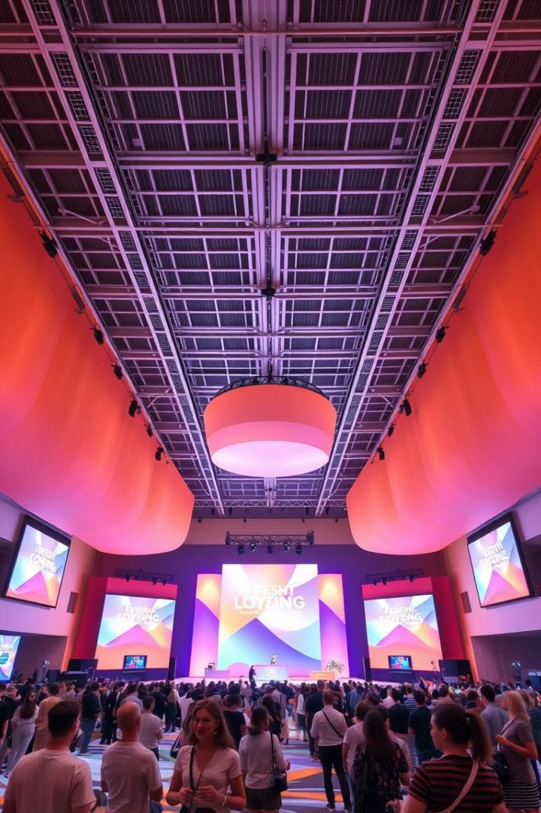
Industry Amplifier & Catalyst for Innovation
Trend Amplification
Events act as megaphones for industry trends. They accelerate the adoption of new ideas.
Market Pulse
Events gauge industry sentiment. They provide insights into market dynamics and consumer preferences.
Innovation Showcase
Events highlight cutting-edge developments. They push industries to continually innovate and improve.
Global Reach
International events connect global markets. They facilitate cross-border collaborations and idea exchange.
Notes:
You’ll become the one everyone trusts to make sure things run smoothly, even when the unexpected hits. Got a vision for how a space should feel? Well, this is where you get to turn it into reality. Whether it’s creating a chic networking lounge or setting up a neon-lit dance floor for an afterparty, you control the atmosphere. You’ll work with lighting, sound, visuals, and décor to create a vibe that people won’t just see—they’ll feel it. Unlike some careers where results take months (or years) to see, in this industry, you get instant feedback. The event happens, the crowd shows up, and you immediately see the impact of your hard work. The best part? Watching people light up as they engage with the experiences you’ve created. You’ll know you’ve nailed it when people can’t stop smiling, taking selfies, and sharing their experience on social media.

Slide 7
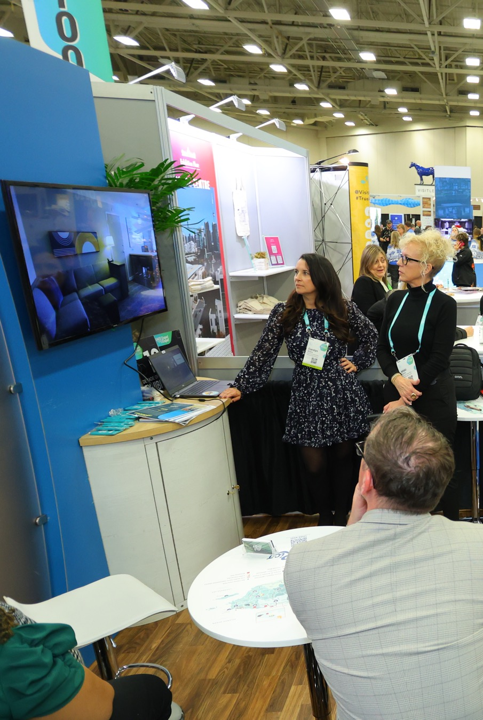
Let’s Explore the Diverse Career Paths….
MF
Notes:
In the exhibitions and events world, there’s no “one size fits all.” Whether you're a creative, a numbers whiz, or a hands-on builder, this industry has a career path with your name on it. Forget the idea that you have to fit into a single box. You can be a Booth Designer crafting Insta-worthy spaces, a Venue Manager running top-tier event venues, a Sales Executive negotiating big deals with global brands, or even a Show Contractor who gets to bring entire experiences to life from the ground up. There’s a role for every kind of talent, so whatever makes you tick, this industry has a spot for you. Think about the coolest event you’ve ever been to—maybe it was a killer music festival, a mind-blowing tech conference, or an exclusive fashion show. Guess what? Someone had to dream it up and make it happen. That could be you.

Slide 8
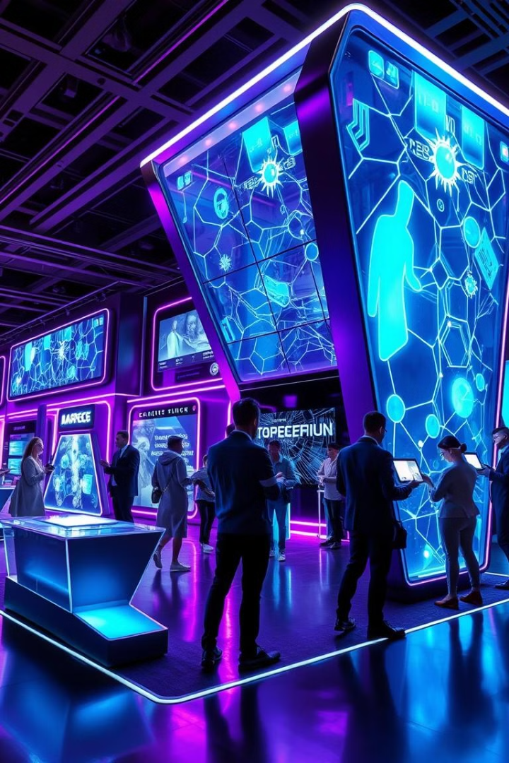
Booth Designer: Crafting Visual Experiences
Creative Freedom
Design eye-popping, attention-grabbing exhibits that make people stop in their tracks.
Large-Scale Impact
Your work gets seen by thousands, maybe even millions
of people.
Innovative Thinking
Think outside the box to create sleek, futuristic trade show booths and interactive brand experiences.
Notes:
Booth Designers get to think outside the box, creating eye-popping, attention-grabbing exhibits that make people stop in their tracks. Whether you’re designing sleek, futuristic trade show booths or interactive brand experiences, your canvas is as big as your imagination. And the best part? Your work gets seen by thousands, maybe even millions of people. So, if you’re into making things that wow, this is your time to shine. Love the hustle?

Slide 9
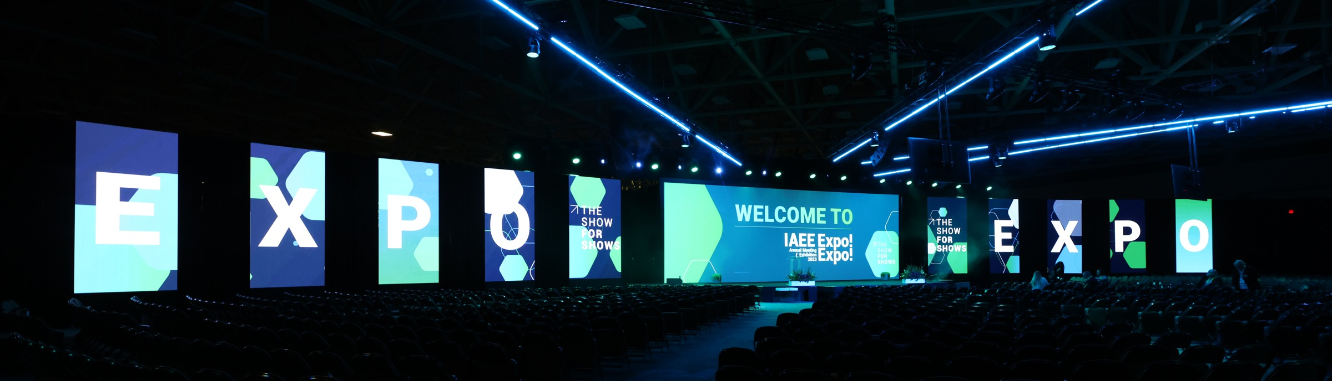
Event Professional/Show Producer: The Master Planner
1
Dream It
Conceptualize and design unforgettable experiences that leave a lasting impact.
2
Plan It
Coordinate all aspects of the event, from logistics to creative elements.
3
Execute It
Bring visions to life, overcoming challenges and creating memorable moments.
Notes:
Event Producers are the masterminds who design, plan, and execute experiences that leave a lasting impact. If you’re into big-picture thinking and want to be the one turning visions into reality, this is where you’ll thrive. Every day is a new challenge, and every project is a chance to create something unforgettable. If you’re all about design, style, and aesthetics, this industry has your creative side covered.

Slide 10




Sales Executive: Closing the Big Deals
Network
Connect with top brands and high-profile clients
in the industry.
Pitch
Sell experiences, opportunities, and the unique
value of events.
Close
Secure deals for booth spaces, sponsorships, and event partnerships.
Notes:
In the exhibitions and events industry, Sales Executives are the rockstars closing deals with top brands and high-profile clients. From selling booth space at world-class expos to securing sponsorships for the hottest festivals, you’ll be in the heart of the action. And because this industry is always evolving, you’re not just selling a product—you’re selling an experience, an opportunity, a vibe. It's fast-paced, it’s high-energy, and it’s perfect for anyone who thrives on making connections and sealing the deal.

Slide 11
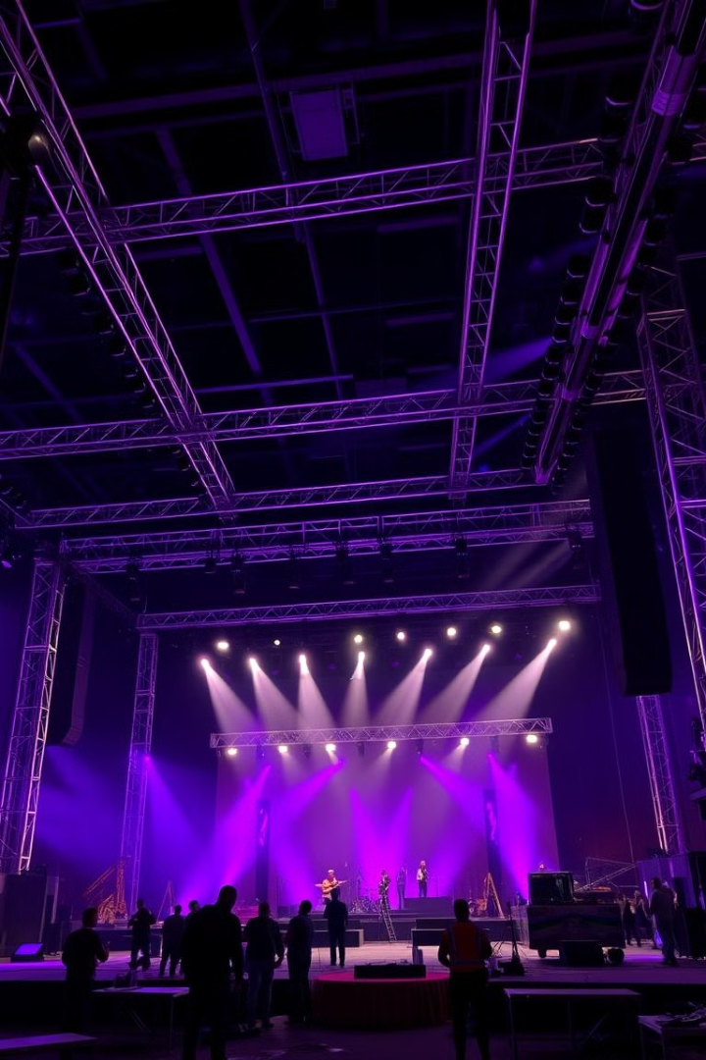
Show Contractor: Building Dreams from Scratch
1
Hands-On Creation
Transform blank spaces into jaw-dropping environments from the ground up.
2
Technical Expertise
Set up stages, install displays, and manage complex production elements.
3
Tangible Results
See your work take shape in real-time and witness the final product.
Notes:
If you love the thrill of bringing something to life from scratch, then a role like Show Contractor or Production Manager could be your dream gig. You’ll be in the trenches—setting up stages, installing mind-blowing displays, and transforming blank spaces into jaw-dropping environments. And when the event kicks off, you get to step back and see it all come together, knowing you helped make it happen. There’s something seriously satisfying about being hands-on and seeing your work literally take shape in real-time.

Slide 12




Venue Manager: The Logistics Mastermind
Coordination
Client Relations
Problem-Solving
Manage multiple event spaces and ensure smooth operations.
Work closely with vendors, clients, and staff to meet expectations.
Address challenges quickly to keep events running flawlessly.
Notes:
Have a knack for logistics and love being in control of it all? Venue Managers are the heartbeat of any event, ensuring that everything runs like a well-oiled machine. From managing multiple event spaces to coordinating with vendors, clients, and staff, you’ll make sure the event goes off without a hitch. And since venues are the backdrop for some of the coolest experiences out there—concerts, expos, conferences, and more—you’ll always be at the center of the action. If you love organizing, problem-solving, and making things happen, this role’s for you.
What makes this industry even cooler is that it’s constantly evolving. With new technology, trends, and challenges popping up all the time, you can carve out your own niche in ways you never thought possible. Want to work in Sustainable Event Planning? Virtual and Hybrid Event Design? Maybe you’ll even create the next big thing in event tech. The possibilities are endless, and as the industry changes, so will the opportunities. This isn’t a career where you get stuck doing the same thing over and over. It’s a world where you can keep reinventing yourself and finding new ways to thrive.

Slide 13

Climbing the
Career Ladder
1
Entry-Level Positions
Start your journey in roles like event coordinator or production assistant. Gain valuable experience and industry insights.
2
Mid-Level Management
Progress to event manager or production lead. Take on more responsibility and showcase your leadership skills.
3
Senior Roles
Reach positions like exhibition director or head of events. Lead large-scale projects and shape company strategies.
Notes:
As you gain experience, you'll have the chance to advance to more complex and higher-level roles. Whether it's moving into management positions or specializing in a particular type of event, the industry offers clear pathways for growth and new challenges that keep your career exciting and fulfilling. Various industry certifications, play a crucial role in professional development. They validate your skills and knowledge, making you stand out in a competitive job market. Certifications not only enhance your credibility but also provide you with up-to-date industry knowledge and best practices that can elevate your work and open new career opportunities. Earning certifications shows a commitment to your field and a willingness to invest in your growth. It’s a way to stay current with industry trends, improve your skills, and demonstrate your expertise to employers and clients.

Slide 14

Salary Expectations
Position
Average Salary Range
Event Manager
$50,000 - $80,000
Production Lead
$60,000 - $90,000
Exhibition Director
$80,000 - $120,000+
Notes:
In the events industry, as you ascend to positions like event manager, production lead, or exhibition director, you could be looking at average salaries ranging from $50,000 to well over $100,000, depending on your experience, the size of the events you manage, and the scope of your responsibilities. Additionally, when you venture down the entrepreneurial pathway and establish your own event company, the earning potential becomes even more enticing. Successful event entrepreneurs often enjoy six-figure incomes and beyond, with the added bonus of creating their own schedules and work environments. So, whether you're eyeing those high-paying managerial positions or considering blazing your own trail as an event entrepreneur, the events industry offers a landscape of lucrative opportunities that can help you achieve the financial prosperity you aspire to.

Slide 15

Factors Influencing Earnings
1
Experience
Years in the industry and track record of successful events can significantly boost your earning potential.
2
Event Size
Managing larger, more complex events often comes with higher compensation.
3
Scope of Responsibilities
Broader roles overseeing multiple aspects of events command higher salaries.
4
Industry Connections
A strong network can lead to better opportunities and higher-paying positions.
Notes:
Networking is your VIP pass to career acceleration. Meet the movers and shakers, and watch your opportunities explode. The right connections can open doors you didn’t even know existed! Great events are built by great people. By building relationships, you create a network of go-to vendors, creative partners, and industry mentors. It’s like having your own squad of superheroes. Knowledge is power, and your network is a treasure trove. From the latest trends to behind-the-scenes tips, your connections keep you in the know and ahead of the curve. Whether you’re planning a local meetup or an international extravaganza, a strong network means you’ve got connections all over the globe. Expand your horizons and bring diverse, exciting elements to your events! Great ideas often come from collaboration. Building relationships means you’ve got a team of innovators to brainstorm with, turning cool concepts into unforgettable experiences. The more people know and like you, the more buzz you can create around your events. Relationships translate to support, endorsements, and a crowd that’s excited to attend! Being known for your professionalism and reliability makes people want to work with you. Strong relationships build trust, and trust is the foundation of any successful event.

Slide 16





Skills for Success
Time Management
Master juggling multiple tasks and deadlines
to ensure flawless event execution.
Networking
Build strong relationships with vendors,
clients, and industry professionals.
Creativity
Develop unique event concepts that set
you apart from the competition.
Problem-Solving
Think on your feet to overcome unexpected
challenges during events.
Notes:
Did you know the exhibitions and events industry pumps billions into the global economy every year? That’s right—this sector is a major player in business and commerce, driving economic growth and creating jobs worldwide. From high-energy trade shows to dazzling product launches, events are big business, and you could be at the center of it all! Resilience and Everlasting Demand: No matter what’s happening in the world, events keep rolling. They’re a key part of how businesses connect, innovate, and thrive, even during tough times. This means there’s always a need for talented pros who can plan, organize, and execute unforgettable events. Your skills will always be in demand, making it a stable and exciting career path.

Slide 17

Your Journey Starts Now
Educate Yourself
Take courses in event management. Stay updated on industry trends and technologies.
Gain Experience
Volunteer for events. Intern with established companies. Build your
portfolio.
Network Actively
Attend industry conferences. Join professional associations. Connect with mentors.
Set Clear Goals
Define your career path. Create a roadmap for achieving your financial aspirations.
Notes:
Step into the whirlwind world of exhibitions and events that traverse continents, giving you the opportunity to groove with diverse cultures and collaborate with international teams. It's like fueling your career with a cocktail of vibrant global experiences, opening your mind to new perspectives and innovative approaches from around the world. Immerse yourself in the dynamic industry that hones your awareness of global business and cultural nuances. This isn't just about being in the know - it's about mastering the art of navigating the intricacies of different cultures, fueling your adaptability and adding that extra dash of cool to your professional persona in a world where connections and cultural understanding are key.

Slide 18

Your Future in Events: Endless Possibilities
1
Start Your Journey
Choose a path that aligns with
your skills and passions.
2
Grow and Adapt
Embrace new challenges and stay
ahead of industry trends.
3
Make Your Mark
Create unforgettable experiences
and shape the future of events.
Notes:
Check it - the events industry isn't just about throwing epic parties and jaw-dropping conferences. It's like the secret sauce that spices up so many other industries, injecting a hefty dose of adrenaline and inspiration. From tech and hospitality to fashion and entertainment, events bring these scenes together, creating a melting pot of ideas and innovation. It's where new trends are born, partnerships are forged, and game-changing collaborations spark into life. Events are the hype machines that give industries a major visibility boost. They're the platform where businesses, brands, and talents showcase their A-game, drumming up excitement and setting the stage for industry-wide success. Think of events as the megaphone that amplifies the voices of industries, shining a spotlight on their latest achievements and pushing the boundaries of what's possible. It's like the jet fuel that propels these scenes to new heights, and it's all happening in the sizzling world of events.

Slide 19

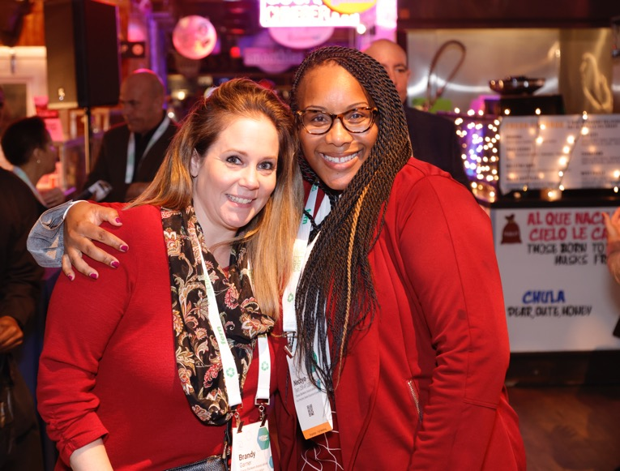

Next Steps
1
Explore Careers in the Exhibitions
and Events Industry
2
Apply for Industry Scholarships
3
Learn More
4
Reach Out
Notes:
Explore Careers in the Exhibitions and Events Industry: Inspire the audience to learn about the diverse opportunities within our field.
Apply for Industry Scholarships: Highlight the resources available to help them pursue education and training in this space.
Learn More: Direct them to our websites for additional information on how to get involved, access resources, and stay informed.
Reach Out: Encourage them to connect with us directly if they have questions or need guidance.

Slide 20

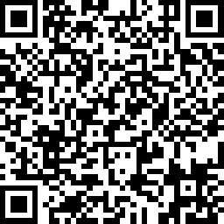
The Exhibitions Industry Collective is comprised of six key industry organizations including the Exhibitions & Conferences Alliance (ECA), Exhibition Services & Contractors Association (ESCA), Experiential Designers & Producers Association (EDPA), International Association of Exhibitions & Events (IAEE), International Association of Venue Managers (IAVM), and the Society of Independent Show Organizers (SISO).
Our Mission
We aim to use our shared knowledge to create a visible, meaningful, and lasting foothold on careers in the exhibition’s ecosystem.
This presentation’s intended use is for business events professionals to educate those looking to explore careers in exhibitions and events. Visit the Collective website for our job board and additional resources.
The content, logos, trademarks, and other intellectual property associated with the Exhibitions Industry Collective are protected by applicable laws. Any use, reproduction, modification, or distribution of its materials, including but not limited to print, digital, or incorporation into generative AI systems, without express written permission from the Exhibitions Industry Collective is strictly prohibited. For permissions or inquiries, please contact Tommy Goodwin tommy.goodwin@exhibitionsconferencesalliance.org.
www.exhibitionsindustryawareness.com
Take Our Survey!

