Slide 1

Understanding and Using
Nutrition Labels
Audio, w/ CC. Title & Logo fade in.
Welcome to PlateSmart Initiative!
Your health is important, and eating right is one of the major factors that influences your well-being. In this module, we will take a look at one important strategy you can use in your daily life to make healthier food decisions for every meal: understanding and using nutrition labels.
Click “Begin” when you are ready.
BEGIN

Slide 2
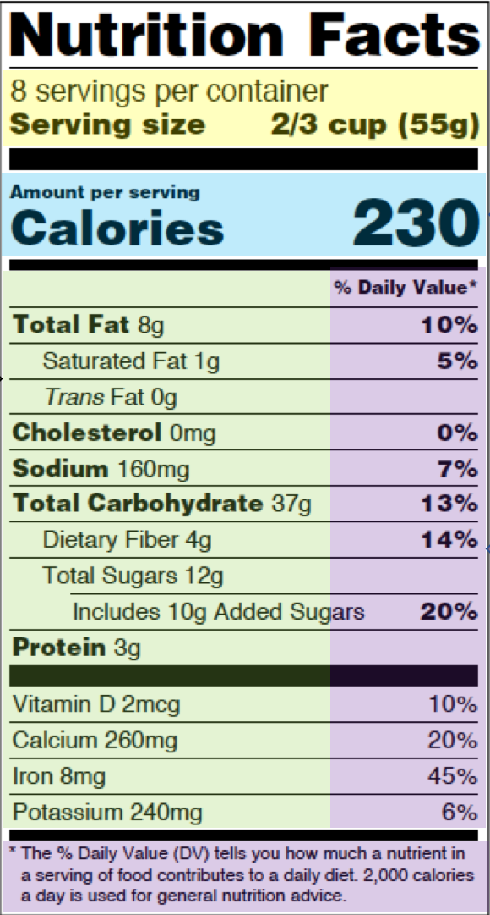
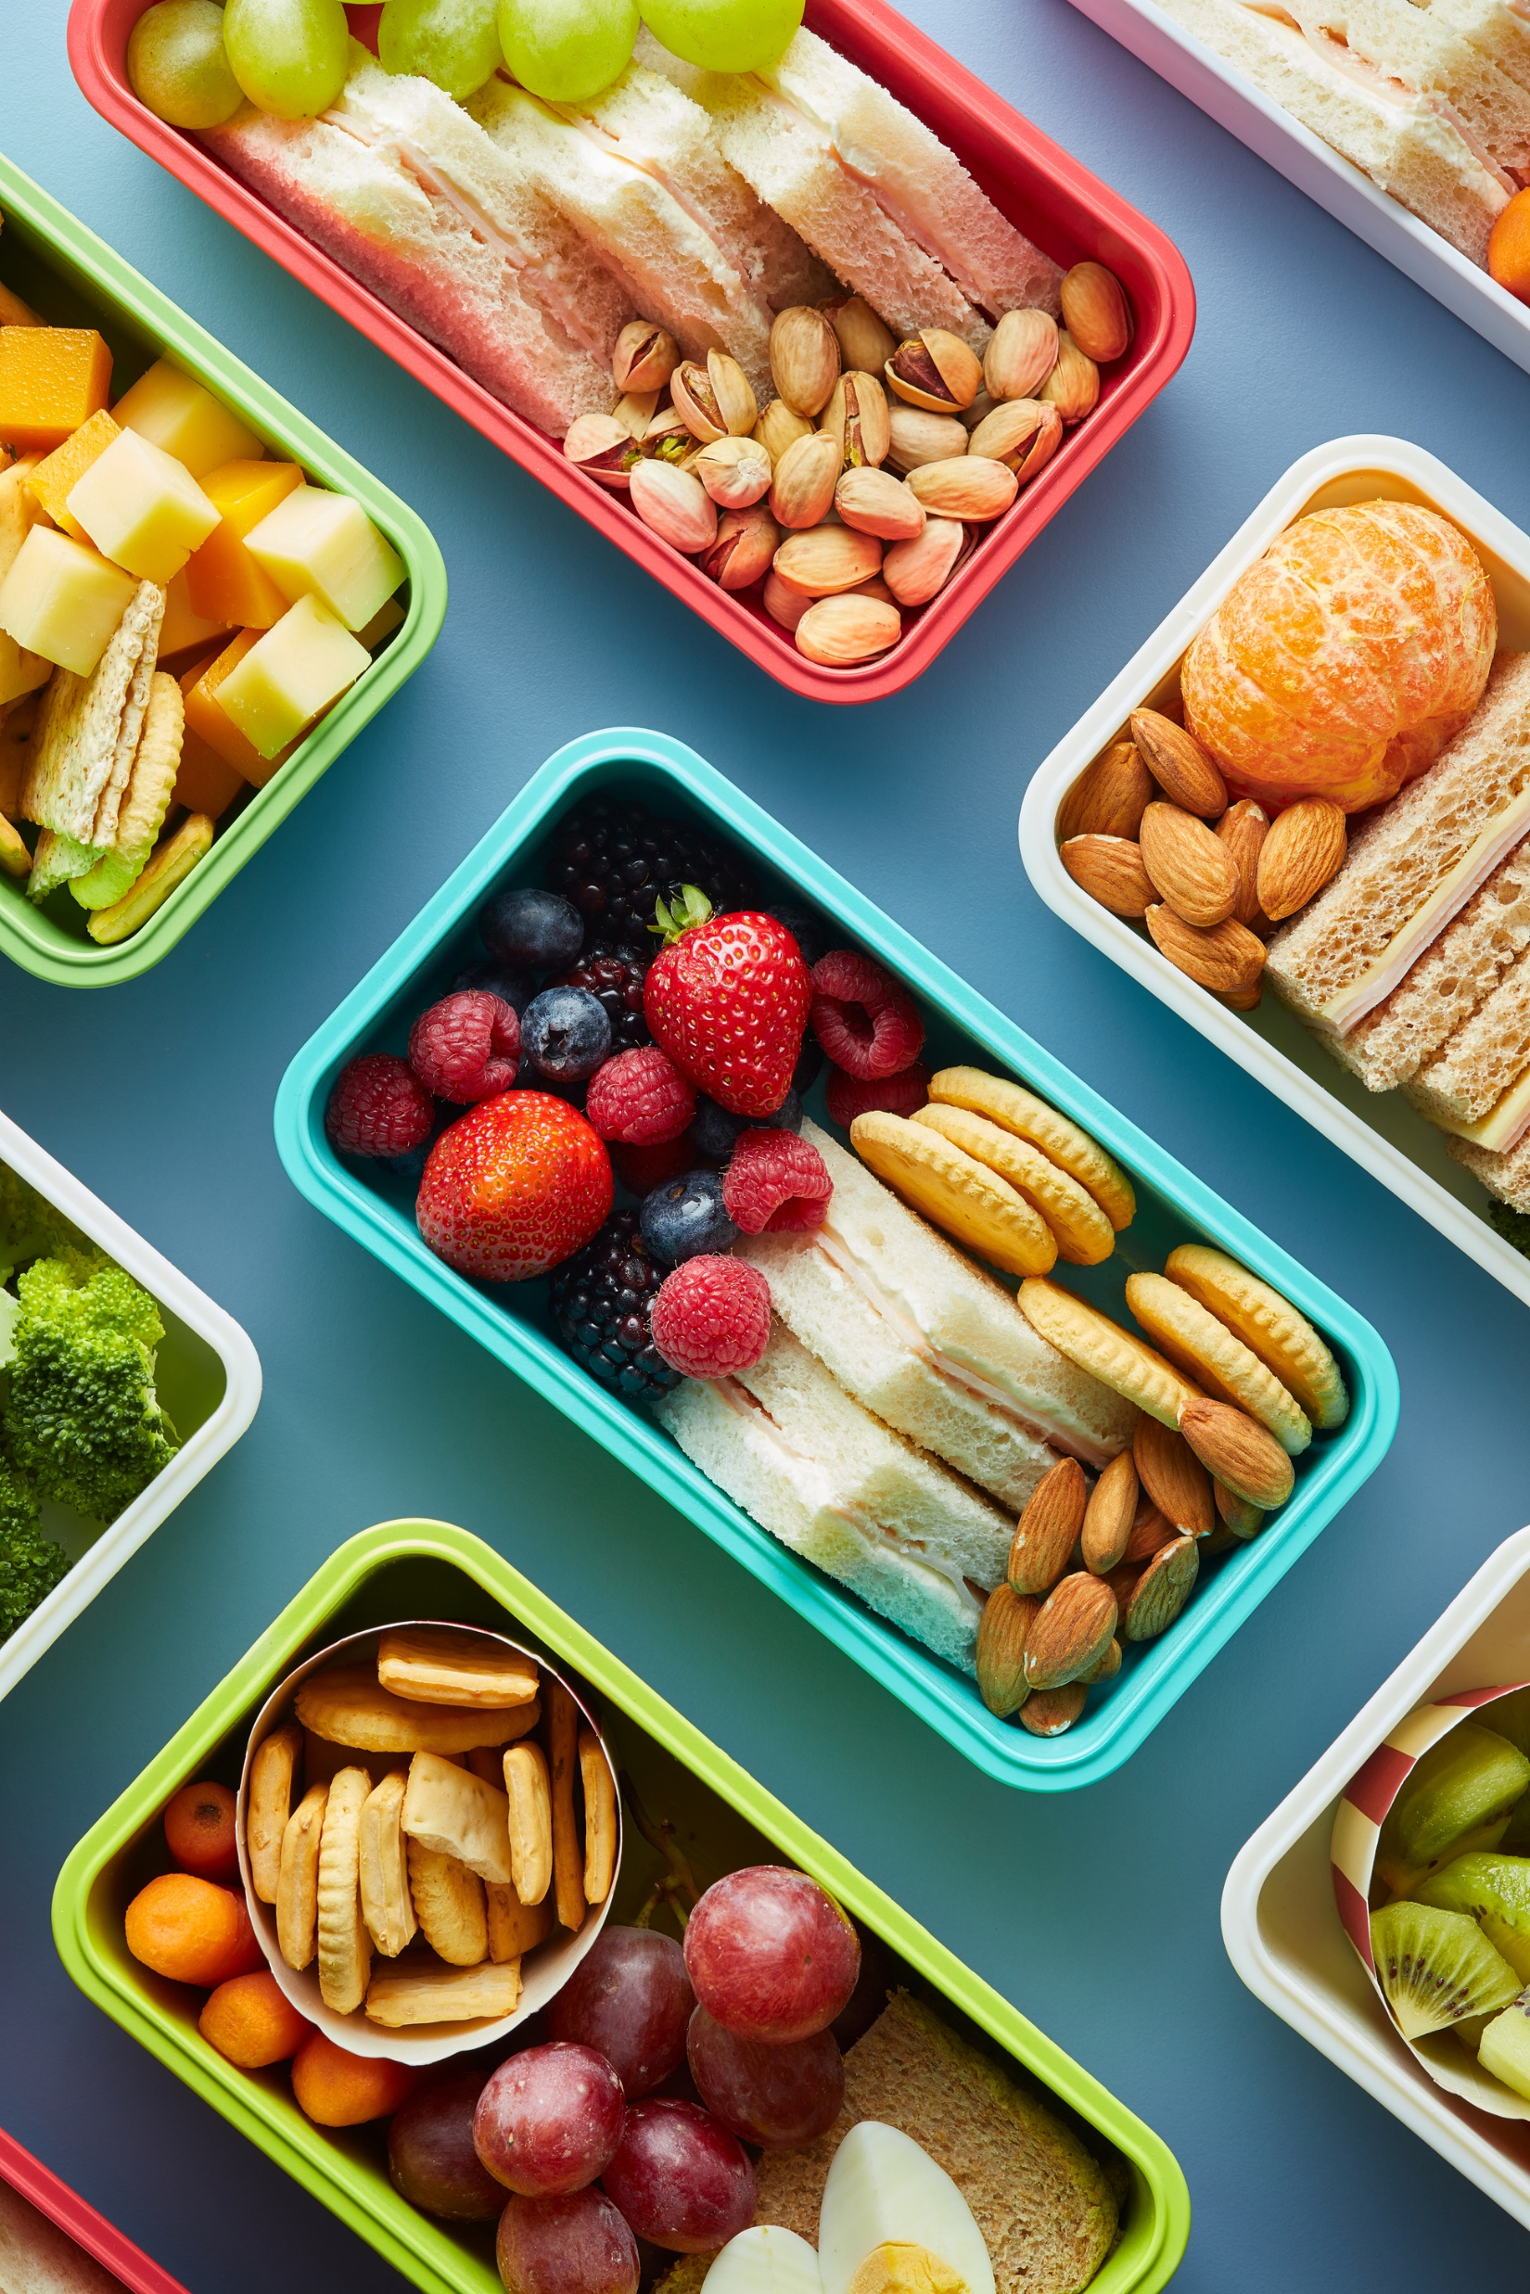

Objectives:
TEXT, animates in; audio accompanies:
By the end of this module, you’ll be able to:
Identify the different parts of a nutrition label
Determine whether a particular food meets your dietary requirements
Organize a healthy meal using nutrition label information to guide your choices
Continue
Pictures animate in
This Photo by Unknown Author is licensed under CC BY-SA-NC

Slide 3
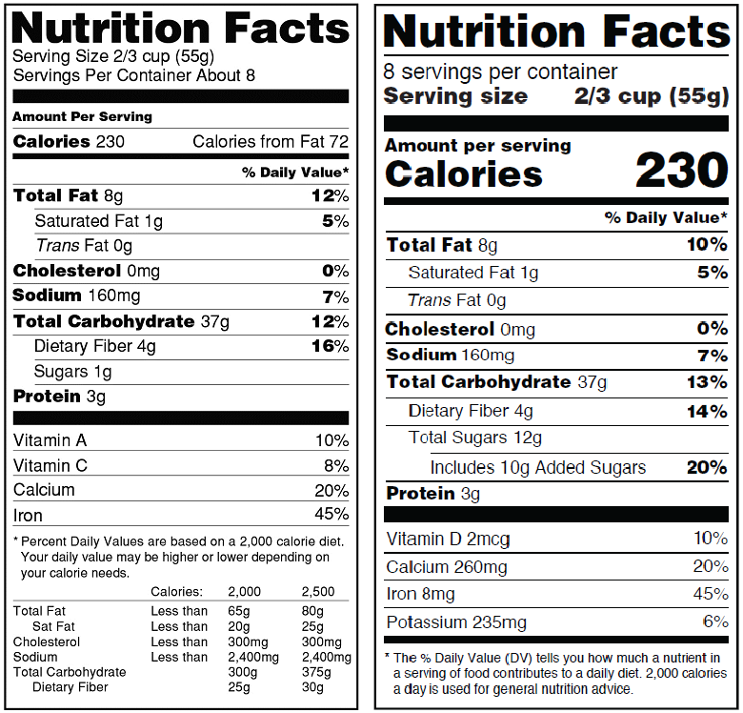
What is a Nutrition Label?
TEXT, animates in; audio accompanies:
Nutrition labels are tools for making healthy daily decisions about the foods we eat.
Nutrition labels:
Are found on most packaged food and beverages
Provide information about the nutritional content of the food
Can be used to compare food items to select the healthier option
You’ve probably seen them before, but let’s take a loot at a nutrition label more closely together.
This Photo by Unknown Author is licensed under CC BY-SA-NC
Continue

Slide 4
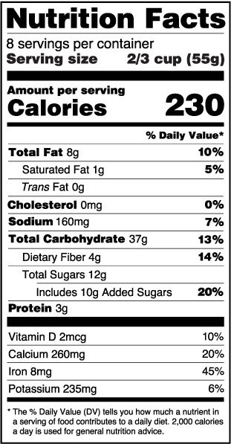
Instructions with Audio:
Select each section of the nutrition label to learn more about it.
User will click highlighted areas of the nutrition label and receive corresponding information:
Calories – calories are how much energy a food provides us. Calorie needs can vary by individuals’ age, sex, height, weight, and physical activity level, but most labels use a 2000 calorie diet as a standard reference.
Serving size – how much of the food is the recommended amount to be eaten at one time. Consider the amount of one serving versus the amount of servings in a whole container or unit of the food. If you plan to eat multiple servings, you will need to multiply the nutrition information accordingly. For example, two servings of a 150 calorie food comes to 300 calories.
Percentage daily value – the percentage of the recommended daily amount of a nutrient to receive in a day. Less than 5% is considered a low amount of a nutrient, while over 20% is considered a high amount of that nutrient.
Nutrient list – the different macronutrients (proteins, carbs, sugar, fats) and micronutrients (vitamins and minerals) are listed here.
Continue
This Photo by Unknown Author is licensed under CC BY-SA-NC

Slide 5
What to consider:
AUDIO ONLY:
Once you understand the parts of a nutrition label, it is easy to start using them to make healthier choices about the food you eat.
AUDIO AND TEXT, animated in:
As you read the label, take the following into consideration:
Determine the single serving information – how big is one serving? How much are you planning to eat?
AUDIO: This will influence the total amount of calories and nutrients that you consume.
Know what nutrients to limit. Some nutrients such as added sugars, saturated and trans fats, and sodium should be limited.
AUDIO: In general, a percent daily value of 5% or lower is considered a low amount of a nutrient in a food. Look for foods with a low amount of added sugars, saturated and trans fats, and sodium.
Know what ingredients to get enough of, such as fiber, protein, and vitamins and minerals like calcium, potassium, iron, and vitamins A, C, and D.
AUDIO: In general, a percent daily value of 20% or higher is considered a high amount of a nutrient in a food. Look for foods with higher % daily values of fiber, protein, and desirable minerals and vitamins.
Animate on the side with audio:
5% = low daily value
20% = high daily value
Continue

Slide 6
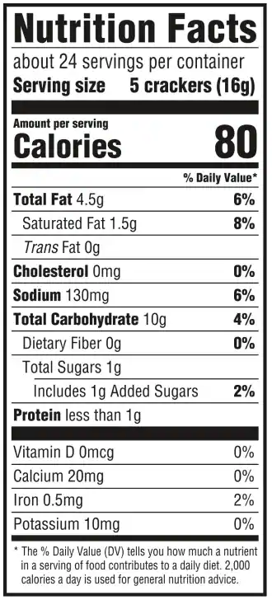
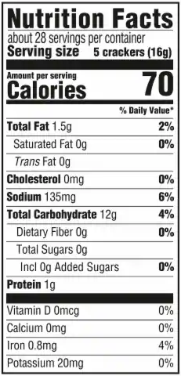
Audio: Consider the following nutrition labels for different snack crackers. We can see that both have a serving size of 16 grams or 5 crackers, but the number of calories, fat, sodium, and carbohydrates differs.
Audio cont’d + text animated: If we consider limiting saturated fats to be our nutrition goal, which option is the better choice? Select the option you think is best.
User Clicks Label 1 (feedback, audio & text)
Not quite! According to this label, there are 1.5 grams or 8% of the daily value of saturated fat in Product 1, compared to 0 grams in Product 2. If we’re looking to lower our intake of saturated fat, then product 2 is a better choice.
**highlight Saturated Fat line on the label
Product 1
Product 2
User Clicks Label 2 (feedback, audio & text)
Correct! According to this label, Product 2 has 0 grams of Saturated fat, while Product 1 has 1.5 grams, or 8% of the daily value. If lowering our intake of Saturated fats is the goal, then product 2 is the better choice.
**highlight Saturated Fat line on the label
Audio + animated button: Let’s try another one
Continue

Slide 7
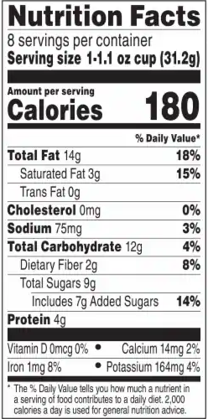
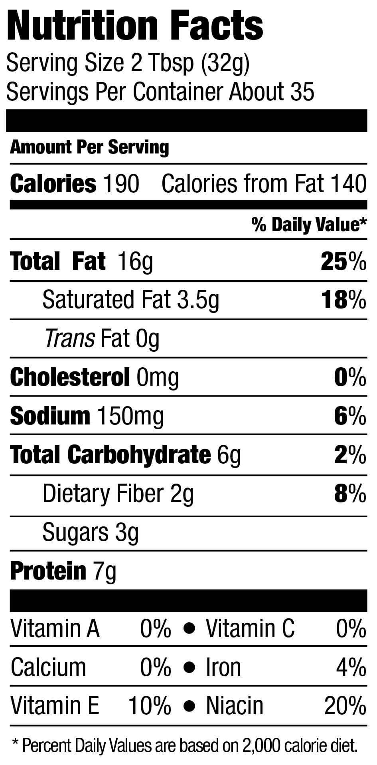
Audio: Consider the nutrition labels for two different types of peanut butter below.
Audio cont’d + text animated: If we consider limiting sodium to be our nutrition goal, which option is the better choice? Select the option you think is best.
User Clicks Label 1 (feedback, audio & text)
Correct! According to this label, Product 1 has 75mg or 3% of the daily value of sodium, while Product 2 has double that, at 150mg or 6% of the daily value. Good choice!
**highlight Sodium line on the nutrition label
Product 1
Product 2
User Clicks Label 2 (feedback, audio & text)
Not quite! Product two has 150 mg of sodium, which is 6% of the daily value, while product 1 has only 75mg, or 3% of the daily value. That’s half as much! Therefore, product 1 is the better choice.
**highlight Sodium line on the nutrition label
Continue
Audio + animated button: Let’s plan a meal.

Slide 8
Let’s Plan a Meal! (branched scenario)
AUDIO: This exercise is going to put together what you have learned to plan a healthy meal.
Your goal for this meal is to increase protein and fiber, and reduce added sugar as you craft a peanut butter sandwich. Review the nutrition labels for each ingredient option to select the healthiest nutrition option.
TEXT:
Goal:
increase protein and fiber
Reduce added sugar
Select the best option from each category
Continue

Slide 9
Branching Scenario Path:
User selects an option from each pair of choices. The user received feedback on their selection as they go with a counter on each slide indicating the amount of protein, fiber, and added sugar.
Final result slide the user received their nutrition score and feedback on how effective their choices were.

Slide 10
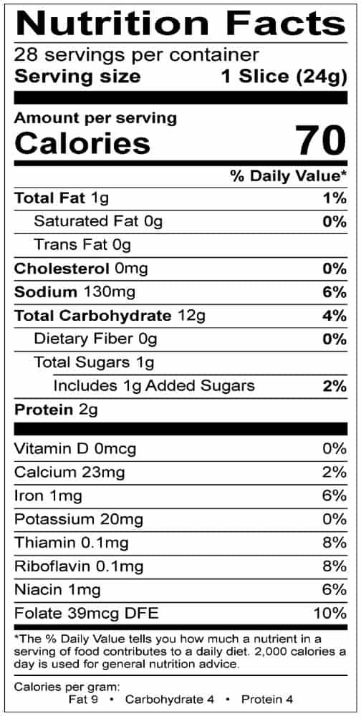
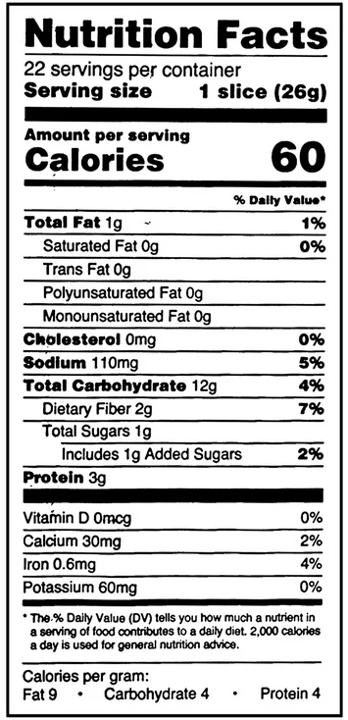
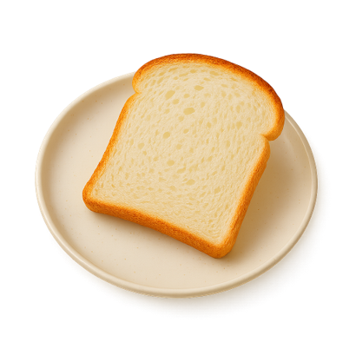
Choose a Bread!
Counter
(Updates on Each Slide Level)
Fiber: 0
Protein: 0
Added Sugar: 0

Slide 11
When user selects a bread on the previous slide, they will go onto the next slide for selecting a peanut butter. The counter on the screen will show the nutrients score carried over from the previously selected slide (i.e. bread choice)
Bread 1
Fiber: 0g
Protein: 2g
Added Sugar: 1g
Bread 2
Fiber: 2g
Protein: 3g
Added Sugar: 1g

Slide 12
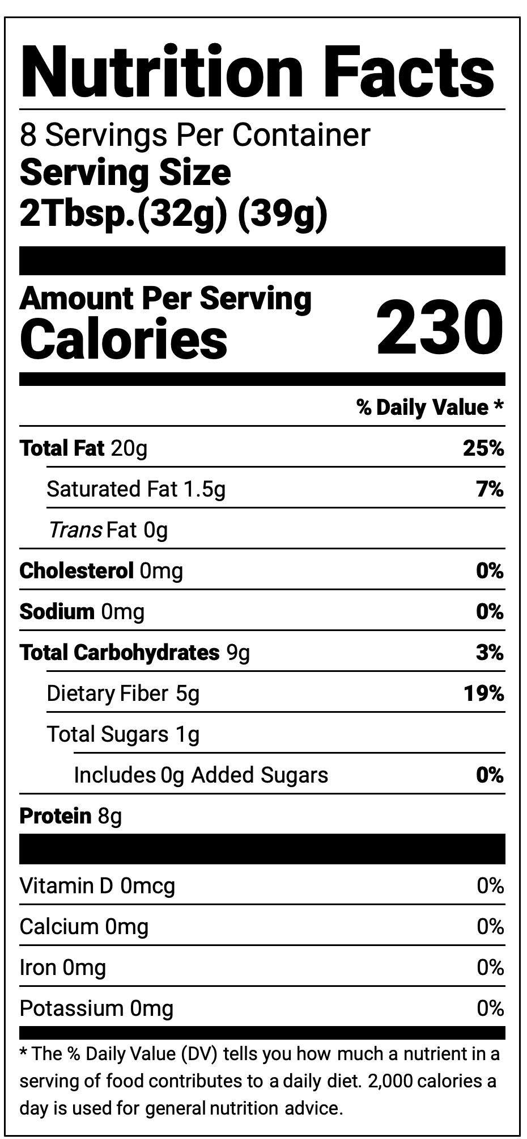
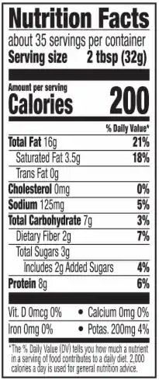
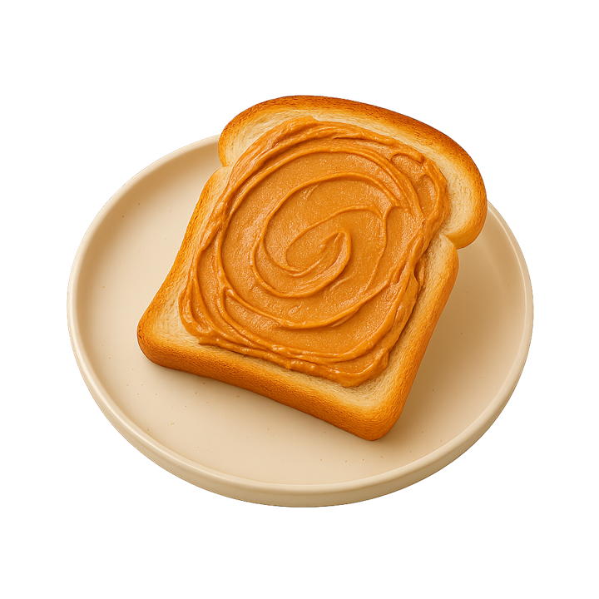
Choose a Peanut Butter!
Counter will show “bread score” based on previous select.

Slide 13
Bread 1 + PB1
Fiber: 5g
Protein: 10g
Added Sugar: 1g
Bread 1 + PB2
Fiber: 2g
Protein: 10g
Added Sugar: 3g
Bread 2 + PB1
Fiber: 7g
Protein: 11g
Added Sugar: 1g
Bread 2 + PB 2
Fiber: 4g
Protein: 11g
Added Sugar: 3g
After selecting their peanut butter, the user will be moved to the jelly slide. Their counter will show the running total of nutrients for their bread + peanut butter score from the previous two choices. The slide layouts will be the same except for the counter showing the nutrient scores.

Slide 14
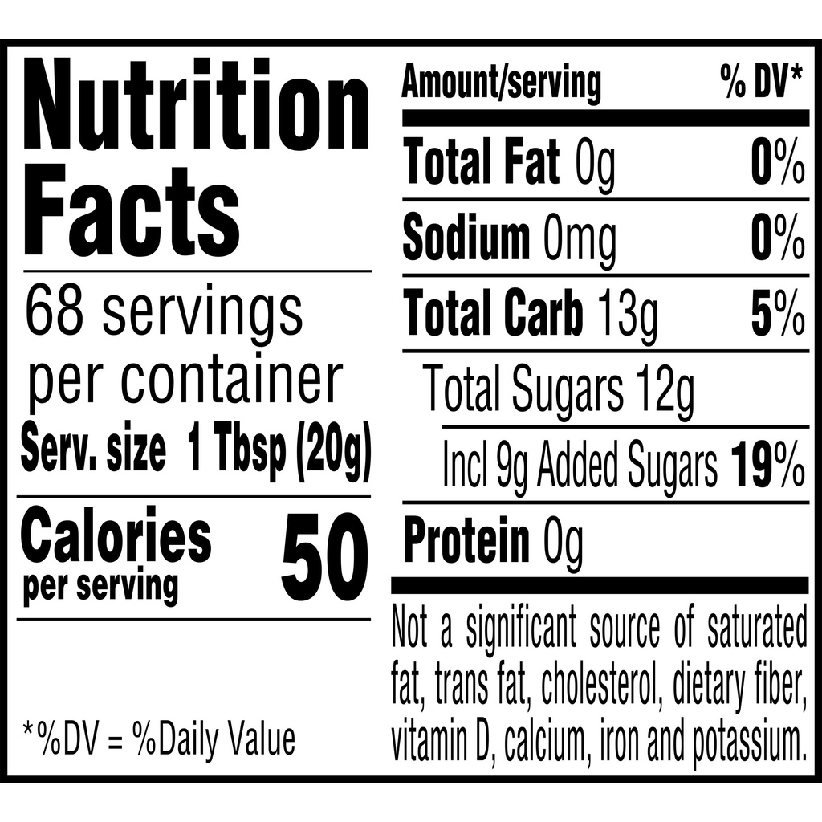
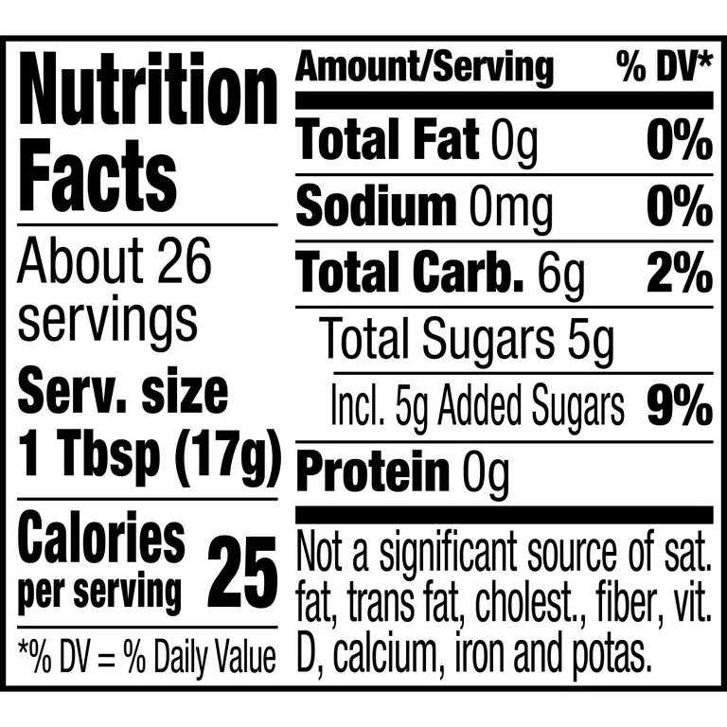

Choose a Jelly!
Counter will show “bread + PB score” based on previous select.

Slide 15
Bread 1 + PB1 + Jelly 1
Fiber: 5g
Protein: 10g
Added Sugar: 10g
Bread 1 + PB2 + Jelly 2
Fiber: 2g
Protein: 10g
Added Sugar: 8g
Bread 2 + PB1 + Jelly 1
Fiber: 7g
Protein: 11g
Added Sugar: 10g
Bread 2 + PB 2 + Jelly 2
Fiber: 4g
Protein: 11g
Added Sugar: 12g
Bread 1 + PB1 + Jelly 2
Fiber: 5g
Protein: 10g
Added Sugar: 6g
Bread 1 + PB2 + Jelly 1
Fiber: 2g
Protein: 10g
Added Sugar: 12g
Bread 2 + PB1 + Jelly 2
Fiber: 7g
Protein: 11g
Added Sugar: 6g
Bread 2 + PB 2 + Jelly 1
Fiber: 4g
Protein: 11g
Added Sugar: 8g
Results Slides will include feedback with the total fiber/protein/sugar score. The “best” selection will have a “continue button” while the other slides will have a “try again” button to return to the start of the scene.

Slide 16

Review!
Questions to Review Content (multiple choice)
What is the purpose of a nutrition label? (to describe the nutritional information about a food and allow us to make healthy choices about what we eat)
What does the calorie count of a food indicate? (the amount of energy that a food gives us)
Which nutrients should we limit or avoid? (sat/trans fats, sodium, added sugar)
Which nutrients should we aim to get more of? (fiber, protein, minerals/vitamins)
What %DV is considered a “high” amount of a nutrient? >20%
What %DV is considered a “low” amount of a nutrient? <5%
Finish Lesson

