Slide 1
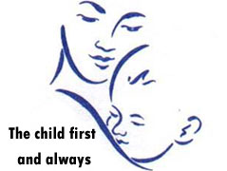

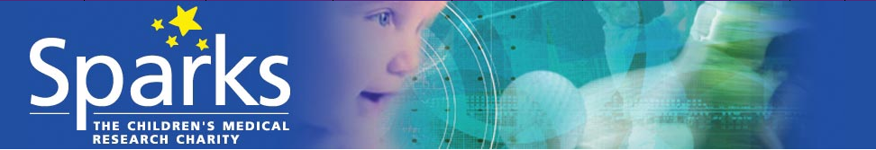


Modelling neonatal intraventricular haemorrhage using organotypic samples from the wall of the lateral ventricle
Dawes WJ, Obernier K*, Tisdall M
Great Ormond Street Hospital London
*University of California, San Francisco
Notes:
Morning and thank you for the opportunity to speak, my name is William Dawes and I’m an ST8 based at Queens Square and Great Ormond Street
Today I’m going to talk to you about how we can use organotypic samples from the wall of the lateral ventricle to investigate how haemorrhage impacts on the ependyma and underlying SVZ

Slide 2
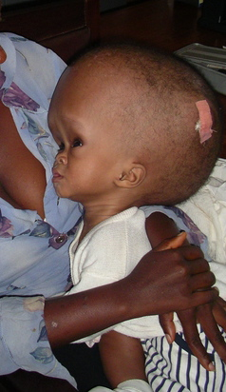
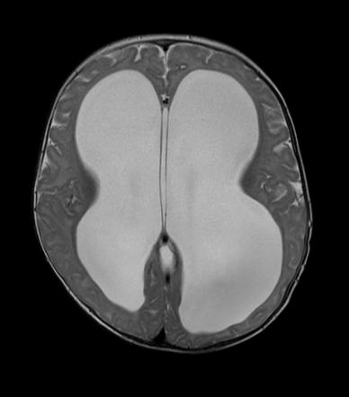

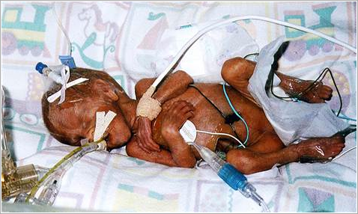

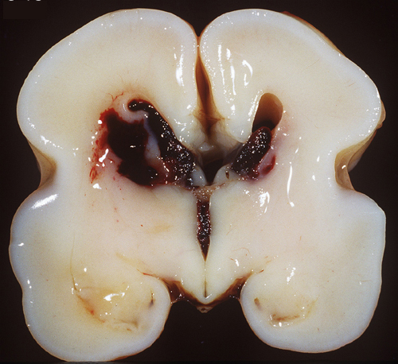
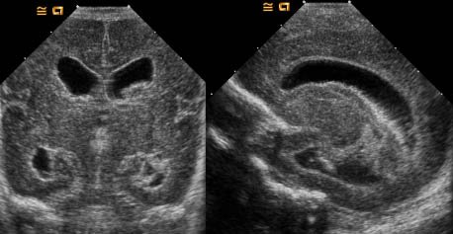
HYDROCEPHALUS
NEONATAL INTRAVENTRICULAR HAEMORRHAGE (IVH)
?
NEURODISABILITY
Through what mechanism does IVH impact on the ependyma and underlying Subventricular Zone..?
Is this process amenable to intervention..?
Notes:
As we all know despite improvements in perinatal care which reduced the incidence of IVH, PHH secondary to IVH remains the most common cause of hydrocephalus in children, similarly whilst outcome following low grade haemorrhage confined to the germinal matrix remains unclear the presence of IVH and in particular PHH is significantly associated with poor Neurodevelopmental outcome.
The question then is
(1) Through what mechanism does IVH impact on the ependyma and underlying SVZ
(2) Is this process amenable to intervention - can we in some way reduce the secondary impact of IVH both to reduce the rate of hydrocephalus and to improve Neuro developmental outcome..?
Stagger the presentation of slide 2 - start with Neonatal IVH then reveal hydrocephalus and disability then the black box
Then

Slide 3
?
CURRENT UNDERSTANDING
HUMAN AUTOPSY STUDIES
ANIMAL STUDIES
CSF ANALYSIS
ADVANCED RADIOLOGY
NEUROENDOSCOPY
?ORGANOTYPIC SAMPLE ANALYSIS / ‘LIVE-SLICE’ SAMPLES
Notes:
Direct visualisation of the ependyma using neuroendoscopy - this demonstrates islands of haemosiderin staining and areas of adhesions
Radiological assessment - connectomes work in prematurity is gathering pace but remains quite a blunt tool - macroscopic overview - whitelaw tool for assessing brain development
Human Autopsy studies - implicate ependymal denudation and underlying white matter change dominiquez peres work
Animal studies - physiological and injection models - implicate skewed NSPC development and impact on postnatal migration of cells
CSF analysis - implicate the inflammatory/ cytokines soup hypothesis with the role of TGFbeta

Slide 4
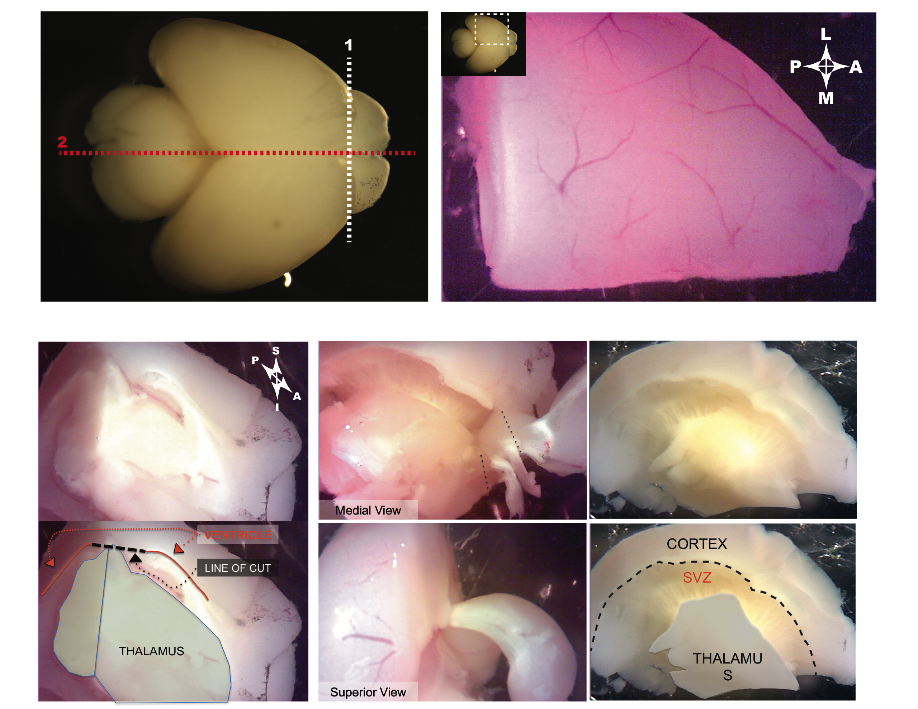
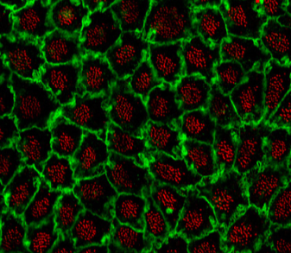
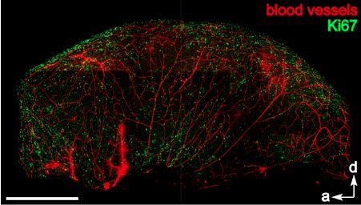
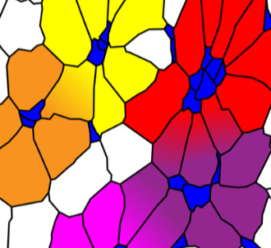
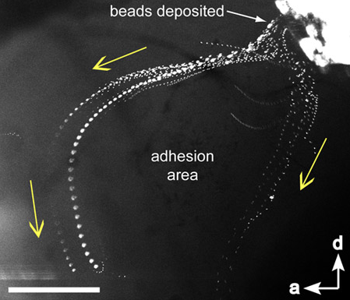
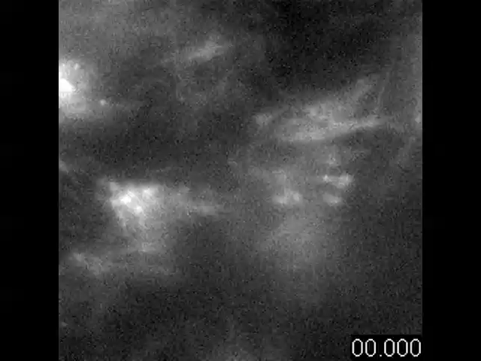
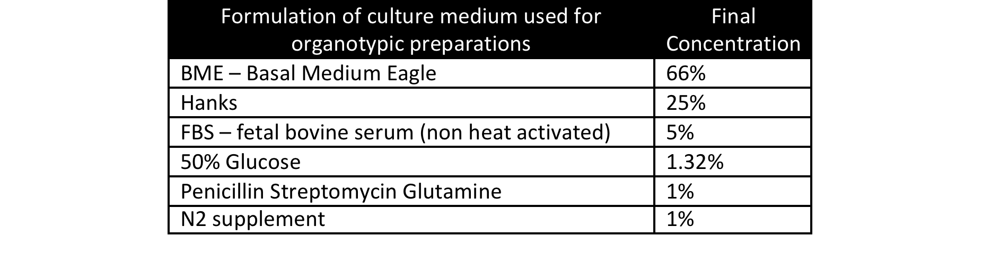
WHOLE MOUNT PREPARATION
Cell 2008
ORGANOTYPIC SLICE PREPARATION
Notes:
Organotypic or live slice samples can be used to monitor and observe the impact of IVH
There are various different ways that this can be done but in essence the technique allows dynamic assessment of the wall of the lateral ventricle
Obtaining samples of the SVZ from the newborn mouse pup is a relatively straightforward procedure - the pup is culled and the brain removed - it is then divided in the midline and the brain stem removed revealing the lateral wall of the lateral ventricle
This paper thin sample can then be maintained in artificial medium and used to assess - ependymal flow, cilia beat frequency, activity of the NSPC

Slide 5
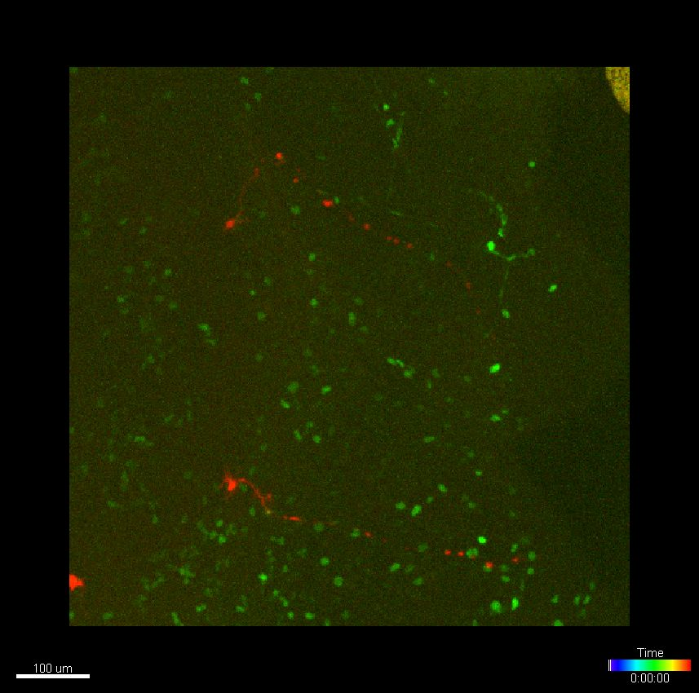
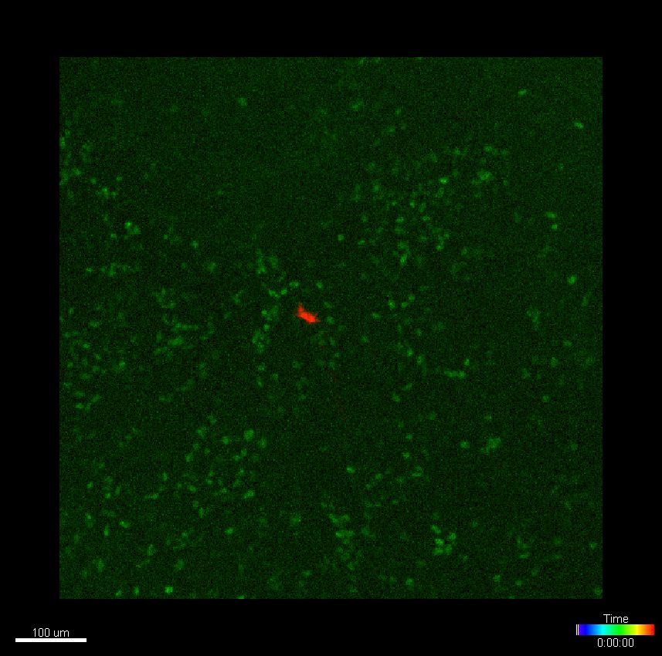
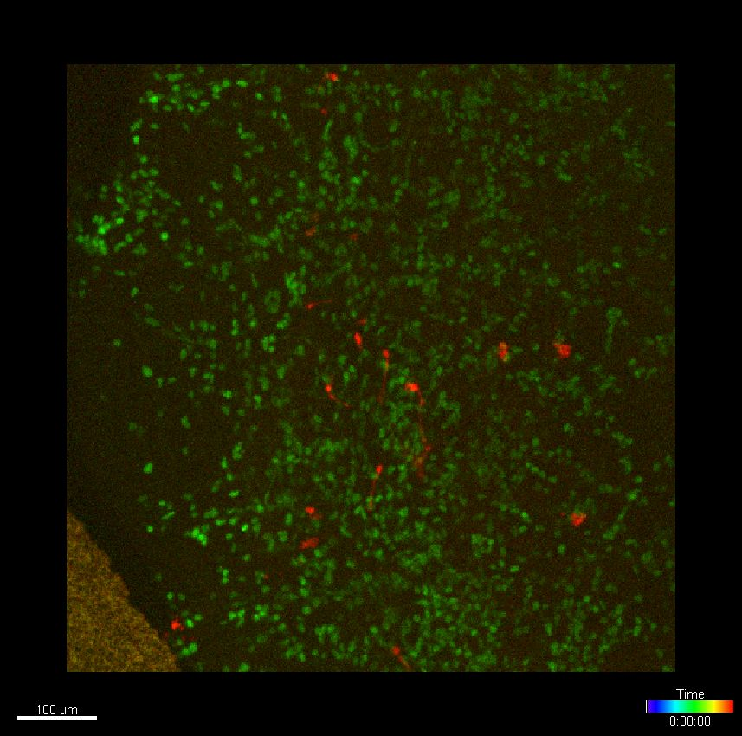
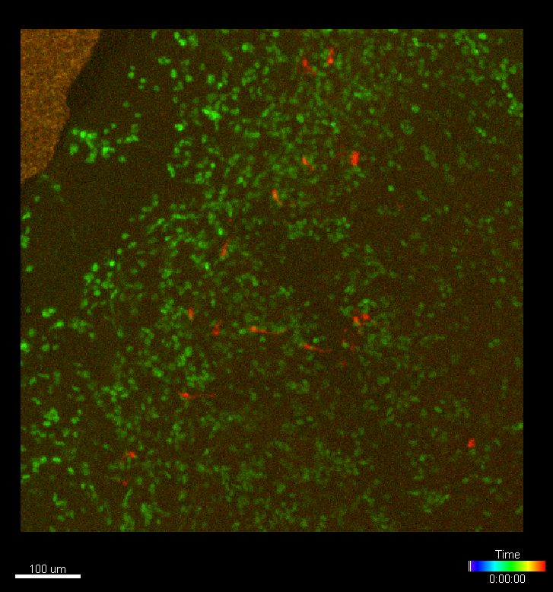
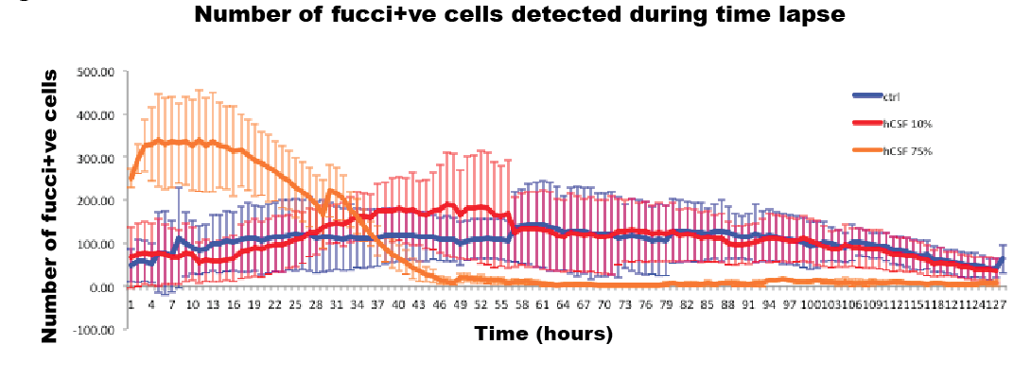
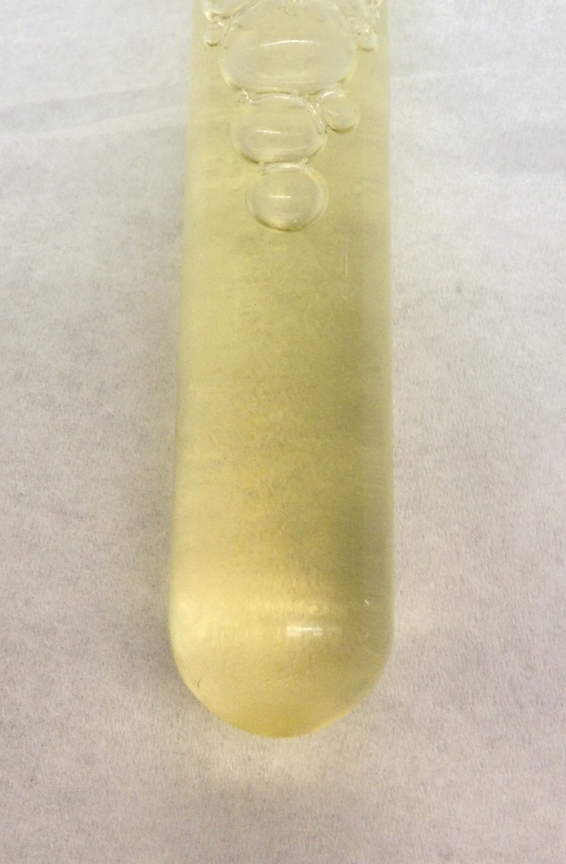
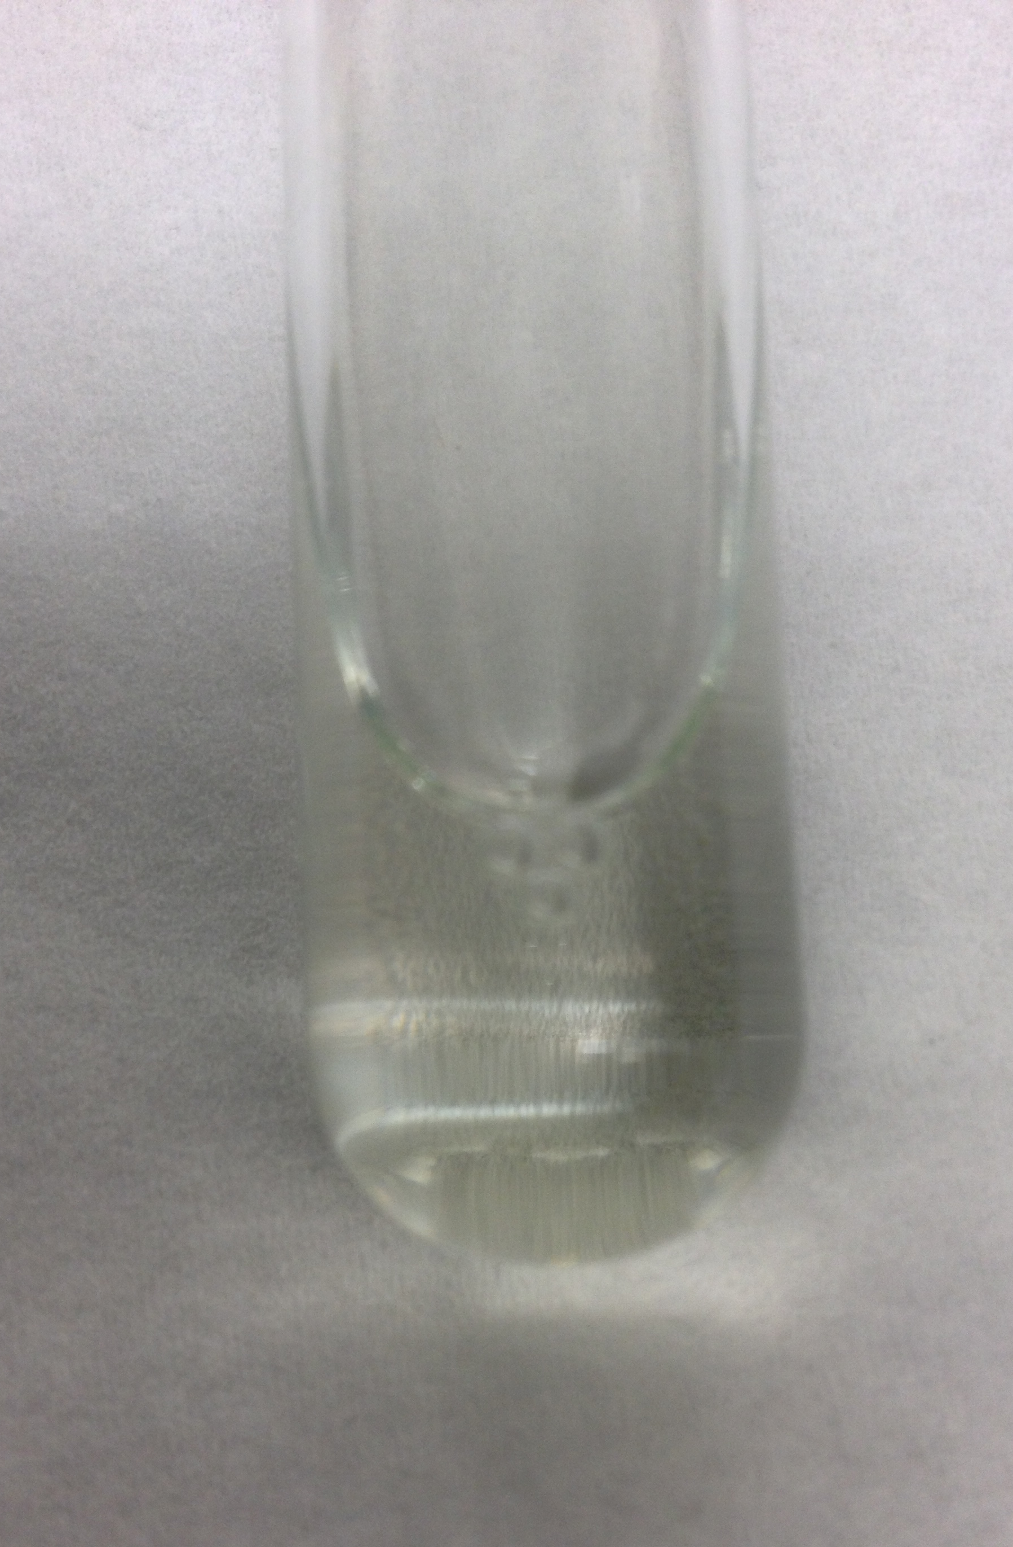
High concentration of human CSF in the culture medium significantly increased early proliferation in the wall of the lateral ventricle
STANDARD MEDIUM AT TIME POINT ZERO
‘CLEAR CSF’ MEDIUM
Xanthochromia
Clear CSF
Notes:
To assess how xanthochromic CSF might impact on the SVZ we took two samples of CSF one aspirated from a VAD - the other aspirated from a spina bifida repair - we tried various concentrations added to the standard medium and found that Xanthochromic CSF essentially shut down cell division / fluorescence - whilst clean CSF showed significantly increased early proliferation..?
Again these are preliminary results but they demonstrate that there are questions to be answered and potentially a rich seam of research in determining the mechanism through which IVH impacts on the SVZ

Slide 6
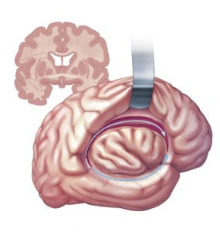
CSF collection and analysis from neonates with intraventricular haemorrhage approval for use in animal and human studies
IRAS ID: 198936
Rec Reference: 16/LO/1792
Disconnection Hemispherotomy for the treatment of medically intractable epilepsy exposes the wall of the lateral
FUTURE
PLANS
IRAS ID: 247396
Rec Reference: 18/LO/1275
Notes:
The next iteration of the project is to continue to collect human CSF for the mouse studies
& to collect samples of the human lateral ventricle - SOLVe trial - essentially taking samples of the lateral wall from children at the time of disconnective surgery for the treatment of intractable epilepsy
We have just been granted ethical approval and hope to begin the process of optimising the model soon

Slide 7
SUMMARY
Whole mount preparations facilitate en-facé analysis
Organotypic samples facilitate dynamic analysis of the wall of the lateral ventricle
Combination of mouse and human whole mounts with human CSF has the potential to offer insight into the impact of IVH on the wall of the lateral ventricle
Thank you

