Slide 1
SRHSB St Michaels Hospital
28th June 2018
Will Dawes BSc FRCS PhD

Slide 2
Overview
The impact of xanthochromic CSF on the wall of the lateral ventricle
  Preclinical data
  Clinical data
Design and conception of the ENLIVEN Trial

Slide 3
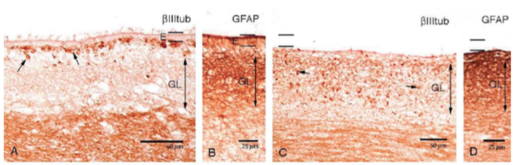
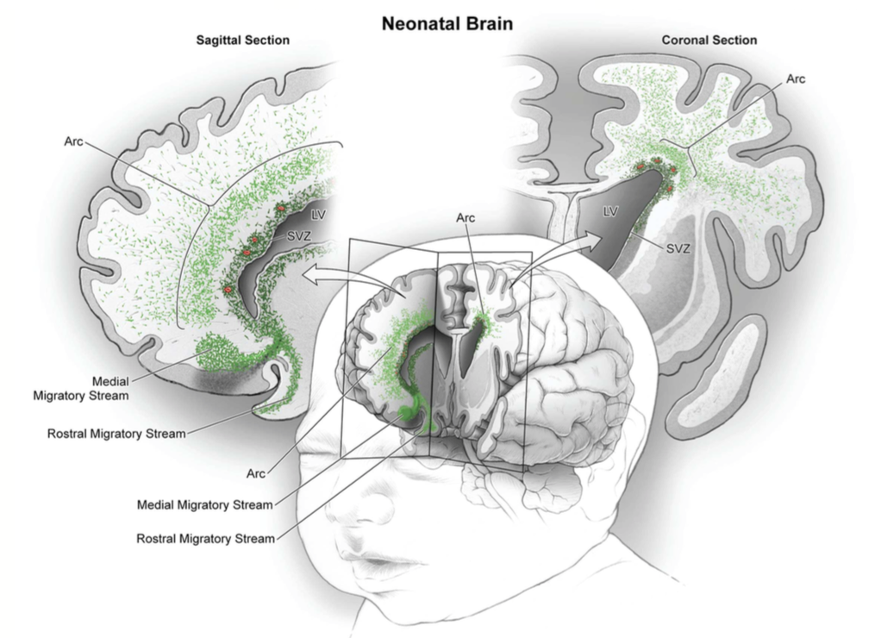
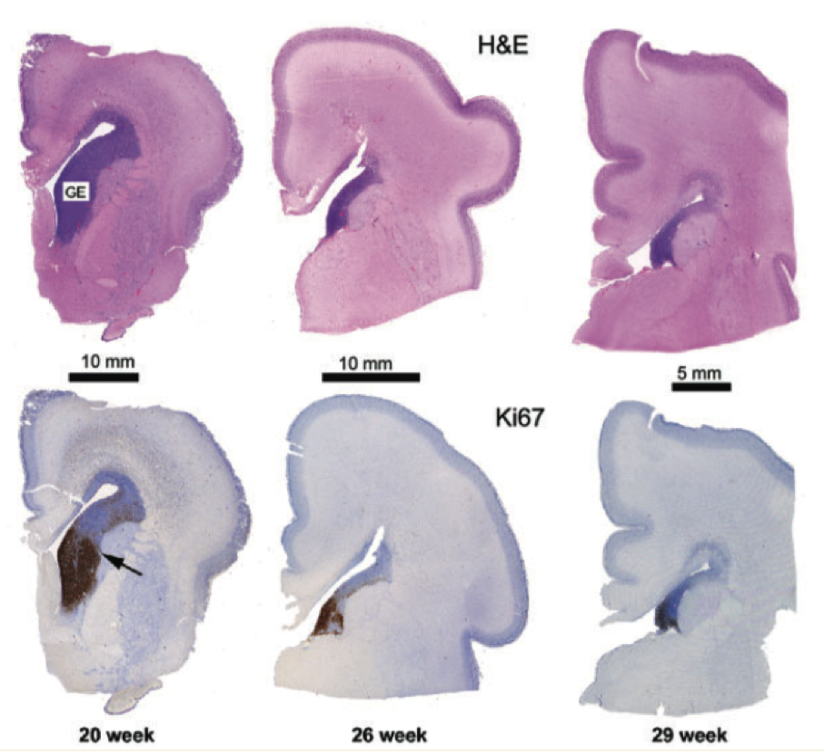
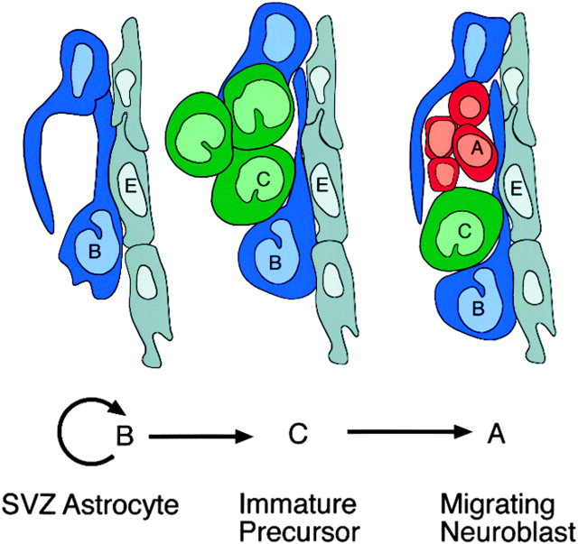
Blood products within the CSF
Ependymal Denudation
Increased propensity for hydrocephalus
Impact on NSPC Microenvironment
Failure of migration cues for postnatal NSPC
Dominiguez-Pinos 2005
Paredes 2016
Doetsch 1999
Del Bigio 2011
Notes:
Preclinical Data
Ependymal denudation
Increased propensity for hydrocephalus
Direct impact on underlying NSPC
Impact of Neuroblast / NSPC migration out of the SVZ
Direct impact on NSPC activity within the SVZ
Failure in migration of postnatally developed cells Carlen Nature Neuroscience 2009
NSPC within the SVZ are exquisitely sensitive to microenvironmental cues – Dominiguez-Pinos – J Neuropath and Exp Neurol 2005
Ependymal integrity is critical for NSPC function – Bystron et al Nature Review Neuroscience 2008
Disruption of ependymal function increases the incidence of hydrocephalus

Slide 4
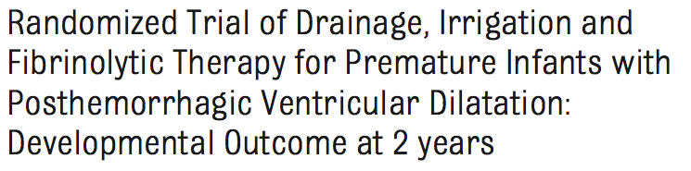

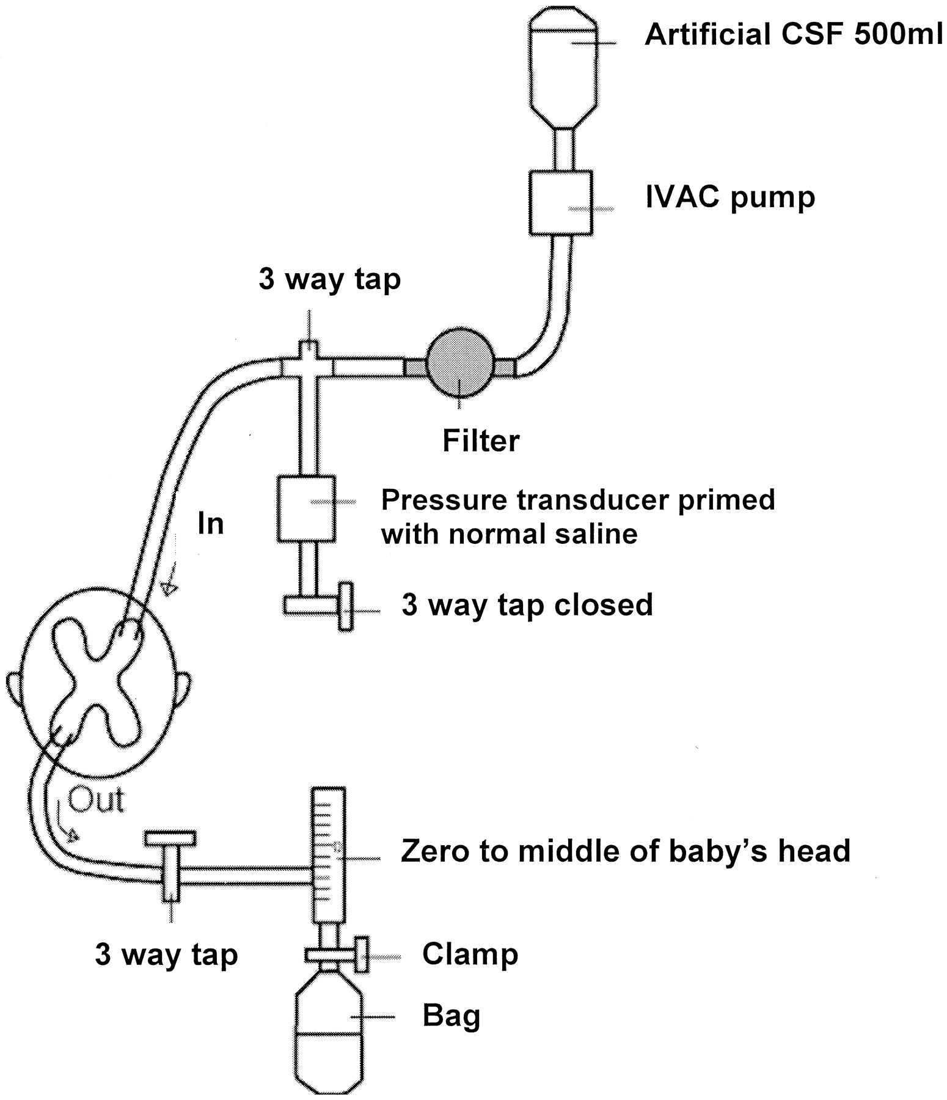
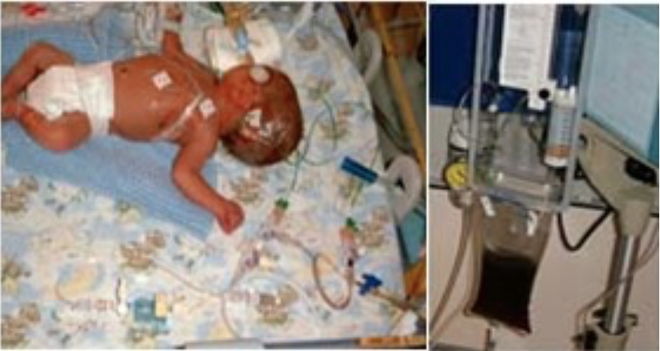
2010 – Cited by 66
DRIFT
Drainage Irrigation and Fibrinolysis Therapy
“..11 of 35 (31%) in the DRIFT group had severe cognitive disability versus 19 of 32 (59%) in the standard group”
Notes:
Among the survivors, 11 of 35 (31%) in the DRIFT group had severe cognitive disability versus 19 of 32 (59%) in the standard group
Repeated tapping of lumbar or ventricular fluid has been tested in randomized trials and did not reduce any disability.7 A randomized trial of reducing CSF production with acetazolamide and furosemide showed worse devel- opmental outcome in the infants re- ceiving the intervention.8
INCLUDE THE RESULTS OF EACH OF THE TRIALS
3-7 days of ventricular lavage
82% F/u at 10 years -

Slide 5
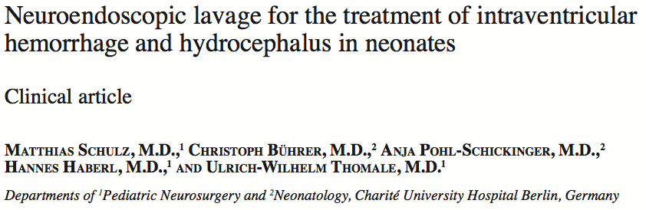

JNS Pediatrics 2014
Cited by 12
“..after the endoscopic lavage, 11 (58%) of 19 patients required a later shunt insertion, as compared with 100% of infants treated conventionally (p <0.05).”
Question:
Could Endoscopic Lavage reduce the risk of progressive hydrocephalus as shown by Schultz et al.
Could Endoscopic Lavage lead to same potential benefit in long term outcome as that seen in the DRIFT Study without the need for prolonged drainage?

Slide 6
Endoscopic clot lavage as an adjunct to subgaleal shunt for the treatment of neonatal post-haemorrhagic hydrocephalus.
Primary Objective – does intraventricular lavage reduce the incidence of hydrocephalus
Secondary Objective – does intraventricular lavage improve neurodevelopmental outcome

Slide 7
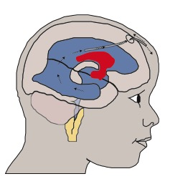
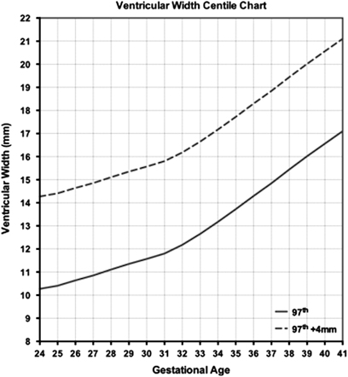
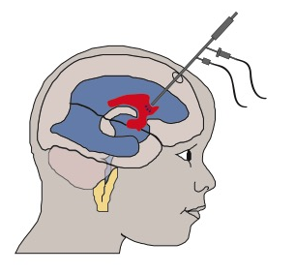
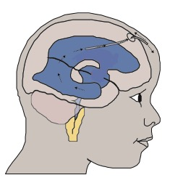
DESIGN
Randomised Controlled Trial with patients allocated to either standard treatment CONTROL or endoscopic lavage (followed by standard treatment) INTERVENTION
Control
VI > 97th Centile + 4mm
Intervention
Sealed envelope randomisation
50 patients i.e. 25 Control and 25 Intervention: (approx 12 patients / year = 4 years data collection)
All treatments identical other than washout

Slide 8
CONSENT 3 STEP PROCESS
Available on www.Prembrain.com
Step 1 – Initial Referral
Step 2 – On arrival to GOSH
Step 3 – Pre-op Consent
Parents asked to sign consent for enrollment in trial
Parents given a copy of the letter of invitation
Parents given parent information leaflet

Slide 9
INTERVENTION
Ventricle with the greatest blood load entered with septostomy to access contralateral ventricle if required
Washout with Artificial CSF - to limit biochemical disturbance
Predicted to take around 30 minutes and should not necessitate additional analgesia
CSF & Blood samples taken and stored for biomarker analysis
POST OP MONITORING
Weekly updates from local team up to term – (NIHR Research Nurse)
Transfer around term for MRI and evaluation regarding the need for VP shunt
OUT PATIENT FOLLOW UP
NEUROSURGERY OPC | RADIOLOGY | BEHAVIOUR
As per standard | 6 month MRI with fMRI & DWI | Early infancy 16-24 weeks Middle infancy 10-14 months Late infancy / ‘toddler-hood’ – 18-36 months

Slide 10
Discussion

Slide 11
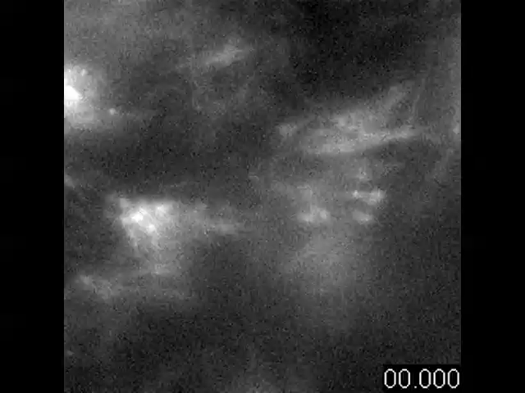
CD24 Fluorescent Immunolabelling of Ependymal Cilia (Ohata 2014)
Super high speed camera with Fluoresence microscopy

Slide 12
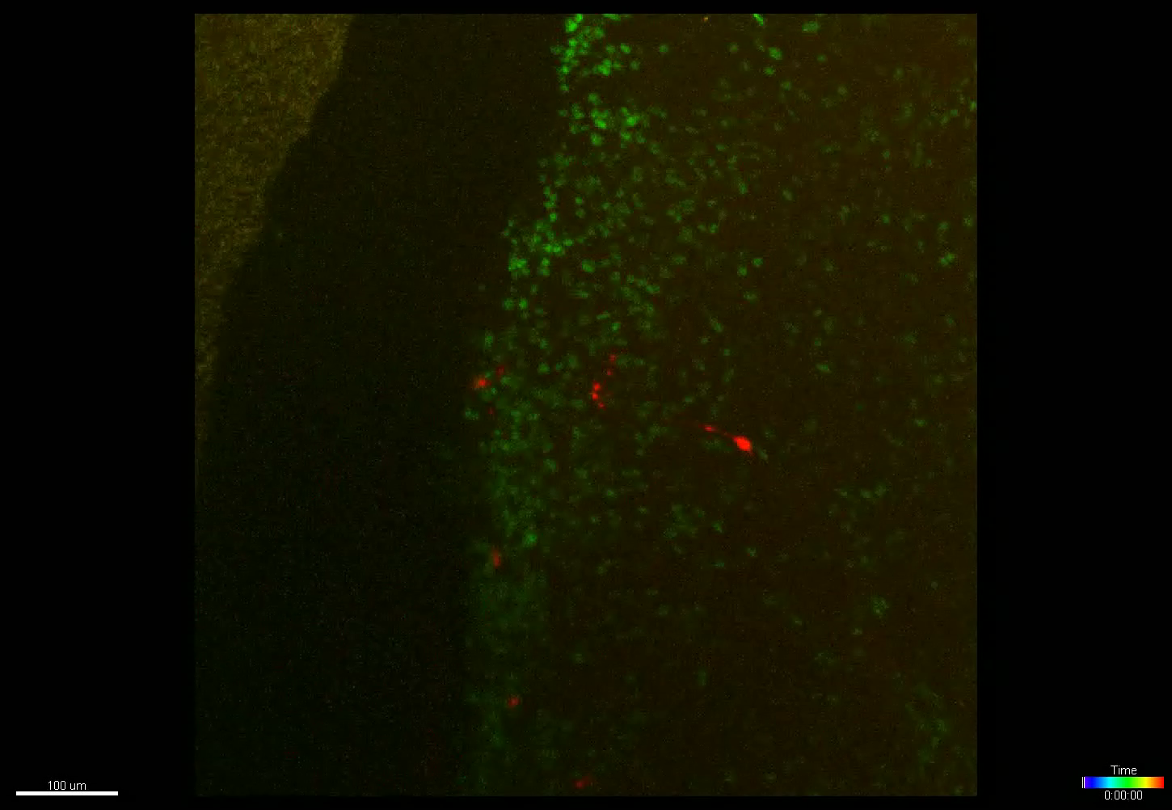
GREEN = FUCCI^{+ve} = Cells in cell cycle RED = hGFAPCreER = Neural Stem Cells
Time Lapse over 72 hours – 1 photo / ten minutes

