Slide 1




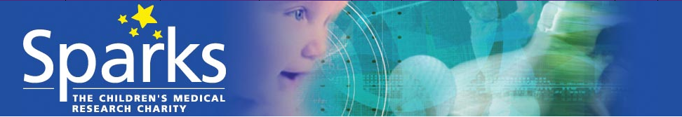


NEONATAL GERMINAL MATRIX HAEMORRHAGE
‘MESSING WITH THE MASTERPLAN’
Mr Will Dawes BSc FRCS(SN) PhD

Slide 2
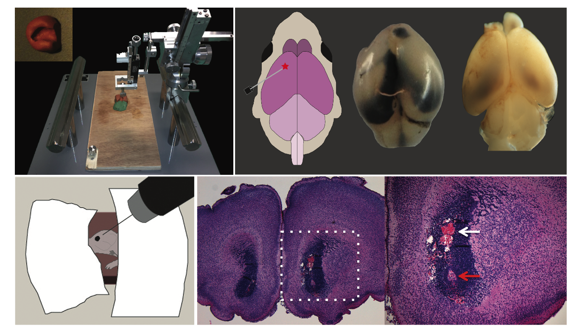

Slide 3
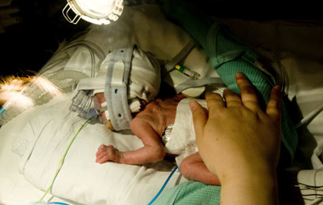
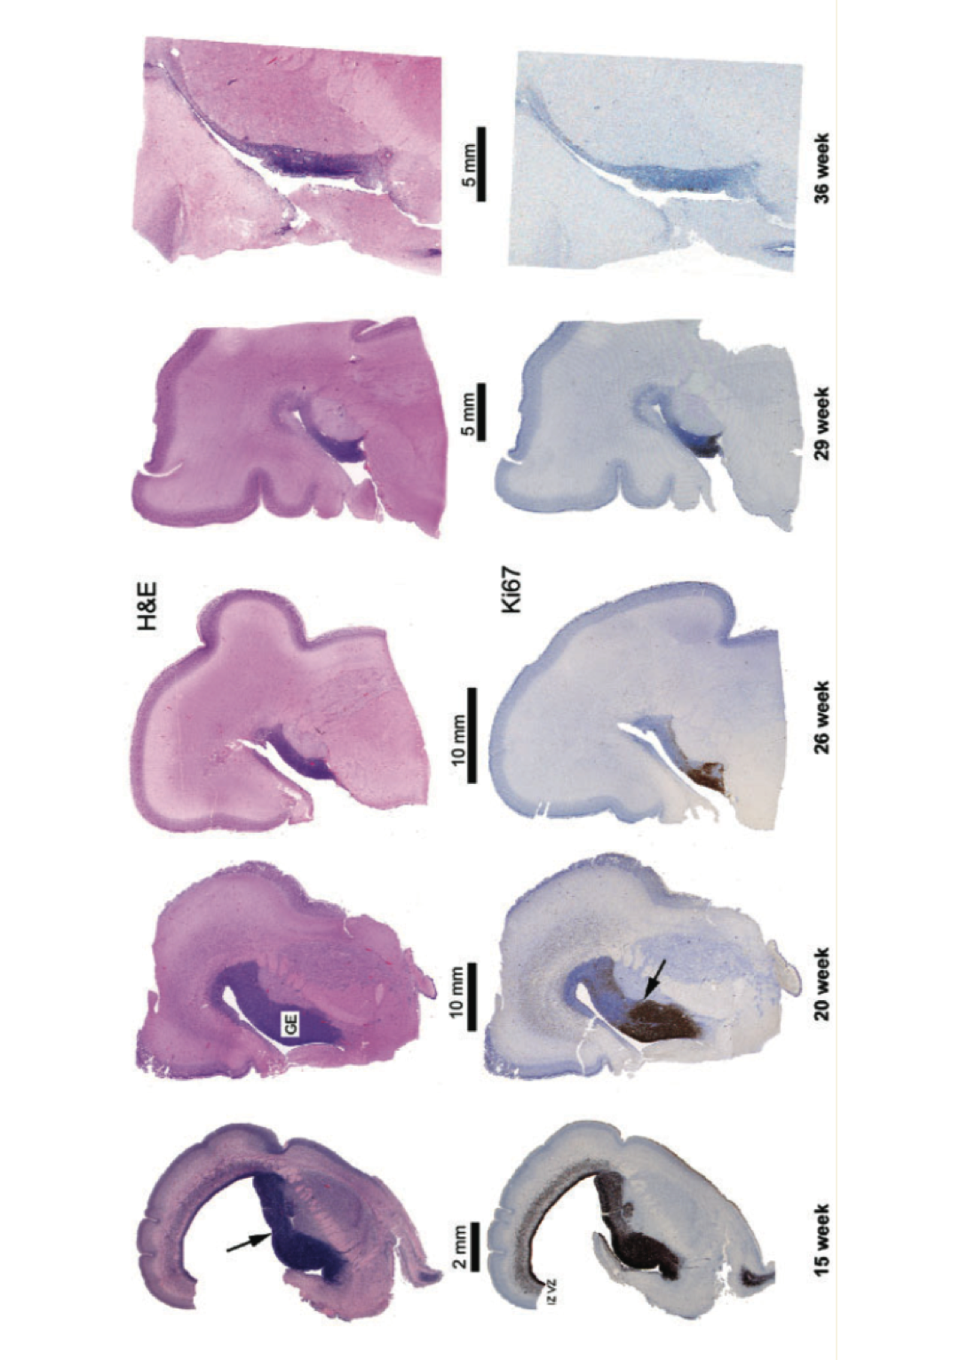
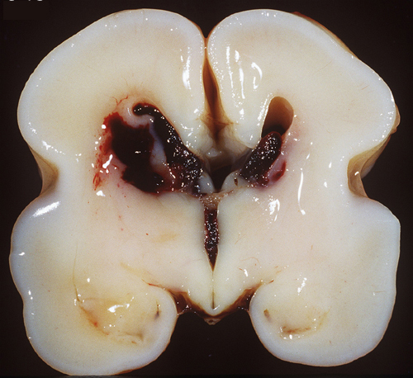
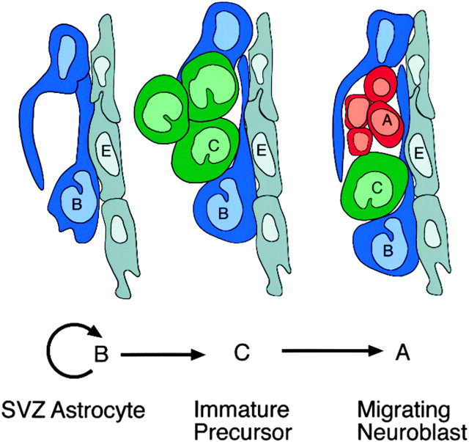
Why are premature babies prone to haemorrhage?
Blood
Vessel
Endothelial Cell with tight junction
Pericyte
Basal Lamina
Fragility of the Blood Brain Barrier
Astrocyte ‘End Feet’
Why does bleeding preferentially occur in the Germinal Matrix
Highly metabolically active region of the developing brain
Notes:
Pericyte – Contractile cell key component of the BBB – regulate capillary blood flow

Slide 4
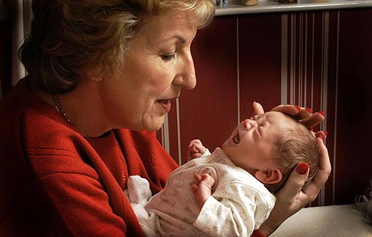
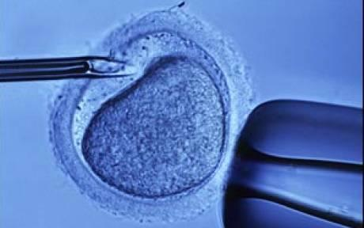
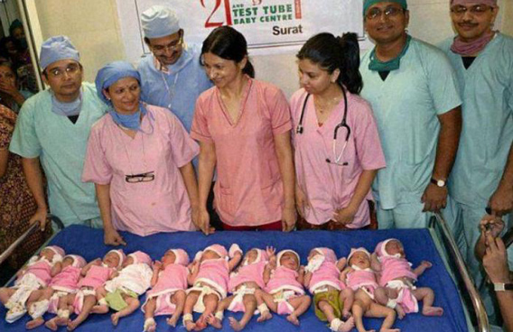
3 Important Points
Premature birth is increasing in incidence and is the
commonest cause of Neurodisability in childhood
(2) Incidence of haemorrhage has reduced but remains high
(3) IVH is the commonest cause of hydrocephalus in the
developed world
Notes:
Sue Tollefsen – Britains oldest mum at 57 – baby girl Freya
Incidence varies but around 20% of premature babies will suffer haemorrhage – with around 40% of them developing ventrivulomegaly – and of that group around half will need a permanent VP shunt (deVries 2013)

Slide 5
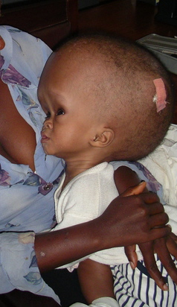
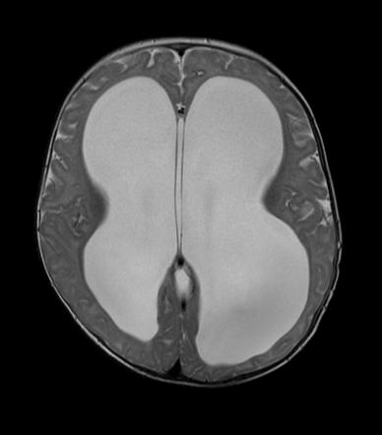

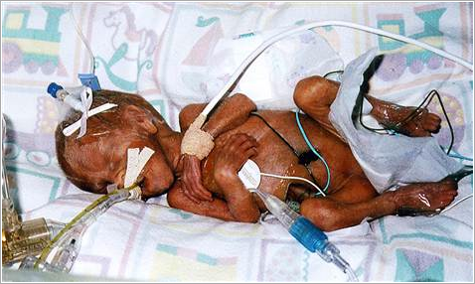

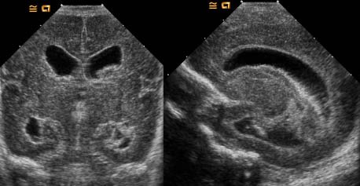
HYDROCEPHALUS
NEONATAL INTRAVENTRICULAR HAEMORRHAGE (IVH)
?
NEURODISABILITY
Through what mechanism does IVH impact on the ependyma and underlying Subventricular Zone..?
Is this process amenable to intervention..?
Notes:
As we all know despite improvements in perinatal care which reduced the incidence of IVH, PHH secondary to IVH remains the most common cause of hydrocephalus in children, similarly whilst outcome following low grade haemorrhage confined to the germinal matrix remains unclear the presence of IVH and in particular PHH is significantly associated with poor Neurodevelopmental outcome.
The question then is
(1) Through what mechanism does IVH impact on the ependyma and underlying SVZ
(2) Is this process amenable to intervention - can we in some way reduce the secondary impact of IVH both to reduce the rate of hydrocephalus and to improve Neuro developmental outcome..?
Stagger the presentation of slide 2 - start with Neonatal IVH then reveal hydrocephalus and disability then the black box
Then

Slide 6
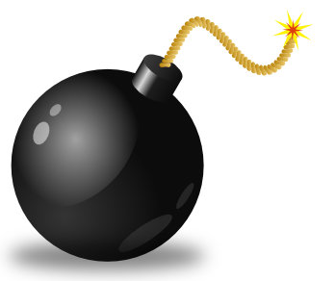
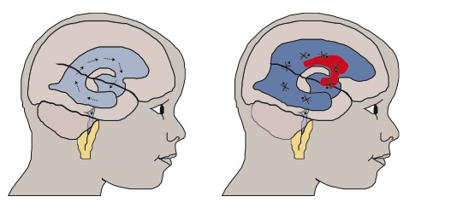

Primary
Injury
Tissue loss with shearing of white matter tracts and damage to developing networks
Blockage of CSF Pathways?
Secondary Injury
Notes:
Damage to the Neural Stem Progenitor Cells within the SVZ
Domínguez-Pinos MD, Páez P, Jiménez A-J, et al. Ependymal denudation and alterations of the subventricular zone occur in human fetuses with a moderate communicating hydrocephalus. Journal of Neuropathology & Experimental Neurology 2005;64(7):595-604.
betaIII tubulin as a marker of neuroblasts

Slide 7
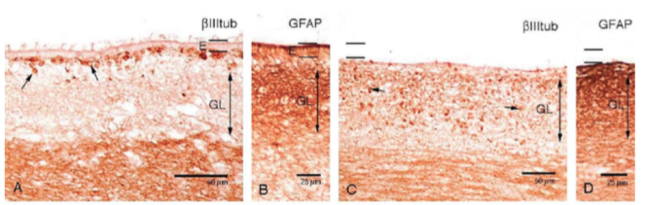
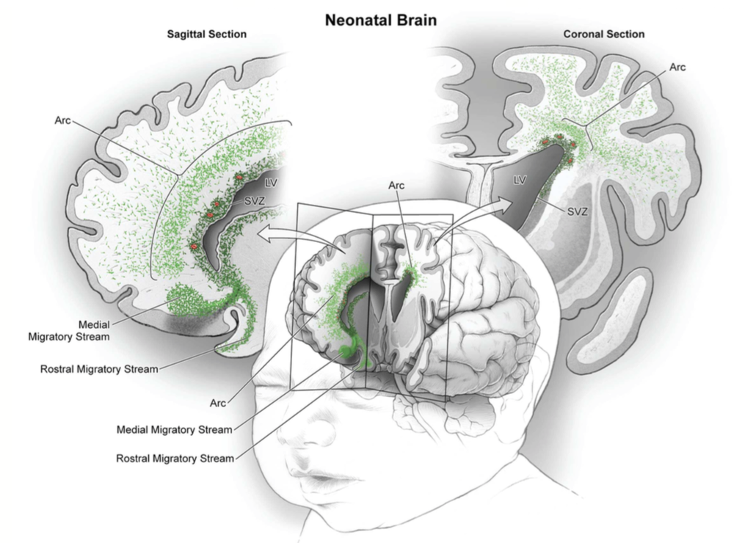
Blood products within the CSF
Ependymal Denudation
Increased propensity for hydrocephalus
Impact on NSPC Microenvironment
Failure of migration cues for postnatal NSPC
Dominiguez-Pinos 2005
Paredes 2016
Doetsch 1999
Del Bigio 2011
Notes:
Preclinical Data
Ependymal denudation
Increased propensity for hydrocephalus
Direct impact on underlying NSPC
Impact of Neuroblast / NSPC migration out of the SVZ
Direct impact on NSPC activity within the SVZ
Failure in migration of postnatally developed cells Carlen Nature Neuroscience 2009
NSPC within the SVZ are exquisitely sensitive to microenvironmental cues – Dominiguez-Pinos – J Neuropath and Exp Neurol 2005
Ependymal integrity is critical for NSPC function – Bystron et al Nature Review Neuroscience 2008
Disruption of ependymal function increases the incidence of hydrocephalus

Slide 8
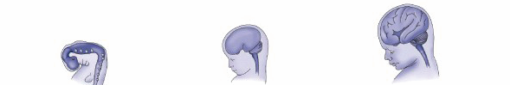
Reduced cortical volume
Reduced dendritic arborisation
Altered connectivity and synchronisation
HAEMORRHAGE
23-26 weeks
ACTIVITY WITHIN THE SVZ
NEUROGENESIS
DESTRUCTIVE
VS
DEVELOPMENTAL
GLIOGENESIS
10
20
30
40
FIRST TRIMESTER 1-13 WEEKS
SECOND TRIMESTER 14-27 WEEKS
THIRD TRIMESTER >27 WEEKS
Mouse Model of MODERATE Grade IVH
Stereotactic injection
Small injection volume (5ul)
Minimal Cortical Damage
Low rate of SDH

Slide 9
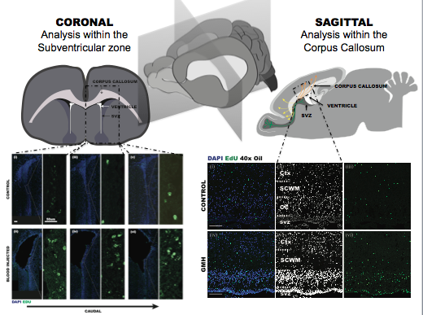

Slide 10
HAEMORRHAGE
23-26 weeks
Clinical
Implications
ACTIVITY WITHIN THE SVZ
NEUROGENESIS
GLIOGENESIS
10
20
30
40
FIRST TRIMESTER 1-13 WEEKS
SECOND TRIMESTER 14-27 WEEKS
THIRD TRIMESTER >27 WEEKS
The activation of precocious proliferation seen in the mouse SVZ may be modulated in part through a downregulation of Notch2 within the proximal / ventricular domain
Modulation of the SVZ could be considered for therapeutic benefit and the model developed here would be an ideal platform.
Notes:
Even without overt tissue damage the presence of IVH appears to impact on cell division / behaviour in the wall of the lateral ventricle.
Current animal models may be masking subtle DEVELOPMENTAL impact of IVH on neurodevelopment

Slide 11


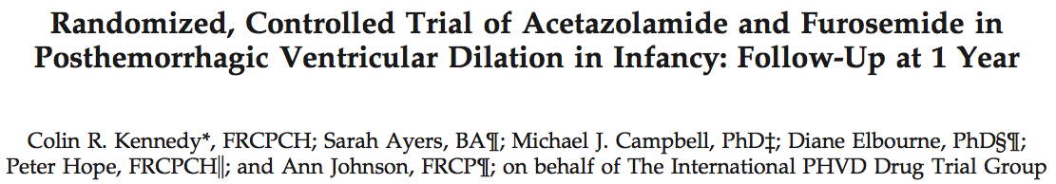

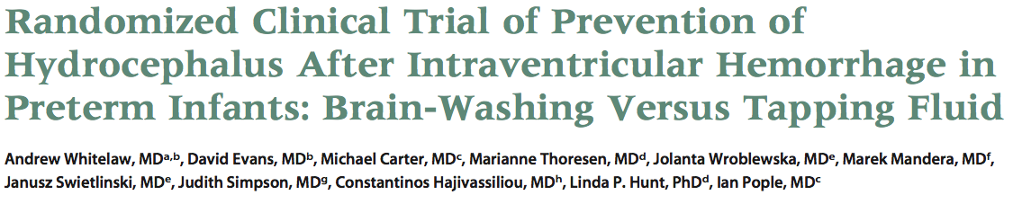
How to Treat?
2001 Cited by 118
2001 Cited by 114
2007 Cited by 112
Temporary CSF Drainage
Allows neonatal maturation – skin thickness, immune function, abdominal function
Defines the group of infants who need permanent shunting
Allows blood and protein within the CSF to clear – potentially reducing the risk of shunt blockage
Notes:
Cochrane was a review of four trials of LP and VT – (three randomised) – no impact on the rate of shunting and may increase the risk of CSF infection
Acetazolamide randomly assigned 177 patients to standard vs standard + Acetazolamide & Fusemide – no impact on hydrocephalus and may increase the risk of neurological deficit
DRIFT trial – 70 patients – no impact on the rate of hydrocephalus or death with increased risk of rebleeding

Slide 12
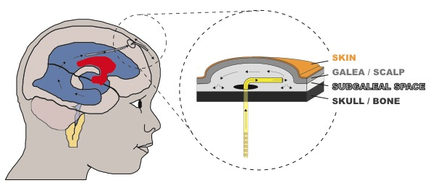
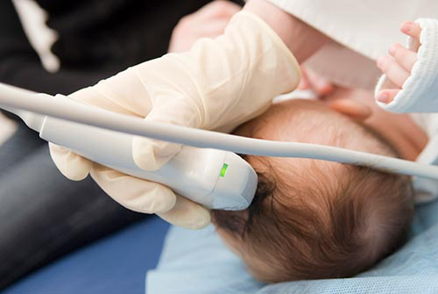
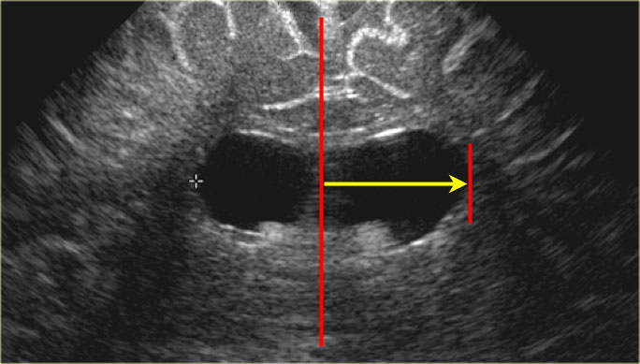
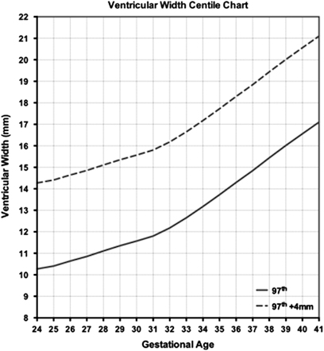
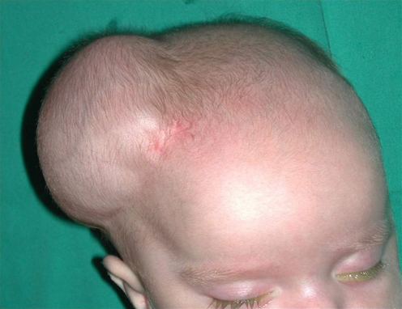
Temporary CSF Diversion
?
Transfer back to local
Decision around term or >2kg weight regarding the need for permanent VP shunt
Role of aEEG & VEP?
Notes:
Ventricular Index above the 97th Centile + 4mm
Amplitude integrated EEG (aEEG)
Visual evoked potentials (VEPs)

Slide 13
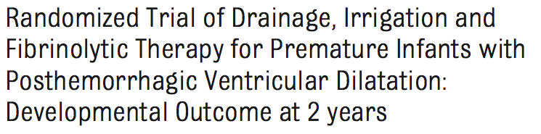
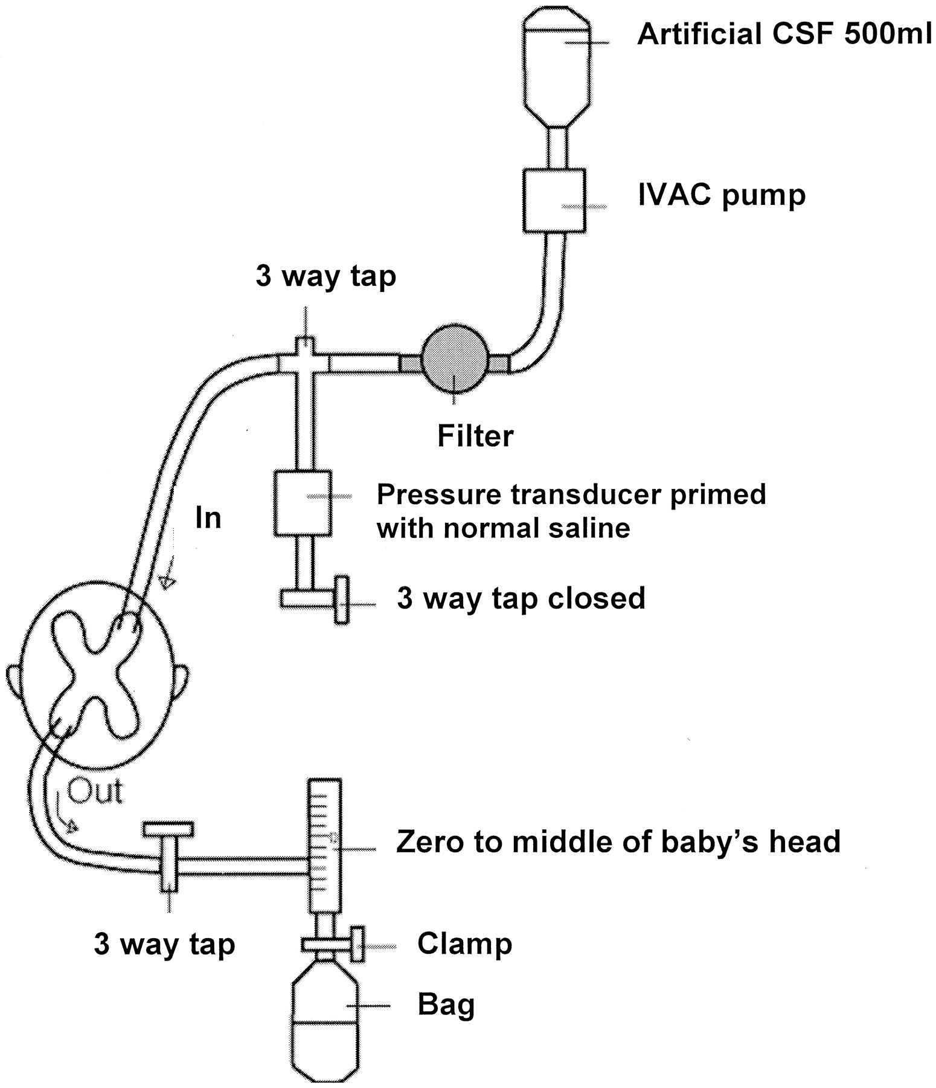
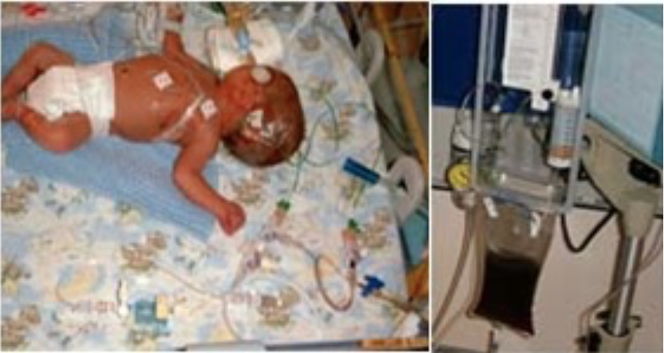
2010 – Cited by 79
DRIFT
Drainage Irrigation and Fibrinolysis Therapy
“..11 of 35 (31%) in the DRIFT group had severe cognitive disability versus 19 of 32 (59%) in the standard group”
Notes:
Among the survivors, 11 of 35 (31%) in the DRIFT group had severe cognitive disability versus 19 of 32 (59%) in the standard group
Repeated tapping of lumbar or ventricular fluid has been tested in randomized trials and did not reduce any disability.7 A randomized trial of reducing CSF production with acetazolamide and furosemide showed worse devel- opmental outcome in the infants re- ceiving the intervention.8
INCLUDE THE RESULTS OF EACH OF THE TRIALS

Slide 14
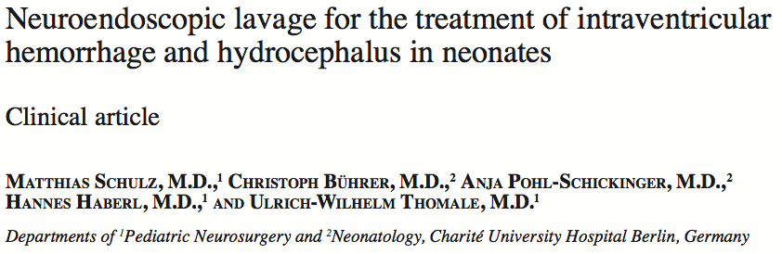

JNS Pediatrics 2014
Cited by 19
“..after the endoscopic lavage, 11 (58%) of 19 patients required a later shunt insertion, as compared with 100% of infants treated conventionally (p <0.05).”
Question:
Could Endoscopic Lavage reduce the risk of progressive hydrocephalus as shown by Schultz et al.
Could Endoscopic Lavage lead to same potential benefit in long term outcome as that seen in the DRIFT Study without the risk of causing rebleeding

Slide 15
Endoscopic clot lavage as an adjunct to subgaleal shunt for the treatment of neonatal post-haemorrhagic hydrocephalus.
Primary Objective – does intraventricular lavage reduce the incidence of hydrocephalus
Secondary Objective – does intraventricular lavage improve neurodevelopmental outcome

Slide 16
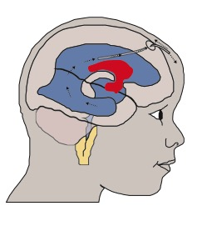
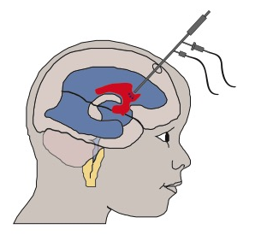
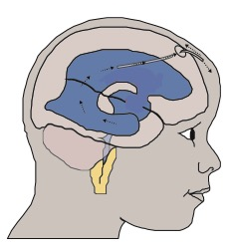
DESIGN
Randomised Controlled Trial with patients allocated to either standard treatment CONTROL or endoscopic lavage (followed by standard treatment) INTERVENTION
Control
VI > 97th Centile + 4mm
Intervention
Sealed envelope randomisation
50 patients i.e. 25 Control and 25 Intervention: (approx 12 patients / year = 4 years data collection)
All treatments identical other than washout

Slide 17
?
CURRENT UNDERSTANDING
HUMAN AUTOPSY STUDIES
ANIMAL STUDIES
CSF ANALYSIS
ADVANCED RADIOLOGY
NEUROENDOSCOPY
?ORGANOTYPIC SAMPLE ANALYSIS / ‘LIVE-SLICE’ SAMPLES
Notes:
Direct visualisation of the ependyma using neuroendoscopy - this demonstrates islands of haemosiderin staining and areas of adhesions
Radiological assessment - connectomes work in prematurity is gathering pace but remains quite a blunt tool - macroscopic overview - whitelaw tool for assessing brain development
Human Autopsy studies - implicate ependymal denudation and underlying white matter change dominiquez peres work
Animal studies - physiological and injection models - implicate skewed NSPC development and impact on postnatal migration of cells
CSF analysis - implicate the inflammatory/ cytokines soup hypothesis with the role of TGFbeta

Slide 18
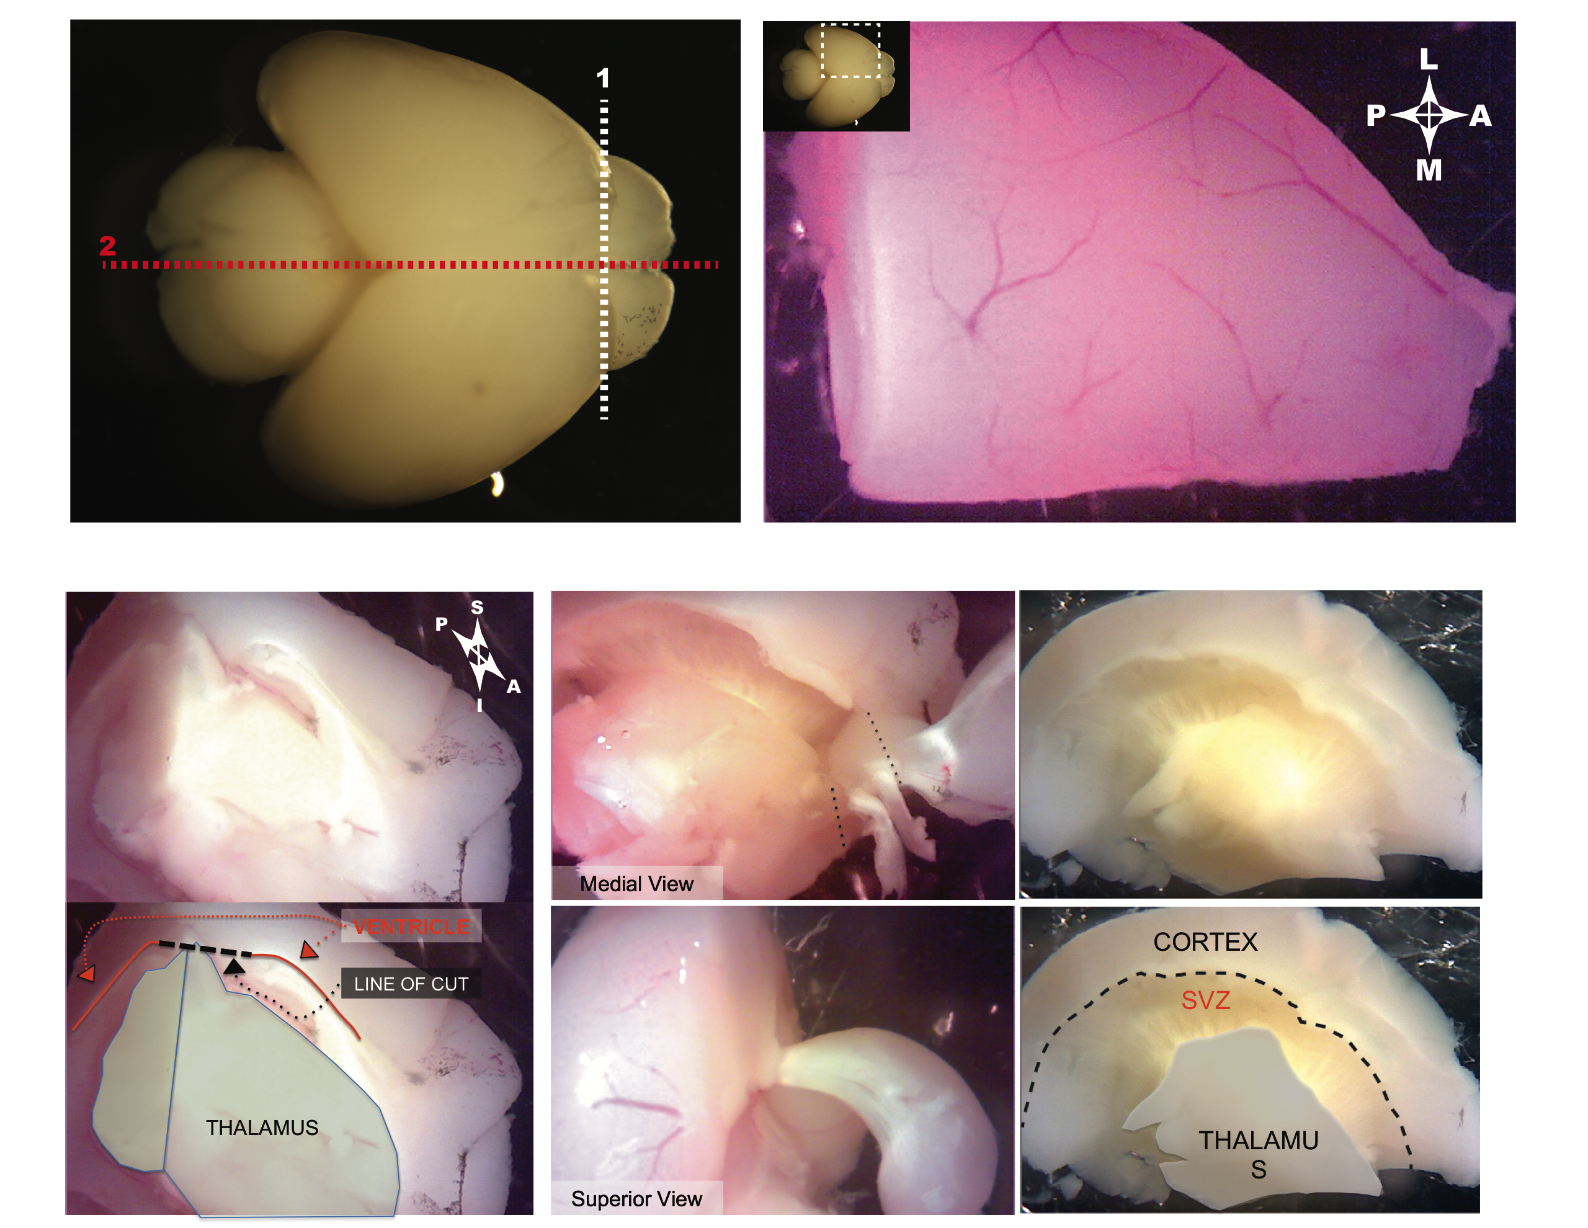
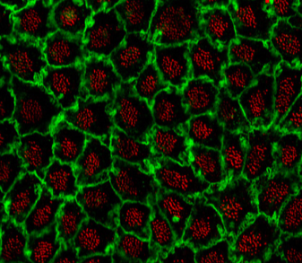
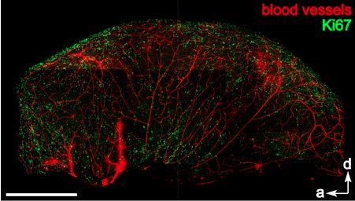
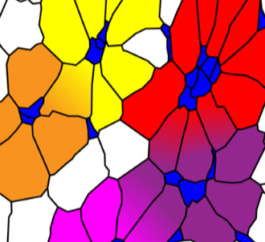
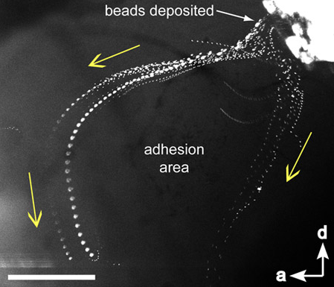
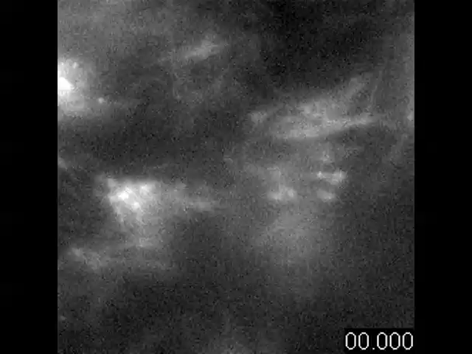
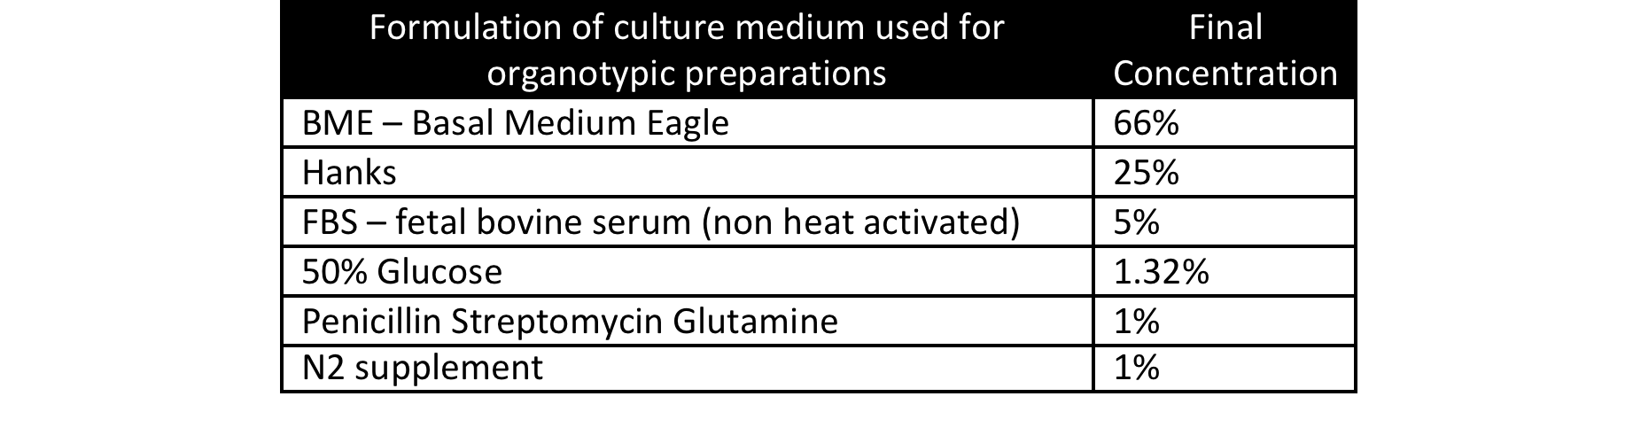
WHOLE MOUNT PREPARATION
Cell 2008
ORGANOTYPIC SLICE PREPARATION
Notes:
Organotypic or live slice samples can be used to monitor and observe the impact of IVH
There are various different ways that this can be done but in essence the technique allows dynamic assessment of the wall of the lateral ventricle
Obtaining samples of the SVZ from the newborn mouse pup is a relatively straightforward procedure - the pup is culled and the brain removed - it is then divided in the midline and the brain stem removed revealing the lateral wall of the lateral ventricle
This paper thin sample can then be maintained in artificial medium and used to assess - ependymal flow, cilia beat frequency, activity of the NSPC
Rat anti CD24 antibody

Slide 19
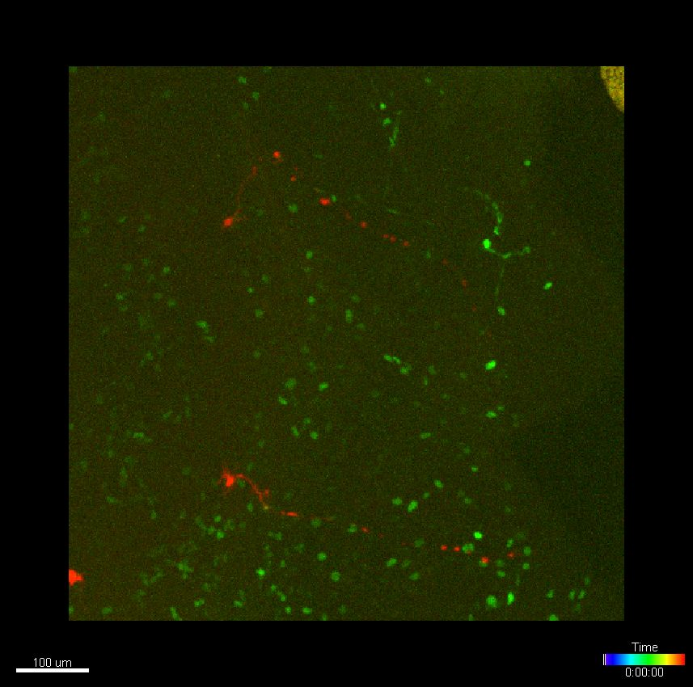
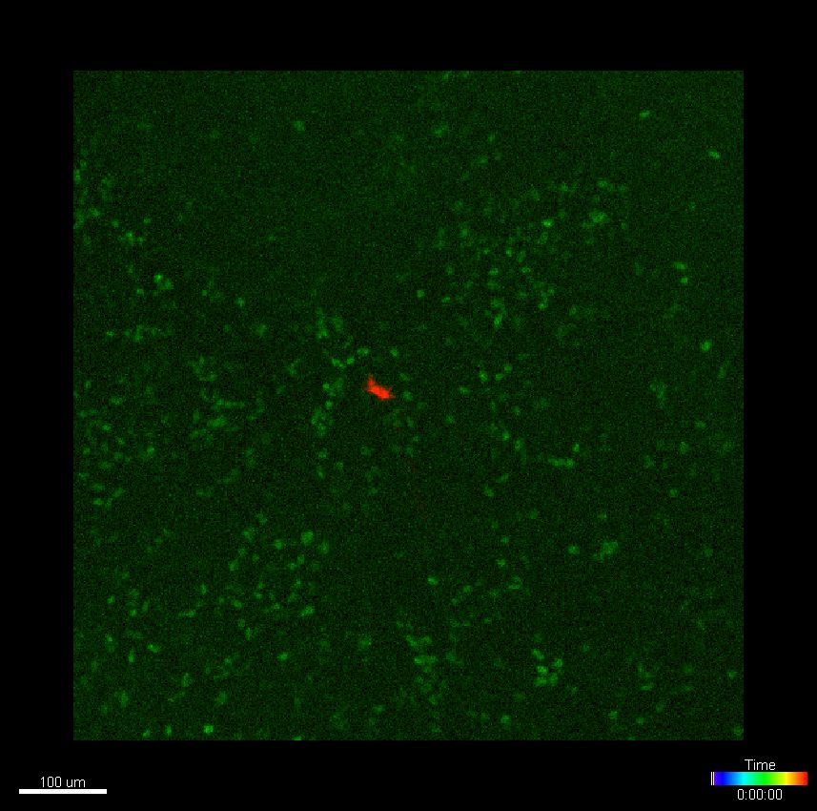
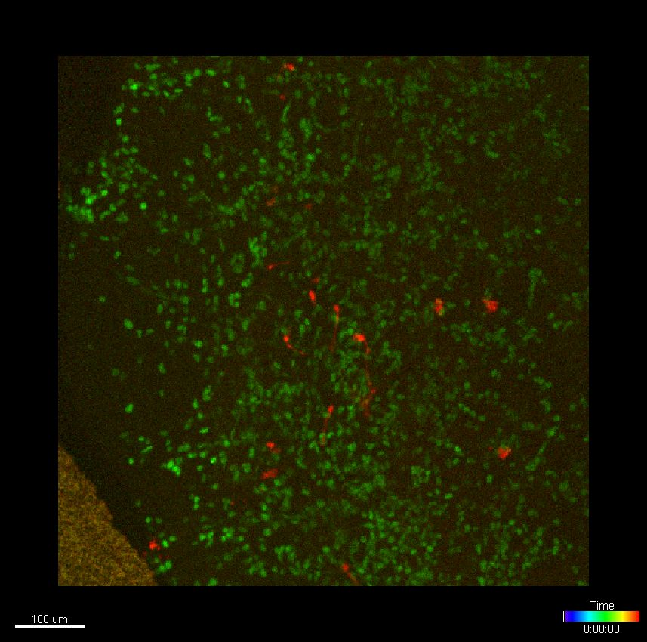
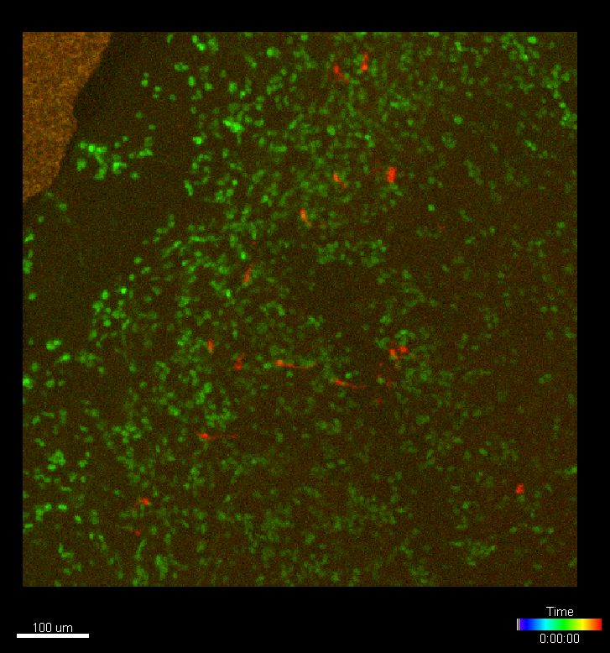
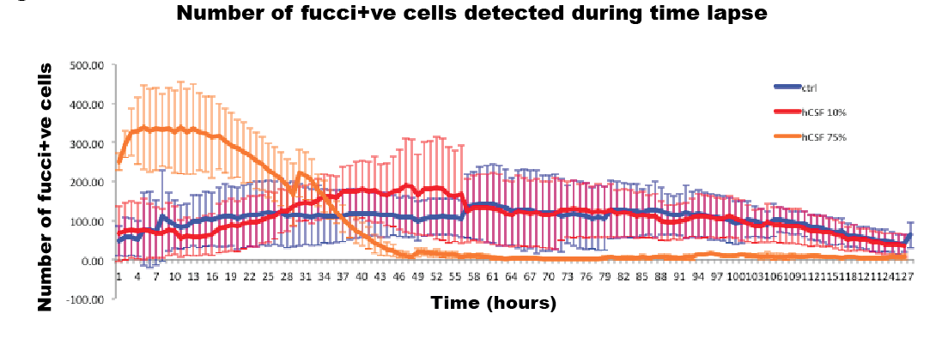
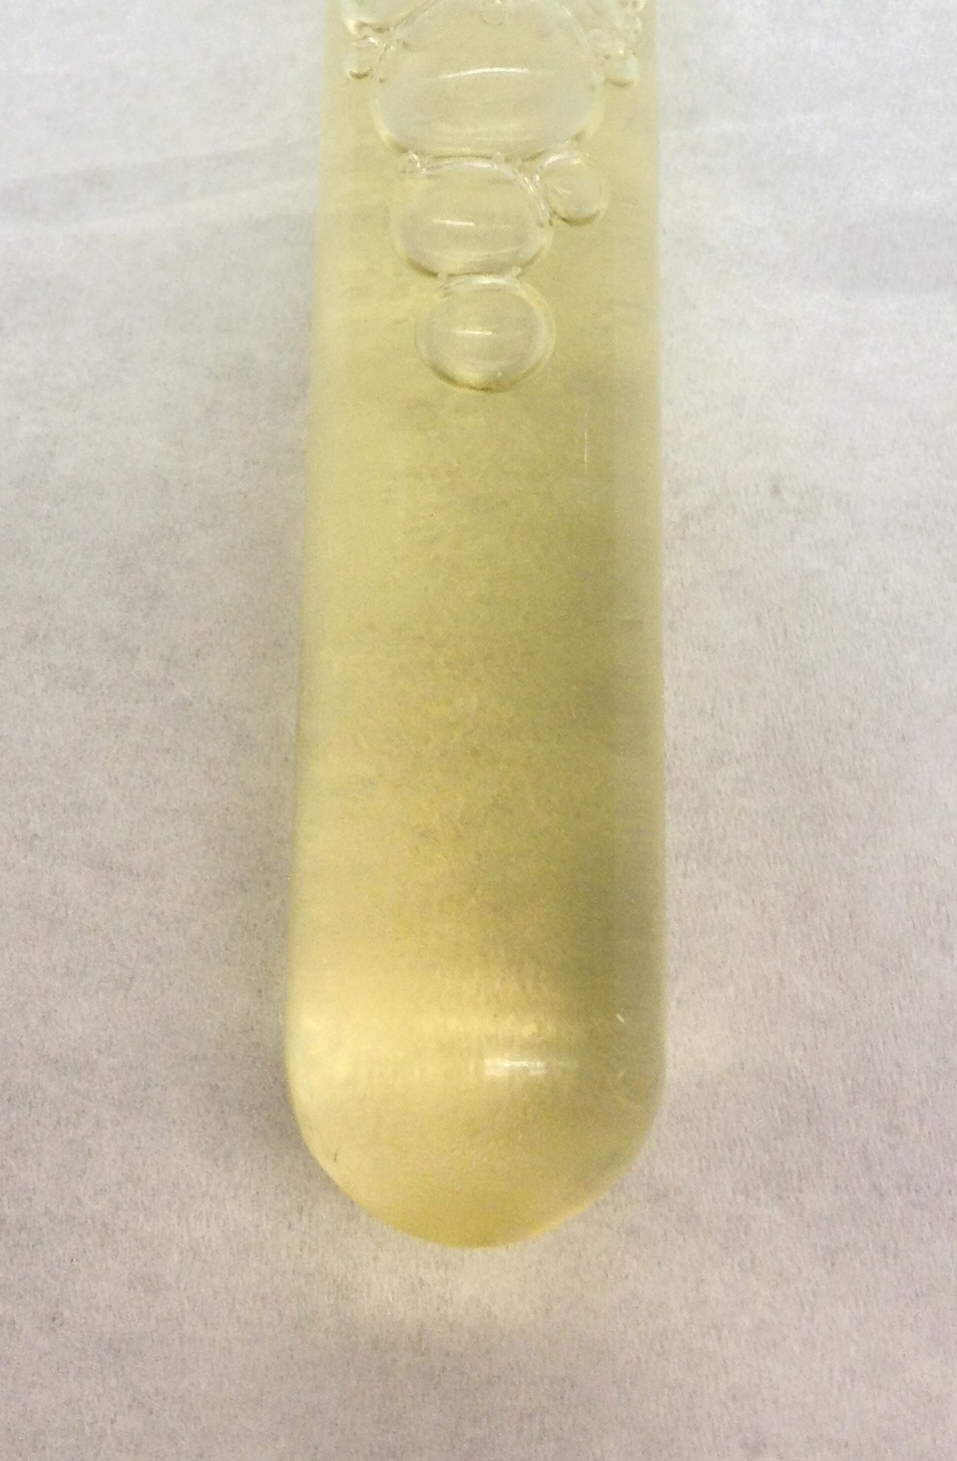
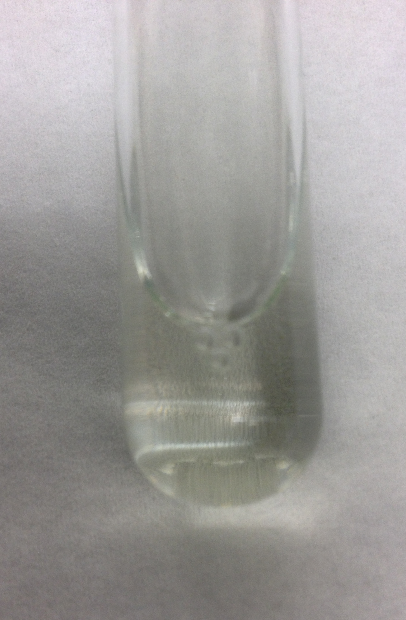
High concentration of human CSF in the culture medium significantly increased early proliferation in the wall of the lateral ventricle
STANDARD MEDIUM AT TIME POINT ZERO
‘CLEAR CSF’ MEDIUM
Xanthochromia
Clear CSF
Notes:
To assess how xanthochromic CSF might impact on the SVZ we took two samples of CSF one aspirated from a VAD - the other aspirated from a spina bifida repair - we tried various concentrations added to the standard medium and found that Xanthochromic CSF essentially shut down cell division / fluorescence - whilst clean CSF showed significantly increased early proliferation..?
Again these are preliminary results but they demonstrate that there are questions to be answered and potentially a rich seam of research in determining the mechanism through which IVH impacts on the SVZ

Slide 20
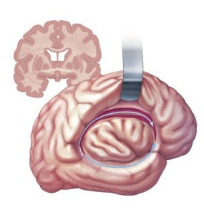
CSF collection and analysis from neonates with intraventricular haemorrhage approval for use in animal and human studies
IRAS ID: 198936
Rec Reference: 16/LO/1792
Disconnection Hemispherotomy for the treatment of medically intractable epilepsy exposes the wall of the lateral
FUTURE
PLANS
IRAS ID: 247396
Rec Reference: 18/LO/1275
Notes:
The next iteration of the project is to continue to collect human CSF for the mouse studies
& to collect samples of the human lateral ventricle - SOLVe trial - essentially taking samples of the lateral wall from children at the time of disconnective surgery for the treatment of intractable epilepsy
We have just been granted ethical approval and hope to begin the process of optimising the model soon

Slide 21
SUMMARY…
Introduction to Germinal Matrix Haemorrhage
  Application of transgenic models
Animal studies to model the disease process
ENLIVEN Clinical study to assess the role of Neuroendoscopic washout
  ENLIVEN Image
  ENLIVEN Develop
  ENLIVEN Biomarker
SOLVe Trial – Organotypic sample preparation from the wall of the lateral ventricle
Thank you

