Slide 1


TRAINING & EDUCATION
RULES OF GOLF 2019
Club Workshop

Slide 2

Welcome

Slide 3
Contents
New Terminology
New Principles
Areas of the Course

Slide 4
New Terminology
OLD NEW
Through the Green General Area
Teeing Ground Teeing Area
Water/ Lateral Hazard Yellow/ Red Penalty Area
Wrong Putting Green Wrong Green
Outside Agency Outside Influence
Abnormal Ground Condition Abnormal Course Condition
Casual Water Temporary Water
Play Prohibited, ESA No Play Zone
Nearest Point of Relief Nearest Point of Complete Relief

Slide 5
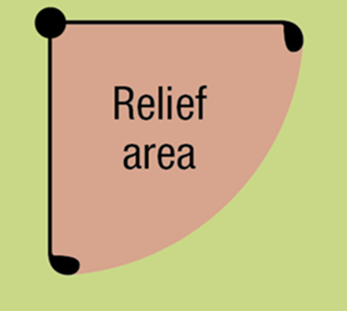
New Principles
Dropping Procedure
Reference Point
The point from which the size of relief area is measured.
Relief Area
The area where a player must drop a ball when taking relief under a Rule.
Reference Point
(tee peg, coin etc)

Slide 6
New Principles
Dropping Procedure
Club Length
Defined as the length of the longest club the player has during the round, other than the putter.
Used to define the player’s teeing area on each hole and in determining the size of the player’s relief area when taking relief under a rule.
Whilst other clubs (other than the putter) can be used we recommend using the longest club at all times.

Slide 7
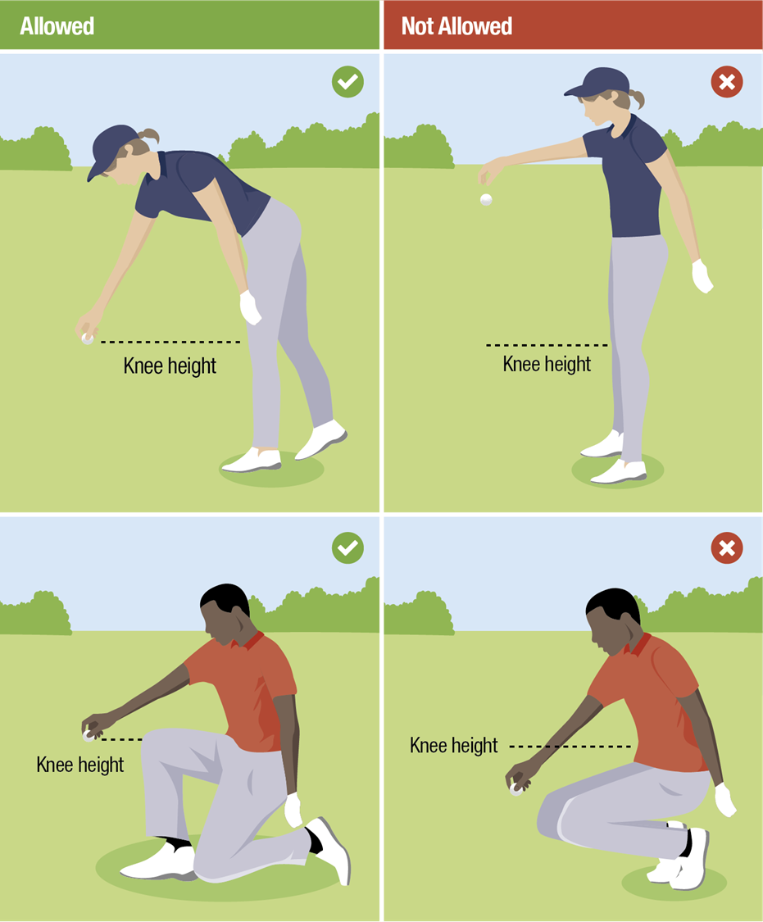
New Principles
Dropping Procedure
Knee Height
Must be dropped from knee height.
Must be dropped straight down without touching player or equipment before hitting ground.
Must be dropped in Relief Area.
Note: ‘Knee height’ means the height of a players knee when in a standing position.

Slide 8
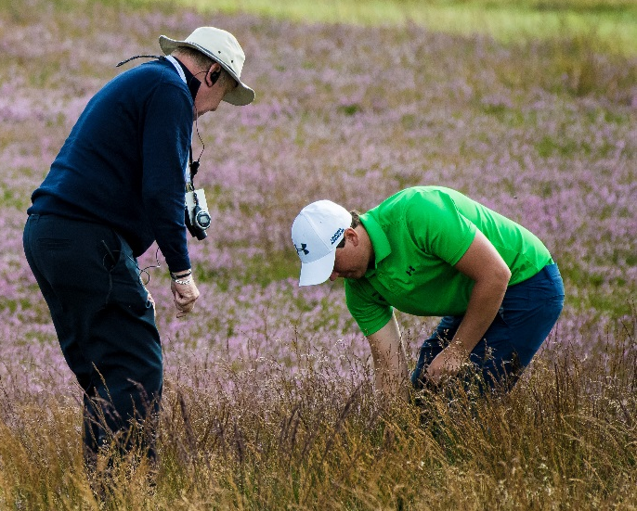
New Principles
Ball searching
Time for ball search
reduced to 3 minutes.
No penalty if a player causes the
ball to moved during search. The ball will always be replaced, even if its original spot is not known.
Not longer required to announce intention to lift a ball for identification purposes

Slide 9
New Principles
Substituted Ball
Whenever taking relief, a player may use either the original ball or another ball.
Striking the Ball more than once/
Accidental deflections
Count the stroke and there is no penalty.
Damaged Clubs
No matter what the nature or cause of the damage:
club treated as conforming for the rest of the round
player may continue with the damaged club, or
have the club repaired

Slide 10
New Principles
Reasonable Judgement in Estimating & Measuring is Accepted
Even if video evidence shows error.
Distance Measuring Devices
Now permitted within the rules.
Caddie assistance
Not permitted to assist in alignment. Penalty if still behind player when player takes stance.

Slide 11
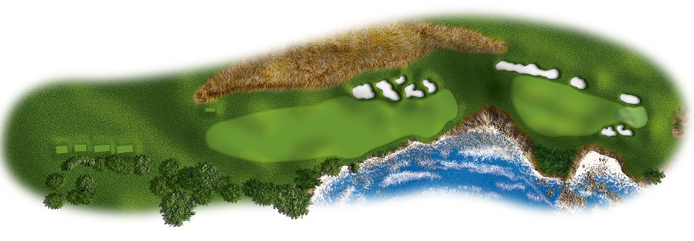
Areas of the Course
Bunkers
Putting Green
Teeing Area
General Area – everything else
Penalty Area

Slide 12
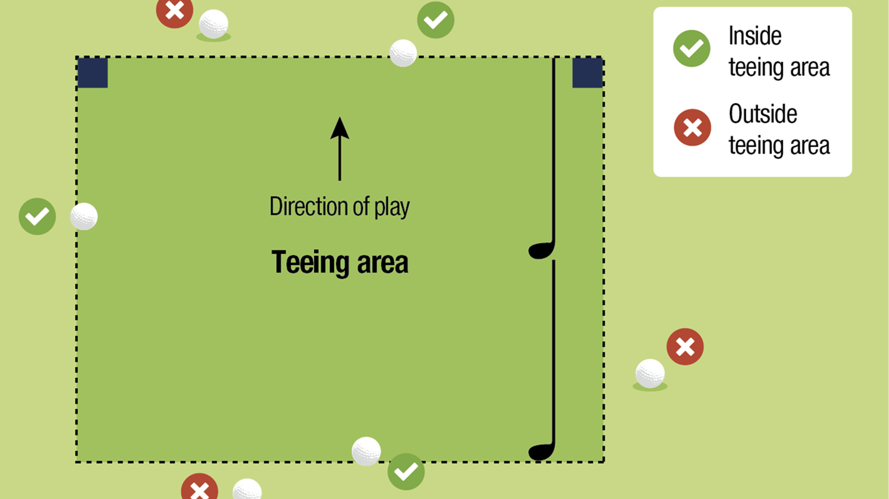
Areas of the Course – Teeing Area

Slide 13
Areas of the Course – General Area
The area of the course that covers all of the course except for the four other defined areas:
The teeing area
All penalty areas
All bunkers
The putting green of the hole being played
The general area includes:
All teeing locations on the course other than the teeing area, and
All wrong greens

Slide 14
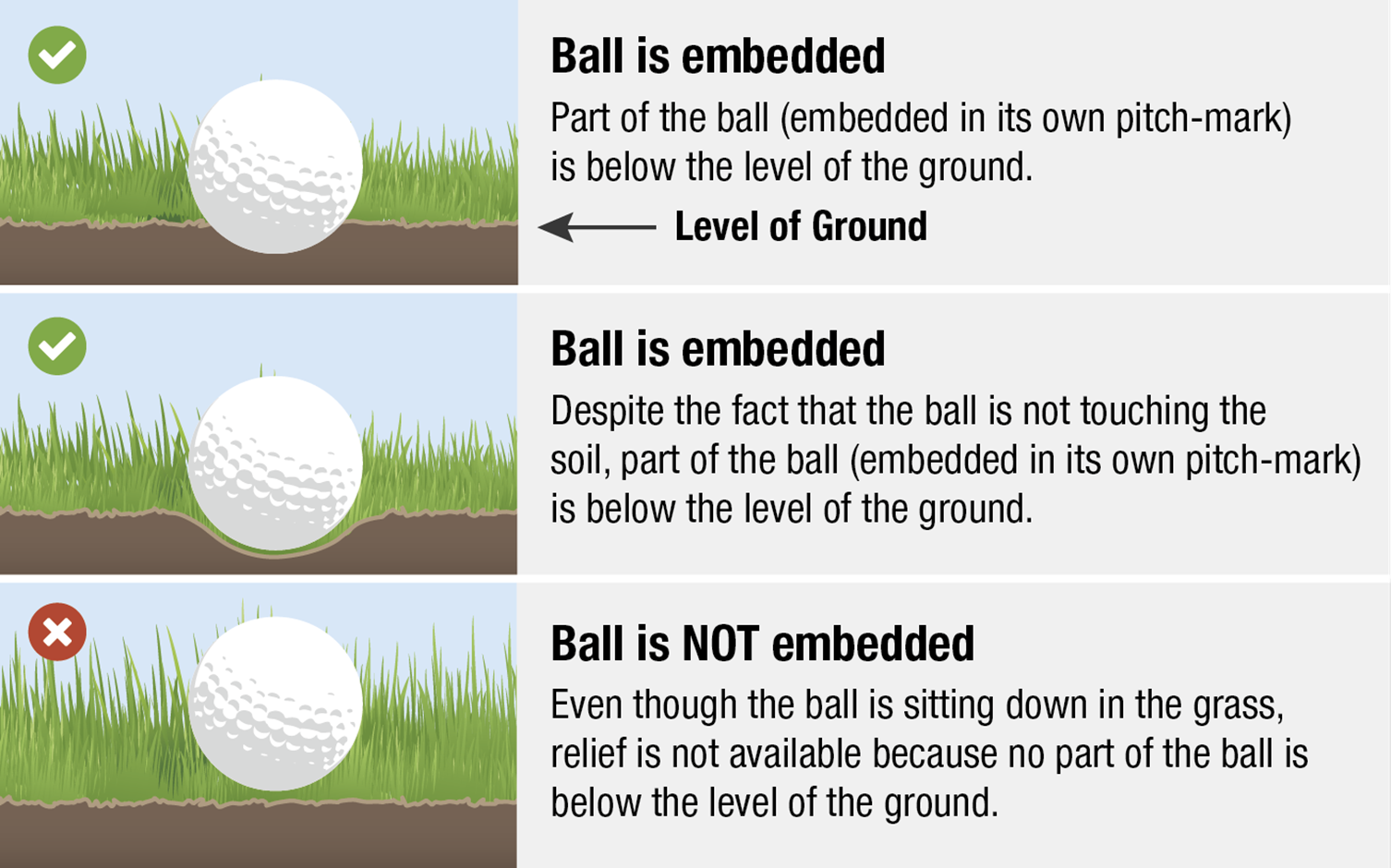
Areas of the Course – General Area

Slide 15
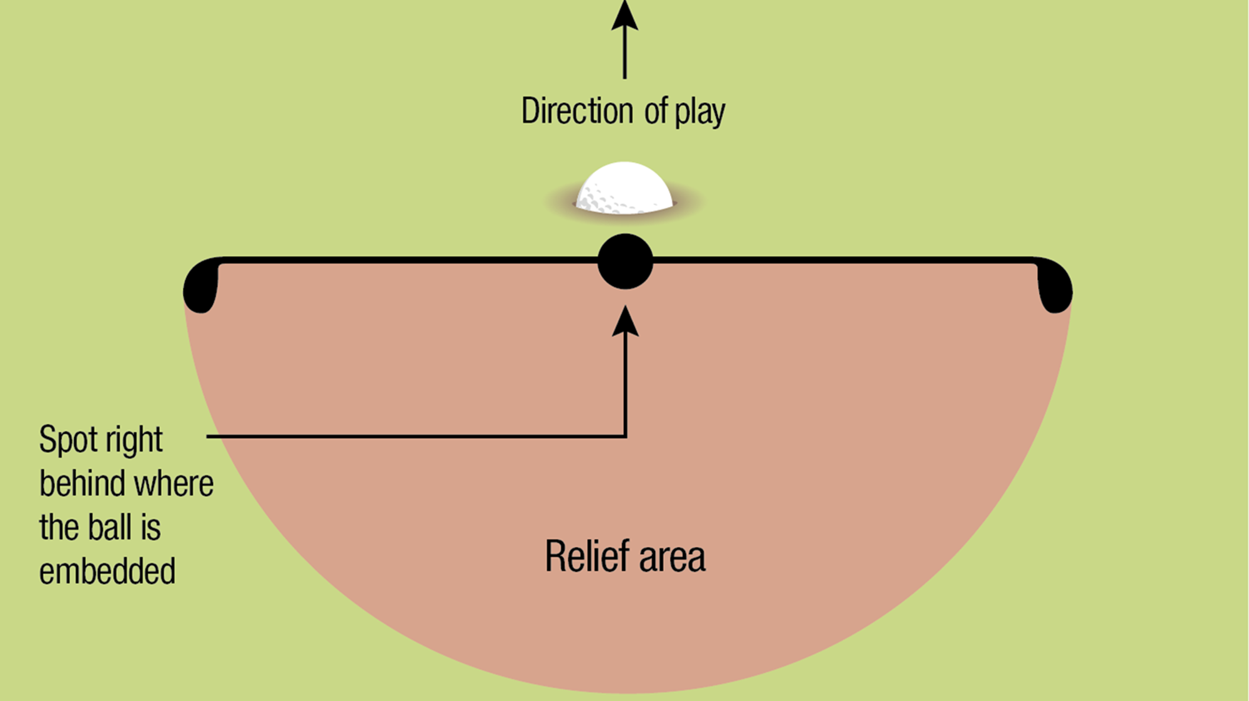
Areas of the Course – General Area

Slide 16
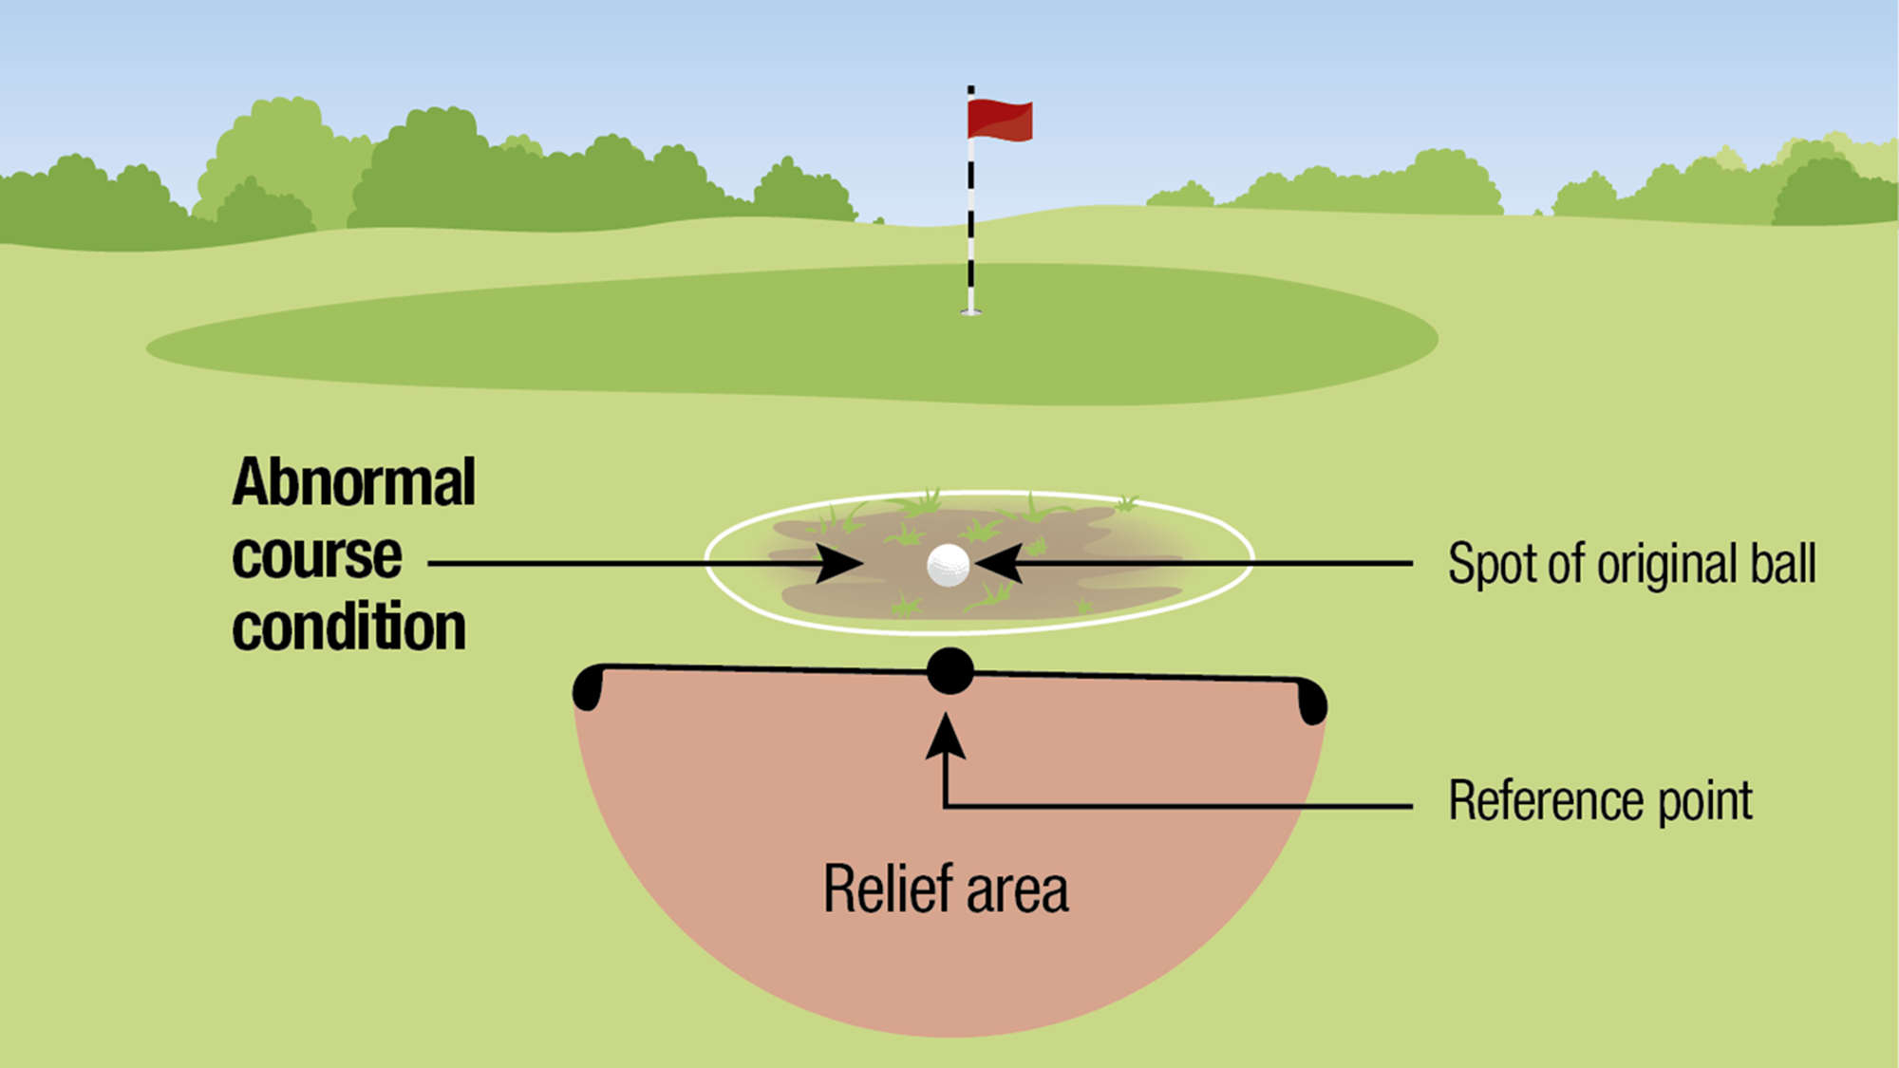
Areas of the Course – General Area

Slide 17
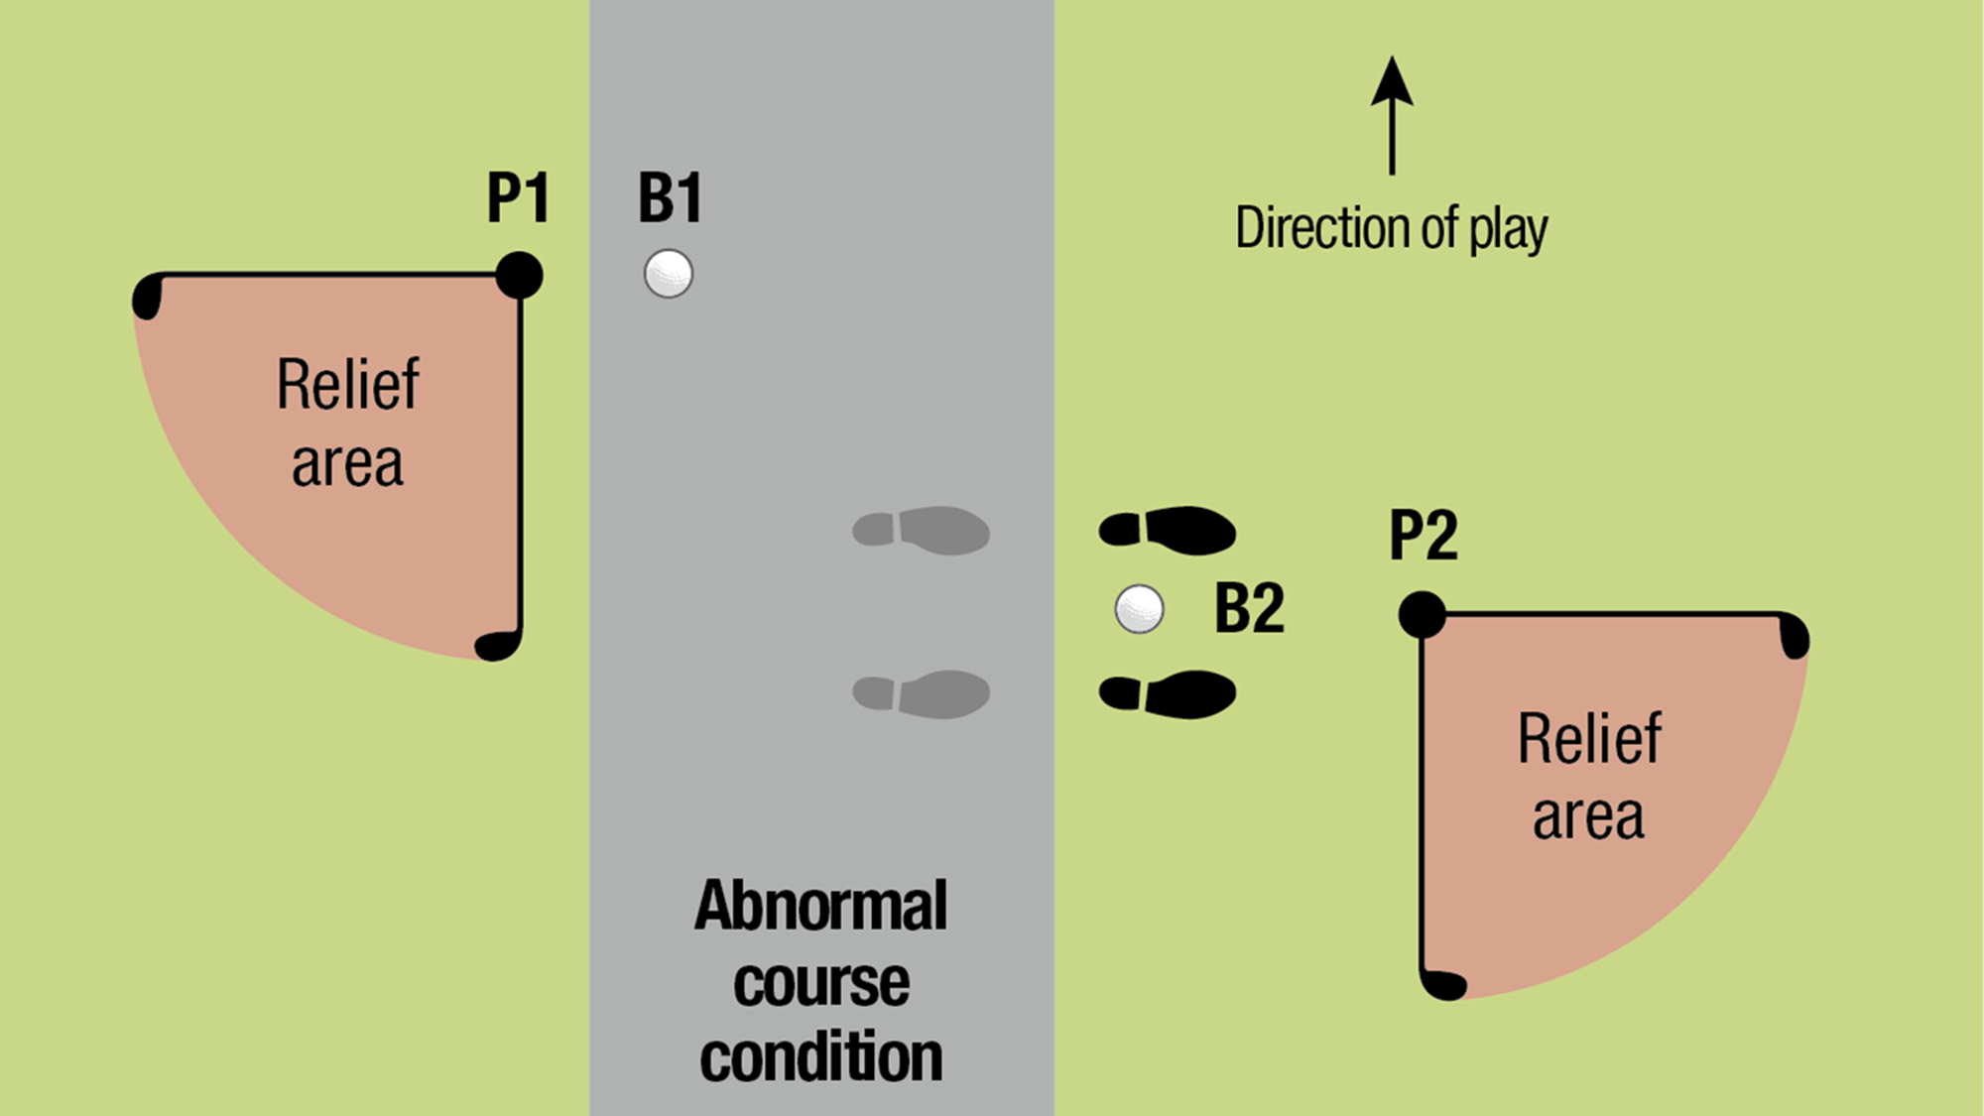
Areas of the Course – General Area

Slide 18
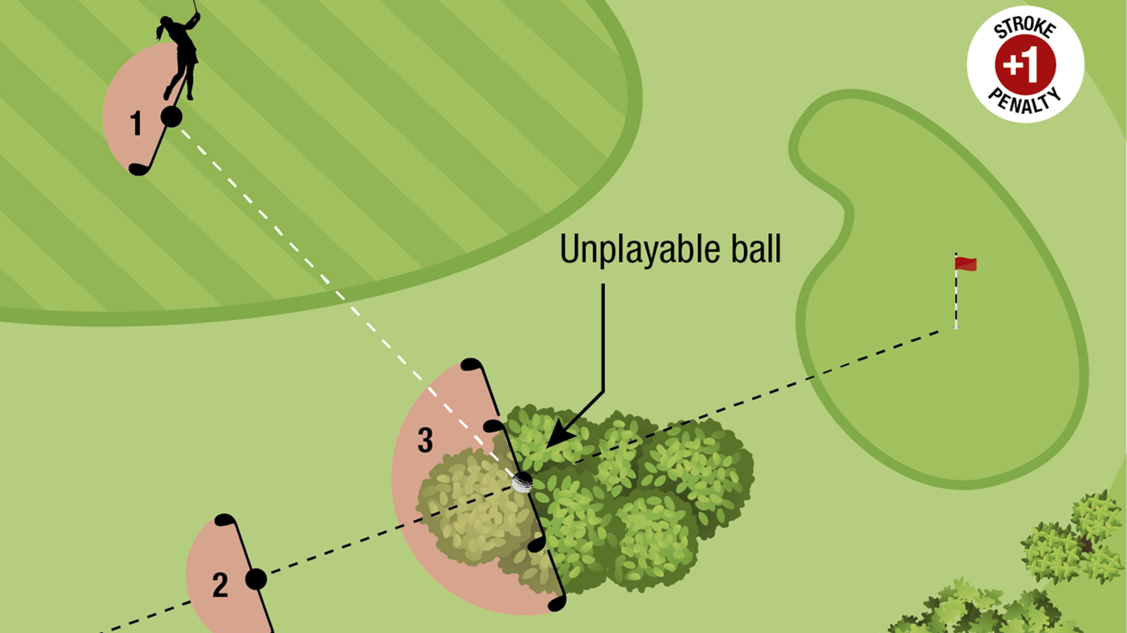
Areas of the Course – General Area

Slide 19
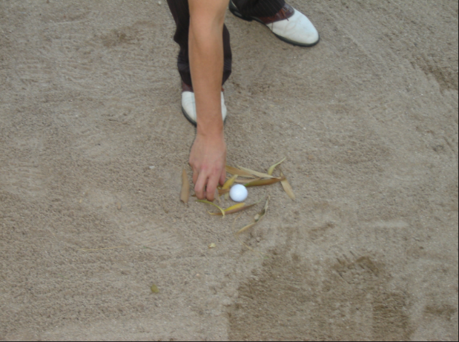
Areas of the Course – Bunkers
Rule 12
Bunkers are one of the 5 defined areas of the course.
A player may now remove loose impediments (leaves, branches, sticks etc) from a bunker.
But is not permitted to ground the club.

Slide 20
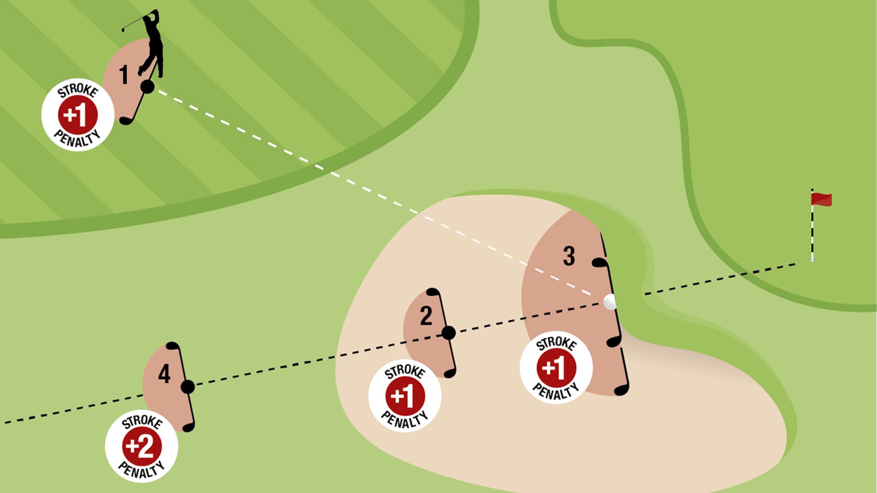
Areas of the Course – Bunkers

Slide 21
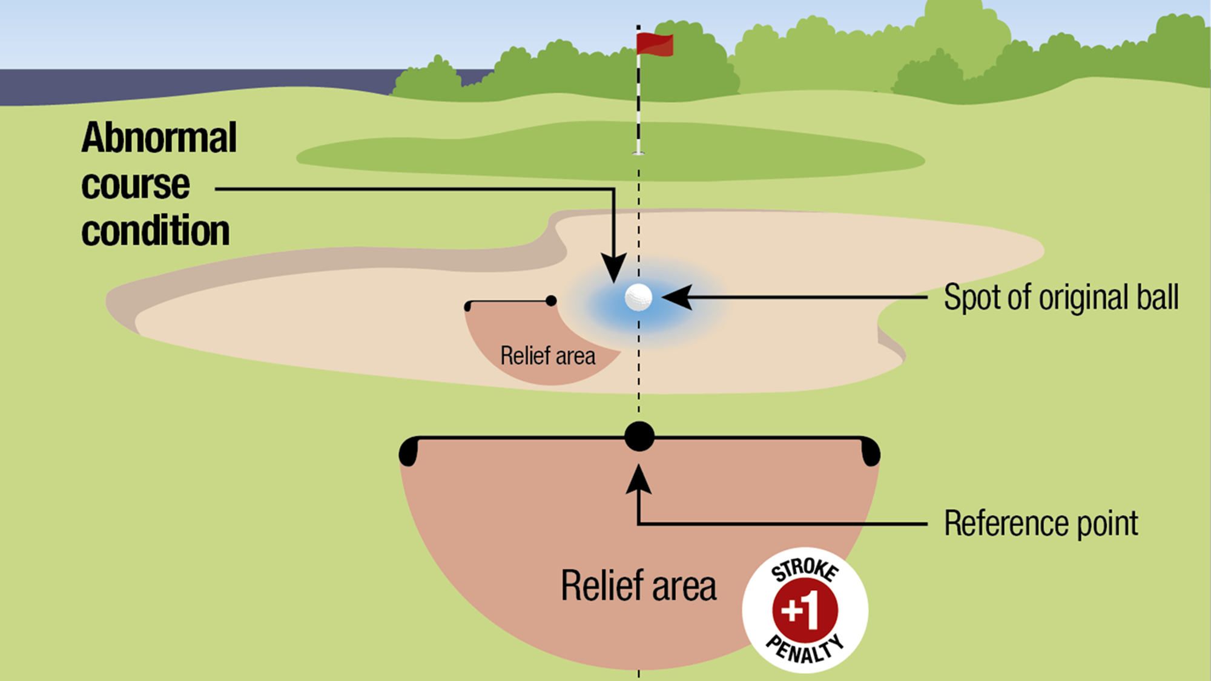
Areas of the Course – Bunkers

Slide 22
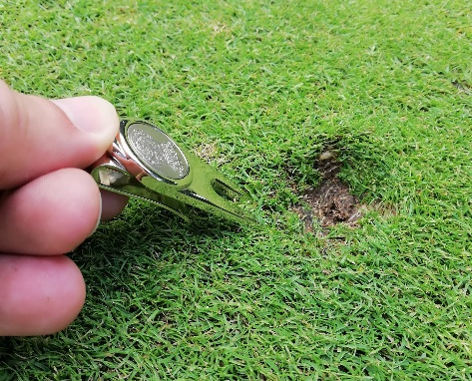
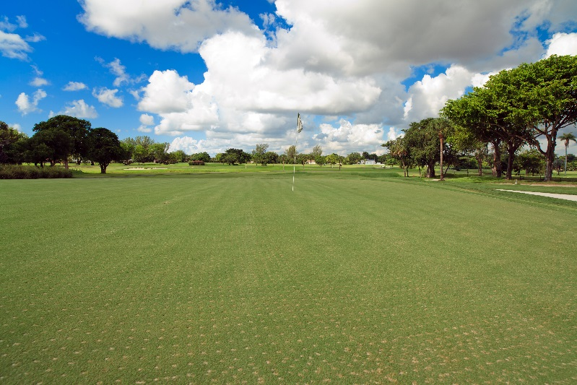
Areas of the Course – Putting Green
Improvements allowed
Whether ball lies on or off green
Repair of damage caused by a person or outside influence permitted
Improvements not allowed
But not natural damage or damage caused by normal maintenance practices

Slide 23

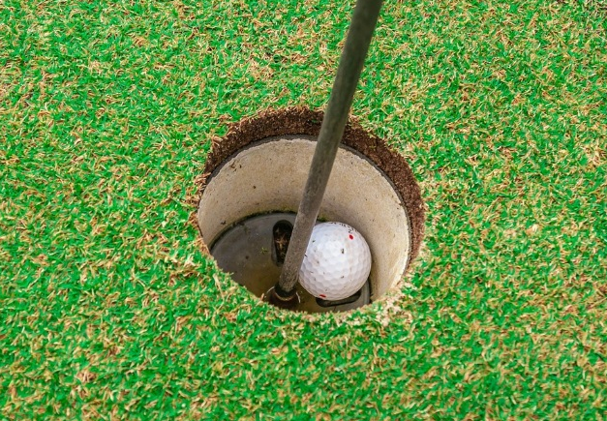
Areas of the Course – Putting Green
Flagstick Left in the Hole
The player may make a stroke with the flagstick left in the hole.
No penalty if ball strikes flagstick.
When Ball is Holed
If any part of the ball is in the hole below the surface of the putting green.

Slide 24
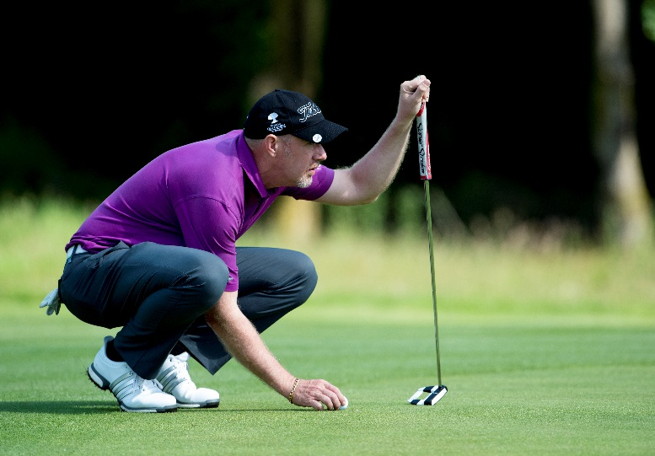
Areas of the Course – Putting Green
Replacing ball or ball marker that moves
Whenever moved accidentally
Whenever moved by natural forces, after ball marked, lifted and replaced
No penalty
Caddies’ new authority
Lifting ball on putting green without authorisation
Touching line of play (player or caddie)

Slide 25
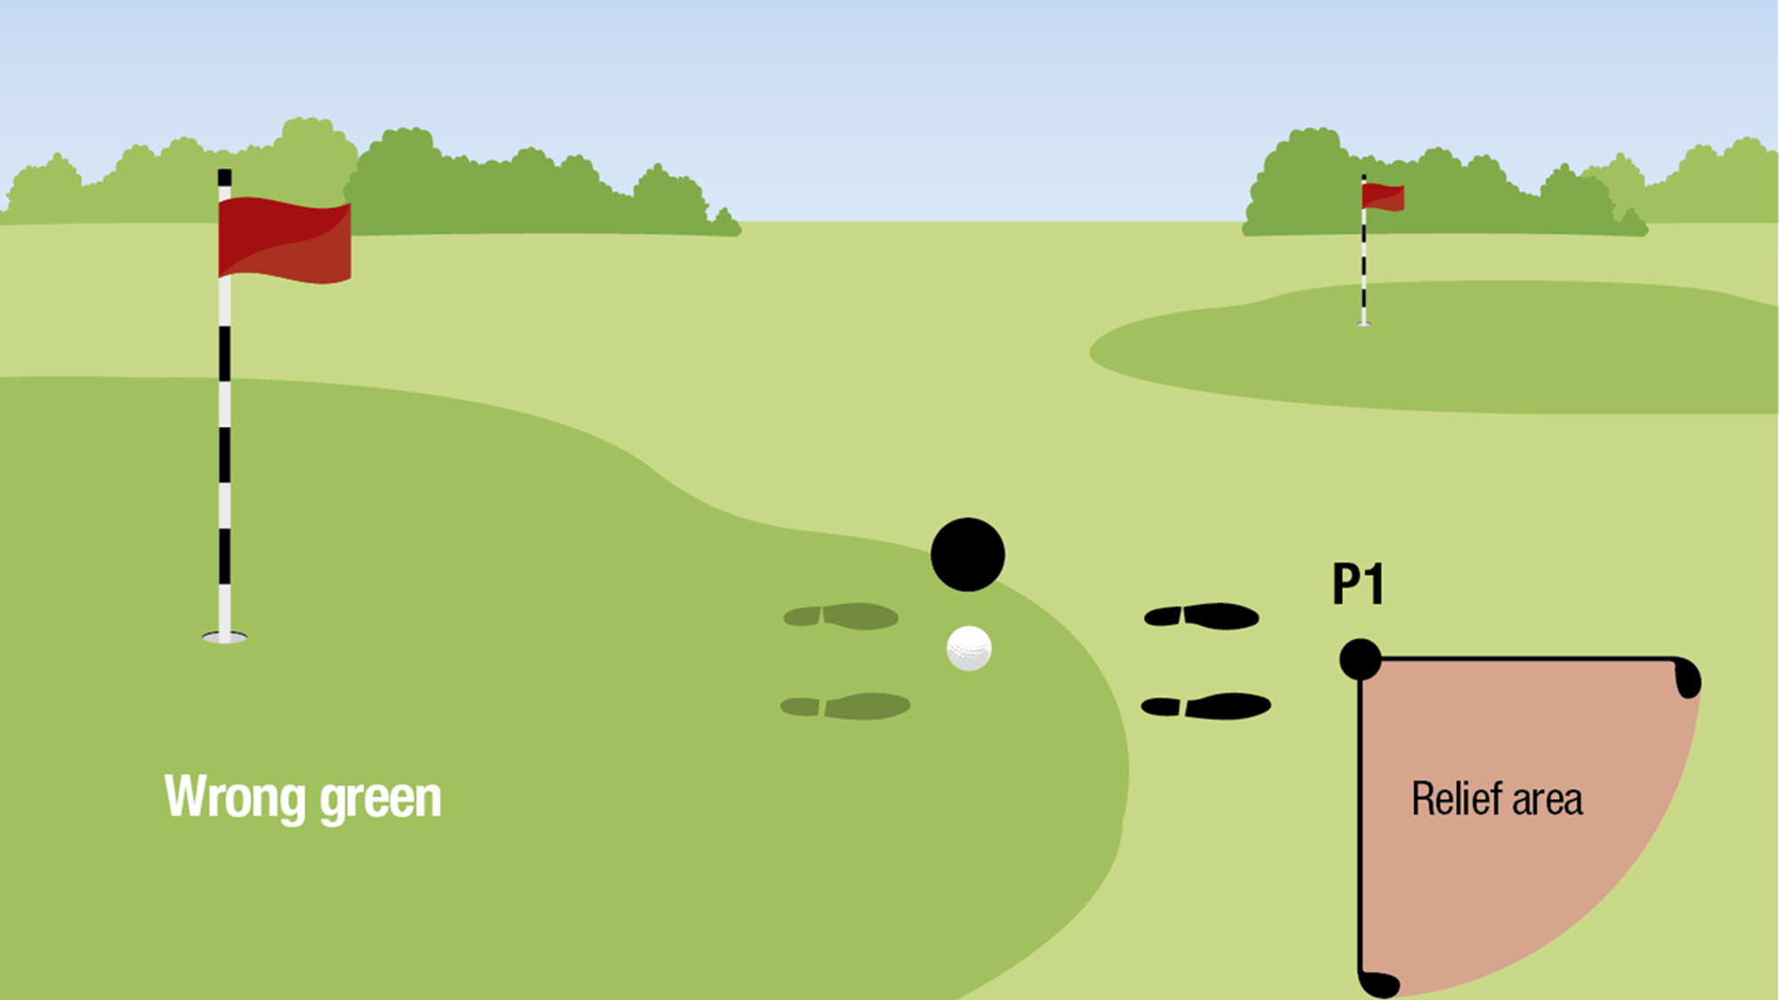
Areas of the Course – Putting Green

Slide 26
Areas of the Course – Penalty Areas
Rule 17
A penalty area is:
1. Any body of water on the course including a sea, lake, pond, river ditch, surface draining ditch or other open watercourse (even if not containing water)
Any other part of the course the Committee defines as a penalty area.
  Two types of penalty area, Yellow and Red.
  May remove loose impediments.
  May ground the club.

Slide 27
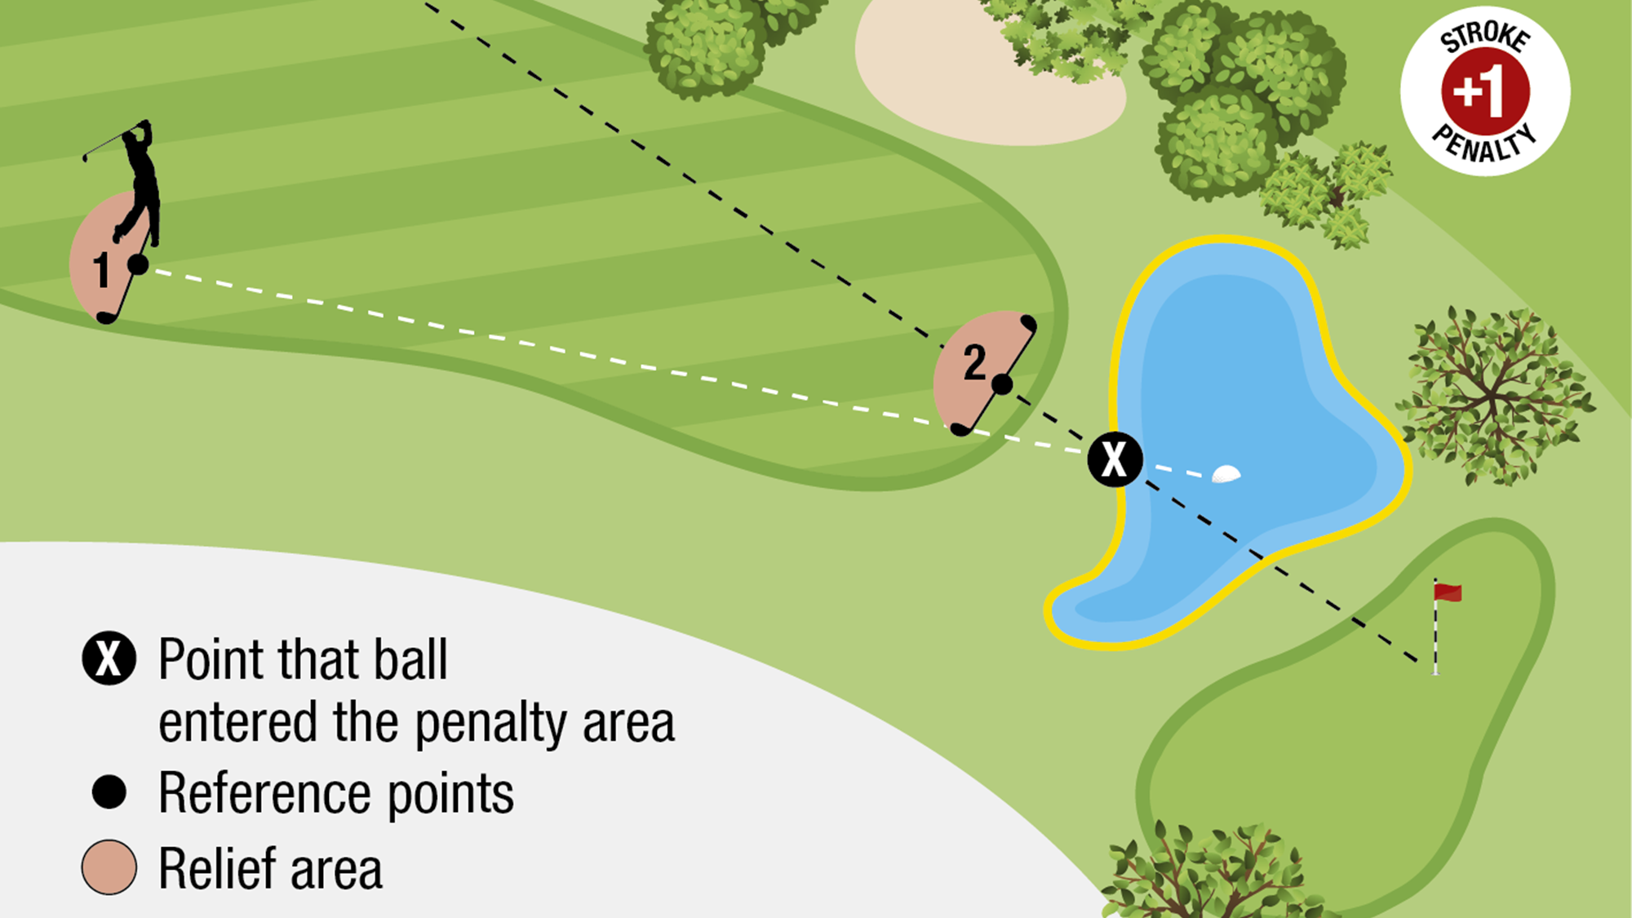
Areas of the Course – Penalty Areas

Slide 28
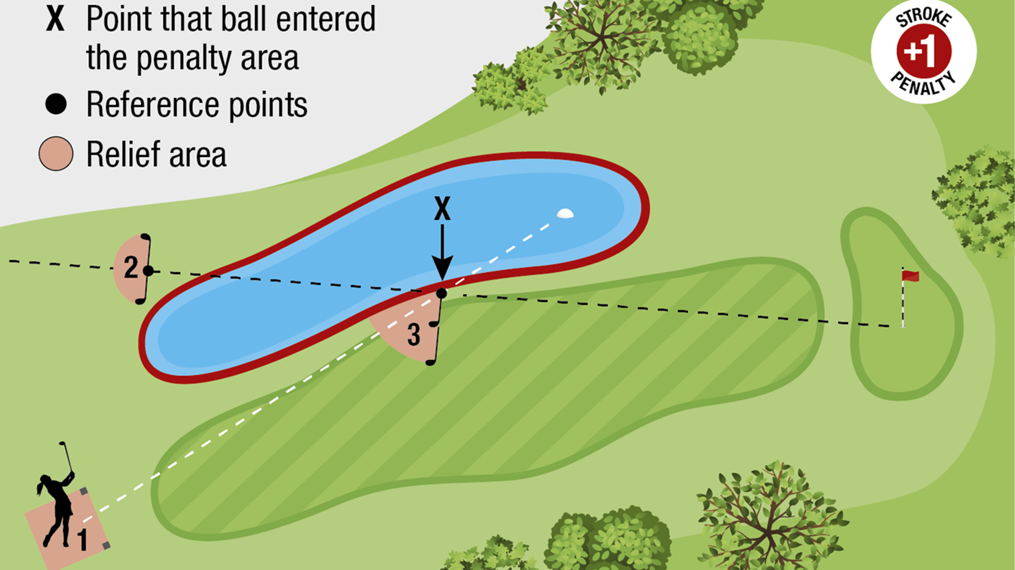
Areas of the Course – Penalty Areas

Slide 29
Areas of the Course - No Play Zones
A part of the course where the Committee has prohibited play. A No Play Zone must be defined as part of either an abnormal course condition or a penalty area.
These may be used for any reason, such as:
Protecting wildlife, animal habitats and environmentally sensitive areas
Protection of young trees, flower beds, re-turfed areas
Protecting players from danger
Preserving sites of historical or cultural interest

