Slide 1
Patient Betrayal The Corruption of Healthcare, Informed Consent and the Physician-Patient Relationship James A Thorp MD on GETTR @JamesAthorpmd Board Certified Ob/Gyn and Maternal Fetal Medicine

Slide 2
COVID-19 & Disaster Capitalism – Part I. Thorp KE, Thorp MM, Thorp EM, Thorp JA Gazette of Medical Sciences. 2022 3(1) https://www.doi.org/10.46766/thegms.medethics.22071901 James A Thorp MD on GETTR @Jamesathorpmd Board Certified Ob/Gyn and Maternal Fetal Medicine

Slide 3
Speaker Conflicts of Interest
NONE for ME
How about Birx, Fauci, Eric Rubin, CDC, FDA, WHO, Voters who pushed the Vax et al???
GETTR @ Jamesathorpmd

Slide 4
Mark Twain
It is much easier to fool someone than
it is to convince them that they have been fooled”
GETTR @ Jamesathorpmd

Slide 5
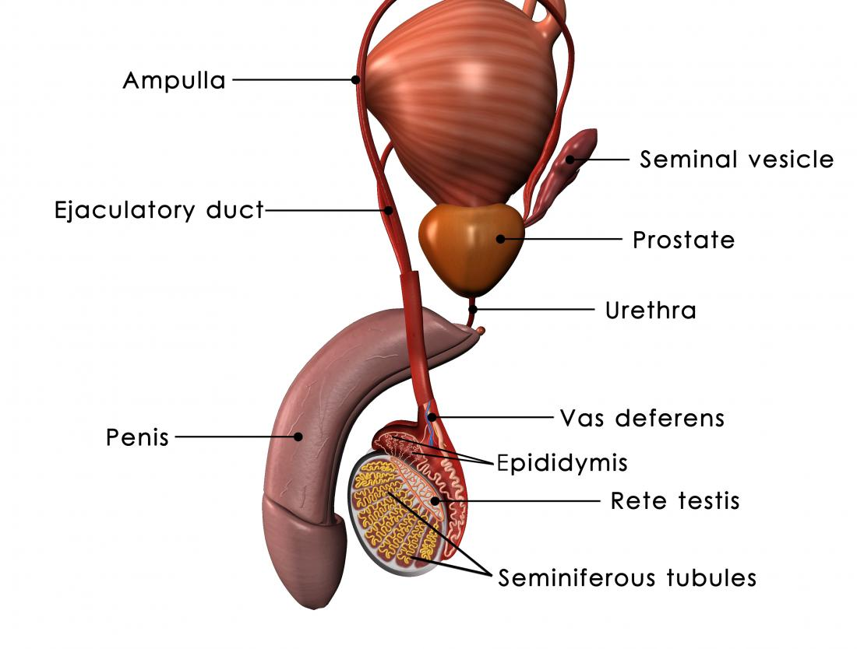
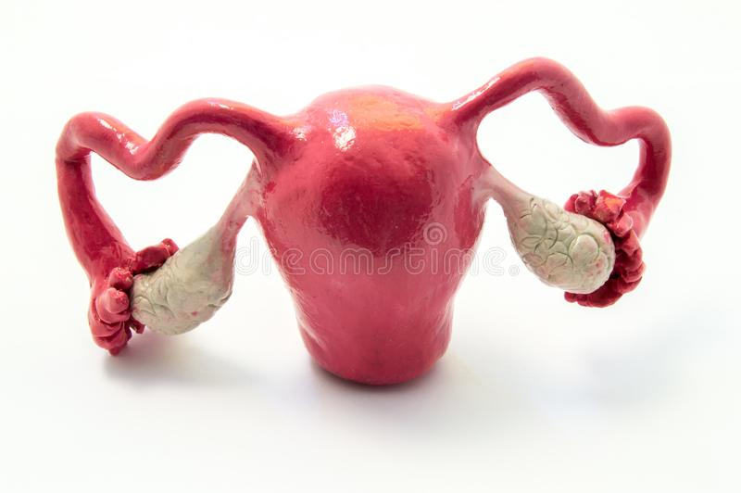
Germ Cells (gametes) Ovum versus Sperm
Male gametes (sperm 23X or 23Y) with 15 million sperm per ejaculation
Female gametes (ovum 23 X) with ONLY about 1 million ovum present in female fetuses prior to birth and only 1 ovum per month at ovulation
“And I will put enmity Between you and the woman,
And between your seed and her Seed;
He shall bruise your head, And you shall bruise His heel.”
GETTR @ Jamesathorpmd

Slide 6
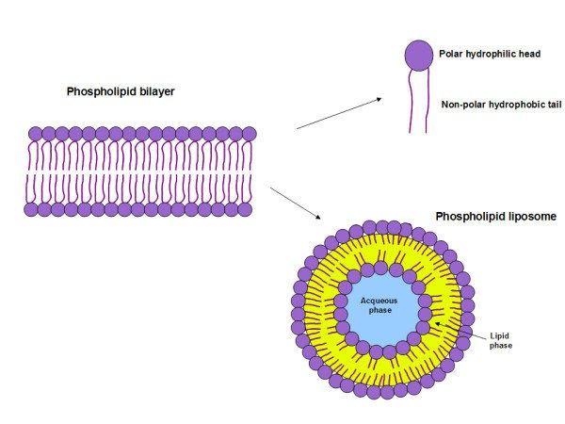
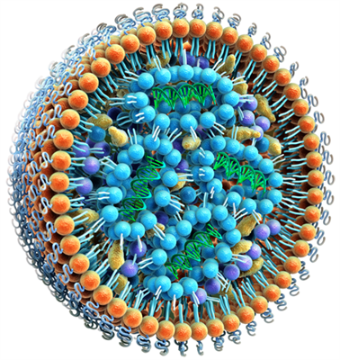
Chemistry of Lipid Nano Particles

Slide 7
Pfizer Japanese Freedom of Information Act (FOIA) Biodistribution Data (public site on phmpt.org)
Michael Yeadon was the Pfizer VP & most senior researcher warned of concentration of the lipid nanoparticles in the ovaries
NO data supporting safety in pregnancy
Reproductive toxicology studies NEVER performed in the ‘gene-based vaccines’ and lipid nanoparticles (LPN’s)
Yeaden’s 2012 review explicitly provided evidence that the LPN’s accumulate in the ovaries (J Controlled Release. 30 May 2012. 160(1):105-112) in the mouse and Wistar rat models
Yeaden states that Pfizer and Moderna “definitely knew” of dangers
GETTR @ Jamesathorpmd

Slide 8
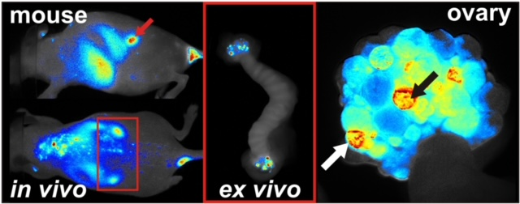
Accumulation of Nanocarriers in the Ovary: A Neglected Toxicity
Lipid nanoparticles (LPN’s) long studied for drug delivery to tissues
LPN’s given intravenously in mouse species and Wistar rats
Concentrations in the ovaries of all animals observed by multispectral fluorescence imaging and confocal laser scanning microscopy
Schadlich A, Hoffmann S, Mueller T, et al. Journal of Controlled Release. 160 (1) May 2012,105-112

Slide 9
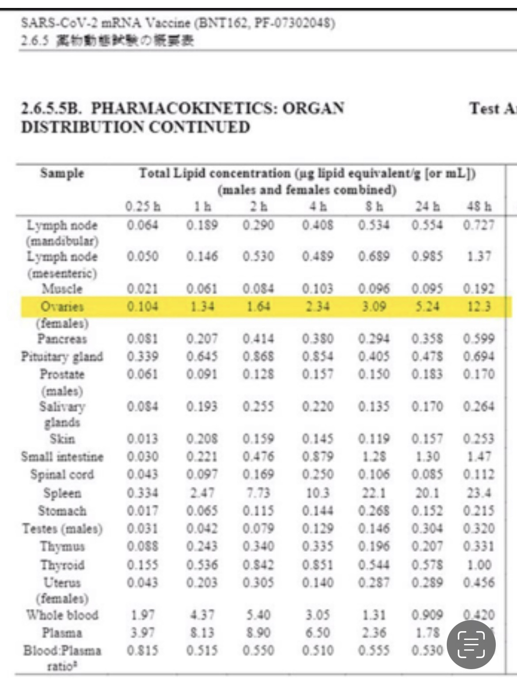
Pfizer Japanese Freedom of Information Act (FOIA) Biodistribution Data Public Site on phmpt.org “They Knew” Michael Yeadon Former Pfizer VP
GETTR @ Jamesathorpmd

Slide 10
The Placental Pathology in COVID-19 Infected Mothers and its Impact on Pregnancy Outcome. Brose P. Placenta September 2022:127:1-7
Lie, Lie, Lie & promote, promote & promote. The stakeholders learned well from Hitler: Repeat lies often enough and it becomes TRUTH
The incidence of abnormal placental pathologies is 49.16%
NO MENTION of “vaccine”
GURANTEED from THORP: If C19 infection causes problem, multiply it by a hundered or a thousand for similar effects from the “vaccine”.
GETTR @ Jamesathorpmd

Slide 14
Reproductive Toxicology a Mandatory Requirement They Lied to the American People Pharma CDC & FDA Killed and Maimed Innocent Victims Alexandra “Sasha” Latypova Broke in Epoch Times August 15, 2022
NO studies in males
Using human dose of 100 mcg mRNA on 28 days & 14 days prior to mating and gestation days 1 & 13
NO numbers provided for the study size
NO study report is available – only Moderna’s “interpretation” of results
GETTR @ Jamesathorpmd

Slide 15
Rat Offspring had Severe Skeletal Dysplasias
They Lied to the World
Pharma CDC & FDA Killed and Maimed Innocent Victims Alexandra “Sasha” Latypova Broke in Epoch Times
“mRNA 1273-related variations in skeletal examination included statistically significant increases in the number of F1 rats with 1 or more wavy ribs and 1 or more rib nodules. Wavy ribs appeared in 6 fetuses and 4 litters with a fetal prevalence of 4.03% and a litter prevalence of 18.2%. Rib nodules appear in in 5 of those 6 fetuses”.
“Maternal toxicity in the form of clinical observations was observed for 5 days following the last dose (DG 13), correlating with the most sensitive period for rib development in rats ( DGs 14 to 17”)
mRNA-1273 was toxic to pregnant females and caused damage to the baby development during the same time.
GETTR @ Jamesathorpmd

Slide 16
FDA LIED in Labeling of Moderna Spikevax
“No vaccine-related fetal malformations or variations and no adverse effect on postnatal development were observed in this study”
This was published in medical journal Reproductive Toxicology August 2021, Volume 103, pages 28-35
NB: this was published 9 months after the start of the massive propaganda coercion campaign to vaccinate pregnant women globally – Thanks ABOG
GETTR @ Jamesathorpmd

Slide 17
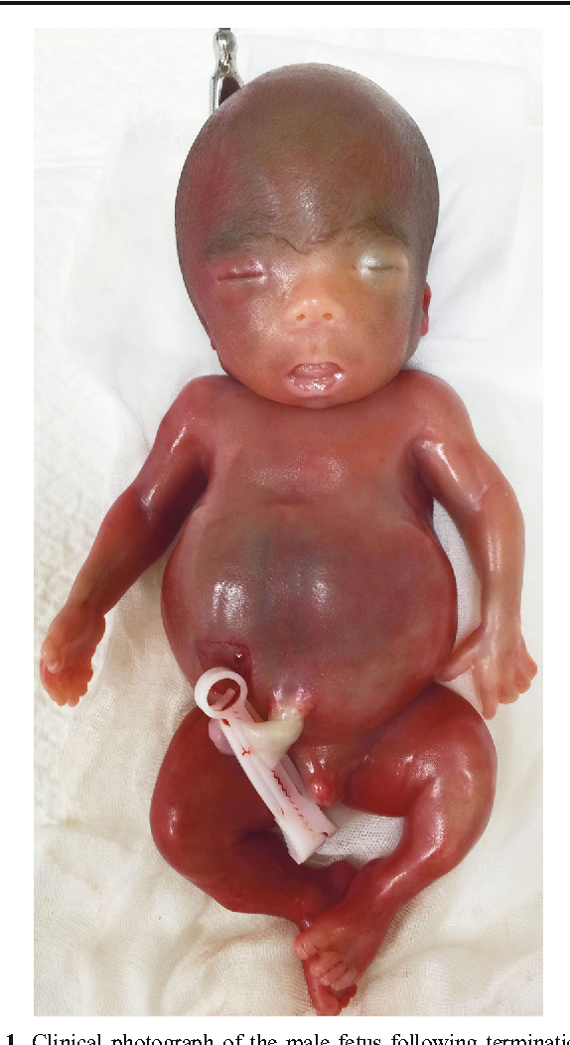
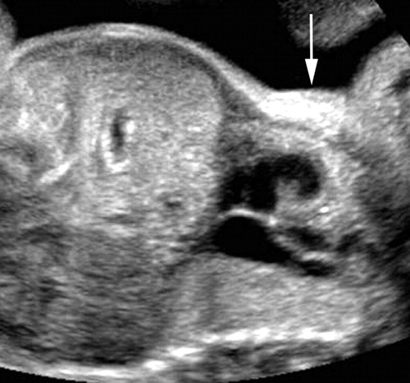
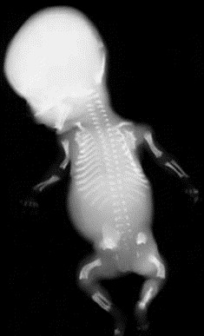
Lethal Skeletal Dysplasias
GETTR @ Jamesathorpmd

Slide 18
COVID-19 “Vaccine” & Women of Reproductive Age
Retrospective cohort study
VAERS Jan 1, 1998 to June 30, 2022
Outcomes investigated based upon 43+ years OB & MFM experience
Outcomes COVID19 ‘vaxx’ compared to Influenza vaccines
Monte Carlo, Proportional reporting ratio, Poisson distribution
Three sets of denominators: per time, per vax, per person
GETTR @ Jamesathorpmd
Thorp, Price, Deskevich, Long, Tankersly, Being Submitted

Slide 19
COVID-19 “Vaccine” & Women of Reproductive Age
Menstrual abnormalities
Miscarriage (spontaneous abortion)
Fetal chromosomal abnormalities
Fetal cystic hygroma
Fetal malformations
Fetal cardiac abnormalities
Fetal cardiac arrythmia
Fetal cardiac arrest
Fetal growth restriction (IUGR / FGR)
Fetal surveillance abnormalities
Fetal vascular malperfusion (Doppler)
Placental thrombosis
Amniotic fluid reduction (oligohydramnios)
Fetal death
GETTR @ Jamesathorpmd
Thorp, Price, Deskevich, Long, Tankersly, Being Submitted

Slide 20
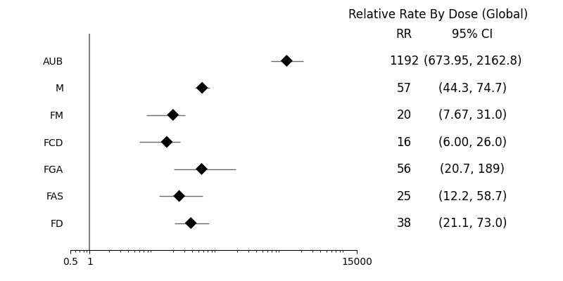
COVID-19 “Vaccine” & Women of Reproductive Age
GETTR @ Jamesathorpmd
Thorp, Price, Deskevich, Long, Tankersly, Being Submitted

Slide 21
Phase I/II study of COVID-19 RNA Vaccine BNT162b1 in Adults
“RNA is required for protein synthesis, does not integrate into the genome, is transiently expressed, and is metabolized and is eliminated by the body’s natural mechanisms and, therefore is considered safe^{4,7}”
Mark J Mulligan et al. Nature. August 12, 2020 586:589-593

Slide 22
Intracellular Reverse Transcription of Pfizer BioNTech COVID-19 mRNA Vaccine BNT162b2 In Vitro in Human Liver Cell Line
Markus Aldén et al
Current Issues in Molecular Biology. February 25, 2022. 44:1115-1126
https://doi.org/10.3390/cimb44030073

Slide 23
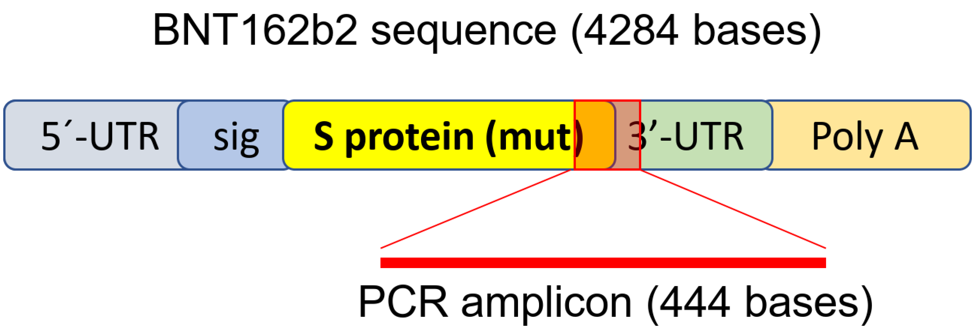
Intracellular Reverse Transcription of Pfizer BioNTech COVID-19 mRNA Vaccine BNT162b2 In Vitro in Human Liver Cell Line (Huh7)
COVID-19 vaccine BNT162B2 mRNA enters the human liver cell in vitro
It is reverse transcribed intracellularly into DNA within 6 hours
Alden M et al. Current Issues in Molecular Biology. February 25, 2022. 44:1115-1126 https://doi.org/10.3390/cimb44030073

Slide 24
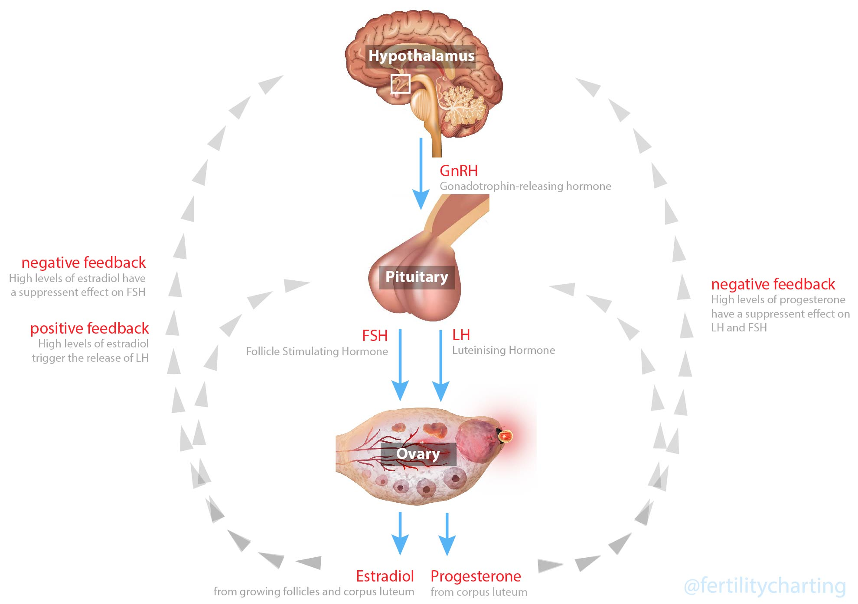
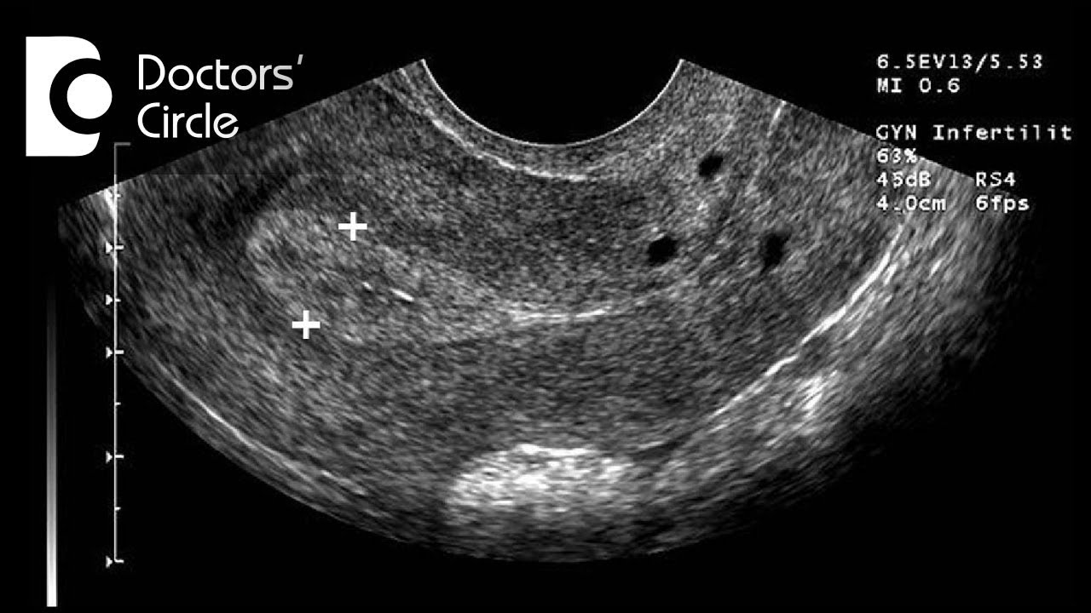
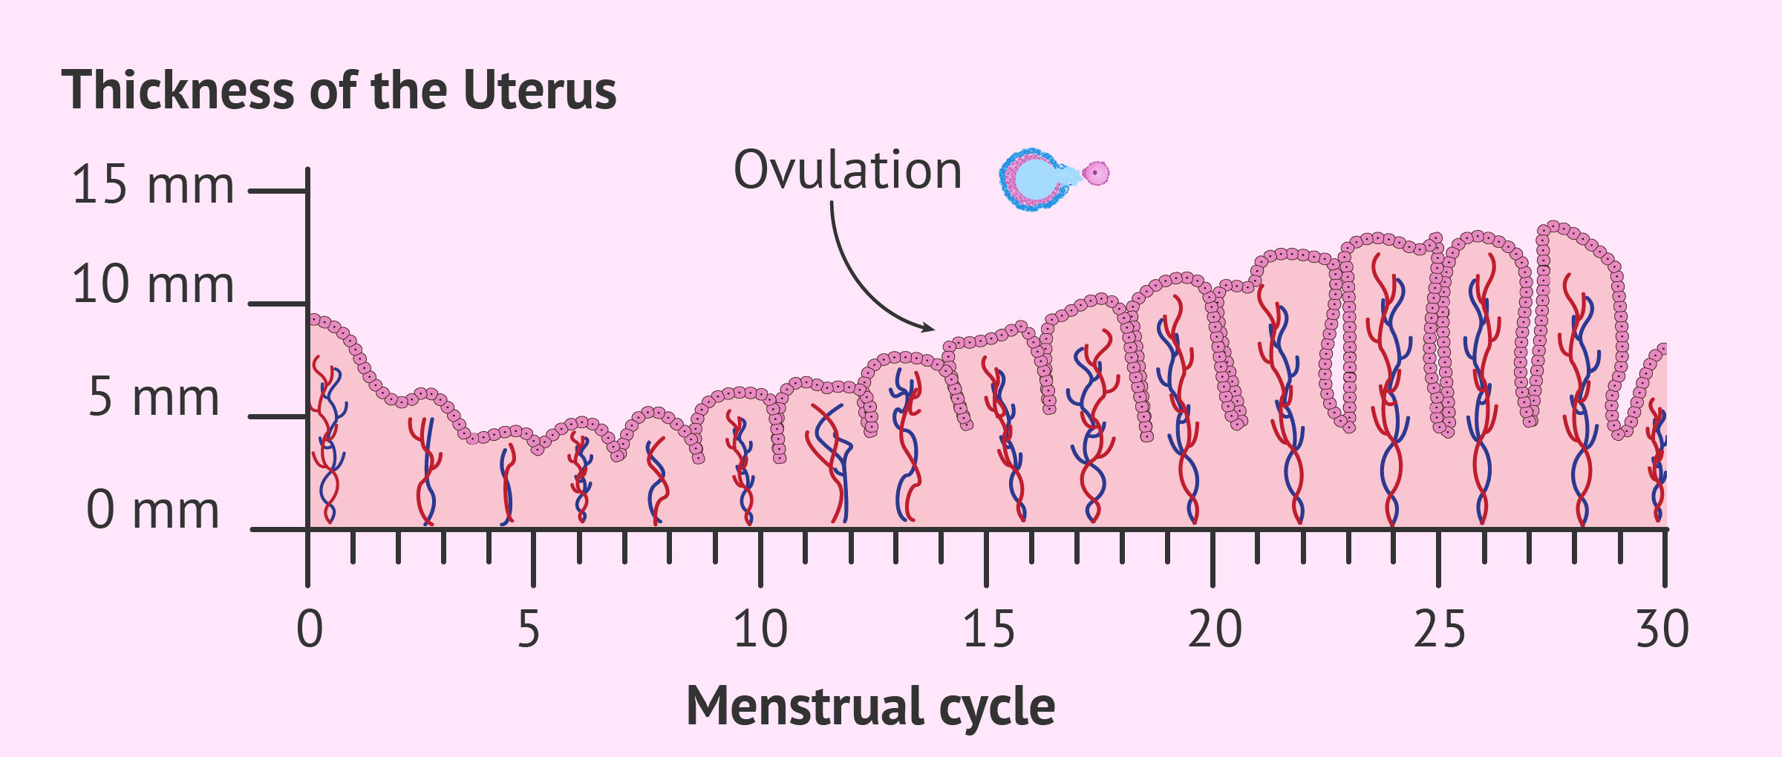
The Complexity of Ovulation and Normal Organized Menstruation
Ovarian inflammation form LNP’s disrupting hormones: likely contributes
Inflammatory assault from “vaxx” likely contributes
Spike protein assault from “vaxx” likely contributes
Hypothalamic-pituitary abnormalities?
Other endocrine factors, thyroid, adrenal?
Anxiety / Stress? NO
GETTR @ Jamesathorpmd

Slide 25
COVID-19 and the Unraveling of Experimental Medicine – Part II
K.E Thorp MD, James A Thorp MD, Elise M Thorp BS FNTP. G Med Sci. 2022 3(1): 074-106

Slide 26
Menstrual Irregularities and the COVID-19 Pandemic
Significant reporting of irregular menses in 2021: multiple sources including social media, VAERS and DMED data
My Cycle Story of Tiffany Parotto, CEO and founder
Publications in peer-reviewed medical journals documenting adverse vaginal bleeding events associated with COVID-19 pandemic
Part I: COVID-19 and the Surge in Decidual Cast Shedding. G Med Sci. 2022; 3(1):107-117 (Just published)
Part II: COVID-19 and the association with abnormal menstruation
Part III: Covid-19 and the association with post-menopausal bleeding
GETTR @ Jamesathorpmd

Slide 27
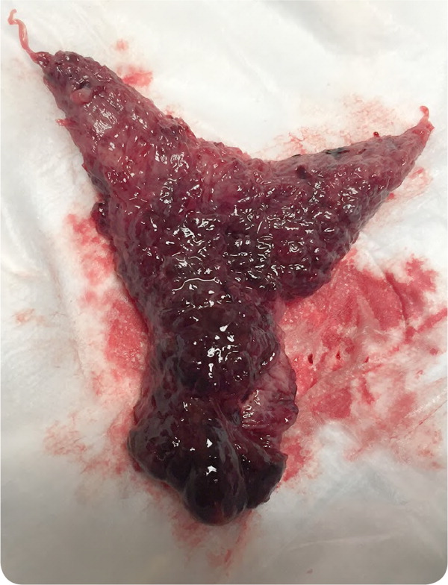
Menstrual Irregularities and the COVID-19 Pandemic MyCycleStory.com (MCS) Part I: COVID-19 and the Surge in Decidual Cast Shedding (DCS)
Significant reporting of DCS via MCS with 294 in 7.5 months of 2021
Prior 109 years pre-pandemic < 40 reported in the medical literature
Usual associations: ectopic pregnancy, miscarriage, prolonged progesterone
Causes of surge in pandemic???
Parotto T, Thorp JA, Hooker B, et al. Gazette of Medical Sciences. 2022; 3(1):107-117. GETTR @ Jamesathorpmd

Slide 28
Part I: COVID-19 and the Surge in Decidual Cast Shedding. Gazette of Medical Sciences. 2022; 3(1):107-117
Causes of surge in pandemic???
Increased miscarriages?
Increased ectopic pregnancy?
Abnormal clotting / consistency of blood?
Parotto T, Thorp JA, Hooker B, et al. Gazette of Medical Sciences. 2022; 3(1):107-117.
GETTR @ Jamesathorpmd

Slide 29
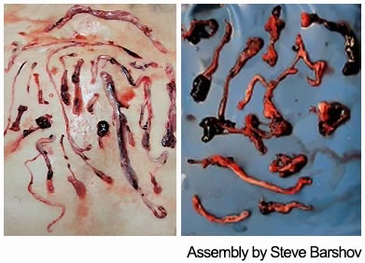
Compliments of
Embalmer
Sir Richard Hirschman

Slide 30
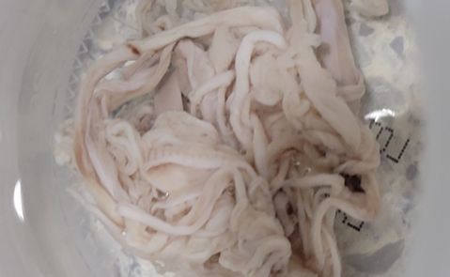
Compliments of Embalmer Sir Richard Hirschman

Slide 31
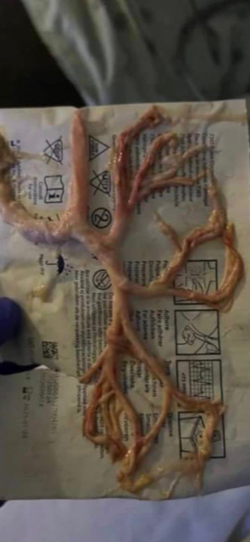
Compliments of Embalmer Sir Richard Hirschman

Slide 32
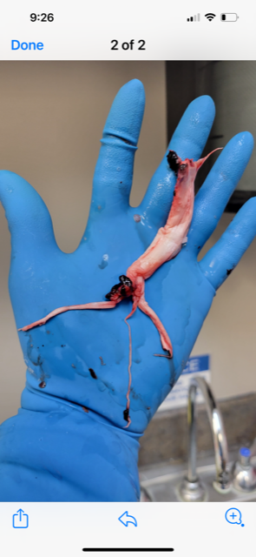
Courtesy of Embalmer Sir Richard Hirschman

Slide 33
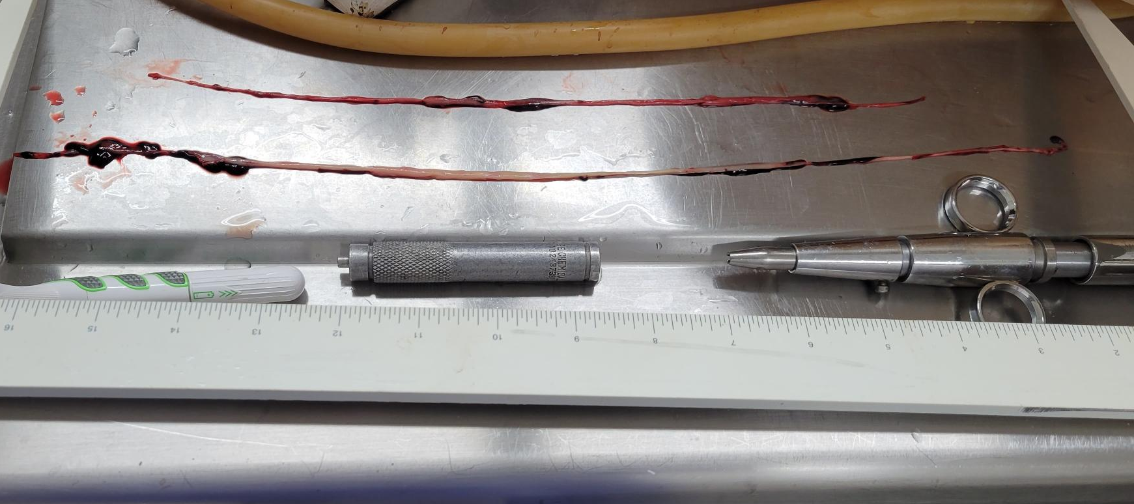
Courtesy of Embalmer Sir Richard Hirschman

Slide 34
Decidual Cast
“Uterine Cavity Cast”
Post-Mortem
“Pulmonary artery Cast”
Post-Mortem
“Right Carotid Artery Cast”

Slide 37
COVID-19 and the Unraveling of Experimental Medicine – Part I
Review of the immune function and the COVID-19 response
Flaws of contemporary medical theory & practice exposed
Herd immunity
Dynamic energy-based functional framework that explains various clinical and pathologic phenomena related to COVID-19 infection
395 references
K.E Thorp MD, James A Thorp MD, Elise M Thorp BS FMTP. G Med Sci. 2022 3(1): 015-045

Slide 38
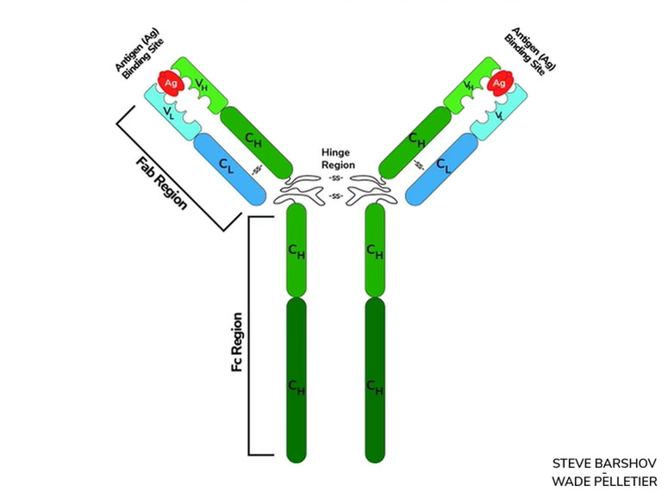
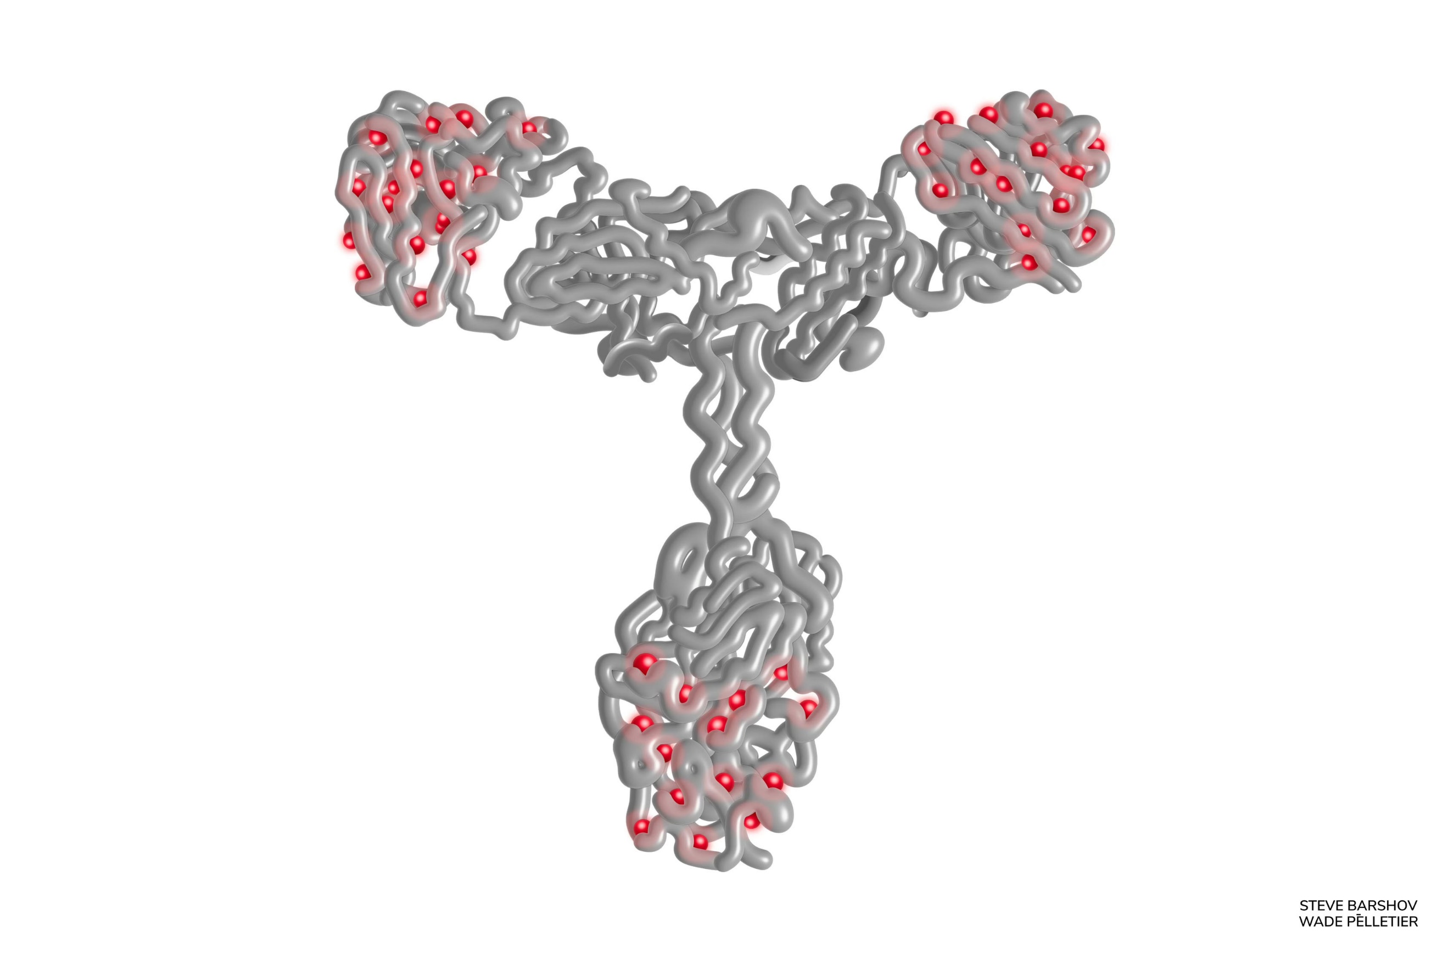
K.E Thorp MD, James A Thorp MD, Elise M Thorp BS FMTP. G Med Sci. 2022 3(1): 015-045

Slide 39
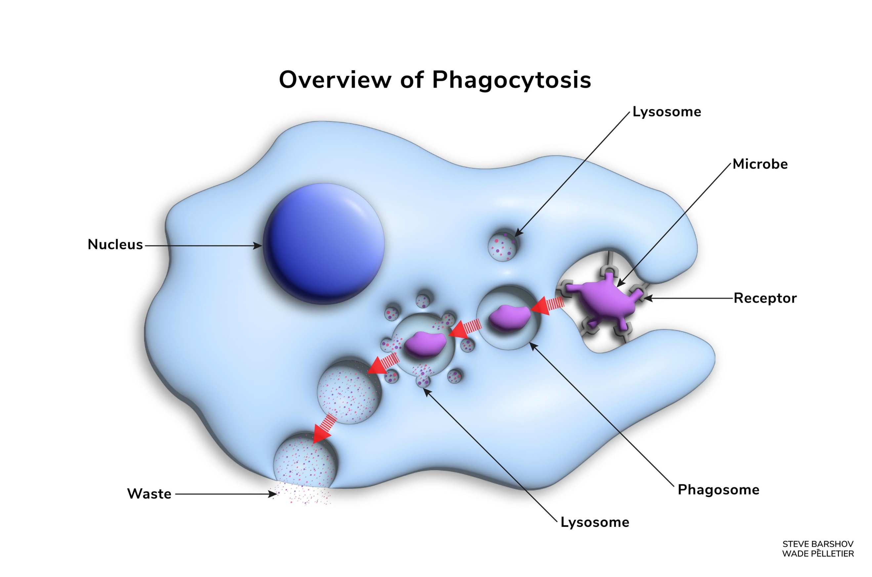
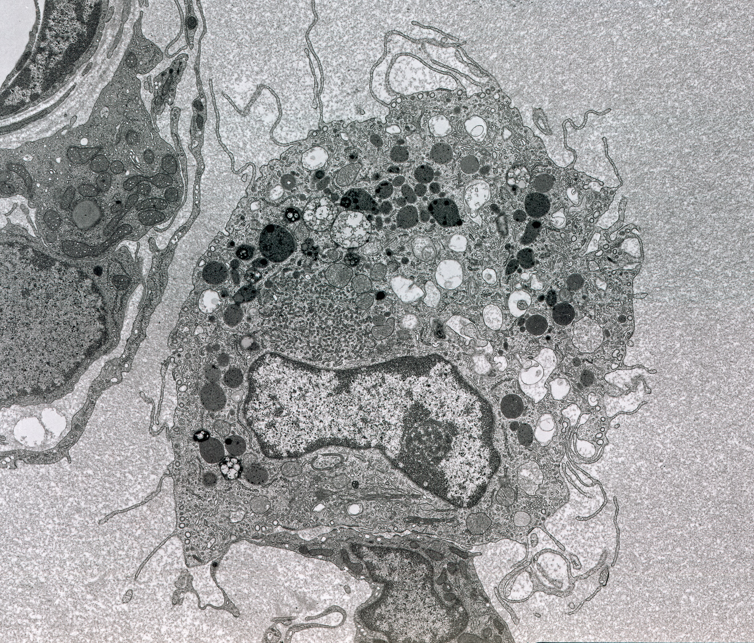
K.E Thorp MD, James A Thorp MD, Elise M Thorp BS FMTP. G Med Sci. 2022 3(1): 015-045

Slide 40
Thorp JA, Hollenbeck SA, Viglione DD, Green PC, Hodge JR, Tamburro JA, Tran TN and Glassman DS. Novel therapy for COVID-19: Does intravenous ozonated-daline affect blood and tissue oxygenation? Journal of Gynecological Research and Obstetrics June 10, 2020. 6(2): 046-050. DOI: https://dx.doi.org/10.17352/jgro.000085.
Thorp KE, Thorp JA. Ozone Preconditioning: Waking up the dragon. G Med Sci. 2021; 2(3): 010-039. https://www.doi.org/10.46766/thegms.intmed.21051402
Thorp JA, Thorp KE, Lile EK, Viglione J. Unexpected magnetic attraction: Evidence for an organized energy field in the human body. G Med Sci. 2021; 2(4): 001-015. https://www.doi.org/10.46766/thegms.pubheal.21071202
Thorp JA, Thorp KE. Science, Skepticism & Reality. G Med Sci. 2021; 2(4): 032-034. https://www.doi.org/10.46766/thegms.pubheal.21081005
Thorp KE, Thorp JA, Walker PR. Aether, fields & energy dynamics in living bodies - Part I. G Med Sci. 2021; 2(5): 014-025. https://www.doi.org/10.46766/thegms.medphys.21100603
Thorp KE, Thorp JA, Walker PR. Aether, fields & energy dynamics in living bodies - Part II. G Med Sci. 2021; 2(6): 001-020. https://www.doi.org/10.46766/thegms.medphys.21110401
Thorp KE, Thorp JA, Walker PR. Aether, fields & energy dynamics in living bodies - Part III. G Med Sci. 2021; 2(6): 021-047. https://www.doi.org/10.46766/thegms.medphys.21112203
Thorp JA, Thorp KE, Lile EK, Viglione J. Unexpected magnetic attraction: Evidence for an organized energy field in the human body. G Med Sci. 2021; 2(4): 001-015. https://www.doi.org/10.46766/thegms.pubheal.21071202
Thorp JA, Thorp KE, Thorp EM, Viglione DD. Ozone Preconditioning in Viral Disease. Virology: Current Research. Volume 6:S1, 2022. https://www.hilarispublisher.com/open-access/ozone-preconditioning-in-viral-disease.pdf
Thorp KE, Thorp JA, Thorp EM. COVID-19 and the Unraveling of Experimental Medicine - Part I. G Med Sci. 2022; 3(1): 015-045. https://www.doi.org/10.46766/thegms.pubheal.22012306
Thorp KE, Thorp JA, Thorp EM. COVID-19 and the Unraveling of Experimental Medicine - Part II. G Med Sci. 2022; 3(1):074-https://www.doi.org/10.46766/thegms.pubheal.22022804
Thorp KE, Thorp JA, Thorp EM. COVID-19 and the Unraveling of Experimental Medicine - Part III. G Med Sci. 2022; 3(1):118-158. https://www.doi.org/10.46766/thegms.pubheal.22042302
Parotto T, Thorp JA, Hooker B, Mills PJ, Newman J, Murphy L, et al. COVID-19 and the surge in Decidual Cast Shedding. G Med Sci. 2022; 3(1): 107- 117. https://www.doi.org/10.46766/thegms.pubheal.22041401

Slide 41
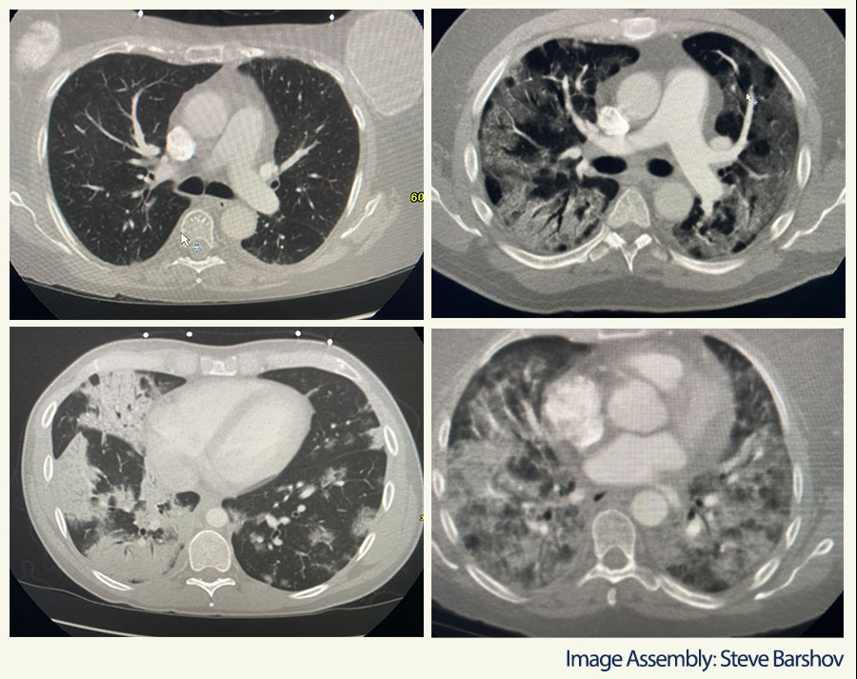
K.E Thorp MD, James A Thorp MD, Elise M Thorp BS FMTP. G Med Sci. 2022 3(1): 015-045

Slide 43
COVID-19 and the Unraveling of Experimental Medicine – Part II
Containment/mitigation strategies such as lockdowns came at great social and economic costs and yet failed to impact the spread and evolution of the SARS-CoV-2 virus.
Evidence suggests the social fallout alone from such strategies exceeded the morbid sequelae of the pandemic itself.
The mRNA vaccines were an unqualified failure. They neither halted viral spread nor conferred herd immunity and, in their wake, spawned a laundry list of disabling side effects.
40-fold increase in adverse event reports compared to trivalent influenza vaccines in the years preceding the pandemic.
Medical science must face this mass casualty event which, in all likelihood, will surpass any of the pharmacologically-induced disasters of the 20th century
292 references
K.E Thorp MD, James A Thorp MD, Elise M Thorp BS FNTP. G Med Sci. 2022 3(1): 074-106

Slide 44
COVID-19 and the Unraveling of Experimental Medicine – Part II
K.E Thorp MD, James A Thorp MD, Elise M Thorp BS FNTP. G Med Sci. 2022 3(1): 074-106

Slide 45
COVID-19 and the Unraveling of Experimental Medicine – Part II
K.E Thorp MD, James A Thorp MD, Elise M Thorp BS FNTP. G Med Sci. 2022 3(1): 074-106

Slide 46
COVID-19 and the Unraveling of Experimental Medicine – Part II
K.E Thorp MD, James A Thorp MD, Elise M Thorp BS FNTP. G Med Sci. 2022 3(1): 074-106

Slide 47
Shimakuburo TT et al. N Engl J Med June 17, 2021;384:2273-2282

Slide 48
Shimakuburo TT et al. N Engl J Med June 17, 2021; 384: 2273-2282
Outcomes | Total Vaccinated | Vaccinated in 1st & 2nd Trimesters | Vaccinated in 3rd Trimester
Live Birth | 712 | 12 | 700
Spontaneous Abortion (aka ‘SAB’ or miscarriage) | 104 | 104 | 0
Stillbirth | 1 | 0 | 1
Induced Abortion or Ectopic Pregnancy | 10 | ? | ?
Total Live Birth, SAB or Stillbirth | 817 | 116 | 701
Total All Outcomes | 827 | ? | ?
Rate of Spontaneous Abortion (aka SAB or Miscarriage) | 13% | 90%

Slide 49
COVID-19 ‘vax’ Rivals or Exceeds ‘Efficacy’ of Abortion Pill
Shimakuburo TT et al. N Engl J Med June 17, 2021; 384: 2273-2282
COVID-19 ‘vax’ has spontaneous abortion rate of 90% (Shimakuburo)
The ‘morning after’ abortion pill (RU486 aka mifepristone) has reported ‘efficacy rates’ of terminating pregnancy of 80% to 90%
Both COVID-19 ‘vaxx’ and Mifepristone demonstrate comparable abortifacient properties BOTH should have a black box warning
Both must have mandatory informed, UNCOERCED consent
Both should be strictly avoided in the general population
ColleenHuberNMD.Substack.com August 6, 2021

Slide 50
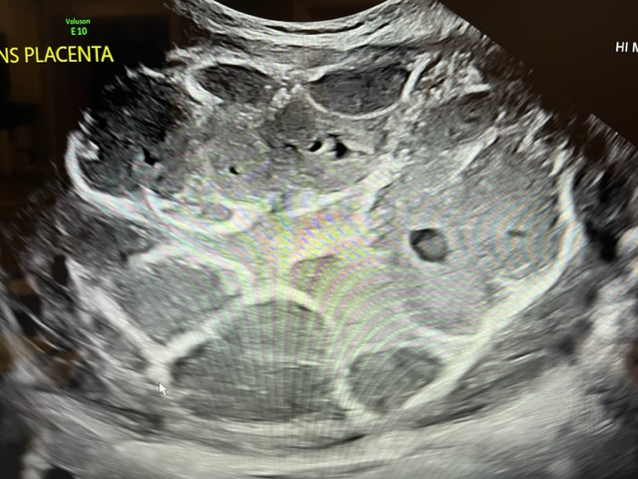

Slide 52
COVID-19 and the Unraveling of Experimental Medicine – Part III
Early Treatment (ET): cheap, widely available, home-based therapies—ozone preconditioning, hydroxychloroquine, and light/vitamin treatment—which, had they been implemented early could have reduced morbidity and mortality by 80% or more.
ET could have prevented about 4.8 million deaths globally and 768,000 in the US and in the process put an early end to the pandemic.
Fraudulent mRNA vaccine scheme and the dark web of manipulation and disinformation promulgated by those who sponsored this dangerous and ill-conceived experiment.
The pandemic sounds a clarion call mandating widescale reform of the healthcare system, medical-industrial complex, and their incestuous relationship with governmental and academic oversight bodies
495 References
Published hyperlink appendix to 1,366 peer-reviewed medical publications documenting severe adverse events occurring after the COVID-19 ‘vaccines’
K.E Thorp MD, James A Thorp MD, Elise M Thorp BS FNTP. G Med Sci. 2022 3(1): 118-158

Slide 53
COVID-19 and the Unraveling of Experimental Medicine – Part III
K.E Thorp MD, James A Thorp MD, Elise M Thorp BS FNTP. G Med Sci. 2022 3(1): 118-158

Slide 54
COVID-19 and the Unraveling of Experimental Medicine – Part III
Appendix 1 Continued Below
K.E Thorp MD, James A Thorp MD, Elise M Thorp BS FNTP. G Med Sci. 2022 3(1): 118-158

Slide 55
COVID-19 and the Unraveling of Experimental Medicine – Part III
K.E Thorp MD, James A Thorp MD, Elise M Thorp BS FNTP. G Med Sci. 2022 3(1): 118-158

Slide 56
Independent COVID-19 ‘vaxx’ Data Sources Documenting Death and Severe injury
VAERS
Military DMED database
Scottish Infant Mortality
OneAmerica CEO Scott Davison
Millennial ‘all cause’ mortality
NEJM Shimabukuro data
Embalmers Post-Mortem clots
Steve Kirsch SubStack data
Epidemiological data
Temporal relationships to vaxx rollout
Peer-reviewed medical publications
Unprecedented young athletes’ deaths
Unprecedented pilot deaths
***Pfizer FOIA post market data

Slide 58
Ozone Preconditioning in Viral Disease
Narrative review of 239 relevant publications and present new data not previously published from our group.
Ozone, a tri-atomic oxygen molecule is a natural substance made by the human white blood cells and metabolized into hydrogen peroxide and many lipo-peroxidases. Ozone is one of the most important modulators of the human immune system.
Multiple potential mechanisms by which ozone treats a variety of viral and other illnesses at the atomic and cellular levels. While these mechanisms are operative, they represent passive events resulting from the ozone’s impartation of resonant energy to the human energetics’ fields.
Ozone may be one of the most potent preconditioning agents yet discovered in the human body.
A spate of case reports describing beneficial outcomes with ozone treatment in diverse viral syndromes including Human Immunodeficiency Virus (HIV), Human Papillomavirus (HPV), hepatitis C, herpes zoster, ebola, and SARS-CoV-2. Additionally, we found in vitro studies describing inactivation of herpes and HIV by ozone treatment.
We reviewed our successful use of ozone as an adjuvant and/or primary agent for the successful treatment of COVID-19.
We report two cases of safe & successful use of ozone therapy in the maternal-fetal dyads in the severely infected/affected fetuses with CMV; this has never been reported in the medical literature.
James A Thorp MD, KE Thorp MD, Elise M Thorp BS FNTP, Deborah D Viglione. Virology: Current Research. 6:S1, Feb 3 2022

Slide 59
Physician reported
5 month old baby
Breast-feeding
Pfizer 2nd vaxx 3.17.2021
After breast fed 3.18.2021 and developed a rash, extreme irritability, inconsolable, fever
Elevated liver enzymes
Thrombotic Thrombocytopenia Purpura (TTP)
Died 2 days post vaxx

Slide 60
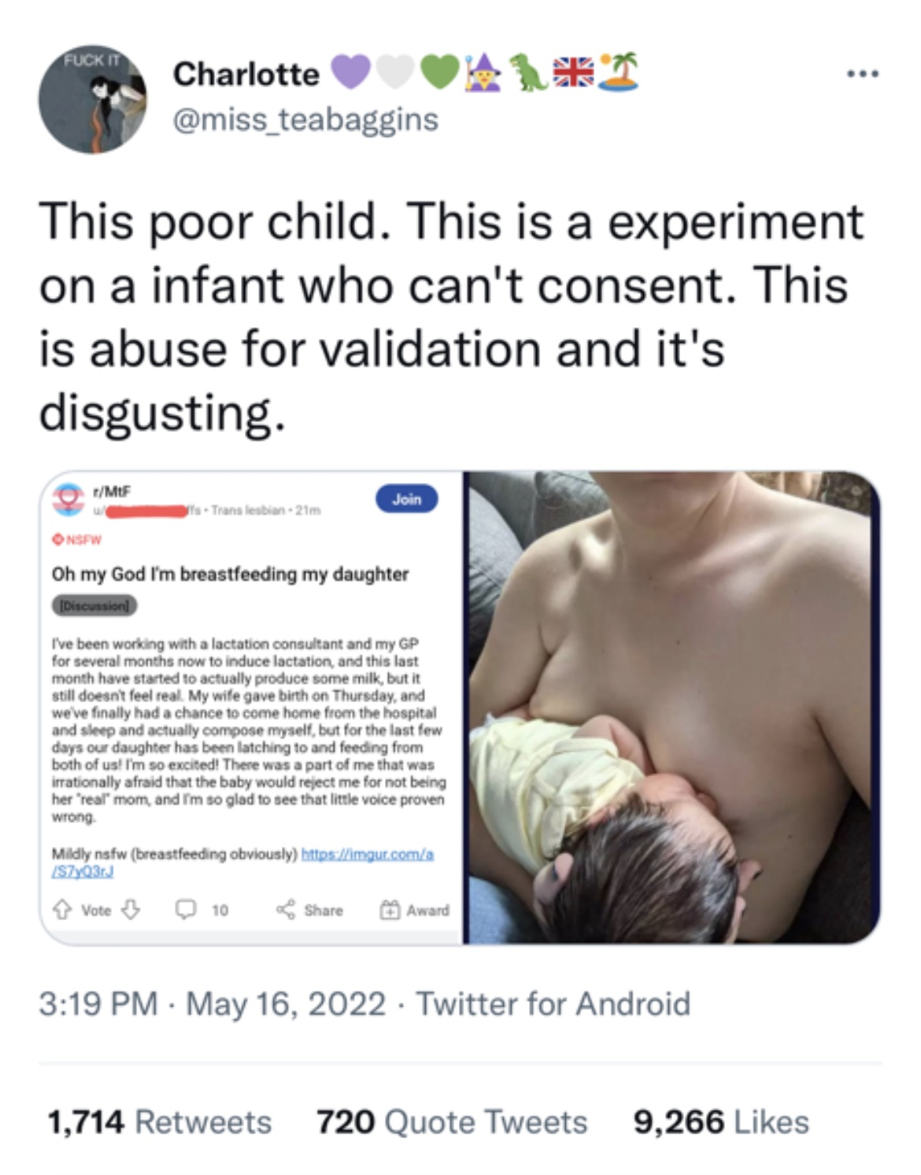
Chest-feeding: The Preferred
Politically Correct Terminology
Risks to newborn / infant of milk toxicity?
Promoted by SMFM, ACOG, AAP et al
Abomination and insult to God, every woman and man
Sexual abuse?
Medical and psychiatric abuse?
Abuse a baby to validate one’s false identity?
Romans 1: Given over to reprobate minds & delusion

Slide 62
Objectives
COVID-19 ‘vaccines’ in Pregnancy and Women of Reproductive age
Gag orders issued September 2021 “COVID-19 Misinformation”
DATA sources for concerns of ‘vaccine’ in women
Data sources for concerns of ‘vaccine’ in pregnant women
VAERS data
DMED data
Pfizer Freedom of Information Act (FOIA) data release
Publications in peer-reviewed medical journals documenting adverse events associated with COVID-19 ‘vaccines’
GETTR @ Jamesathorpmd

Slide 63
Thank You

Slide 64
How to Hide Data, Obscure Reality and Promote Disaster Capitalism The Dirty Tricks of the Medical Industrial Complex – and their Flagship Corrupt Medical Journals Lancet & NEJM
Lie, Lie, Lie & promote, promote & promote. Like Hitler: Repeat lies and, they believe the lie.
Blame the adverse effects on COVID19 not the vaccine
Play with the numerators & denominators to get your desired result
Shimabakuro NEJM, Mandeep Mehra LANCET, Placenta, Am J Obstet Gynecol
GETTR @ Jamesathorpmd

Slide 65
COVID-19 Vaccination in Pregnancy Kalafat E, Heath P, Prasad S, et al. Am J Obstet Gynecol, September 2022:127:1-7
“Observational studies corroborate SARS-CoV-2 infection in pregnant people, emphasizing that the potential maternal and fetal benefits of vaccination greatly outweigh the potential risks of vaccination”
GETTR @ Jamesathorpmd

Slide 66
Reproductive Toxicology a Mandatory Requirement They Lied to the American People Pharma CDC & FDA Killed and Maimed Innocent Victims Alexandra “Sasha” Latypova Broke in Epoch Times Aug 15, 2022
The study of ADVERSE EFFECTS on reproduction
Part I: fertility and reproductive performance in the general population in BOTH male & female rats
Part II: Teratogenesis in embryo and fetus in rat and rabbit
Part III: Perinatal and postnatal developments in rats to evaluate effects in the last trimester and in lactation
GETTR @ Jamesathorpmd

Slide 67
Reproductive Toxicology a Mandatory Requirement They Lied to the World Pharma CDC & FDA Killed and Maimed Innocent Victims Alexandra “Sasha” Latypova Broke in Epoch Times August 15, 2022
“strong transfer of antibodes from pregnant rat (dam) to fetus
mRNA & spike protein pass all barriers, dam to fetus
Dams experienced toxicity during gestation at highest level of antigen detected
Toxicity admitted: loss of fertility, inability to use hind limb, other effects
Other toxicities & possible deaths waived off “non-mRNA 1273 related”
GETTR @ Jamesathorpmd

