Slide 1


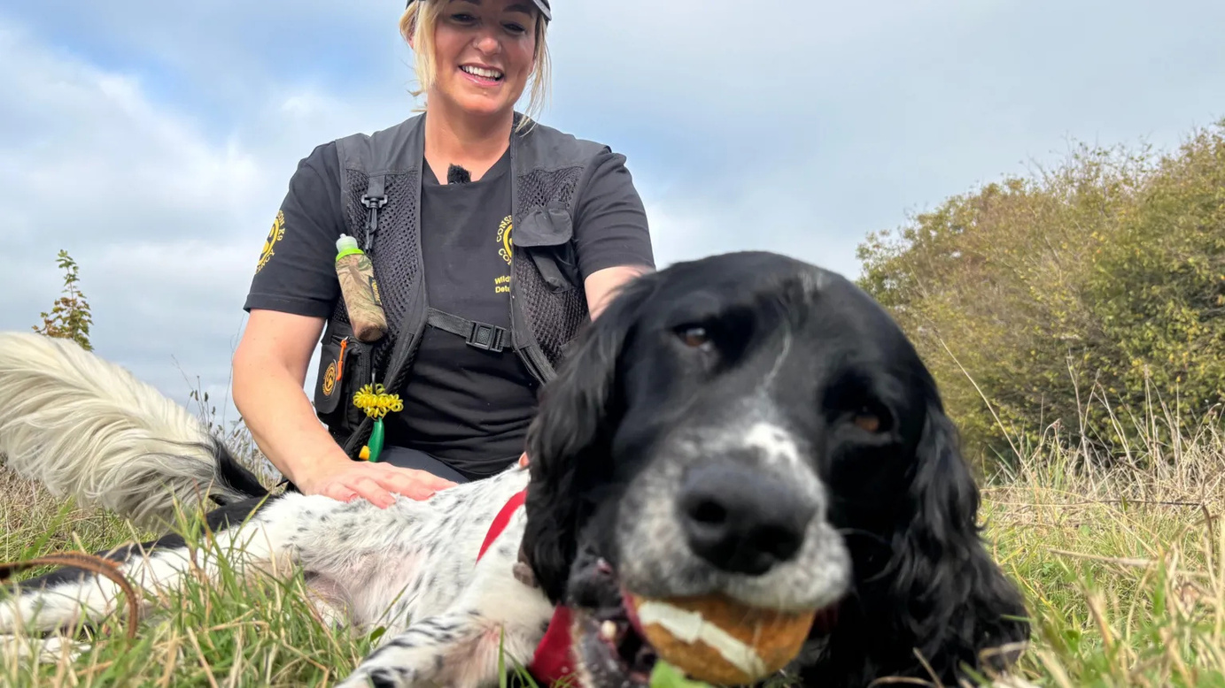


PRIMARY
AWARD FOR FIVE-TIME ABANDONED SUPERDOG
CRIME FIGHTING SPANIEL CELEBRATED WITH NATIONAL AWARD

Slide 2
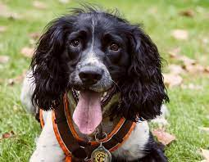
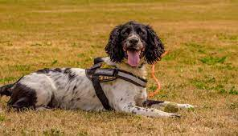
AWARD FOR FIVE-TIME ABANDONED SUPERDOG
PRIMARY
IN WHAT OTHER WAYS DO ANIMALS HELP HUMANS?
WHAT OTHER AWARDS SHOULD THERE BE FOR ANIMALS?

Slide 3
AWARD FOR FIVE-TIME ABANDONED SUPERDOG
PRIMARY
CRIME FIGHTING SPANIEL CELEBRATED WITH NATIONAL AWARD
Henry is a springer spaniel with a very special job — helping police stop wildlife crime.
But life didn’t start easily for him. Full of energy, Henry was returned to animal shelters five times because people thought he was “too much to handle.”
Everything changed when the Naturewatch Foundation, a charity that protects animals, adopted him. They saw his amazing sense of smell and trained him to be a wildlife crime detection dog.
Now, Henry works with police to find illegal traps, poisoned bait, and harmed animals hidden in the countryside. His work has helped to protect endangered species and catch people who hurt animals.
Because of his amazing efforts, Henry won the ‘Animal of the Year’ award from the International Fund for Animal Welfare. His handler says Henry has “a sixth sense” for finding clues — and the energy that once caused problems is now his superpower!
Henry’s story shows how rescue animals can do incredible things when given a second chance. From unwanted pet to award-winning detective, he’s proving that real heroes sometimes have four legs and a wagging tail.

Slide 4

AWARD FOR FIVE-TIME ABANDONED SUPERDOG
PRIMARY
COLUMN ADDITION
SUBTRACTION
HALVING & DOUBLING

Slide 5
AWARD FOR FIVE-TIME ABANDONED SUPERDOG
PRIMARY
COLUMN ADDITION
SUBTRACTION
HALVING & DOUBLING
26 + 43 =
78 - 56 =
Half of 240...
Is the same as 240 ÷ 2
26
+43
78
-56
Let’s use the bus stop method.
2 2 4 0
9
2
1
2
0
26
+43
9
78
+56
2
Half of 240 = 120
6
3
Double 60...
Is the same as 60 x 2
6 0 x 2 = 12
26 + 43 = 69
78 - 56 = 32
Return the 0 = 120
Double 60 = 120

Slide 6
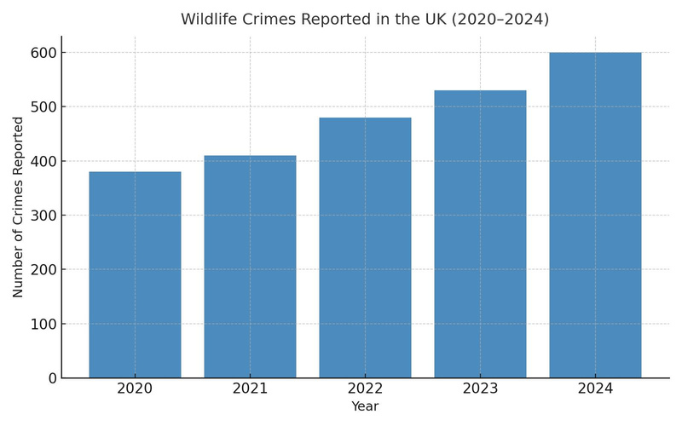
AWARD FOR FIVE-TIME ABANDONED SUPERDOG
PRIMARY
1) Charities and police forces record the number or wildlife crimes reported each year in the UK.
a) Which year recorded the highest number of wildlife crimes?
b) By how many did the number of crimes increase overall between 2020 and 2024?
c) How many crimes were reported in total?
d) If Henry worked on half of every crime reported, how many crimes did he work on each year?
e) How could improved reporting (rather than more crime) explain the rise is numbers?
380
410
480
530
600

Slide 7
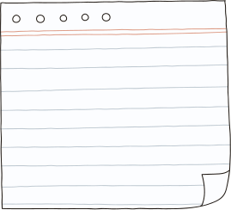
AWARD FOR FIVE-TIME ABANDONED SUPERDOG
PRIMARY
Mail
From: Naturewatch Foundation
To: Training Team
Subject: Training Report
Hi Team,
After Henry’s recent success in helping to solve wildlife crime, several police forces across the UK have requested our help.
Please can you provide the following information to allow us to put together a training report for dogs like Henry? His training schedule is below.
a) What is Henry’s total training time per week?
b) How many more minutes per week does Henry work on Scent Training than Obedience?
c) In order to help him recover, Henry will soon do halve his training on Tuesdays and Fridays. How many minutes will he do on those days now?
Thanks for your help with this.
Kind regards
Naturewatch Foundation Management

Slide 8
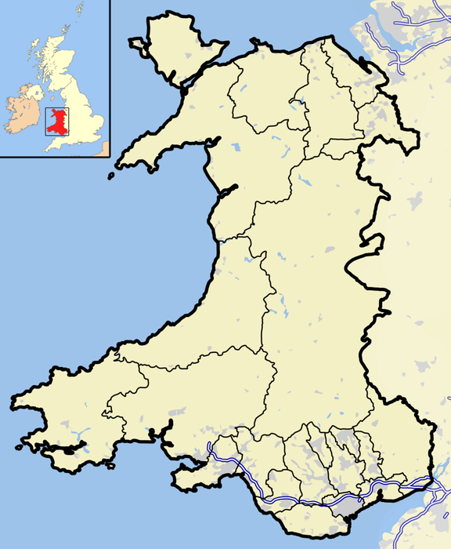

AWARD FOR FIVE-TIME ABANDONED SUPERDOG
PRIMARY
The map shows 3 of Henry’s patrol areas. Each square on the map is 1cm. The scale of the map is 1cm:15km.
1) If Henry is at headquarters in Wrexham (H) and is called to the SW area. Approximately how far must he and the handler travel to get there in km?
2) What are the approximate perimeters of each of Henry’s patrol areas?
NW -
NE -
SW -
3) What is the total perimeter of all three areas?
4) It takes Henry 2 hours to walk 10km. How long does it take him to walk the width of the NW area?
5) A third patrol areas will be added in the central region, with a perimeter of 100km. Draw this on the map.
6) Henry gets 25 treats per week and drinks 21 litres of water. If another dog joins the team, how many treats and litres of water will they consume together each week?
16
NW
15
NE
14
13
H
12
11
10
9
8
7
SW
6
5
4
3
2
1
A
B
C
D
E
F
G
H
I
J
K
L
Scale: 1cm : 10km

Slide 9

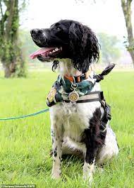
AWARD FOR FIVE-TIME ABANDONED SUPERDOG

