Slide 1
Implementing a continuous quality improvement program
Name Withheld Case Study

Slide 2
Agenda
Overview & Challenge
The Challenge & Need for OD
Details of the Process
Formal and Informal Assessments Review
Recommendations
Notes:
Today Im going to take you on a journey through Name Withheld’s experience with implementing a Continuous Quality Improvement Program. Why and how they did it, how success is being measured, and my recommendations.

Slide 3
Name Withheld: A brief overview
Name Withheld, Inc- serving clients since 1983
Core market trending down
Adjacent markets largely unfamiliar
Notes:
Name Withheld, Inc is a small third-party administrator of ###### for large corporations that recently became 100% employee-owned. Though still under 200 employees, Name Withheld is recognized as the premiere administrator for these niche policies and has grown over 50% in the last 4 years in a planned strategy to diversify into related markets as the legacy policies become less attractive in today’s economy. The business model includes the constructing customized software to handle complex calculations and unique business rules in an onboarding project (new clients or current clients’ new product lines), followed by a multi-year contract for recurring revenue in administering the policies.
With such a historically concentrated effort on a very specific market, this turn was a strain on the business. The complex software development associated with the core product did not align as expected with the requirements of the adjacent markets, and employees were faced with building a lot from scratch; the projects that needed to complete before the recurring revenue kicked in took longer and cost more, delaying projected revenue and disappointing clients negotiating budget change orders, or absorbing the additional costs.
educate employee owners on the CQI mindset so that they can approach their work, utilizing those capabilities and applying it to making their jobs more efficient, effective, increase quality, increase customer satisfaction, just make overall improvements. The second is recognized corporate-level improvement - improvements - to either the bottom line from a cost savings perspective, quality perspective, increasing quality, efficiency perspective, helping to increase our time to market by making things more efficient, less time consuming and reducing waste, increasing customer satisfaction and reducing overall risk
the impact of the result on the corporation or really our primary driver that was the... the initiation for the project itself. We want to keep our staff at reasonable levels but do more work, though do do more with the same Staff we have, if you will, obviously, we want to look at profitability and productivity to help ensure that, but we didn't want to continue to be inefficient and have to exponentially increase our staff every time we take on a new project or a new activity or service. So those were the inherent drivers, I guess. The rest of the drivers or objectives that I talked about from an employee investment level, those were were provided to us by the methodology we chose for CQI, which is Kaizen. Okay? So the Kaizen philosophy really comes with, if you want to implement this, you need to be committed that the all employees are going to participate, including the leaders, all employees are going to get trained, all employees are responsible for being improvement experts in their own work. And that's kind of what you sign up for when when you pick that methodology, which very much aligned with our our values and our culture

Slide 4
the OD need/challenge
Keep up with work efforts without spending
Improve Time-to-Market without compromising quality
Notes:
Name Withheld was faced with a dilemma. They could not afford to back out of the adjacent markets – contracts had them locked into supporting the policies – and the core market was fading. Additionally, the unexpected delays and missed estimates meant that resources stayed on projects longer, and the incoming projects were delayed. They had to find a way to reduce time to market and save costs without spending more on resources.

Slide 5
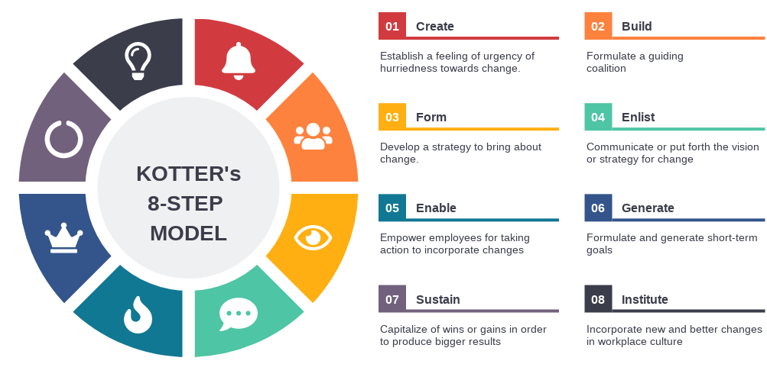
Details of the process
Kotter Model of Change Chosen
Coalition Gathered
Assessment Facilitated
Strategy Developed & Communicated
Employees Trained & Empowered
Short-term Goals & Wins Identified
Notes:
The effort sprouted with a decision to utilize the Kotter Model for change. It was clear that a sense of urgency had been established, so ##### got the ok to build a guiding coalition, sending out a request for interested parties to apply to be on the team, headed by three members of management.
The team was determined and worked together to build a RFP to engage an OD consultancy for help in implementing Name Withheld’s goals they felt could be achieved with implementation of a CQI program. The extended team participated in proposal meetings from three agencies chosen by the management staff and voted on the agency to help Name Withheld.
The chosen agency began with an orientation and assessment using the Appreciative Inquiry methodology to measure the organization’s readiness for change; the assessment was conducted using a survey, functional area focus groups and individual interviews; During this time, the team established a charter and organized, waiting for the assessment outcome to put goals in place.
With assessment results in hand, the starting point was established; a 3-year strategy was developed in three phases to attain the program goals;

Slide 6
the appreciative inquiry process
Notes:
The chosen agency began with an orientation and assessment using the Appreciative Inquiry methodology to measure the organization’s readiness for change; the assessment was conducted using a survey, functional area focus groups and individual interviews; During this time, the team established a charter and organized, waiting for the assessment outcome to put goals in place.
With assessment results in hand, the starting point was established; a 3-year strategy was developed in three phases to attain the program goals

Slide 7
formal and informal assessments review
Notes:
Name Withheld’s overall evaluation plan is to incrementally focus on the priorities regarding where they need to expend energy on the CQI principles or practices that are most important to achieving their goals at any point in time.
Because of this approach, the evaluation is ever changing and agile. What they are measuring internally to the program is using an agile approach as well.
Name Withheld is meeting the challenge of anticipated “Ever-changing” evaluation needs by using multiple focused phases to deliver metrics one phase at a time so that in the event the anticipated metrics for a later phase need to change, there is ample time to plan that out.
The only financial metric to date is to obtain $500K in efficiencies by 2023. As the program evolves and employees are trained and engage in the process, this goal may be updated in favor of a more relevant goal and metric.
There are two categories defined as efficiencies: one is freeing up time or capacity – which translates t billable hours of work saved in improvements multiplied by a blended billable rate. The theory is that these “saved” hours become freed up to work on projects or activities that would bring in revenue to the company. Those are considered soft dollars, because they're not saving any money, but freeing up capacity to do more and more billable work. The other component is hard dollars saved in an improvement such as reducing expenses or eliminating the need for a product or service with a cost associated.

Slide 8
formal and informal assessments review
Nov 2019-Feb 2020
Phase 1: Set Baseline; Assessment & Design
Mar – Dec 2020
Phase 2: Educate & Participate
100% of employees trained
Create Design Team for CQI Program
100% participation in Kaizen Teian (Bright Ideas)
Kaizen Leadership Training
Notes:
While Name Withheld has baselined the effort by taking data from the initial assessment, the first two phases of evaluation are rather informal and agile, in that they aren’t set on what they want to understand and measure just yet other that some basic KPIs to keep them on track that include training in ###### training, Kaizen Teian Orientation, and CQI Foundations training for every employee.
The organizational re-focus brought on by the COVID pandemic in the early stages of Phase 2 set the schedule behind a bit, but Name Withheld bounced back fairly quickly, adjusting training plans to working in a fully remote environment
Phase 1 :Assessment & Design (Nov 2019-Feb 2020)
Kick-off with Senior Leadership and Core Team
Initial assessment to determine current state and Name Withheld’s readiness for CQI,
Creation of a Design Team to champion the CQI implementation
Phase 2 Kick-off & Pilot Projects (Mar – Dec 2020)
Formal company-wide kick-off,
Introductory training for ##### and CQI concepts for the core project team
Kaizen Leadership Training
Train the Trainer program aimed at educating select Name Withheld employees in CQI Foundations and certifying them to train the balance of the organization
Support in generation of short-term wins
Support in development of a Kaizen Teian (small improvements) program

Slide 9
formal and informal assessments review, con’t.
Jan.–Dec. 2021
Phase 3: Leadership Development & Scaling up
$500K in efficiencies realized by EOY 2023
Benchmarking visits to ESOPs with strong CQI Culture
Jan.–Dec. 2022
Phase 4: Business as Usual
Continued Coaching for Internal Consultants
Notes:
Phase 3 Leadership Development & Scaling up (Jan -Dec 2021)
Leadership Development and Coaching (Sr Leadership – Operationalize CQI)
Supervisor Development and Coaching
Rollout of Kaizen Teian (small improvements) program
Identify new CQI projects
Review progress against goals and metrics
Benchmarking Visits to ESOP companies with strong CQI cultures
Scale up and Sustain: With Design team, assess current progress, determine training needs and supports needed to scale up and sustain CQI culture.
Phase 4: Business as Usual (Jan-Dec 2022)
Coaching support to internal consultants
Internal consultants lead new projects
Development of internal Trainer Network
Training and Coaching support to senior leaders
Design Team reviews progress against goals/metrics

Slide 10
Summary of the appraisal process

Slide 11
challenges in evaluating or measuring success
How do we know that the things we are reporting on are the most important?
Are we using the right calculations?
How do we measure intangibles?
What if we find out that some areas we are measuring are not so important ?
What if we miss an important metric?
How many metrics are enough?
Notes:
One challenge in evaluating success is determining the most appropriate metrics to report, how to measure them – especially the intangible impacts like engagement which are so important to program success but difficult to measure.
It is essential to the Kaizen philosophy to be committed to having all employees participate, including the leaders, as all employees are responsible for being improvement experts in their own work. Therefore, measuring that all employees receive the training or tools to be successful is a quality initial metric for the program.
Considering the nature of the Continuous Quality Improvement program, it would certainly be confusing to equalize each of the improvements made when reporting on the count of improvements. How far does Name Withheld need to go to make people understand the impact of each change? Or is a count a good enough measure for now? And that's kind of what you sign up for when you pick that methodology, which very much aligned with Name Withheld’s values and culture
So what happens if Name Withheld spends time designing a Metrics Dashboard and stakeholders change their mind about what they want to see, especially those funding the program? (next slide)
How do we know that the things we are reporting on are the most important?
Are we using the right calculations?
How do we measure intangibles?
What if we find out that some areas we are measuring are not so important ?
What if we miss an important metric?

Slide 12
challenges in evaluating or measuring success
Notes:
One of the greatest challenges faced by any organization in evaluating and measuring success is the fact that we cannot predict the future. As one famous saying goes, “Man plans, the universe laughs” We can decide what we think we want to measure, but as the effort evolves there may be additional measures that become important, or perhaps the ones we once thought were so important don’t seem to matter after awhile or simply provide little value.
And that is all ok. The important thing is that we accept the idea that there may changes in how and what is evaluated, and consider mitigation in case changes are requested or just make sense.

Slide 13
working around the challenges
Notes:
One of the ways Name Withheld has worked into the evaluation plan to be ready for these challenges is to keep an open mind and an agile approach to metrics and measurements. This is why for Phase 1&2 the key metrics are around just getting employees educated and participating – or practicing- a CQI/ Employee Owner mindset.
In terms of keeping the core Kaizen philosophy intact by rejecting any metrics that focus only on bottom-line results and not on culture-building, employee learning and growth, and client satisfaction measures – the Operational Excellence team that is driving the effort has company values, mission and vision to support these areas.

Slide 14
Recommended appraisal methodology
Notes:
While Name Withheld’s current evaluation plan will likely gain results, there are a few areas where I would insert additional measures.

Slide 15
Recommended methodology
Climate surveys:
Random, quarterly
Targeted, at mid-project for Gemba Kaizen efforts
Critical Incident Plan
Resolve issues with Data
Non-Judging, Non-Blaming
Notes:
First, I would be sure to sprinkle in periodic climate surveys randomly each quarter and targeted climate surveys to participants in the Gemba Kaizen teams. These surveys would seek to understand how individuals felt overall about the effort and progress made, about their perspective on the future of the effort and whether they felt it was on track, and whether they felt the training they received adequately prepared them for understanding the tools needed to perform the projects.
Next, I would ensure that a Critical Incident Process was in place to handle any issues that arise that includes a means to gather the facts, analyze the situation and provide feedback. Any time there is a large change effort in an organization there is a need to appropriately handle any confusion or resistance. The Critical Incident Technique uses facts to determine and issue and its root cause in a non-judgmental manner. This aligns with a key philosophy of CQI itself of taking a non-judgmental and non-blaming approach to all work.
Finally, as revealed in the interview – there is a need to better document the evaluation plan itself. This is handy in an agile approach so that the philosophies can remain intact even if the measures reported may change. For example, in following a CQI practice of balancing results and process, it is imperative to keeping a balanced set of measurements that the metrics not be purely results-oriented, but rather also include the effort’s objective to imbue an employee-owner/ CQI mindset in each person.

Slide 16
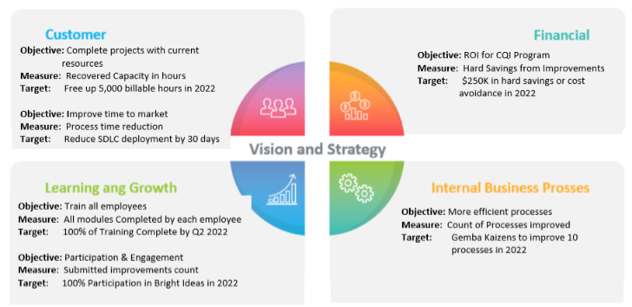
Demonstrating the outcome
&
Processes
Notes:
While Name Withheld has created a Metrics dashboard that displays results and progress, it is not defined by the perspectives of a Balanced Scorecard.
I would simply break down the current metrics which fit nicely into these categories and ensure going forward that the metrics remain fairly balanced among the quadrants.

