Slide 1
Needs Assessment
For atlassian systems training at Name Withheld services
Notes:
Name Withheld, Inc is a small third-party administrator of products for some of the largest carriers in the country. A highly values-driven and employee-focused company, Name Withheld achieved 100% Employee Ownership through its Employee Stock Ownership Plan (ESOP) in 2019. With over 30 years of success, Name Withheld’s team of just under 200 employee-owners has experienced a planned growth of 30% over the last 2 years and is implementing a Continuous Quality Improvement (CQI) program that includes integrated training in business acumen fundamentals and Kaizen Teian (suggesting improvements).

Slide 2
Agenda
Purpose & Objectives
Methodology
Assessment Data
Recommendations
Research
Summary
Proposal
Introduction

Slide 3
Introduction
Issue / Project Tracking & Reporting
Documentation
Time Tracking and Financial Reporting
Notes:
As markets become saturated with competition delivering faster for lower costs, Name Withheld faces decreasing revenue with comparatively slow, expensive delivery – being driven by values is no longer enough. Seeking sustainability by leveraging new markets and reducing time to market is a large corporate rock, or goal. One area where Name Withheld has control over performance efficiency is employee knowledge and skills in the Atlassian suite. Atlassian is the core system used by all employees in some capacity, comprised of three main applications: JIRA, Confluence and , Tempo – used for ticketing, documentation and time-logging respectively. Given the importance Atlassian applications hold in daily operations and strategic decision-making, it is imperative that employees master role-specific areas of the system.
Currently the applications are completely supported by a team of peers representing all business areas - one to two representatives per business area – who provide support, monitor a questions and issues queue, implement and communicate quarterly system upgrades, and review and implement user requests for configuration changes and improvements to the applications

Slide 4
Needs Assessment Design Proposal
Notes:
Once employees have a solid understanding of toolsets, overall productivity increases; morale surges with shared understanding of workflows and processes; and reporting is accurate, allowing for astute business decisions which leads to Name Withheld Services achieving its goal of a sustainable business practice.

Slide 5
Purpose & Objectives
Purpose: Outline explicit areas of focus for optimal training program design
Objectives:
Determine the training areas that will enhance knowledge and skills in the targeted areas
Align with Name Withheld’s strategic goals of implementing a CQI and employee-ownership mindset
Identify and define the applications’ “Superusers”
Notes:
We will satisfy these objectives by gathering, analyzing and metricizing data to determine training gaps that impede work efficiency. During the process we will also identify performance gaps that may not be resolved by training. While these areas will be communicated to Name Withheld, it is not within the scope of this project to address them

Slide 6
Research Questions
Do employees have the knowledge of the system necessary to perform their job duties?
If not, what are the gaps to be addressed? Which can be identified as training gaps?
What are the superlative knowledge and skillsets of the Atlassian systems that, when achieved, will translate to optimal job performance?
How do we design a sustainable training system that provides optimal training to new employees and enables the acumen needed to understand and suggest relevant improvements?

Slide 7
Methodology
Population and Sample
Needs Assessment Instrument
Data Analysis Used
Questions so far?
Notes:
1. With this assessment, we sought to engage persons of various roles and accountabilities. By targeting improvement in daily work tasks as a driver, we hoped it would be easier to gain buy-in for a training program. In confirming the tasks outlined by individuals with managers we can be sure that the training plan would focus on areas of primary responsibility.
In taking a graduated approach, we began by querying the general population, narrowing down to focus groups and individual interviews for areas where we needed more granular data and agreeance on direction and tactical guidance.
2. After reviewing the choices for needs analysis approach with Name Withheld, it was determined that the Complex Needs Assessment was the best fit, as described above. The core team responsible for training (APC Team) determined that the approach to garner the most useful information would be a hybrid approach to include an initial general survey to gauge interest and perceived need for training; followed by a targeted Job and Tasks Questionnaire to better understand how the Atlassian tools are used in each role. We then confirmed and prioritized the tasks reported in the questionnaire by interviewing managers and sharing the questionnaire data. This helped to gather interest at a higher level in support of an organized and well-planned training program
3. We used several methods for collecting and analyzing data as prescribed in a complex needs assessment. A survey was distributed to the entire company to generate data to measure the general interest level and perceived need. This was the introductory data collection method by which we would determine the direction of subsequent data collection methods.
Next , a Job Analysis Questionnaire was distributed to key areas for a focus on job tasks and where the Atlassian Toolsets are used …this allowed us to gain insight into the practical use of each application and the identification and quantification of the most popular tasks executed in the applications, helping to define focus areas for on-boarding and subsequent training.
Direct managers and supervisors from departments of heavy Atlassian product suite users (Client Relations and Implementation Services) were interviewed to confirm data received in the Job Analysis Questionnaire. The main intent was to confirm that tasks reported in the Job Analysis Questionnaire are relevant to the role and provide priority but also marks the high bar for those with top knowledge, skills and abilities in the toolset - and defines the average user.
Lastly, Three groups were then selected to participate in focus groups based on responses to the survey and feedback from data tools listed above.
The combination of the Job Analysis Questionnaire and Manager Interviews helped to identify Superusers who provide data to define skills and knowledge of a Superuser with a goal of having the APC team seek to leverage their assistance in supporting the system, and possibly assisting with training efforts.
With 75% of respondents noting a need to ‘execute on process’ – meaning seeing work efforts through workflows - we assembled this group to discuss specific gaps where they felt they needed training. A bit of discussion around the ‘Search & Research’ category made its way into this discussion as the two tasks often go together.
Survey results indicated a strong desire for the documentation application, Confluence. Correlating metrics from the Job Task Analysis indicated that 70% of respondents use Confluence regularly for creating, editing and searching for documentation. This group offered specific suggestions for areas where training could improve productivity and quality of content.
I know that was a lot… are there any questions around the methodology and design of the needs assessment?
Ok great, on to the results !

Slide 8
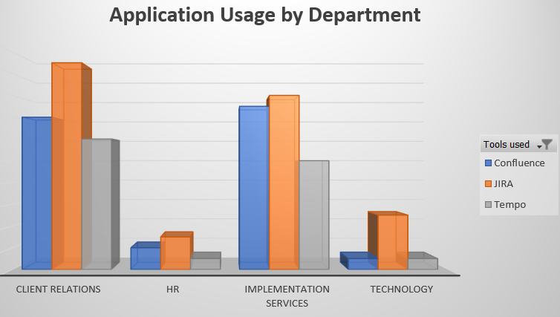
Assessment Data & Results
Background data
Survey Results
Task Creation
Notes:
While JIRA is the most –used application of the toolset, The assessment showed the Discrepancy needs to be highest in the Confluence application, which is not surprising since there has never been a formal training program for it.
Democratic needs support this data, with 68% of survey respondents citing a need for training on creating content and organizing documentation and 67% citing a need for more targeted training in utilizing page-building tools.
Yes, Chris, I see your hand is raised – you have a question?
Ah, yes good point, when we are referring to :
Discrepancy Needs: The difference between current state and what is expected to happen (Sleezer, et al., 2014, p. 39)
Democratic Needs: What the majority population prefers. (Sleezer, et al., 2014, p. 39)

Slide 9
Job Task Analysis – Key Application Tasks
Training Others (5%)
Organizing Work or Documents (30%)
Monitor & Review Tasks (40%)
Superuser/ Admin / Configuration (15%)
Create Tasks & Tickets (40%)
Search & Research (55%)
Reporting (65%)
Execute on Process / Workflow (75%)
Time Tracking (90%)
Documentation (70%)
Notes:
Interviews held with supervisors prove the Analytic needs to be aligned with Discrepancy and Democratic needs, however, interviews and focus groups revealed additional concern in understanding how to ‘Search & Research’ application data and ‘Execution on Process and Workflow’ to be high on management’s training priorities. The survey results showed that the interest in training was significant and the areas of interest aligned with the job tasks identified and the prioritization of the tasks provided by management interviews.
While Time tracking appears to be the most popular task, it is only because most everyone has to do it. The initial survey results indicated that the majority of employee-owners were comfortable with their knowledge in that area.
Analytic Needs: What insight, experience and study determine. (Sleezer, et al., 2014, p. 39)
Any further questions before we move on to recommendations? (pause) ok, great.

Slide 10
Summary & Recommendations
Notes:
Considering the challenges, this Needs Assessment proved to be comprehensive enough to provide reliable data to design a training program. The concern is whether Name Withheld will be able to sustain and support this program without dedicated resources. Despite the lack of support, there are many options to a traditional approach, which will be outlined in the recommendations.
We recommend that Name Withheld take the next steps immediately to capitalize on the fresh data and interest in training. Because of the lack of dedicated support, we would suggest that the APC team involve the identified and interested superusers and managers in designing and facilitating training sessions.
Involving stakeholders and making them accountable for knowledge of the systems may encourage individuals to take an active role in their own skills and knowledge of the applications. We would like to offer that in the spirit of the impending CQI program, Name Withheld consider integrating Atlassian system knowledge and skills into performance evaluation, or individual key performance indicators.
With the ideal competencies identified in the superuser focus group, and job tasks identifying specific tasks that require Atlassian application skills, it would be formidable to require a portion of the training as part of job duties.

