Slide 2
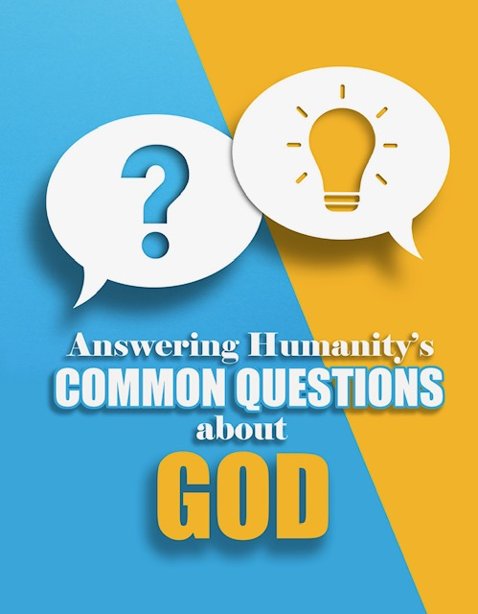
SESSION ONE
THE RELATIONSHIP

Slide 3
THEME VERSE FOR THE STUDY
But in your hearts revere Christ as Lord. Always be prepared to give an answer to everyone who asks you to give the reason for the hope that you have. But do this with gentleness and respect…
1 Peter 3:15

Slide 4
THE RESONS FOR THIS STUDY

Slide 5
THE RESONS FOR THIS STUDY
To provide help for those who don’t believe in Jesus to understand why those who do believe in Jesus can do so with confidence.

Slide 6
THE RESONS FOR THIS STUDY
To provide help for those who don’t believe in Jesus to understand why those who do believe in Jesus can do so with confidence.
To help those who are considering placing their faith in Jesus as the way to have a relationship with God to overcome the doubts that they are having that are keeping them from making that decision.

Slide 7
THE RESONS FOR THIS STUDY
To provide help for those who don’t believe in Jesus to understand why those who do believe in Jesus can do so with confidence.
To help those who are considering placing their faith in Jesus as the way to have a relationship with God to overcome the doubts that they are having that are keeping them from making that decision.
To help those who believe in Jesus to grow in their confidence in sharing why they believe in him with others.

Slide 8
INTRODUCTION
You may never need some of the information that is in this training. There are those who will give their lives to Christ after sharing a simple salvation presentation. We will be learning a presentation that we can share with others to help them understand how they can become a Christian.

Slide 9
INTRODUCTION
You may never need some of the information that is in this training. There are those who will give their lives to Christ after sharing a simple salvation presentation. We will be learning a presentation that we can share with others to help them understand how they can become a Christian.
There are others who may not receive Christ after a simple presentation. In fact, you may not be able to give the presentation because of their skepticism about God.

Slide 10
GO TO THE WEBSITE:
www.answeringcommonquestions.com
ON YOUR PHONE
CREATE A QUICK LINK TO YOUR
PHONE HOME SCREEN
IF POSSIBLE
the following slides show what you will see….

Slide 11
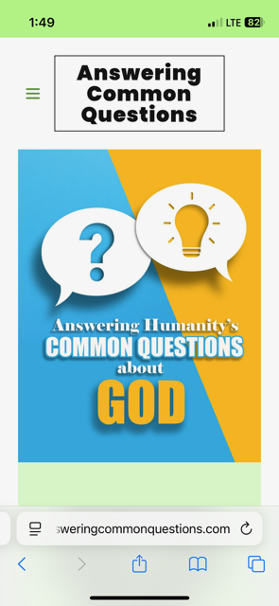

Slide 12
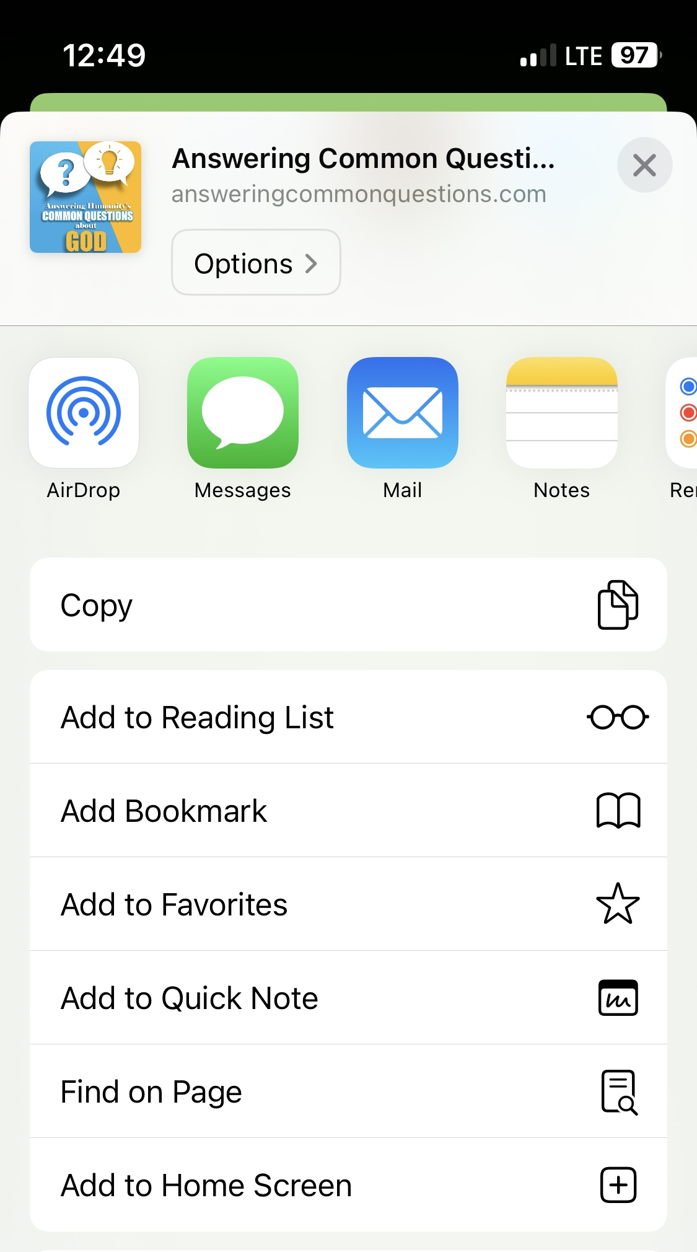

Slide 14
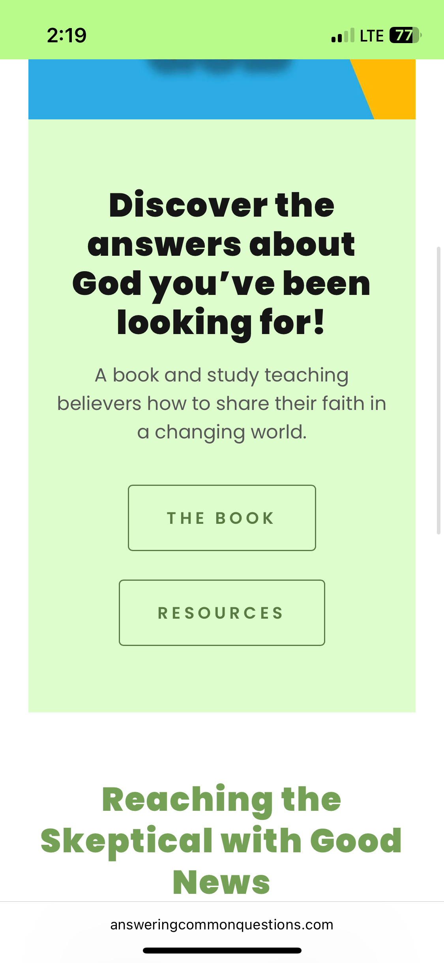

Slide 15
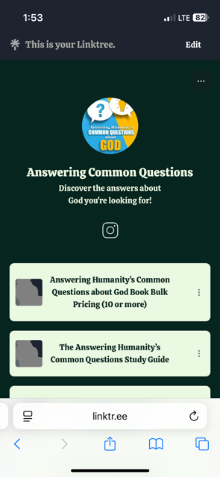

Slide 16
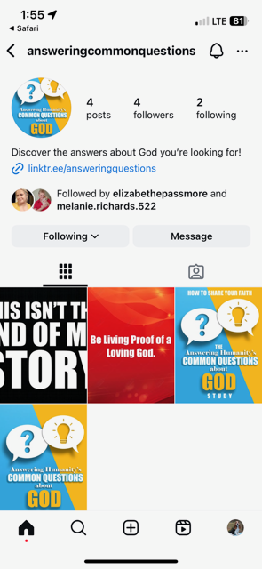

Slide 19
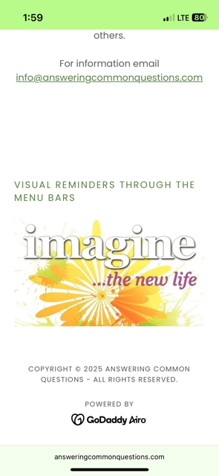

Slide 22
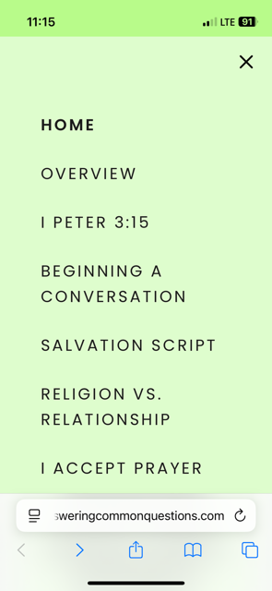

Slide 23
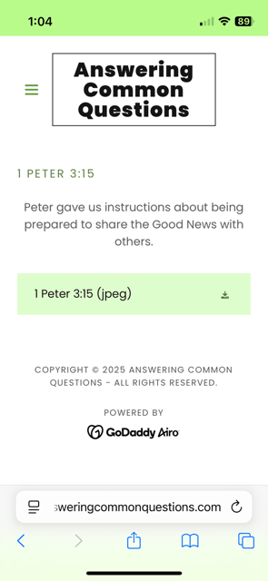

Slide 24
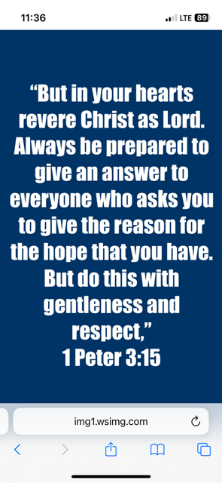

Slide 25
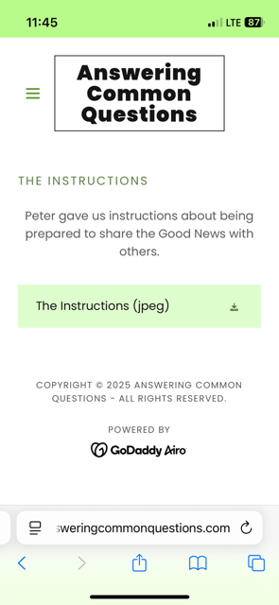

Slide 27
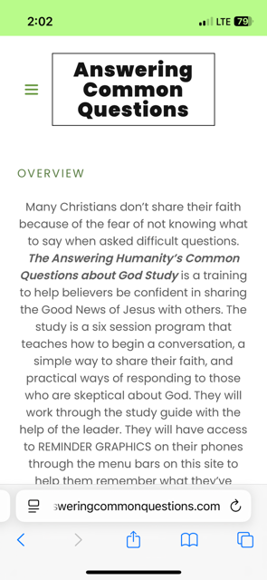

Slide 28
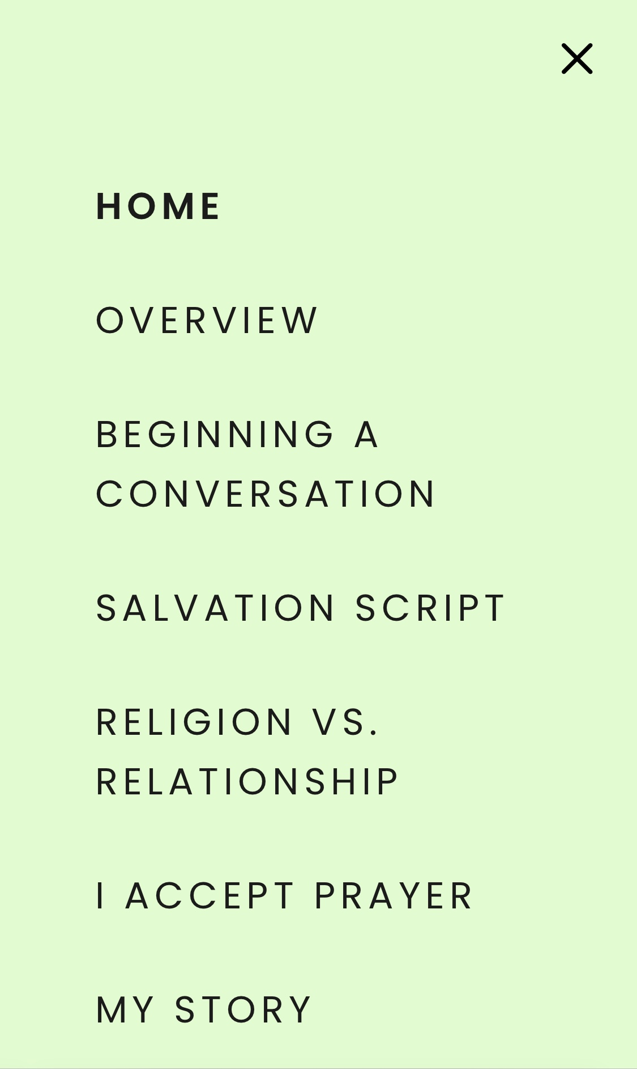

Slide 30
BEGINNING A CONVERSATION
F.I.R.E.

Slide 31
BEGINNING A CONVERSATION
F.I.R.E.
Family: Tell me about your family.

Slide 32
BEGINNING A CONVERSATION
F.I.R.E.
Family: Tell me about your family.
Interests: Do you have any special hobbies?

Slide 33
BEGINNING A CONVERSATION
F.I.R.E.
Family: Tell me about your family.
Interests: Do you have any special hobbies?
Religious Background: When you attend church, where do you attend?

Slide 34
BEGINNING A CONVERSATION
F.I.R.E.
Family: Tell me about your family.
Interests: Do you have any special hobbies?
Religious Background: When you attend church, where do you attend?
Exploratory Questions:

Slide 35
BEGINNING A CONVERSATION
F.I.R.E.
Family: Tell me about your family.
Interests: Do you have any special hobbies?
Religious Background: When you attend church, where do you attend?
Exploratory Questions:
Have you come to the place in your life where you know for certain that you have a relationship with God and that you will go to Heaven when you die?

Slide 36
Often, this question will open the door for you to share the Good News about Jesus. If they say they are not certain, we can say – “Do you mind if I take 3 or 4 minutes to share with you how you can know for certain?” You will then share the salvation presentation that you will learn. If they seem skeptical about what you have asked, you can move on to the following two exploratory questions….

Slide 37
BEGINNING A CONVERSATION
F.I.R.E.
Family: Tell me about your family.
Interests: Do you have any special hobbies?
Religious Background: When you attend church, where do you attend?
Exploratory Questions:
Have you come to the place in your life where you know for certain that you have a relationship with God and that you will go to Heaven when you die?
What do you believe we have to do to have a relationship with God?

Slide 38
BEGINNING A CONVERSATION
F.I.R.E.
Family: Tell me about your family.
Interests: Do you have any special hobbies?
Religious Background: When you attend church, where do you attend?
Exploratory Questions:
Have you come to the place in your life where you know for certain that you have a relationship with God and that you will go to Heaven when you die?
What do you believe we have to do to have a relationship with God?
Have you done what you believe is necessary to have a relationship with God?

Slide 39
REMINDER GRAPHIC ON WEBSITE:
BEGINNING A CONVERSATION

Slide 40
RELIGION vs. RELATIONSHIP
PRESENTATION

Slide 41
Remember, we have asked the first exploratory question or possibly all exploratory questions. For example, we have asked – “Have you come to the place in your life where you know for certain that you have a relationship with God and that you will go to Heaven when you die?” We will begin by talking about religion….

Slide 42
CLOSE YOUR STUDY GUIDE AND LISTEN
TO THE PRESENTATION

Slide 43
GOD
Religion

Slide 44
GOD
Law
Religion

Slide 45
GOD
SIN
Law
Religion

Slide 46
GOD
SIN
Law
Love
Religion

Slide 47
GOD
SIN
Law
(punishment)
Love
Religion

Slide 48
GOD
SIN
Law
(punishment)
(death)
Love
Religion

Slide 49
GOD
SIN
Law
(punishment)
(death)
Love
(Savior)
Religion

Slide 50
GOD
SIN
Law
(punishment)
(death)
Love
(Savior)
(Jesus)
Religion

Slide 51
GOD
SIN
Law
(punishment)
(death)
Love
(Savior)
(Jesus)
Religion
Relationship

Slide 52
GOD
SIN
Law
(punishment)
(death)
Love
(Savior)
(Jesus)
forgiveness
Religion
Relationship

Slide 53
GOD
SIN
Law
(punishment)
(death)
Love
(Savior)
(Jesus)
forgiveness
(accept)
Religion
Relationship

Slide 54
GOD
SIN
Law
(punishment)
(death)
Love
(Savior)
(Jesus)
forgiveness
(accept)
Religion
Relationship

Slide 55
OPEN YOU STUDY GUIDE AND NOTICE THE PRESENATION THAT IS INCLUDED
IN YOUR MATERIAL

Slide 56
REMINDER GRAPHIC ON WEBSITE:
RELIGION vs. RELATIONSHIP

Slide 57
REMINDER GRAPHIC ON WEBSITE:
I ACCEPT

Slide 58
Why is Jesus the only way to God?

Slide 59
This is a common question from those who are skeptical about having a relationship with God through Jesus. How can we respond to this? We can talk to them about the difference between what other religions believe and what Christians believe. We all believe in a “Go Between.” We believe in something or someone that helps us connect with God. Our “Go Between” is different.

Slide 60
To learn this, let’s remember something. Religions have someone or something that gives them the law. We see this on the illustration.

Slide 61
GOD
SIN
Law
(punishment)
(death)
Love
(Savior)
(Jesus)
forgiveness
(accept)
Religion
Relationship

Slide 62
Who gives the religions their laws?

Slide 63
THE GO BETWEEN

Slide 64
THE GO BETWEEN
There is a common belief among most major religions that believe in a God. They believe that they need help experiencing their God. We need someone or something connected to Him to tell us how we experience Him. We need a go-between who tells us the rules we are to follow. They are mediators. This means, they tell us what we need to do to form a relationship with someone else.

Slide 65
For Example:
Judaism has the Torah. Buddhism has the Darma. Islam has the Qur’an. Greek Religions have the Logos.

Slide 66
Because none of us always obey the laws, we need a different type of mediator. We call him a
“Love Mediator.” We need someone who loves us and can help us connect to God even though we break the law. What are the qualifications of the love mediator who can connect us with God? The scriptures talk about this mediator….

Slide 67
LOVE MEDIATOR

Slide 68
For there is one God and one mediator between God and mankind, the man Christ Jesus, ⁶ who gave himself as a ransom for all people.
1 Timothy 2:5-6

Slide 69
What’s the difference between Jesus and the mediator’s of other religions? Jesus took the punishment for our sins as a ransom. He met the requirements of a love mediator. What are they?...

Slide 70
LOVE MEDIATOR

Slide 71
LOVE MEDIATOR
Sinless: We need someone who doesn’t miss the mark. We need someone who is always moral and does what is right. If he is a failure like us, we won’t respect him. Why should we listen to him?

Slide 72
LOVE MEDIATOR
Desire: We need someone who wants us to be forgiven and not be punished. He doesn’t want us to be judged even though we deserve it. He wants us to be forgiven and not suffer the consequence. John 3:17 says, “For God did not send his son into the world to condemn the world, but to save the world through him.”

Slide 73
LOVE MEDIATOR
Sacrifice: We need someone who loves us so much that he’s willing to take our punishment. (We must accept it). We need someone who is willing to do whatever is necessary to allow us to be forgiven and have a relationship with God. We need someone who is willing to die for us. We must accept what he did for us. It must become personal.

Slide 74
LOVE MEDIATOR
Death to Life: We need someone who cannot be stopped by death. (If he could come back to life, then through him, so can we!) Because we need to be connected to God, we need someone who is both God and man. We need someone who has a father who is supernatural who has power over nature including death and a mother who was natural connecting him to humanity. His resurrection proves his connection to God.

Slide 75
There is only one who meets the criteria of a Savior. He is Jesus. That is why Jesus said about himself, “Jesus answered, “I am the way and the truth and the life. No one comes to the Father except through me.” (John 14:6)

Slide 76
There is only one who meets the criteria of a Savior. He is Jesus. That is why Jesus said about himself, “Jesus answered, “I am the way and the truth and the life. No one comes to the Father except through me.” (John 14:6)
When we understand what is needed to have a relationship with God, we understand that to believe in Jesus is not narrow-minded, it is what gives us hope of reconciling with God.

Slide 77
REMINDER GRAPHIC ON WEBSITE:
LOVE MEDIATOR

Slide 78
WE NEED TO SHARE OUR STORY!

Slide 79
WE NEED TO SHARE OUR STORY!
We need to begin thinking about those we know who need to hear about Jesus. We also need to begin praying that God would give us the opportunity to share the message of salvation with them and that they would be receptive to what we say. Let’s begin identifying those need Jesus.

Slide 80
IDENTIFYING THOSE IN MY
CIRCLE OF INFLUENCE

Slide 81
traffic pattern
acquaintances
co-workers
neighbors
friends
family
ME

Slide 82
WE NEED TO SHARE OUR STORY!
In your study guide, under each category write down the names of those you know who need to hear the Good News about Jesus

Slide 84
SESSION TWO
MY STORY

Slide 85
GOD
Religion

Slide 86
GOD
Law
Religion

Slide 87
GOD
SIN
Law
Religion

Slide 88
GOD
SIN
Law
Love
Religion

Slide 89
GOD
SIN
Law
(punishment)
Love
Religion

Slide 90
GOD
SIN
Law
(punishment)
(death)
Love
Religion

Slide 91
GOD
SIN
Law
(punishment)
(death)
Love
(Savior)
Religion

Slide 92
GOD
SIN
Law
(punishment)
(death)
Love
(Savior)
(Jesus)
Religion

Slide 93
GOD
SIN
Law
(punishment)
(death)
Love
(Savior)
(Jesus)
Religion
Relationship

Slide 94
GOD
SIN
Law
(punishment)
(death)
Love
(Savior)
(Jesus)
forgiveness
Religion
Relationship

Slide 95
GOD
SIN
Law
(punishment)
(death)
Love
(Savior)
(Jesus)
forgiveness
(accept)
Religion
Relationship

Slide 96
GOD
SIN
Law
(punishment)
(death)
Love
(Savior)
(Jesus)
forgiveness
(accept)
Religion
Relationship

Slide 97
SESSION TWO
My Story

Slide 98
INTRODUCTION

Slide 99
INTRODUCTION
One of the most convincing arguments for giving our lives to Christ is our own story.

Slide 100
INTRODUCTION
One of the most convincing arguments for giving our lives to Christ is our own story.
It’s personal to us. We need to know how to tell our story.

Slide 101
THE STORY OF PAUL
The actual account of what happened to Paul is found in Acts 9:1-19. He would re-tell what happened to him as he shared the Good News about Jesus with others. Let’s read about one of those occasions…

Slide 102
READ ACTS 21:27-40

Slide 103
We learn that they were in Jerusalem. The Jewish people wanted Paul killed for speaking against Jewish law. The Jewish people believed that the Torah (book of the Law in the scriptures) provided the law that they were to follow to earn a relationship with God. Paul believed that no one was perfect and could not follow the law at all times. We all miss the mark of the way God wants us to live. We are all sinful. This message was contrary to what the Jews believed and it angered them. The Romans took him in custody to protect him from the crowd. Paul then asked the Romans to allow him to speak to the crowd. Remember, at this time he was known as Saul.

Slide 104
READ ACTS 22:1-16

Slide 105
His being baptized was significant. It revealed his new belief in the death, burial and resurrection of Jesus. It revealed that he understood his own sin and need for forgiveness through Jesus. His sins had been washed away. He now had a new life through Christ and a new purpose. He was to tell what he had seen and heard which led to his belief about Jesus. God had revealed to Ananias what Saul’s calling would be…

Slide 106
But the Lord said to Ananias, “Go! This man is my chosen instrument to proclaim my name to the Gentiles and their kings and to the people of Israel.
Acts 9:15

Slide 107
What do we learn about Paul?

Slide 108
What do we learn about Paul?
He was trained in Jewish theology. He was a protector of the Jewish faith. Because of this…

Slide 109
What do we learn about Paul?
He saw Christians as a threat to the Jewish way of life. They measured their spirituality by their ability to obey rules. This led him to live a competitive spirituality. The goal is to be better than others. He was a skeptic about Jesus.

Slide 110
What do we learn about Paul?
He was so threatened by Christians that he had them put to death. They were known as “The Way.” He wouldn’t have wanted someone to do this to him! This is one way we know that what we are doing is wrong behavior and sin.

Slide 111
What do we learn about Paul?
He had an encounter on the road to Damascus. He was faced with something he could not handle on his own. He was blinded. He had limited ability. He couldn’t heal himself. This man, who relied on his own authority and ability to make it through life, now needed the help of someone else. Not only that, he was confronted with his bad behavior from the one he was harming - Jesus. He asked him – “Why are you persecuting me?” Get the picture! He must rely on the person that he had been harming to be the one to help him

Slide 112
with his problem, a problem that he fully deserved to be experiencing because of his actions. He needed the one whom he was harming to be willing to forgive him and help him. The good news is HE DID! He forgave him and provided a way for him to be healed of his blindness. These actions of love overwhelmed Paul and caused him to have a change of heart. He found what he was really looking for. He found the unconditional love from someone that we all desire.

Slide 113
Paul just told his story. How do we tell ours? If you were the one arrested by the Romans and asked to speak to the crowd, what story would you tell about your experience of placing your faith in Jesus? We want to help you develop your story. To do this, we need to answer some questions.

Slide 114
You will begin developing your story in your
Student Guide by answering four questions.

Slide 115
ANSWERING FOUR QUESTIONS
TO TELL OUR STORY

Slide 116
Question #1:
  What was my life like before I became a Christian?

Slide 117
Question #1:
  What was my life like before I became a Christian?
      What was I living for? (My Identity) Before you became a Christian, how would you have completed this statement…. “I identified as someone who believed life was about _____________________.” Write about what you lived for before becoming a Christian.

Slide 118
Question #2:
  What caused me to consider giving my life to Christ?

Slide 119
Question #2:
  What caused me to consider giving my life to Christ?
    Did something happen that caused you to realize that you needed help with your life?

Slide 120
Question #3:
  How did you become a Christian?

Slide 121
Question #3:
  How did you become a Christian?
    What did you say to God to become a Christian?

Slide 122
Question #4:
  What has your life been like since giving your life to Christ?

Slide 123
Question #4:
  What has your life been like since giving your life to Christ?
    What gives your life meaning?

Slide 124
REMINDER GRAPHIC ON WEBSITE:
MY STORY

Slide 125
WE ARE TO SHARE THE MESSAGE
OF JESUS WITH OTHERS

Slide 126
Jesus said…
…“Go into all the world and preach the gospel to all creation.
Mark 16:15

Slide 127
ANOTHER STORY ABOUT PAUL
READ ACTS 17:16-34

Slide 128
Epicureanism is the philosophical doctrine of Epicurus holding that the highest good is pleasure which can be experienced through indulgence.

Slide 129
The idol of the Epicurean was pleasure. It was their god.

Slide 130
Then there were the Stoics. It was the school of philosophy founded by Zeno (a Greek philosopher) who taught that people should be free from passion, unmoved by joy or grief, and submit without complaint to the circumstances of life.

Slide 131
The idol of the Stoic was their self ability – what they could do on their own.

Slide 132
These philosophies don’t provide what we desire in life. Pleasure ends and we’re looking for more. The Epicurean philosophy doesn’t give us what we desire. We also discover that we can’t handle every situation in life like the Stoics believed. Some things are out of our control and it’s difficult for these things not to affect our emotions. We try them, but they fall short. These two realities about pleasure and self-effort could very well be the reason why they were curious to learn about Christ and how he connects us to God. They must have been looking for something more, something that only God could provide.

Slide 133
Even the people whom Paul was interacting with at this place, some of the most intellectual of their day, were searching for God. They even had a name for him. They called Him “The Unknown God.”

Slide 134
²²Paul then stood up in the meeting of the Areopagus and said: “People of Athens! I see that in every way you are very religious. ²³For as I walked around and looked carefully at your objects of worship, I even found an altar with this inscription: to an unknown god.
Acts 17:22-23

Slide 135
Paul told them who He was…

Slide 136
Paul told them who He was…
For in him we live and move and have our being.’ As some of your own poets have said, ‘We are his offspring.’ ²⁹“Therefore since we are God’s offspring, we should not think that the divine being is like gold or silver or stone—an image made by human design and skill.
Acts 17:28-29

Slide 137
WHO IS THE UNKNOWN GOD?

Slide 138
WHO IS THE UNKNOWN GOD?
He’s the God that we can know personally. God was near to them and wanted to be in a relationship.

Slide 139
WHO IS THE UNKNOWN GOD?
He’s the God that we can know personally. God was near to them and wanted to be in a relationship. Paul said…
God did this so that they would seek him and perhaps reach out for him and find him, though he is not far from any one of us.
Acts 17:27

Slide 140
WHO IS THE UNKNOWN GOD?
He’s also the God who meets our desires. What desires? We have several…

Slide 141
WHO IS THE UNKNOWN GOD?
We have a desire to know where we came from.

Slide 142
Paul talked about…
The God who made the world and everything in it….
Acts 17:24
For in him we live and move and have our being….
Acts 17:28

Slide 143
WHO IS THE UNKNOWN GOD?
We have a desire to know what is right and wrong. They were told of their need to repent. In other words, they did something wrong and needed to change. We will be judged because of what we do wrong and for what we do with Jesus. Did we accept him for our forgiveness?

Slide 144
WHO IS THE UNKNOWN GOD?
In the past God overlooked such ignorance, but now he commands all people everywhere to repent. ³¹ For he has set a day when he will judge the world with justice by the man he has appointed. He has given proof of this to everyone by raising him from the dead.”
Acts 17:30-31

Slide 145
WHO IS THE UNKNOWN GOD?
We have a desire for life after death. He taught them about Jesus’ resurrection. We read…

Slide 146
…Paul was preaching the good news about Jesus and the resurrection.
Acts 17:18

Slide 147
WHO IS THE UNKNOWN GOD?
We have a desire to have meaning in life. Our meaning comes in being a part of God’s family and representing Him.

Slide 148
Remember….
They were living for two things.

Slide 149
They were living for two things.
Some live for what they can do in their own strength without God. (Stoics).

Slide 150
They were living for two things.
Some live for what they can do in their own strength without God. (Stoics).
Some live for pleasure. (Epicureans).

Slide 151
The difference in their image of the Unknown God made of gold or silver or stone and the God who created us is that gold or silver or stone don’t love us back. We’re looking for someone to love us back.

Slide 152
What does this love look like? How do we know what this love looks like? We need someone who shows us what this love is like. Paul told them about the one who had come to be the example of God’s love. His name was Jesus.

Slide 153
He told them about Jesus and they responded to what he had said. They didn’t all respond the same way. The Bible says…

Slide 154
³²When they heard about the resurrection of the dead, some of them sneered, but others said, “We want to hear you again on this subject.” ³³At that, Paul left the Council. ³⁴Some of the people became followers of Paul and believed. Among them was Dionysius, a member of the Areopagus, also a woman named Damaris, and a number of others.
Acts 17:32-34

Slide 155
THE THREE RESPONSES TO HEARING THE MESSAGE OF JESUS

Slide 156
THE THREE RESPONSES TO HEARING THE MESSAGE OF JESUS
Some don’t believe it because they can’t trust what they have heard.

Slide 157
THE THREE RESPONSES TO HEARING THE MESSAGE OF JESUS
Some don’t believe it because they can’t trust what they have heard.
Some are considering that it might be true, but they need more reason to place their faith in Jesus.

Slide 158
THE THREE RESPONSES TO HEARING THE MESSAGE OF JESUS
Some don’t believe it because they can’t trust what they have heard.
Some are considering that it might be true, but they need more reason to place their faith in Jesus.
Some believe what they hear about Jesus, know he is the way to have a relationship with God and that they need him in their lives and accept what Jesus did for them.

Slide 159
Thinking about the 3 responses we have to the message about Jesus, what has your response been?

Slide 160
HOW HAVE I RESPONDED TO JESUS?

Slide 161
Let’s think back to the salvation presentation. At the end of what we share we ask – “Is there any reason why you wouldn’t be willing to give your life to Jesus right now?” What do we do if they say they aren’t ready? We can ask them questions related to how people respond to the message of Jesus. Let’s take a look at them…

Slide 162
HOW HAVE I RESPONDED TO JESUS?
If you don’t believe in him, what would it take for you to believe?

Slide 163
HOW HAVE I RESPONDED TO JESUS?
If you don’t believe in him, what would it take for you to believe?
If you are considering placing faith in what he did for you, what is holding you back from making that decision?

Slide 164
HOW HAVE I RESPONDED TO JESUS?
If you don’t believe in him, what would it take for you to believe?
If you are considering placing faith in what he did for you, what is holding you back from making that decision?
If you do believe in Jesus and have placed your faith in what he did for you, why did you do it?

Slide 165
REMINDER GRAPHIC ON WEBSITE:
THE RESPONSE QUESTIONS

Slide 166
THE DIFFERENCE MAKERS

Slide 167
THE DIFFERENCE MAKERS
Some could only use their head to make decisions.

Slide 168
THE DIFFERENCE MAKERS
Some could only use their head to make decisions.
Others were able to use their heads and their hearts.

Slide 169
THE DIFFERENCE MAKERS
Some could only use their head to make decisions.
Others were able to use their heads and their hearts.
Paul reasoned with people to help those who were only using their heads to understand their need for a change of heart. We can learn how to reason with others who are only using their heads to also have a change of heart.

Slide 170
SOME REALITIES

Slide 171
SOME REALITIES
I can’t make anyone believe in God.

Slide 172
SOME REALITIES
I can’t make anyone believe in God.
I can’t change someone’s heart.

Slide 173
SOME REALITIES
I can’t make anyone believe in God.
I can’t change someone’s heart.
I can’t make someone feel conviction for doing something that God does not desire.

Slide 174
SOME REALITIES
I can’t make anyone believe in God.
I can’t change someone’s heart.
I can’t make someone feel conviction for doing something that God does not desire.
We choose for ourselves who or what we trust in.

Slide 175
SOME REALITIES
I can’t make anyone believe in God.
I can’t change someone’s heart.
I can’t make someone feel conviction for doing something that God does not desire.
We choose for ourselves who or what we trust in.
God can use me to help others have a change of heart.

Slide 177
SESSION THREE
TRUTH & LOGIC

Slide 178
SHARING YOUR PERSONAL STORY:
Take time now and stop the video and have students who are willing to share their personal stories of how they accepted Christ.

Slide 179
REMINDER:
At the conclusion of the previous session, we learned that some only use their heads when thinking about God and others use their heads and their hearts. Some use only logic and others use logic and faith. We need to determine what is true.

Slide 180
GOD
Religion

Slide 181
GOD
Law
Religion

Slide 182
GOD
SIN
Law
Religion

Slide 183
GOD
SIN
Law
Love
Religion

Slide 184
GOD
SIN
Law
(punishment)
Love
Religion

Slide 185
GOD
SIN
Law
(punishment)
(death)
Love
Religion

Slide 186
GOD
SIN
Law
(punishment)
(death)
Love
(Savior)
Religion

Slide 187
GOD
SIN
Law
(punishment)
(death)
Love
(Savior)
(Jesus)
Religion

Slide 188
GOD
SIN
Law
(punishment)
(death)
Love
(Savior)
(Jesus)
Religion
Relationship

Slide 189
GOD
SIN
Law
(punishment)
(death)
Love
(Savior)
(Jesus)
forgiveness
Religion
Relationship

Slide 190
GOD
SIN
Law
(punishment)
(death)
Love
(Savior)
(Jesus)
forgiveness
(accept)
Religion
Relationship

Slide 191
GOD
SIN
Law
(punishment)
(death)
Love
(Savior)
(Jesus)
forgiveness
(accept)
Religion
Relationship

Slide 192
SESSION THREE
Truth & Logic

Slide 193
TRUTH

Slide 194
We all have a desire to know the truth. Why? What we believe to be true guides our choices throughout life. Our beliefs become the filter that we use when deciding what we say and what we do.

Slide 195
The Two Paths to Discovering Truth

Slide 196
There are two paths that we take to discover what is true. Our search for truth happens by understanding the physical and the spiritual. (Some have a different name for the spiritual).

Slide 197
Physical Truth (Head) = scientifically looking at physical elements in the natural world to come to conclusions. We look at the physical evidence and decide on the best explanation for what we discover. This differs from spiritual truth.

Slide 198
Physical Truth (Head) = scientifically looking at physical elements in the natural world to come to conclusions. We look at the physical evidence and decide on the best explanation for what we discover. This differs from spiritual truth.
Spiritual Truth (Heart) = made up of our gut level feelings (Morality). Some don’t call it spiritual, they just say that they feel it in their gut that it is true or false. We all have gut level feelings within us. It’s called morality. We know the difference between right and wrong without someone having to tell this to us.

Slide 199
  We know something is right when we treat others the way we want to be treated and we know something is wrong when we don’t.

Slide 200
  We know something is right when we treat others the way we want to be treated and we know something is wrong when we don’t.
  We have a spiritual gut feeling that something is true or false.

Slide 201
This even happens in the scientific world. A scientist has a hunch, a gut level feeling about something, and then works to prove his theory through physical facts. It began with an inward belief about something. The Greeks had a word for this called “splanchnon” which means – “intestines” or “guts.” Another word for this is our spirit.

Slide 202
LOGIC

Slide 203
We may ask, “Is it logical?” Let’s consider a question… “Is there a God?” How do we decide if there is a God? This is where faith comes in.

Slide 204
THE TWO TYPES OF FAITH

Slide 205
Blind faith = We believe something just because someone says it’s true. This is “child-like” faith.

Slide 206
Blind faith = We believe something just because someone says it’s true. This is “child-like” faith.
Reasoned faith = I’ll believe something because the evidence points to it being the best explanation. (Logic)

Slide 207
  We reason using physical evidence.

Slide 208
  We reason using physical evidence.
  It is supported through a gut level feeling that it is true. Many used both reason and a gut level feeling when we decided to give our lives to Jesus. We know that gut level feeling to be the Holy Spirit.

Slide 209
THE ROLE THAT LOGIC PLAYS IN BELIEF

Slide 210
Can we come to a logical conclusion that there is a God? Believing in God is logical. The facts point us to God. Not everyone believes this.

Slide 211
Many who do not believe in the existence of God claim that people who do believe in Him are unintelligent and don’t use common sense to form their beliefs. The opposite is actually the truth. Through their logic, or reasoning, they put two and two together and come up with an answer that there is a God.
Many look around and see the circumstances of life and they say, there must not be a God. Why do they believe this? The answer is that God doesn’t do what they would do if they were God.

Slide 212
If there is a God, surely He is better than we are. We are corrupted but a powerful God who is worthy of believing in is not corrupted.

Slide 213
If there is a God, we don’t know as much as He does. He knows the past, present and the future and knows how what is happening today fits in to the big picture.

Slide 214


Slide 215
What do you see when you look at the image? Do you see the vase? Why do you see the vase? Is it because I told you there was a vase? Did I influence you to look for a vase? Is there something else that you could see? Some see a vase when they look at the image and others see two people looking at each other when they see the image. The image hasn’t changed. The difference is in how we see the image or what we’re looking for when we look at the image. Someone tells us what to see. People tell us what to see about God. However, there may be another view of God.

Slide 216
Some may have been told something about God for a long time that simply isn’t true. Why do they see Him in this way? Many struggle with God’s existence because of the presence of evil in the world.

Slide 217
REMINDER GRAPHIC ON WEBSITE:
TRUTH & LOGIC

Slide 218
OUR LOGIC CAN CONVINCE US
THAT WE NEED GOD

Slide 219
There is an explanation for evil.

Slide 220
There is an explanation for evil.
THE LIST ILLUSTRATION

Slide 221
X
THE WORLD
Lying
Stealing
Murder
Rape
GOD
PEOPLE
God is our best hope!

Slide 222
Patrick Glynn, an atheist-turned-Christian concluded…
“Today, it seems to me, there is no good reason for an intelligent person to embrace the illusion of atheism or agnosticism, to make the same intellectual mistakes I made. I wish…I had known then what I know now.” (Patrick Glynn, an atheist turned Christian, Strobel, p. 60)

Slide 223
The evidence of miracles leads us to believe in God. A miracle occurs when something happens that cannot be explained through the natural world.

Slide 224
Creation is an example of a miracle. Nature cannot create itself. It can change and adapt but it cannot bring something into existence that does not already exist. Paul’s being healed of his blindness is another example of a miracle.

Slide 225
“Believe me when I say that I am in the Father and the Father is in me; or at least believe on the evidence of the miracles themselves.”
John 14:11

Slide 226
The evidence of people who believe in God who do not stop believing in Him when faced with severe difficulties. Their hope is evidence of God.

Slide 227
Look at the people who believe God is true who face severe difficulties in their lives yet their hope does not change. The physical changes around them, but the spiritual remains steadfast because they trust in an unchanging God. There is another reason to believe in God…

Slide 228
Our need for answers is evidence of God. Our asking the same questions is evidence that we were created by an intelligent God who wants us to have answers.

Slide 229
They are the same questions that the Epicureans and Stoics had that Paul addressed. Someone created us to have the same questions. God has the answers!

Slide 230
THE FOUR FUNDAMENTAL QUESTIONS

Slide 231
  ORIGIN: Where did I come from?

Slide 232
  ORIGIN: Where did I come from?
  MORALITY: What is right and wrong behavior?

Slide 233
  ORIGIN: Where did I come from?
  MORALITY: What is right and wrong behavior?
  MEANING: What is my purpose in life?

Slide 234
  ORIGIN: Where did I come from?
  MORALITY: What is right and wrong behavior?
  MEANING: What is my purpose in life?
  DESTINY: Is there life after death?

Slide 235
REMINDER GRAPHIC ON WEBSITE:
4 FUNDAMENTAL QUESTIONS

Slide 236
As people have searched for these answers they have led to four beliefs related to the existence or non-existence of God.

Slide 237
THE WORLD VIEWS

Slide 238
Naturalism/Materialism. The belief that the universe (or nature) has always been in existence. Because the universe has always been, there is no need for a God to begin it. Those who are Atheists and Agnostics fall within this world view.

Slide 239
Pantheism. The belief that God is in all things. I am God and you are God and the essence of God is in all things of nature. They emphasize the protection of people and the environment. To destroy anything in nature is to destroy God. Those who fall within this world view include Hindus, Buddhists, Tao’s, and other eastern religions.

Slide 240
Deism. The belief that there is a God who created the universe, but He is impersonal and we cannot have a relationship with Him. The Greek religions fall within this world view. For example, Zeus is the God who created the world.

Slide 241
Theism. The belief that there is a God who created the universe and that He is personal and that we can have a relationship with Him. Those who are Christians, Jewish, and Islamic fall within this world view.

Slide 242
REMINDER GRAPHIC ON WEBSITE:
THE WORLD VIEWS

Slide 244
SESSION FOUR
ORIGIN & MORALITY

Slide 245
GOD
Religion

Slide 246
GOD
Law
Religion

Slide 247
GOD
SIN
Law
Religion

Slide 248
GOD
SIN
Law
Love
Religion

Slide 249
GOD
SIN
Law
(punishment)
Love
Religion

Slide 250
GOD
SIN
Law
(punishment)
(death)
Love
Religion

Slide 251
GOD
SIN
Law
(punishment)
(death)
Love
(Savior)
Religion

Slide 252
GOD
SIN
Law
(punishment)
(death)
Love
(Savior)
(Jesus)
Religion

Slide 253
GOD
SIN
Law
(punishment)
(death)
Love
(Savior)
(Jesus)
Religion
Relationship

Slide 254
GOD
SIN
Law
(punishment)
(death)
Love
(Savior)
(Jesus)
forgiveness
Religion
Relationship

Slide 255
GOD
SIN
Law
(punishment)
(death)
Love
(Savior)
(Jesus)
forgiveness
(accept)
Religion
Relationship

Slide 256
GOD
SIN
Law
(punishment)
(death)
Love
(Savior)
(Jesus)
forgiveness
(accept)
Religion
Relationship

Slide 257
SESSION FOUR
ORIGIN & MORALITY

Slide 258
QUESTION 1: ORIGIN: Where did we come from?

Slide 259
If there is a God, what is He like?

Slide 260
We were either created by a God separate from nature who brought nature into existence – a super–nature or supernatural force, or there was no creation of nature as the universe has always been. If this is true, there is no need for a God to create us. What does the evidence say?

Slide 261
What does the evidence say about where
the natural world came from?

Slide 262
Does it prove that the universe (nature) has always existed revealing that there is no need for a God?

Slide 263
Does it prove that the universe (nature) has always existed revealing that there is no need for a God?
Does it prove that there was a beginning point to the universe revealing the existence of a force separate from nature that has the ability to create nature who is a “supernature” or “supernatural” being?

Slide 264
Does it prove that the universe (nature) has always existed revealing that there is no need for a God?
Does it prove that there was a beginning point to the universe revealing the existence of a force separate from nature that has the ability to create nature who is a “supernature” or “supernatural being?
If the physical evidence is inconclusive, what does the spiritual evidence (our gut level feeling) tell us is the best explanation of where we came from.

Slide 265
WAS THERE A BEGINNING POINT?

Slide 266
EDWIN HUBBLE.

Slide 267
EDWIN HUBBLE. His telescope proved that there are many galaxies and they are expanding outward. Light is like sound. It changes colors with distance. As time moves on there is expansion, but when we reverse time, there is contraction. It moves backwards toward a specific point.

Slide 268
STEPHEN HAWKING.

Slide 269
STEPHEN HAWKING. Ultimately, when we reverse time, the universe constricts to a point. Hawking said space gets so tight that there is no spatial volume. You keep tightening the curve. If this is true, there can be no mass in this space. In other words – nothing exists. How do we explain this? He said that “The actual point of creation lies outside the scope of presently known laws of physics.”

Slide 270
CHARLES TOWNES.

Slide 271
CHARLES TOWNES. The former chairman of the Physics Department at Columbia University and Nobel Prize winning physicist wrote... In my view the question of origin seems always left unanswered if we explore for a scientific point of view alone. Thus, I believe there is a need for some religious or metaphysical explanation. I believe in the concept of God and in His existence.

Slide 272
ROBERT JASTROW.

Slide 273
ROBERT JASTROW. A PhD in theoretical physics from Columbia University and was also an astronomer physicist and cosmologist and a leading NASA scientist. He said… "Astronomers now find they have painted themselves into a corner because they have proven, by their own methods, that the world began abruptly in an act of creation to which you can trace the seeds of every star, every planet, every living thing in this cosmos and on the earth. And they have found that all this happened as a product of forces they cannot hope to discover. That there are what I or anyone would call supernatural forces at work is now, I think, a scientifically proven fact."

Slide 274
ALBERT EINSTEIN.

Slide 275
ALBERT EINSTEIN. He was a Pantheist who believed that there is a divine essence in all of us and that there is no creator God. His research, which supported the Theory of Relativity, led to the discovery that the universe was expanding. He didn’t like this conclusion because it opened up the possibility that there is a supernatural being who created us. Because of this, he introduced an equation into his formula called the “cosmological constant” that supported the belief that the universe was stagnant and not expanding.

Slide 276
REMINDER GRAPHIC ON WEBSITE:
THE SCIENTISTS

Slide 277
This evidence supports the belief that there was a beginning point of nature and time. The question is – “Who started it?” Who brought the first physical mass into existence? If it is not nature, then there must be something super-nature (supernatural) that is separate from nature who brought it about. This super-nature being is called God, no matter what our idea of who he is or may be.

Slide 278
QUESTION 2: MORALITY:
What is right and wrong behavior?

Slide 279
We desire to be accepted and not judged.

Slide 280
We desire to be accepted and not judged.
Judgment and morality are intertwined together.

Slide 281
We desire to be accepted and not judged.
Judgment and morality are intertwined together.
We must decide what is right and wrong (morality) and we filter our behaviors according to those beliefs about right and wrong (we make judgments).

Slide 282
We desire to be accepted and not judged.
Judgment and morality are intertwined together.
We must decide what is right and wrong (morality) and we filter our behaviors according to those beliefs about right and wrong (we make judgments).
It is natural in our desire not to be judged that we determine morality on our terms according to how we want to behave and what we want to live for.

Slide 283
We desire to be accepted and not judged.
Judgment and morality are intertwined together.
We must decide what is right and wrong (morality) and we filter our behaviors according to those beliefs about right and wrong (we make judgments).
It is natural in our desire not to be judged that we determine morality on our terms according to how we want to behave and what we want to live for.
Are we the ones who are to make the determination about what is right and wrong or is this the responsibility of the one who created us?

Slide 284
Who establishes the rules - mankind or the one who created mankind?

Slide 285
DOING WHAT FEELS GOOD TO ME

Slide 286
DOING WHAT FEELS GOOD TO ME
We want to do what makes us feel good.

Slide 287
DOING WHAT FEELS GOOD TO ME
We want to do what makes us feel good.
We find others who agree with our way of life and we begin convincing others that our way of life is not wrong but is right.

Slide 288
WHAT KIND OF GOD ARE WE LOOKING FOR?

Slide 289
WHAT KIND OF GOD ARE WE LOOKING FOR?
We want someone who protects us. (Helps us in times of trouble)

Slide 290
WHAT KIND OF GOD ARE WE LOOKING FOR?
We want someone who protects us. (Helps us in times of trouble)
We want someone who helps us find joy in life. (Gives us a reason to live that is meaningful)

Slide 291
WHAT KIND OF GOD ARE WE LOOKING FOR?
We want someone who protects us. (Helps us in times of trouble)
We want someone who helps us find joy in life. (Gives us a reason to live that is meaningful)
If these two things are true about God, His telling us that something is wrong is done to protect us from harm or to keep us from living for something that does not ultimately give us joy.

Slide 292
BASIC QUESTIONS

Slide 293
BASIC QUESTIONS
Will my decision harm others?

Slide 294
BASIC QUESTIONS
Will my decision harm others?
Will my decision harm myself?

Slide 295
There is a name for these behaviors – SIN. We’ve all done it. The Bible says… for all have sinned and fall short of the glory of God. (Romans 3:23)

Slide 296
We’ve missed the mark of who God wants us to be.
He wants to be like Him in treating others with
respect and love.

Slide 297
WHY THE COMMANDS?
(Exodus 20:12-17)

Slide 298
They keep us from harming others and ourselves.

Slide 299
I am to honor my father and mother. Why? If they are parenting the right way, they are doing it to protect me and guide me on my course of life.
I am not to murder.
I am not to commit adultery. Sexual behavior was meant to be a symbol of lifelong loving commitment.
I should not steal. To do so is to take something that could be used for the survival of others or for their benefit.
I am not to lie. To lie is to manipulate the truth which can bring harm to others and to myself.
I am not to covet. To do so is to live for something that doesn’t truly satisfy my desire for joy in life and is, therefore, harmful.

Slide 300
HE’S TRYING TO PROTECT US!

Slide 301
FOLLOWING GOD’S LEADERSHIP

Slide 302
So I say, walk by the Spirit, and you will not gratify the desires of the flesh. ¹⁷ For the flesh desires what is contrary to the Spirit, and the Spirit what is contrary to the flesh. They are in conflict with each other, so that you are not to do whatever you want. ¹⁸ But if you are led by the Spirit, you are not under the law. ¹⁹ The acts of the flesh are obvious: sexual immorality, impurity and debauchery; ²⁰ idolatry and witchcraft; hatred, discord, jealousy, fits of rage, selfish ambition, dissensions, factions ²¹ and envy; drunkenness, orgies, and the like. I warn you, as I did before, that those who live like this will not inherit the kingdom of God. ²² But the fruit of the Spirit is love, joy, peace, forbearance, kindness, goodness, faithfulness, ²³ gentleness and self-control. Against such things there is no law.
Galatians 5:16-23

Slide 303
BEHAVIORS THAT PLEASE GOD

Slide 304
I show love to others.

Slide 305
I show love to others.
I have joy because I’m living the way God wants me to live by showing love.

Slide 306
I show love to others.
I have joy because I’m living the way God wants me to live by showing love.
I’m living in a way that encourages peaceful relationships through showing care and concern for others.

Slide 307
I show love to others.
I have joy because I’m living the way God wants me to live by showing love.
I’m living in a way that encourages peaceful relationships through showing care and concern for others.
I bear with the failing of others because I know the reason for their failures. They have been misguided.

Slide 308
I show love to others.
I have joy because I’m living the way God wants me to live by showing love.
I’m living in a way that encourages peaceful relationships through showing care and concern for others.
I bear with the failing of others because I know the reason for their failures. They have been misguided.
I am kind to others.

Slide 309
I show love to others.
I have joy because I’m living the way God wants me to live by showing love.
I’m living in a way that encourages peaceful relationships through showing care and concern for others.
I bear with the failing of others because I know the reason for their failures. They have been misguided.
I am kind to others.
I do good things for others that benefit them.

Slide 310
I love others consistently which leads them to have faith in me.

Slide 311
I love others consistently which leads them to have faith in me.
I treat people with care, wanting people to know that I love them. This leads me to speak to and treat others in a way that is received well.

Slide 312
I love others consistently which leads them to have faith in me.
I treat people with care, wanting people to know that I love them. This leads me to speak to and treat others in a way that is received well.
I don’t allow how people treat me in a negative way to control how I treat them. I remain in control wanting to do what is best for them.

Slide 313
There are no laws against any of these behaviors

Slide 314
BEHAVIORS THAT WE DO TO PLEASE OURSELVES

Slide 315
To the weak I became weak, to win the weak. I have become all things to all people so that by all possible means I might save some.
1 Corinthians 9:22

Slide 316
^{What is the person’s struggle?}

Slide 317
Replacing God: idolatry, witchcraft.
An idol is whatever person or thing we’ve made our god other than the Creator God. They are the most important to us. We talk about it the most. We spend our free time with it the most. We spend our money on it the most. We form relationships with others who share our passion for whatever it is or who they may be.

Slide 318
Hurtful Attitudes: hatred, jealousy, selfishness, envy
Life becomes a competition. We feel our value is in being as good or better than others and when we don’t measure up we respond out of hurtful attitudes. We hate those who are better than us which leads us to act out in our hatred. We are jealous of those who have what we want and we act out in order to take it from them or keep them from keeping it. We are only thinking about ourselves and what we want instead of others and what they need.

Slide 319
Causing Division or Harm: discord, dissensions, factions, rage
We begin to believe that we are always right and we push our agenda on others, not having any concern for their feelings or their reasons for their differing beliefs. The attitude becomes – “It’s me against you” or “It’s us against them.” This leads to speaking hurtful words, making false accusations or acting out in physical violence to force our point of view on others.

Slide 320
Substance Abuse: drunkenness
We want to feel good so we abuse substances in order to have a pleasurable experience. This is done either to escape some type of discomfort or to feel the physical high which feels good to us. We rely on these substances to deal with our pain, whatever it may be, or to make us feel good rather than relying on God to give us a way to feel true joy.

Slide 321
Sexual Behaviors: sexual immorality, impurity, debauchery, orgies
Sexuality is a part of the human experience. For humanity to survive, humans need to reproduce. Sexuality was created to be a pleasurable experience which bound together two people who were committed to love one another for life. Sexuality was never intended to be used as a pleasurable experience to satisfy a personal desire in order to make ourselves feel good.

Slide 322
So God created mankind in his own image, in the image of God he created them; male and female he created them.
²⁸ God blessed them and said to them, “Be fruitful and increase in number; fill the earth and subdue it. Rule over the fish in the sea and the birds in the sky and over every living creature that moves on the ground.”
Genesis 1:27-28

Slide 323
That is why a man leaves his father and mother and is united to his wife, and they become one flesh.
Genesis 2:24

Slide 324
Sexual preferences keep some from accepting God.

Slide 325
How can share Good News with those who are living an alternate sexual lifestyle?

Slide 326
One approach is to ask them – “Have ever thought about why God has the view he has about sexuality?”

Slide 327
  What if there was no God?

Slide 328
  What if there was no God?
    A logical conclusion to humanity’s existence is that we procreate and produce more humans.

Slide 329
  What if there was no God?
    A logical conclusion to humanity’s existence is that we procreate and produce more humans.
    It could be seen as a service to humanity that we reproduce for the survival of our species.

Slide 330
    We do it to protect the family from not having
    it’s needs met.

Slide 331
    It gives us a purpose to do something that means something – to help the community. When we help others, it gives us joy.

Slide 332
  What if there is a God?

Slide 333
God’s purpose for sexuality is to reproduce and increase in number (Genesis 1:28) and to serve as a pleasurable experience for a husband and wife who have committed themselves to one another for a lifetime (Genesis 2:24).

Slide 334
    Do you think He may have an issue with those who choose to give sexuality a purpose that it was never meant for?

Slide 335
THE WRAP UP

Slide 336
We’ve leaned that people live for many reasons other than to please God. Until we come to understand that what we live for doesn’t provide for us what we need, we will not change.

Slide 337
We’re missing the mark of who we should be!

Slide 339
SESSION FIVE
DESTINY

Slide 340
Salvation Presentation using your Smart Phone.
Go to Religion V Relationship 2
(YOU MAY ALSO WANT TO MAKE A QUICK LINK FOR THIS PAGE ON YOUR HOME SCREEN ON YOUR PHONE FOR EASY ACCESS!)

Slide 341
GOD
Religion

Slide 342
GOD
Law
Religion

Slide 343
GOD
SIN
Law
Religion

Slide 344
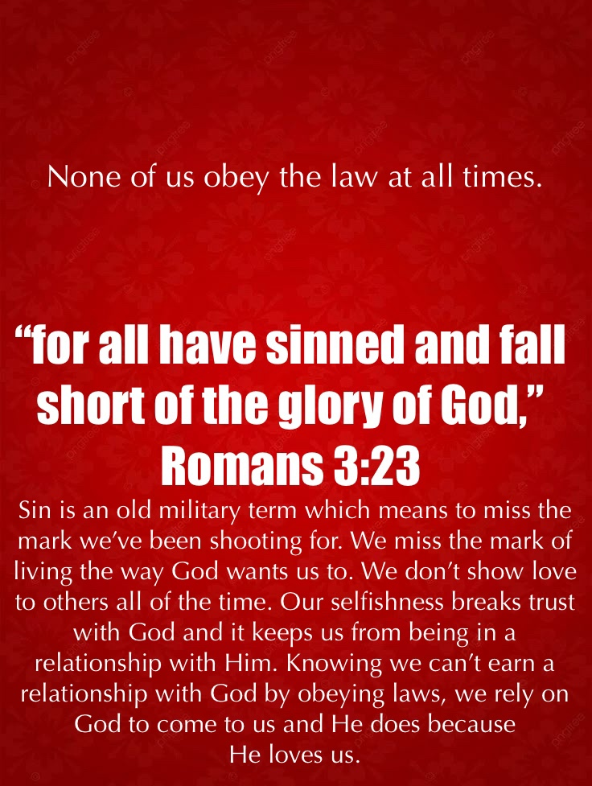

Slide 345
GOD
SIN
Law
Love
Religion

Slide 346
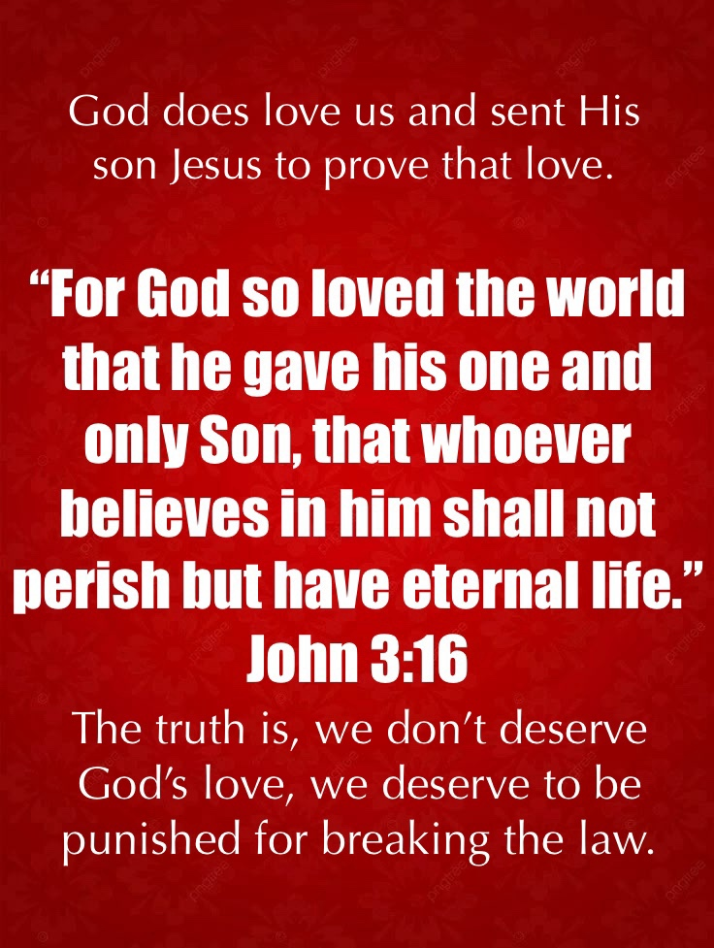

Slide 347
GOD
SIN
Law
(punishment)
Love
Religion

Slide 348
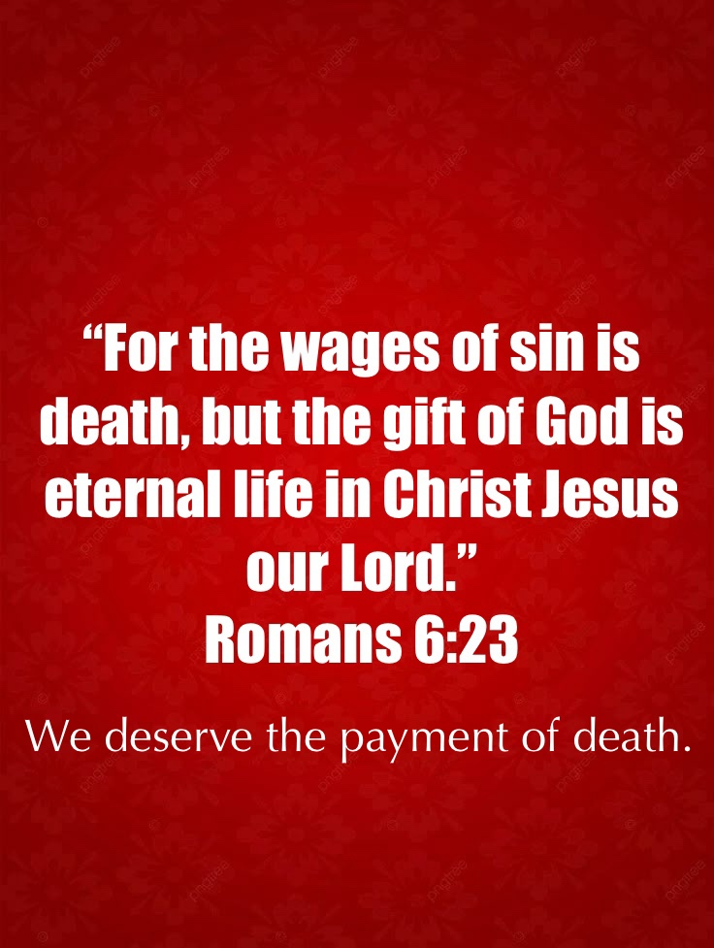

Slide 349
GOD
SIN
Law
(punishment)
(death)
Love
Religion

Slide 350
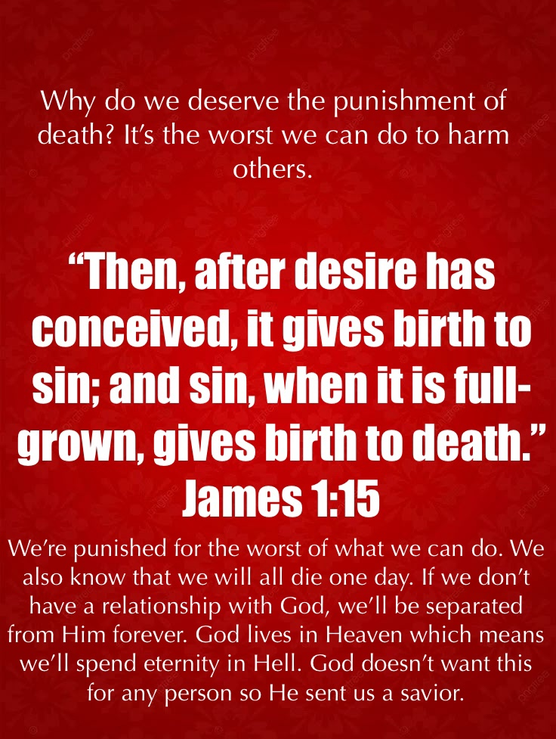

Slide 351
GOD
SIN
Law
(punishment)
(death)
Love
(Savior)
Religion

Slide 352
GOD
SIN
Law
(punishment)
(death)
Love
(Savior)
(Jesus)
Religion

Slide 353
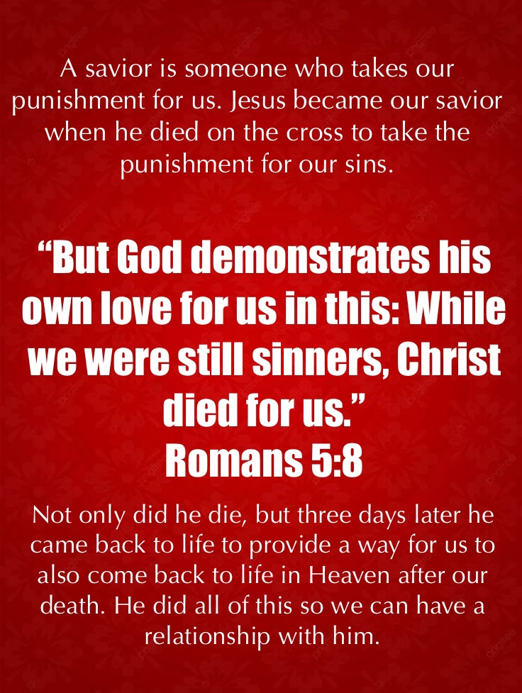

Slide 354
GOD
SIN
Law
(punishment)
(death)
Love
(Savior)
(Jesus)
Religion
Relationship

Slide 355
GOD
SIN
Law
(punishment)
(death)
Love
(Savior)
(Jesus)
forgiveness
Religion
Relationship

Slide 356
GOD
SIN
Law
(punishment)
(death)
Love
(Savior)
(Jesus)
forgiveness
(accept)
Religion
Relationship

Slide 357
GOD
SIN
Law
(punishment)
(death)
Love
(Savior)
(Jesus)
forgiveness
(accept)
Religion
Relationship

Slide 358
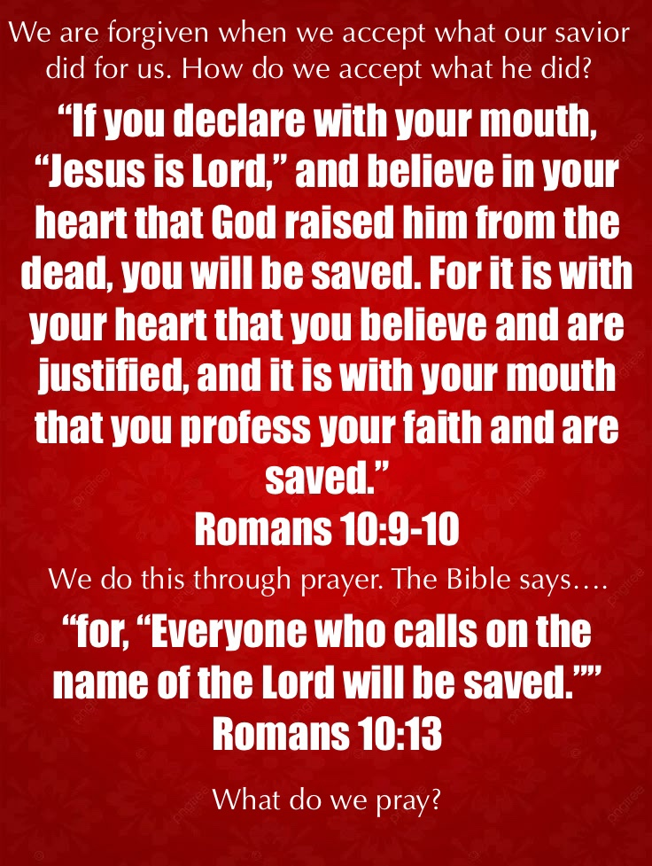

Slide 359
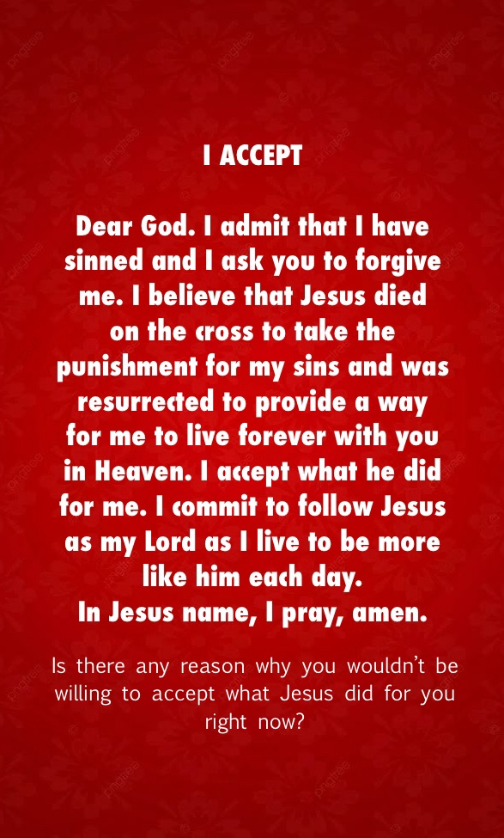

Slide 360
SESSION FIVE
DESTINY

Slide 361
QUESTION 3: DESTINY
IS THERE LIFE AFTER DEATH, AND IF THERE IS, HOW CAN I EXPERIENCE IT?

Slide 362
We’ve all wondered if there is life after death. Why? We have a desire to live forever. We desire for there to be a life to come. If there is a God and there is a Heaven where He lives, how can this become my destiny. I need a way to experience this new life. I need help in coming back to life in Heaven. I need someone who has the power himself to come back to life. My belief in what he did and my belief in his ability to also bring me back to life in heaven is required for me to live in Heaven with God. How can I come to believe that Jesus came back to life and is capable to also bring me back to life in Heaven? This sounds like a stretch for many to believe. We can believe with confidence that Jesus did come back to life. How?

Slide 363
Five Evidences of Reality

Slide 364
Five Evidences of Reality
The disciples died for their beliefs.

Slide 365
Five Evidences of Reality
The disciples died for their beliefs.
The conversion of skeptics. James, the brother of Jesus (John 7:5) and Paul.

Slide 366
Five Evidences of Reality
The disciples died for their beliefs.
The conversion of skeptics. James, the brother of Jesus (John 7:5) and Paul.
Changes to key social structures.

Slide 367
They no longer believed they needed to offer an animal sacrifice to atone for their sins. They now believed that Jesus was the final sacrifice. They no longer believed that you were connected to God through obeying the commandments. We are incapable to always follow the law and can’t earn a relationship with God. They no longer worshipped on the Sabbath, but began worshipping on Sunday acknowledging the day of the week that Jesus rose from the dead. They no longer believed that God was one person, but expressed who He is in three persons – The Father, Son, and Holy Spirit. They no longer believed that the Messiah was going to be a political leader who would destroy the Roman empire. They believed that he would save the world from their sins through his death and resurrection.

Slide 368
Five Evidences of Reality
The disciples died for their beliefs.
The conversion of skeptics. James, the brother of Jesus (John 7:5) and Paul.
Changes to key social structures.
Communion and Baptism.

Slide 369
Five Evidences of Reality
The disciples died for their beliefs.
The conversion of skeptics. James, the brother of Jesus (John 7:5) and Paul.
Changes to key social structures.
Communion and Baptism.
The emergence of the church marked by the following of a belief.

Slide 370
For what I received I passed on to you as of first importance: that Christ died for our sins according to the Scriptures, ⁴that he was buried, that he was raised on the third day according to the Scriptures…
1 Corinthians 15:3-4

Slide 371
For what I received I passed on to you as of first importance: that Christ died for our sins according to the Scriptures, ⁴that he was buried, that he was raised on the third day according to the Scriptures…
1 Corinthians 15:3-4
The beliefs were - We believe Christ died for our sins. We believe he was buried. We believed that he was raised again on the third day.

Slide 372
For what I received I passed on to you as of first importance: that Christ died for our sins according to the Scriptures, ⁴that he was buried, that he was raised on the third day according to the Scriptures…
1 Corinthians 15:3-4
The beliefs were - We believe Christ died for our sins. We believe he was buried. We believed that he was raised again on the third day.

Slide 373
REMINDER GRAPHIC ON WEBSITE:
RESURRECTION EVIDENCE

Slide 374
Remember, it is because of Jesus’ resurrection and coming back to life that we can also come back to life in Heaven after our death. It gives hope of a new life to come.

Slide 375
Why is eternity important?

Slide 376
Why is eternity important?
We all need something.

Slide 377
Why is eternity important?
We all need something.
We all need hope!

Slide 378
But in your hearts revere Christ as Lord. Always be prepared to give an answer to everyone who asks you to give the reason for the hope that you have. But do this with gentleness and respect
1 Peter 3:15

Slide 379
Do you have hope?

Slide 380
“What do we place our hope in?”

Slide 381
“Hope is the feeling that what is wanted can be had or that events will turn out for the best.”

Slide 382
1. HOPE IS ABOUT THE FUTURE

Slide 383
2. HOPE IS A FEELING

Slide 384
We put these together and understand that hope is a feeling that we have about the future!

Slide 385
Where does hope come from?

Slide 386
3. HOPE COMES FROM THE ACTIONS PERFORMED THAT LEAD TO THE DEDSIRED FUTURE

Slide 387
Have we done what is needed to experience the future that we desire?

Slide 388
4. HOPE REQUIRES BELIEF

Slide 389
We have the hope of a good ending to the story because of our belief in what someone did for us that we cannot do. God provided a Savior who took our punishment for our sins and was resurrected to provide a way for us to come back to life in Heaven after our death. Because of Jesus’ resurrection, we have the hope of a better future in Heaven. This world isn’t the end of my story!

Slide 390
WE BELIEVE THIS WORLD ISN’T THE END OF
OUR STORY!

Slide 391
5. WE CAN MAINTAIN HOPE

Slide 392
If I am limited as to what I can do to change the future, to maintain hope, I must partner with someone who is capable to do what I am incapable of doing.

Slide 393
If I am limited as to what I can do to change the future, to maintain hope, I must partner with someone who is capable to do what I am incapable of doing.
We maintain hope when we believe in a world without pain and suffering.

Slide 394
If I am limited as to what I can do to change the future, to maintain hope, I must partner with someone who is capable to do what I am incapable of doing.
We maintain hope when we believe in a world without pain and suffering.
We maintain our hope when we know we are going to be with the one we love.

Slide 395
We’re looking in the future to a time when we are with God who loves us unconditionally, in a place where there are no problems that need anyone’s help. We’re looking toward a time of being at peace with the one we care for the most. This gives us hope.

Slide 396
6. HOPE HAPPENS IN COMMUNITY

Slide 397
We see hope through others. We see how they respond to the difficulties of life with confidence. We want the hope that others have!

Slide 398
We see hope through others. We see how they respond to the difficulties of life with confidence. We want the hope that others have!
This is why Christians can be powerful influences leading people to come to know God personally. We don’t lose our joy because we know in the end, God is up to something good and we’ll be in a much better place than we are today.

Slide 399
REMINDER GRAPHIC ON WEBSITE:
WE ALL NEED HOPE

Slide 401
SESSION SIX
MEANING

Slide 402
GOD
Religion

Slide 403
GOD
Law
Religion

Slide 404
GOD
SIN
Law
Religion

Slide 405
GOD
SIN
Law
Love
Religion

Slide 406
GOD
SIN
Law
(punishment)
Love
Religion

Slide 407
GOD
SIN
Law
(punishment)
(death)
Love
Religion

Slide 408
GOD
SIN
Law
(punishment)
(death)
Love
(Savior)
Religion

Slide 409
GOD
SIN
Law
(punishment)
(death)
Love
(Savior)
(Jesus)
Religion

Slide 410
GOD
SIN
Law
(punishment)
(death)
Love
(Savior)
(Jesus)
Religion
Relationship

Slide 411
GOD
SIN
Law
(punishment)
(death)
Love
(Savior)
(Jesus)
forgiveness
Religion
Relationship

Slide 412
GOD
SIN
Law
(punishment)
(death)
Love
(Savior)
(Jesus)
forgiveness
(accept)
Religion
Relationship

Slide 413
GOD
SIN
Law
(punishment)
(death)
Love
(Savior)
(Jesus)
forgiveness
(accept)
Religion
Relationship

Slide 414
SESSION SIX
MEANING

Slide 415
MEANING:
What is my purpose in life?

Slide 416
We’re all looking for a reason to live. We want to feel like our lives have significance. The question is – “What gives my life meaning? The good news is that when we discover it, we experience something that we all desire. What is it?

Slide 417
We live to experience one of two feelings:

Slide 418
We live for happiness. Happiness is a temporary feeling.

Slide 419
We live for happiness. Happiness is a temporary feeling.
  Happiness is often dependent on our circumstances.

Slide 420
We live for happiness. Happiness is a temporary feeling.
  Happiness is often dependent on our circumstances.
  Our purpose is to get what makes us happy.

Slide 421
We live for happiness. Happiness is a temporary feeling.
  Happiness is often dependent on our circumstances.
  Our purpose is to get what makes us happy.
    What happens when the happiness wears off?

Slide 422
We live for happiness. Happiness is a temporary feeling.
  Happiness is often dependent on our circumstances.
  Our purpose is to get what makes us happy.
    What happens when the happiness wears off?
    What happens when we face difficulties? (my circumstances are hard)

Slide 423
We live with joy. Joy can be a never-ending good feeling of satisfaction.

Slide 424
We live with joy. Joy can be a never-ending good feeling of satisfaction.
  People with joy don’t rely on their circumstances for happiness, they rely on a relationship with someone who has a love for them that never fails and disappoints.

Slide 425
We live with joy. Joy can be a never-ending good feeling of satisfaction.
  People with joy don’t rely on their circumstances for happiness, they rely on a relationship with someone who has a love for them that never fails and disappoints.
  It gives them their sense of identity. (I am a child of God!)

Slide 426
Yet to all who did receive him, to those who believed in his name, he gave the right to become children of God…
John 1:12

Slide 427
We live with joy. Joy can be a never-ending good feeling of satisfaction.
  People with joy don’t rely on their circumstances for happiness, they rely on a relationship with someone who has a love for them that never fails and disappoints.
  It gives them their sense of identity. (I am a child of God!)
  It gives them joy when they help others have a relationship with the one they know.

Slide 428
We live with joy. Joy can be a never-ending good feeling of satisfaction.
  People with joy don’t rely on their circumstances for happiness, they rely on a relationship with someone who has a love for them that never fails and disappoints.
  It gives them their sense of identity. (I am a child of God!)
  It gives them joy when they help others have a relationship with the one they know.
  It’s their purpose to help as many people as possible to have this relationship. It’s what gives their lives meaning.

Slide 429
Whatever we trust in to give our lives meaning gives us our identity. We’ve “identified” what we believe will satisfy us and we identify as one who believes in whatever or whomever it is.

Slide 430
IDENTITY

Slide 431
One of the most significant obstacles keeping people from choosing to begin a relationship with God is their struggle with identity. Who we want to be is different than who God wants us to be!

Slide 432
1. WE CAN UNDERSTAND WHAT MAKES UP OUR IDENTITY.

Slide 433
There are certain aspects of our identity…
Our identity is what makes us feel alive.

Slide 434
There are certain aspects of our identity…
Our identity is what makes us feel alive.
It is what gives us a reason to live.

Slide 435
There are certain aspects of our identity…
Our identity is what makes us feel alive.
It is what gives us a reason to live.
It gives us a sense of purpose.

Slide 436
There are certain aspects of our identity…
Our identity is what makes us feel alive.
It is what gives us a reason to live.
It gives us a sense of purpose.
It results in a good feeling (happiness or joy).

Slide 437
It’s influenced by two factors:

Slide 438
It’s influenced by two factors:
Who we feel we should be and

Slide 439
It’s influenced by two factors:
Who we feel we should be and
Who our community tells us we should be.

Slide 440
As societies have changed, the definition of who we should be has changed. The reason for this shift comes from the influence of those who desire to live in a way that a society has previously determined to be unacceptable. We begin judging ourselves by what we believe others expect us to be.

Slide 441
OUR IDENTITY CAN BE IN CRISIS

Slide 442
If we don’t measure up to the expectations of a community, we find ourselves in identity crisis.

Slide 443
Our beliefs are in conflict with what those in the community believe. We are judged for not changing our beliefs.

Slide 444
Our identity is in crisis when who we are doesn’t match who God wants us to be.

Slide 445
We find our value in living the way we want rather than living the way God wants us to live. We are in conflict with God. How do we solve this crisis?

Slide 446
This crisis is solved in one of three ways….

Slide 447
This crisis is solved in one of three ways….
To exclude who God created us to be and wants us to be and be who we want to be separate from Him, believing that I know what is best for myself.

Slide 448
This crisis is solved in one of three ways….
To exclude who God created us to be and wants us to be and be who we want to be separate from Him, believing that I know what is best for myself.
Understand that I have a desire to be someone whom God did not create me to be or wants me to be but I believe that God knows what is best for me and He wants what is best for me which leads me to work to shift my desire to please Him.

Slide 449
This crisis is solved in one of three ways….
To exclude who God created us to be and wants us to be and be who we want to be separate from Him, believing that I know what is best for myself.
Understand that I have a desire to be someone whom God did not create me to be or wants me to be but I believe that God knows what is best for me and He wants what is best for me which leads me to work to shift my desire to please Him.
Include God in my life, but only in areas of my life where I am in agreement with Him.

Slide 450
This crisis is solved in one of three ways….
To exclude who God created us to be and wants us to be and be who we want to be separate from Him, believing that I know what is best for myself.
Understand that I have a desire to be someone whom God did not create me to be or wants me to be but I believe that God knows what is best for me and He wants what is best for me which leads me to work to shift my desire to please Him.
Include God in my life, but only in areas of my life where I am in agreement with Him.
- If I do this, can He really be my God?

Slide 451
To better answer this, we need to define God. Who is God?...

Slide 452
God = any deified person, object or activity.

Slide 453
God = any deified person, object or activity.
Deity = a person, thing or activity that is revered.

Slide 454
God = any deified person, object or activity.
Deity = a person, thing or activity that is revered.
God = a person, object or activity that we value the most that is placed in the position of highest importance.

Slide 455
What can we learn from this?

Slide 456
Our “god” is a part of our identity.

Slide 457
Our “god” is a part of our identity.
Our identity is determined by who or what we value the most.

Slide 458
Our “god” is a part of our identity.
Our identity is determined by who or what we value the most.
This person or thing becomes the defining element of who we are.

Slide 459
Living for a god other than the true God can satisfy us until we are faced with a situation that our god can’t solve.

Slide 460
Our identity is in crisis if our god doesn’t do what we need our god to do for us.

Slide 461
Our Desires:

Slide 462
Our Desires:
We desire to be protected resulting in our desire for a solution to our problems. This gives us hope.

Slide 463
Our Desires:
We desire significance resulting in our having a reason to live that makes the world a better place. This gives us purpose.

Slide 464
Our Desires:
We desire to be loved even when we don’t deserve it resulting in our need for a relationship with someone who loves us unconditionally that no one can take away. This gives us joy.

Slide 465
With these in mind, we answer some god questions….

Slide 466
The God Questions….

Slide 467
The God Questions….
Does your god solve your problems?

Slide 468
The God Questions….
Does your god solve your problems?
Does your god give you a sense of significance by making you feel that what you do for your god matters?

Slide 469
The God Questions….
Does your god solve your problems?
Does your god give you a sense of significance by making you feel that what you do for your god matters?
Does your god love you back even when you don’t deserve it?

Slide 470
REMINDER GRAPHIC ON WEBSITE:
THE GOD QUESTIONS

Slide 471
We are all the same. It is the process of our searching for our identity that leads us to whomever or whatever our god becomes. It is this same process that has led people to find their identity in being a child of the God who created them. They have determined that He meets all of their desires. They also believe that He wants what’s best for them.

Slide 472
I’m in identity crisis if I’m not living for what God created me to live for.

Slide 473
Dear friends, let us love one another, for love comes from God. Everyone who loves has been born of God and knows God. ⁸ Whoever does not love does not know God, because God is love.
1 John 4:7-8

Slide 474
For the Son of Man came to seek and to save the lost.
Luke 19:10

Slide 475
My purpose is to seek and to save the lost!

Slide 476
REMINDER GRAPHIC ON WEBSITE:
IDENTITY – (MEANING)

Slide 477
We have spent much time discovering truth. Remember, we use the physical and the spiritual. The physical is researched through science and historical events. We look at evidence and come to conclusions about the best possible explanations. The spiritual is a gut level feeling of what we believe to be true after looking at all of the evidence. What is your gut telling you? There are certain gut level feelings that we have which lead us to come to know God. There are five of them. We’ll call them beliefs.

Slide 478
To be identified with God, we need to have certain beliefs. We can ask those we are telling about Christ if they share these beliefs?

Slide 479
THE 5 BELIEFS QUESTIONS
Do you believe that God exists (God Exists)? After looking at all of the evidence, do you believe that someone created the universe and that we are not an accident? Do you believe there is someone who is separate from nature who has power over all things?

Slide 480
THE 5 BELIEFS QUESTIONS
Do you believe that you have missed the mark and sinned (I have sinned)? Do you know deep down what is right and wrong and that you don’t measure up to who you were created to be – always good and loving?

Slide 481
THE 5 BELIEFS QUESTIONS
Do you believe that you can never obey enough rules to earn a relationship with God because you know you will fail (I can’t earn it)? Do you know that you are not perfect and will not always do what is right?right?

Slide 482
THE 5 BELIEFS QUESTIONS
Do you believe that God still loves you and wants to have a relationship with you (God wants me)? Do you believe that God sending Jesus to show His love for you is proof that He wants a relationship with you?

Slide 483
THE 5 BELIEFS QUESTIONS
Do you believe that Jesus is the way to have a relationship with God (Jesus is the way)? Do you believe that he came to earth to show you how to live, take the punishment for your sin and come back to life to provide a way for you to also come back to life in Heaven after your death? Do you believe you experience this through being forgiven for your sins by accepting what Jesus did for you?

Slide 484
If they answer “YES” to these questions, they can begin their relationship with God by praying. Give them an opportunity to become a Child of God by leading them in the Prayer of Salvation:

Slide 485
Dear God, I ADMIT that I have sinned and ask for your forgiveness. I BELIEVE that Jesus died on the cross to take the punishment for my sins and was resurrected to provide a way for me to live forever with you in Heaven. I COMMIT to follow Jesus as the Lord of my life as I live to become like him. I pray this in Jesus’ name. Amen.

Slide 486
REMINDER GRAPHIC ON WEBSITE:
THE 5 BELIEFS

Slide 487
REMEMBER – THIS IS A GRAPHIC!
REMINDER GRAPHIC ON WEBSITE:
I ACCEPT

Slide 488
WHAT DO I DO IF THEY BECOME A CHRISTIAN?

Slide 489
WHAT DO I DO IF THEY BECOME A CHRISTIAN?
We want to help new believers begin their relationship with God in a good way. To do this, we want to encourage them to take specific actions. Encourage them to…

Slide 490
WHAT DO I DO IF THEY BECOME A CHRISTIAN?
Tell others about their new relationship with God.

Slide 491
WHAT DO I DO IF THEY BECOME A CHRISTIAN?
Connect with a church that will help them grow as a new Christian.

Slide 492
WHAT DO I DO IF THEY BECOME A CHRISTIAN?
Obey Jesus’s instruction to be baptized letting people know of their belief in the loving life Jesus lived, his death and burial for their sins and his resurrection providing eternal life for them in Heaven.

Slide 493
WHAT DO I DO IF THEY BECOME A CHRISTIAN?
Begin to grow in their relationship with God by reading the Bible and talking to Him through prayer.

Slide 494
WHAT DO I DO IF THEY BECOME A CHRISTIAN?
Engage in showing God’s love to others by helping those who are in need.

Slide 495
REMINDER GRAPHIC ON WEBSITE:
WHAT NOW?

Slide 496
Are You Ready?

Slide 497
Are you ready to share the Good News about Jesus with others? Hopefully, this course has prepared you. Let’s end by remembering the scripture which is the foundation of this study…

Slide 498
But in your hearts revere Christ as Lord. Always be prepared to give an answer to everyone who asks you to give the reason for the hope that you have. But do this with gentleness and respect…
1 Peter 3:15

Slide 499
Jesus made a strong statement about the need for us to share Good News. The Bible teaches…

Slide 500
Jesus went through all the towns and villages, teaching in their synagogues, proclaiming the good news of the kingdom and healing every disease and sickness. ³⁶ When he saw the crowds, he had compassion on them, because they were harassed and helpless, like sheep without a shepherd. ³⁷ Then he said to his disciples, “The harvest is plentiful but the workers are few. ³⁸ Ask the Lord of the harvest, therefore, to send out workers into his harvest field.”
Matthew 9:35-38

Slide 501
It’s time to go into the field and share
GOOD NEWS!

