Slide 1
CSA Importer – CARM
Introductory Program Engagement Session
Presented: December 16, 2021

Slide 2
Teleconference Technical Guidelines
Join the WebEx information from the invitation, upon joining the meeting the call in details (phone number, meeting ID and access ID) will be provided.
You will be muted upon joining the meeting, to join the conversation press the unmute button at the bottom-middle of your WebEx screen.
If you are only calling in, please mute your phone by pressing *6 and unmute your phone press *7 to join the discussion. Once you are finished speaking, please mute your phone again by pressing *6.

Slide 3
OBJECTIVES
Engagement Sessions
Establish a forum to engage directly with CSA Importers on program and policy changes that will be implemented to support CARM solution.
Promote continued high-level of compliance through well articulated policy and program changes
Increase CSA Importer readiness for CARM implementation
Enable business decision making
Identify potential policy gaps
Today’s Meeting Objectives
Highlight KEY program and policy changes

Slide 4
Rules of Engagement
What to expect
What not to expect
Forum to engage on a policy and program level
Topic specific sessions
Transparent dialogue
Engagement on future CSA Importer D Memo revisions (CARM)
Forum to revisit or challenge decisions already made
Engagement or responses on technical aspects of the CARM solution

Slide 5
AGENDA
The following topics will be covered:
  CARM Client Portal and Program Enrollment
  CSA Clearance and Release Process
  New Financial Security Model
  NEW CSA Importer CAD (Type – TT)
  NEW Extended Accounting/billing option
  Corrections, Adjustments, Mass Adjustments
  ECCRD Chapters 17, 24 & 26

Slide 6
CARM Client Portal & Program Enrollment
Will be the Agency’s primary program enrollment application centralizing, automating and streamlining commercial registration processes
Provides new self-service options and greater visibility to importers regarding their importing activities.
At present, 84% of CSA Importers have set up their CARM Client Portal account
Full implementation of CCP will launch as part of CARM Release 2
  CSA membership information and forms will be migrated into CARM system by CBSA
Enrollment in PIP will continue to take place through the Trusted Trader Portal.

Slide 7
CSA Clearance and Release Process
FAST lane eligibility and benefits
Expedited CSA border clearance process
Release benefits including:
  HS Code exemption on release document (e.g., IID, PARS, RMD) for non-regulated goods
  Exemption from “Appraisal Quality” (AQ) for non-regulated goods
  Auto-acquittal of release transactions based on CSA importer BN
Accounting trigger will continue to be initiated from company records and systems regardless of clearance or release process used

Slide 8
Release Prior to Payment (RPP) Security
CSA Importers must have RPP security (bond or cash) for all goods including CSA clearance, other releases options and CLVS.
Dependency on use of Broker security for RPP will no longer be
Brokers will be able to see if importer has RPP however, will not have visibility of the details relating to importer’s RPP (e.g., amount)
Amount of security is calculated based on monthly accounts receivable inclusive of GST/HST, AMPs, Interest, etc.
RPP security monitoring and nudging through CARM solution
* Recommendation: CSA importers should review current bond amounts

Slide 9
RPP Security Formula
RPP Security Formula
Security for RPP can be provided in the form of a bond or cash deposit. An importer’s requirements for each are as follows:
Post a bond for 50% of their highest monthly AR with a minimum floor of $25,000 per RM. For example,
  if an importer’s highest monthly AR is $100,000, they will be required to post a bond for $50,000; or,
  if an importer’s highest monthly AR is $20,000, they will be required to post a bond for $25,000.
Post a cash deposit for 100% of their highest monthly AR. For example, if an importer’s highest monthly AR is $5,000 or $30,000, they will be required to post a cash bond for $5,000 or $30,000, respectively.
RPP Security Calculation Timeframe
The current 12 month timeframes for calculating RPP security are from July 25th to July 24th, with updates required by October 15th of each year. For consistency and simplicity, this model will continue. For importers without 12 months of history an estimation will be permitted as it is today.
RPP bond updates required
July 25th
Security Calculation Period for Highest Monthly AR
July 24th
Review Period
Oct. 15th

Slide 10
New CSA Importer CAD – Type TT
B3 is replaced by Commercial Accounting Declaration (CAD) submitted via EDI or CARM Client Portal
New CSA Importer Trusted Trader CAD (Type TT) – unique features not available to non-CSA Importers:
  Multiple shipments can be consolidated onto a single TT type
  CSA clearances and other release types can be combined in a consolidate CAD
CSA importers can use F type CAD for CLVS, or can use a TT type CAD for CLVS shipments
CSA importers may continue to use C type CAD for release, accounting and payment at FPOA (e.g. hand carried goods)

Slide 11
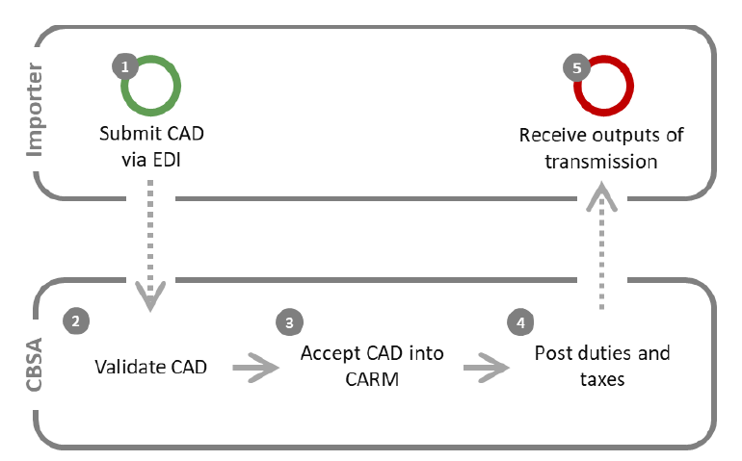
Accounting for Imported Goods (CAD) cont.
CSA Importer no longer required to calculate amounts payable, from CADs, corrections, and adjustments
  CARM system will calculate amounts
  Will post amounts owning to the importer’s account
CSA importer is no longer required to self assess interest.
  Interest calculated by the CARM system

Slide 12
New EXTENDED Accounting/Billing Options
Timing | CARM CSA Option 1 | CARM CSA Option 2
Accounting Period (CAD) | For all goods released in month 1, CAD due on or before payment due date. | For all goods released between the 18th of month 1 to the 17th of month 2, CAD due on or before payment due date.
Billing Period | All goods released in month 1 | All goods released between the 18th of month 1 to the 17th of month 2
Payment due date | 10 weekdays* after the 17th of month 2 | 10 weekdays* after the 17th of month 2
Min/Max CAD&PMT (calendar days) | 31-62 days from release | 15-45 days from release
Example: goods released July 1. CAD&PMT due date: | August 31** | July 31**
Note: *Weekdays is defined as Monday to Friday, inclusive of holidays.
**In the example, the payment due date, 10 weekdays after 17th of month 2, falls on 31st of the month.

Slide 13
SUN | MON | TUES | WED | THUR | FRI | SAT
 |  | 1 | 2 | 3 | 4 | 5
6 | 7 | 8 | 7 | 10 | 11 | 12
13 | 14 | 15 | 16 | 17 | 18 | 19
20 | 21 | 22 | 23 | 24 | 25 | 26
27 | 28 | 29 | 30
New Extended Accounting/Billing Option
- Option “1”-
MONTH 1
RELEASED (RECEIVED)
SUN | MON | TUES | WED | THUR | FRI | SAT
 |  |  |  | 1 | 2 | 3
4 | 5 | 6 | 7 | 8 | 9 | 10
11 | 12 | 13 | 14 | 15 | 16 | 17
18 | 19/1 | 20/2 | 21/3 | 22/4 | 23/5 | 24
25 SOA | 26/6 | 27/7 | 28/8 | 29/9 | 30/10 CAD+ PAY | 31
MONTH 2

Slide 14
- Option 2 -
SUN | MON | TUES | WED | THUR | FRI | SAT
 |  | 1 | 2 | 3 | 4 | 5
6 | 7 | 8 | 9 | 10 | 11 | 12
13 | 14 | 15 | 16 | 17 | 18 | 19
20 | 21 | 22 | 23 | 24 | 25 | 26
27 | 28 | 29 | 30
MONTH 1
RELEASED (RECEIVED)
SUN | MON | TUES | WED | THUR | FRI | SAT
 |  |  |  | 1 | 2 | 3
4 | 5 | 6 | 7 | 8 | 9 | 10
11 | 12 | 13 | 14 | 15 | 16 | 17
18 | 19/1 | 20/2 | 21/3 | 22/4 | 23/5 | 24
25 SOA | 26/6 | 27/7 | 28/8 | 29/9 | 30/10 CAD+ PAY | 31
MONTH 2

Slide 15
Statement of Account (SOA) / Daily Notice (DN)
CSA importers will no longer be required to generate or transmit an RSF to the CBSA
Importers will receive DN and SOA. Also viewable on importer’s CCP account.
SOA will be generated on the 25th of each month
Currently, CSA Accounting Option 1 requires an interim payment as the accounting and billing period are not harmonized.
Under CARM interim payments are not necessary for either option since the CSA accounting and Billing periods are harmonized for each CSA option.
More than1 payment can be made in the same month.

Slide 16
Corrections, Adjustments, Mass Adjustments
A correction is a change to a CAD that occurs prior to the payment due date
  No interest on corrections
  Depending on CARM CSA accounting/billing option chosen, and CAD date, the CSA importer may have up to 62 days, interest free to correct
  This will reduce the number of adjustments required and interest
An adjustment is a change to a CAD that occurs from the payment due date onward
Consolidated TT type CADs improves ability to consolidate accounting
Consolidated TT type CADs can be amended with a single correction or adjustment
Mass adjustment function can be used to bundle changes across multiple CADs.

Slide 17
Update on CSA Importer ECCRDs
ECCRD Chapters 17, 24 & 26
Electronic requirements and business rules for CARM CSA are found in the following ECCRDs:
Ch. 17 covers Trade Chain Partner List uploads and updates, CSA Clearance (CSA data set), RNS Notices and OGD/OGA Requirements
Ch. 24 covers Daily Notices (CADs posting), SOA, Payment
Ch. 26: covers CADs, corrections and adjustments, consolidated CADs, consolidated adjustments and mass adjustments.
CSA importers must be familiar will all these ECCRDs as they all include CSA content.

Slide 18
Thank You!
For more information about CARM:
Visit the CARM section of the CBSA website
CARM Client Support Unit http://cbsa-ut.isvcs.net/contact-dev/prod-snapshot/csform-formulairesc-eng.html
Visit the CARM Client Portal
Visit the CARM Google Drive for resources
Join the CARM LinkedIn Group for the latest news
Questions? Email: CBSA.CARM_Engagement-Engagement_de_la_GCRA.ASFC@cbsa-asfc.gc.ca
Join the email distribution list by emailing CBSA.CARM_Engagement-Engagement_de_la_GCRA.ASFC@cbsa-asfc.gc.ca

Slide 19
CSA Importer – CARM Engagement Sessions
Contact:
Commercial Program Directorate
Kimberly Paradis, Manager
CBSA_CIA_Unit-Unite_MOAG.ASFC@cbsa-asfc.gc.ca

