Slide 1
University of South Florida BIOSat: Botany in Orbit Satellite
Subsystem: Embedded System, Sensors, Wireless Communication, and Environmental Control
Team Name: Astroflora
Team Members Names: Phillip Cornett, Joseph Moore, Christopher Serrano, and Abigail Wittenbrook
Date: February 23, 2024
Notes:
Fill out the information according you your team

Slide 2
Subsystem Requirements
ID | Requirement | Rationale
Payload-1 | Payload shall be capable of circulating air through the chamber at a velocity of 0.3-0.5 m/s using fans and compression tanks. | Proper air circulating is necessary to sustain plant growth.
Payload-2 | The grow light shall provide an intensity of 200-250 umol/m2/s with a light wavelength of 400-700 nm for 16-18 hours daily. | To sustain red romaine lettuce growth, specific light intensities and wavelengths for set intervals are necessary.
Payload-3 | Payload shall be capable of collecting data through the sensor array, including humidity, pH, alcohol, ethylene, temperature, CO2, and O2. | To analyze red romaine lettuce growth, specific measurements are required, including humidity, pH, alcohol, ethylene, temperature, CO2, and O2
Payload-6 | Payload shall include optical/fisheye camera imaging on the root and sprout zones. | Root and leaf images are required for visual assessment of growth patterns.
Payload-8 | Thermal Insulation and heating shall be capable of always keeping the temperature between 18-22C. | Keeping the plant's temperature at a healthy level is crucial for sustaining red romaine lettuce growth.
Notes:
Remind everyone what you are trying to accomplish and the requirements that are driving your decisions.

Slide 3
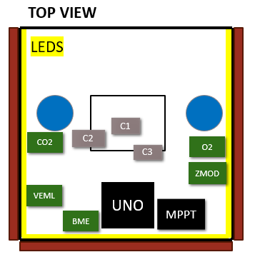
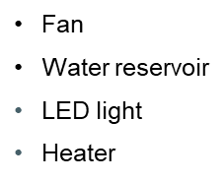
Current Design
Power Control
MPPT maximizing solar power efficiency multi-output
Sensor Array
5 different sensors: O2, CO2, VOC, Light, Alcohol, and Temp/Humidity
COMM
DIGI XBee Radio Frequency Module
Data Collection
Microcontroller sent via modules to antennas
Payload/Life Support
1 Hyperspectral camera
2 Optical cameras
Sensor Array
Notes:
Any 3D models, schematics, or diagrams are appreciated so add them to demonstrate the progress you are making. Its ok if its not final but let us know what you are doing to meet your requirements. Add more slides as needed.

Slide 4
Power Budget
Component | Voltage | Current | Time usage | Max Expected Current Draw | Power Draw
Solar Panels | 10V | 2A | N/A | N/A | 20W
Battery | 3.7V | 6Ah | N/A | N/A | 22.2WH
Temp and VOC Sensor | 3.3V | 2mA | 2 ms | 2mA | 6.6mW
O2 Sensor | 3.3V - 5V | 6.5mA | 1 min | 6.5mA | 21.45mW
CO2 Sensor | 3.3V - 5V | 4mA | 1 min | 4mA | 13.2mW
Alcohol Sensor | 3.3V - 5V | 10mA | 5 mins | 10mA | 33mW
Light Sensor | 3.3V | 2uA - 45uA | 24hr | 45uA | 148.5uW
Heater | 5V | 200mA | As needed | 200mA | 1W
Fan | 5.5V | .03A | As needed | 73mA | .4W
LED | 3.3V - 5V | 16mA(per light) | 24hr | 320mA | 1.056W
OV2640 | 2.75V | 50mA 600uA (Stand-by) | Depends | 20mA | 140mW
GPS | 3.6V | 10mA 100mA | N/A | N/A | 360mW 36mW
Receiver | 2V | 8mA | N/A |  | 16mW
Wireless Module | 3.6V | Transmit (215mA) Receive (29mA) Sleep (2.5uA) | N/A | N/A | 774mW 104.4mW
SD Card Module | 5V | .2mA 200mA | N/A | N/A | 1mW 1W

Slide 5
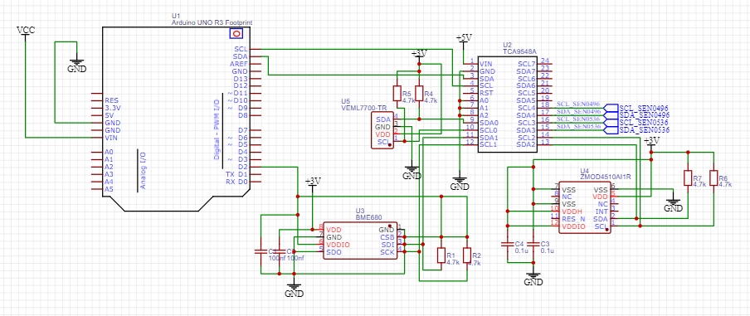
Electric Schematic

Slide 6
This Week's Tasks
The code for the camera has been compiled and tested.
This image was captured after adjusting the focus and resolution to take a close-up.

Slide 7
This Week's Tasks
Moved on from sending simple messages to transmitting actual sensor data.
Began exploring how to log sensor data onto an SD card. Aimed to save the data for XBee transmission.
Soldered pins to my XBee development board to transmit a clearer signal.
Notes:
What did you accomplish this week?! Add slides as needed.

Slide 8
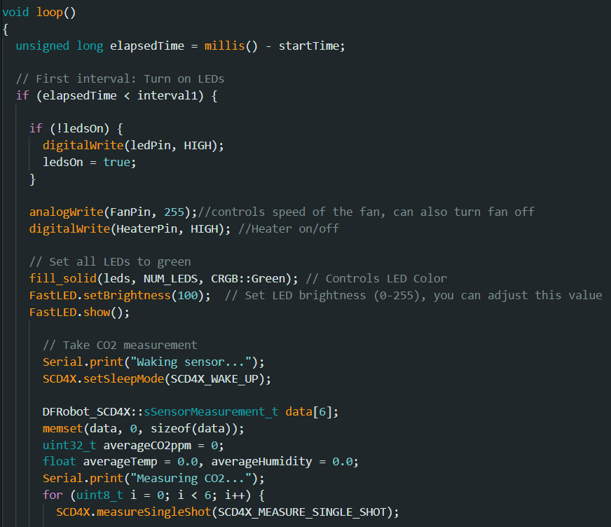
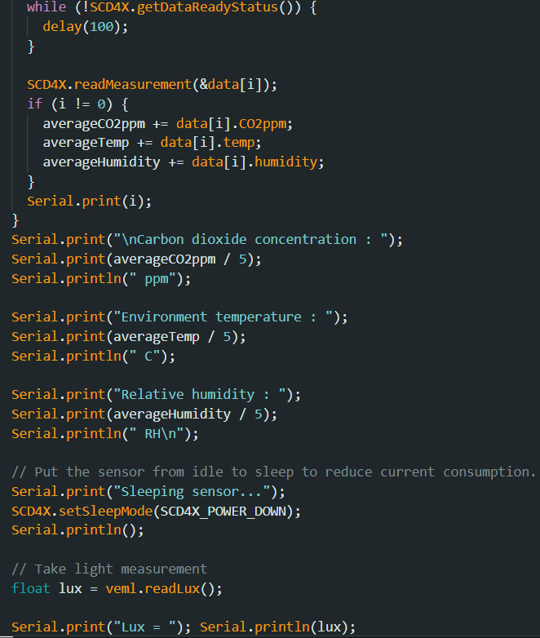
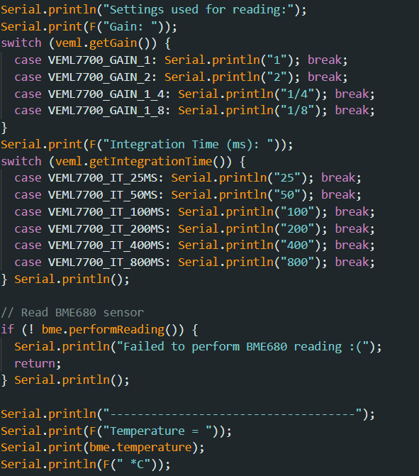
This Week's Tasks
Implementation of sensors into day cycle code worked, was able to successfully capture sensor data at given intervals.
Notes:
What did you accomplish this week?! Add slides as needed.

Slide 9
Next Week's Goals
Configure sensors and cameras to store data into the SD card for transmission.
Add the new alcohol sensor to the design.
Refine Arduino script to successfully transmit and receive data from the SD card and not just the sensor. Solder RP-SMA connector to XBee module to begin testing with the purchased antenna.
Finalize implementing initiating a round of measurements with the day/night cycle along with Implementing control systems such as fans, lights, and heaters.
Notes:
What will you get done next week?

Slide 11
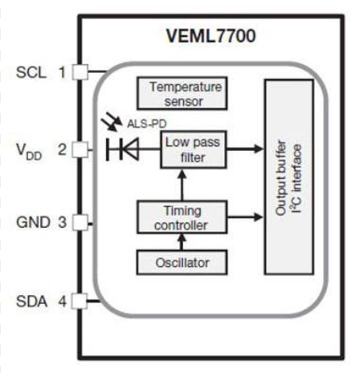
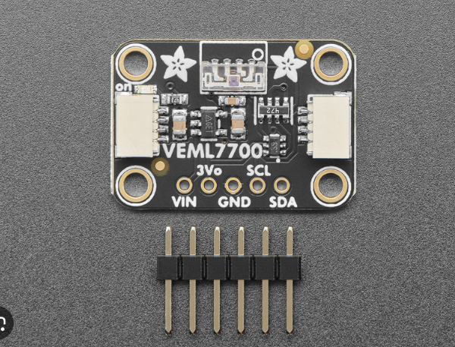
Light Sensor (VEML7700-TR)

Slide 12
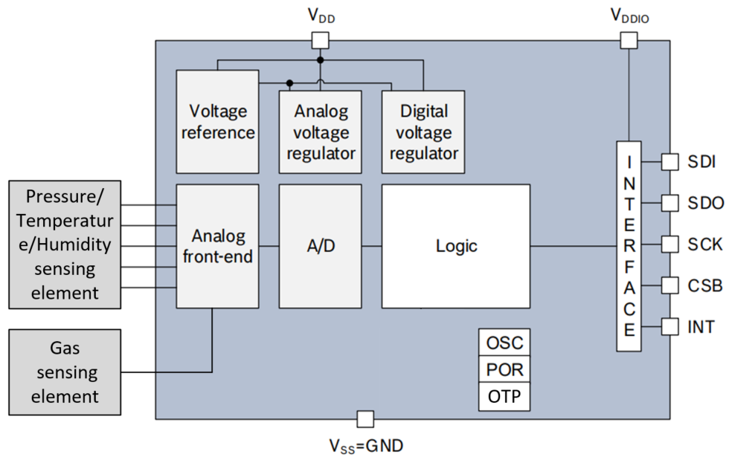
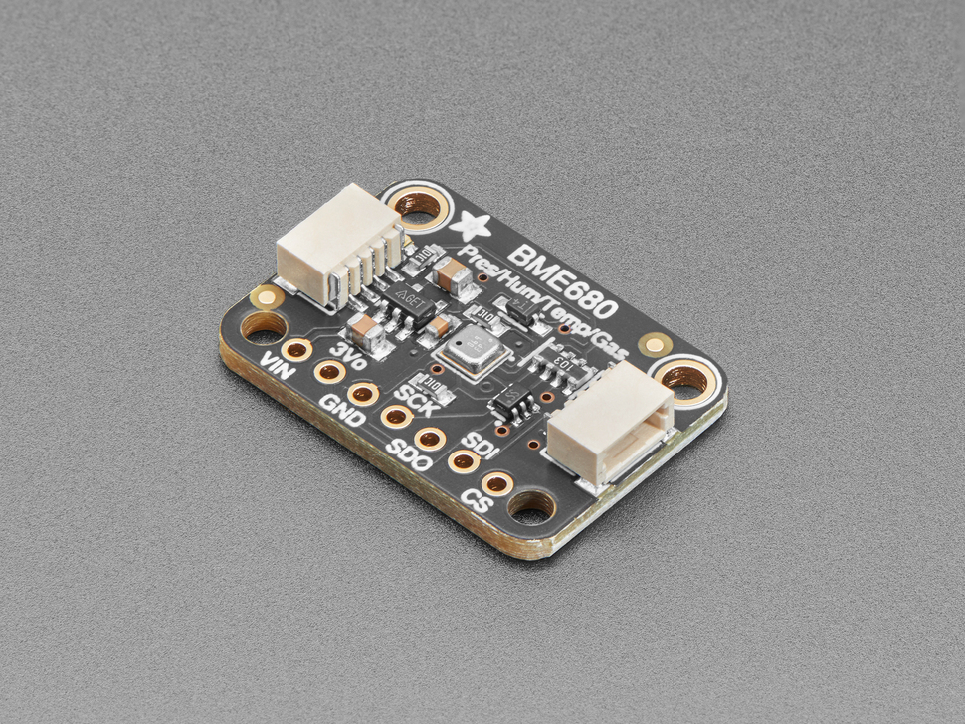
Temperature/Humidity (BME680)

Slide 13
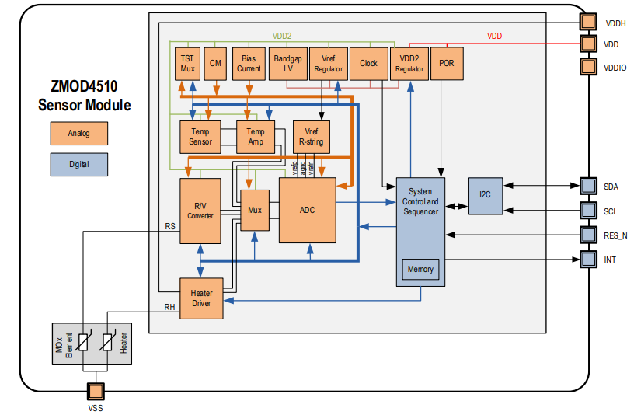
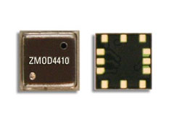
Alcohol (ZMOD4510 )

Slide 14
Light Sensor (VEML7700-TR)

Slide 15
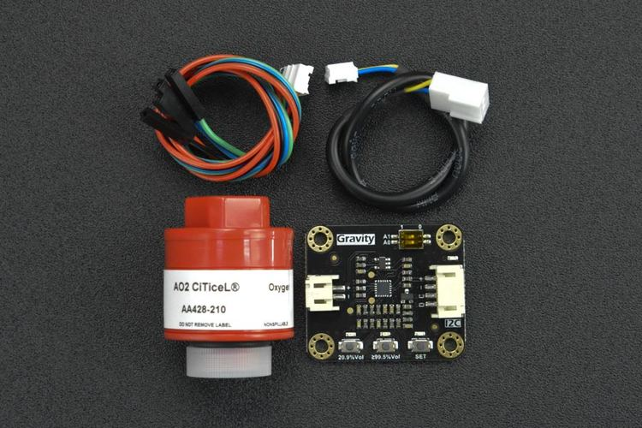
SEN053A & SEN0496

