Slide 1

University of South Florida
BIOSat: Botany in Orbit Satellite
Subsystem: Embedded System, Sensors, Wireless Communication, and Environmental Control
Team Name: Astroflora
Team Members Names: Phillip Cornett, Joseph Moore, Christopher Serrano, and Abigail Wittenbrook
Date: March 22, 2024
Notes:
Fill out the information according you your team

Slide 2
Subsystem Requirements
ID | Requirement | Rationale
Payload-1 | Payload shall be capable of circulating air through the chamber at a velocity of 0.3-0.5 m/s using fans and compression tanks. | Proper air circulating is necessary to sustain plant growth.
Payload-2 | The grow light shall provide an intensity of 200-250 umol/m2/s with a light wavelength of 400-700 nm for 16-18 hours daily. | To sustain red romaine lettuce growth, specific light intensities and wavelengths for set intervals are necessary.
Payload-3 | Payload shall be capable of collecting data through the sensor array, including humidity, pH, alcohol, ethylene, temperature, CO2, and O2. | To analyze red romaine lettuce growth, specific measurements are required, including humidity, pH, alcohol, ethylene, temperature, CO2, and O2
Payload-6 | Payload shall include optical/fisheye camera imaging on the root and sprout zones. | Root and leaf images are required for visual assessment of growth patterns.
Payload-8 | Thermal Insulation and heating shall be capable of always keeping the temperature between 18-22C. | Keeping the plant's temperature at a healthy level is crucial for sustaining red romaine lettuce growth.
Notes:
Remind everyone what you are trying to accomplish and the requirements that are driving your decisions.

Slide 3
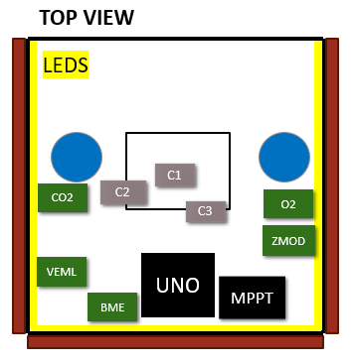
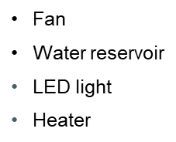
Current Design
Power Control
MPPT maximizing solar power efficiency multi-output
Sensor Array
5 different sensors: O2, CO2, VOC, Light, Alcohol, and Temp/Humidity
COMM
DIGI XBee Radio Frequency Module
Data Collection
Microcontroller sent via modules to antennas
Payload/Life Support
1 Hyperspectral camera
2 Optical cameras
Sensor Array
Notes:
Any 3D models, schematics, or diagrams are appreciated so add them to demonstrate the progress you are making. Its ok if its not final but let us know what you are doing to meet your requirements. Add more slides as needed.

Slide 4
Power Budget
Component | Voltage | Current | Time usage | Max Expected Current Draw | Power Draw
Solar Panels | 10V | 2A | N/A | N/A | 20W
Battery | 3.7V | 6Ah | N/A | N/A | 22.2WH
Temp and VOC Sensor | 3.3V | 2mA | 2 ms | 2mA | 6.6mW
O2 Sensor | 3.3V - 5V | 6.5mA | 1 min | 6.5mA | 21.45mW
CO2 Sensor | 3.3V - 5V | 4mA | 1 min | 4mA | 13.2mW
Alcohol Sensor | 3.3V - 5V | 10mA | 5 mins | 10mA | 33mW
Light Sensor | 3.3V | 2uA - 45uA | 24hr | 45uA | 148.5uW
Heater | 5V | 200mA | As needed | 200mA | 1W
Fan | 5.5V | .03A | As needed | 73mA | .4W
LED | 3.3V - 5V | 16mA(per light) | 24hr | 320mA | 1.056W
OV2640 | 2.75V | 50mA 600uA (Stand-by) | Depends | 20mA | 140mW
GPS | 3.6V | 10mA 100mA | N/A | N/A | 360mW 36mW
Receiver | 2V | 8mA | N/A |  | 16mW
Wireless Module | 3.6V | Transmit (215mA) Receive (29mA) Sleep (2.5uA) | N/A | N/A | 774mW 104.4mW
SD Card Module | 5V | .2mA 200mA | N/A | N/A | 1mW 1W

Slide 5
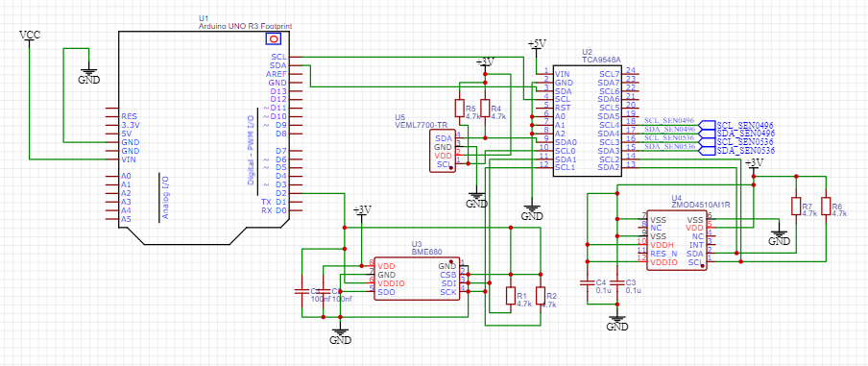
Electric Schematic

Slide 6
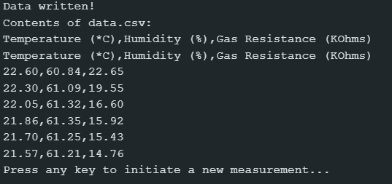
This Week's Tasks
The sensor array is functioning and saves its data in a SD card as a csv file.

Slide 7
This Week's Tasks
Range Test | Configuration | Maximum Distance | Minimum Received RSSI / Power | Minimum Transmit RSSI / Power
Beard Parking Garage | Module Antenna | ~ 96 ft | -54 dBm / 60 mW | -51 dBm / 76.2 mW
 | High gain antennas | ~ 96 ft | - 49 dBm / 91 mW | -47 dBm / 110 mW
Field Testing | Module Antenna | 1108.8 ft | - 78 dBm / 17 mW | - 72 dBm / 22 mW
 | High Gain Antennas | 1108.8 ft | - 73 dBm / 21 mW | - 68 dBm / 26 mW
Local Long Range | Module Antenna | 3485 ft | -73 dBm / 21 mW | -74 dBm / 20 mW
 | High Gain Antennas | 3485 ft | -68 dBm / 26 mW | -66 dBm / 28 mW
Clear line of sight is necessary
-103 dBm / 9 mW is the antenna sensitivity
Tethered weather balloon altitude is 100 ft – 1970 ft
Notes:
What did you accomplish this week?! Add slides as needed.

Slide 8
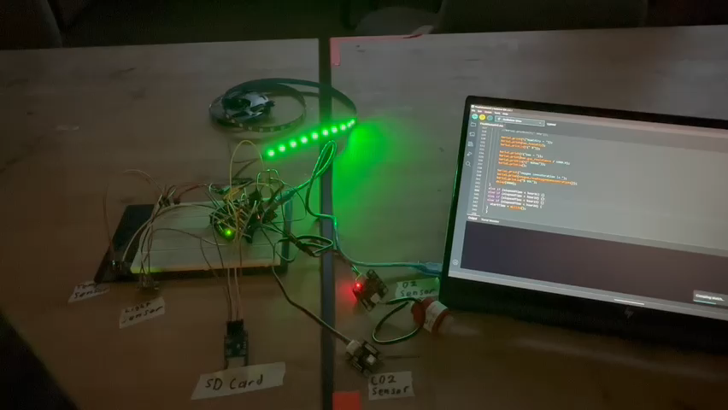
This Week's Tasks
Tested day cycle code, foundation of the day cycle is fully operational. All sensors are collecting data and displaying (besides alcohol), and LEDs are resembling an earth day cycle.
Notes:
What did you accomplish this week?! Add slides as needed.

Slide 9
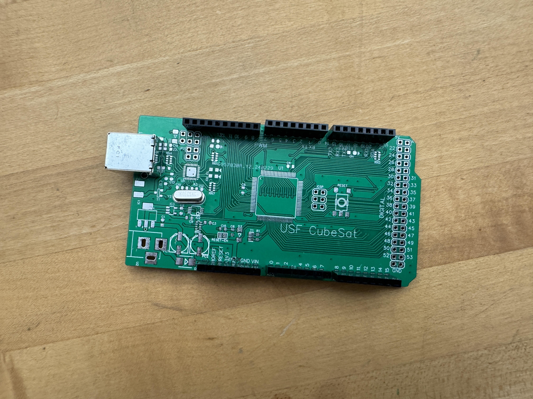
PCB Assembly

Slide 10
Next Week's Goals
Configure sensors and cameras to store data into the SD card for transmission.
Add the new alcohol sensor to the design.
Attempt to max out antennas’ range by elevating the receiving antenna.
Integrate communication system to full system with using actual package size and wiring.
Configure heating and fan system to work analogous to the sensors. Adjust certain sensors to take measurements more frequently throughout the day.
Integrate irrigation teams water pump and sensor and solar panels team’s burn wire.
Notes:
What will you get done next week?

Slide 12
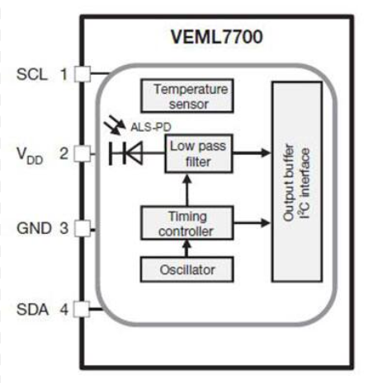
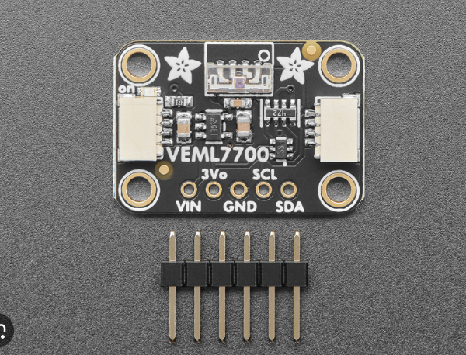
Light Sensor (VEML7700-TR)

Slide 13
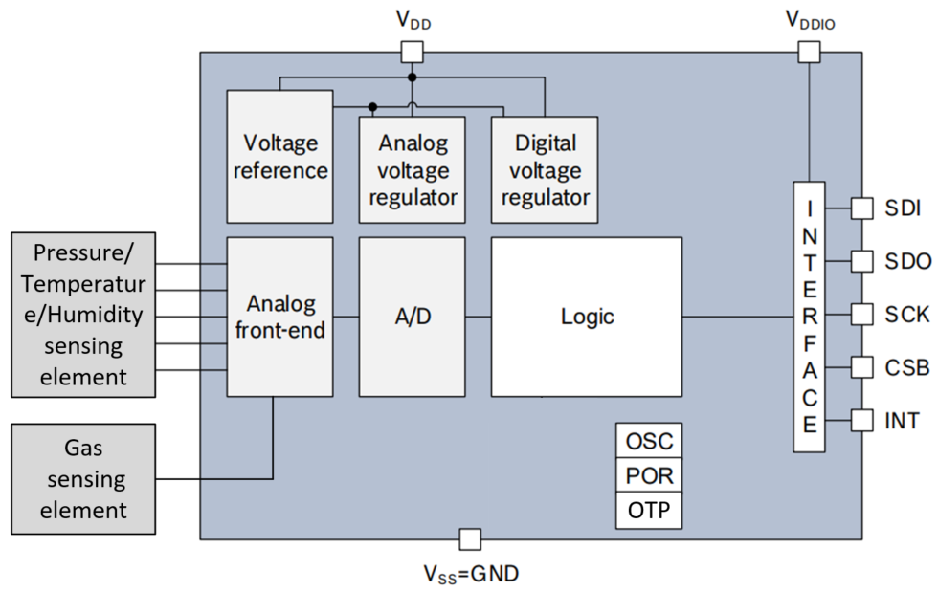
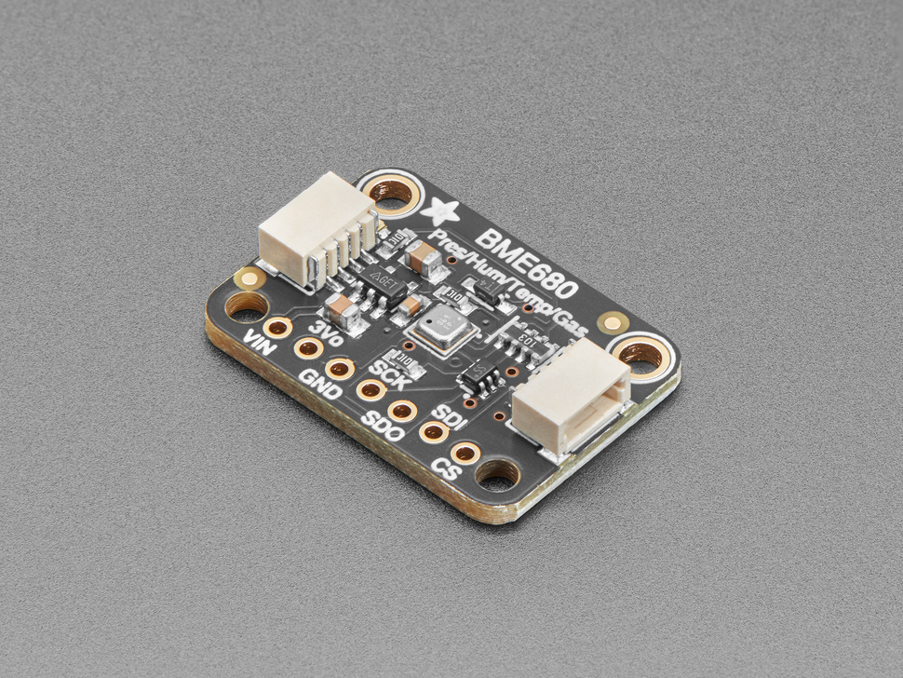
Temperature/Humidity (BME680)

Slide 14
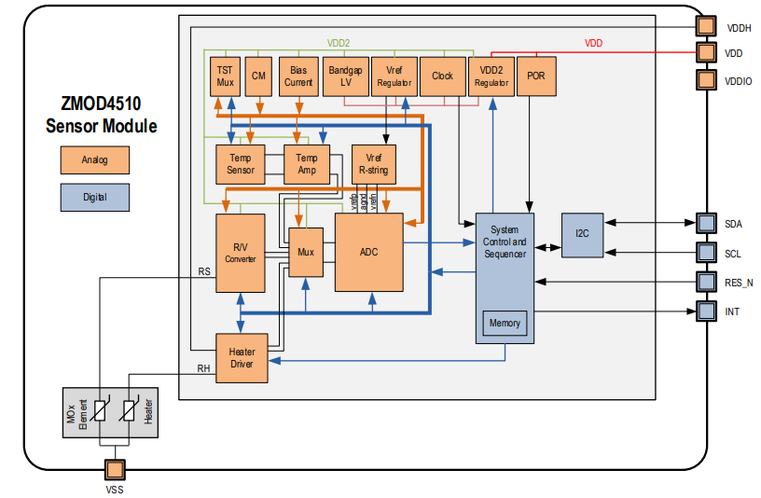
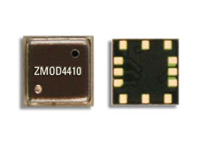
Alcohol (ZMOD4510 )

Slide 15
Light Sensor (VEML7700-TR)

Slide 16
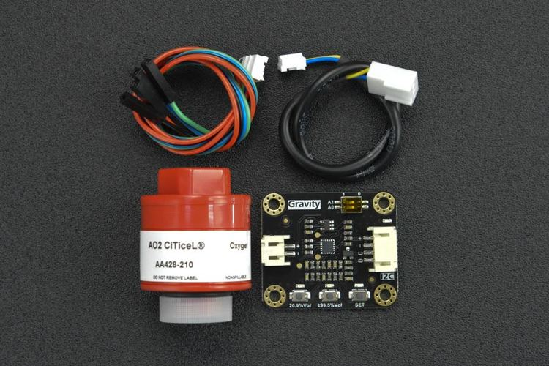
SEN053A & SEN0496

