Slide 1
Empowering Girls with Solar Powered Classrooms!
Solar For Her
Notes:
Talking points:
This first slide is for introduction purpose. Presenter can use different styles of introductory discussion, depending on their skills and practice.
However, the presenters can introduce Solar For Her as a national level campaign, dedicated to shift girls schools in Pakistan on Solar Energy. The campaign focuses on girls schools, which may also include boys, who generally have no or in proper electricity facility, particularly in poor areas, where temperature remains too high or even too low, making it difficult for little kids to continue their education in harsh weather condition.
The campaign is led by a group of five voluntary individuals, all Pakistanis, working in the field of solar energy systems, climate change communication and campaigning.
For more information about this campaign, visit the website https://solarforher.com

Slide 2
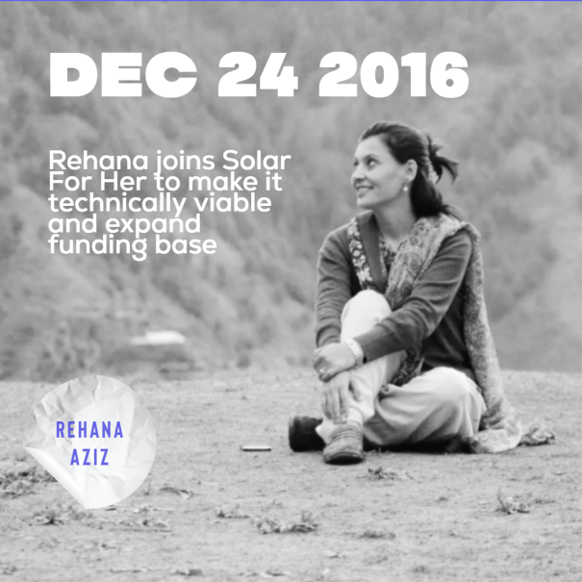
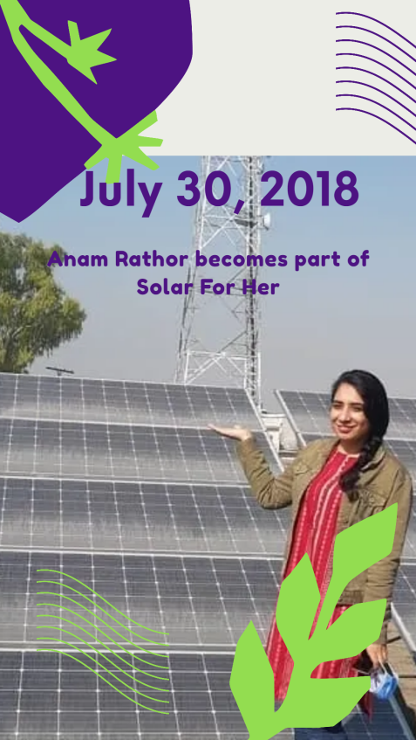
Our team!
Notes:
Talking points:
This first slide is for introduction purpose. Presenter can use different styles of introductory discussion, depending on their skills and practice.
However, the presenters can introduce Solar For Her as a national level campaign, dedicated to shift girls schools in Pakistan on Solar Energy. The campaign focuses on girls schools, which may also include boys, who generally have no or in proper electricity facility, particularly in poor areas, where temperature remains too high or even too low, making it difficult for little kids to continue their education in harsh weather condition.
The campaign is led by a group of five voluntary individuals, all Pakistanis, working in the field of solar energy systems, climate change communication and campaigning.
For more information about this campaign, visit the website https://solarforher.com

Slide 3
Why we started Solar For Her
Compromised learning environment
Schools without electricity
Classrooms with temperature from 50 Degree C to below Zero
Notes:
This slide elaborates the reasons why this campaign was started in Pakistan.
A study informs that an estimated 48% of schools in Pakistan are without electricity. In rural, far flung areas, schools usually have less facilities like proper infrastructure, water, electricity, furniture etc. making it difficult for little girls and boys to continue their education.
There are many areas in Pakistan where temperature during summer reaches 50 Degree C. Similarly, many parts of Pakistan observe temperature in below zero Degree C. When schools are without electricity, classrooms during extremely hot temperature become a difficult place to learn. Spending 4 to 5 hours in classrooms are not easy when there is no fan running in the absence of electricity.
Similarly, in extremely cold areas like northern part of Pakistan, classrooms become so dark when there is no electricity and light system. It also becomes major health concern for little kids to study in open area during extremely cold day.
When schools are provided with proper electricity system, learning environment becomes conducive, making it easy for girls and boys to study and spend their school day with joy!
For more information about this campaign, visit the website https://solarforher.com

Slide 4
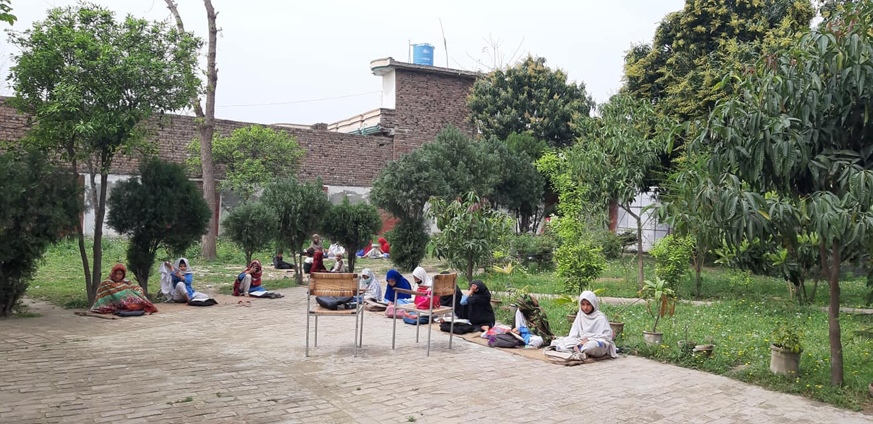
The Idea!
Shift girls schools on Solar Power to runs fans and lights in classrooms
Protect girls (and boys) students from harsh weather during classes!
Notes:
This slide explains the idea Solar For Her campaign pitched in 2017, helping girls (and boys) access solar powered classrooms and fight climate change.
In Pakistan, especially in rural areas, many schools are not connected to national grid. Many areas suffer from load management issue and electricity is not available for hours. To help little girls (and boys) protect from harsh weather condition during their class time, Solar For Her campaign started to raise funds through individuals to install solar system at schools building.
The idea of installing solar system at schools is not just an easy option to provide electricity in schools but also a compelling strategy to fight climate change and empower girls. Electricity produced through solar system is cheap, affordable and also environment friendly. Secondly, solar system maintenance is also not a difficult job and school teachers, even students, can learn how to manage solar systems at schools.
For more information about this campaign, visit the website https://solarforher.com

Slide 5
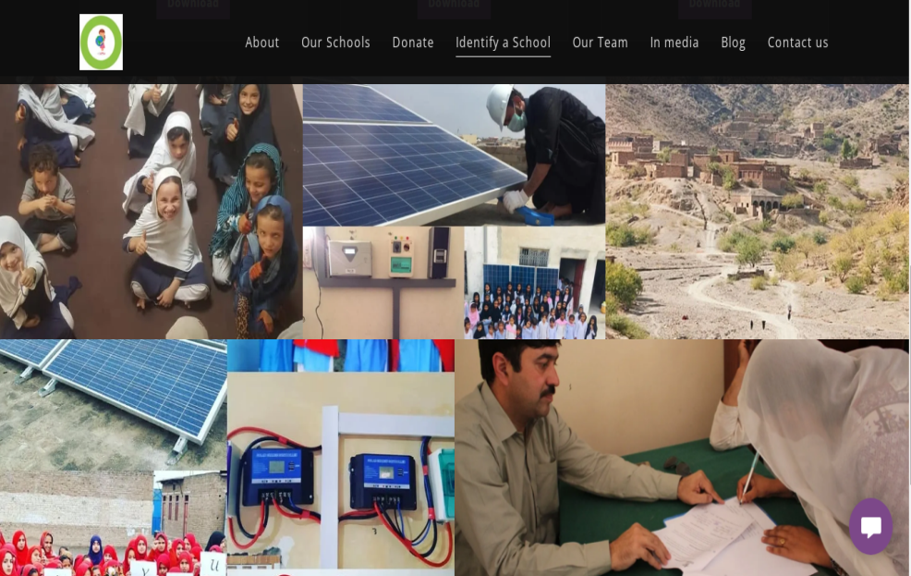
How the campaign works!
Crowd funding to raise funds – https://solarforher.com
Anyone who has access to internet can share school information by using our website’ online form!
Solar For Her core team select school as per selection criteria, deliver equipment and provide technical support
Local partners – school management, local organization or volunteers help in installation, maintenance & report back
Notes:
This slide shed light on the strategy Solar For Her works in Pakistan.
The campaign raises funds usually through crowd funding. The campaign website https://solarforher.com plays pivotal role in the overall campaign making it easy and understandable for everyone to learn the way Solar For Her works, collect funds, identify schools, procure and install solar system at girls schools.
Anyone can donate in the campaign by using the campaign website linked a paypal account of one of the core team members. Interested individuals who wish to donate other than the paypal, can contact core team members and decide to donate through cash or other means like in-kind support/donating system equipment, solar panels, batteries, inverters etc.
The website offers everyone share details of schools online with Solar For Her team. School selection criteria is also available on the website. Keeping in mind the school selection criteria, anyone can identify a girls schools which needs electricity through solar power system.
Basic information like condition of the school, infrastructure, electricity arrangement, enrollment of girls (and boys), teachers’ availability, accessibility and details of contact person can be provided online through a downloadable format available on the website.
Core team of Solar For Her review the provided information and take decision, mainly on the basis of girls enrollment and need for solar system. The need for solar system also depends on school infrastructure suitable for installation of solar system like proper space for installation of solar panels and no shading obstructing direct sunlight.
If school selection is decided, Solar For Her works with a local partner regarding transportation of solar equipment, installation and making agreement regarding future care and maintenance of the solar system. Local partner can either be school management committee, local organization or a well known individual volunteer. Local partners also need to agree on contributing in the campaign in terms of supporting local level transportation, arrangement of solar installer/technician and payment of system installation.
There’s no condition on who owns the schools. It can either be a public, private or community run school. However, preference is given on girls schools up to Grade 5. Other schools can also be considered, depending upon funds availability and capacity of local partner regarding system care and maintenance over the months and years to come.
Everyone can download relevant files like school selection criteria, process and required information from the campaign website.
For more information about this campaign, visit the website https://solarforher.com

Slide 6
Our Target!
Initial Plan
30 Girls Schools
Accomplished
14 Schools
In process
1 School
Future Plan
At least One Solar Powered Girls School in Every District of Pakistan!
Notes:
This slide explains the target and achievement so far made by Solar For Her in Pakistan.
In the first phase, Solar For Her aims to shift 30 girls schools on solar power. So far, 12 schools across Pakistan have now access to solar power, benefitting over 3400 school girls. As of December 2021, another school is in the process of system installation. Every month, data is being updated on the campaign website. Therefore, it’s good to check the campaign website regularly and update this slide for the presentation purpose.
In future, Solar For Her would increase the scope of the campaign after necessary consultation and set new target for its second phase plan.
For more information about this campaign, visit the website https://solarforher.com

Slide 7
How we progressed!
2018
One School
Notes:
This slide shed light on the strategy Solar For Her works in Pakistan.
The campaign raises funds usually through crowd funding. The campaign website https://solarforher.com plays pivotal role in the overall campaign making it easy and understandable for everyone to learn the way Solar For Her works, collect funds, identify schools, procure and install solar system at girls schools.
Anyone can donate in the campaign by using the campaign website linked a paypal account of one of the core team members. Interested individuals who wish to donate other than the paypal, can contact core team members and decide to donate through cash or other means like in-kind support/donating system equipment, solar panels, batteries, inverters etc.
The website offers everyone share details of schools online with Solar For Her team. School selection criteria is also available on the website. Keeping in mind the school selection criteria, anyone can identify a girls schools which needs electricity through solar power system.
Basic information like condition of the school, infrastructure, electricity arrangement, enrollment of girls (and boys), teachers’ availability, accessibility and details of contact person can be provided online through a downloadable format available on the website.
Core team of Solar For Her review the provided information and take decision, mainly on the basis of girls enrollment and need for solar system. The need for solar system also depends on school infrastructure suitable for installation of solar system like proper space for installation of solar panels and no shading obstructing direct sunlight.
If school selection is decided, Solar For Her works with a local partner regarding transportation of solar equipment, installation and making agreement regarding future care and maintenance of the solar system. Local partner can either be school management committee, local organization or a well known individual volunteer. Local partners also need to agree on contributing in the campaign in terms of supporting local level transportation, arrangement of solar installer/technician and payment of system installation.
There’s no condition on who owns the schools. It can either be a public, private or community run school. However, preference is given on girls schools up to Grade 5. Other schools can also be considered, depending upon funds availability and capacity of local partner regarding system care and maintenance over the months and years to come.
Everyone can download relevant files like school selection criteria, process and required information from the campaign website.
For more information about this campaign, visit the website https://solarforher.com

Slide 8
How we progressed!
2019
Four Schools
Notes:
This slide shed light on the strategy Solar For Her works in Pakistan.
The campaign raises funds usually through crowd funding. The campaign website https://solarforher.com plays pivotal role in the overall campaign making it easy and understandable for everyone to learn the way Solar For Her works, collect funds, identify schools, procure and install solar system at girls schools.
Anyone can donate in the campaign by using the campaign website linked a paypal account of one of the core team members. Interested individuals who wish to donate other than the paypal, can contact core team members and decide to donate through cash or other means like in-kind support/donating system equipment, solar panels, batteries, inverters etc.
The website offers everyone share details of schools online with Solar For Her team. School selection criteria is also available on the website. Keeping in mind the school selection criteria, anyone can identify a girls schools which needs electricity through solar power system.
Basic information like condition of the school, infrastructure, electricity arrangement, enrollment of girls (and boys), teachers’ availability, accessibility and details of contact person can be provided online through a downloadable format available on the website.
Core team of Solar For Her review the provided information and take decision, mainly on the basis of girls enrollment and need for solar system. The need for solar system also depends on school infrastructure suitable for installation of solar system like proper space for installation of solar panels and no shading obstructing direct sunlight.
If school selection is decided, Solar For Her works with a local partner regarding transportation of solar equipment, installation and making agreement regarding future care and maintenance of the solar system. Local partner can either be school management committee, local organization or a well known individual volunteer. Local partners also need to agree on contributing in the campaign in terms of supporting local level transportation, arrangement of solar installer/technician and payment of system installation.
There’s no condition on who owns the schools. It can either be a public, private or community run school. However, preference is given on girls schools up to Grade 5. Other schools can also be considered, depending upon funds availability and capacity of local partner regarding system care and maintenance over the months and years to come.
Everyone can download relevant files like school selection criteria, process and required information from the campaign website.
For more information about this campaign, visit the website https://solarforher.com

Slide 9
How we progressed!
2020
Three Schools
Notes:
This slide shed light on the strategy Solar For Her works in Pakistan.
The campaign raises funds usually through crowd funding. The campaign website https://solarforher.com plays pivotal role in the overall campaign making it easy and understandable for everyone to learn the way Solar For Her works, collect funds, identify schools, procure and install solar system at girls schools.
Anyone can donate in the campaign by using the campaign website linked a paypal account of one of the core team members. Interested individuals who wish to donate other than the paypal, can contact core team members and decide to donate through cash or other means like in-kind support/donating system equipment, solar panels, batteries, inverters etc.
The website offers everyone share details of schools online with Solar For Her team. School selection criteria is also available on the website. Keeping in mind the school selection criteria, anyone can identify a girls schools which needs electricity through solar power system.
Basic information like condition of the school, infrastructure, electricity arrangement, enrollment of girls (and boys), teachers’ availability, accessibility and details of contact person can be provided online through a downloadable format available on the website.
Core team of Solar For Her review the provided information and take decision, mainly on the basis of girls enrollment and need for solar system. The need for solar system also depends on school infrastructure suitable for installation of solar system like proper space for installation of solar panels and no shading obstructing direct sunlight.
If school selection is decided, Solar For Her works with a local partner regarding transportation of solar equipment, installation and making agreement regarding future care and maintenance of the solar system. Local partner can either be school management committee, local organization or a well known individual volunteer. Local partners also need to agree on contributing in the campaign in terms of supporting local level transportation, arrangement of solar installer/technician and payment of system installation.
There’s no condition on who owns the schools. It can either be a public, private or community run school. However, preference is given on girls schools up to Grade 5. Other schools can also be considered, depending upon funds availability and capacity of local partner regarding system care and maintenance over the months and years to come.
Everyone can download relevant files like school selection criteria, process and required information from the campaign website.
For more information about this campaign, visit the website https://solarforher.com

Slide 10
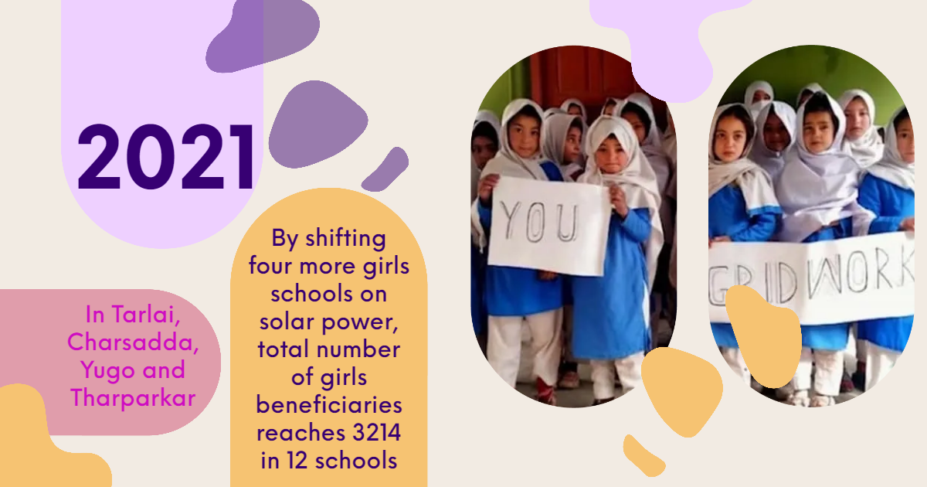
How we progressed!
2021
Four Schools
Notes:
This slide shed light on the strategy Solar For Her works in Pakistan.
The campaign raises funds usually through crowd funding. The campaign website https://solarforher.com plays pivotal role in the overall campaign making it easy and understandable for everyone to learn the way Solar For Her works, collect funds, identify schools, procure and install solar system at girls schools.
Anyone can donate in the campaign by using the campaign website linked a paypal account of one of the core team members. Interested individuals who wish to donate other than the paypal, can contact core team members and decide to donate through cash or other means like in-kind support/donating system equipment, solar panels, batteries, inverters etc.
The website offers everyone share details of schools online with Solar For Her team. School selection criteria is also available on the website. Keeping in mind the school selection criteria, anyone can identify a girls schools which needs electricity through solar power system.
Basic information like condition of the school, infrastructure, electricity arrangement, enrollment of girls (and boys), teachers’ availability, accessibility and details of contact person can be provided online through a downloadable format available on the website.
Core team of Solar For Her review the provided information and take decision, mainly on the basis of girls enrollment and need for solar system. The need for solar system also depends on school infrastructure suitable for installation of solar system like proper space for installation of solar panels and no shading obstructing direct sunlight.
If school selection is decided, Solar For Her works with a local partner regarding transportation of solar equipment, installation and making agreement regarding future care and maintenance of the solar system. Local partner can either be school management committee, local organization or a well known individual volunteer. Local partners also need to agree on contributing in the campaign in terms of supporting local level transportation, arrangement of solar installer/technician and payment of system installation.
There’s no condition on who owns the schools. It can either be a public, private or community run school. However, preference is given on girls schools up to Grade 5. Other schools can also be considered, depending upon funds availability and capacity of local partner regarding system care and maintenance over the months and years to come.
Everyone can download relevant files like school selection criteria, process and required information from the campaign website.
For more information about this campaign, visit the website https://solarforher.com

Slide 11
How we progressed!
2022
Two Schools
3637 Girls so far!
Notes:
This slide shed light on the strategy Solar For Her works in Pakistan.
The campaign raises funds usually through crowd funding. The campaign website https://solarforher.com plays pivotal role in the overall campaign making it easy and understandable for everyone to learn the way Solar For Her works, collect funds, identify schools, procure and install solar system at girls schools.
Anyone can donate in the campaign by using the campaign website linked a paypal account of one of the core team members. Interested individuals who wish to donate other than the paypal, can contact core team members and decide to donate through cash or other means like in-kind support/donating system equipment, solar panels, batteries, inverters etc.
The website offers everyone share details of schools online with Solar For Her team. School selection criteria is also available on the website. Keeping in mind the school selection criteria, anyone can identify a girls schools which needs electricity through solar power system.
Basic information like condition of the school, infrastructure, electricity arrangement, enrollment of girls (and boys), teachers’ availability, accessibility and details of contact person can be provided online through a downloadable format available on the website.
Core team of Solar For Her review the provided information and take decision, mainly on the basis of girls enrollment and need for solar system. The need for solar system also depends on school infrastructure suitable for installation of solar system like proper space for installation of solar panels and no shading obstructing direct sunlight.
If school selection is decided, Solar For Her works with a local partner regarding transportation of solar equipment, installation and making agreement regarding future care and maintenance of the solar system. Local partner can either be school management committee, local organization or a well known individual volunteer. Local partners also need to agree on contributing in the campaign in terms of supporting local level transportation, arrangement of solar installer/technician and payment of system installation.
There’s no condition on who owns the schools. It can either be a public, private or community run school. However, preference is given on girls schools up to Grade 5. Other schools can also be considered, depending upon funds availability and capacity of local partner regarding system care and maintenance over the months and years to come.
Everyone can download relevant files like school selection criteria, process and required information from the campaign website.
For more information about this campaign, visit the website https://solarforher.com

Slide 12
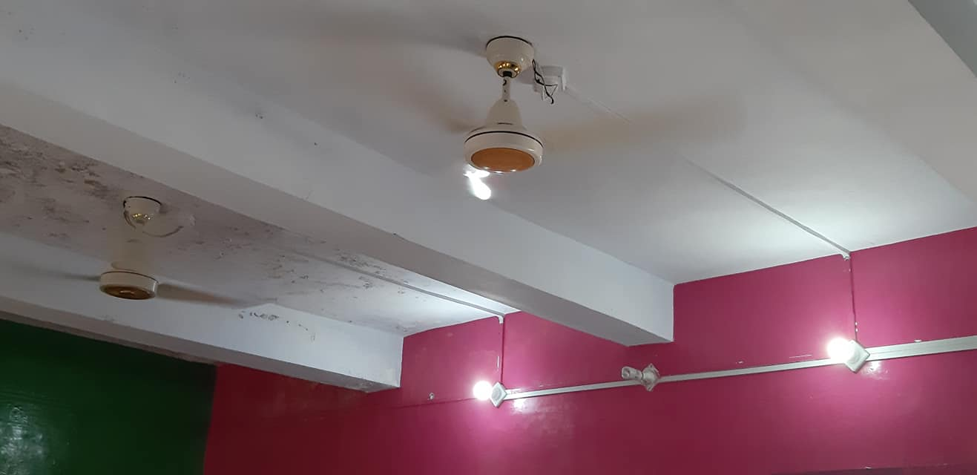
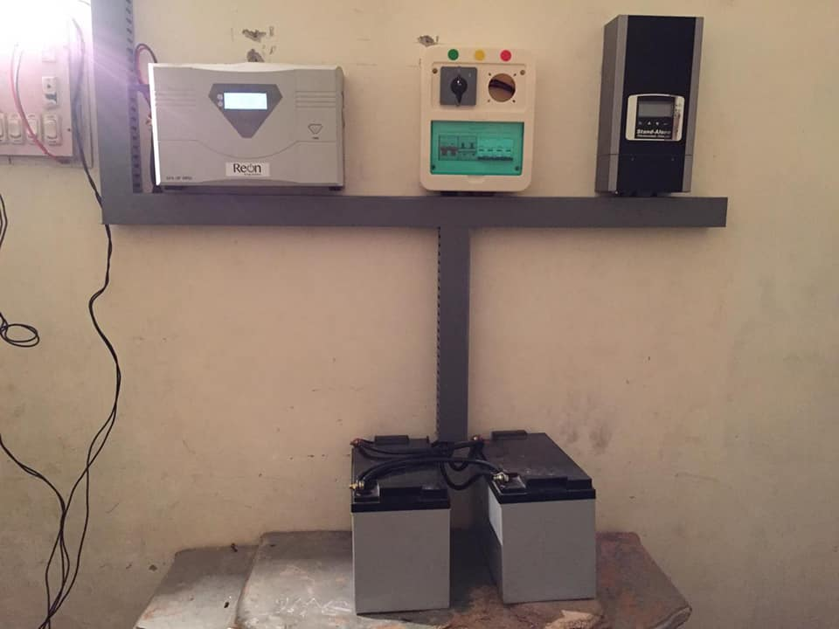
How much it costs?
USD 450
A small off-grid DC system for a 1 – 2 room school building
300 Watt power to run 2 dc fans and 4 – 6 bulbs
USD 1000
A hybrid solar system for a 2 – 4 room school building
1kW power to run 2 – 4 normal fans and 4 – 6 bulbs
Notes:
This slide explains which types of solar systems are being donated in this campaign, how much its costs and which equipment can be run after the system installation.
The campaign installs both off-grid dc system and hybrid solar system, depending upon the need of the school. A small 1 to 2 room building needs a small dc system which can run 2 ceiling fans and 4 to 6 dc bulbs. It costs around USD 425, which equals to PKR 70,000 approximately. This type of solar system requires installation of a separate dc wiring and provision of 12 volt dc fans and bulbs. A relatively bigger school, having up to 4 rooms can be supported with 1kW hybrid solar system to run 2 to 4 ceiling fans and 4 to 6 bulbs. This type of system doesn’t require separate wiring inside the building and operate the existing fans and bulbs over 220 volt electricity. 1kW hybrid solar system costs around USD 910, which equals to PKR 150,000 approximately. System requirement and costing keeps on changing depending upon market price fluctuation and other technical requirement.
Sometime, a couple of solar companies also donate in-kind equipment to Solar For Her. For example, in recent past, a renowned solar company Reon Industries donated solar systems for 3 girls schools by donating 1kW solar panels, inverters and batteries for each school. Similarly, another reputed company Samber Energy Lahore contributed Balance of System (BOS) including wiring, AC/DC breakers, terminal, connectors etc. as well as transportation cost for the 3 schools. In a special case during 2020, GIZ under it’s Renewable Energy & Energy Efficiency (REEE) project also donated a 7kW On-Grid solar system to Solar For Her campaign which was installed in Islamabad Model Schools for Girls in Tarlai, Islamabad, in collaboration with Direcrorate of Education Islamabad, Hashoo Foundation and NEPRA. This project has also Net-Metering facility, a first ever unique initiative in Solar For Her campaign.
For more information about this campaign, visit the website https://solarforher.com

Slide 13
Solar For Her in Mainstream Media!
Notes:
This slide explains media coverage of Solar For Her campaign.
Looking at the success of Solar For Her, a number of mainstream media in Pakistan have featured this campaign, highlighting the campaign success and its impact on girls education and promotion of solar energy in Pakistan. One of the prominent names in media circle is BBC Urdu which featured the story of Solar For Her in a special digital documentary. Later on, BBC journalist won Aghahi award on making the story of Solar For Her.
Other TV channels like PTV News, ARY News and Lahore News also featured Solar For Her in their shows. Core teams of Solar For Her have appeared in number of online forums and webinars, highlighting the work Solar For Her does in Pakistan to promote girls education with the use of solar energy technology.
System requirement and costing keeps on changing depending upon market price fluctuation and other technical requirement.
For more information about this campaign, visit the website https://solarforher.com

Slide 14
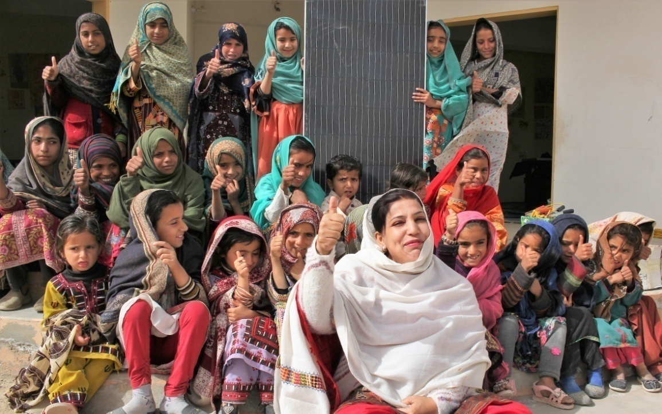
Support Our Cause!
https://solarforher.com
#SolarforHER
Notes:
This slide explains how individuals can support the cause of Solar For Her.
There’ are three recommended ways to support Solar For Her. First, anyone can donate to the cause of Solar For Her. Individuals can donate through the campaign website which is linked one of its members paypal account. Those who wants to donate directly, other than the paypal option, can contact Solar For Her team directly.
Second way to support Solar For Her is to become the campaign volunteer or connectors. Campaign connectors can apply to become volunteers by filling the online form available on the campaign website. Main responsibilities of campaign volunteers/connectors is to identify potential schools, help in fundraising as well as in systems transportation, installation and report back.
Another exciting way to support Solar For Her is to become our voice by spreading the word. Any individual, organization or a company can use these slides to make presentations among their audience, write blogs or post over social media, asking friends to donate for the cause.
Feel free to identify other ways in which you can support this campaign.
For more information about this campaign, visit the website https://solarforher.com

