Slide 1

The Normanby 10k 12th July, 09:30-11:00
We’re very pleased to be back with the Normanby 10k in its 10th year.
Thank you for your support once again for our local running event ☺
The event:
The event is licensed under UK Athletics and we hope to see around 900 runners coming through Normanby, Thealby and Burton villages.
As always, we encourage you to come out, show off the amazing community spirit and cheer on the runners through the village. We will also be doing our bit to encourage the runners to spend time in the local area after the event ☺
Expect to see a few Bumblebees as part of the run as the event continues with its Bee theme and every runner leaves with a packet of wildflower seeds to take home ☺
You can find out more about the event and download a more detailed diversion description here: https://curlysathletes.co.uk/normanby-hall-10k and please get in touch with queries. Contact@curlysathletes.co.uk
Road closures:
Some road closures are in place from 09:15-11:00, so please have a look at the following information pages to help you plan your morning.
Normanby residents can exit the village via Burton direction, please take care as runners will be on the road coming from Burton direction on the opposite side of the road.
This year the run will go along Wiltshire Avenue rather than the high street as per previous years, so please come out and cheer on the runners ☺ We have a one-way system in place for vehicles heading from the playing field to Darby road direction.
Accessing Scunthorpe is via Flixborough and accessing Normanby Park is via Thealby ☺
We apologise for any disruption and really appreciate your support. The Normanby 10k helps support the Fit Mums & Friends charity. The Hedgehog Half Marathon that’s coming through the villages on the 12th of October works with Appleby based Andrews Hedgehog Hospital.

Slide 2
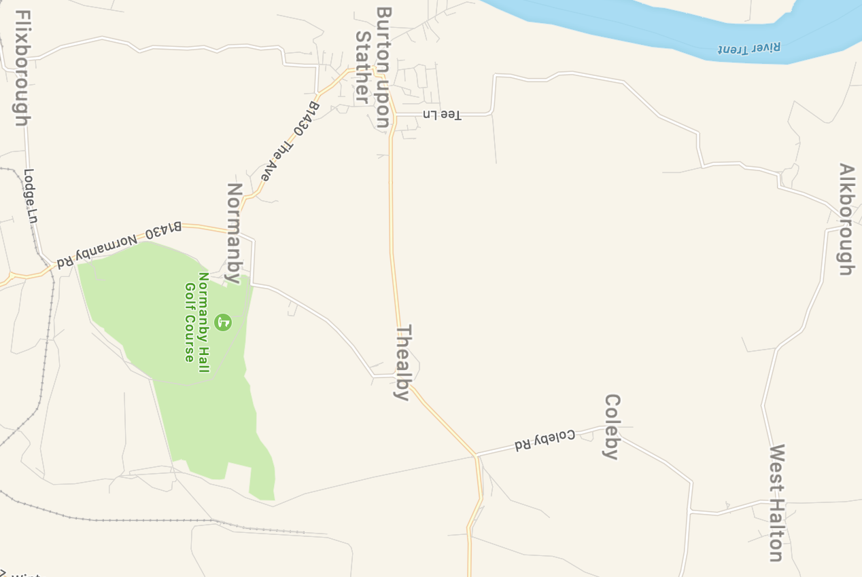
5. Wiltshire Avenue Road closure 09:15 – 11:00 / closed heading southbound direction only (towards the avenue) Normanby / Open to Darby Road direction
Scunthorpe
1. Road closure 09:15-11:00
Access to Burton / Normanby hall & golf
2. Road closure 09:15 – 11:00 / closed heading Burton to Normanby / open Normanby to Burton
4. Road closure 09:15 – 10:30 / closed heading Thealby to Burton / open Burton to Thealby
Access to Pony club/chicken farm ONLY
3. Road closure 09:15 – 11:00
Burton Access
Access to PARK & GOLF

Slide 3
Access is via Thealby throughout
Approaching Normanby from Scunthorpe –
Turn left before Normanby Park Wall Side at Lodge Lane sign posted to Flixborough (signposted diversion / Flixborough).
Head through Flixborough and just after the church take a right turn and head to Burton upon Stather, at the end of Flixborough road junction turn left and then a quick right turn onto Barnston Way, at the end of Barnston Way turn left onto Burton High st (proceed with caution as runners will be on this road) follow this road all the way out of Burton.
Once you enter Thealby Village take the first right hand road (again proceed with caution as runners will be coming out of this junction turning left) This will lead you to the park car park or the golf club.
Leaving Normanby Park / Golf club – Only right turn available DO NOT TURN LEFT as the road is closed and you will be turn around. You can then head to Winterton to town or via Thealby / Burton / Flixborough (the reverse of the above route)
Accessing Normanby Hall and the Golf Course
Sunday 12th July 09:15-11:00
THE NORMANBY 10K
Accessing Scunthorpe from Burton
Sunday 12th July 09:15-11:00
THE NORMANBY 10K
Access is via Flixborough (but can also be via Thealby to Winterton)
You will be unable to leave the village via Normanby and the road will be closed after the Playing fields area.
All roads in Burton village remain open but please take care as runners (and a bumblebee) will be passing through from around 09:20-11:00
Turn down Flixborough road next to Burton Junior School (this can also be accessed via Barnston Way) Turn left before Barnston Way to continue on Flixborough Rd.
You will then leave Burton and continue on Flixborough Rd which becomes Burton Rd and takes you into Flixborough village.
Turn left at the junction as this will take you down High St and Lodge Lane, leaving Flixborough.
As you arrive at the next junction turn right and this will take you to Scunthorpe via the B1430 Normanby Rd
This is also the route to access The Pony Club, Cricket Club & Farms at the South Lodge entrance of Normanby Hall). At the junction with Normanby road you would instead turn left. However this is a controlled access only so you will need to interact the the TM team in order to do this. The road is manned and coned further down to prevent access to Normanby so please only use to access these areas. The same applies if accessing from Scunthorpe direction for these sites.

Slide 4
Approaching from Scunthorpe –
Turn left before Normanby Park Wall Side at Lodge Lane sign posted to Flixborough (signposted diversion / Flixborough).
Head through Flixborough and just after the church take a right turn and head to Burton upon Stather.
This will then lead you straight into the village. Please take care through the village as runners will be on the roads and paths.
Leaving Normanby Park / Golf club – Only right turn available DO NOT TURN LEFT as the road is closed and you will be turned around. You can then head to Winterton to town or via Thealby / Burton / Flixborough (the reverse of the above route)
Access for Burton from Scunthorpe direction
12th July 09:15-11:00
THE NORMANBY 10K
Access for Burton from Winterton direction
12th July 09:15-10:30
THE NORMANBY 10K
Wiltshire Avenue – One way access closure
12th July 09:15-10:30
THE NORMANBY 10K
Approaching from Winterton –
Down Coleby Road Hill from A1077 top Rd
Turn right around ½ a mile after the bottom of the hill towards West Halton
Just before you leave West Halton take the last left and head towards Alkborough
Follow the road in Alkborough until you come to a Junction, at the Junction turn left and you will then head through Walcot village which then leads to Burton.
Down Thealby Lane from A1077 Top Rd
Turn right before Thealby towards Coleby.
Head through Coleby and then turn left through West Halton
Just before you leave West Halton take the last left and head towards Alkborough
Follow the road in Alkborough until you come to a Junction, at the Junction turn left and you will then head through Walcot village which then leads to Burton.
This will then lead you straight into the village. Please take care through the village as runners will be on the roads and paths.
Wiltshire Avenue Closed Access at junction with Darby Road.
Access / exit for residents is available through out the run but we ask that you head through from the junction with The Avenue towards Darby Road direction.
Access is full open at the Avenue end of Wiltshire Avenue and Exit is fully open at the Darby Road End

