Slide 1
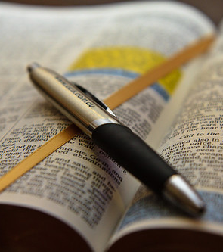
How to read the Bible
Kids bible fellowship
This PhotoCC BY

Slide 2

Here a little, there a little…
Isaiah 28:9-11 Whom shall he teach knowledge? and whom shall he make to understand doctrine? them that are weaned from the milk, and drawn from the breasts. For precept must be upon precept, precept upon precept; line upon line, line upon line; here a little, and there a little: For with stammering lips and another tongue will he speak to this people.
Hebrews 5:12-14 For when for the time ye ought to be teachers, ye have need that one teach you again which be the first principles of the oracles of God; and are become such as have need of milk, and not of strong meat. For every one that useth milk is unskilful in the word of righteousness: for he is a babe. But strong meat belongeth to them that are of full age, even those who by reason of use have their senses exercised to discern both good and evil.

Slide 3
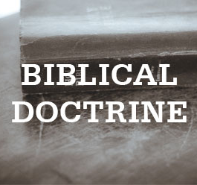
This is why you need to test doctrine
While many doctrines at first glance seem to be good and truthful, when you read them line upon line precept upon precept and STUDY it out, you’ll see very quickly that they’re all lies. Founded upon the sand instead of Yeshua the Rock. He laid the foundation and that’s the foundation we need to make sure we’re building upon.
Isaiah 28:15 Because ye have said, We have made a covenant with death, and with hell are we at agreement; when the overflowing scourge shall pass through, it shall not come unto us: for we have made lies our refuge, and under falsehood have we hid ourselves:
Ezekiel 13:2-3, 6-8, 10-12 Son of man, prophesy against the prophets of Israel that prophesy, and say thou unto them that prophesy out of their own hearts, Hear ye the word of the Lord; Thus saith the Lord God; Woe unto the foolish prophets, that follow their own spirit, and have seen nothing! They have seen vanity and lying divination, saying, The Lord saith: and the Lord hath not sent them: and they have made others to hope that they would confirm the word. Have ye not seen a vain vision, and have ye not spoken a lying divination, whereas ye say, The Lord saith it; albeit I have not spoken. Therefore thus saith the Lord God; Because ye have spoken vanity, and seen lies, therefore, behold, I am against you, saith the Lord God. Because, even because they have seduced my people, saying, Peace; and there was no peace; and one built up a wall, and, lo, others daubed it with untempered morter: Say unto them which daub it with untempered morter, that it shall fall: there shall be an overflowing shower; and ye, O great hailstones, shall fall; and a stormy wind shall rend it. Lo, when the wall is fallen, shall it not be said unto you, Where is the daubing wherewith ye have daubed it?

Slide 4
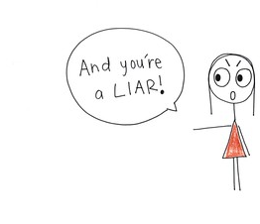
Why are lies their refuge?
Lies are Ephraim’s (USA) refuge because they don’t read line upon line, and because they are disobedient to His Ten Commandments that’s why Yeshua becomes a stone of stumbling unto them. So they either stumble at the apostate Christian churches (the left per Ezk 4), or they stumble at the circumcision sect Torah movement (who is the right per Ezk 4) believing in the doctrines of devils instead of the doctrine of Yeshua Messiah.
Isaiah 28:12-13 To whom he said, This is the rest wherewith ye may cause the weary to rest; and this is the refreshing: yet they would not hear. But the word of the Lord was unto them precept upon precept, precept upon precept; line upon line, line upon line; here a little, and there a little; that they might go, and fall backward, and be broken, and snared, and taken.
1 Peter 2:7-8 Unto you therefore which believe he is precious: but unto them which be disobedient, the stone which the builders disallowed, the same is made the head of the corner, And a stone of stumbling, and a rock of offence, even to them which stumble at the word, being disobedient: whereunto also they were appointed.

Slide 5
This is why you need the holy spirit to understand the bible
Only when one has the Spirit of Truth (given to those who obey the Ten C’s John 14:15-17) will they then be able to understand what is written in the Bible, man on their own could never interpret the scriptures(hence the 45-50K denominations in counting) when they’re all inspired by God’s Spirit.
2 Timothy 3:16-17 🔥All scripture is given by inspiration of God, and is profitable for doctrine🔥, for reproof, for correction, for instruction in righteousness: That the man of God may be perfect, thoroughly furnished unto all good works.

Slide 6

How the bible connects, with the OT & NT as written in Isaiah 28:9-11
~300,000 Textual Variants: Scholars, such as Professor Daniel Wallace, note there are approximately 300,000 to 400,000 textual variations (differences) among the New Testament manuscripts. However, these are generally minor differences in spelling or word order, with 98% agreement between major text families.
~3,000 Hidden Connections: The New Testament includes approximately 350 direct quotations of the Old Testament, but scholars have documented over 3,000 allusions—indirect references that connect the New Testament to the Old Testament.
~63,000 Cross-References: The Bible is often described as having over 63,000 cross-references linking its books together from Genesis to Revelation.
300+ Prophecies: The Old Testament contains over 300 prophecies concerning the Messiah, all of which are believed by Christians to be fulfilled by Yeshua in the New Testament.
Example Matthew 9:13 with Hosea 6:6-7 “I desire mercy, not sacrifice” is the gospel in a nutshell.

Slide 7
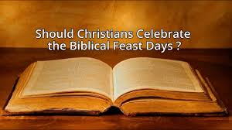
Examples of doctrines how it’s taught vs how scripture teaches us
The feasts: in the Torah movement they teach you can do the feasts wherever and however you like because they’re the “moedims” of Yah and they’re forever. They even go as far to say that they’re rehearsing for the feasts to come in the Kingdom. But what does scripture say about it?
While they’re right with saying the feasts are forever and that they’re moedims, they miss the fact that there are precepts in the law & the prophets that show you HOW to keep His Holy feasts.
First precept is forever, next is in the land when you have rest round about from all your enemies, third on the day (moedim even means appointed time), as a holy convocation (gathering together in one place), with our bridegroom Yeshua. We’re not in the times of feasting but mourning, warning, lamentation, and woe! They miss the warnings about doing what’s right in their own eyes and that if you do it’s as inquity before Him!

Slide 8
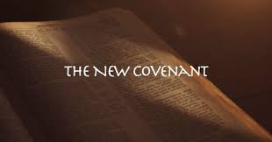
Continuing with examples
New covenant: the Christians collectively as a whole agree that we’re in the New covenant based off Hebrews 8 and what Yeshua says regarding it at “the last supper”, but again what does scripture say about this?
Scripture shows that we can’t be in the NC yet because the NC per prophecy doesn’t start till after the millennial reign, in the NC we also won’t have to teach anyone to know the Lord for all will know Him from the least to the greatest, we will have the law written on our hearts (free will is completely taken away vs now we have the “option” to sin), it’s only made with His people Israel and Judah (they cling to the title gentiles) and Israel are those who lay ahold of His covenants of promise Ten C’s & eating clean, and one last requirement is He will forgive us our sins (cast them as far as the east and west).

Slide 9
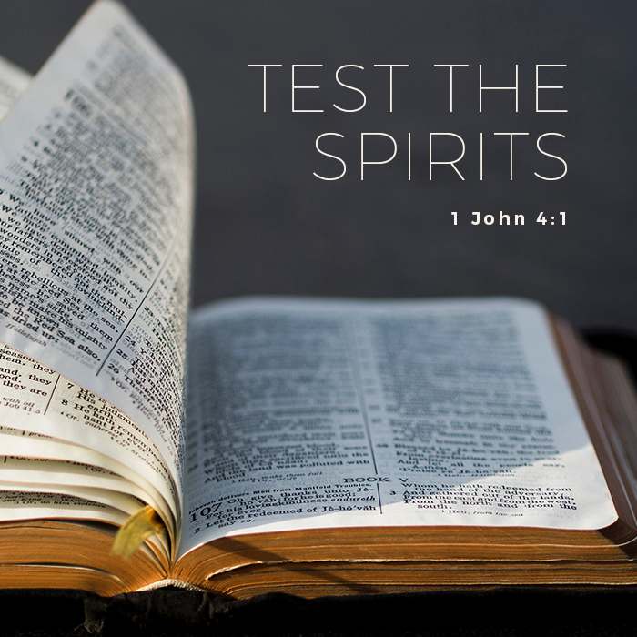
Wrapping it up
This is why you need to make sure you study to show thyself approved and test the spirits 1 John 4 to see if they’re from God or not. This includes testing doctrine to make sure it aligns with what is already written, if it doesn’t add up throw it out. We’re to have hearts for His truth and not be like the world who receives not the love the of the truth because those people will not be saved 2 Thessalonians 2.

